Slide 1
Nonthermal X-ray Emission with SRG/eROSITA
A Biased View towards Pulsars
Martin Mayer – Remeis Observatory Bamberg (FAU)
Nonthermal Astrophysics in Southern Africa – 29.07.2024
In collaboration with
Manami Sasaki (FAU), Werner Becker (MPE), Peter Predehl (MPE)

Slide 2
Outline
The SRG/eROSITA telescope: Mission design and data products
eROSITA as a survey machine: Searching for new rotation-powered pulsars
eROSITA for single objects: Investigating the extended Vela X pulsar wind nebula
Summary

Slide 3
The SRG/eROSITA Telescope

Slide 4
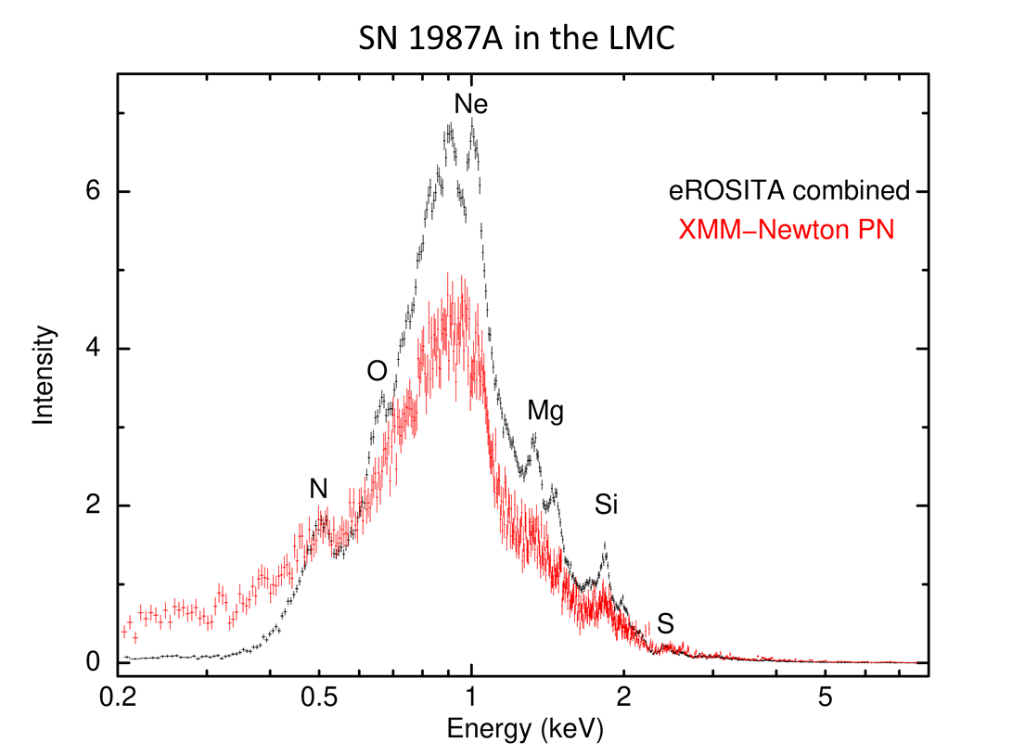
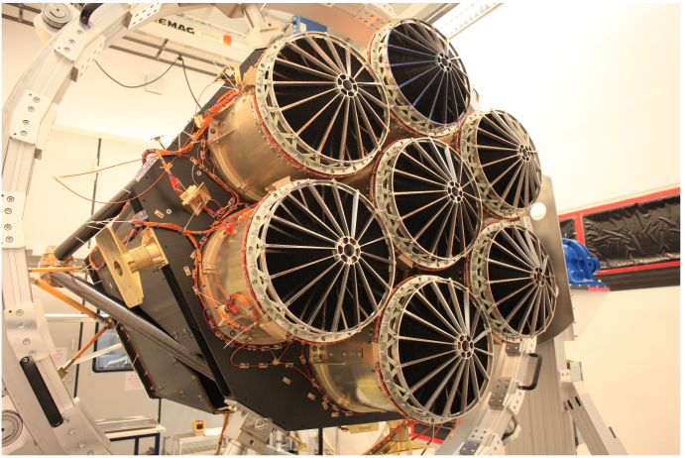
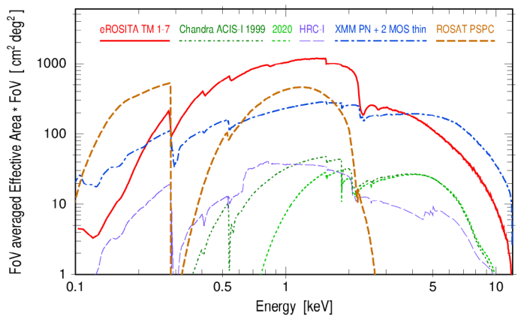
Introduction: SRG/eROSITA
eROSITA first-light press release
C. Maitra, F. Haberl (MPE)
eROSITA: Soft X-ray telescope on German-Russian SRG satellite
Original mission goal: 4-year all-sky X-ray survey, ~ 25 times deeper than precursor ROSAT
2.2 years achieved until mission interruption
Telescope specifics:
7 identical telescope modules (TMs) with single-chip CCD detectors
Energy range 0.2 – 10 keV
Large combined effective area
Field of view ~ 1 degree
Good spectral resolution (cf. XMM EPIC-pn)
Predehl et al. 2020
Predehl et al. 2020

Slide 5
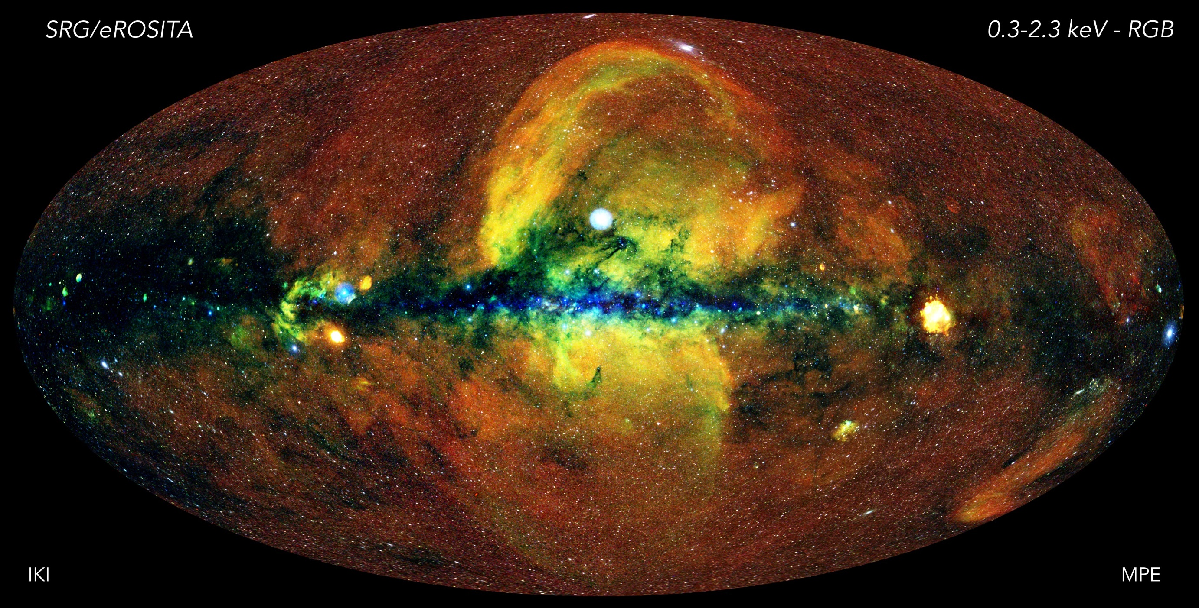
Introduction: SRG/eROSITA
eRASS1 all-sky image
Credit: MPE/IKI
Russian Consortium
German
Consortium

Slide 6
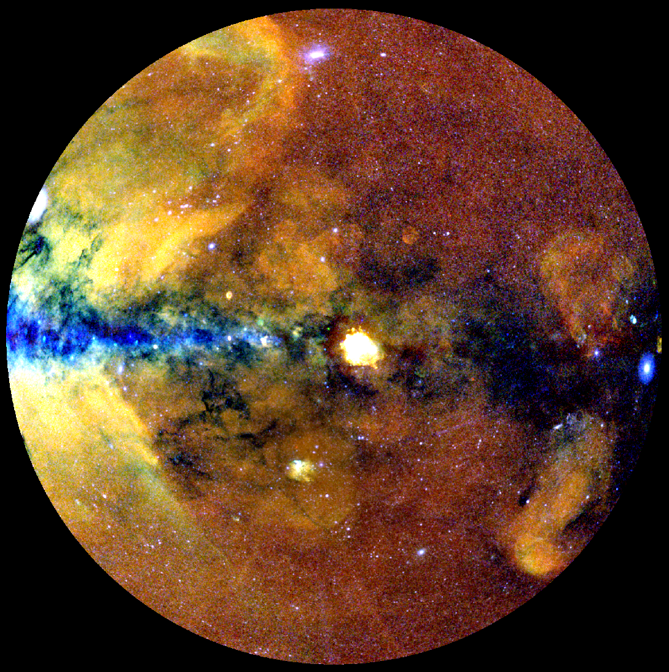
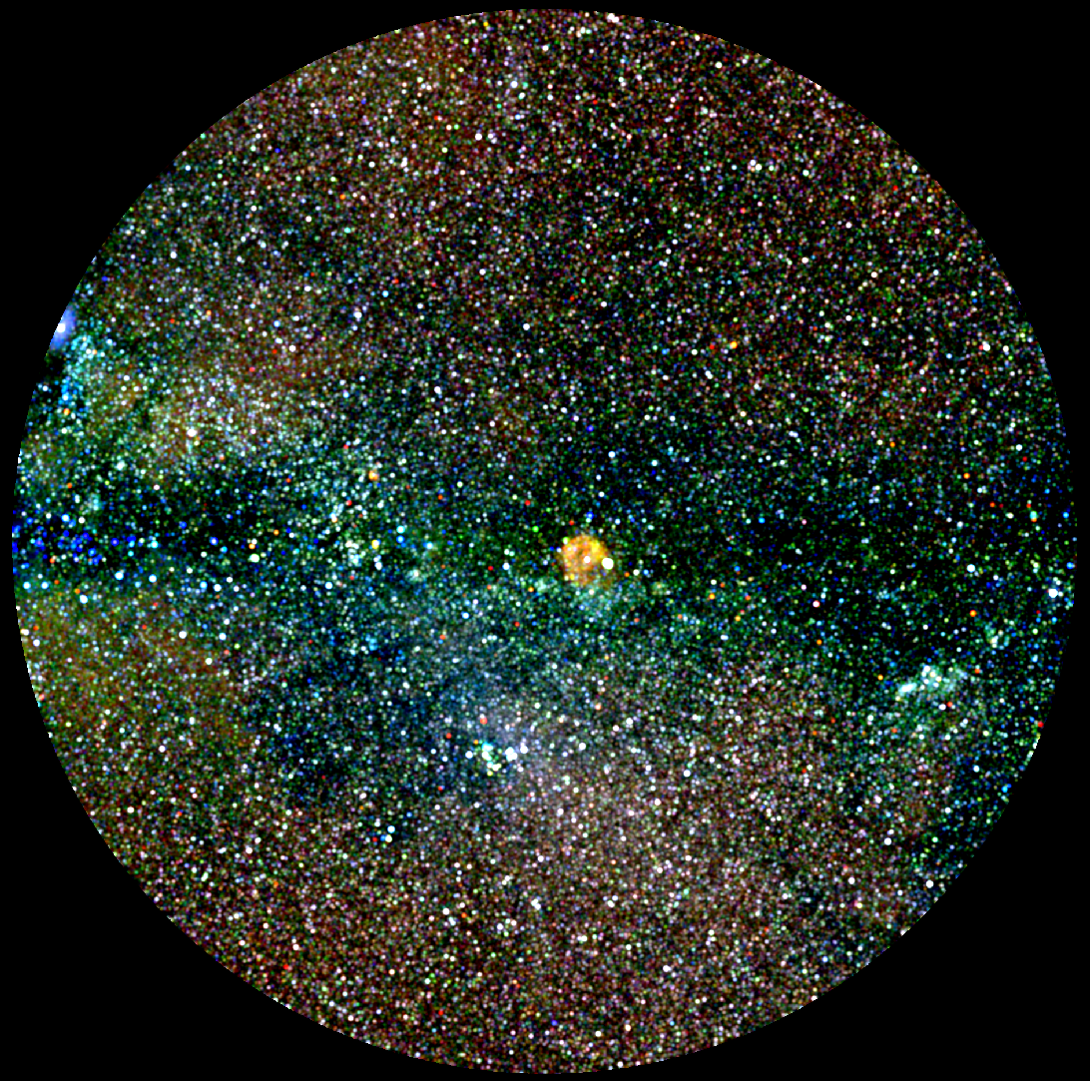
eROSITA DR1: The First All-Sky Survey (eRASS1)
eRASS1 diffuse emission (Merloni et al. 2024)
Credit: J. Sanders (MPE)
eRASS1 point sources (Merloni et al. 2024)
Credit: J. Sanders (MPE)
Hoinga SNR
Becker+2021
100 000 000 diffuse X-ray photons
900 000 X-ray point sources

Slide 7
Searching for Rotation-Powered Pulsars with Fermi-LAT & SRG/eROSITA
Searching for Rotation-Powered Pulsars with Fermi-LAT & SRG/eROSITA
& Multiwavelength Followup

Slide 8
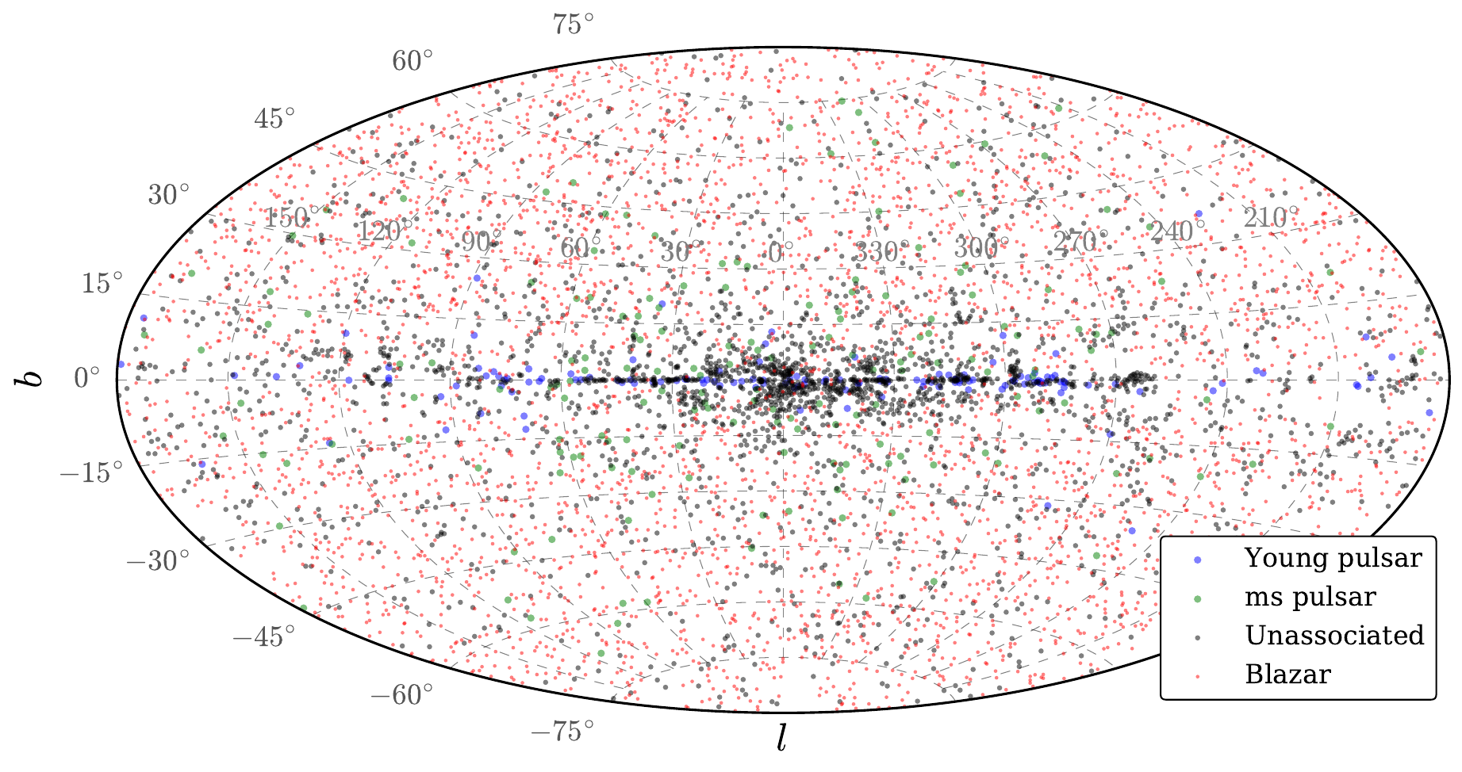
Motivation: The Fermi-LAT Source Catalog
Distribution of 4FGL-DR4 Sources
Ballet et al. 2023

Slide 9
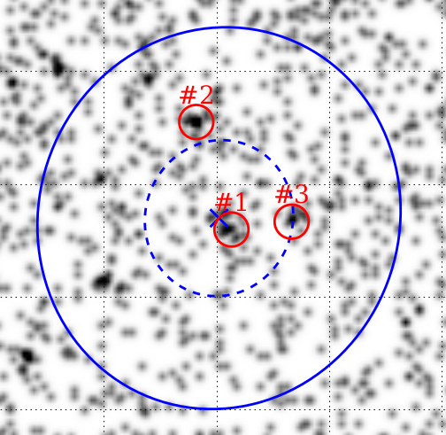
Motivation: Identifying Unassociated 4FGL Sources
Goal: Identify unassociated sources (of pulsar-type) based on their X-ray counterparts
Precise positions allow for radio/optical confirmation
Cross-match with eROSITA All-Sky Survey (eRASS:4) Catalog (see Merloni et al. 2024)
Challenges:
Large gamma-ray error ellipses (~ 5 arcmin)
X-ray pulsar counterparts typically faint (~ 10 counts)
Example eRASS:4 image of 4FGL error ellipse

Slide 10
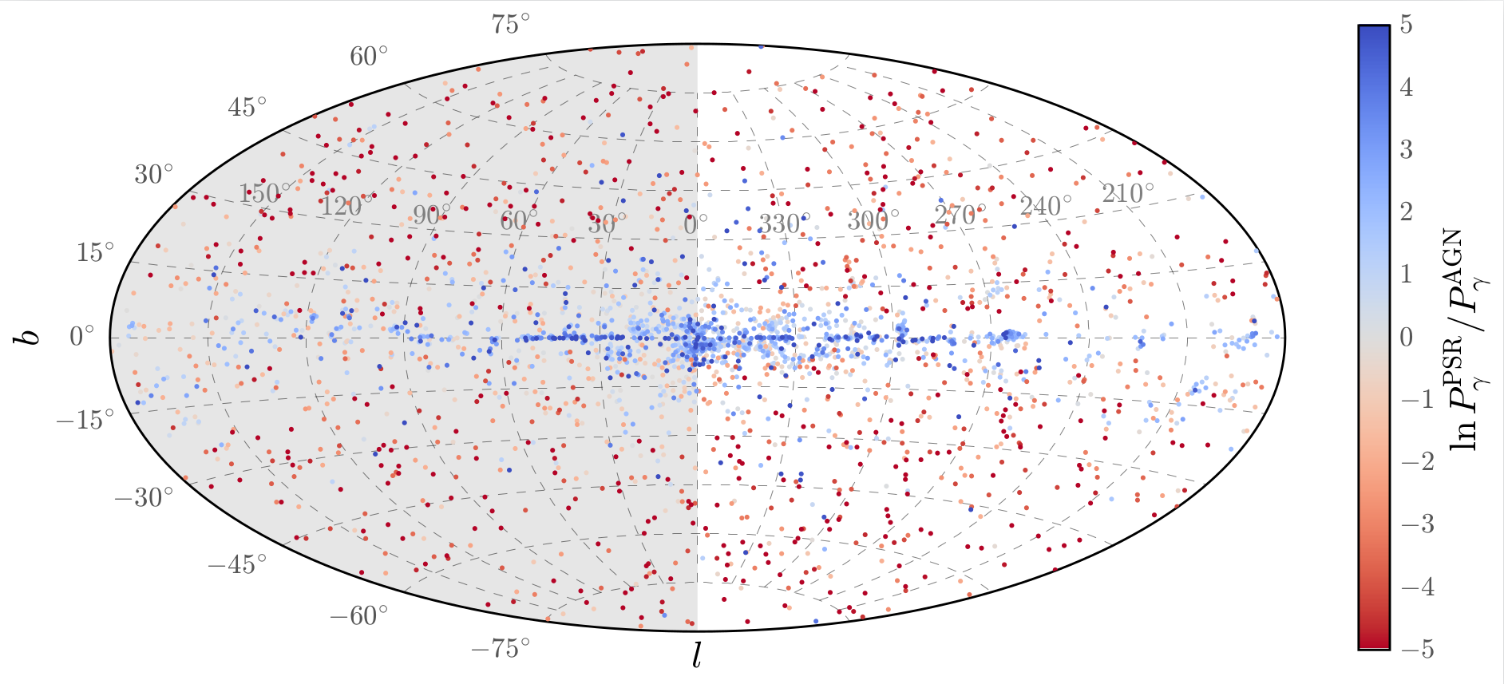
Search Strategy: Prior Classification
Mayer & Becker 2024

Slide 11
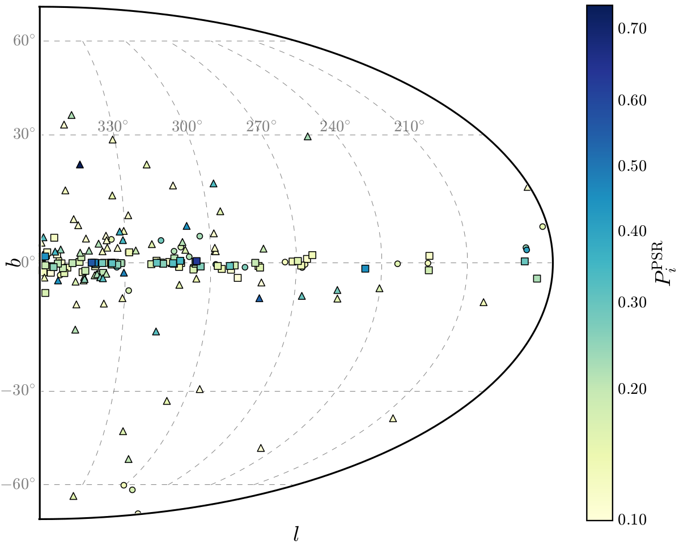
Results: Catalog of Pulsar Candidates
Final cleaned catalog of candidate X-ray pulsar counterparts to Fermi-LAT sources
Around 160 candidates with P_{PSR} > 0.1
Predict ~ 25 new pulsars in top 100 candidate matches
Expect similar numbers of young (squares) and millisecond (triangle) pulsars
Mayer & Becker 2024

Slide 12
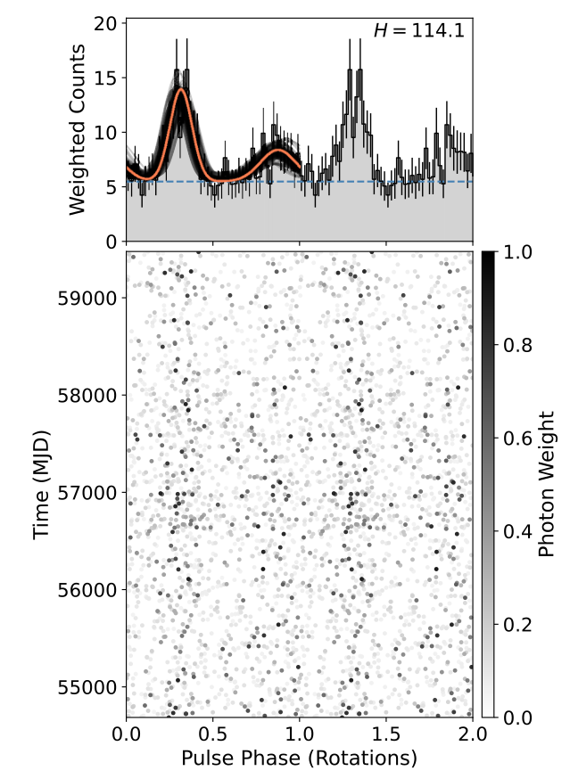
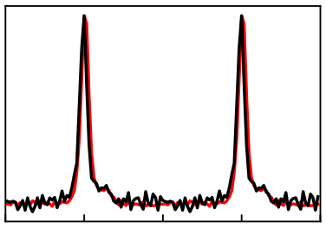
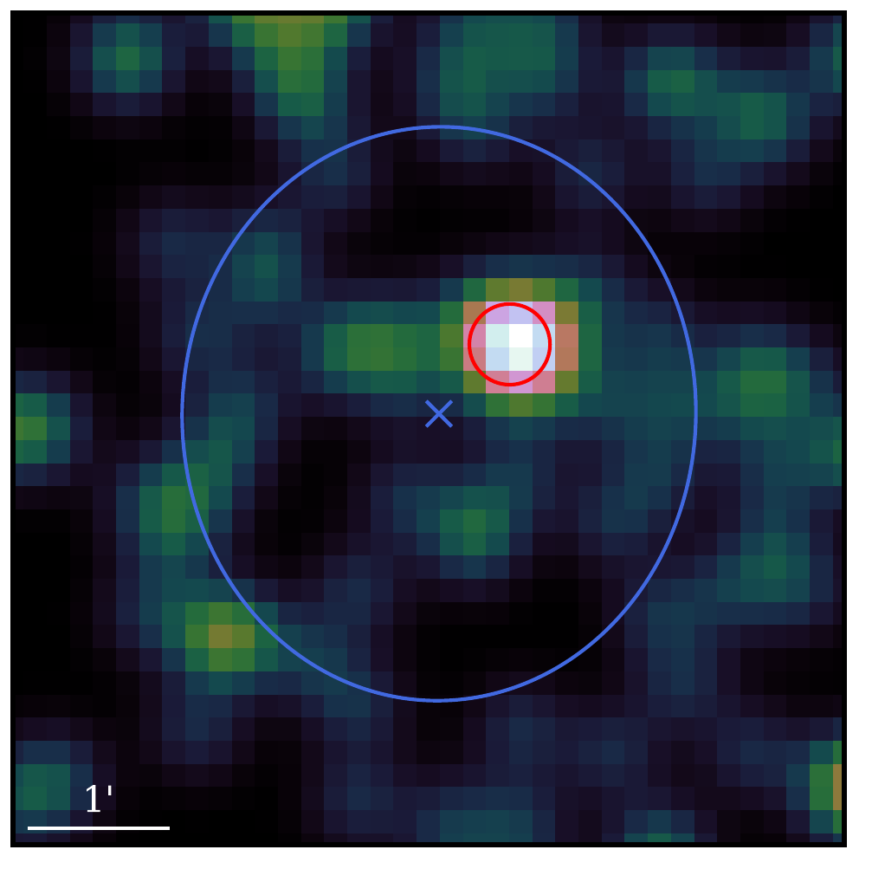
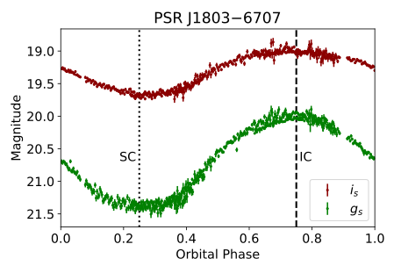
Followup example: Multiwavelength view of PSR J1803−6707
γ-ray pulsations
(Clark et al. 2023)
Radio pulsations
Clark et al. 2023
eRASS1 Perspective
Flux Density
J1803-6707 (TRAPUM)
Pulse Phase
Optical modulation
Fermi 95% error ellipse

Slide 13
Characterizing Nonthermal X-ray Emission from the Vela X Pulsar Wind Nebula

Slide 14
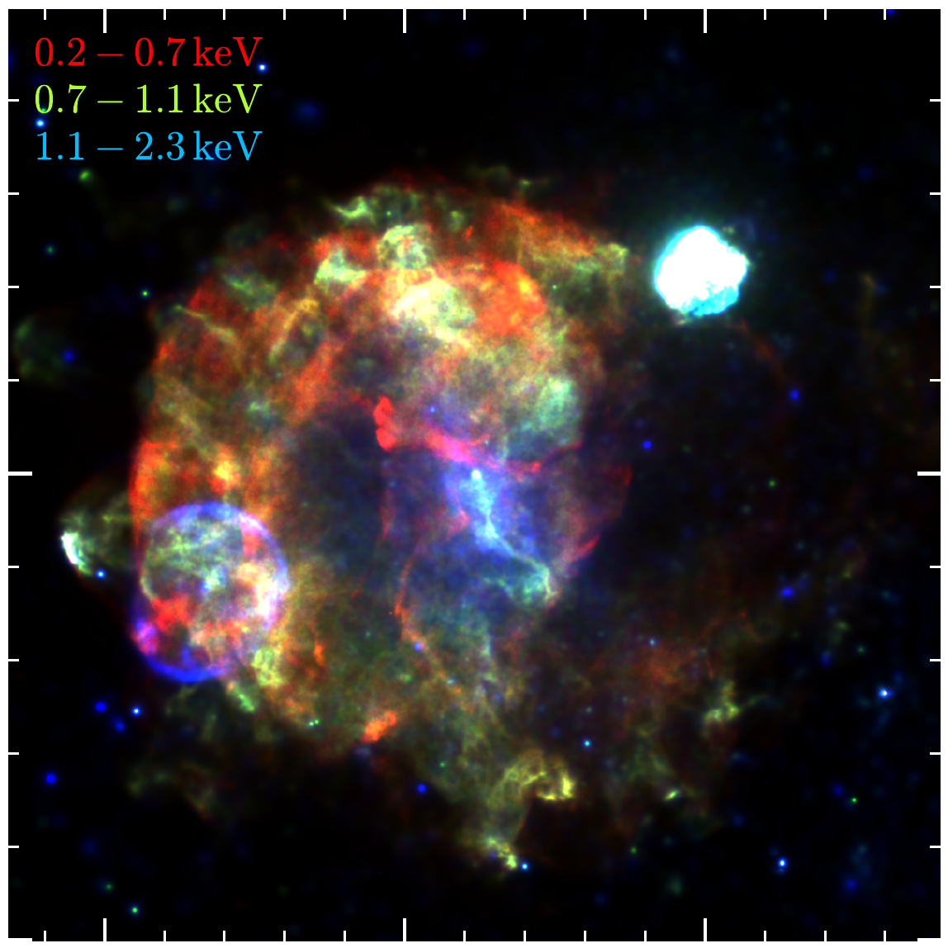
Vela X & The Vela Supernova Remnant
Vela X: Pulsar wind nebula (PWN) of energetic PSR B0833-45
Embedded in very extended Vela SNR
Nearby (~ 290 pc; Dodson+03)
Age ~ 11 – 30 kyr (Aschenbach+95, Lyne+96, Espinoza+17)
eRASS:4 data allow for disentangling thermal & nonthermal X-rays
First view of X-ray synchrotron emitting electrons on large scales
eRASS:4 image of Vela (logarithmic scale)
Mayer et al. 2023
eRASS:4 image of Vela (linear scale)
Mayer et al. 2023
Puppis A
(Mayer+22)
Vela X
Vela Jr.
(Camilloni+23)
2°

Slide 15
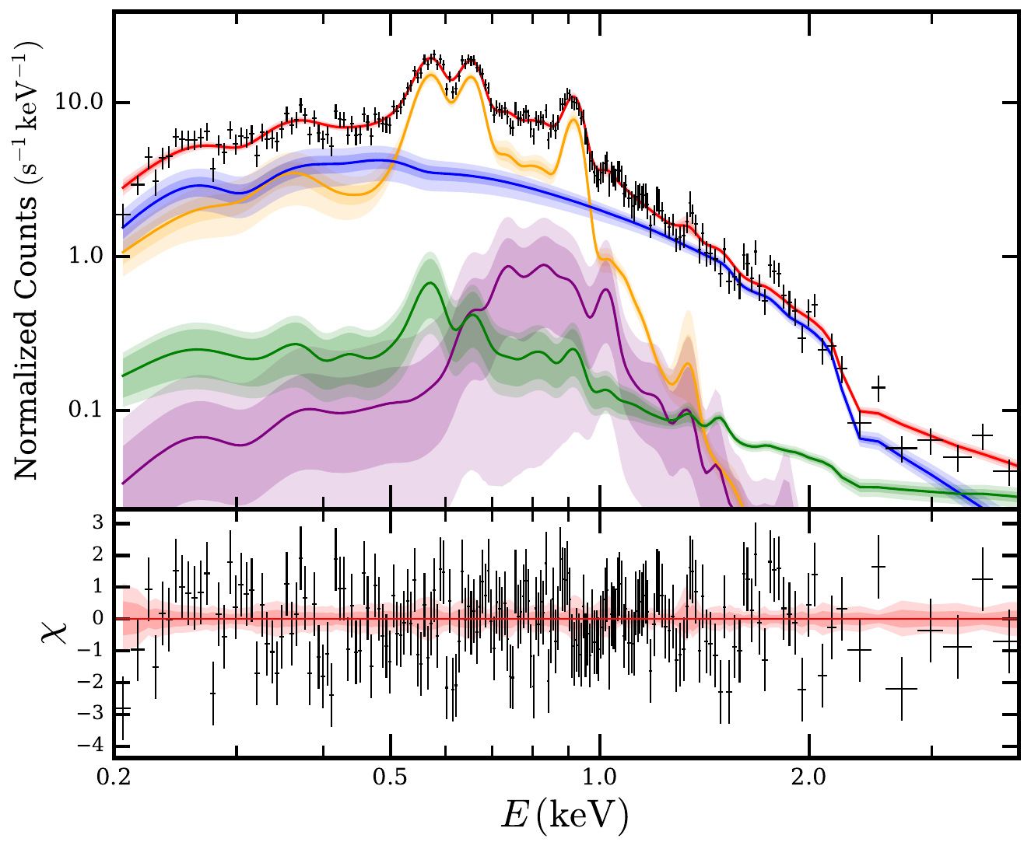
Analysis: X-ray Spectroscopy
TBabs*(vapec+vapec+powerlaw)
+ background
Adaptive Voronoi binning (Cappellari+03)
Around 500 spectra with uniform statistics (~ 10⁴ X-ray photons)
Characterize thermal & nonthermal components via spectral modelling
Nonthermal flux & photon index, (absorption, plasma temperature, abundances, ...)

Slide 16
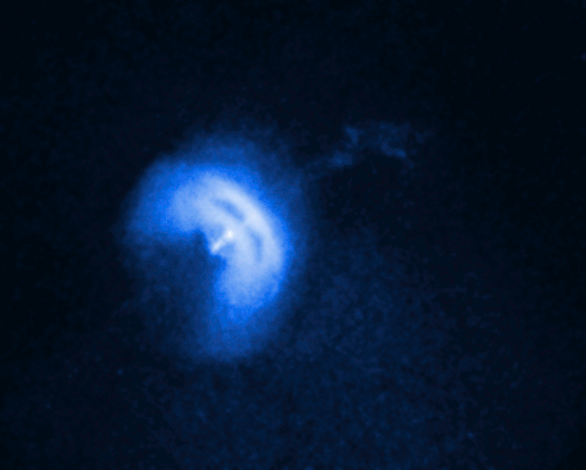
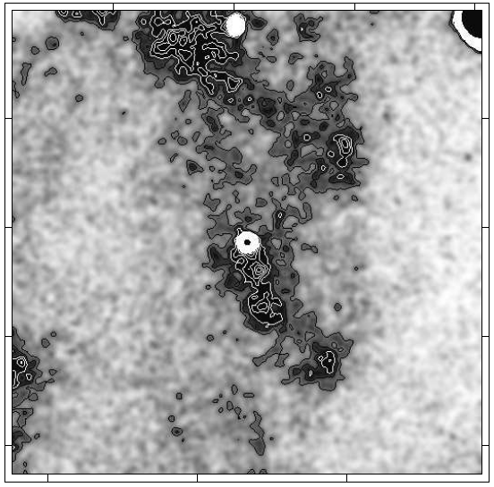
Results: Nonthermal Emission
Vela X in X-rays:
Compact PWN core with „jet“ and equatorial torus (e.g., Helfand+2001)
X-ray synchrotron emission in „Cocoon“ visible with ROSAT & XMM (e.g. Markwardt+1995, Slane+2018)
Now: Observe much larger size of diffuse synchrotron emission of PWN; radial extent of 2° - 3°
eROSITA: Nonthermal intensity (1.0-5.0 keV)
Vela PWN core
(Durant et al. 2013, chandra.si.edu)
Vela X
Vela Jr.
2°
Lu+2000:
ROSAT view of Vela center (0.9-2.4 keV)
1°

Slide 17
Results: Particle Diffusion in Vela X
Synchrotron emission from relativistic electrons diffusing through ambient medium
Characteristic physical extent (Abeysekara+17) limited by energy loss
φ
r_{D} ~ 14 pc
Synchrotron
Inverse Compton
R
Synchrotron intensity (1.0-5.0 keV)
Position angle
Radius from pulsar (arcmin)

Slide 18
Results: Particle Diffusion in Vela X
Synchrotron emission from relativistic electrons diffusing through ambient medium
Characteristic physical extent (Abeysekara+17) limited by energy loss
Spectral softening consistent with radiative energy losses (Tang+12)
Assuming ISM B-field:
Synchrotron
Inverse Compton
Synchrotron Photon Index
Position angle
Radius from pulsar (arcmin)

Slide 19
Results: Multiwavelength View of Vela X
X-ray synchrotron emission originates from TeV-energy electron population
No apparent counterpart in the north in TeV & radio bands
TeV emission would be crucial for constraining magnetic field & particle population
?
?
Radio (Hurley-Walker+17)
1°
Nonthermal X-rays (eROSITA)
TeV gamma-rays (H.E.S.S.+16)

Slide 20
Summary
eROSITA all-sky survey data sensitive to nonthermal X-ray emission at E < 2 keV
Systematic search for new pulsar candidates via Fermi-LAT - eROSITA crossmatch
Candidate catalogue designed for optical/radio followup
Discovery of very extended component in Vela X PWN
Physical picture unclear without multiwavelength analysis
Mayer et al. (2023), A&A, 676, A68 Mayer & Becker (2024), A&A, 684, A208

Slide 21
Summary
eROSITA all-sky survey data sensitive to nonthermal X-ray emission at < 2 keV
Systematic search for new pulsar candidates via Fermi-LAT -eROSITA crossmatch
Candidate catalogue designed for optical/radio followup
Detailed study of nonthermal X-ray emission of Vela X
Discovery of extremely extended X-ray PWN, up to 15 pc from pulsar
Mayer et al. (2023), A&A, 676, A68 Mayer & Becker (2024), A&A, 684, A208
eRASS1 data are public!

Slide 22
Extra Slides Fermi Pulsars

Slide 23
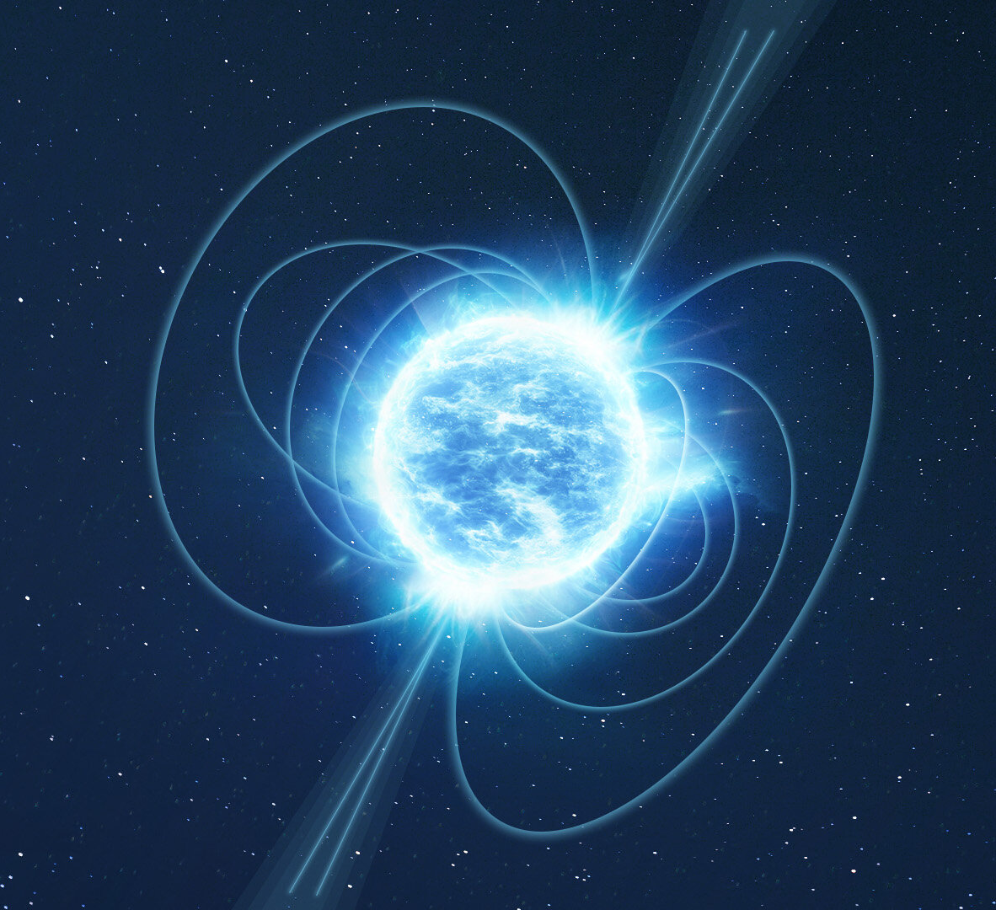
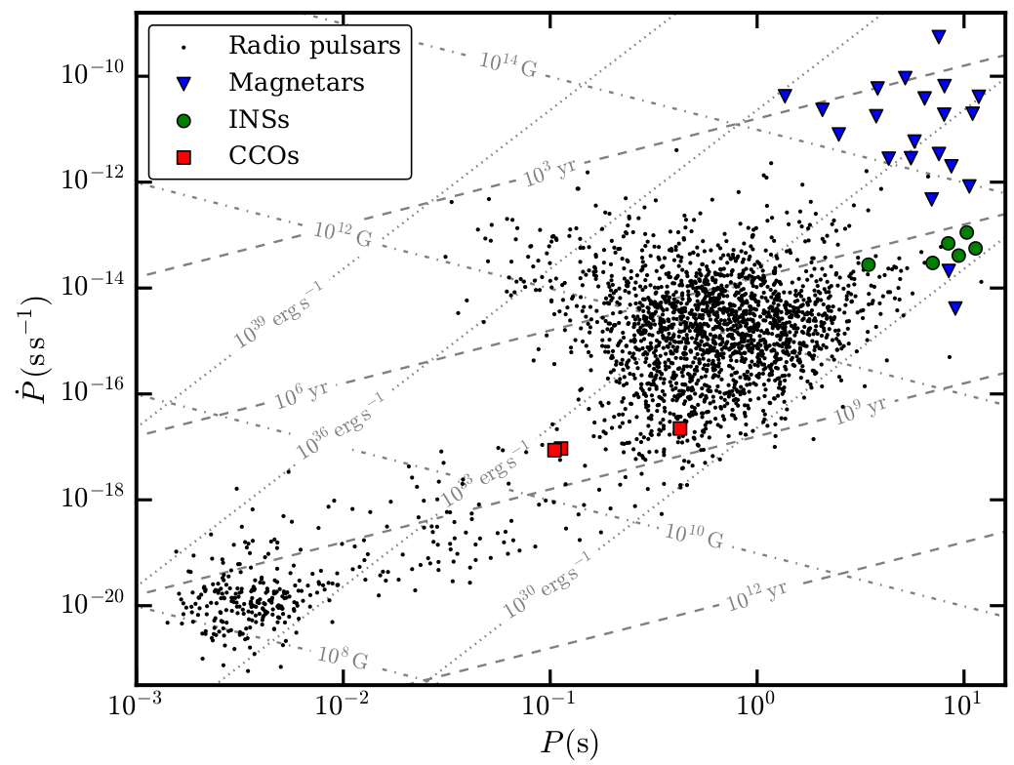
Introduction: Neutron Star Zoo
Zoo of non-accreting neutron stars
(Credit: ATNF pulsar database, Manchester et al. 2005)
Magnetized neutron star (artist‘s impression; www.esa.int)
Rotation-powered pulsars: Energy for emission supplied by spin-down
Young energetic pulsars (e.g. Crab, Vela)
Millisecond („recycled“) pulsars: Small periods due to accretion-induced spin-up
Around 3000 known, mostly observed through radio pulsations
Magnetospheric emission at X-ray & gamma-ray energies
„Exotic“ types: Magnetars, central compact objects, isolated neutrons stars, ...
Accretion-powered X-ray binaries
Young Pulsars
ms Pulsars

Slide 24
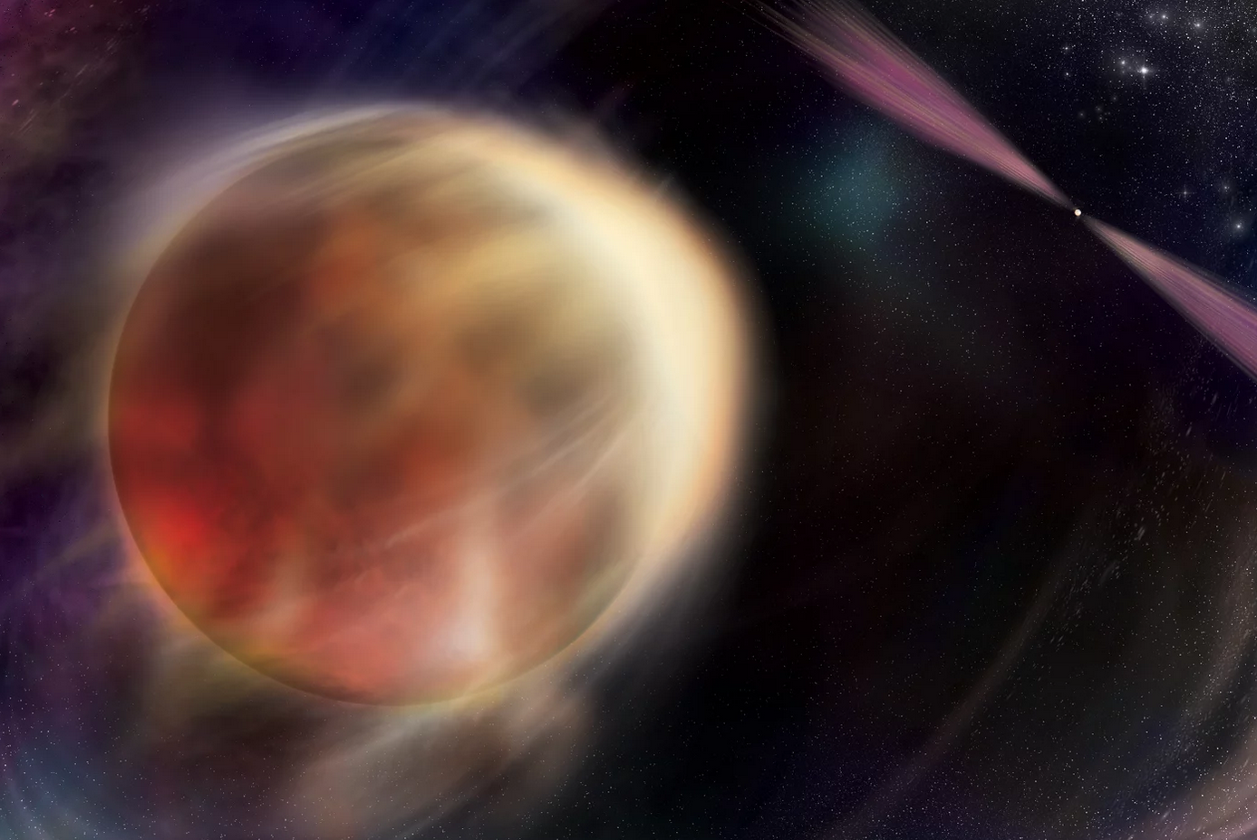
Motivation: High-Energy Pulsars
Launch of Fermi satellite (2008) greatly increased sensitivity in GeV band
Present-day: 340 pulsars detected by Fermi-LAT (Smith et al. 2023)
Around 50% young pulsars – 50% millisecond pulsars
Spider binaries (redbacks, black widows): ms pulsars „consuming“ their companions
Gamma-ray-based selection provides a unique view on pulsar population
Spider binary (artist‘s impression)
NASA/Sonoma State University, Aurore Simonnet

Slide 25
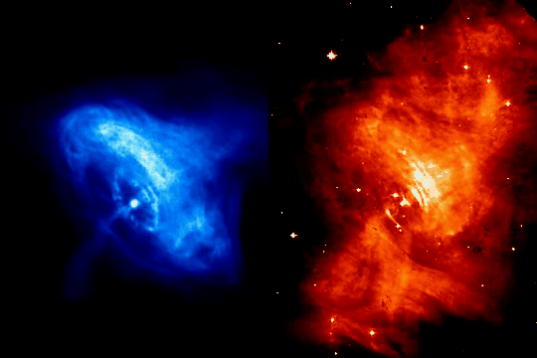
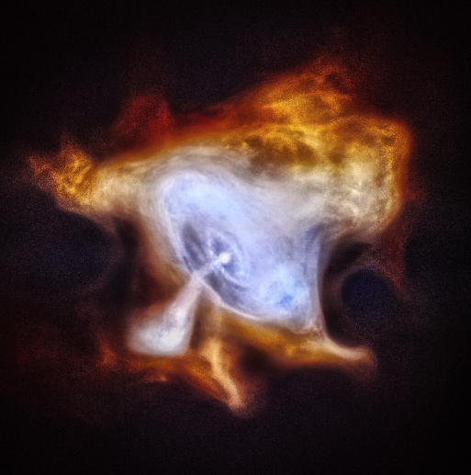
Introduction: Pulsar Wind Nebulae
Crab nebula in X-rays
(nasa.gov)
Crab nebula in X-rays over time
Hester et al. 2002; NASA, JPL-Caltech
PWN: Nebula of electrons (& positrons) accelerated in pulsar magnetosphere
GeV to TeV (PeV?) energies
Ambient Magnetic field ~ 10⁻⁵ – 10⁻⁴ G
Synchrotron emission from radio to X-rays
Ambient radiation field
Inverse Compton radiation powers GeV to TeV gamma-rays

Slide 26
Motivation: eROSITA Two-Year Catalog (eRASS:4)
Cross-match with eROSITA All-Sky Survey (eRASS) Catalog (see Merloni et al. 2024)
Use four-survey catalog (eRASS:4) for maximum sensitivity
Around three million sources on western Galactic hemisphere (~ 140 sources deg⁻²)
Down to F ~ 2 × 10⁻¹⁴ erg s⁻¹ cm⁻² in 0.2 – 2.3 keV
Challenges:
Large gamma-ray error ellipses (~ 5 arcmin)
X-ray pulsar counterparts typically faint (~ 10 counts)
Multiwavelength source properties & probabilistic approach crucial (Salvato et al. 2018)
Example eRASS:4 image of 4FGL error ellipse
95%
1σ
5’

Slide 27
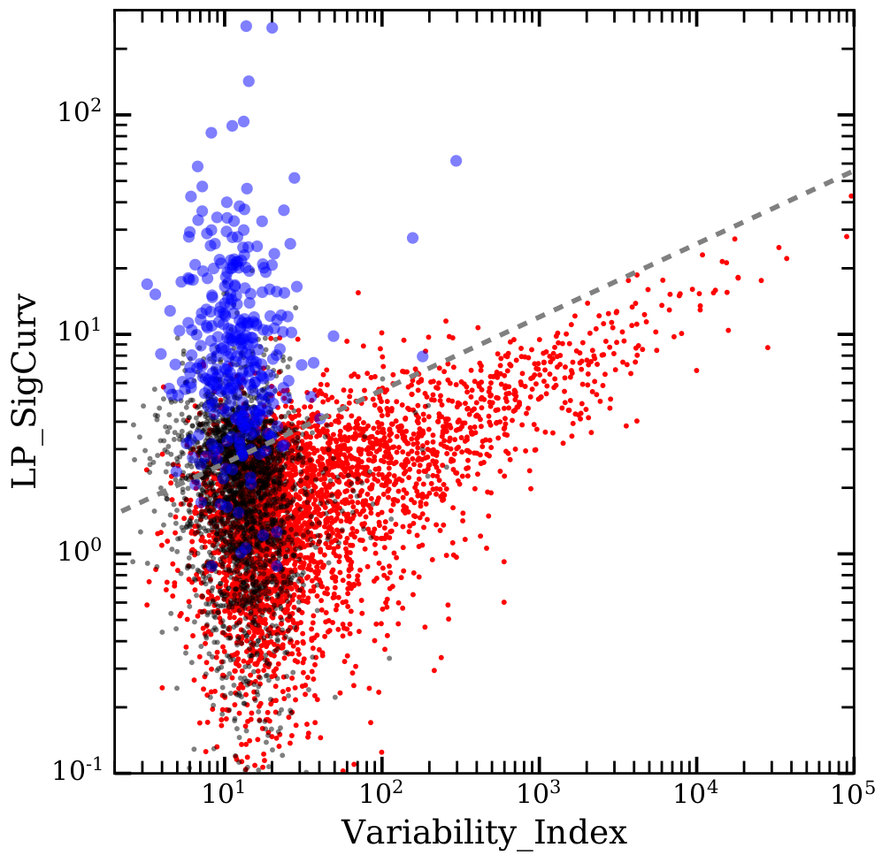
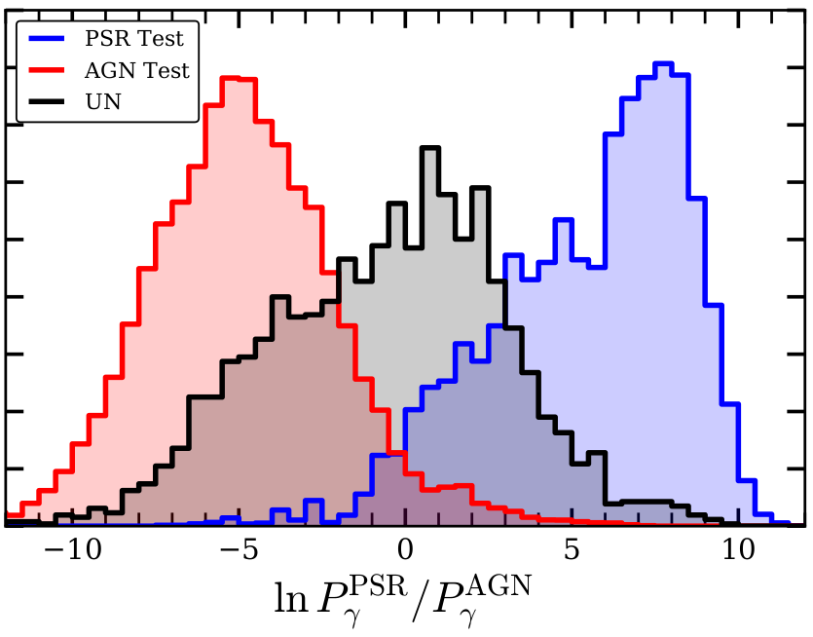
Search Strategy: Prior Classification
Mayer & Becker 2024
Improve on pure positional cross-match using basic X-ray & gamma-ray source properties:
Use random forest classification on 4FGL source properties to predict probability of PSR/AGN class (e.g. Saz Parkinson et al. 2016)
Efficiently separates PSR/AGN candidates
Mayer & Becker 2024
Spectral curvature
Unassociated
Pulsars
AGN
Long-term variability

Slide 28
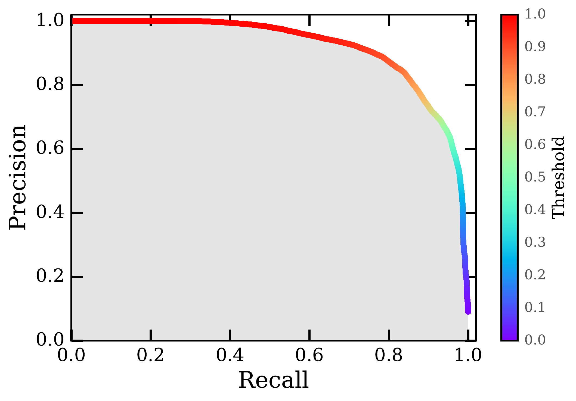
Precision-Recall Curve

Slide 29
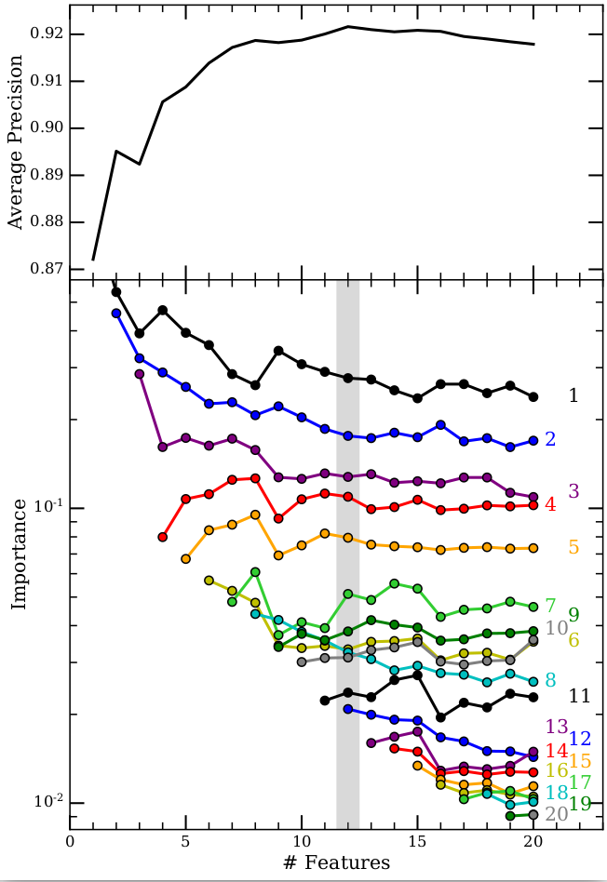
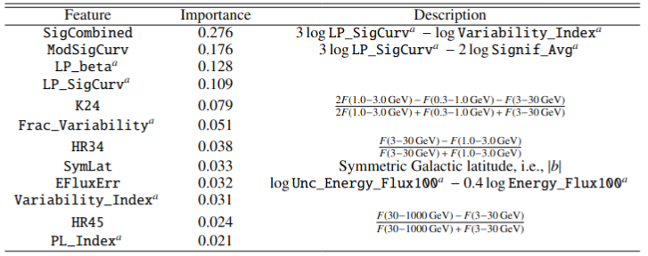
Feature Elimination

Slide 30
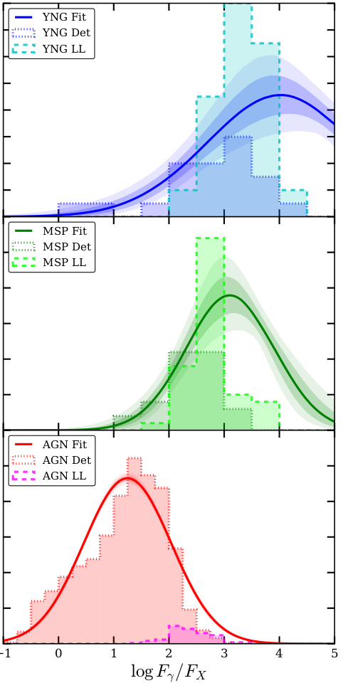
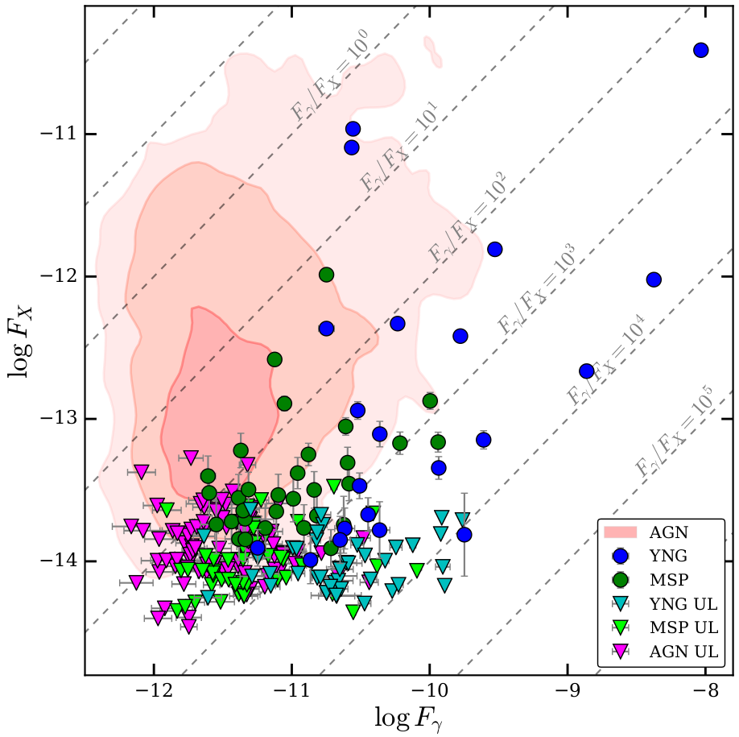
Search Strategy: Multiwavelength Fluxes
Mayer & Becker 2024
Improve on pure positional cross-match using basic X-ray & gamma-ray source properties:
Constrain expected X-ray flux based on observed flux distribution of pulsars (young and millisecond) and blazars
Implies many pulsar counterparts below X-ray detection limit

Slide 31
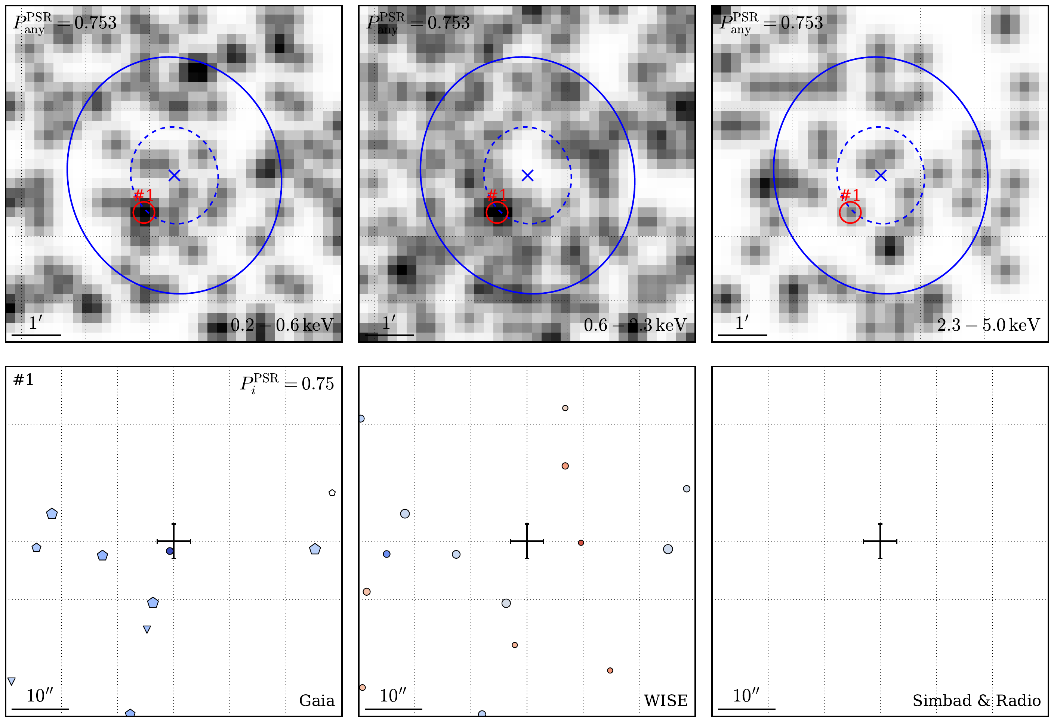
Visual Inspection

Slide 32
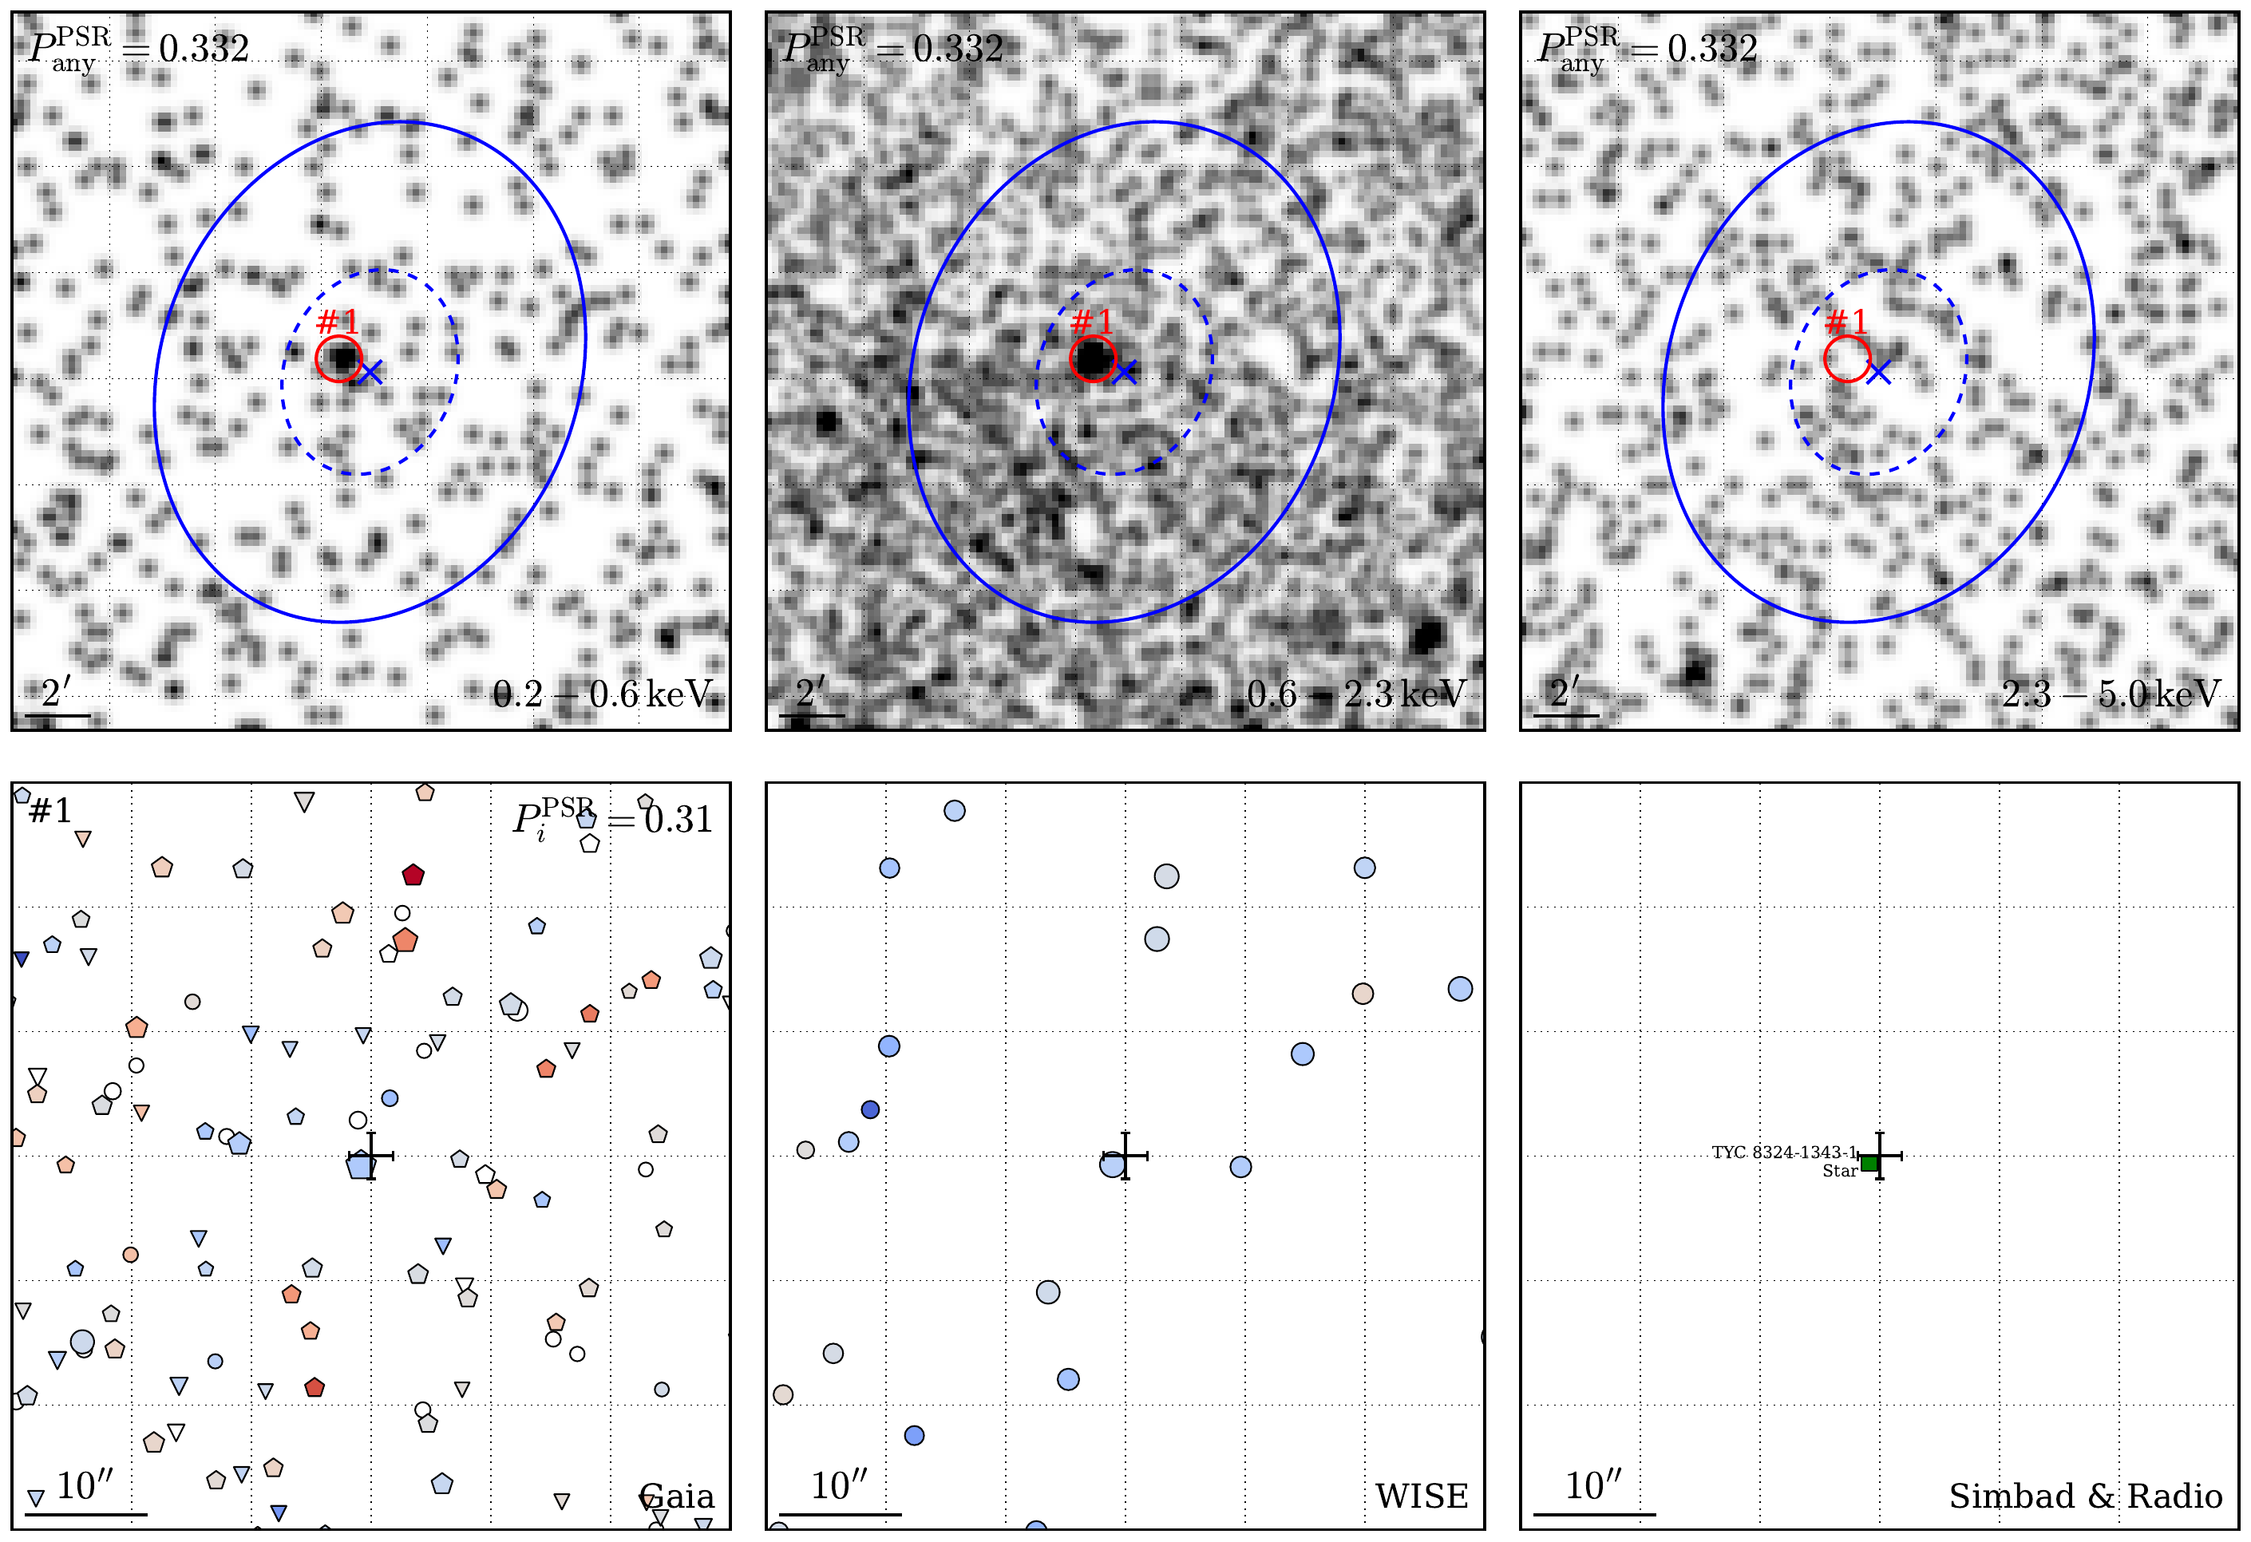
Visual Inspection

Slide 33
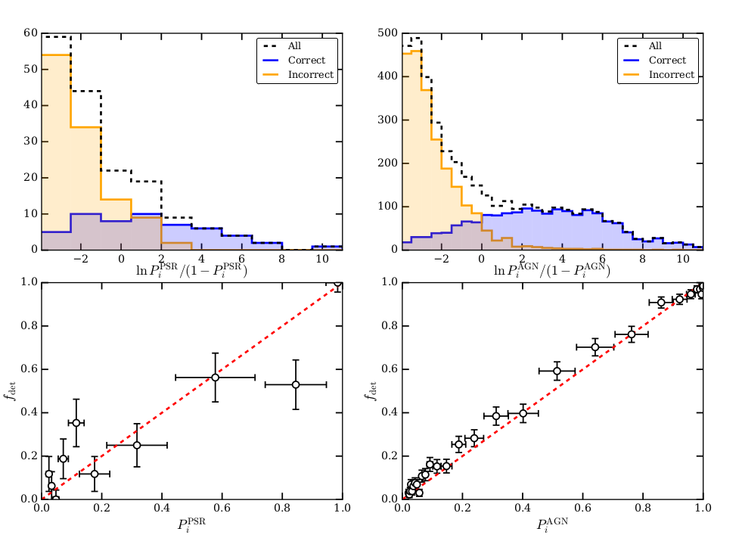
Verification of Probabilities

Slide 34
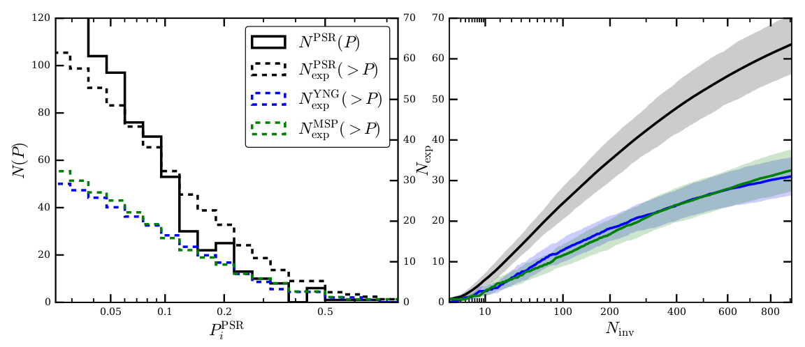
Prediction of expected detections

Slide 35
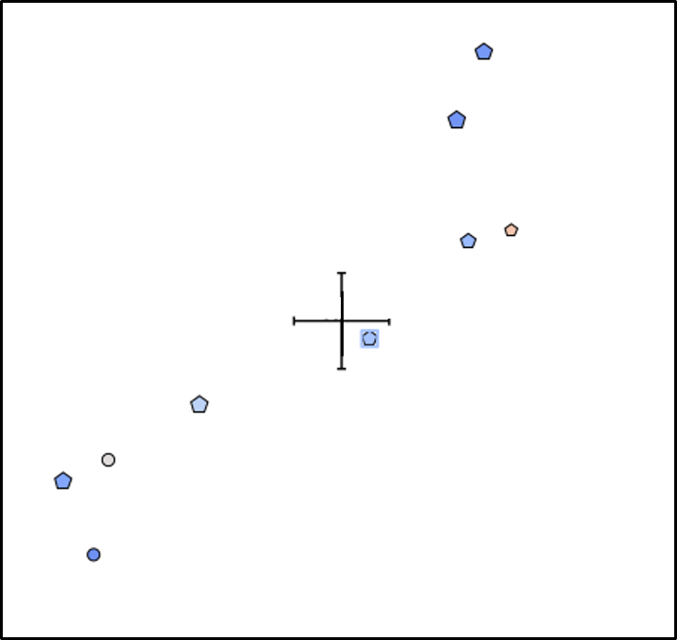
Followup example: PSR J1803−6707 in eRASS1
Clark et al. 2023
eRASS1 Perspective
Gaia Sources
J1803-6707 (TRAPUM)
eRASS1 Position
19th mag Counterpart
Fermi 95% error ellipse
10”

Slide 36
Followup example: Multiwavelength view of PSR J1803−6707
γ-pulsations (Clark et al. 2023)
Radio pulsations (Clark et al. 2023)
Redback binary pulsar (Clark et al. 2023)
2.1 ms spin period
9.1 h orbital period
M_{Companion} > 0.26 M⊙
γ-ray & radio pulsations from pulsar
Orbital modulation in the optical
(No X-ray pulsations yet)
Flux Density
Pulse Phase
Clark et al. 2023

Slide 37
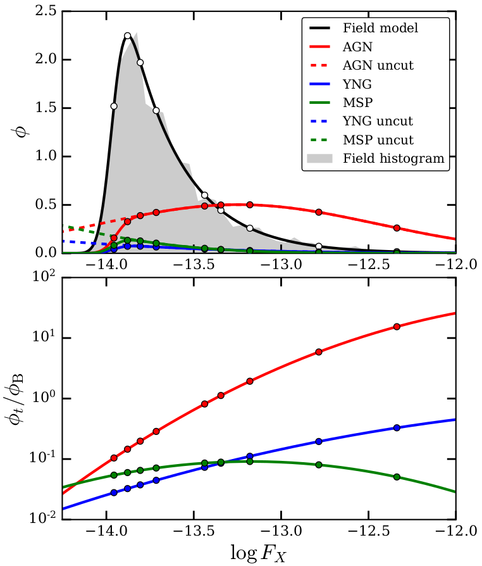
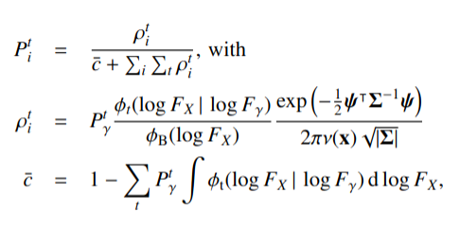
Math
Probabilistic matching similar to NWAY (Salvato et al. 2018), and using Bayesian approach of Budavari & Szalay (2008)
Normalized probability
Spatial separation
Positional errors
Gamma-ray prior
Flux distributions
Local source density
Prior incompleteness

Slide 38
Extra Slides Vela X

Slide 39
Analysis: Imaging & Morphology
Complex energy-dependent morphology with multiple components
Soft band: Diffuse shell & thick tangential filaments
Medium band: Thin radial fingers & clumps
Hard band: Nonthermal emission from Vela X & Vela Jr.
eRASS:4 image of Vela (linear scale)
Mayer et al. 2023
Nonthermal emission
2°

Slide 40
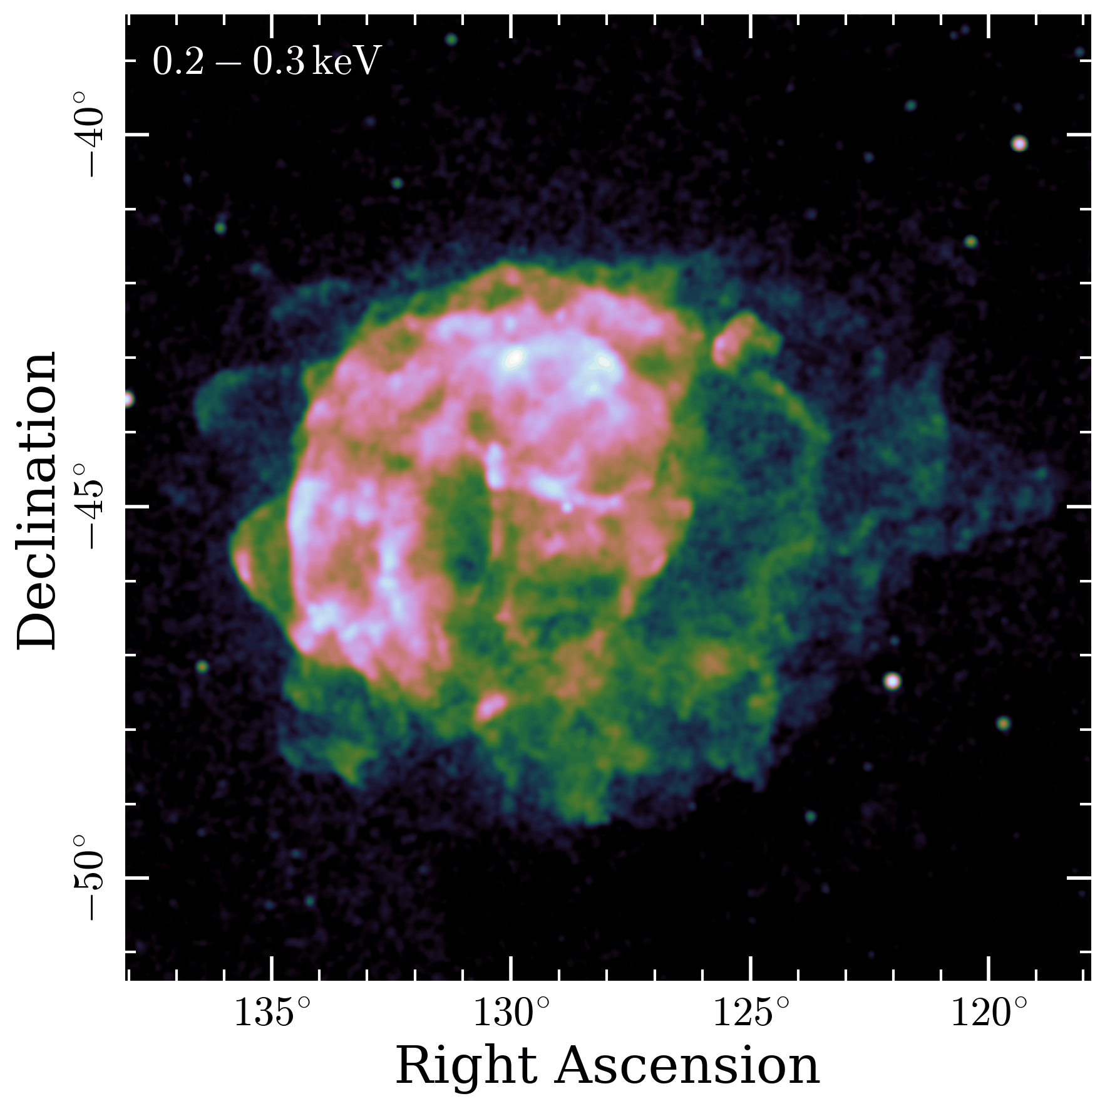
Imaging & Morphology
Complex energy-dependent morphology with multiple components
Soft band: Diffuse shell & thick tangential filaments
Medium band: Thin radial fingers & clumps
Hard band: Nonthermal emission from Vela X & Vela Jr.
2°

Slide 41
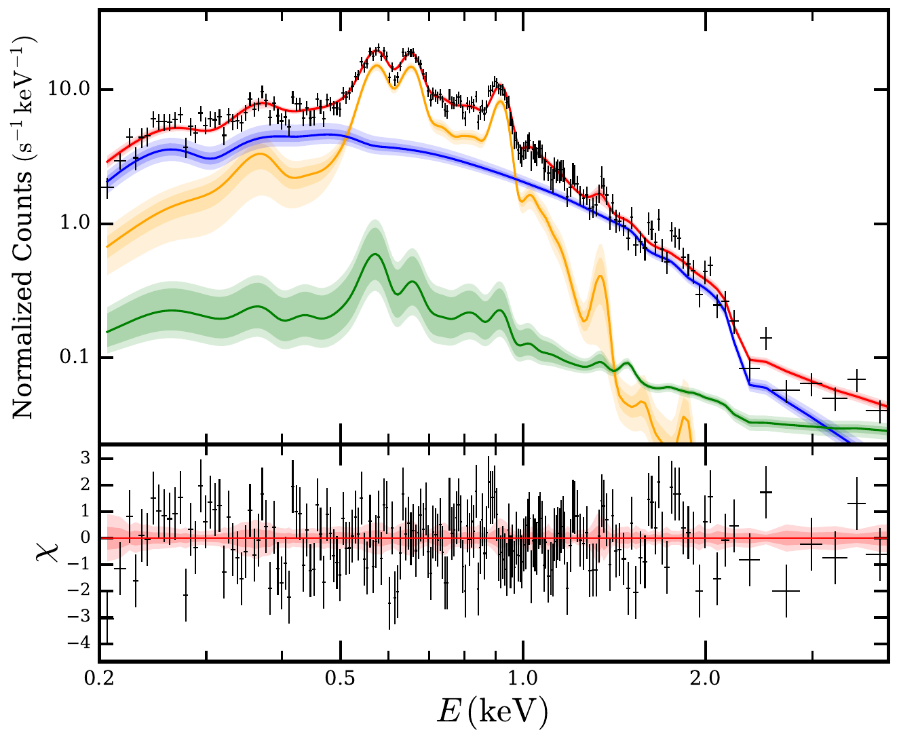
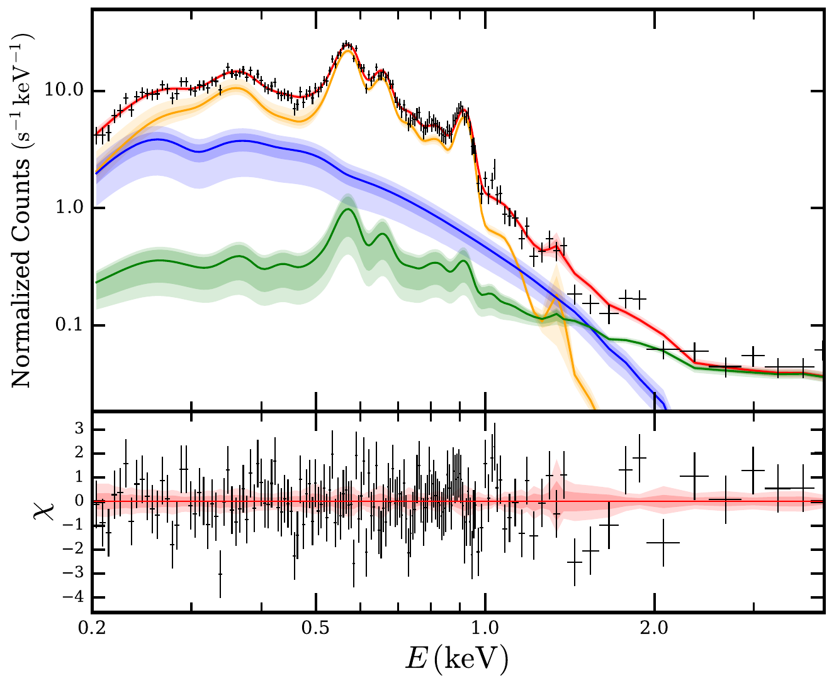
Spectral model
Absorbed plasma in NEI + nonthermal component
TBabs*(vpshock+powerlaw) + backgrund
Photon index in region 2 too steep (Γ = 4)
Hard to constrain kT, τ individually
2
1
1
2

Slide 42
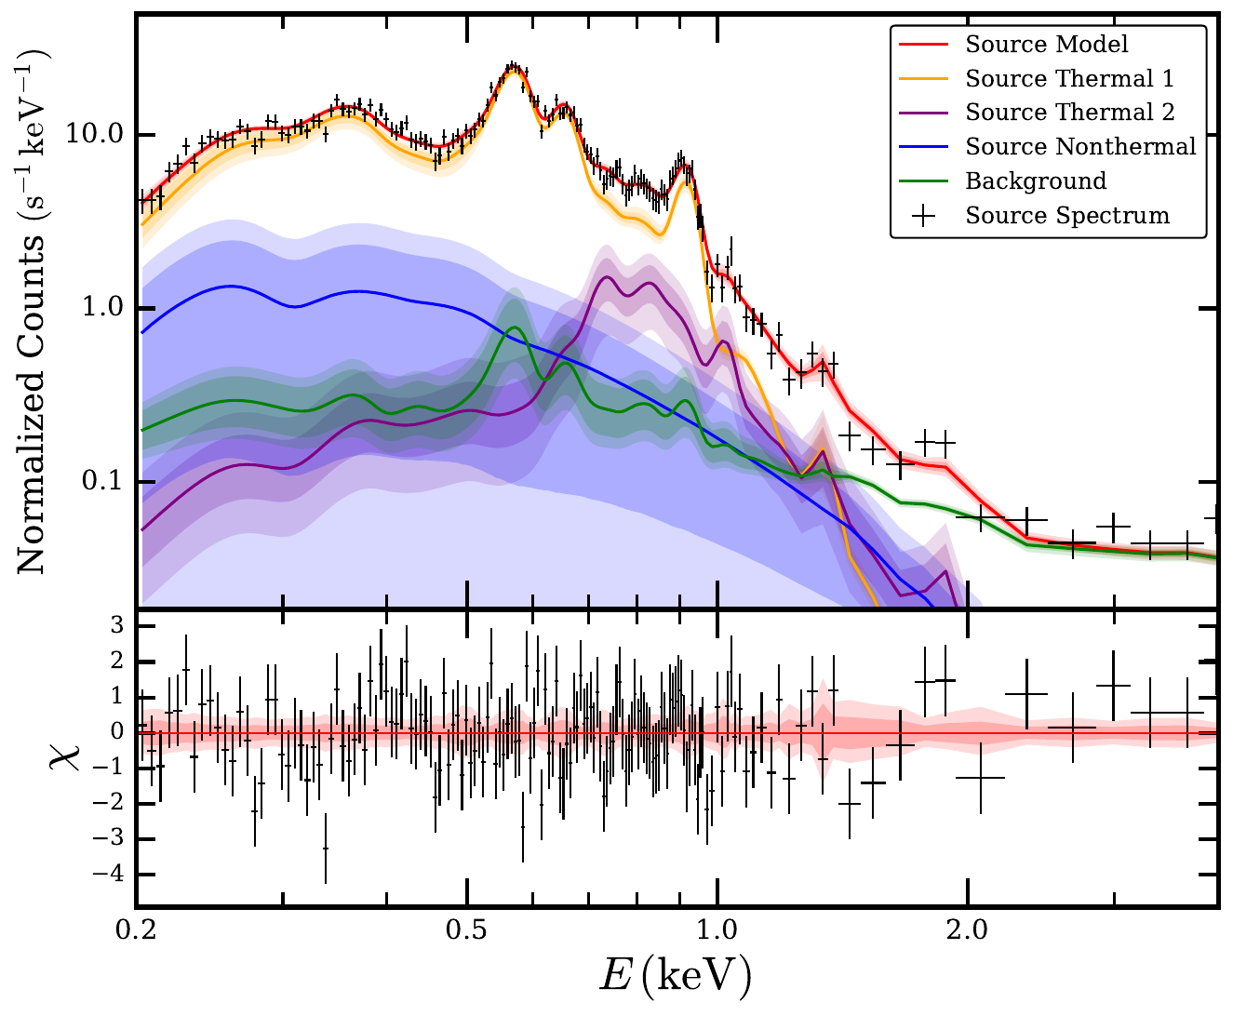
Spectral model
Two absorber plasmas + nonthermal component
TBabs*(vapec+vapec+powerlaw) + background
Mean plasma temperature more well-defined
2
1
1
2

Slide 43
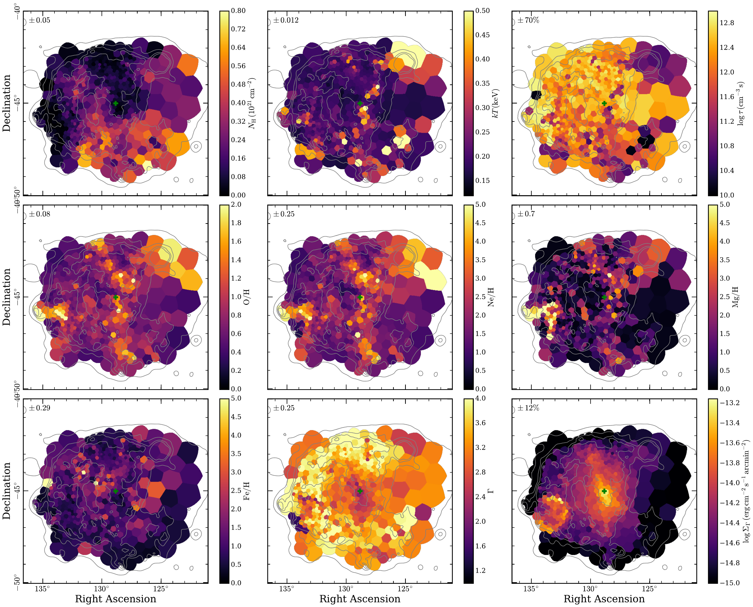
Fits with
NEI Plasma

Slide 44
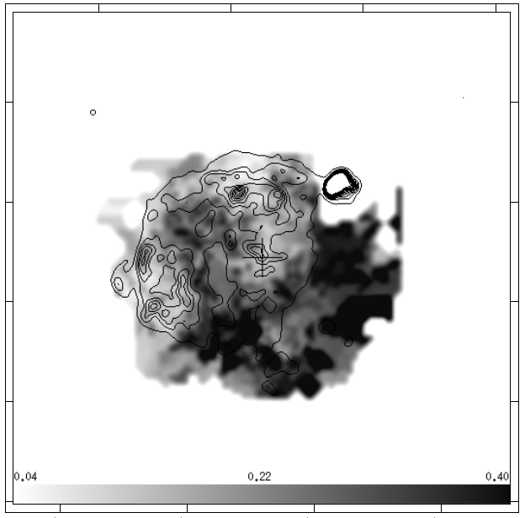
Results: Absorption & Plasma Temperature
Lu & Aschenbach (2000): N_H
Foreground absorption column density
Weighted mean temperature

Slide 45
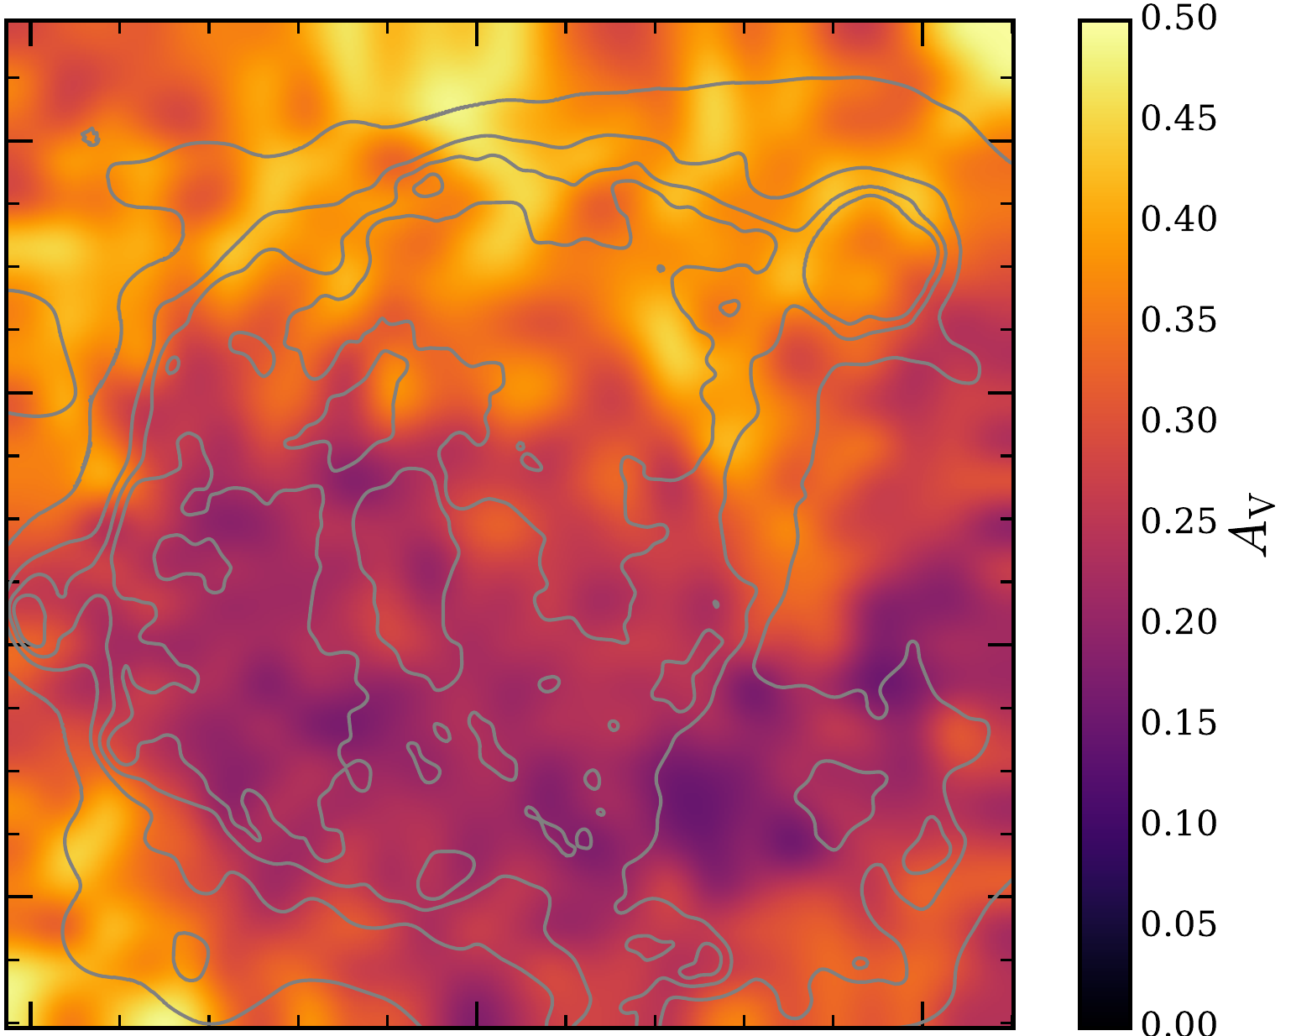
Results: Intervening ISM
Optical Extinction towards Vela
(StarHorse, Anders+22)
Foreground absorption column density
Mayer et al. 2023
Anticorrelation

Slide 46
Results: Foreground Absorption
Foreground absorption column density
Hα line emission
(SHASSA; Gaustad+01)
Correlation! But why?

Slide 47
Results:
ISM & Ejecta
Mayer et al. 2023
Oxygen
Neon
Foreground absorption
Magnesium
Iron

Slide 48
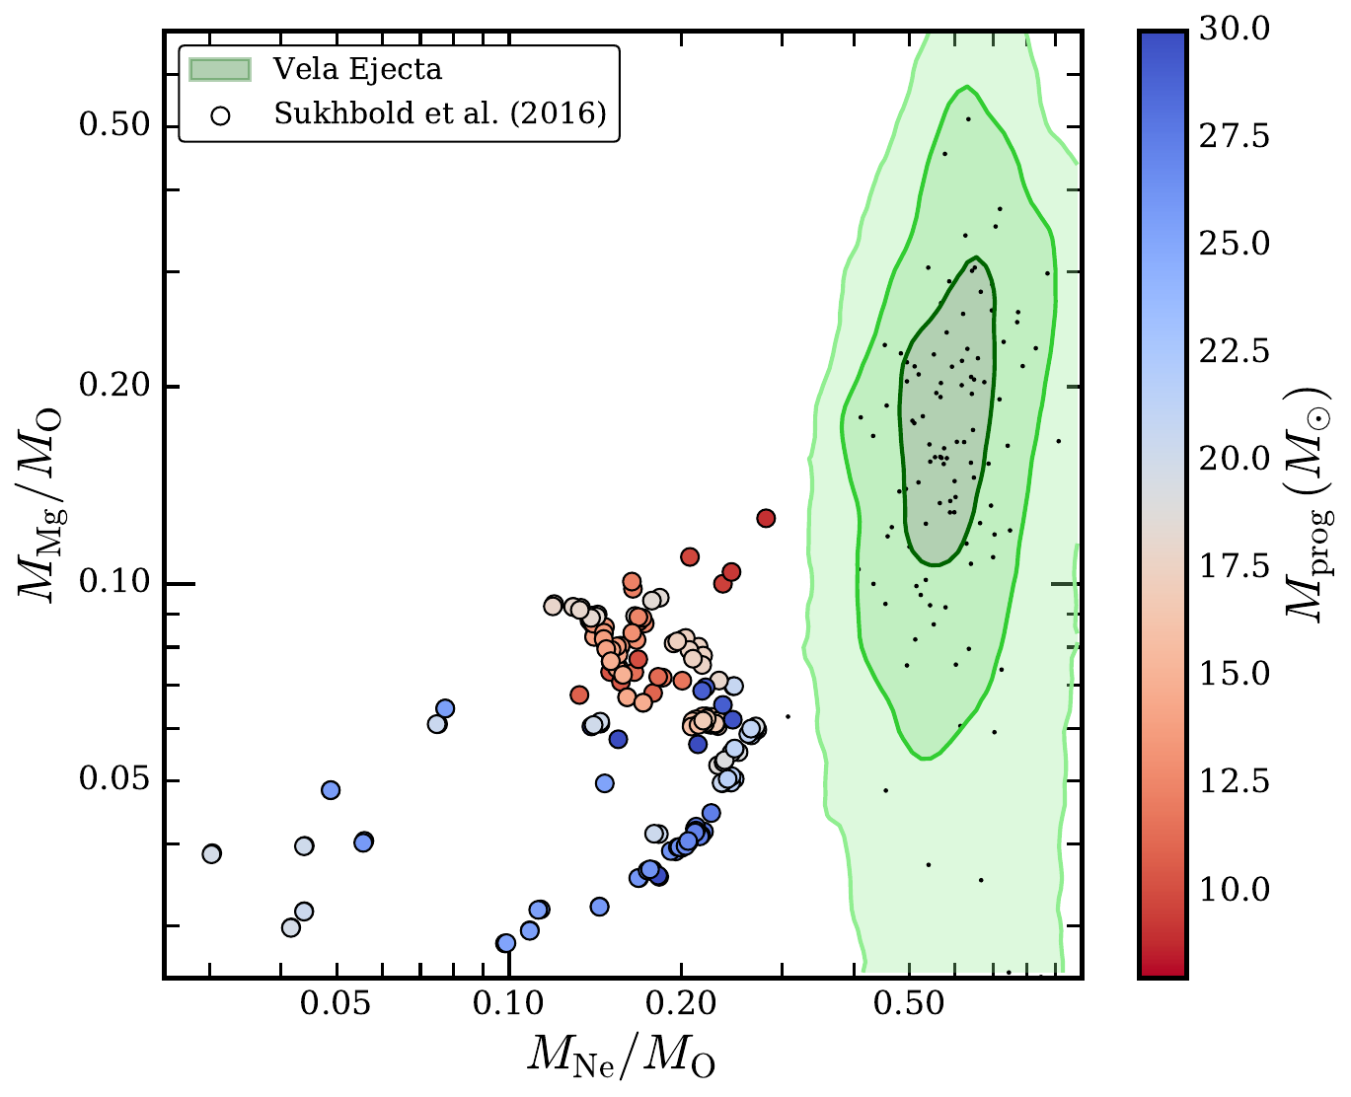
Results: Ejecta
Oxygen
Neon
Observed composition
Sukhbold et al. (2016)
Correlated abundance peaks of oxygen, neon, magnesium
Iron distribution independent from lighter elements
General pattern:
Ne/O, Mg/O supersolar
Not reproduced in nucleosynthesis models (Sukhbold+16)
Magnesium
Iron

Slide 49
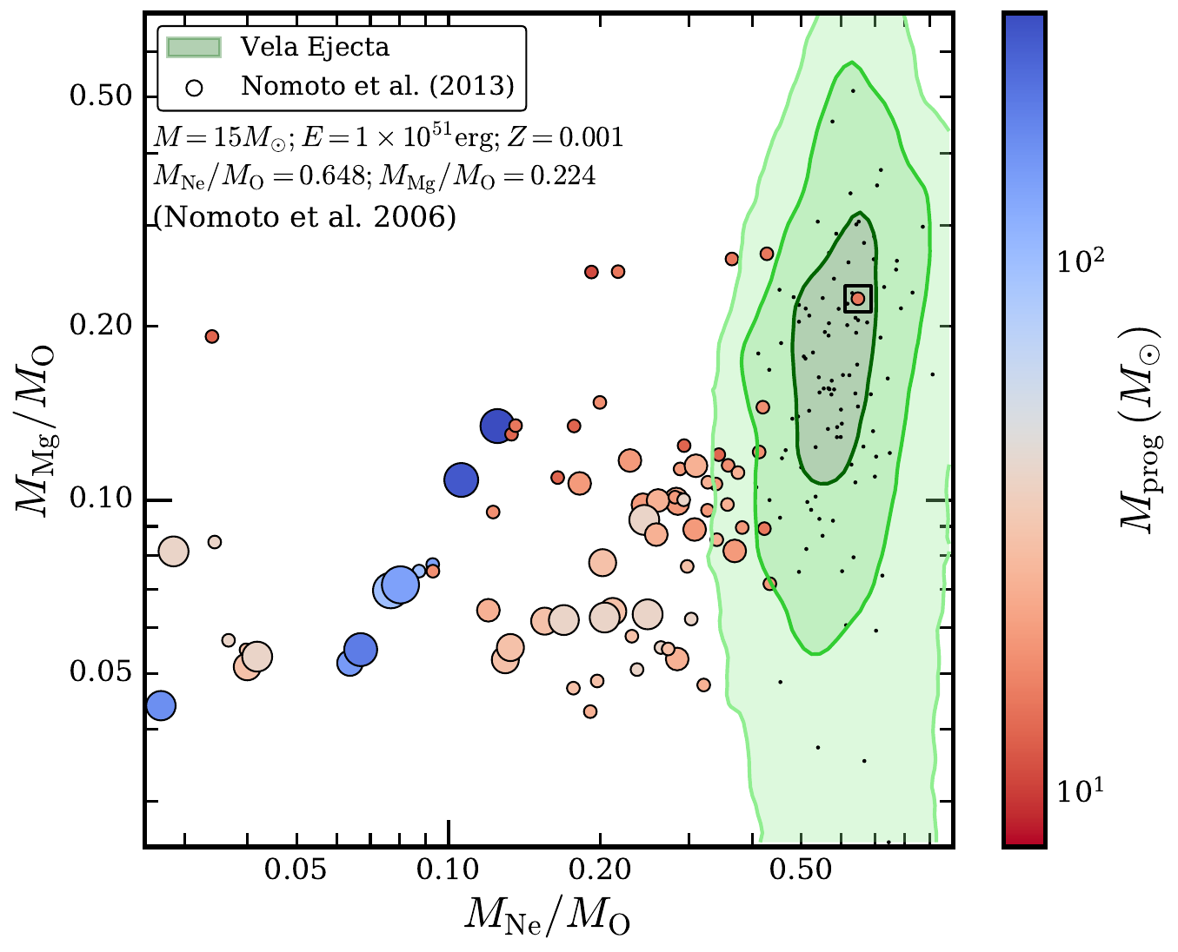
Results: Ejecta
Observed composition
Nomoto et al. (2006)
Correlated abundance peaks of oxygen, neon, magnesium
Iron distribution independent from lighter elements
General pattern:
Ne/O, Mg/O supersolar
Reproducable in low-metallicity model? (Nomoto+06)

Slide 50
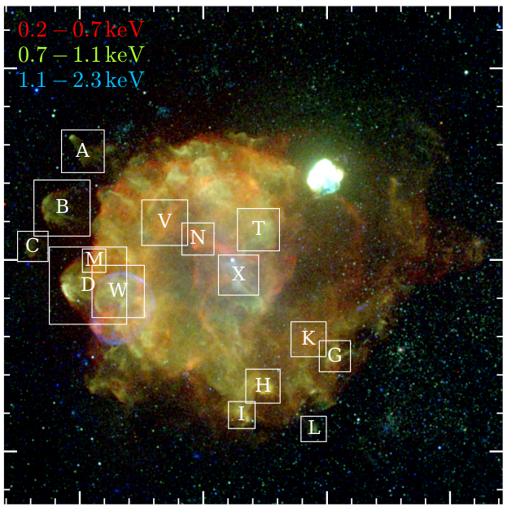
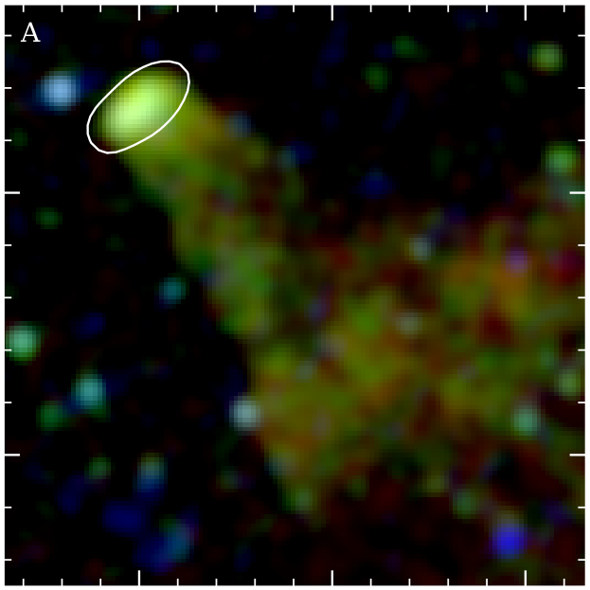
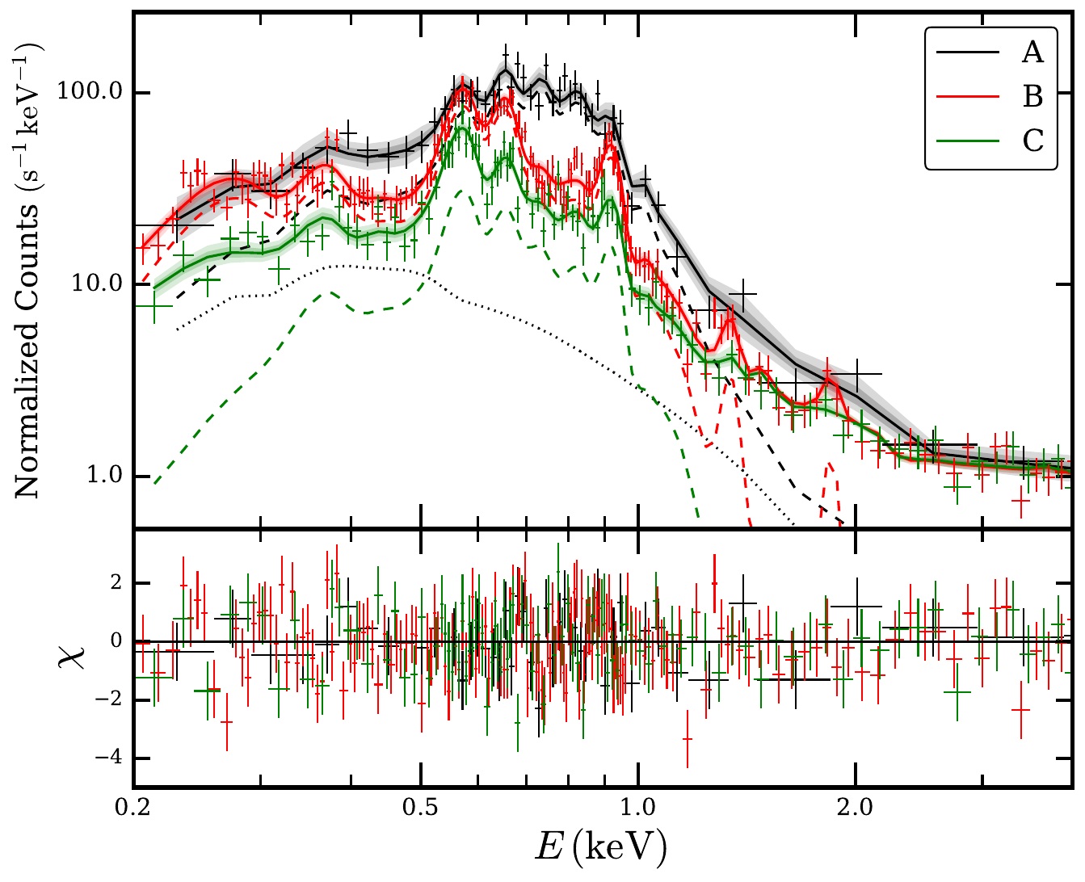
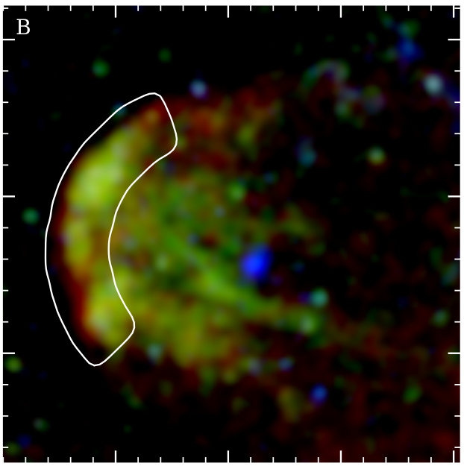
Results: Shrapnels A, B, C
O
Fe L-shell
Ne
Mg
Si
Iron ejecta present in silicon-rich (Katsuda+06), fast shrapnel A?

Slide 51
Results: Ejecta in Shrapnel D
Temperature gradient
O/H ~ 9
Ne/H ~ 16
Little Fe
Mg/H ~ 15
Little Si
Hot light-element ejecta at the apex; cooler shocked ISM along the sides

Slide 52
Shrapnel D: Simulations (Miceli et al. 2013)
Miceli+13: Simulation of an ejecta clump protruding into the unshocked ISM
Unexpected temperature structure?

Slide 53
Comparison with ROSAT (Lu & Aschenbach, 2000)
Foreground absorption
Mean temperature
Lu & Aschenbach (2000)
Lu & Aschenbach (2000)

Slide 54
N_{H} & Hα
(Gaustad+01)

Slide 55
More Ejecta Clumps
Dominant
in Ne
Dominant in Si
Silicon abundance varies between individual clumps

Slide 56
Spectrum at the shock front
kT ~ 0.22 keV
τ ~ 6 × 10¹¹ s/cm³
kT ~ 0.22 keV
τ ~ 1.5 × 10¹⁰ s/cm³
Spectral differences mostly due to different shock ages!
15‘

Slide 57
Nonthermal Photon Index & Surface Brightness
Powerlaw spectral index
Nonthermal intensity (1.0-5.0 keV)
2°
Slane+18

Slide 58
Nonthermal Emission in radial projection
Powerlaw spectral index
Nonthermal intensity

Slide 59
Nonthermal Emission in radial projection II
Powerlaw spectral index
Nonthermal intensity

Slide 60
Bayesian Evidence in Favor of Nonthermal Emission
Slane+18

Slide 61
Origin of Leptonic Emission
X-rays & Radio
Gamma-rays
SYNCHRO-
INVERSE COMPTON

