Slide 1


Exploring the Influence of Cosmic Voids on the propagation of TeV Gamma-Rays and the Puzzle of GRB221009A
Hassan Abdalla
S. Razzaque, M. Böttcher, A. Dominguez, J. Finke
Erlangen 31/07/2024

Slide 2
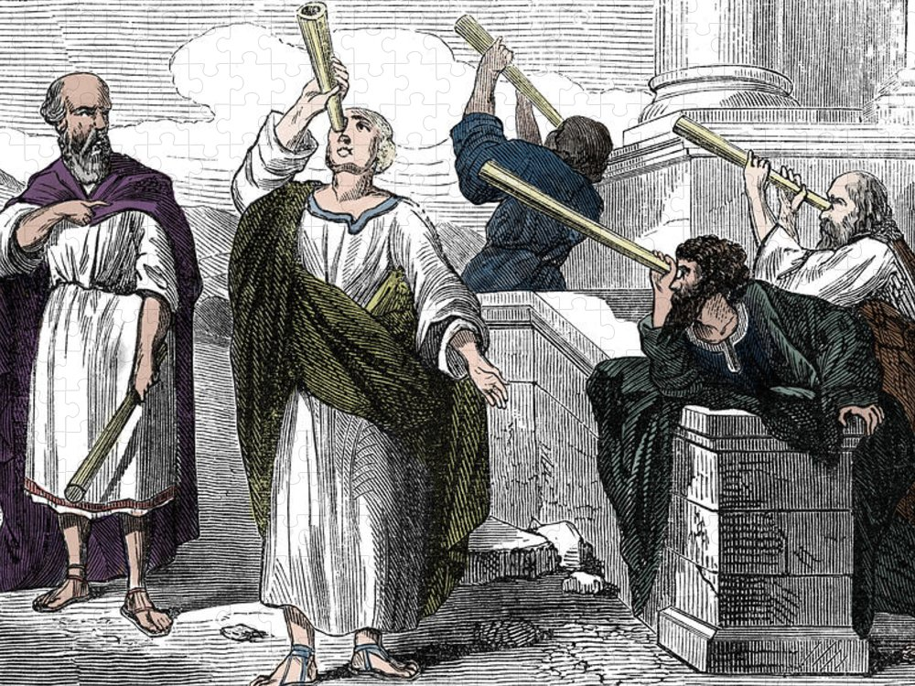
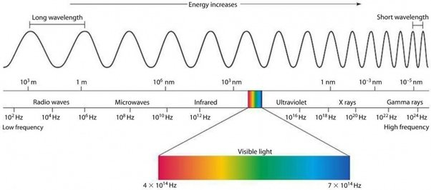
Ancient Astronomers Stargazing

Slide 3
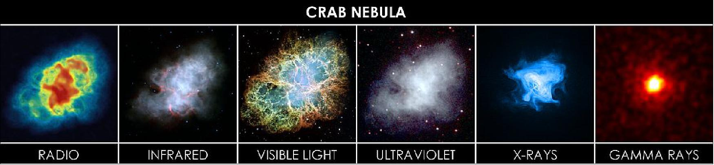
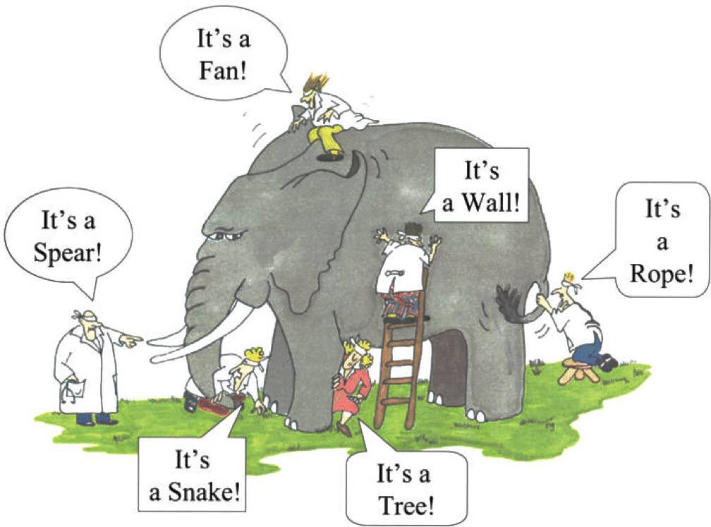
Multi-Wavelength and Multi-Messenger Astronomy: Key to a Deeper Cosmic Insight

Slide 4
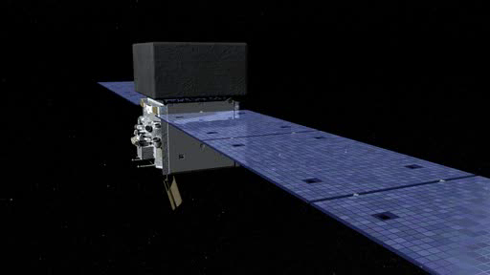
Fermi LAT satellite detector

Slide 5
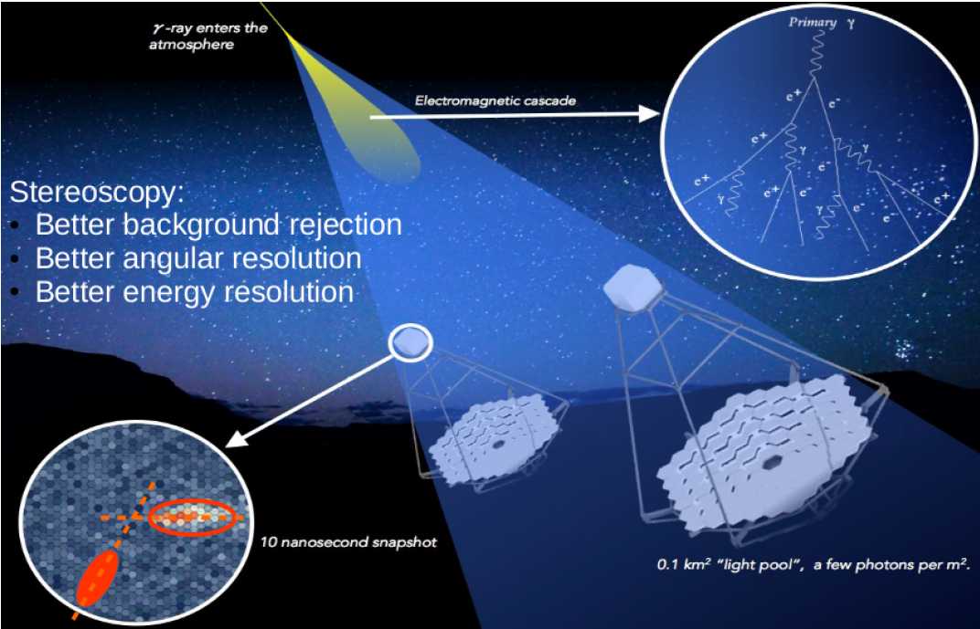
Schematic drawing:
Imaging Atmospheric Cherenkov Technique
Mangano (2017)

Slide 6
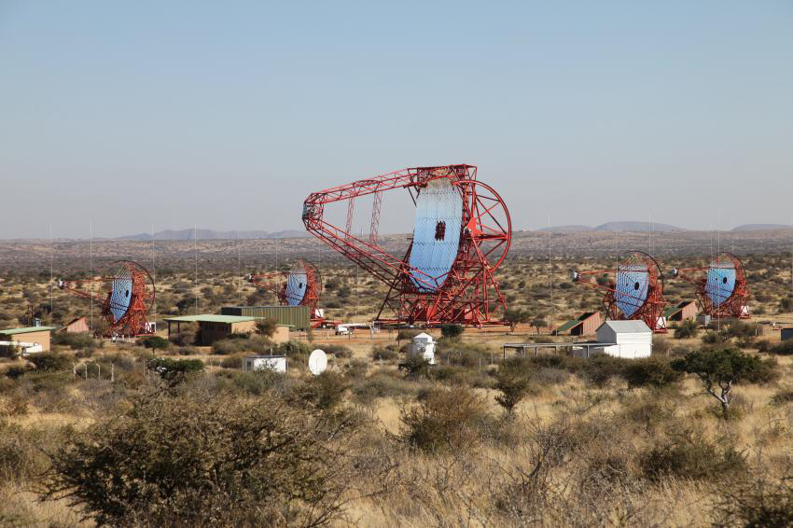
High Energy Stereoscopic System (H.E.S.S.)

Slide 7
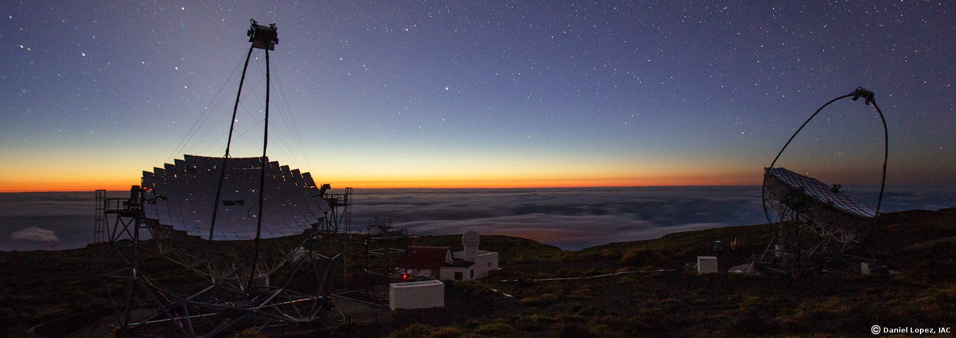
The MAGIC Telescope in La Palma (Canary Islands, Spain)

Slide 8
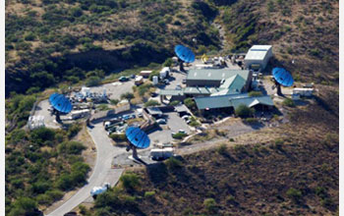
The VERITAS telescopes ( Arizona, USA)

Slide 9
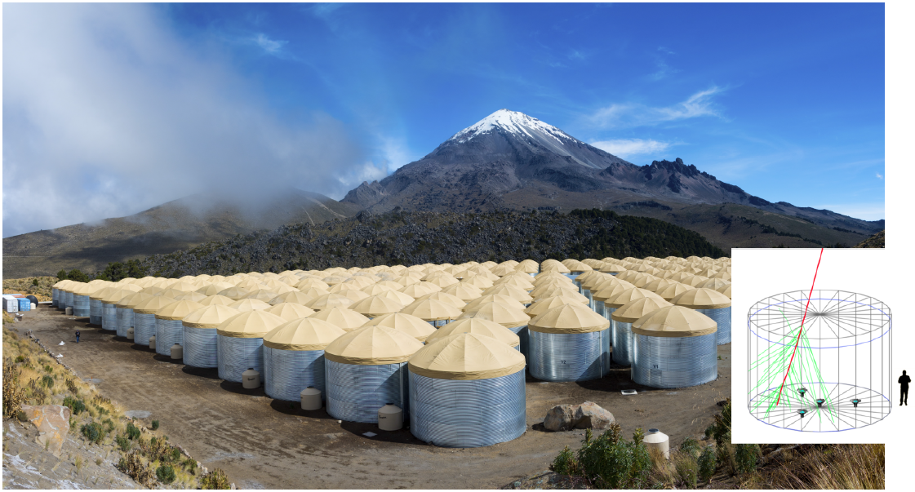
High Altitude Water Cherenkov Observatory

Slide 10
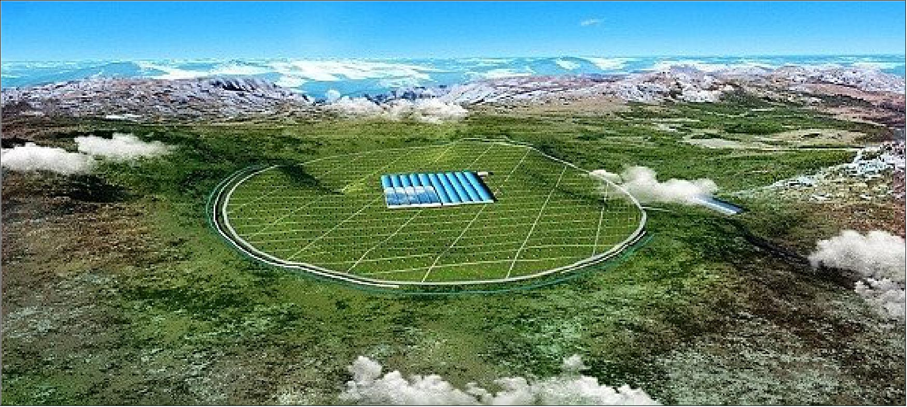
Large High Altitude Air Shower Observatory (LHAASO)
About 4,410 meters above sea level
The observatory covers an area of some 145 hectares

Slide 11
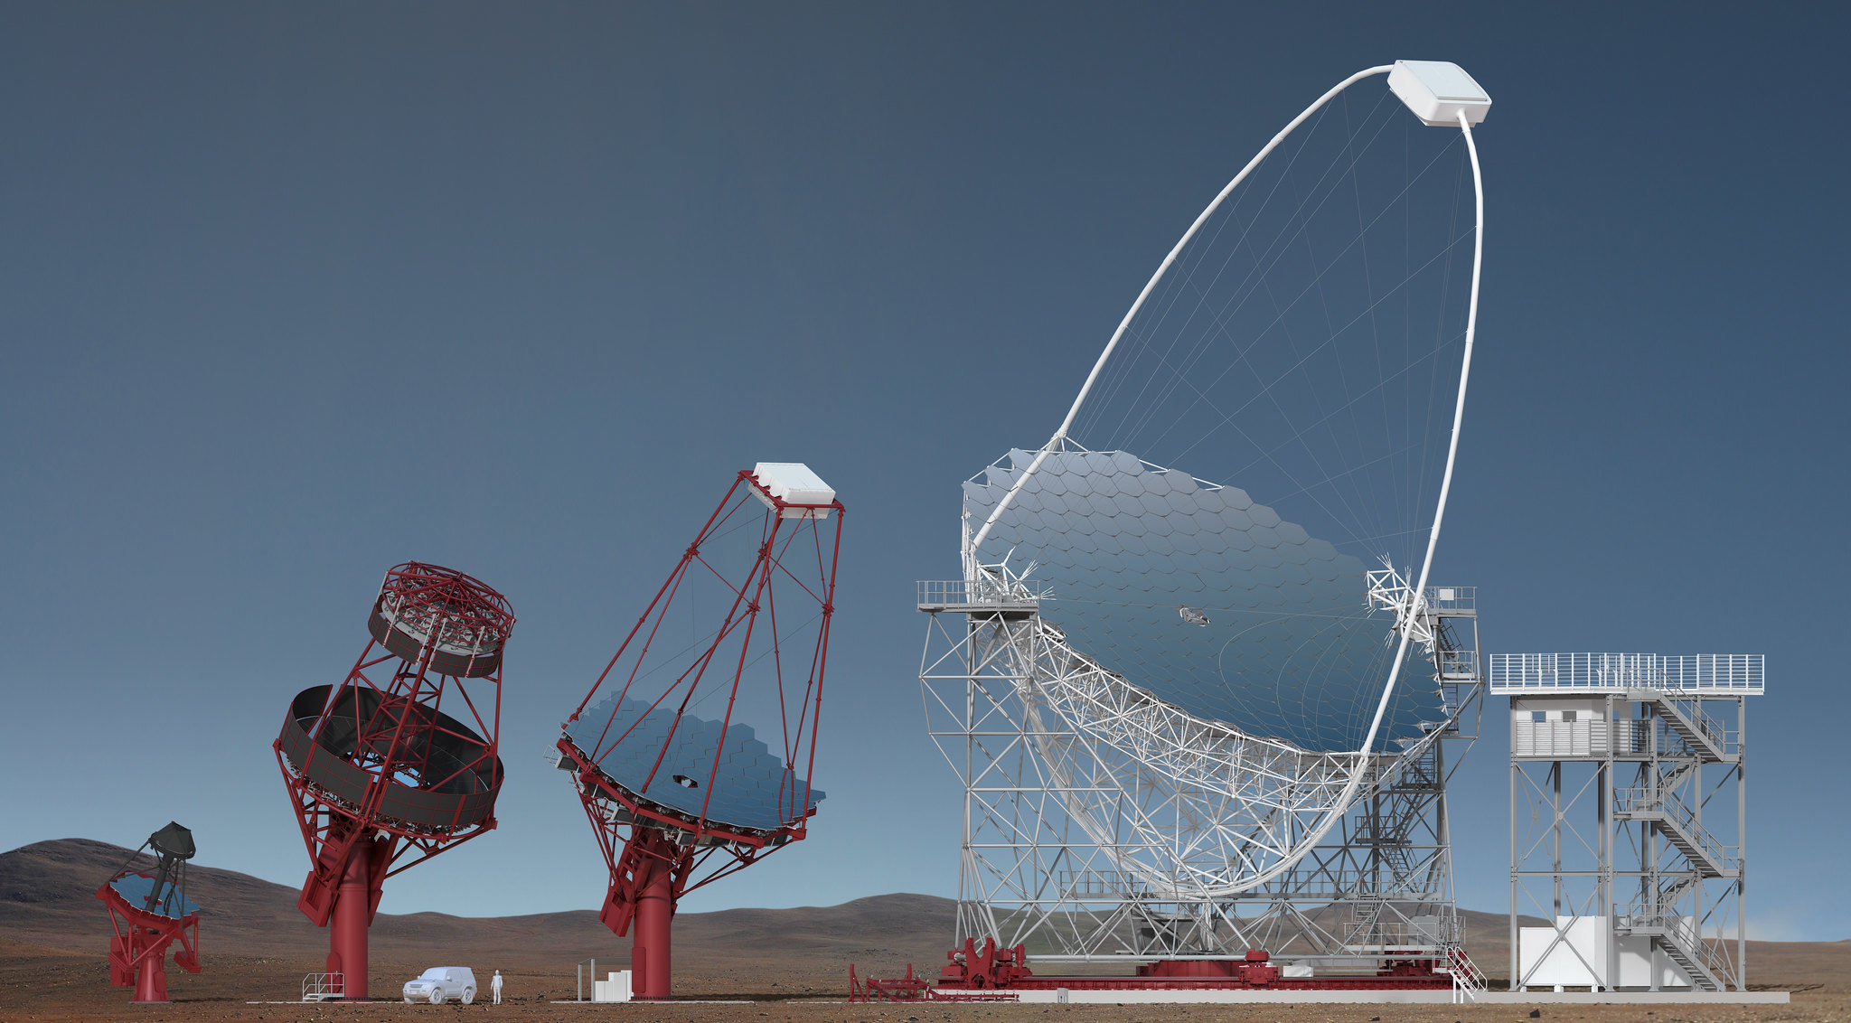
The Cherenkov Telescope Array (CTA)
Over 100 telescopes across two sites.
Coverage: 20 GeV to 300 TeV energy range
31 countries and €300 million.
The CTA will significantly contribute to tracing
the most violent and energetic phenomena

Slide 12
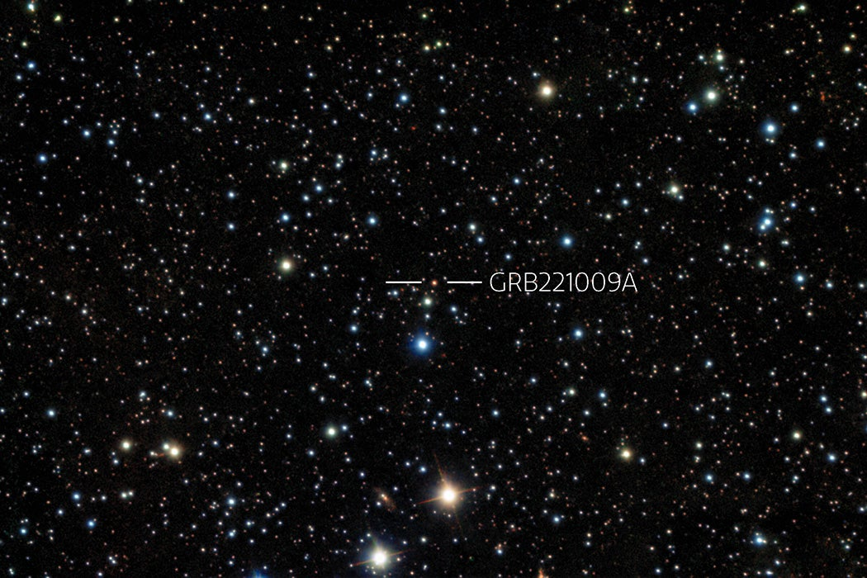
GRB 221009A: RA = 288.264° & Dec = 19.768°
The Greatest Cosmic Explosion Humanity Has Ever Seen !
Nickname:"BOAT"or brightest of all time
International Gemini Observatory/NOIRLab/NSF/AURA/B. O'Connor (UMD/GWU) & J. Rastinejad & W Fong (Northwestern Univ)
Image processing: T.A. Rector (University of Alaska Anchorage/NSF’s NOIRLab), J. Miller, M. Zamani & D. de Martin (NSF’s NOIRLab

Slide 13
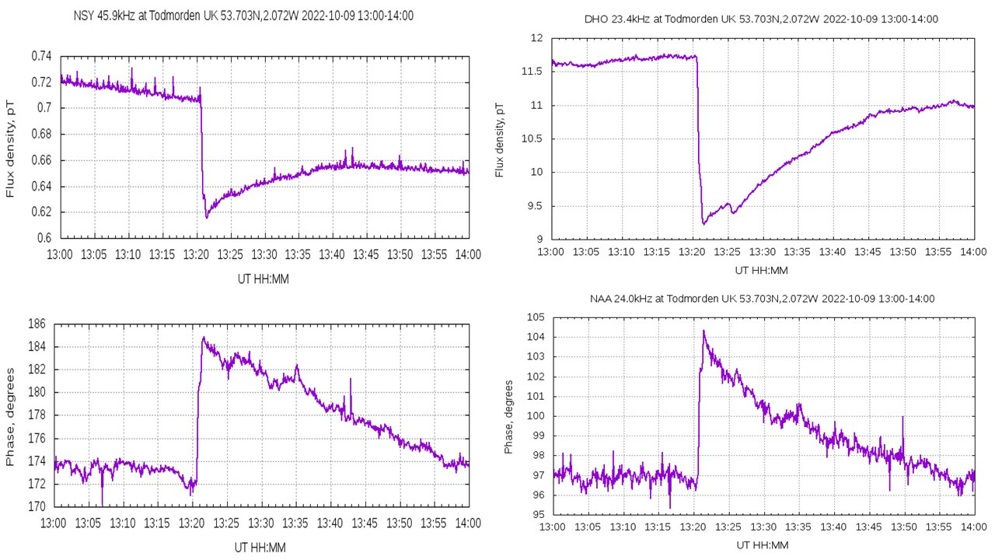
GRB221009A : ionised the Earth's atmosphere, changing how radio waves propagate through it. Detectors in India, Germany and UK observed this change Credit: Rami Mandow @CosmicRami

Slide 14
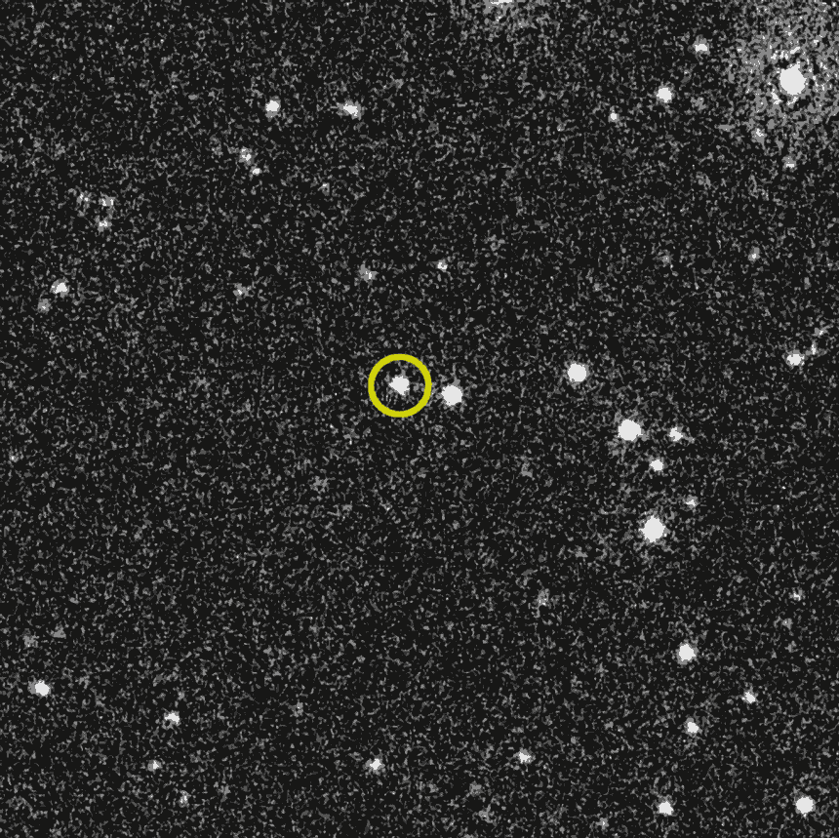
This series of visible-light images from NASA’s Swift telescope’s ultraviolet/optical instrument shows that the bright glow of GRB 221009A (yellow circle) faded over about 10 hours.
Swift/NASA, B. Cenko

Slide 15
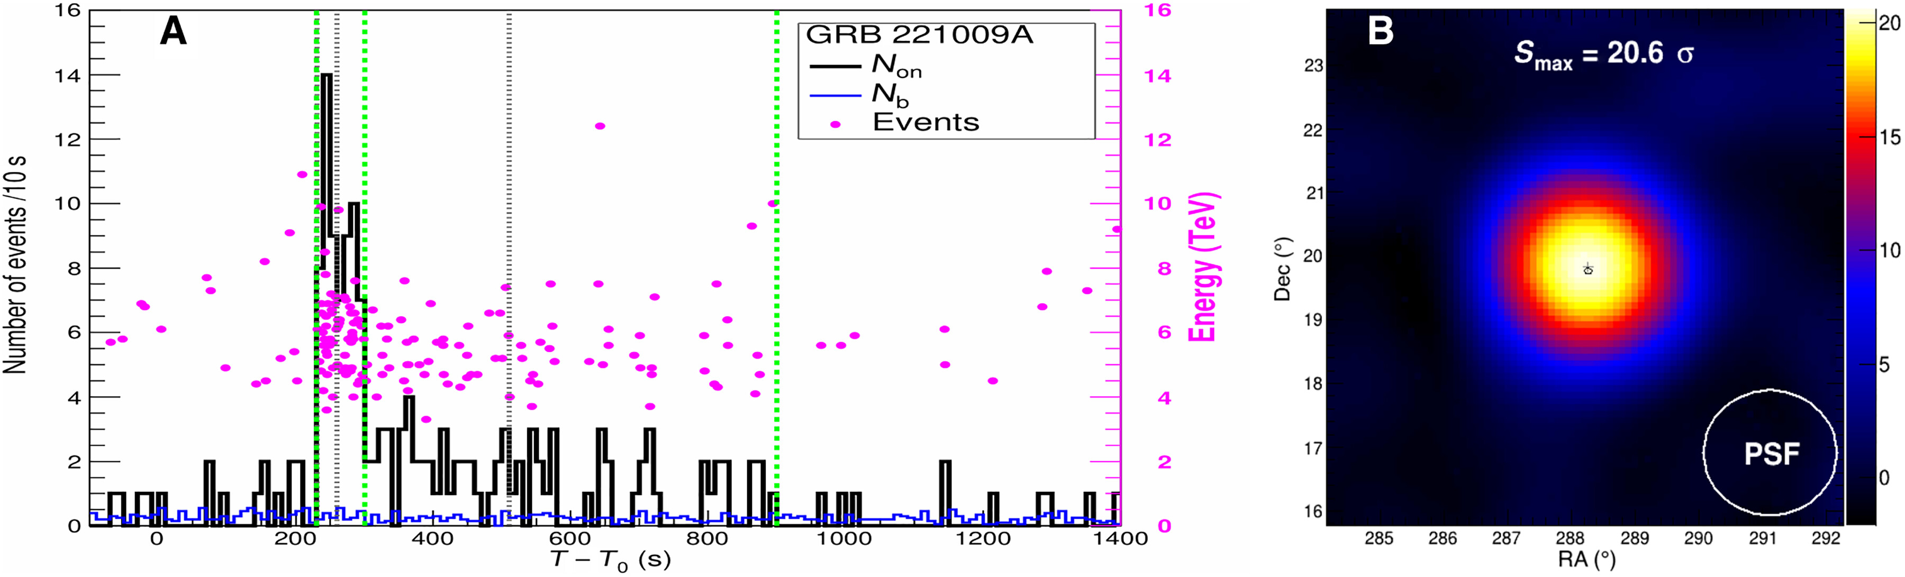
GRB221009A detected by LHAASO
(Large High Altitude Air Shower Observatory)
Cao Z., et al., 2023, Sci. Adv., 9, adj2778
This source detected up to 13TeV
This is puzzling, why?

Slide 16
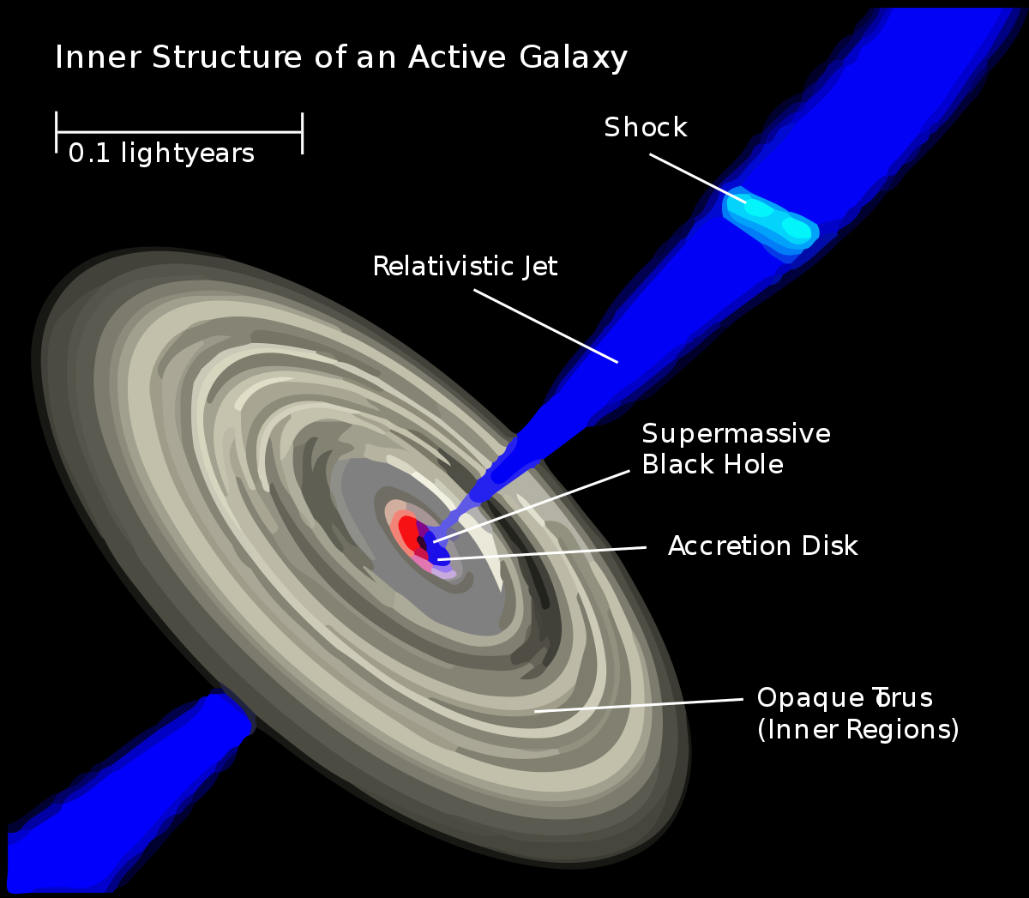
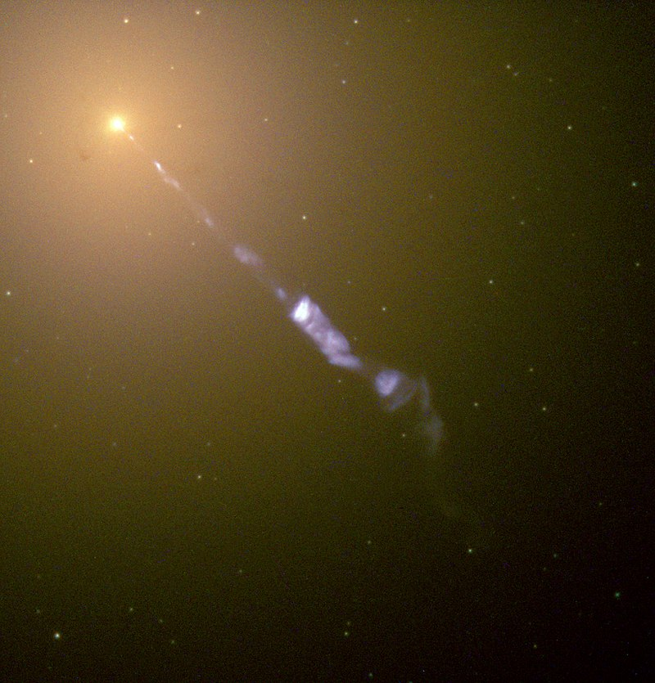
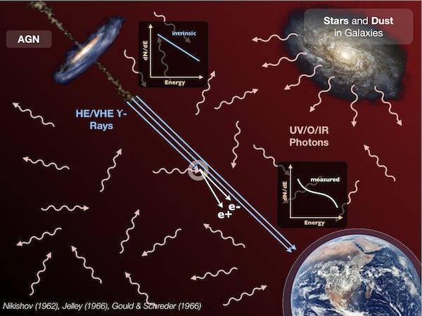
Background:

Slide 17
Extragalactic Background Light (EBL):
The extragalactic background light (EBL) is the integrated intensity of all the light emitted throughout the history of the universe across the whole of the electromagnetic spectrum.
EBL plays an important role in the propagation of very high energy gamma-rays which are attenuated due to the pair production gamma-gamma interactions with the EBL.
Finke et al (2010)

Slide 18
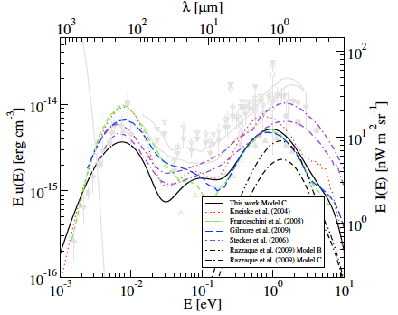
Extragalactic Background Light (EBL):
Finke eta al (2010)

Slide 19
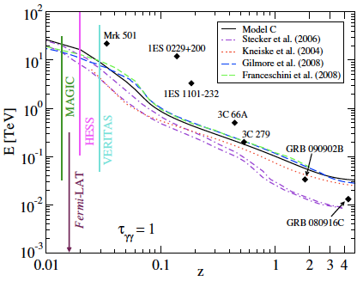
Gamma-rays horizon:
Finke eta al (2010)
Finke et al 2010

Slide 20
Survival Probability (SP) of TeV Gamma-ray Photons from "BOAT"
Since this burst is at redshift z = 0.151
TeV photons are likely to have a low probability of avoiding pair production with the EBL and surviving to reach detectors on Earth.
SP = exp(-τ) :
Using, Saldana-Lopez et al. 2021 EBL model :
* For 1 TeV photon is around 20%
* For 10 TeV photons is around 0.1%
  Note: Slightly different for other EBL models.

Slide 21
Attempts to Solve the Puzzle of GRB 221009A TeV Detection
The existence of exotic Axion Like Particles (ALPs), e.g., Troitsky (2023)
The possibility of Lorentz Invariance Violation (LIV), e.g., Finke & Razzaque 2023
Interactions of extragalactic Ultra-High Energy Cosmic Rays (UHECR), e.g., Das & Razzaque(2023)

Slide 22
Can cosmic voids explain tens of TeV photons detected from GRB 221009A?

Slide 23
EBL inhomogeneity:
- For Stellar and dust components
Motivation:
- Infrared emission from interstellar dust in cosmic voids affecting the TeV gamma-rays.
-

Slide 24
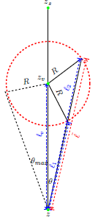
EBL inhomogeneity (Voids)
The radius of the void is denoted as R
The center of the void is represented by z_{v}
The source is located at redshift z_{s}
j(ε,z) = j(ε,z)_{stars} + j(ε,z)_{dust}
We assumed that there is no emission inside the void
j(ε,z) = 0 : inside the void

Slide 25
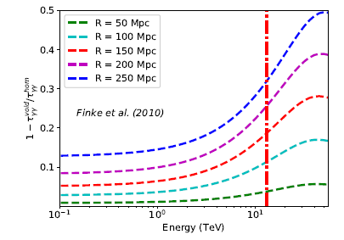
Cosmic voids: GRB 221009A
Gamma-gamma opacity for VHE gamma rays can be reduced by up to 30% at around 13 TeV, the highest-energy photon detected from GRB 221009A

Slide 26
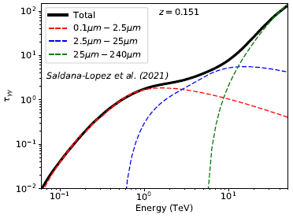
The reduction is substantially higher for TeV photons compared to GeV

Slide 27
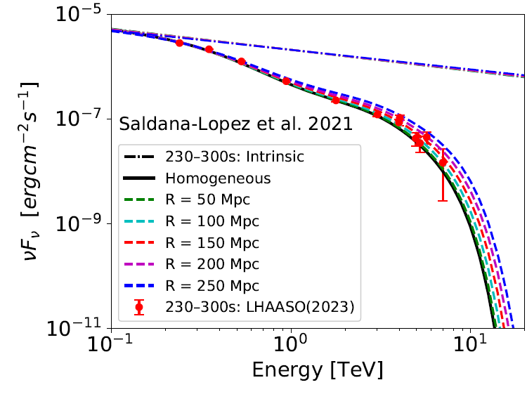
Observed and intrinsic fluxes

Slide 28
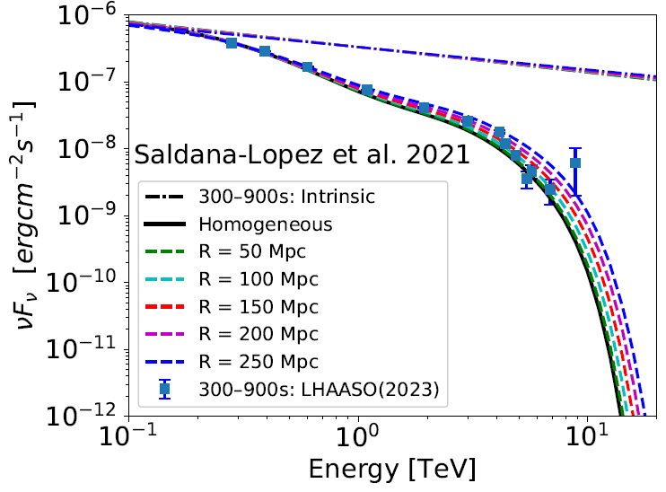
Observed and intrinsic fluxes

Slide 29
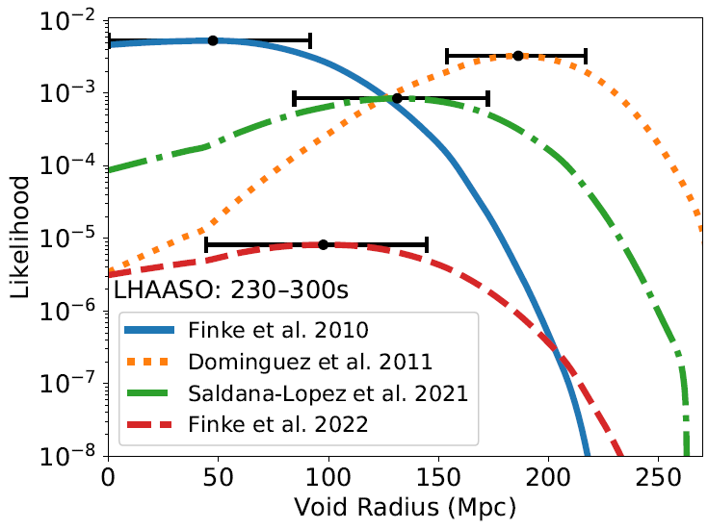
Likelihood Analysis:

Slide 30
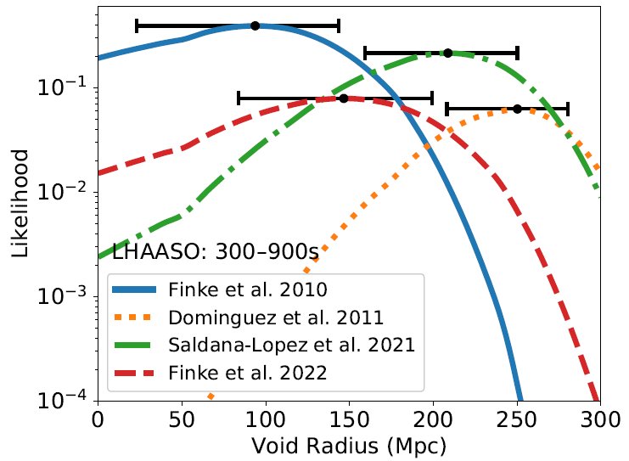
Likelihood Analysis:

Slide 31
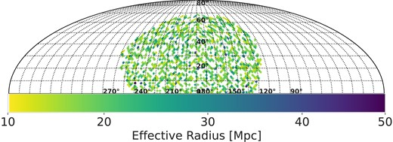
Observational considerations: Void Catalogs of the SDSS DR7, Douglass et al. (2023)

Slide 32
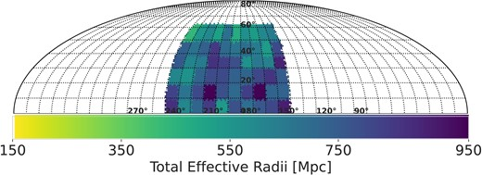
Total Co-Moving Effective Radii Within Each Grid Cell
The accumulated comoving effective radii contained in the volume of the solid angle subtended by each cell within the celestial coordinates of 140◦ to 240◦ in Right Ascension and 0◦ to 60◦ in Declination

Slide 33
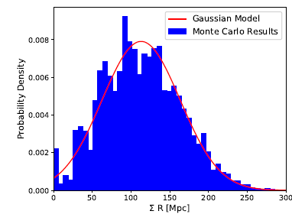
Monte Carlo simulation
Average ΣR = 113 Mpc
Standard Deviation = 50 Mpc
Probability of ΣR ≥ 200 Mpc
is around 5%

Slide 34
Summary and Conclusions:
The optical depth may be reduced by about 10% and 30% at 13 TeV, in the cases of R = 110 Mpc and R = 250 Mpc, respectively.
All EBL models are found to better fit the LHASSO data, considering the potential presence of cosmic voids between us and GRB 221009A.
Our Monte Carlo simulations suggest that the required void content for the best fits is plausible based on the void catalog (SDSS DR7).
Advanced instruments like DESI, along with the future CTA, will offer excellent opportunities to test this hypothesis
For more see, Abdalla et al MNRAS 532, 198–208

Slide 35
Thank you!

Slide 36
Supplementary

Slide 37
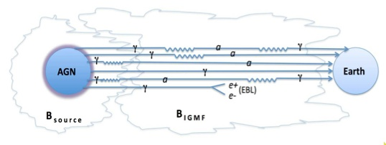
Photon-ALP Conversion
Challenges and Consideration:
The exact magnetic field structures and strength in the host galaxy and the Milky Way are not precisely known.
Complexity of the Mechanism: The process involves
photon conversion to ALP, ALP travel, and reconversion
to photon. Each stage relies on specific magnetic field
conditions, introducing uncertainties.
More comprehensive analysis and detailed GRB spectra are needed to test the photon-ALP conversion hypothesis.
Sergey Troitsky JCAP01(2024)016
From Sanchez-Conde et al. 2009

Slide 38
LIV
Cao Z., et al., 2023, Sci. Adv., 9, adj2778

Slide 39
Challenges in Explaining VHE Gamma Rays from GRB 221009A
Magnetic Field Uncertainties
Neutrino Non-Detection: Lack of PeV neutrinos detected by IceCube challenges the UHECR model
Host Galaxy Propagation: Additional time delays due to UHECR propagation within the host galaxy.
And more!
Further observations and detailed analyses are essential to refine the model and understand high-energy processes in GRBs.
For more details, Das & Razzaque(2023), A&A 670, L12

