Slide 1
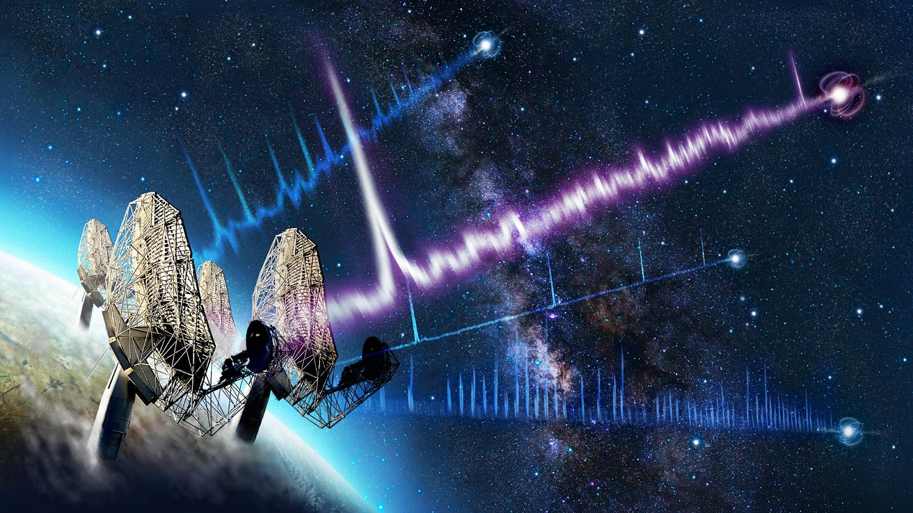
MeerTRAP: Finding short-duration radio transients with MeerKAT
Mechiel Bezuidenhout
Erlangen, 2024/07/30

Slide 3
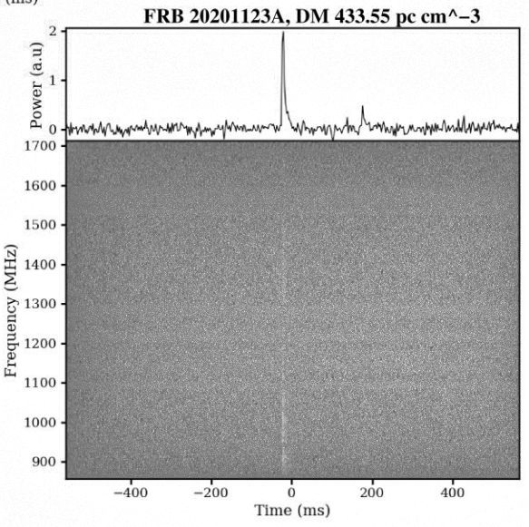
Fast radio TRANSIENTS
Brief (~ms) flashes of radio emission
Pulsars: Galactic; regularly repeating;
Fast Radio Bursts (FRBs): Extragalactic; no (regular) repetition

Slide 4
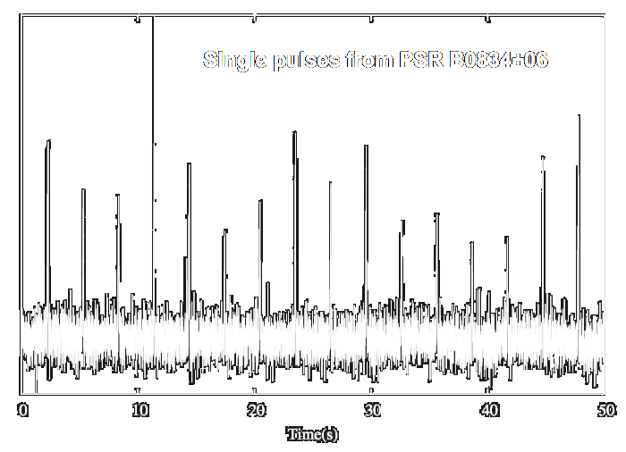
Imaging vs Beamforming
1. Add delay (weight) to each signal
2. Add them all together
OUTCOME: time series
1. Correlate signals
2. Calculate visibilities
3. Fourier Transform
OUTCOME: pretty picture

Slide 5
All LSP pointings
A real-time survey of the Southern
Sky commensal with MeerKAT
LSPs.
Custom back-end
continually sifts for
transients in real
time.
Thousands of
hours on-sky
Image credit:
L. Driessen

Slide 6
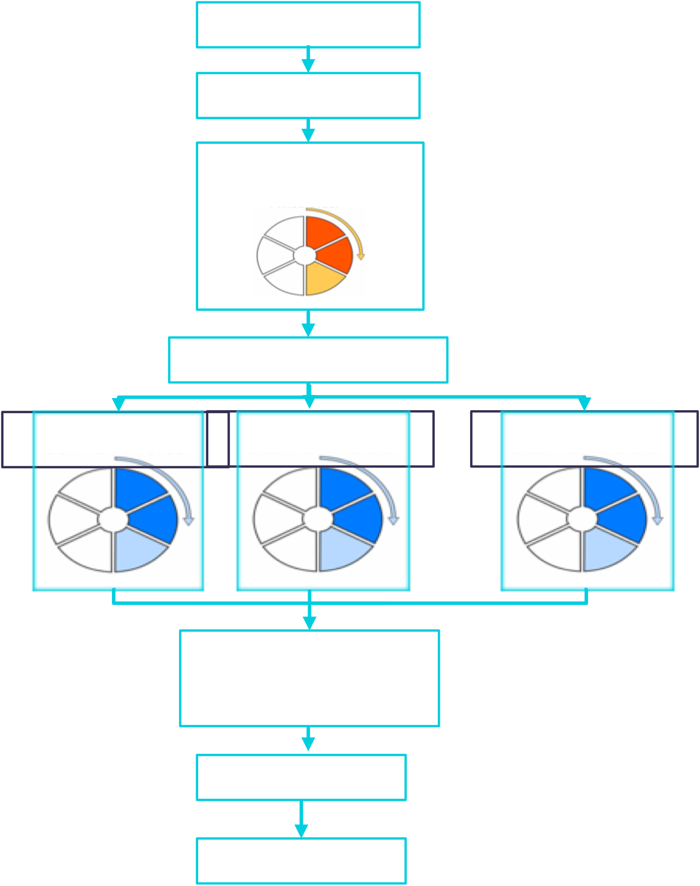
TUSE/FBFUSE
Search Pipeline
Figure credit: Vincent Morello

Slide 7
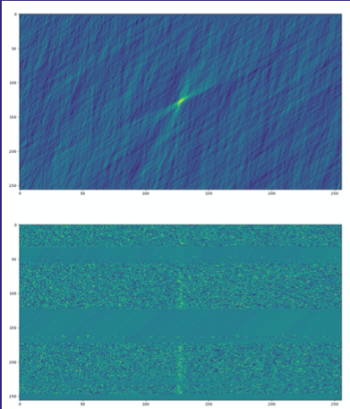
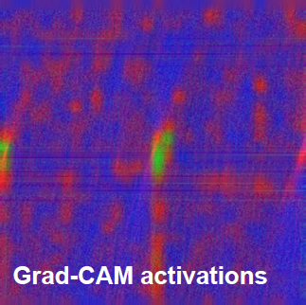
ML classifier (FRBID)
Credit: Zafiirah Hosenie
DM
FREQUENCY
Credit: Mateusz Malenta
TIME
CNN based classifier for finding new FRBs

Slide 8
Results in numbers
~5.5 years of continuous observing
60 FRBs
~ 1 / month
100 Pulsars
~ 1.5 / month!

Slide 9
Fast radio BURSTS
in a nutshell
>800 FRBs
~5,000 events/sky/day
>60 (~8%) repeaters
Some repeaters show very long term (days)
activity cycles (binary systems?)
Extremely energetic events (<150 Jy; ~ 10⁴⁴ erg s⁻¹)
Detected from 110 MHz to 8 GHz (radio only)
No statistically significant counterpart yet

Slide 10
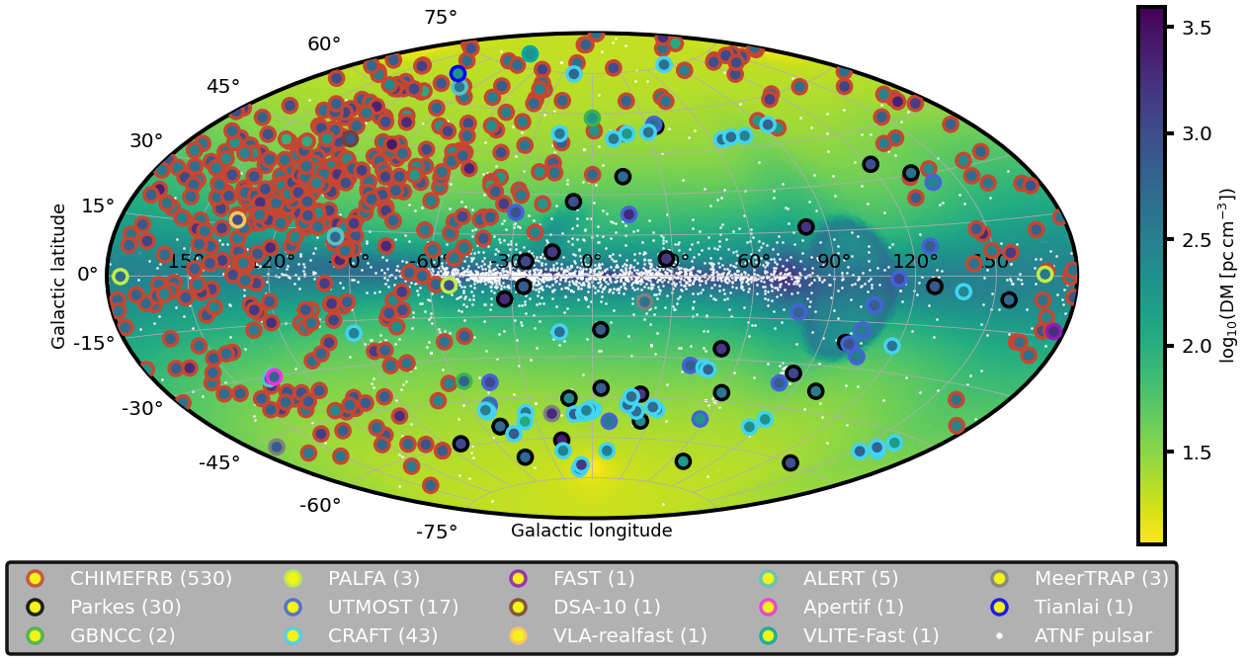
Population

Slide 11
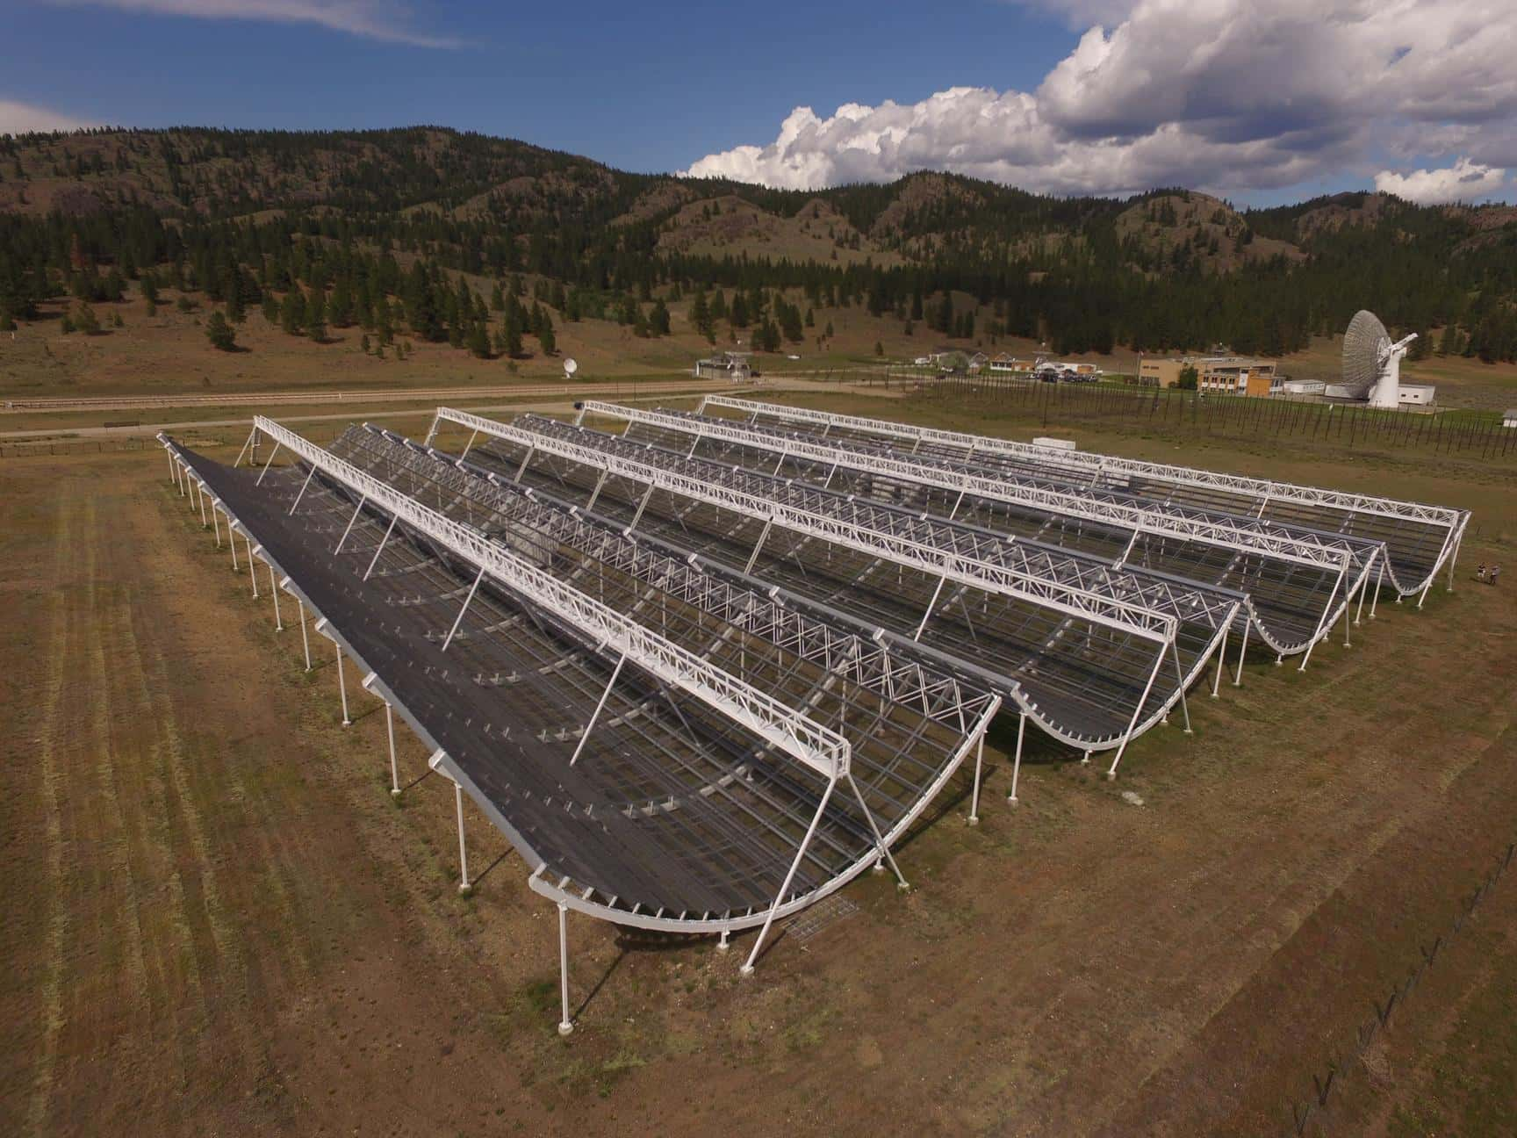
CHIME

Slide 13
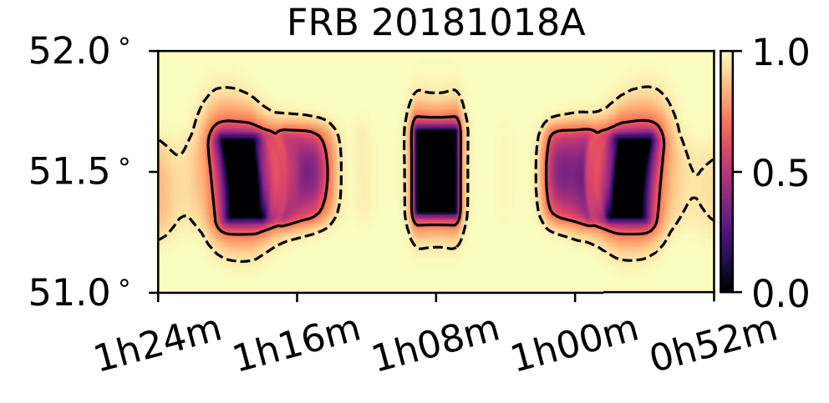
CHIME Localisation

Slide 14
FRB Host association
Need ~arcsec localisation for confident association with host galaxy
26 host associations
Wide range of galaxy types & environments
No statistically significant difference between repeater & non-repeater galaxies
z<0.6
Bhandari et al (2021)

Slide 15
Localisation with MeerKAT
Transient buffer gives instant sub-arcsecond localisation of transients
~1/3rd of our FRBs are localised well enough for host association
Triggering now in place will increase that rate
z<0.6
Bhandari et al (2021)

Slide 16
FRB follow-up observations
Partnered with Fast & Fortunate FRB Follow-up (F⁴) Collaboration
Joint FRB pool for follow-up:
MeerKAT
VLA
ASKAP
EVN
CHIME
Arrange observations with:
Keck Gemini HST
VLT Magellan ALMA
Chandra DESI VLA
z<0.6
Bhandari et al (2021)

Slide 17
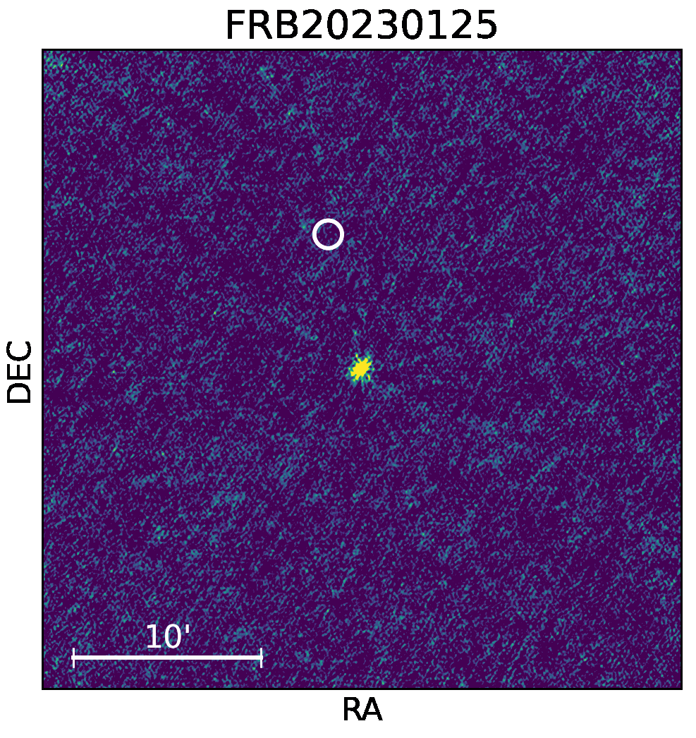
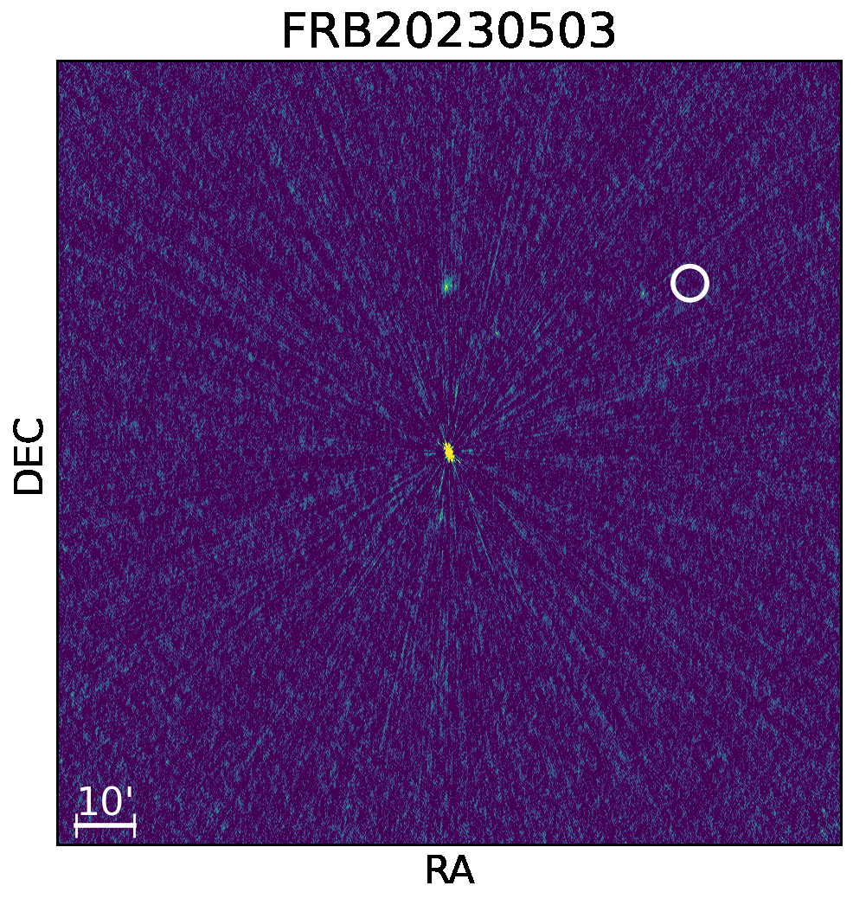
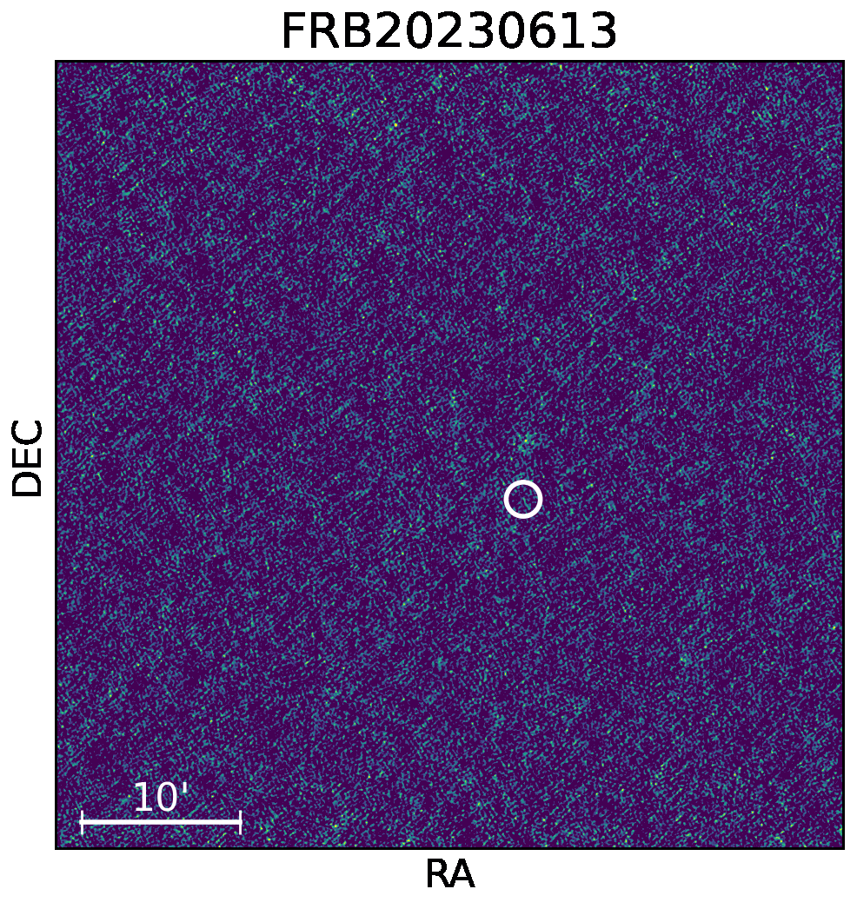
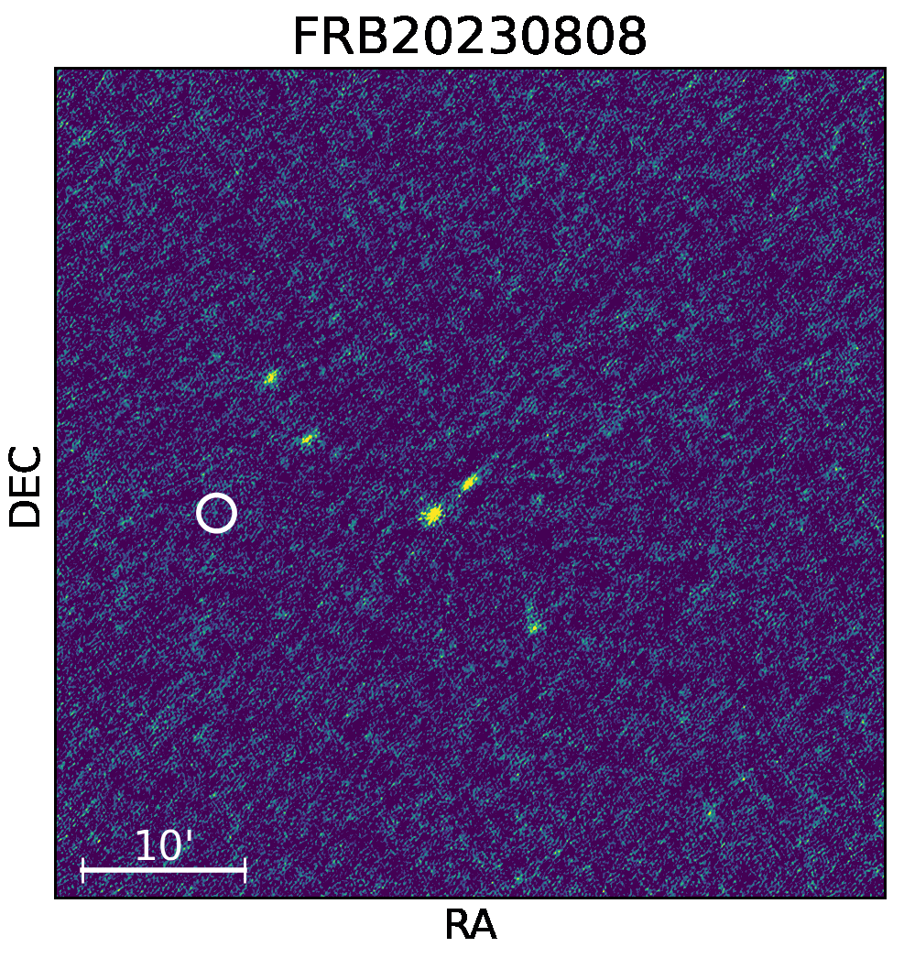
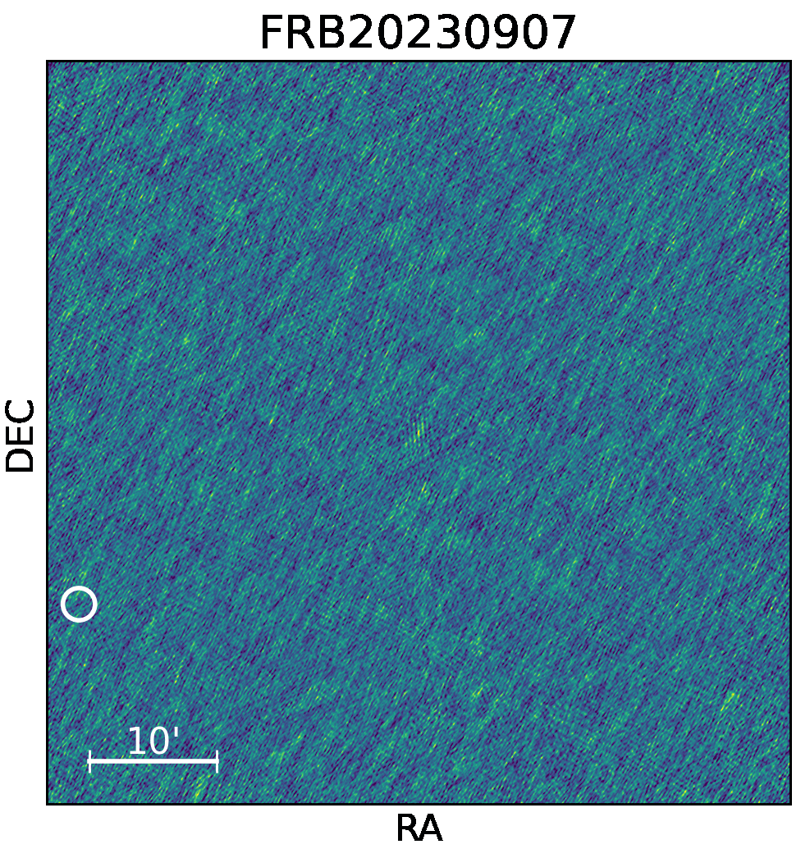
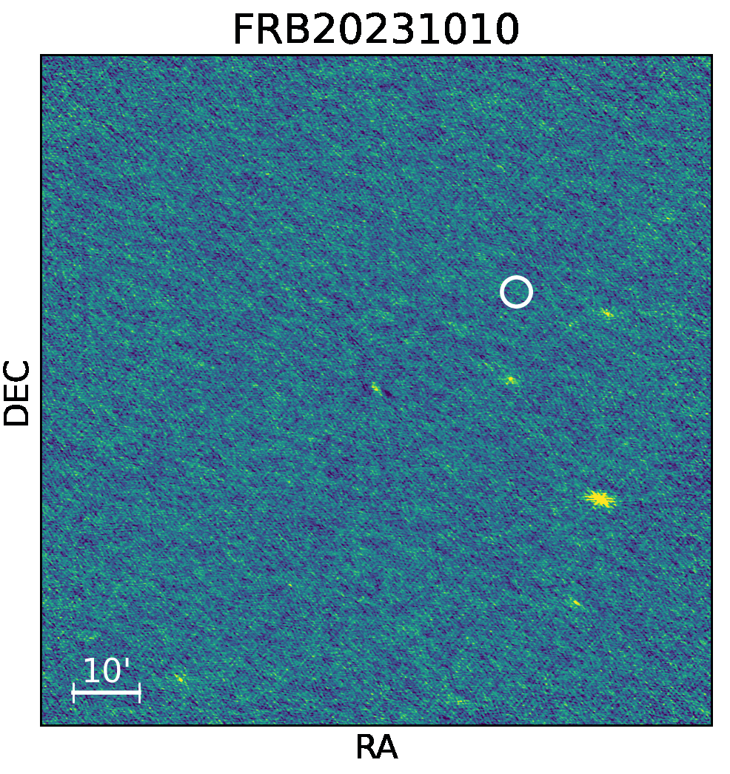
Transient buffer localisations
640.6 pc cm⁻³
L-band
484.8 pc cm⁻³
L-band
483.5 pc cm⁻³
L-band
z<0.6
1 ms integration time/frame.
654.3 pc cm⁻³
L-band
1031.1 pc cm⁻³
L-band
442.8 pc cm⁻³
UHF
[Hanmer+in prep]
Bhandari et al (2021)
[Pastor-Marazuela+in prep]

Slide 18
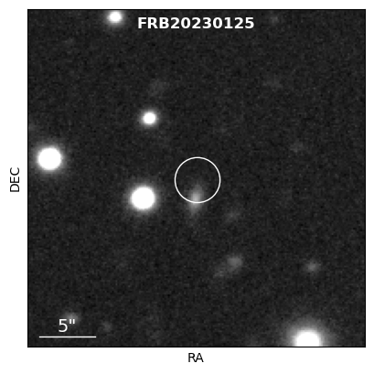
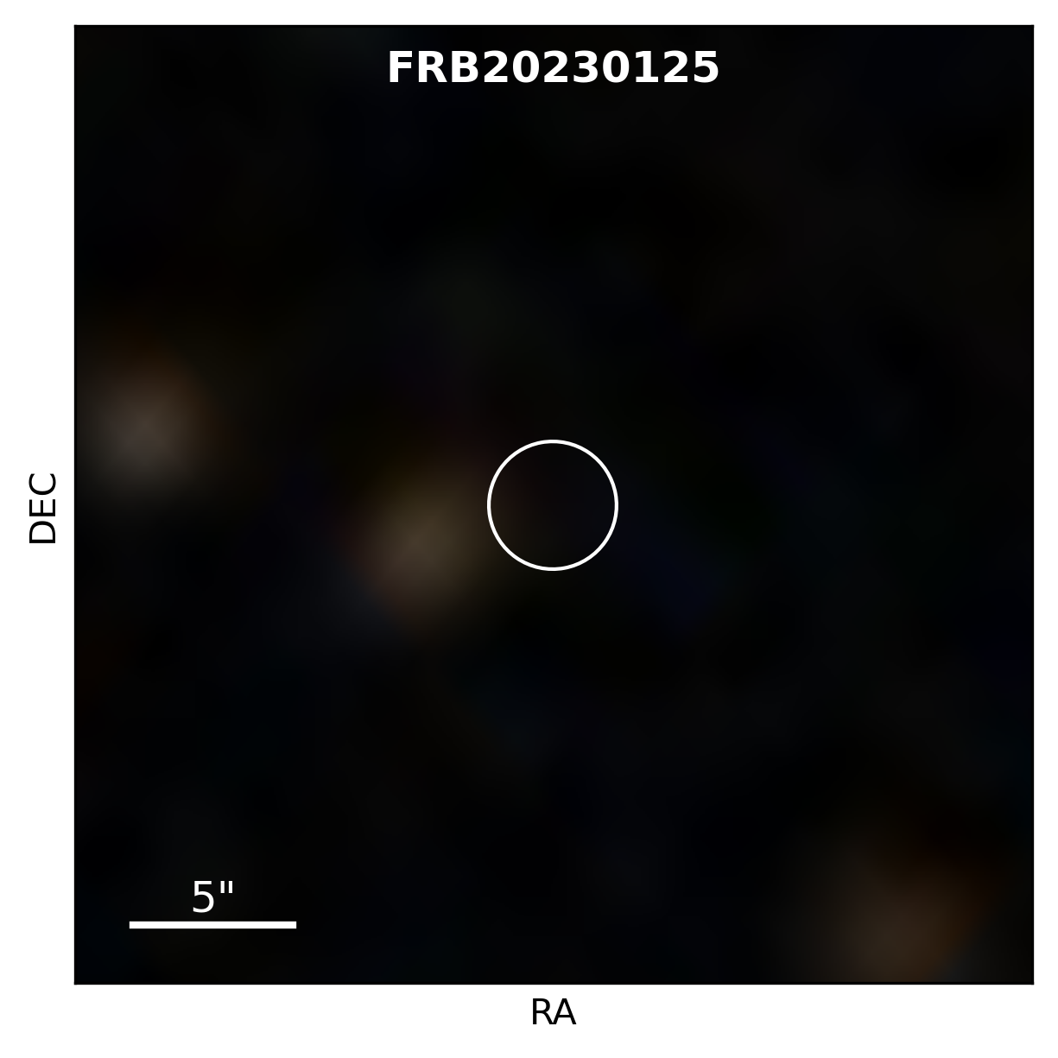
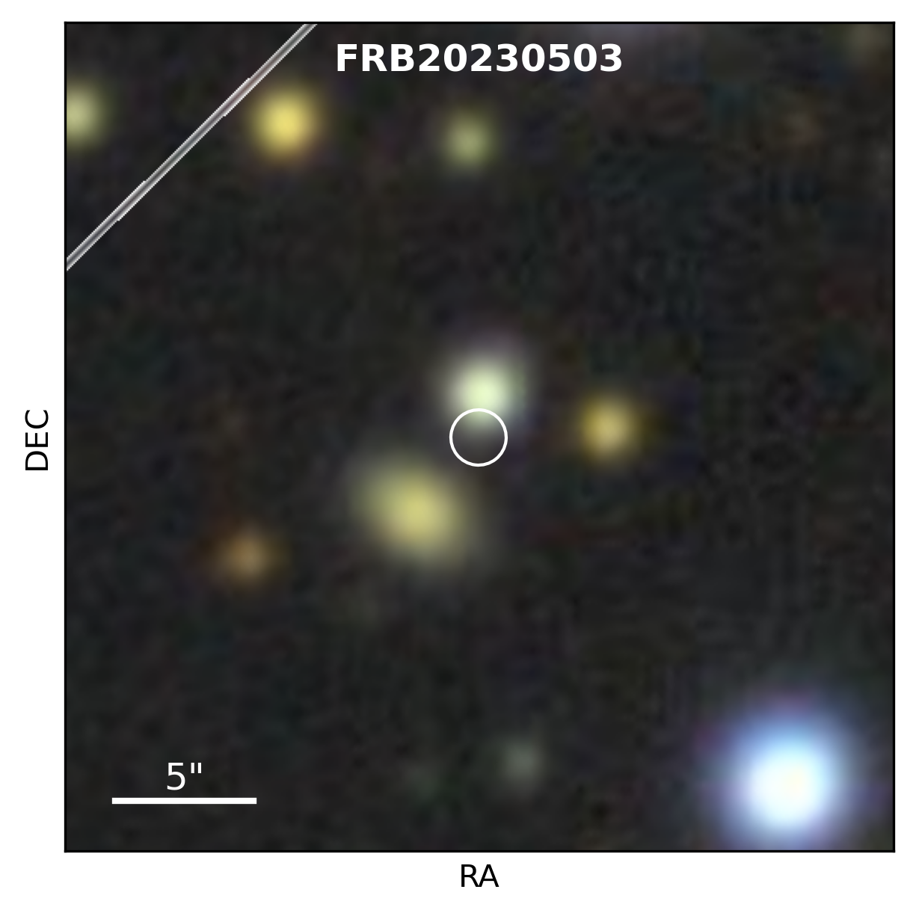
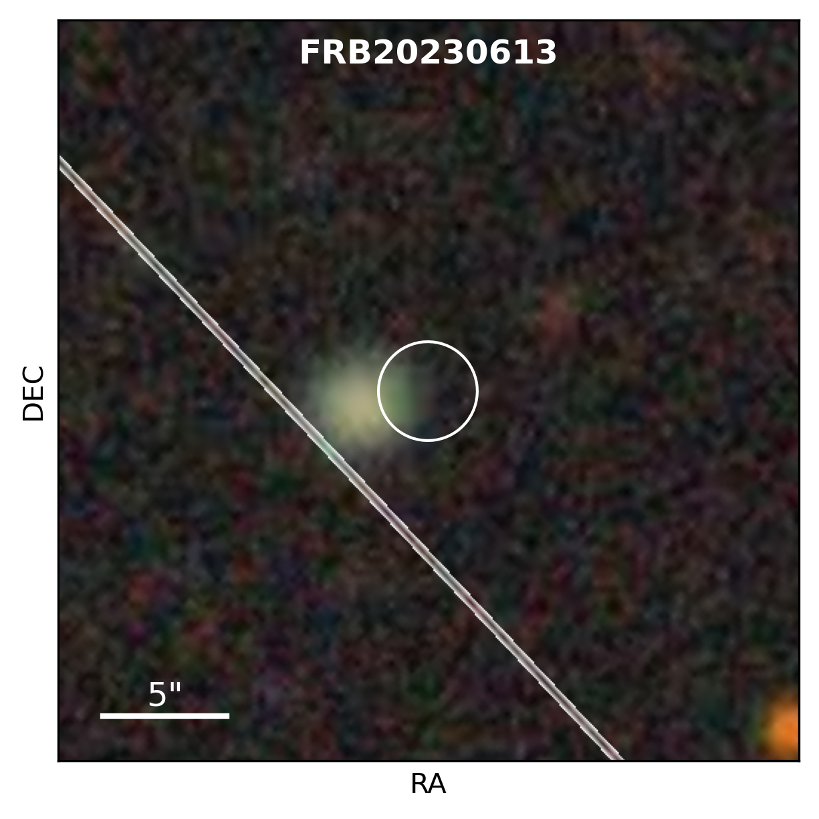
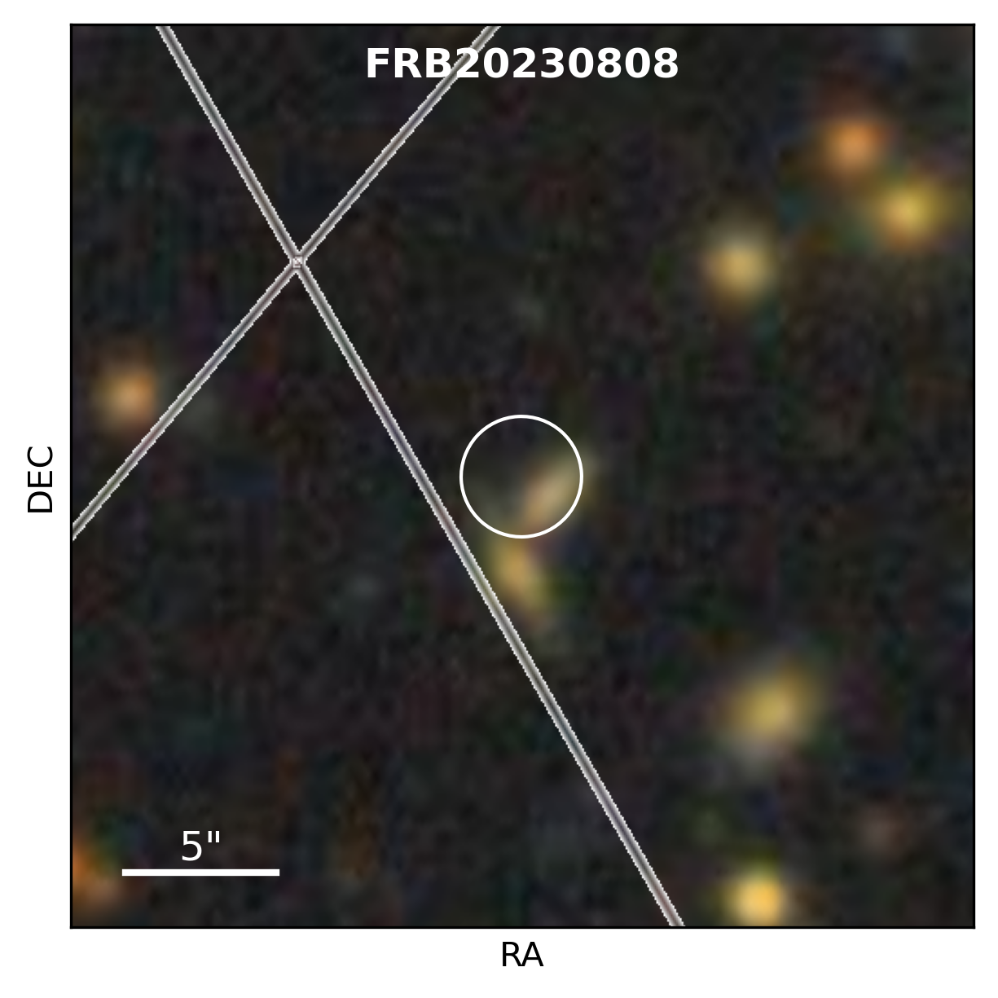
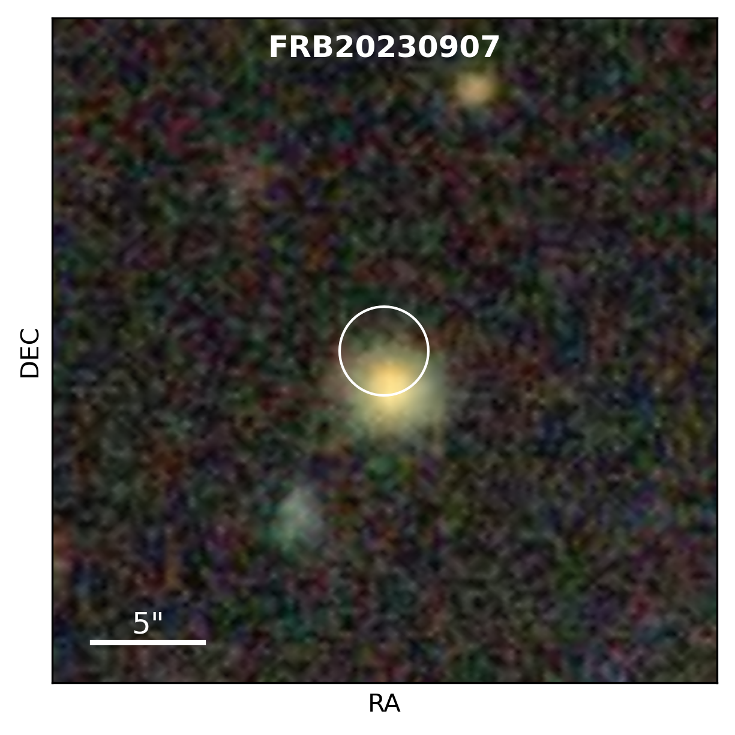
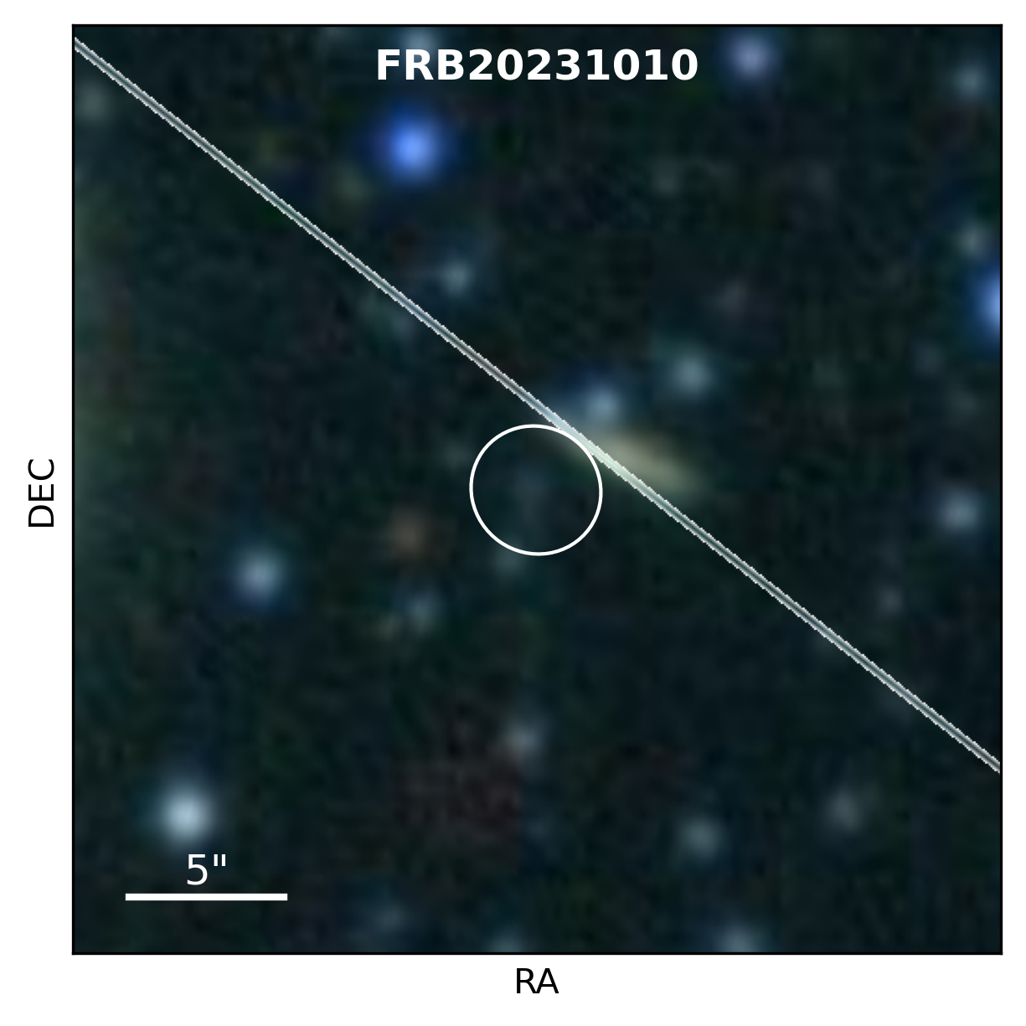
Host galaxies
Error regions: ~2” radius.
Limited by astrometry in most cases.
z = 0.392
Gemini-South R
DESI-Legacy
DESI-Legacy
DSS2
DESI-Legacy
DESI-Legacy
DESI-Legacy
[Hanmer+in prep]
[Pastor-Marazuela+in prep]
Notes:
Each of the FRB localisations shown here has an error region with ~2” radius. We are currently limited by the astrometry, the uncertainty of the FRB position itself is ~0.5” in RA and DEC on average.
For these localised FRBs, we looked at archival optical data to see if there were any visible galaxies at the FRB position. For most of the FRBs, we find galaxies co-located with the FRBs in DESI-Legacy DR10 images. In some cases, there are two potential galaxies that the FRB could be associated with.
DESI-Legacy: magnitude depth 23-25 in g-band
For the first 2023 FRB, there was no available DESI data, so together with the F^4 team we obtained a Gemini-South R-band image of the field. We find a galaxy at the FRB position.

Slide 19
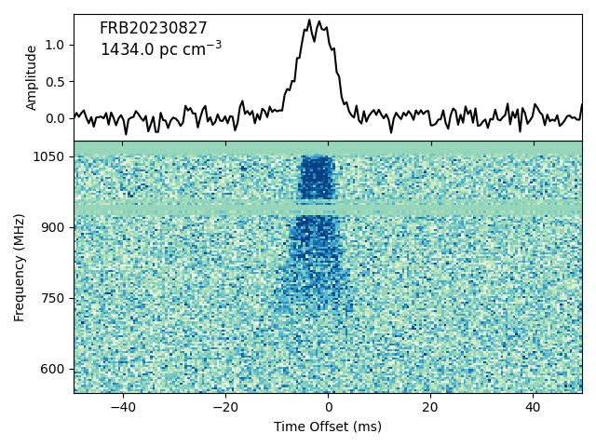
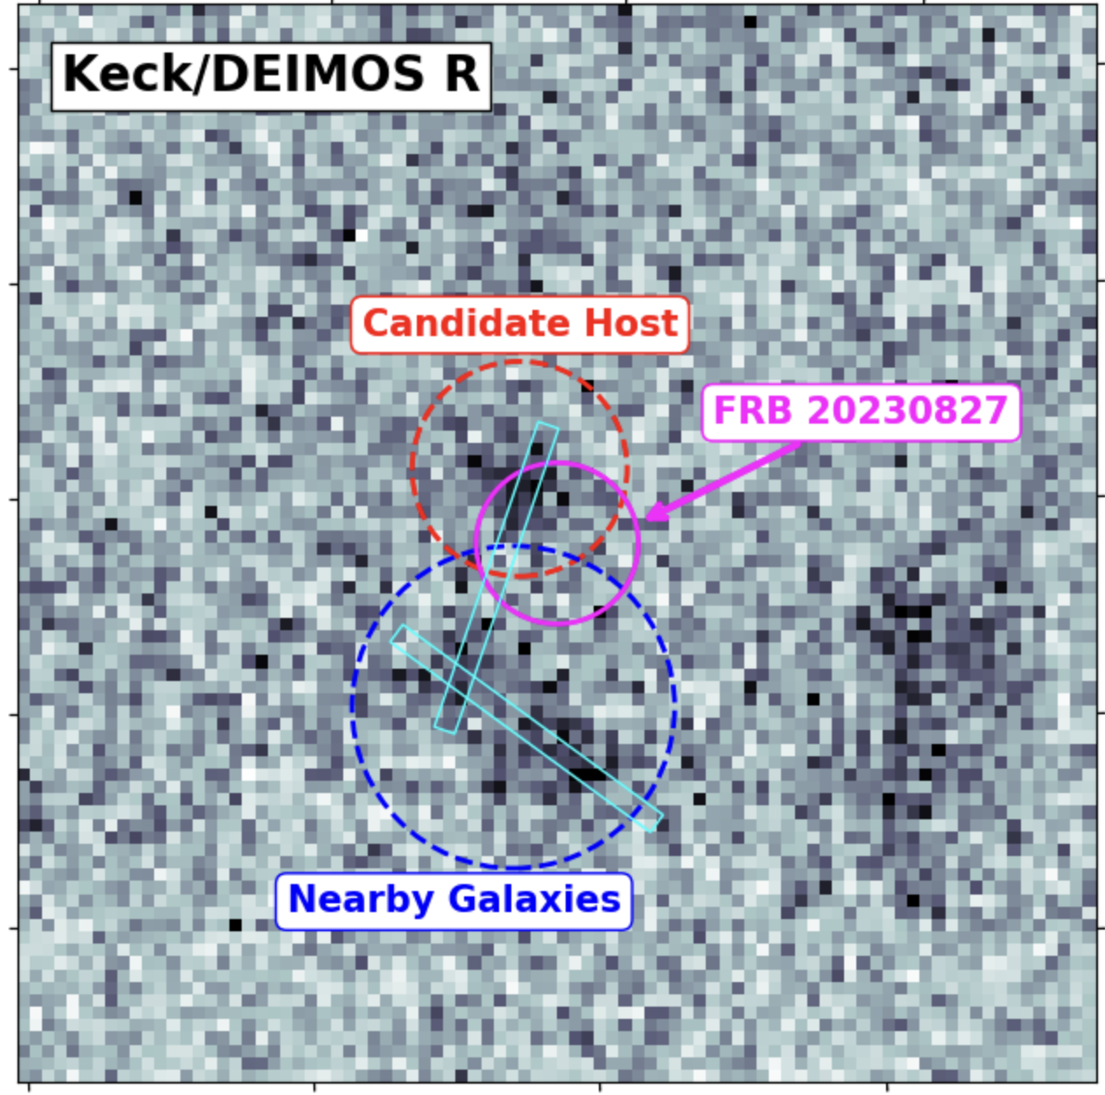
FRB 20230827: high excess DM
Credit:
Alexa Gordon +F⁴,
Blanchard, Kilpatrick, Nugent, Sears
No TB data, but FRB detected in 70 CBs + IB
➙ Localisation with SeeKAT [Bezuidenhout+2023]
~0.75” radius error region
DM = 1434 pc cm⁻³ ; DM_{excess}= 1365 pc cm⁻³
Redshift between 0.84 and 1.95 (Mean 1.61)
➙ Could be the highest z FRB ever localised
Notes:
Back in August 27th, we detected a very bright FRB at a high DM of 1434 pc cm-3, but unfortunately the classifier was a bit slow and the TB data was not saved.
Here you can see the dynamic spectrum, and the broadening at lower frequencies is caused by intra-channel dispersive smearing.
But since the burst has been detected in 70 CBs and the IB, we were able to localise it with SeeKAT, with uncertainties ~0.75” in RA and DEC.
With the F^4 team, we obtained a deep Keck/DEIMOS image of the FRB location, and we identified its most likely host here, and two nearby galaxies just a couple of “ away.
This FRB is highly dispersed, with an excess DM of 1365 pc cm-3, which means that this could be the highest redshift FRB ever localised. From the Macquart relation, z is expected to be between 0.84 and 1.95, with a mean z 1.61.
We are attempting to get a spectrum to measure the redshift, so stay tuned for that.

Slide 20
Searching for persistent emission
2 repeating FRBs (20121102A & 190520B) associated
with diffuse emission from persistent
radio source (PRS).
FRB 20121102A PRS observed 100 MHz -
30 GHz; broken power law spectrum
Magnetar wind nebulae?
Luminosity ~10³⁸ erg/s, in line with models
for wind nebula of young magnetar
z<0.6
Bhandari et al (2021)

Slide 21
MeerTRAP FRB 20190714A
Coincident w/ PanSTARRs
i-band optical galaxy
Deep MeerKAT images
showed diffuse radio emission
at source position
Possibly PRS, but unresolved
Could be associated with
star-forming region
Observations w/ Swift & Hess
found nothing
More similar searches coming
up for 15 MeerTRAP FRBs
z<0.6
Bhandari et al (2021)

Slide 22
Conclusions
FRB origins are still mysterious
Localisation + host association are key to understanding them
MeerKAT has great native localisation capacity
MeerTRAP has produced a large sample of well-localised FRBs
to high redshifts that is being followed up on at multiple wavelengths
Coordinated follow-up between surveys benefit everyone

