Slide 1
Namibian Astronomy: Exploiting Favorable Conditions for Multi-Wavelength Observatories
Hiiko I. Katjaita¹, Michael Backes^{1, 2}, Lott N. Frans¹ ¹University of Namibia, Dept. of Physics, Chemistry & Material Science
²North-West University, Centre for Space Research
July 2024

Slide 2
Outline
Introduction to Namibia
Dark Skies
Cloud Coverage
Precipitable Water Vapor
Radio Frequency Interference
Namibian Multi-wavelength Observatory

Slide 3
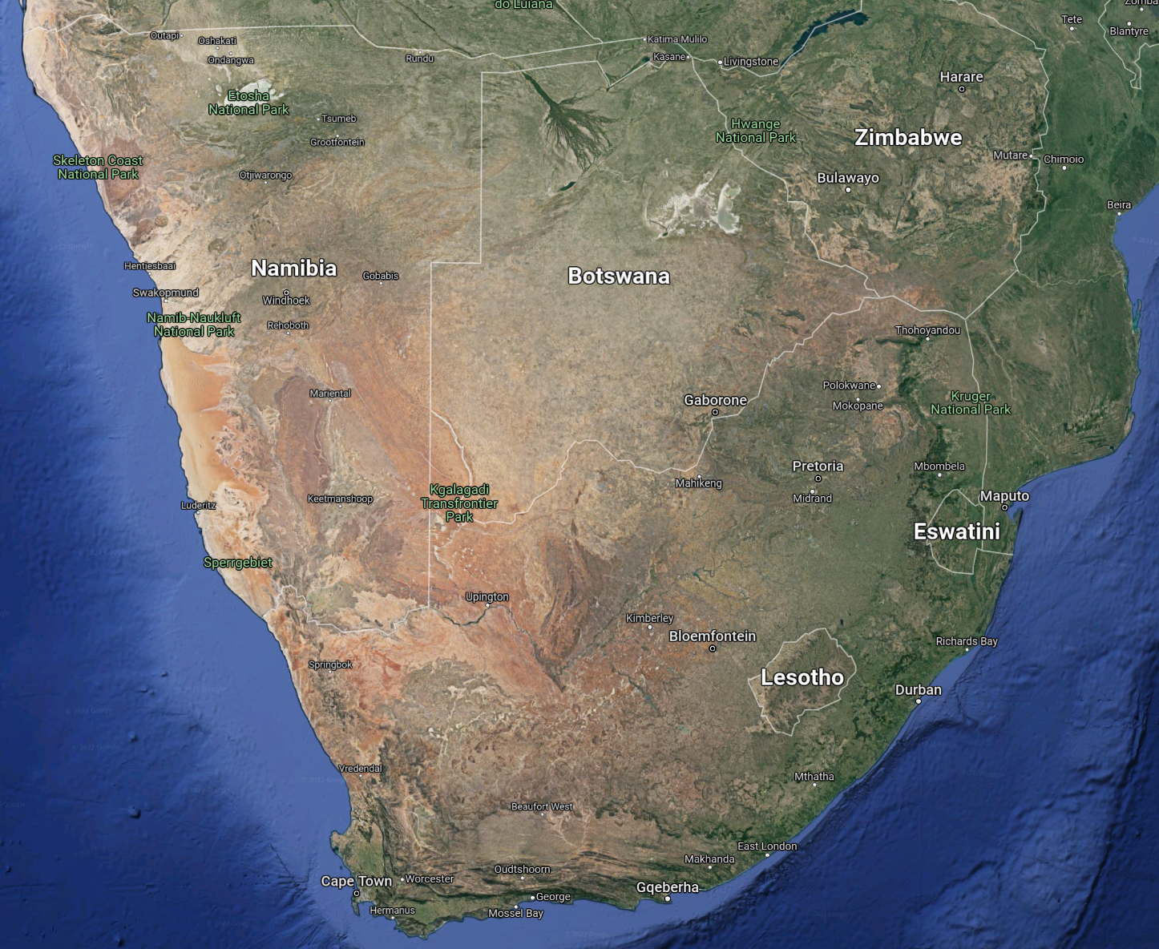
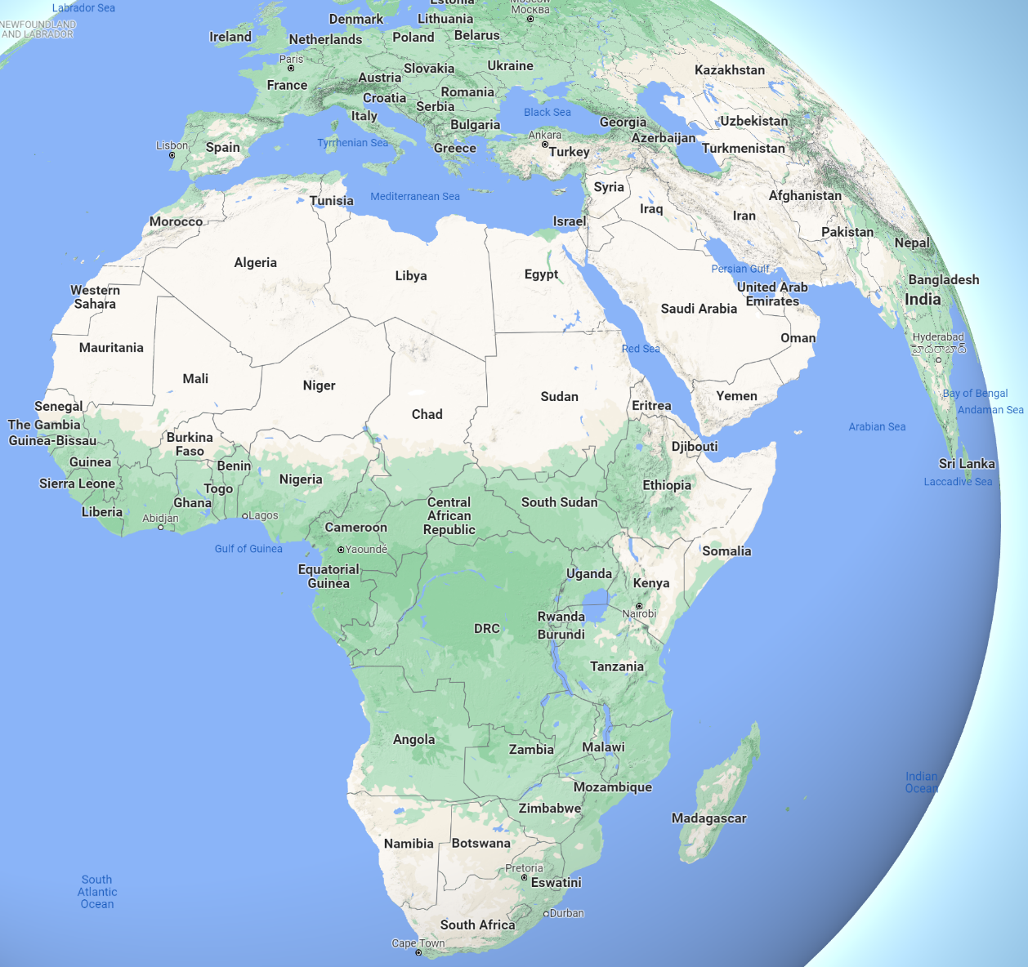
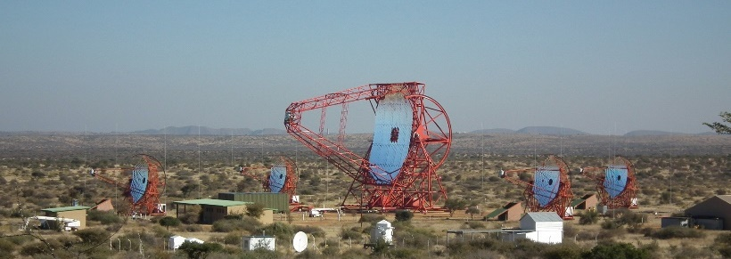
Namibia
H.E.S.S.

Slide 4
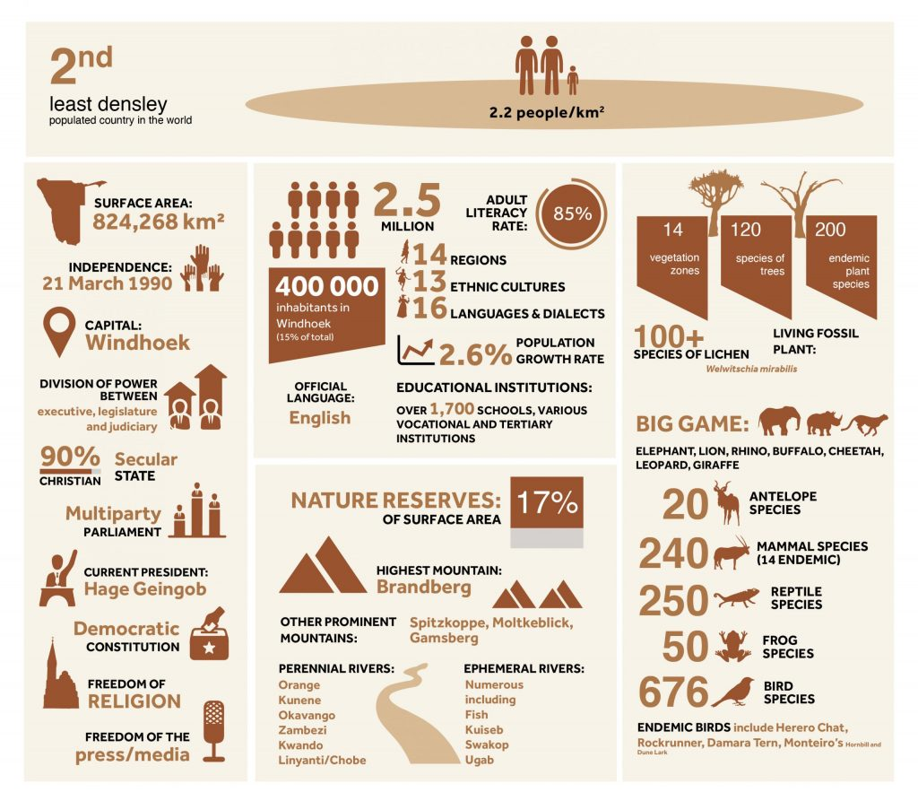
Namibia cont.
[https://namibiaexpo2020dubai.com/about-namibia]

Slide 5
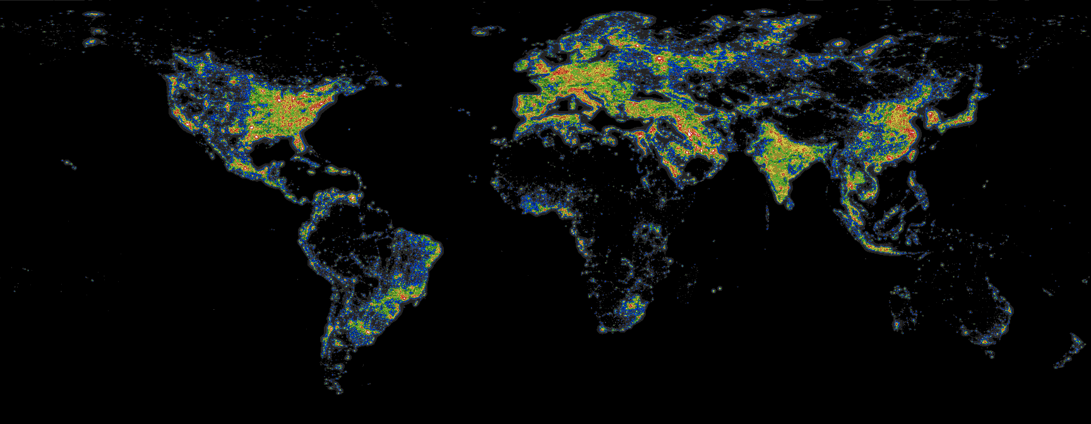
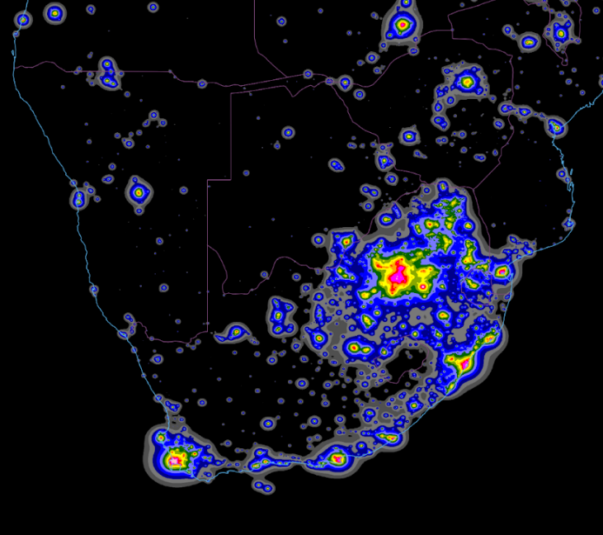
Dark skies
Minimal Light Pollution:
• One of the least light-polluted countries globally.
• Density resulting in vast empty space with minimal artificial light interference, preserving natural dark skies.
[Fabio Falchi, priv. com.]
http://www.lightpollution.it/worldatlas/pages/fig1.htm

Slide 6
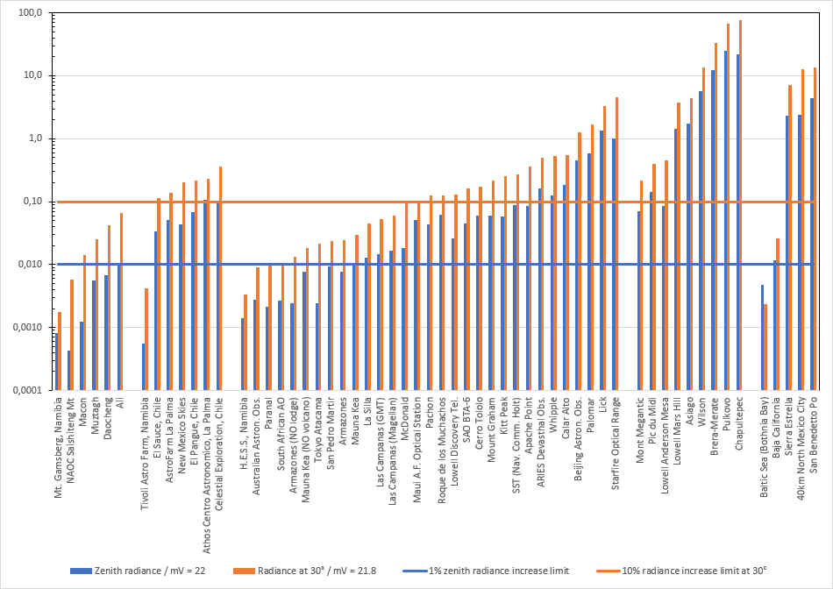
Dark skies cont.
Comparison of Light Pollution: Shows light pollution levels at various astronomical observatories.
Blue Bars: Measure of light pollution directly overhead (zenith radiance).
Orange Bars: Measure of light pollution at 30° above the horizon.
Blue Line: 1% increase limit for acceptable zenith radiance.
Orange Line: 10% increase limit for acceptable radiance at 30°.
Falchi, Backes et al., in prep.

Slide 7
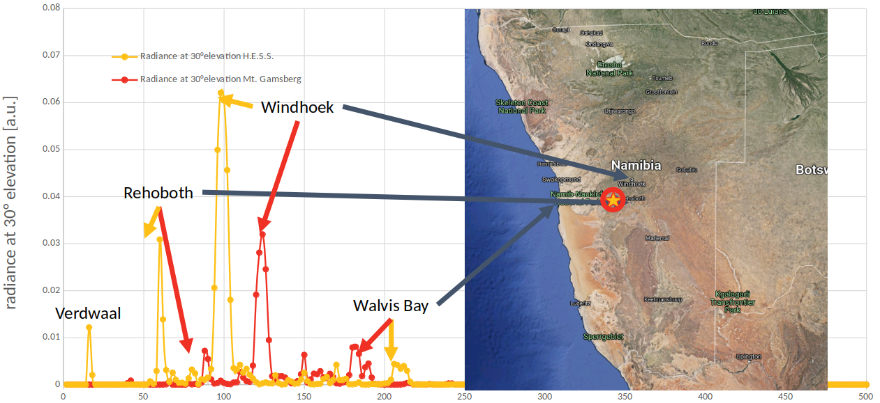
Dark skies cont.
[Falchi, Backes et al., in prep.]

Slide 8
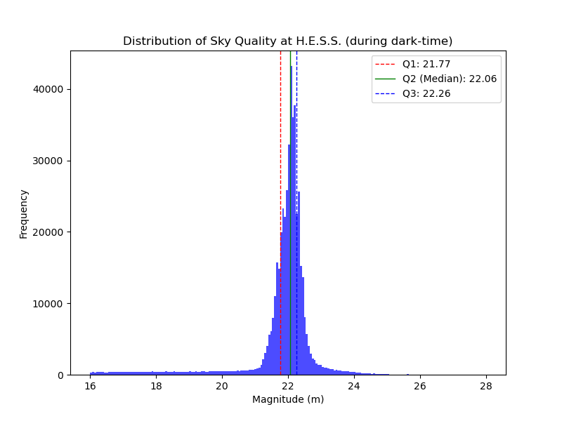
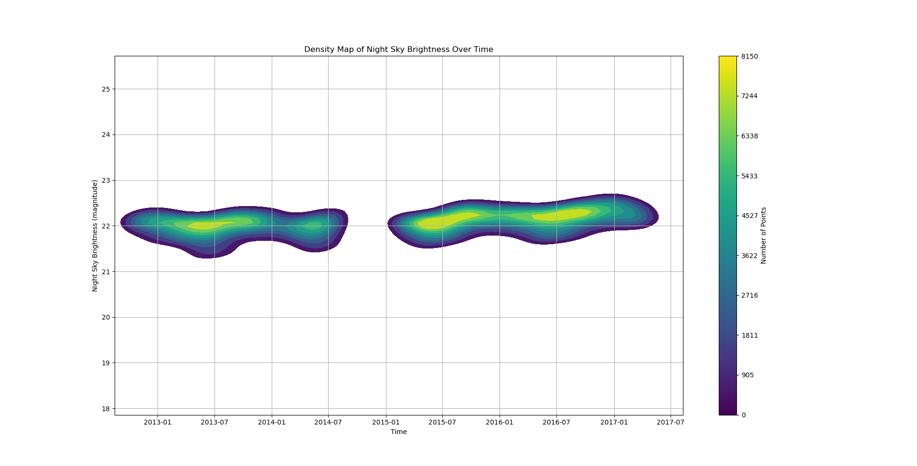
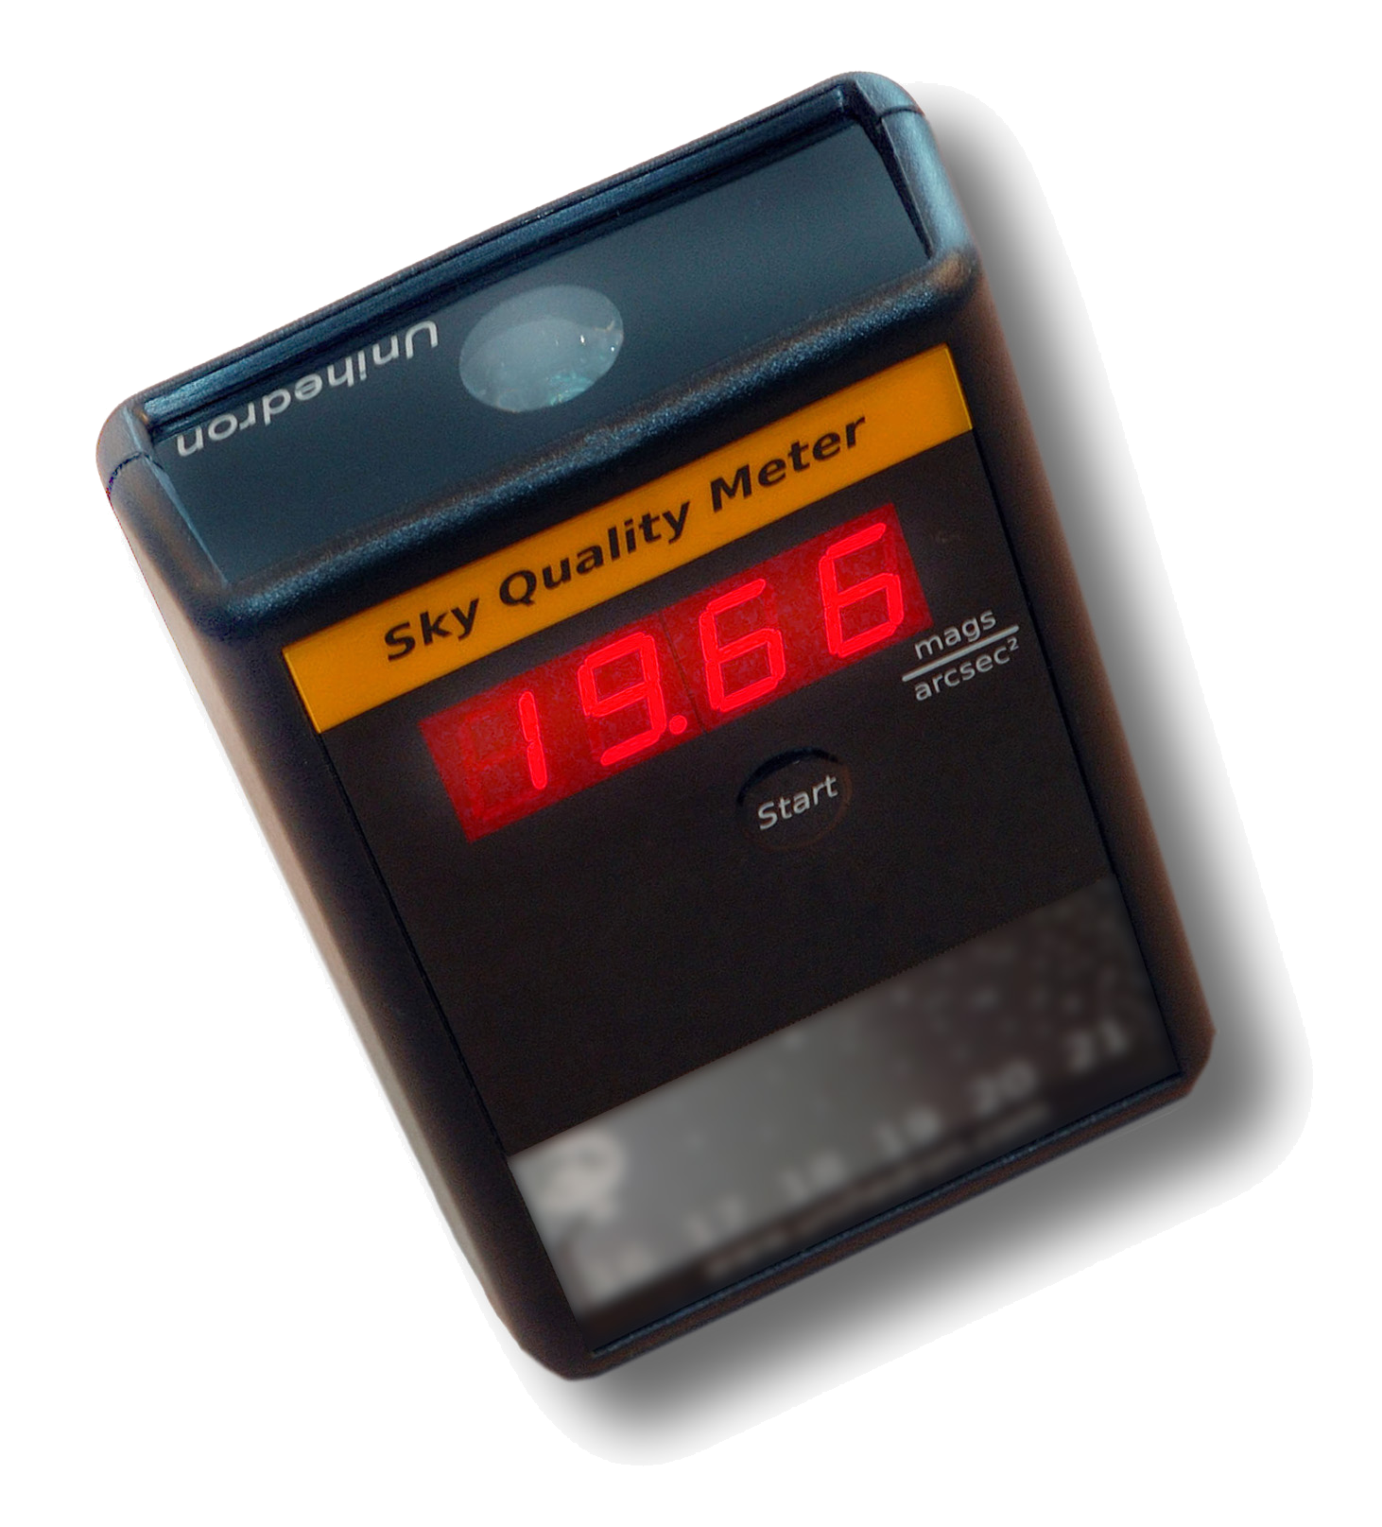
Dark skies : CTA Atmoscope
Night Sky Brightness Measurements:
• Data collected using the Atmoscope at the H.E.S.S. site.
• Density plot reveals average brightness magnitude around 22.06 mpsas.
• Exceptionally dark skies, ideal for sensitive astronomical observations.

Slide 9
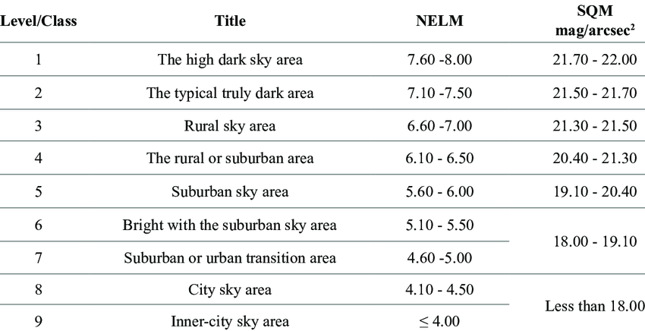
Dark skies cont.
DOI:10.13140/RG.2.2.11949.31206
Available from: https://www.researchgate.net/figure/Sky-brightness-indicator-Bortle-Dark-Sky-Scale_tbl1_360548214 [accessed 30 Jul 2024]

Slide 10
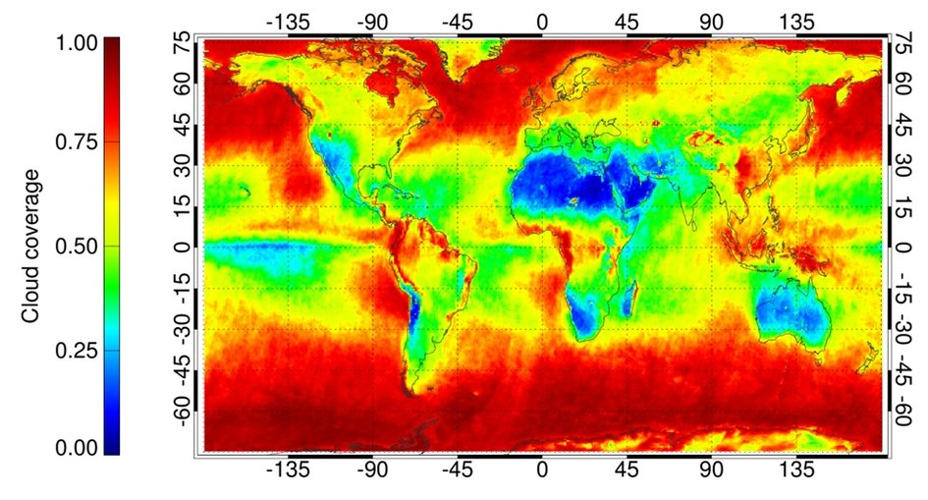
Average annual cloud cover
Exceptional Cloud-Free Skies:
• Namibia boasts one of the world's lowest cloud coverage levels.
• Abundant clear skies provide extended observation hours year-round.
• Ideal for consistent and long-term astronomical studies.
[http://www.esa.int/spaceinimages/Images/2013/09/Cloud_cover]

Slide 11
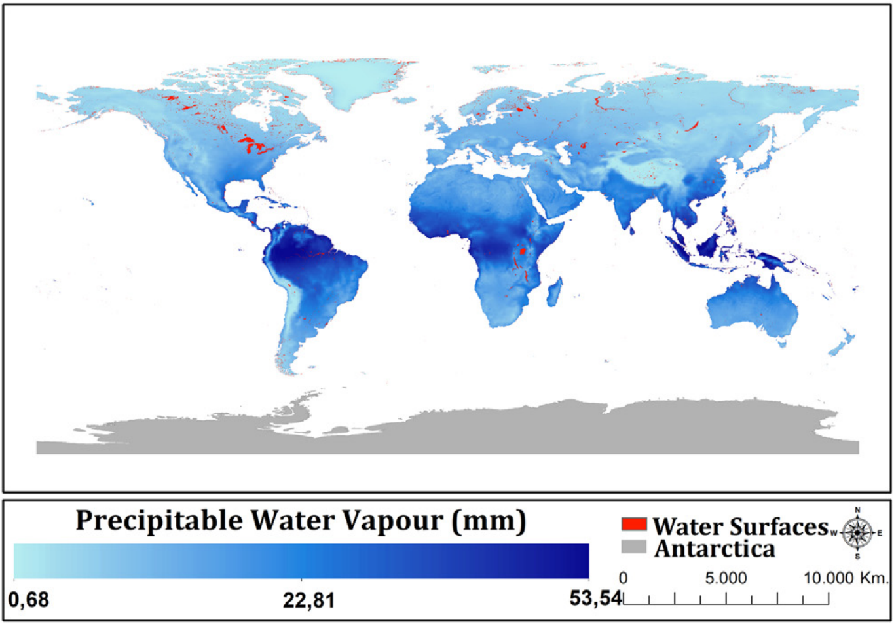
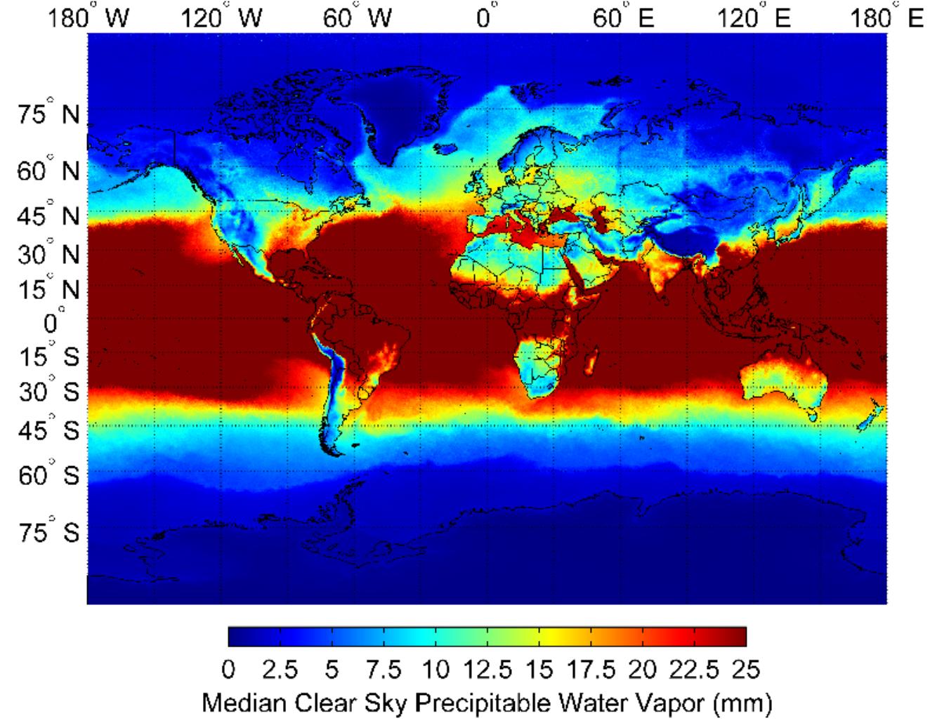
Precipitable Water Vapour
[Aksaker⁺ MNRAS (2020)]
[Suen⁺ (2013)]
Low Precipitable Water Vapor:
• Namibia experiences minimal atmospheric water vapor content.
• Dry atmosphere enhances visibility and reduces signal attenuation.
• Crucial for millimeter and submillimeter wavelength observations.

Slide 12
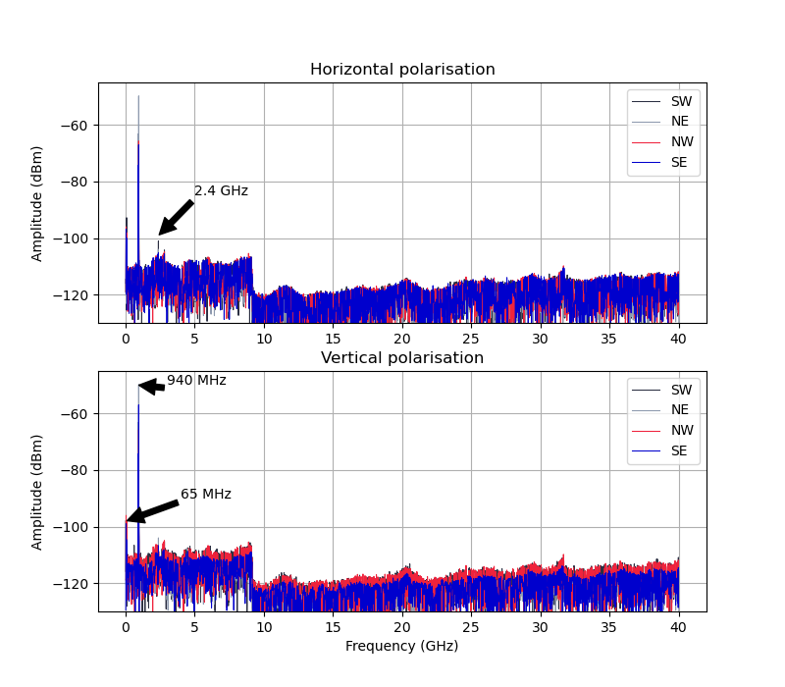
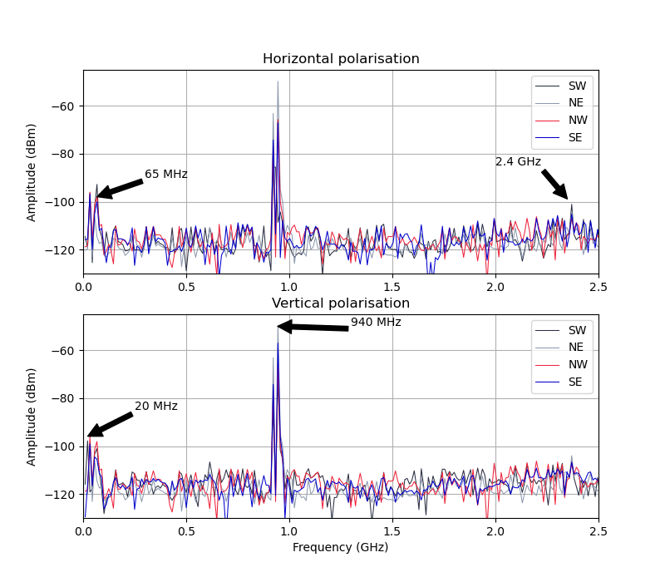
Radio Interference
RFI studies conducted at H.E.S.S. site and Mt. Gamsberg for potential AMT and Water Vapour Radiometer(s)
Proposed AMT observation bands (86 GHz, 230 GHz, and 345 GHz) likely free from significant interference due to low industrial/commercial use and high free-space path loss
No significant interference detected in water vapor observation bands (23.7-23.9 GHz and 31.55-31.75 GHz), crucial for WVR operations
Some interference observed in lower frequency bands (VHF, UHF, some microwave frequencies), but not expected to significantly impact proposed astronomical observations
The RFI study supports the suitability of these Namibian sites for radio astronomical observations.
T. Stander and R.K. Neate
Department of Electrical, Electronic, and Computer Engineering, University of Pretoria

Slide 13
Namibian MWL observatory
[M. Backes+, Southern Space Studies 5, chapter 3 (2023)]

Slide 14
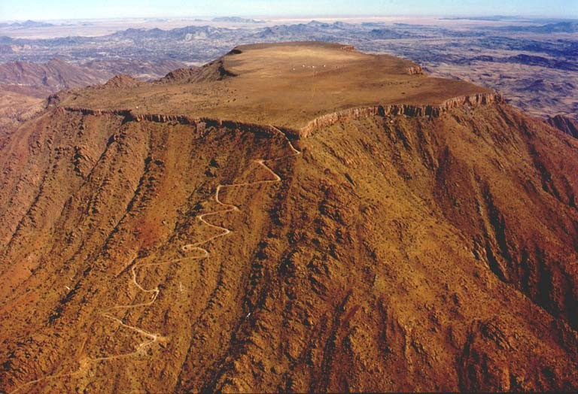
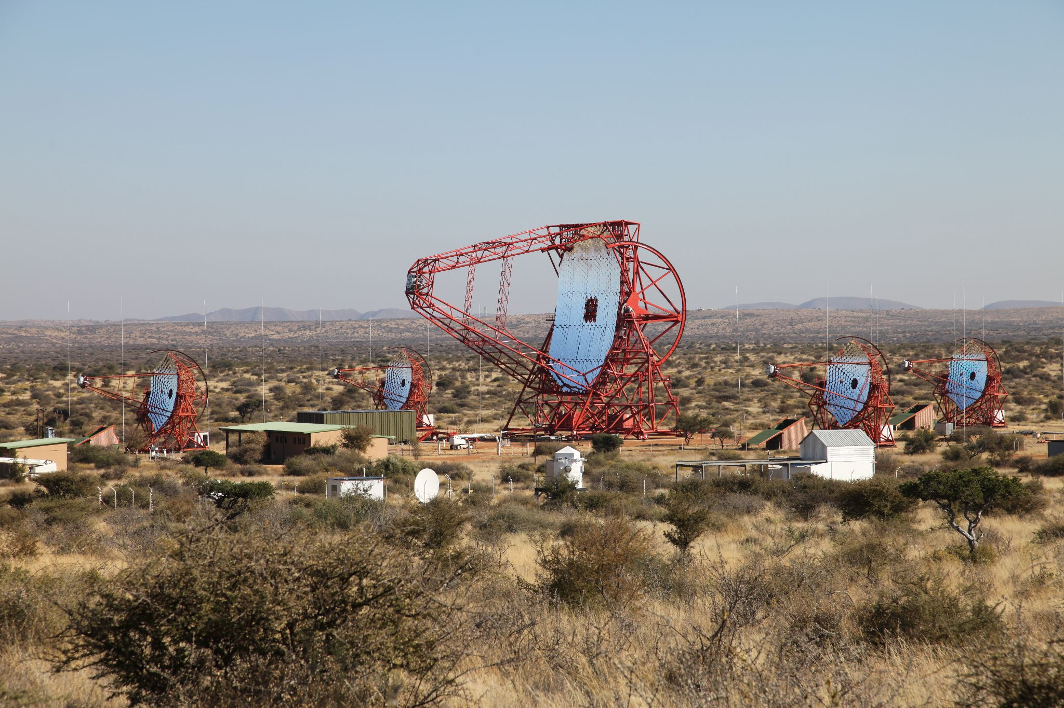
Namibian MWL observatory
Ambition:
World's first true multi-wavelength observatory, hosting telescopes for mm-wave, cm-wave radio astronomy and optical astronomy, and gamma-ray astronomy.
Aims:
It would be bi-located: atop Mt. Gamsberg and in the surrounding area, particularly at the H.E.S.S. site.
It would include the existing H.E.S.S. gamma-ray telescopes.
It would incorporate the planned Africa Millimetre Telescope (AMT) for mm-wave astronomy.
The AMT would also have cm-wave radio astronomy capabilities to serve as a node for the African VLBI Network.
It would potentially include an 8-dish outrigger station for the HIRAX experiment.

Slide 15
Namibian MWL observatory
Possible science of the MWL observatory:
Black hole imaging and dynamics through enhanced Event Horizon Telescope capabilities.
Investigation of magnetic fields' role in jet launch and accretion processes around black holes.
Long-term monitoring of Active Galactic Nuclei.
Ongoing gamma-ray observations with H.E.S.S., focusing on high-energy astrophysics.
Multi-wavelength studies of transient sources.
Just to name a few.

Slide 16
Summary
Namibia offers exceptional dark skies and minimal light pollution, ranking among the best astronomical sites globally.
Consistent clear skies and low cloud coverage provide extended, year-round observation opportunities
Low atmospheric water vapor content enhances visibility across multiple wavelengths.
Radio Frequency Interference (RFI) studies confirm minimal interference in key astronomical bands.
These combined factors make Namibia an ideal location for a multi-wavelength astronomical observatory.
Thank you

