Slide 1
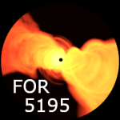
The integrated synchrotron spectrum of HETDEX blazars with LOFAR surveys
Hrishikesh Shetgaonkar
Etienne Bonnassieux, Matthias Kadler
ECAP Erlangen, Germany 15th November 2024
Notes:
Good evening. Hello everyone
I'm hrishi, PhD student from Wü in the Kadler working group.
I going to talk about blazars with LOFAR.
Supervised…
But before I dive into the topic, I want to say that it is nice to be back

Slide 2
Blazars
AGNs where jet is directed towards us
Emit across the electromagnetic spectrum
Relativistic beaming
Compact and core-dominated
Particle accelerators
Perfect laboratories for high-energy astrophysics!
European Southern Observatory (ESO)
2
Notes:
Get rid of auto animation
Skip neutrino
What are AGNs? From observational evidences and to the best of our understanding...
Accreting SMBH
Line of fire… Looking into a headlight. Brightest knows continuously emiting object in the universe
Since the jet is directly pointed at us → relativistic beaming, very bright and core dominated
Relativistic beaming (Doppler boosting, or the headlight effect)
Engines for accelerating particles to high energies(neutrinos…)
How it looks in different frequency

Slide 3
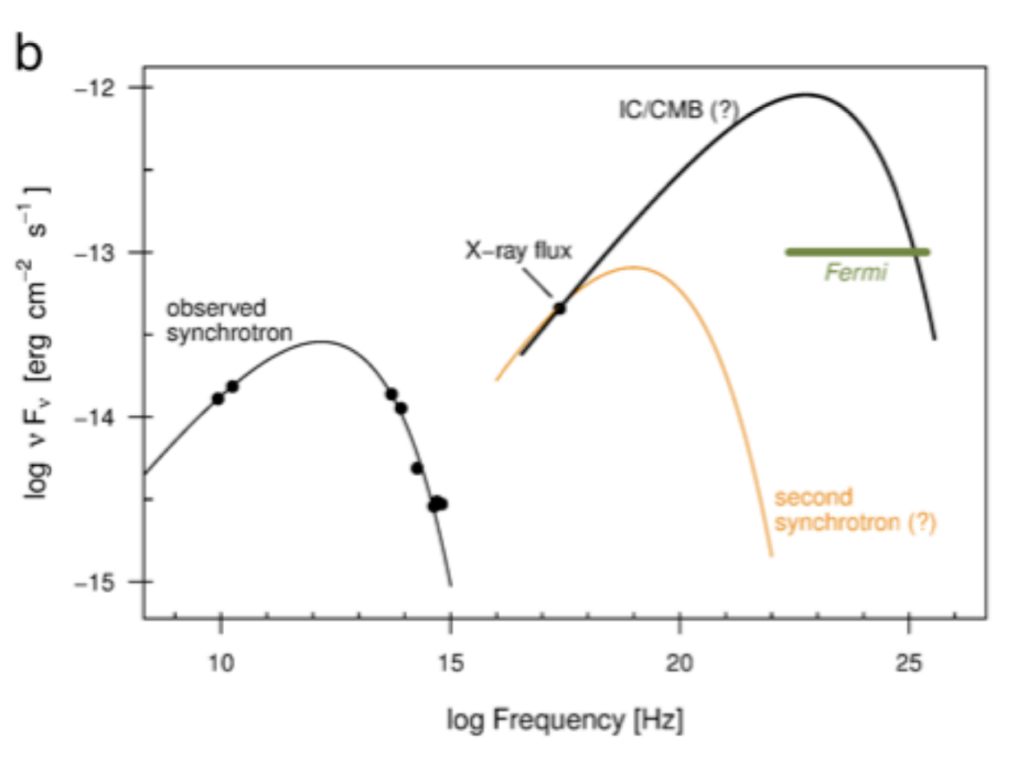
Blazar SEDs
Their SEDs exhibit two main, broadly peaked components
Radio to X-ray SED for PKS 0637-752
Perlman et al. (2019)
3
Notes:
Their spectral energy distributions (SEDs) exhibit two main, broadly peaked, components:
a low-energy one with its maximum between the IR and the X-ray band, and the high-energy one peaking in the γ-rays.
Blazars are under-studied at low radio frequencies in the MHz regime. This is a consequence of the difficulties in reaching the sensitivity and resolution levels necessary for accurate cross-matching to that frequency band. With the release of both the LOFAR Two-metre Sky Survey Data Release 2 (LoTSS DR2) at 144 MHz and LOFAR LBA Sky Survey (LoLSS DR1) at 54 MHz, it is now possible to create complete blazar catalogues in the Northern sky, finding counterparts to blazars identified in Roma-BZCAT(5th Edition) and MOJAVE samples. Here, we present the first results of this study to understand the spectral properties, compactness and radio luminosity distributions of our blazar sample down to the LOFAR bands. Furthermore, we investigate whether the radio-flat spectra (i.e., spectral indices ~0.5) observed in blazars in the GHz regime extend to 144 MHz and 54 MHz, and analyze what deviations from this behavior imply about the physical properties of the underlying plasma population.
Challenges,
Previous work

Slide 4
Blazar SEDs
Their SEDs exhibit two main, broadly peaked components
Historically, blazar population under-studied at low radio frequencies (MHz)
Limitations on survey sensitivity and angular resolution made cross-matching difficult
VLSS - VLA Low-Frequency Sky Survey
74 MHz
Resolution of 80”
Average rms noise of 0.1 Jy/beam
?
Radio to X-ray SED for PKS 0637-752
Perlman et al. (2019)
4
Notes:
Their spectral energy distributions (SEDs) exhibit two main, broadly peaked, components:
a low-energy one with its maximum between the IR and the X-ray band, and the high-energy one peaking in the γ-rays.
Blazars are under-studied at low radio frequencies in the MHz regime.
Ionospheric effects. Bottleneck has been technical difficulties to achieve a good sensitivity and resolution.
This is a consequence of the difficulties in reaching the sensitivity and resolution levels necessary for accurate cross-matching to that frequency band.
VLSS came out in 2007. Covers whole north sky above d >-30
Challenges,
Previous work

Slide 5
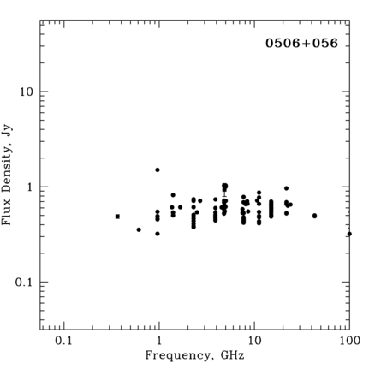
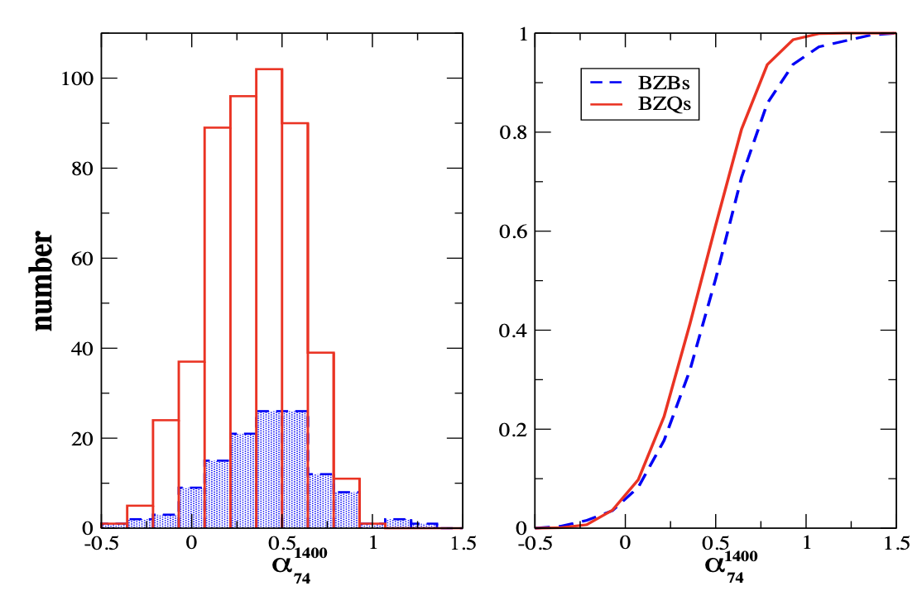
Blazars at low radio frequencies
Blazars typically possess flat spectra at GHz frequencies i.e., α < 0.5 for S (ν) ∝ ν^{-α}
S is Flux Density
α is Radio Spectral Index
Massaro et al. 2013 showed that radio spectral indices remain flat from GHz to MHz regime
$$S_{υ}∝ν^{−α}$$
Flat radio spectrum of blazar TXS 0506+056 https://www.cv.nrao.edu/MOJAVE
The distributions of the radio spectral index (α) for blazars Adapted from: Massaro et al. 2013
5

Slide 6
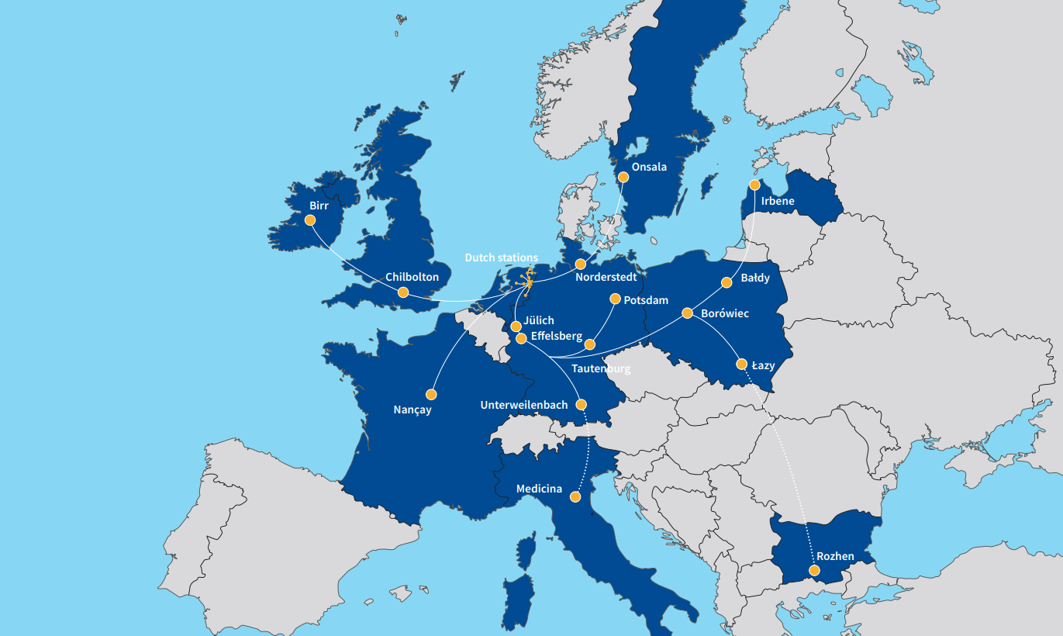
Stations:
24 core
14 remote
14 international
+2 in construction
LOFAR : Low Frequency Array
Stations:
24 core (Dutch)
14 remote (Dutch)
14 international +2 in construction
1

Slide 7
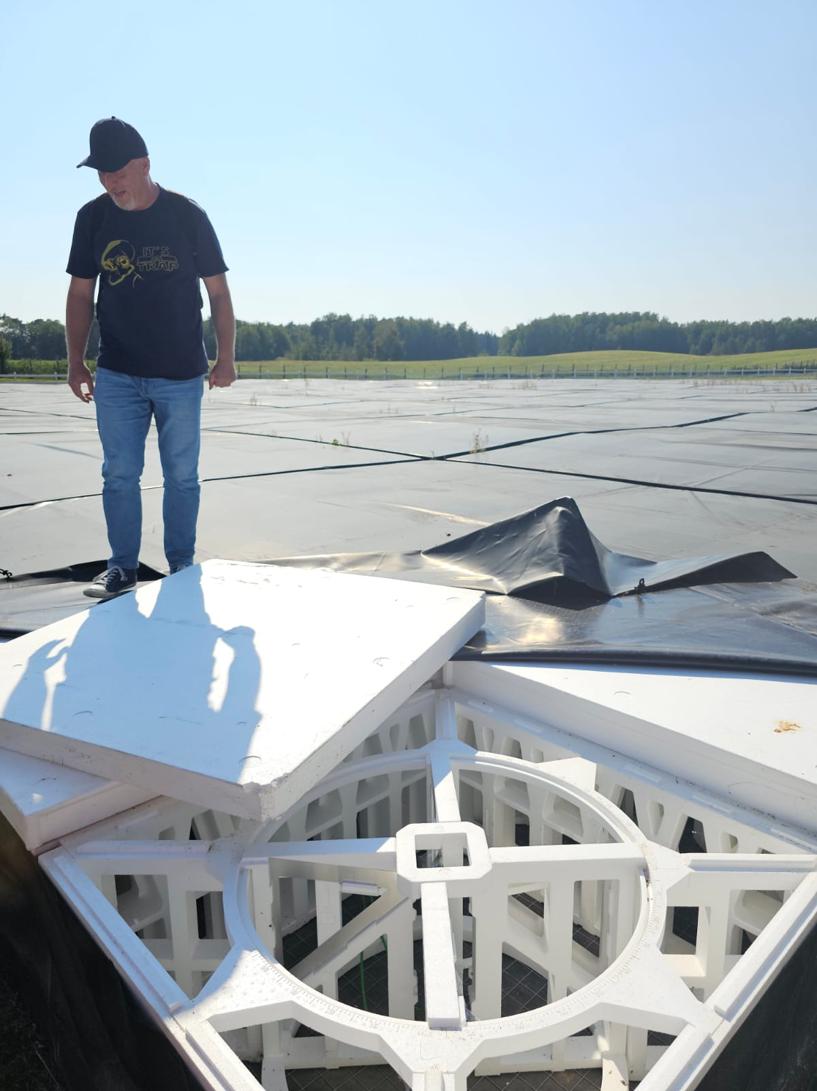
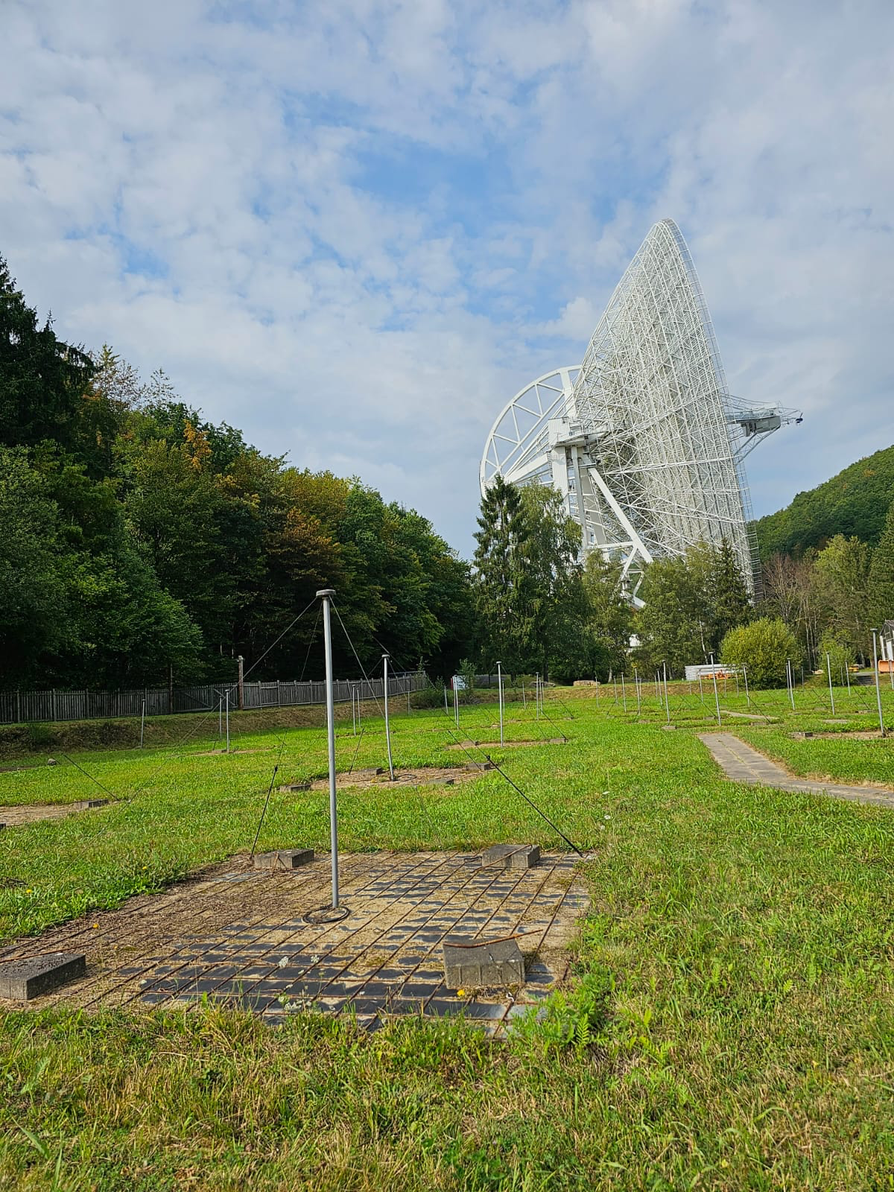
LOFAR Antenna:
HBA
High Band Antenna
144 MHz
LBA
Low Band Antenna
54 MHz
Core and Remote stations
48 HBA and 96 LBA
International stations
96 HBA and LBA
LBA
HBA
2
Notes:
With the release of both the LOFAR Two-metre Sky Survey Data Release 2 (LoTSS DR2) at 144 MHz and LOFAR LBA Sky Survey (LoLSS DR1) at 54 MHz, it is now possible to create complete blazar catalogues in the Northern sky, finding counterparts to blazars identified in Roma-BZCAT(5th Edition) and MOJAVE samples. Here, we present the first results of this study to understand the spectral properties, compactness and radio luminosity distributions of our blazar sample down to the LOFAR bands. Furthermore,

Slide 8
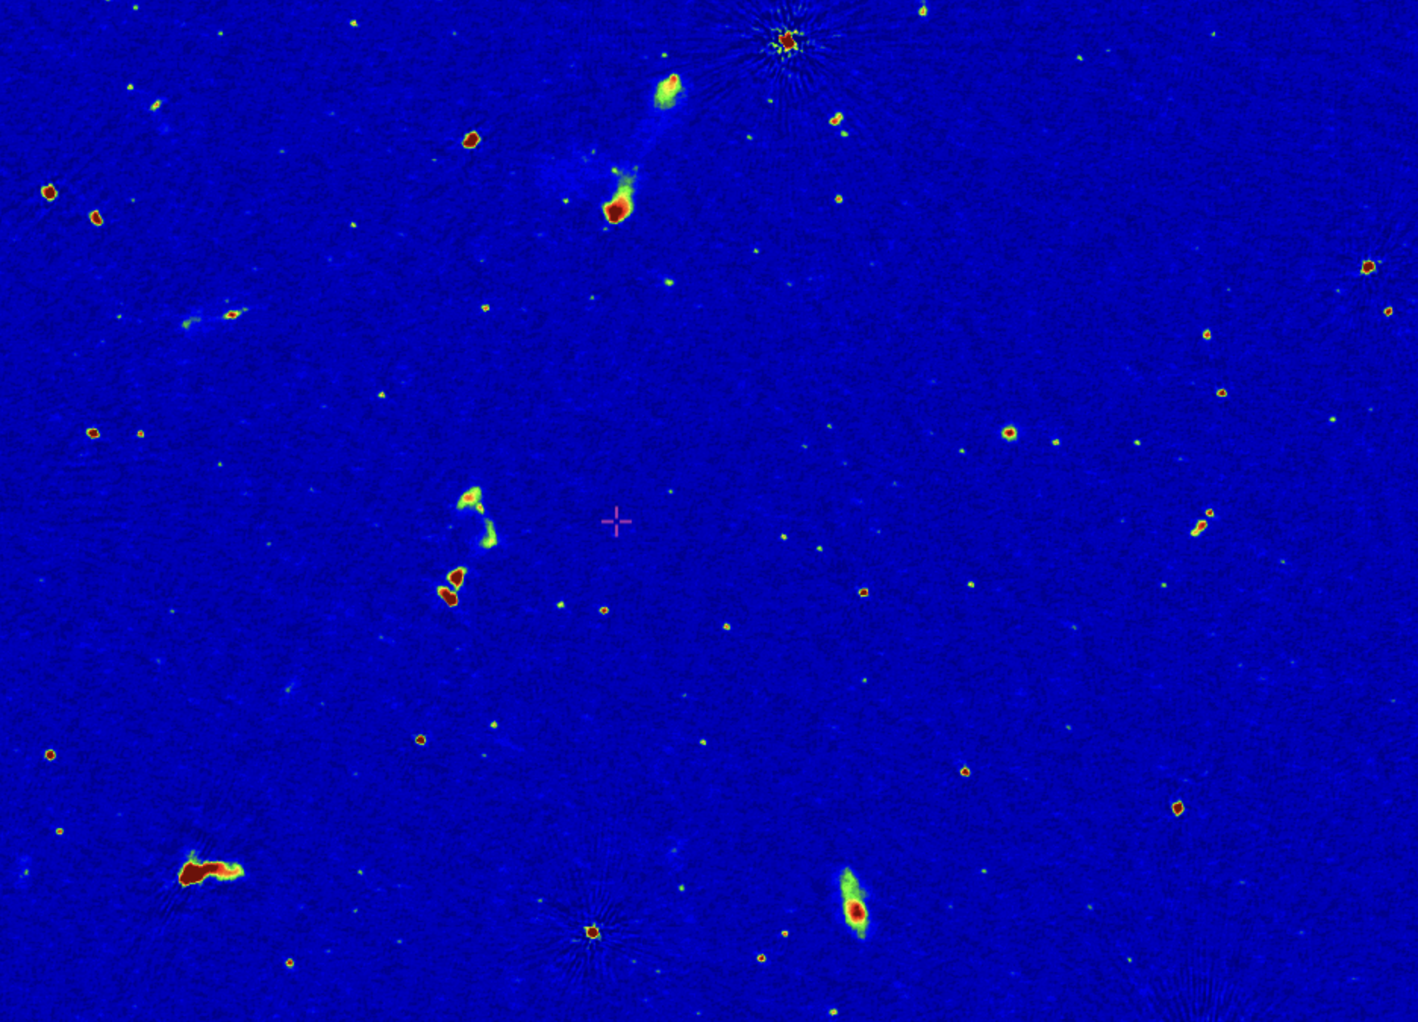
What’s new with LoTSS and LoLSS?
Survey | Central Frequency | Resolution | rms noise | coverage
VLSS | 74 MHz | 80’’ | 100 mJy/beam | > -30° declination
LoLSS* DR1 | 54 MHz | 15’’ | 1.6 mJy/beam | 1.675% of sky (HETDEX*)
LoTSS* DR2 | 144 MHz | 6’’ | 0.083 mJy/beam | 14.229% of sky
LoTSS DR2 High Resolution(6’’) ≈1° FoV Preview https://lofar-surveys.org/
*LoTSS: LOfar Two meter Sky Survey *LoLSS: LOfar LBA Sky Survey *HETDEX: Hobby-Eberly Telescope Dark Energy Experiment
6
Notes:
With the release of both the LOFAR Two-metre Sky Survey Data Release 2 (LoTSS DR2) at 144 MHz and LOFAR LBA Sky Survey (LoLSS DR1) at 54 MHz, it is now possible to create complete blazar catalogues in the Northern sky, finding counterparts to blazars identified in Roma-BZCAT(5th Edition) and MOJAVE samples. Here, we present the first results of this study to understand the spectral properties, compactness and radio luminosity distributions of our blazar sample down to the LOFAR bands. Furthermore,
Not only are we going to lower frequency but also much higher sensitivity and resolution
LoTSS coverage: 14.229% of sky => 5870°^2
LoLSS coverage: 1.675% of sky => 691°^2
What is HETDEX? Hobby-Eberly Telescope Dark Energy Experiment (HETDEX)
HBA and LBA
> we investigate whether the radio-flat spectra (i.e., spectral indices ~0.5) observed in blazars in the GHz regime extend to 144 MHz and 54 MHz, and analyze what deviations from this behavior imply about the physical properties of the underlying plasma population.

Slide 9
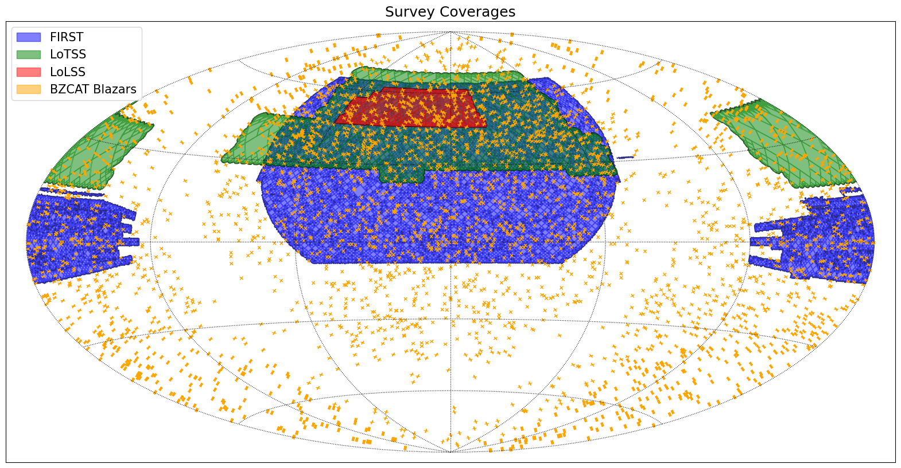
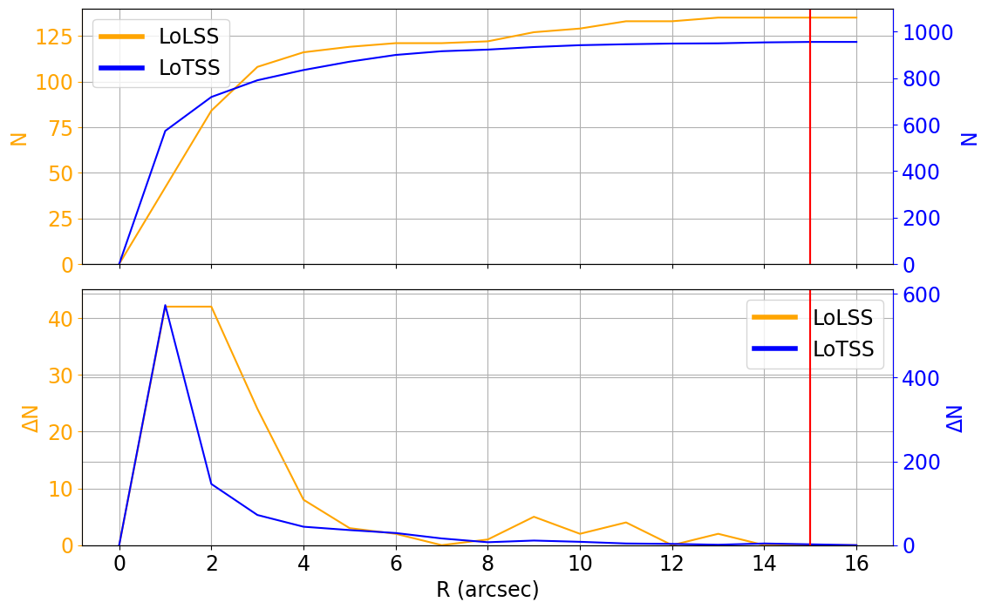
Cross matching with BZCAT Blazar Catalogue
5th Edition of the Roma-BZCAT - Multifrequency Catalogue of Blazars
Massaro et al., 2015
Compilation of multifrequency data from radio to γ-rays for 3561 sources
Cross matching performed within 15’’
956 sources from BZCAT were found in LoTSS DR2 (14.229%)
135 sources from BZCAT were found in LoLSS DR1 (1.675% of sky)
10
7
Notes:
Angular seperation
The number of total matches N(R) as a function of the radius R between 0′′ and 15'′.
(Lower panel)
The difference ∆N(R) between the number of associations at given radius R and those at R − ∆R as a function of the radius R in the same range of the above plot.
More in LoTSS because of larger sky coverage

Slide 10
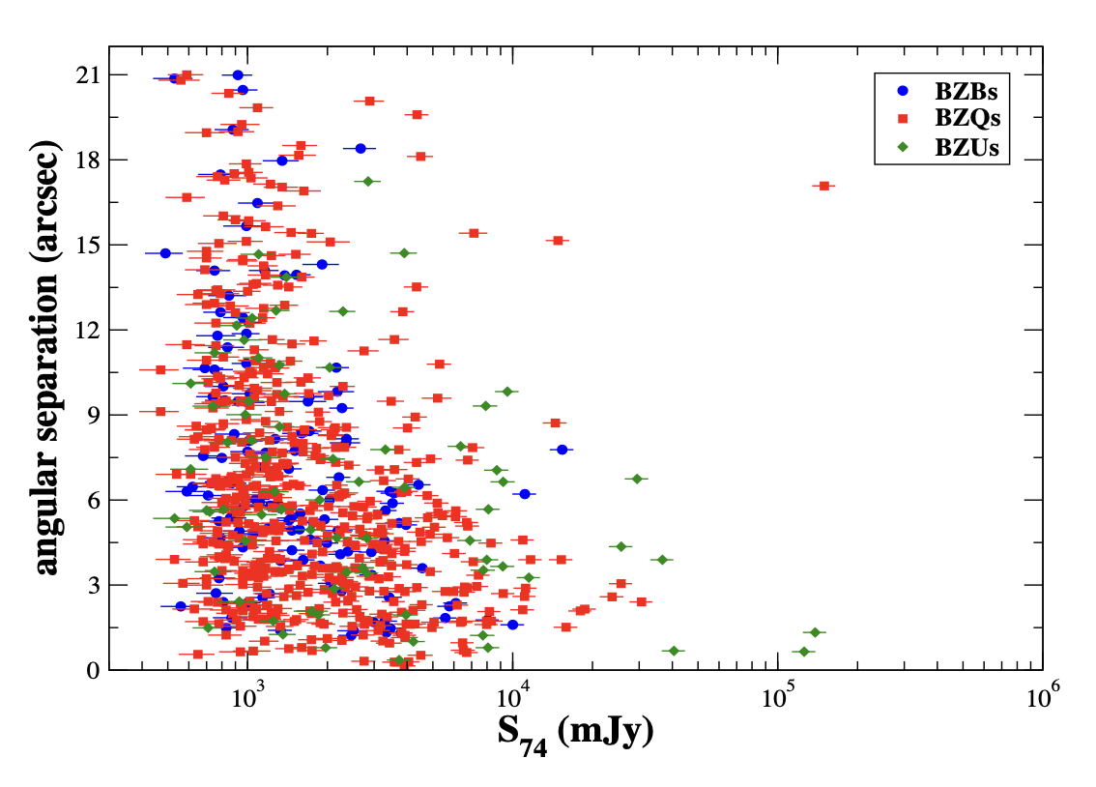
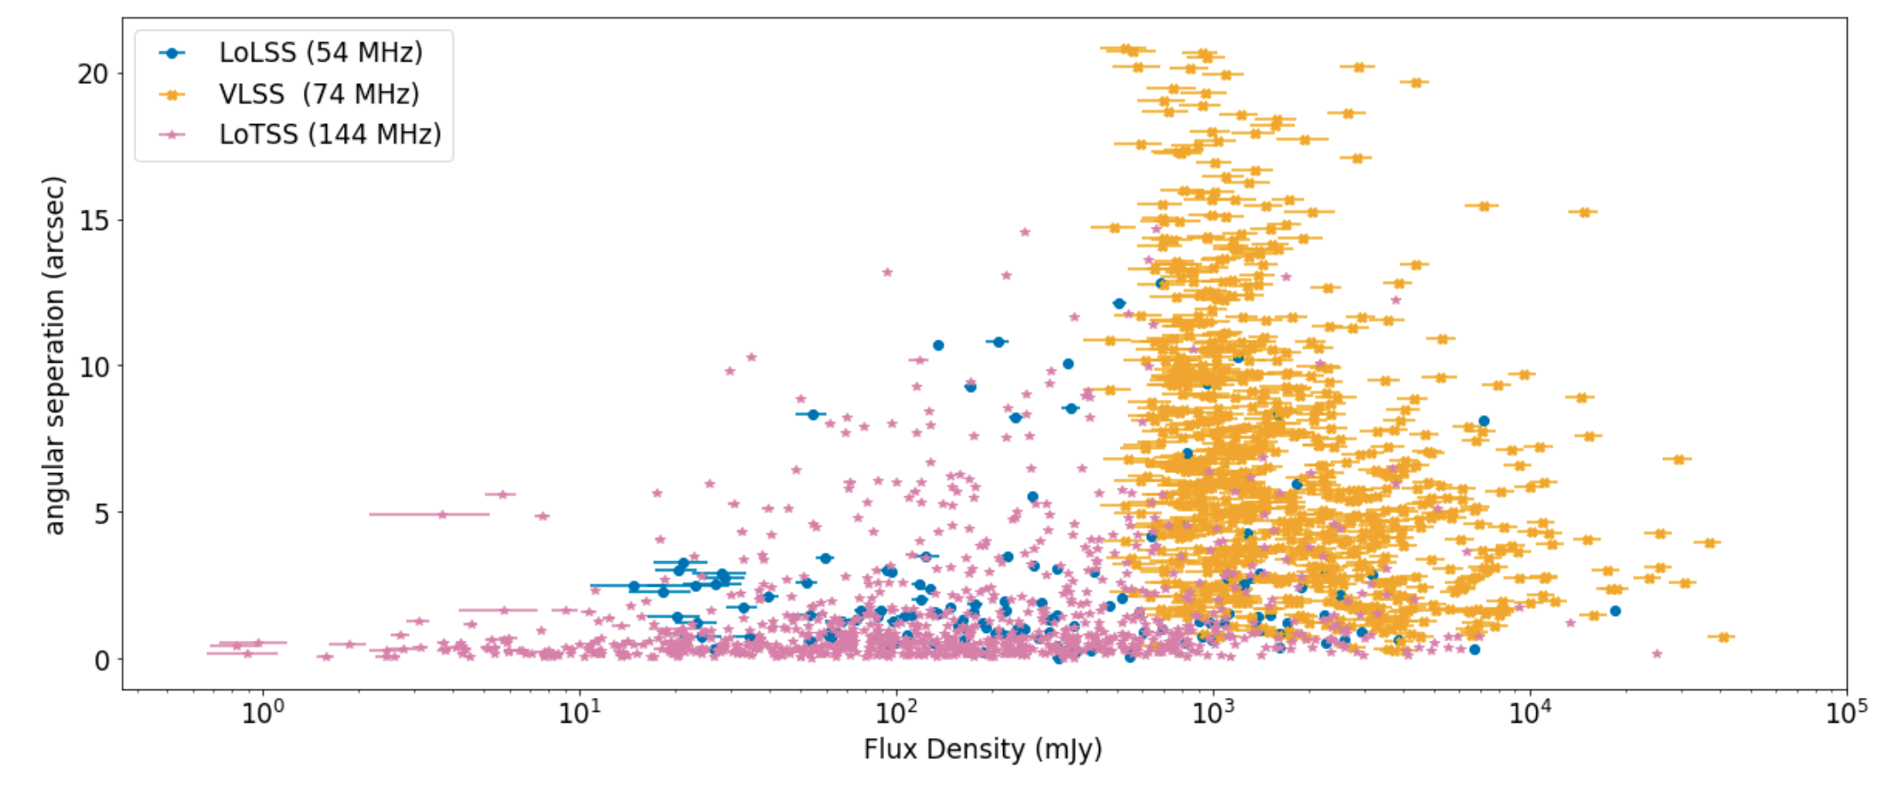
VLSS - BZCAT
The angular separation (BZCAT-VLSS) versus the flux density at 74 MHz
Massaro et al., 2013
8
Notes:
VLSS came out in 2007. Covers whole north sky above d >-30
Not only are we going to lower frequency but also much higher sensitivity and resolution
LoTSS coverage: 14.229% of sky => 5870°^2
LoLSS coverage: 1.675% of sky => 691°^2
What is HETDEX? Hobby-Eberly Telescope Dark Energy Experiment (HETDEX)

Slide 11
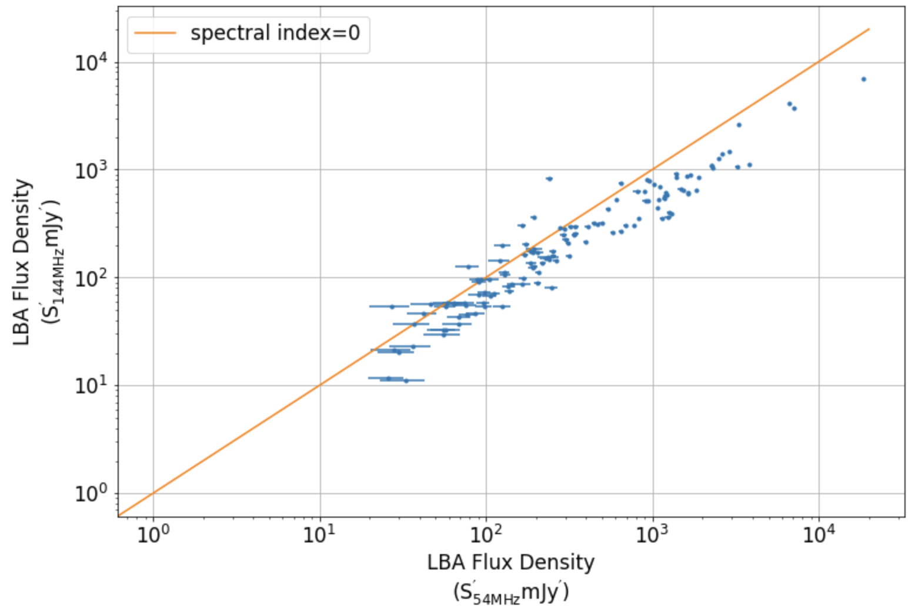
LBA vs HBA flux densities
HBA Flux Density
9
Notes:
VLSS came out in 2007. Covers whole north sky above d >-30
Not only are we going to lower frequency but also much higher sensitivity and resolution
LoTSS coverage: 14.229% of sky => 5870°^2
LoLSS coverage: 1.675% of sky => 691°^2
What is HETDEX? Hobby-Eberly Telescope Dark Energy Experiment (HETDEX)

Slide 12
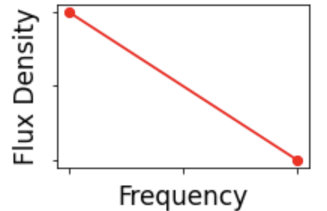
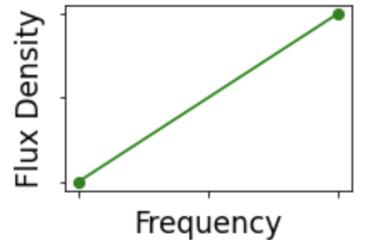
LBA vs HBA flux densities
HBA Flux Density
9
Notes:
VLSS came out in 2007. Covers whole north sky above d >-30
Not only are we going to lower frequency but also much higher sensitivity and resolution
LoTSS coverage: 14.229% of sky => 5870°^2
LoLSS coverage: 1.675% of sky => 691°^2
What is HETDEX? Hobby-Eberly Telescope Dark Energy Experiment (HETDEX)

Slide 13
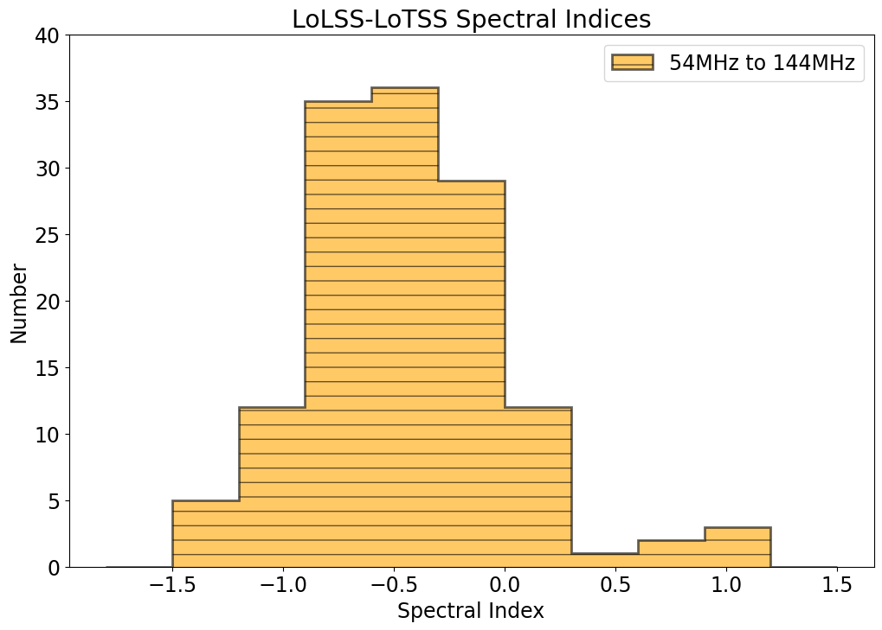
Spectral index distribution
10
Notes:
VLSS came out in 2007. Covers whole north sky above d >-30
Not only are we going to lower frequency but also much higher sensitivity and resolution
LoTSS coverage: 14.229% of sky => 5870°^2
LoLSS coverage: 1.675% of sky => 691°^2
What is HETDEX? Hobby-Eberly Telescope Dark Energy Experiment (HETDEX)

Slide 14
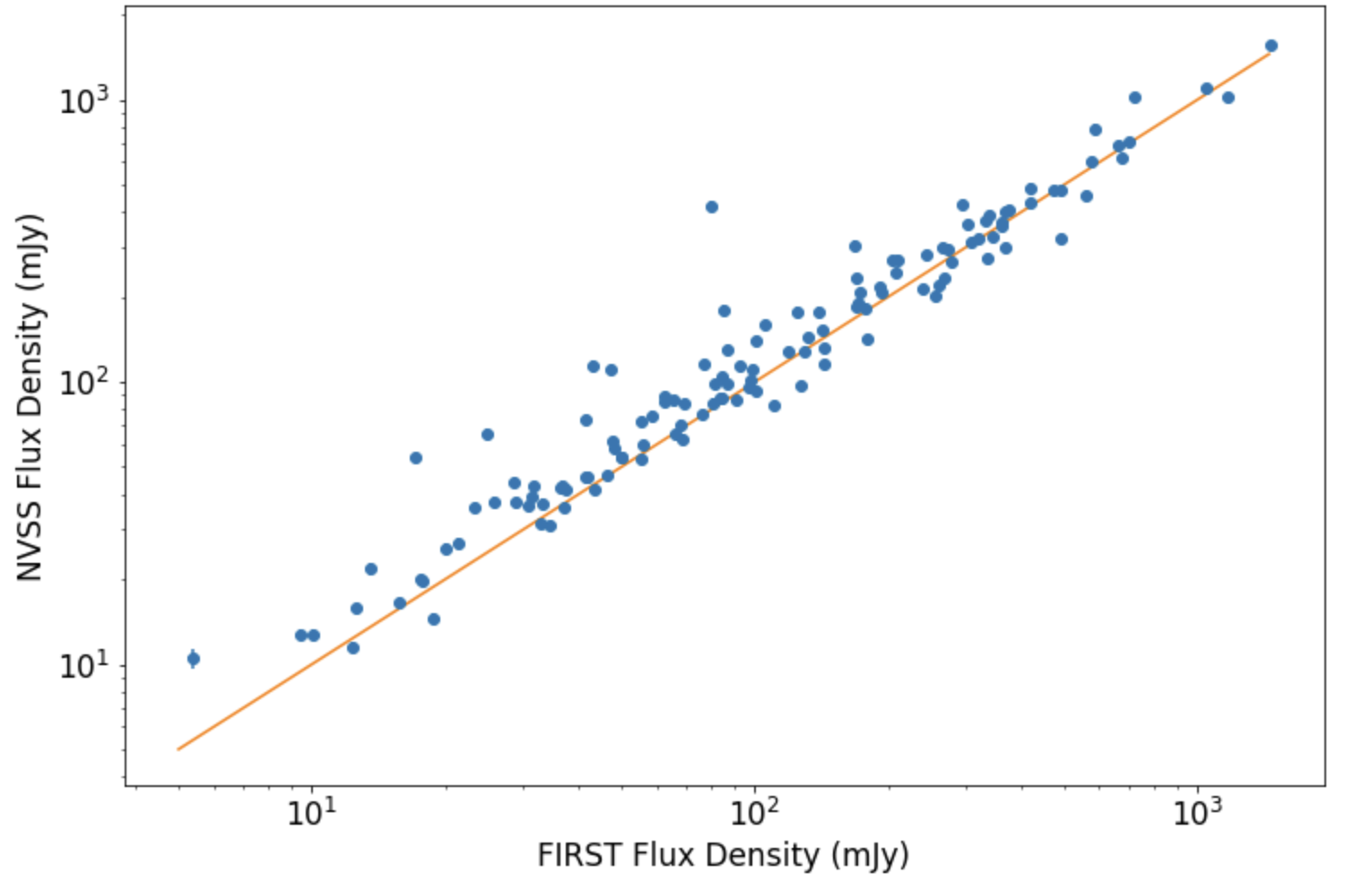
Extending the analysis to 1.4 GHz
NRAO VLA Sky Survey (NVSS)
Covers north of -40° declination
rms: 0.45 mJy/beam
45 arcsec resolution
Faint Images of the Radio Sky at Twenty-cm (FIRST)
10,000 square degrees of the North and South Galactic Caps
rms: 0.15 mJy/beam
5 arcsec resolution
11
Notes:
NVSS has detection limit of 2.5mJy
For FIRST it it is 1 mJy
Fonts bigger
Menition both surveys at 1.4Ghz

Slide 15
Extending the analysis to 1.4 GHz
NRAO VLA Sky Survey (NVSS)
Covers north of -40° declination
rms: 0.45 mJy/beam
45 arcsec resolution
Faint Images of the Radio Sky at Twenty-cm (FIRST)
10,000 square degrees of the North and South Galactic Caps
rms: 0.15 mJy/beam
5 arcsec resolution (comparable to LoTSS)
11
Notes:
NVSS has detection limit of 2.5mJy
For FIRST it it is 1 mJy
Fonts bigger
Menition both surveys at 1.4Ghz

Slide 16
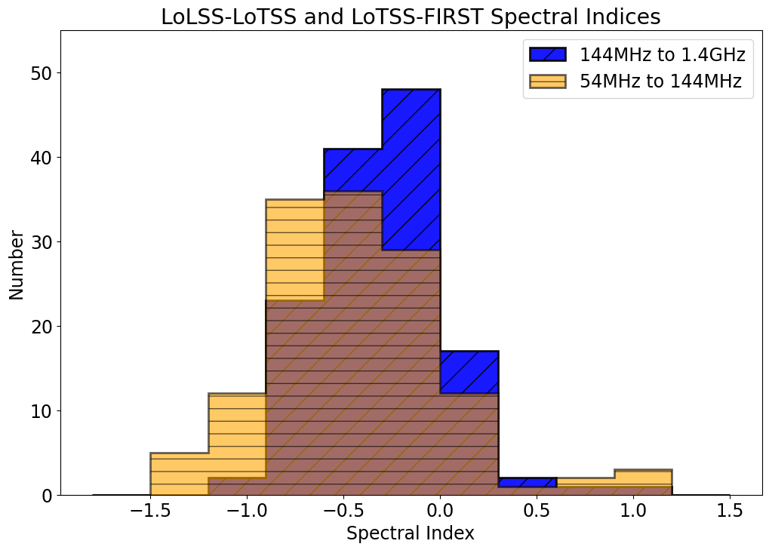
Spectral steepening towards longer λ
Kolmogorow-Smirnow Test
Null Hypothesis: Both are same distribution
pvalue=0.0038
12
Notes:
VLSS came out in 2007. Covers whole north sky above d >-30
Not only are we going to lower frequency but also much higher sensitivity and resolution
LoTSS coverage: 14.229% of sky => 5870°^2
LoLSS coverage: 1.675% of sky => 691°^2
What is HETDEX? Hobby-Eberly Telescope Dark Energy Experiment (HETDEX)
Can reject the null hypothesis with 97% confidence. Null hypothesis being both are same

Slide 17
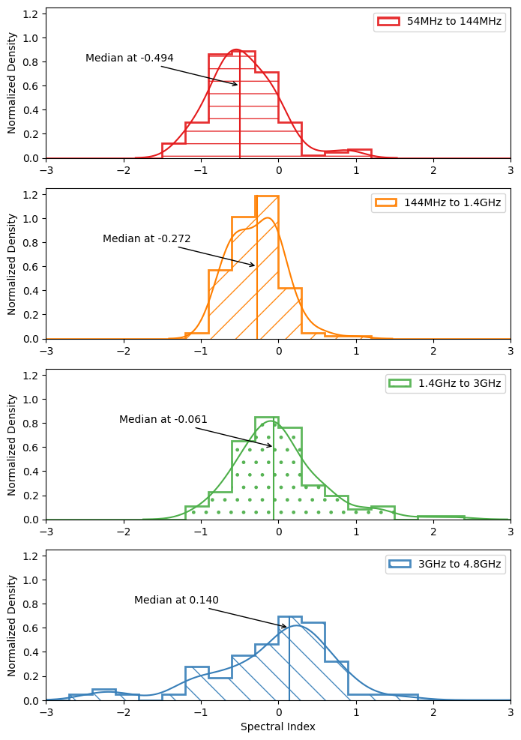
Extending the analysis to even higher frequencies
12
13
Notes:
VLSS came out in 2007. Covers whole north sky above d >-30
Not only are we going to lower frequency but also much higher sensitivity and resolution
LoTSS coverage: 14.229% of sky => 5870°^2
LoLSS coverage: 1.675% of sky => 691°^2
What is HETDEX? Hobby-Eberly Telescope Dark Energy Experiment (HETDEX)
Can reject the null hypothesis with 97% confidence. Null hypothesis being both are same

Slide 18
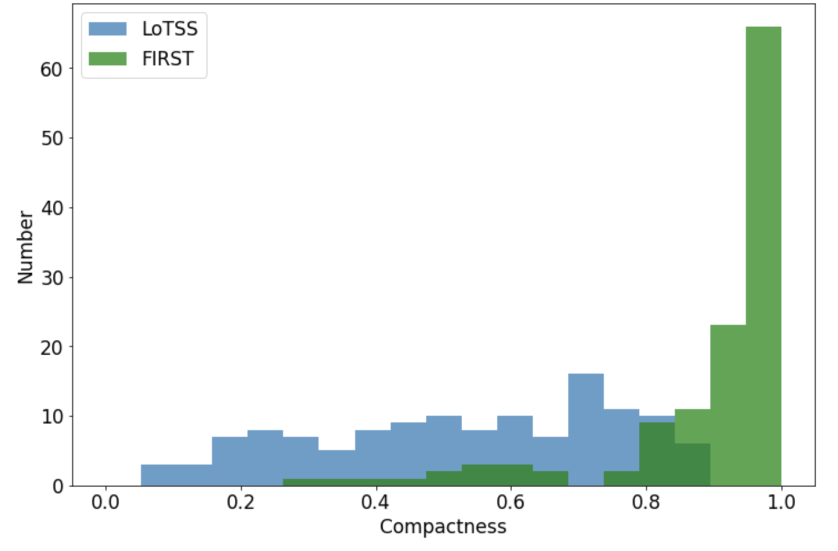
Compactness Comparison
$$Compactness= \left(\frac{Peak Flux Density}{Total Flux Density}\right)$$
FIRST and LoTSS have comparable beam size
Sources appear more compact at 1.4GHz
14
Notes:
There are limitations and we need to take into account some factors:
Resolution is comparable!
But rms is 150uJy vs 90uJy
Change colors
“Peak Flux *Density*”

Slide 19
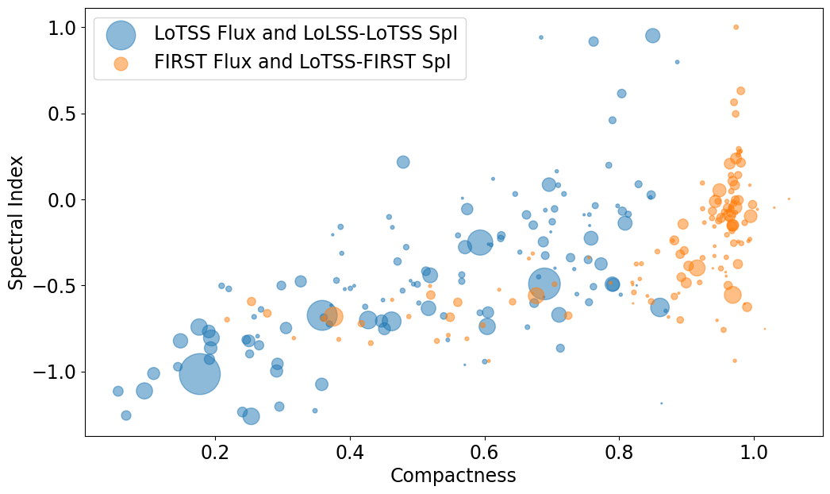
15

Slide 20
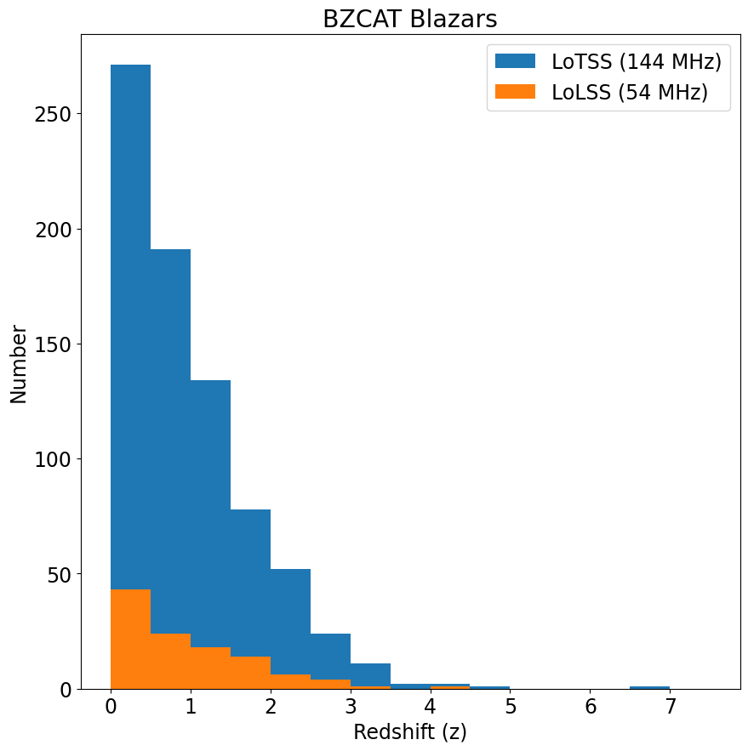
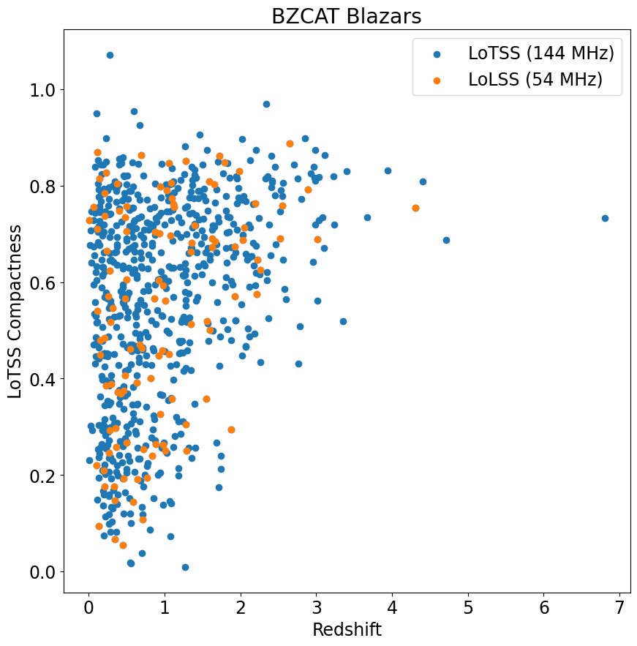
Redshift Distributions
16

Slide 21
Summary and the Road ahead…
135 BZCAT blazars found in LoLSS DR1
Spectral Index at LOFAR frequencies ($α_{54MHz}^{144MHz}$) gets steeper
Sources less compact in LoTSS compared to FIRST
Extend study to other blazar catalogues
Explore radio-gamma relation
Looking forward to LoLSS DR2!
Select interesting candidates for high resolution LOFAR-VLBI imaging
14
17
19
Notes:
Steeper Spectral index: picking up older plasma
Sources less compact in LoTSS. Picks up extended emissions

Slide 22
Summary and the Road ahead…
135 BZCAT blazars found in LoLSS DR1
Spectral Index at LOFAR frequencies ($α_{54MHz}^{144MHz}$) gets steeper
Sources less compact in LoTSS compared to FIRST
Extend study to other blazar catalogues
Explore radio-gamma relation
Looking forward to LoLSS DR2!
Select interesting candidates for high resolution LOFAR-VLBI imaging
14
18
19
Notes:
Steeper Spectral index: picking up older plasma
Sources less compact in LoTSS. Picks up extended emissions

Slide 23
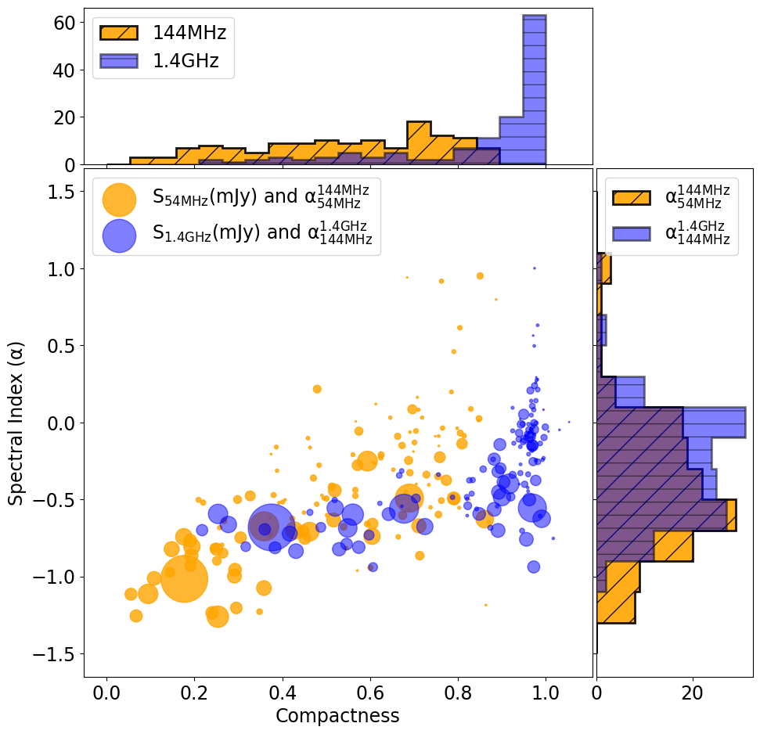
Summary and the Road ahead…
135 BZCAT blazars found in LoLSS DR1
Spectral Index at LOFAR frequencies ($α_{54MHz}^{144MHz}$) gets steeper
Sources less compact in LoTSS compared to FIRST
Extend study to other blazar catalogues
Explore radio-gamma relation
Looking forward to LoLSS DR2!
Select interesting candidates for high resolution LOFAR-VLBI imaging
14
19
19
Notes:
Steeper Spectral index: picking up older plasma
Sources less compact in LoTSS. Picks up extended emissions

Slide 24
Summary and the Road ahead…
135 BZCAT blazars found in LoLSS DR1
Spectral Index at LOFAR frequencies ($α_{54MHz}^{144MHz}$) gets steeper
Sources less compact in LoTSS compared to FIRST
Extend study to other blazar catalogues
Explore radio-gamma relation
Looking forward to LoLSS DR2!
Select interesting candidates for high resolution LOFAR-VLBI imaging
14
19
20
Notes:
Steeper Spectral index: picking up older plasma
Sources less compact in LoTSS. Picks up extended emissions

Slide 25
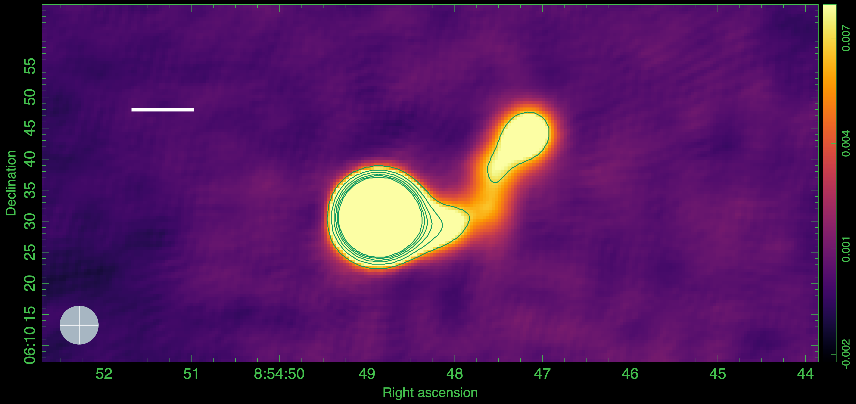
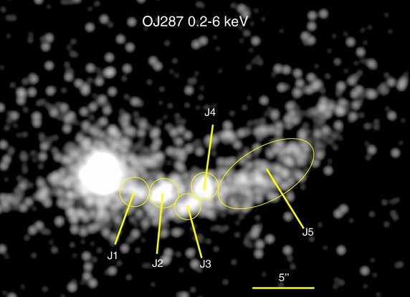
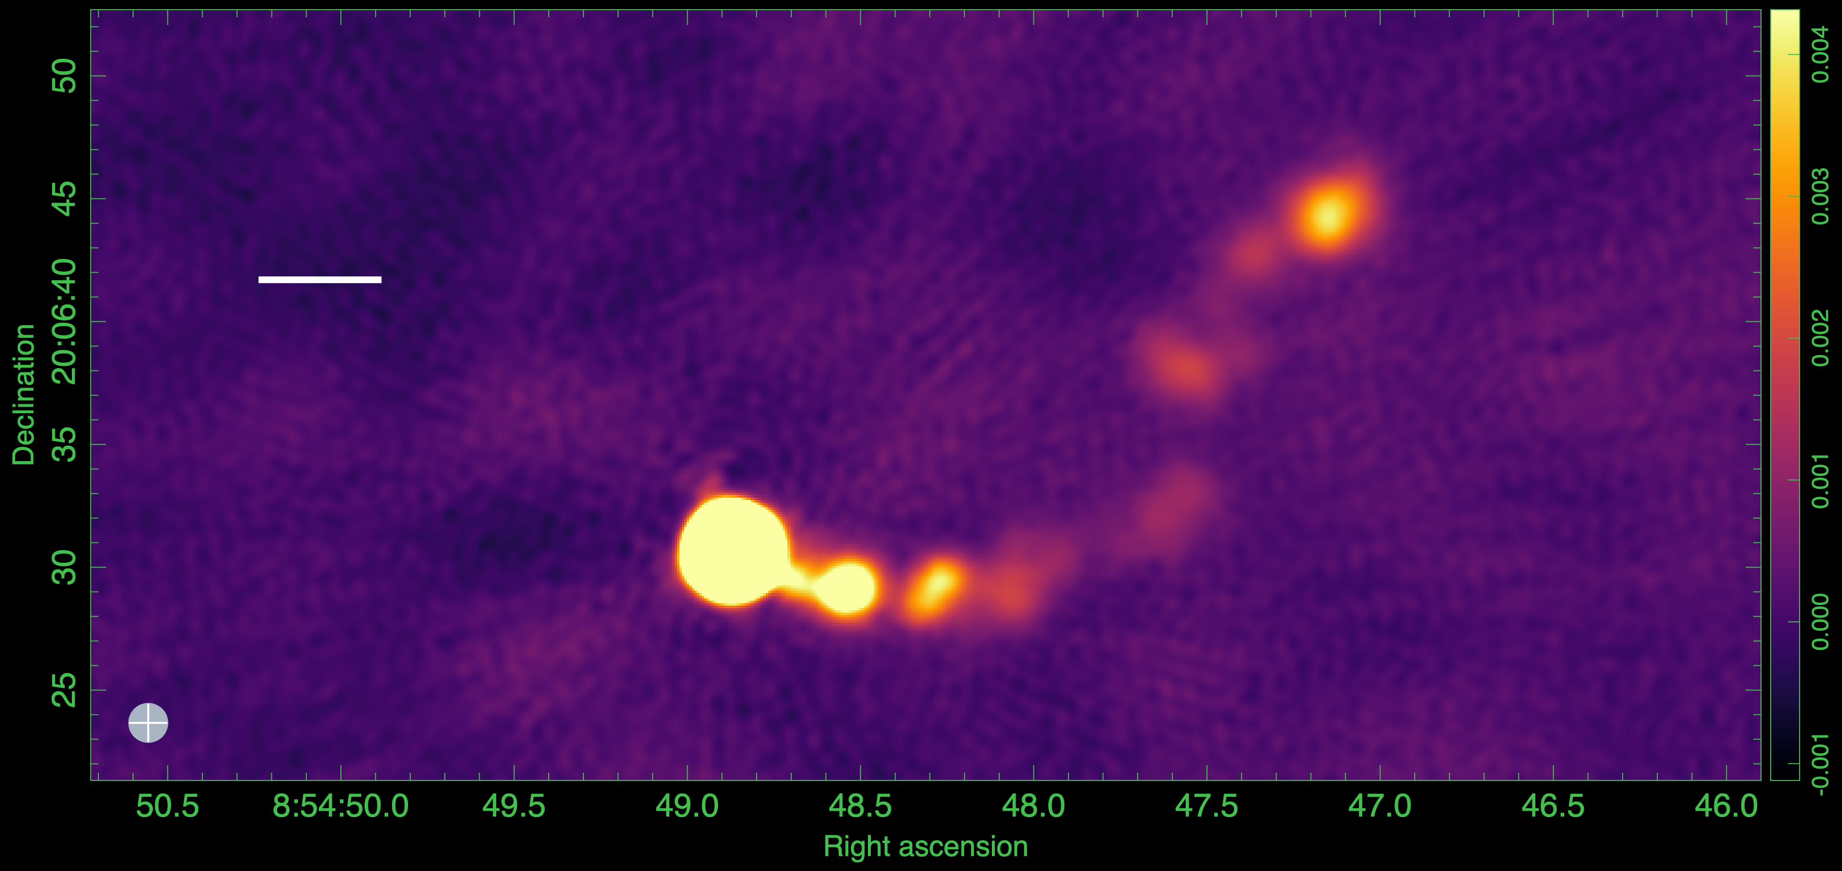
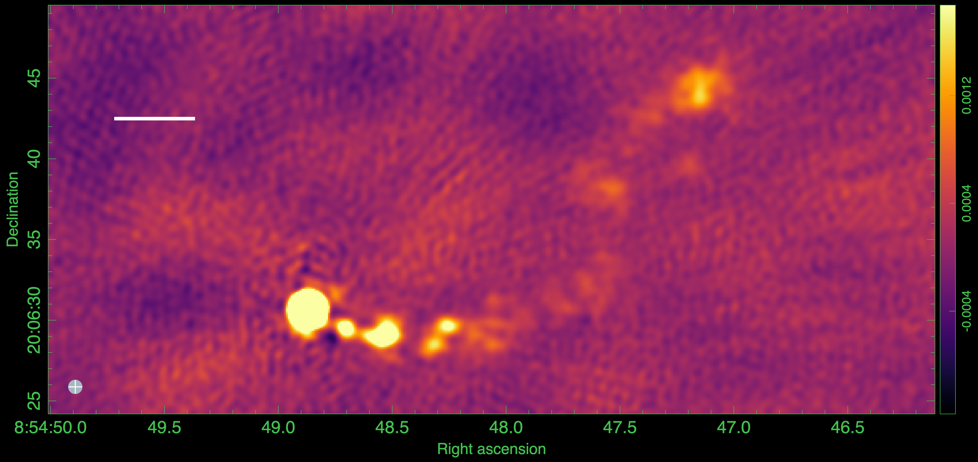
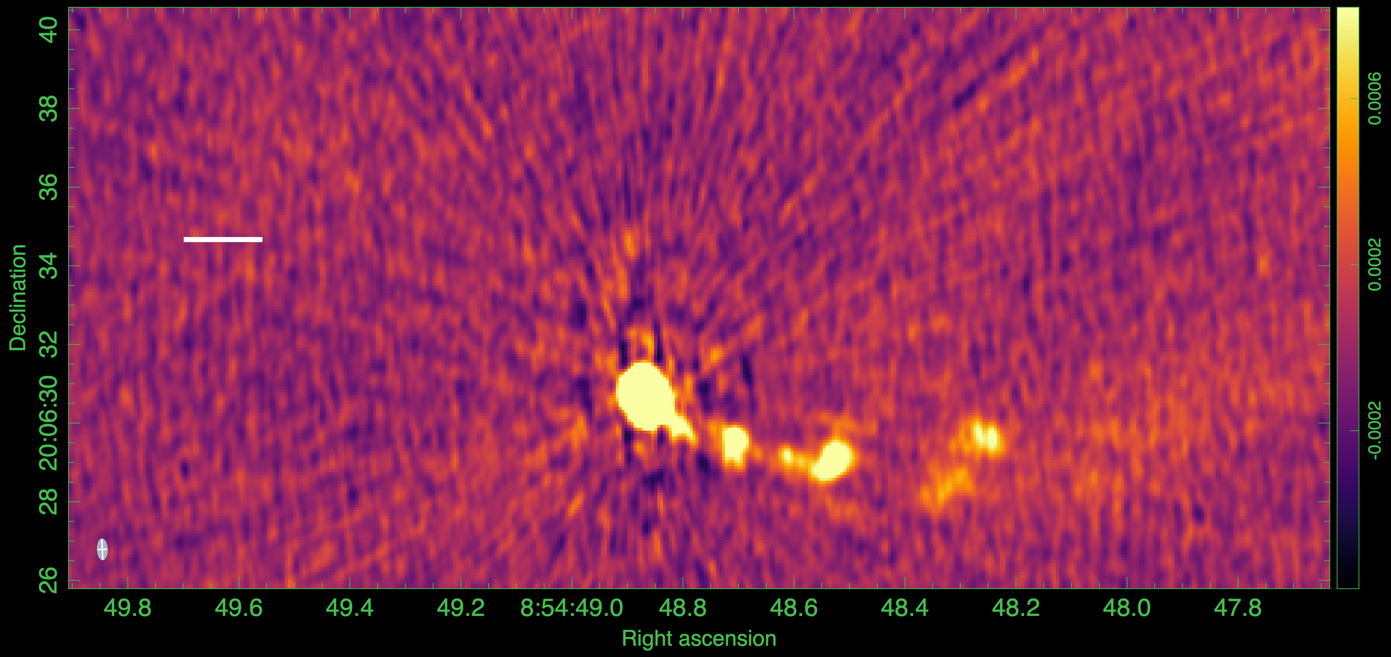
6’’ LOFAR
10”
1.5’’ LOFAR
5”
0.8’’ LOFAR
5”
0.4” LOFAR
Name | Angular Separation from core | Linear Separation (z=0.3) | De-projected Separation
J1 | 3’’ | 14 kpc | 267 kpc
J2 | 5’’ | 23 kpc | 439 kpc
J3 | 8.3’’ | 38 kpc | 726 kpc
J4 | 9’’ | 42 kpc | 802 kpc
J7 | 30’’ | 140 kpc | 1150 kpc!!!
2”
21

Slide 26
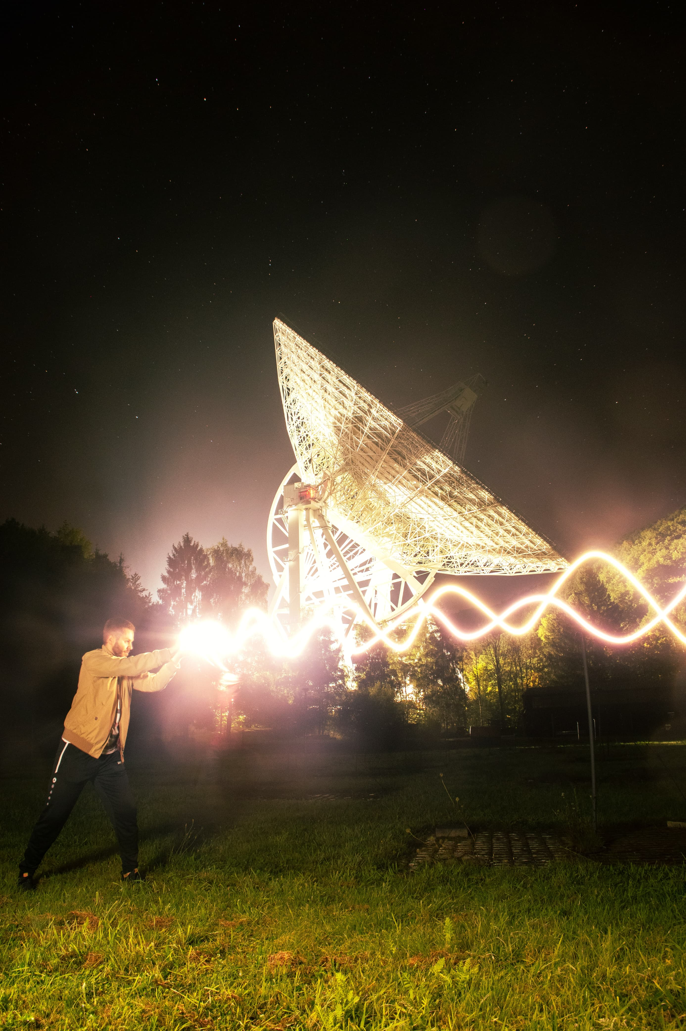
Thank You!
Question?
Comments and suggestions?
hrishikesh.shetgaonkar@uni-wuerzburg.de

Slide 27
Backups

Slide 28
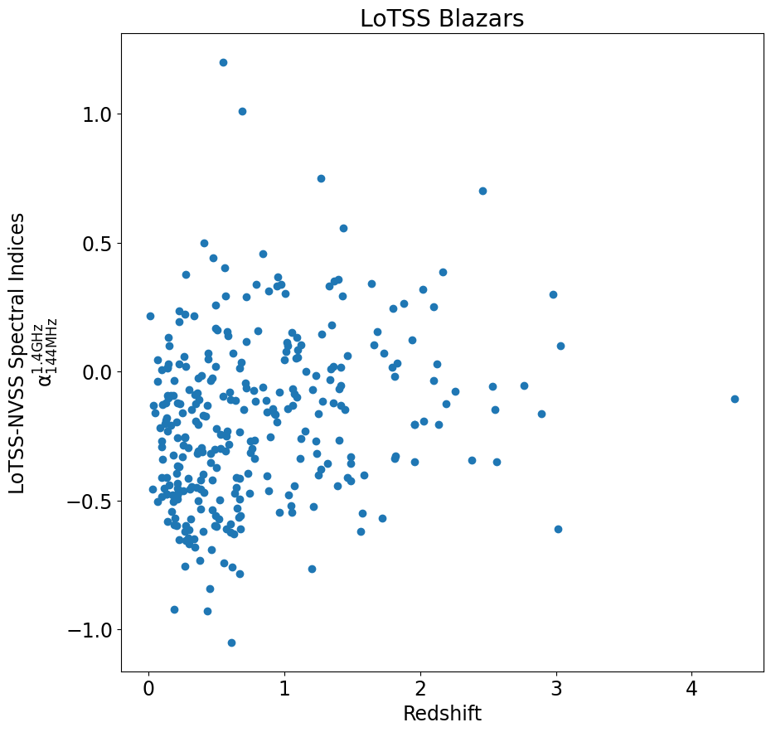
Redshift-SpI
No apparent trend

Slide 29
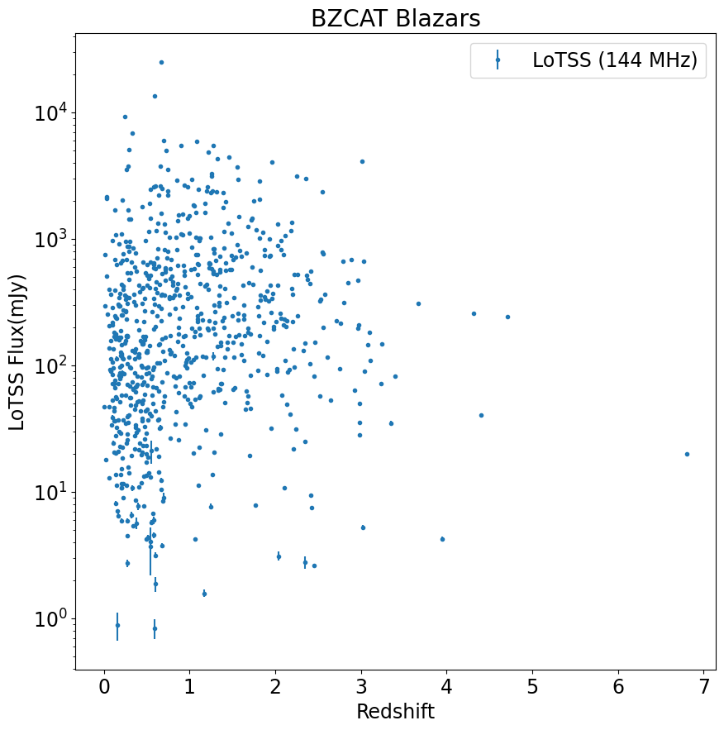
Redshift-LoTSSFlux

Slide 30
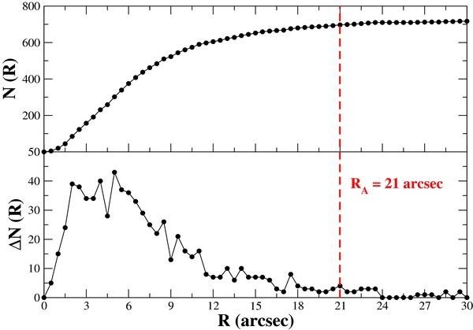
Upper panel: the number of total matches N(R) as a function of the radius R between 0'' and 30''. Lower panel: the difference ΔN(R) between the number of associations at a given radius R and those at R − ΔR as a function of the radius R in the same range as the plot above: Massaro et al. 2013

Slide 31
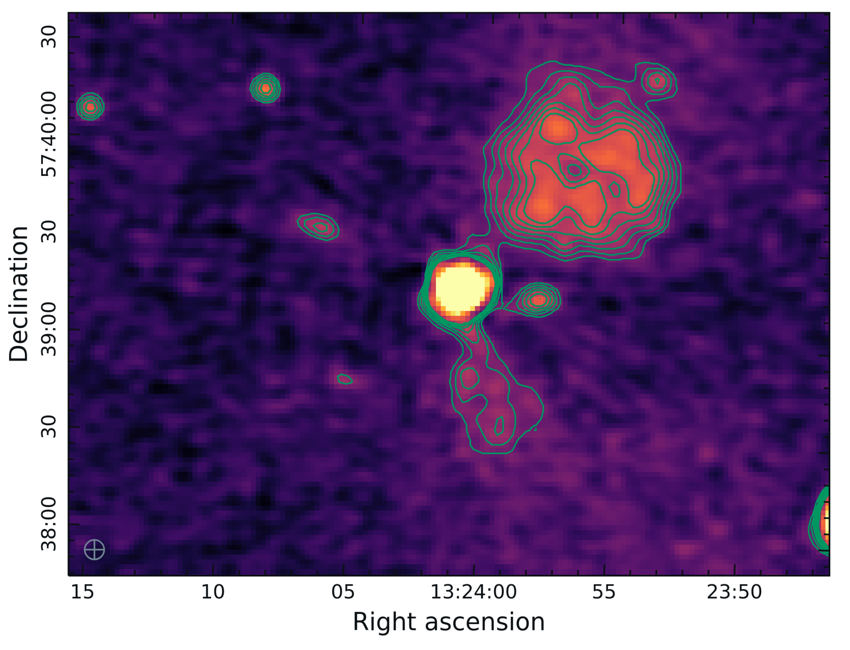
Blazar in Cluster
The Planck SZ2 survey for clusters
Positional matching and redshift matching
One blazar found in the HETDEX region: 5BZG J1324+5739.

Slide 32
Stations:
24 core
14 remote
14 international
+2 in construction
LOFAR : Low Frequency Array
Stations:
24 core (Dutch)
14 remote (Dutch)
14 international +2 in construction
1
Notes:
Marcus already talked about LOFAR, so I’ll skip this

Slide 33
LOFAR Antenna:
HBA
High Band Antenna
144 MHz
LBA
Low Band Antenna
54 MHz
Core and Remote stations
48 HBA and 96 LBA
International stations
96 HBA and LBA
LBA
HBA
2
Notes:
Basically attacking agns from all side; theory, simulation or observations, different scales, different frequencies

Slide 34
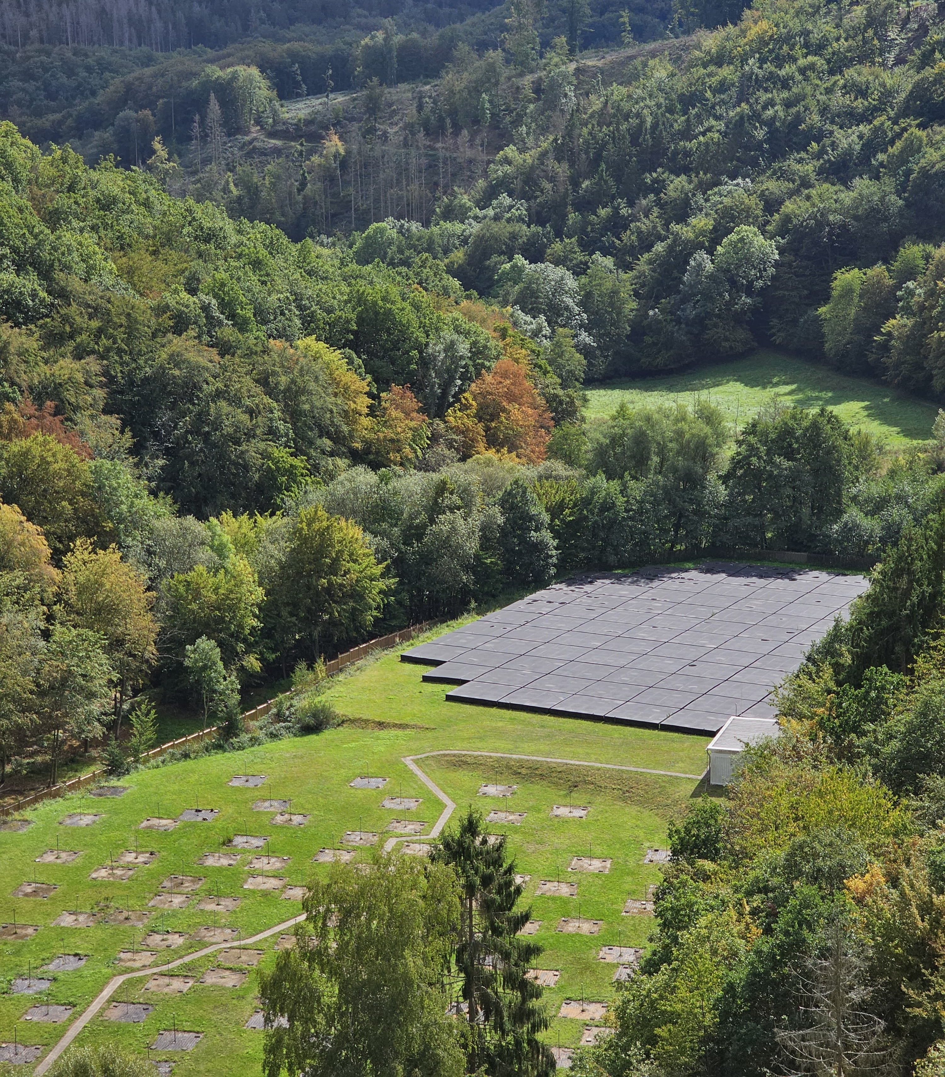
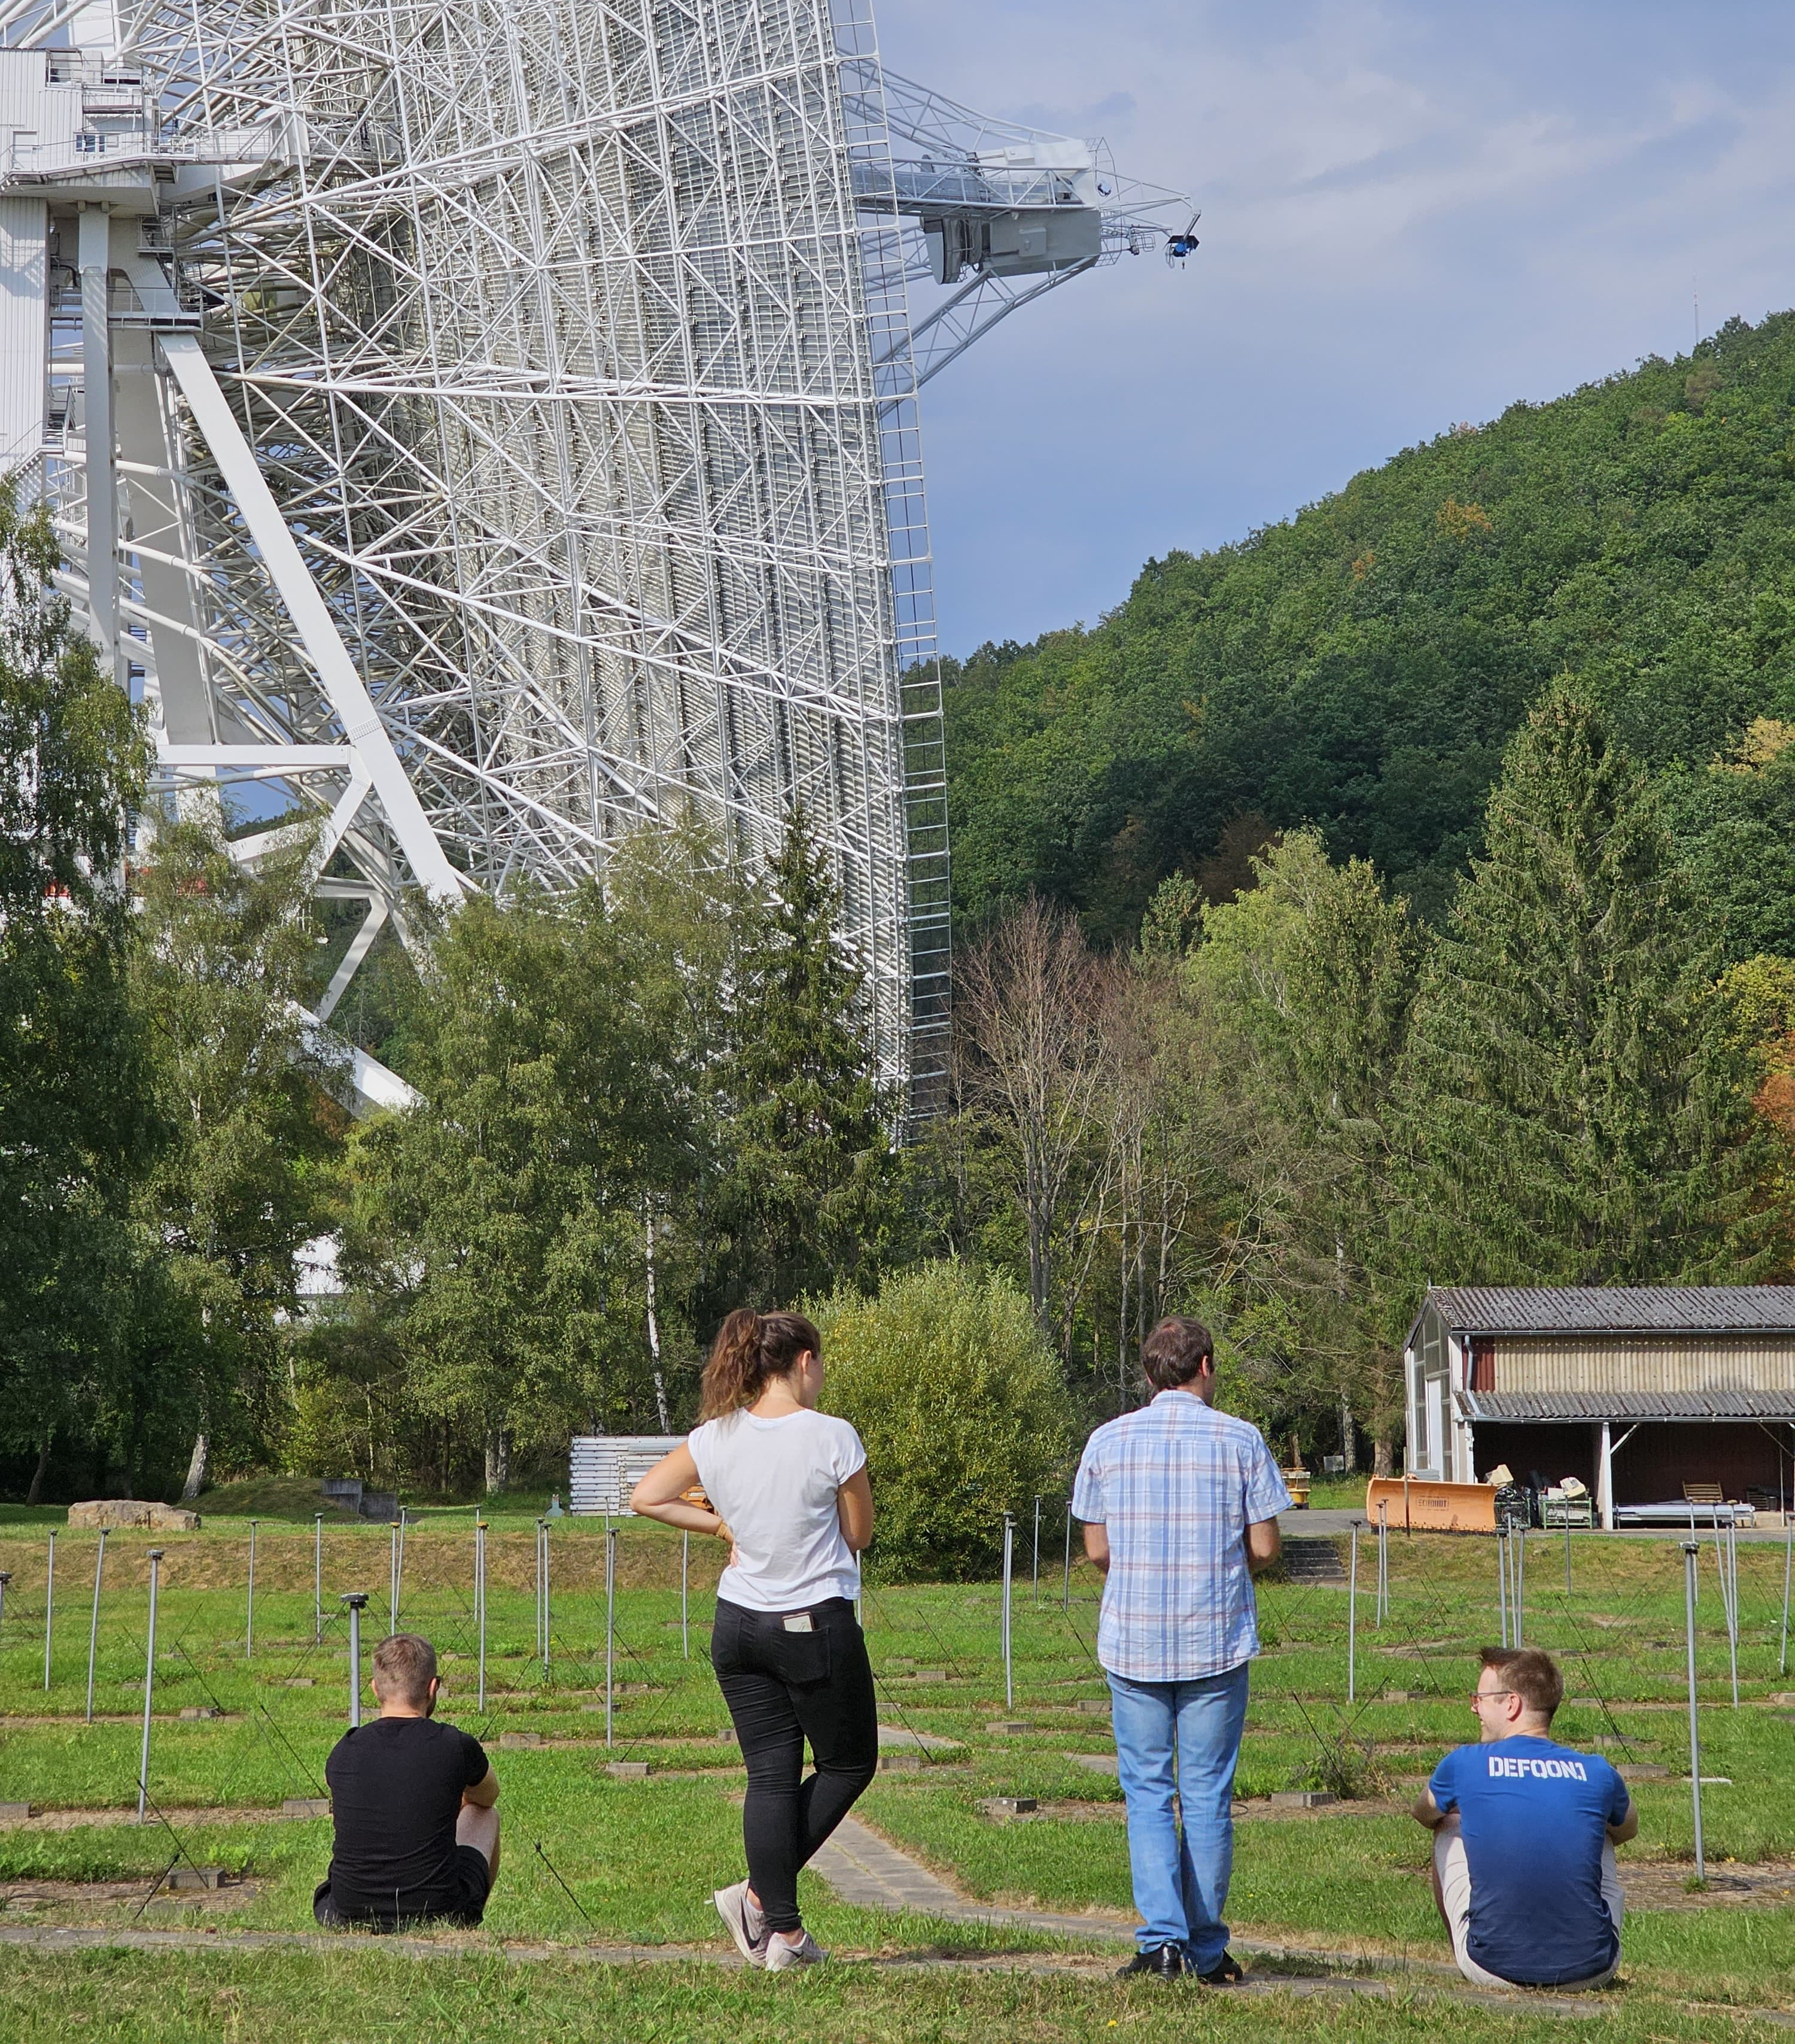
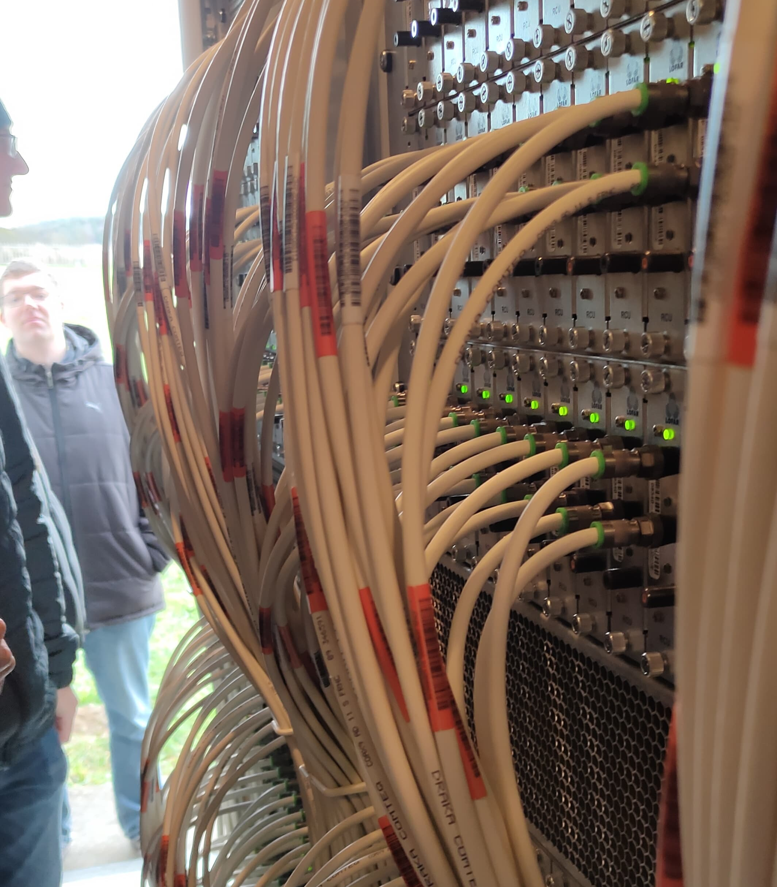
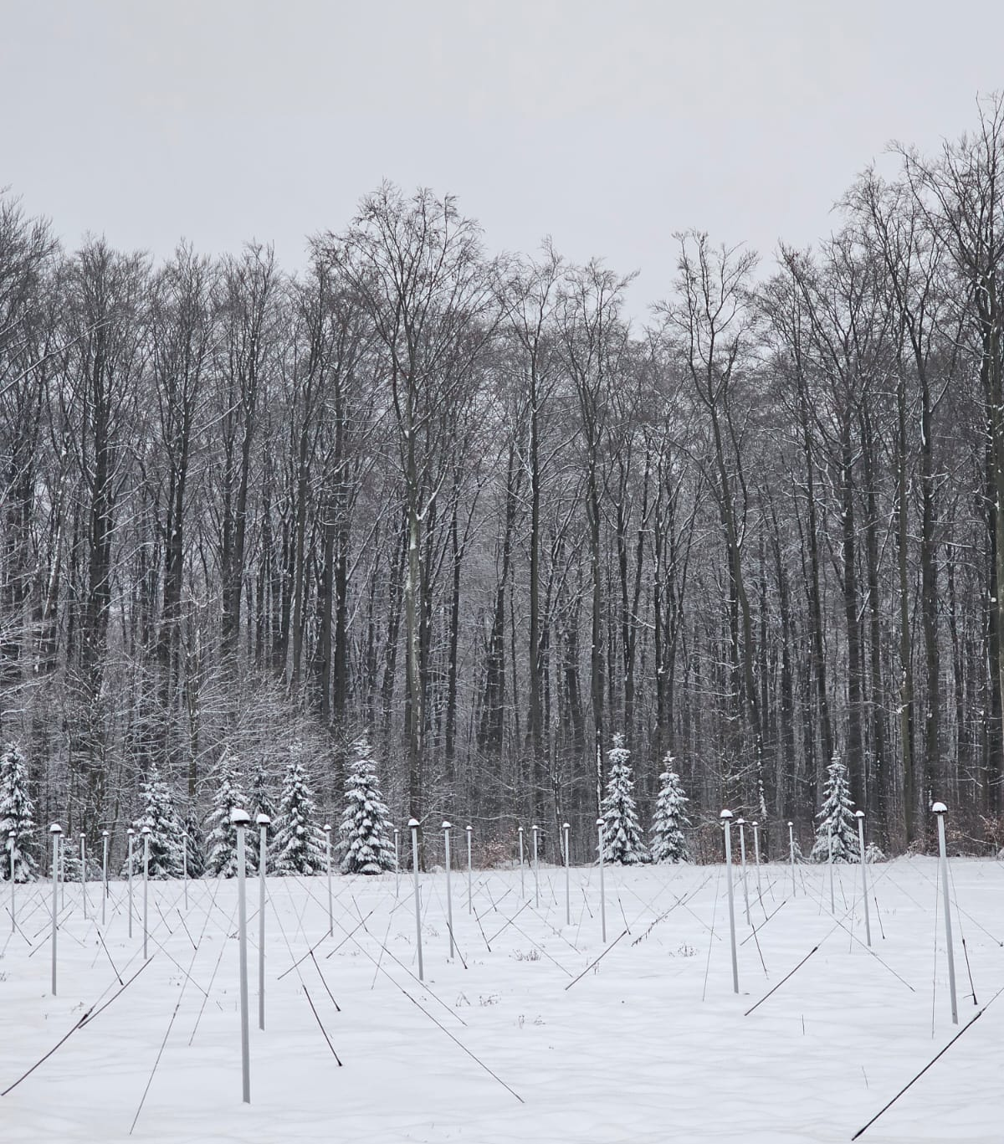
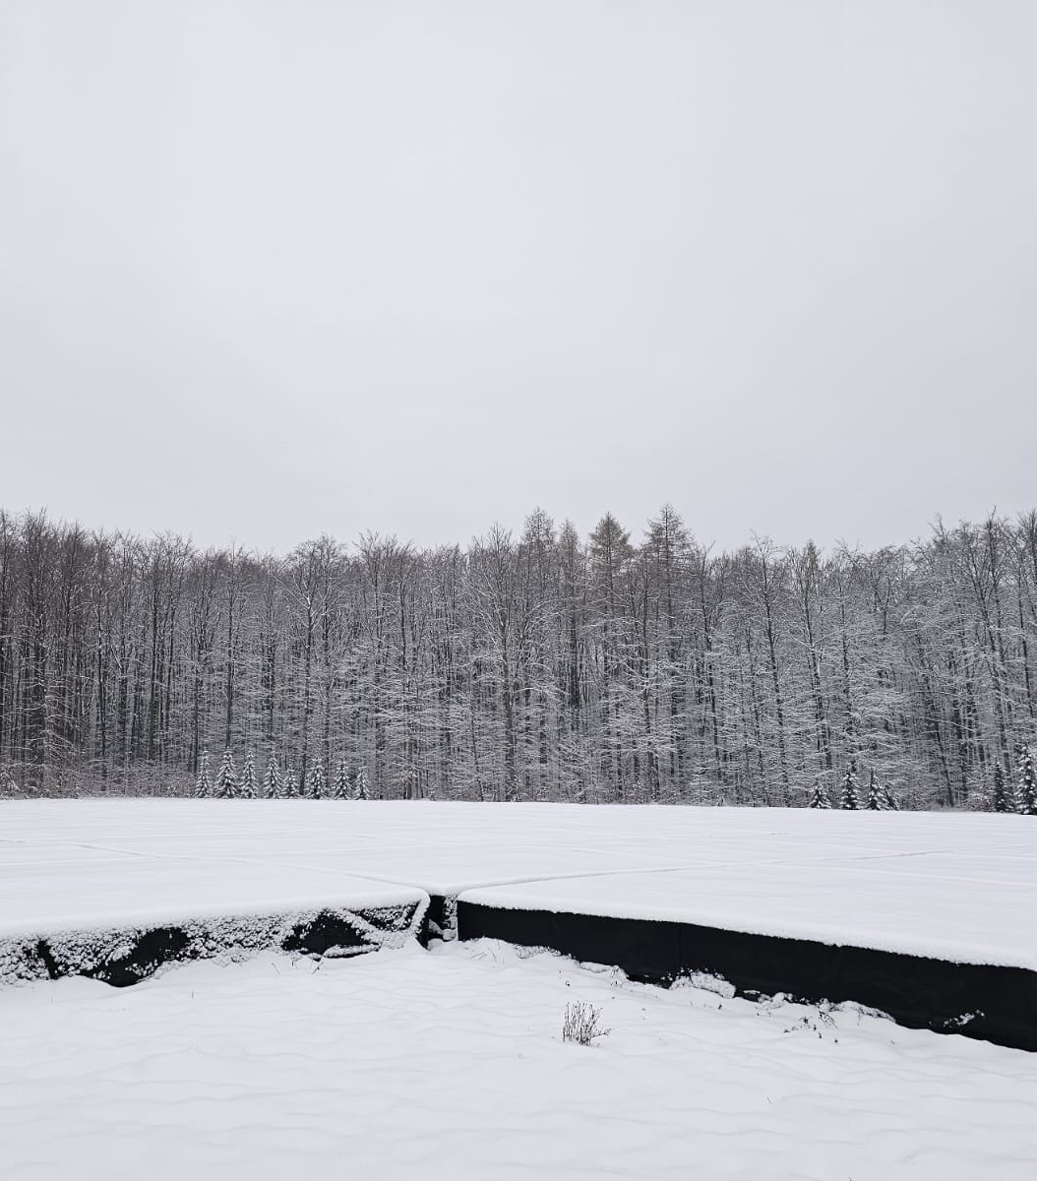
LOFAR in Germany
- DE601: Effelsberg
- DE602: Unterweilenbach
- DE603: Tautenburg
- DE604: Bornim
- DE605: Jülich
- DE609: Norderstedt
3
Notes:
Amazing how a bunch of wires in a field, which can be mistaken for a fence or trampoline are state of the art radio telescopes.
>All weather

Slide 35
AGN?

Slide 36
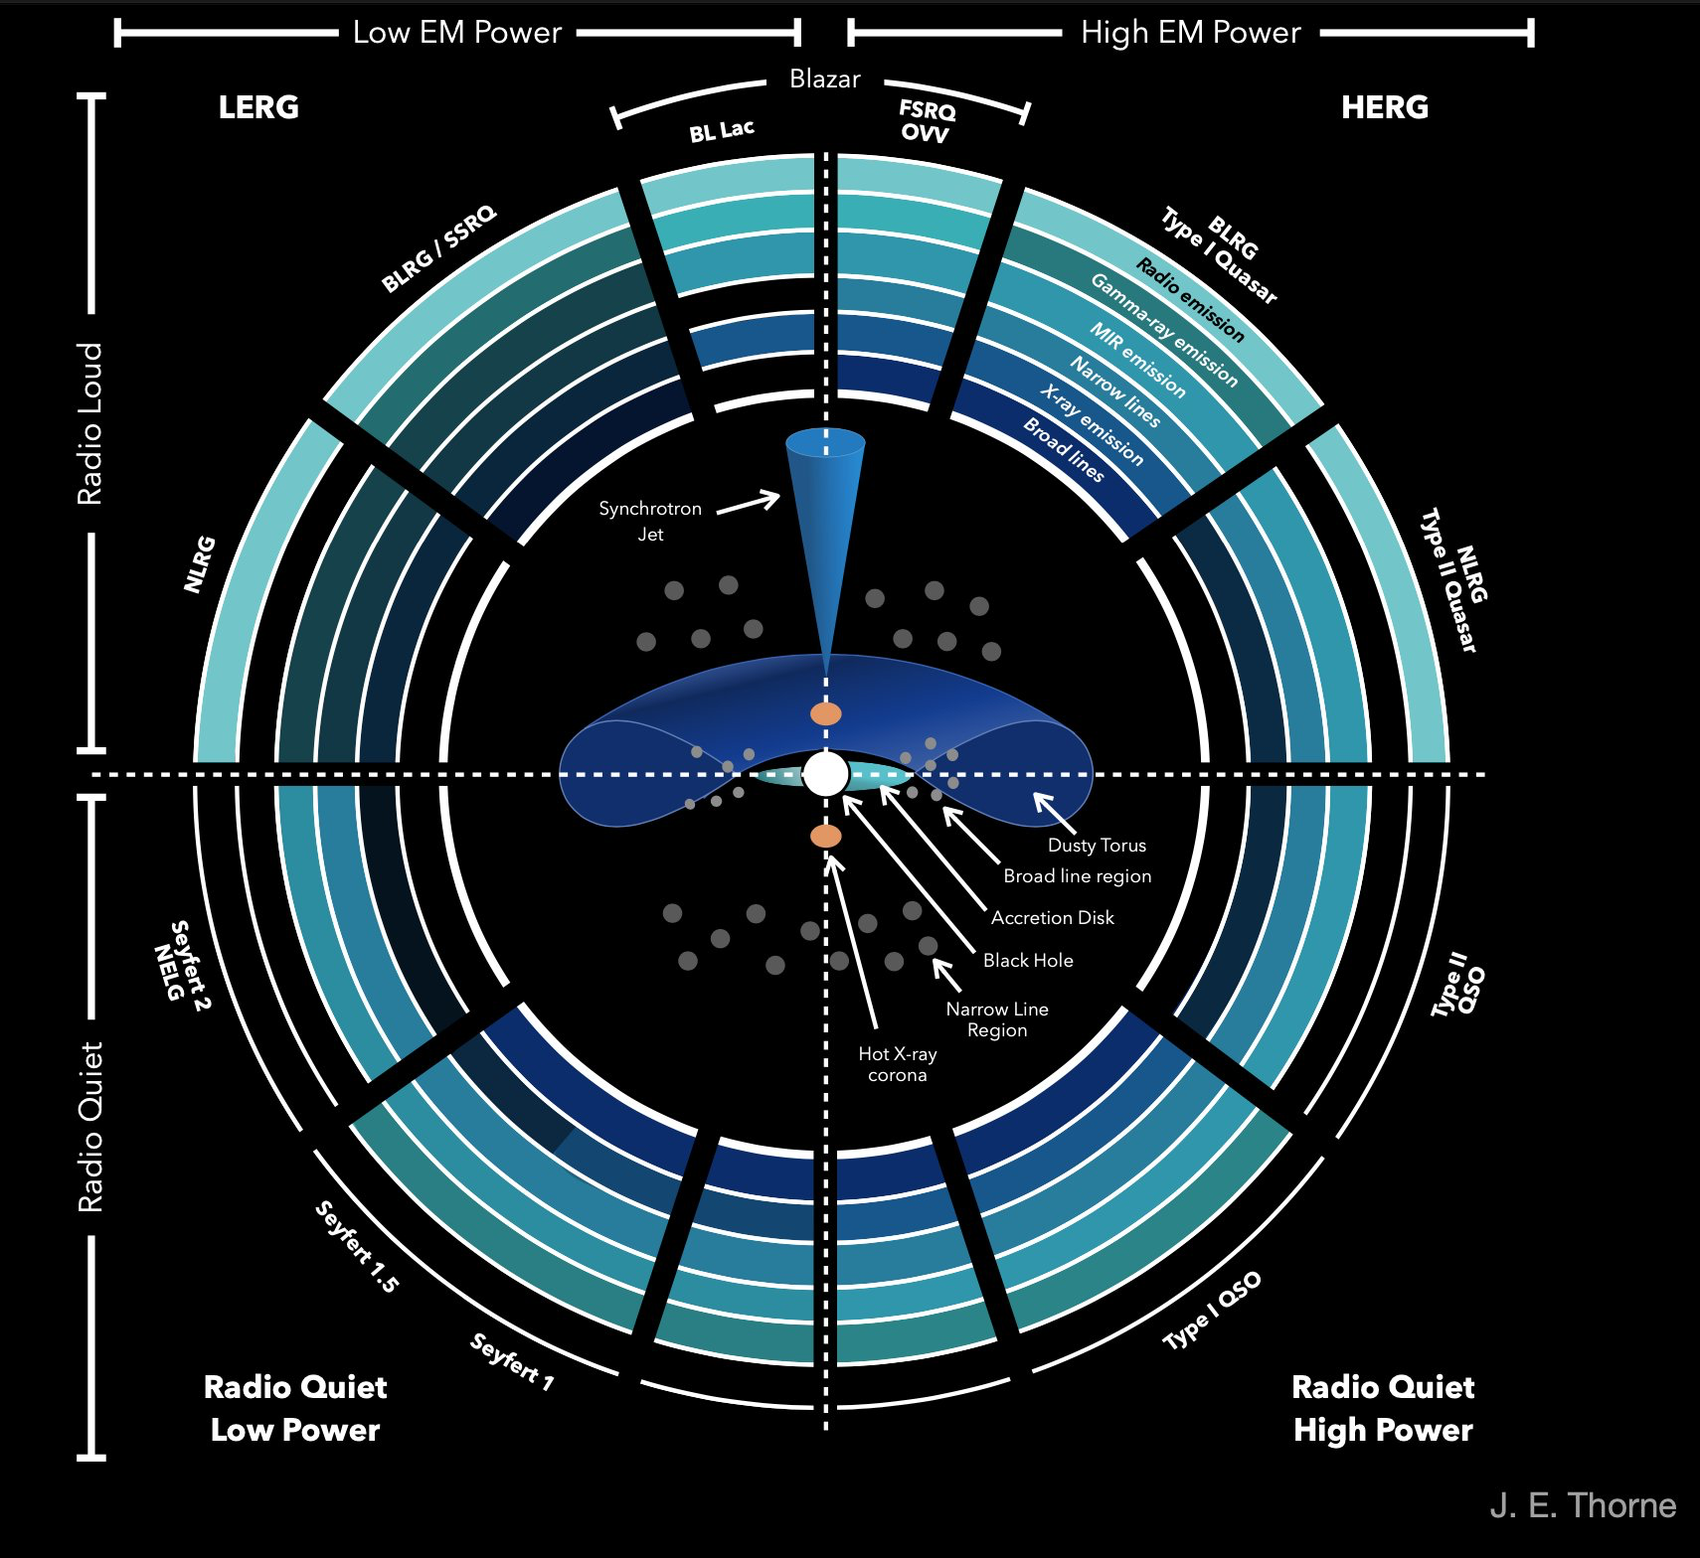
4
Notes:
CygnusA
3C 31
Both are VLA

Slide 37
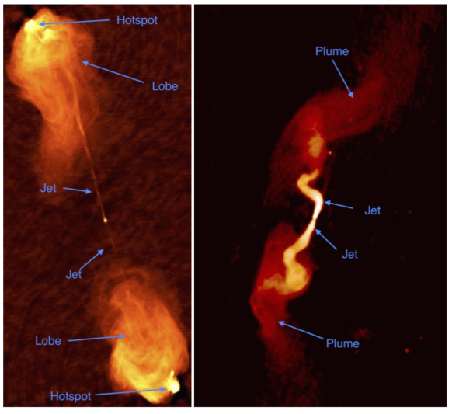
FR 1
FR 2
3C 31
Less collimated, edge-darkened,
no hotspot
Cygnus A
Collimated, edge brightened,
terminal hotspot
4
Notes:
Unification model
CygnusA
3C 31
Both are VLA

