Slide 1
The lightest black hole or the heaviest neutron star?
Arunima Dutta
Max Planck Institute for Radio Astronomy, Germany
PhD supervisors: Michael Kramer, Paulo Freire, David Champion
On behalf of the MeerTIME/TRAPUM GC Collaboration
Radio 2024 Conference, 14th November 2024
Email: adutta@mpifr-bonn.mpg.de

Slide 2
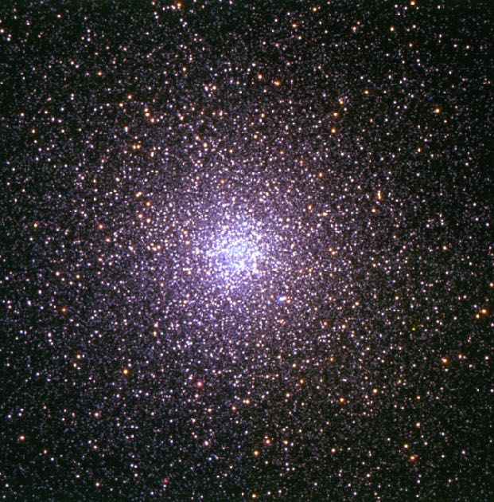
Globular Clusters
Spherical, gravitationally-bound old stellar systems
Large stellar densities, high gravitational interaction rates
Neutron stars acquire companions, recycled to MSPs
Terzan 5
Pulsars per unit stellar mass$∼1000$ times larger than
the Galactic disk
47 Tuc
Arunima Dutta, MPIfR

