Slide 1
Miniaturized Chip-based Receiver Components for the ngVLA and Beyond
Tobias T. Braun, Marcel van Delden, Nils Pohl

Slide 2
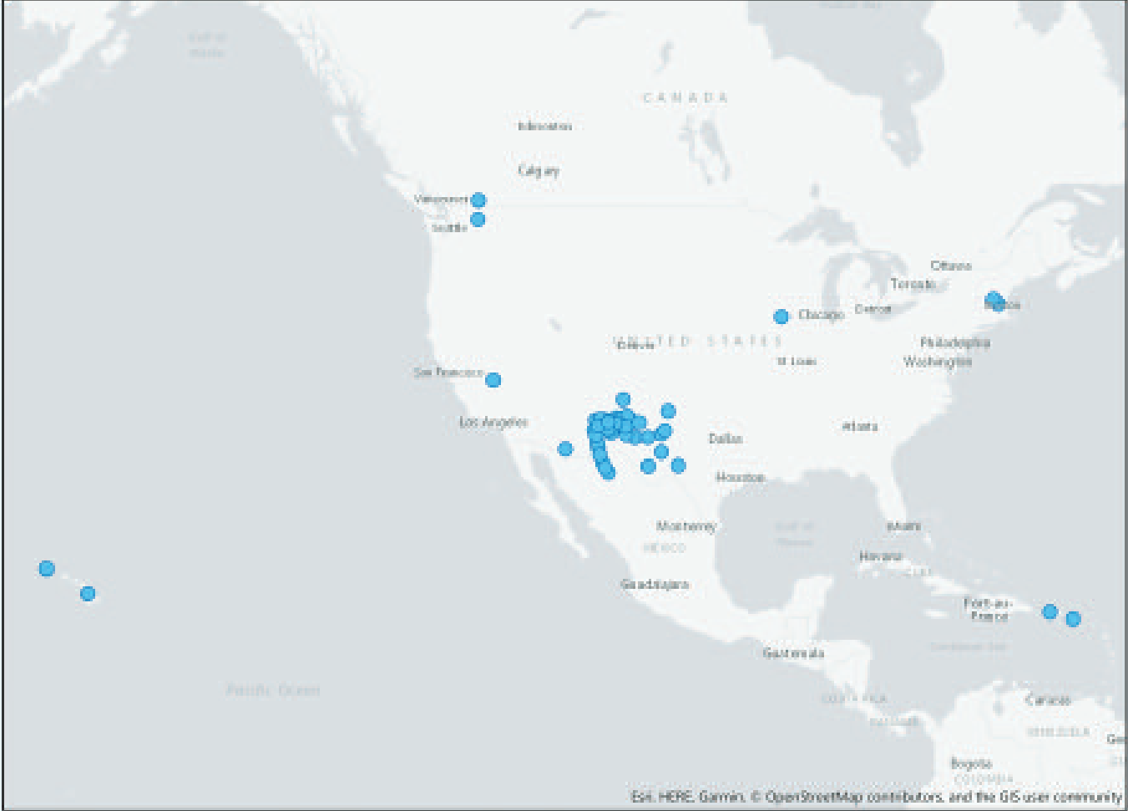
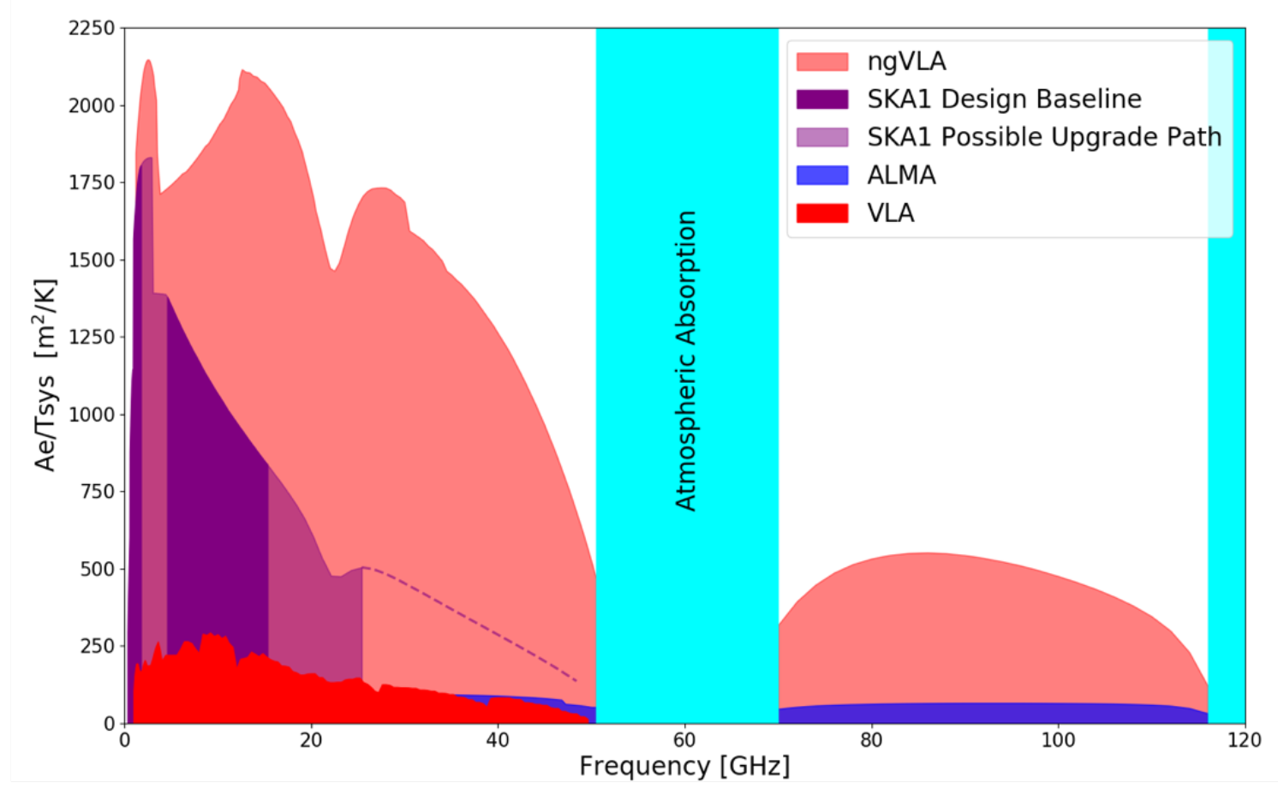
The goal of ngVLA
244 Antennas
18 m diameter
8860 km baselines
Frequencies from 1.2−116 GHz
10x the sensitivity
[1] Next Generation Very Large Array: Technical Overview

Slide 3
The goal of ngVLA
The 1.2−116 GHz frequency range is separated into 6 bands
Bands 1−5 continuously cover 1.2−50.5 GHz
Separate band 6 from 70−116 GHz after interval of athmospheric absorption
Specific frequencies needed to down-convert the signals from the sky
[2] R. Selina, et al., “System Concept Design Description“, NRAO Doc. #: 020.10.20.00.00-0005-REP

Slide 4
Our goal
Generating those frequencies for band 6 of ngVLA
while fulfilling the phase noise requirements
[2] R. Selina, et al., “System Concept Design Description“, NRAO Doc. #: 020.10.20.00.00-0005-REP

Slide 5
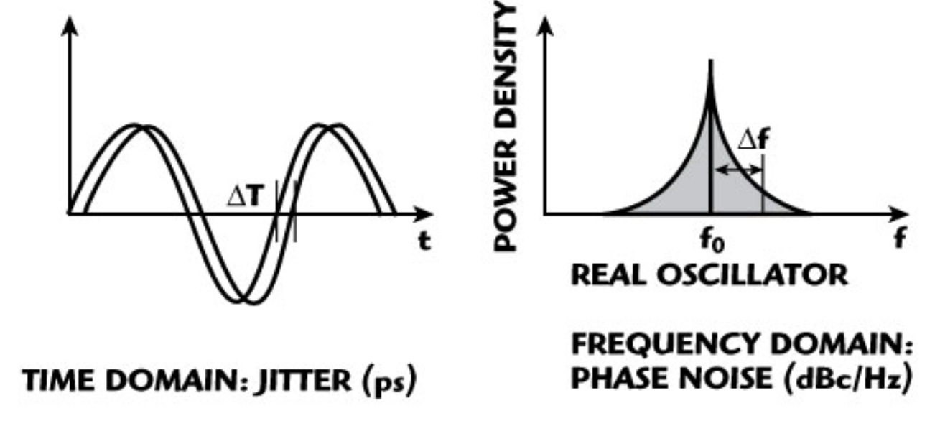
What is phase noise?
Smearing of the edges
Skirts around desired frequency
[3] https://synergymwave.com/articles/2007/09/

Slide 6
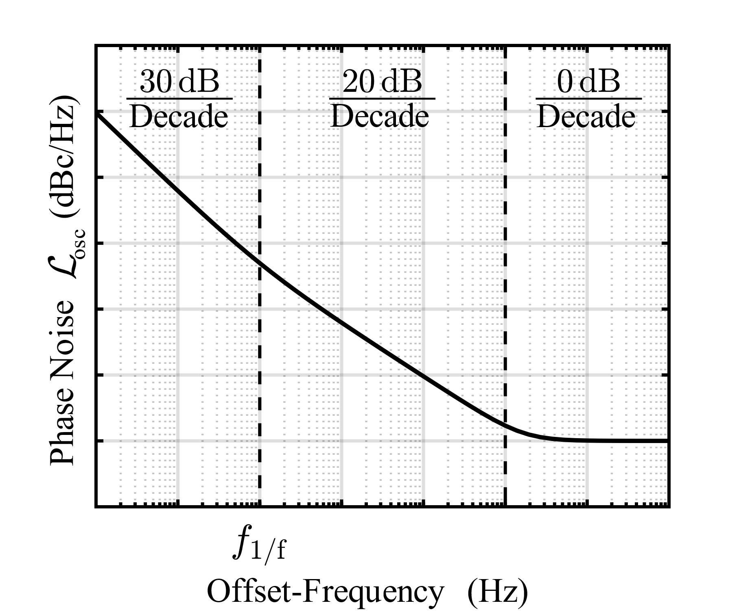
What is phase noise?
Phase noise in dependency of offset frequency
Measurable with spectrum analyzer
Decreases with known slopes
Measurement at one specific offset frequency sufficient
Best oscillator type for radio astronomy’s requirements?

Slide 7
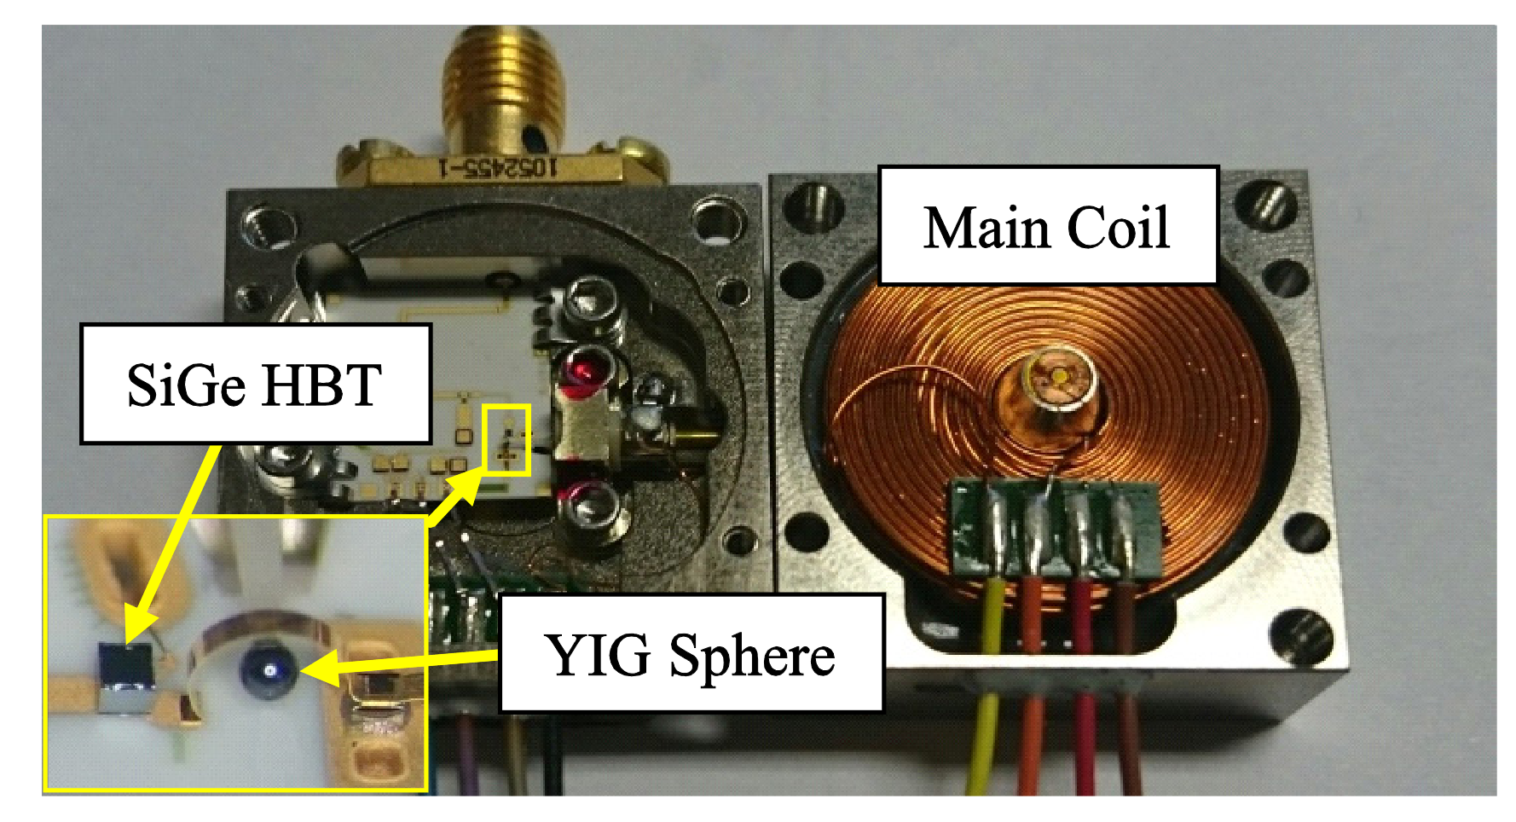
State of the art
Advantages YTO:
Low phase noise
High tuning range
Disadvantages YTO:
Bulky
Sensitive
Expensive
Max. frequency limited
Band 6 frequencies not possible
[4] W. Stein, F. Huber, S. Bildik, M. Aigle and M. Vossiek, "An improved ultra-low-phase noise tunable YIG oscillator operating in the 6–12 GHz range," 2017 EuMC

Slide 8
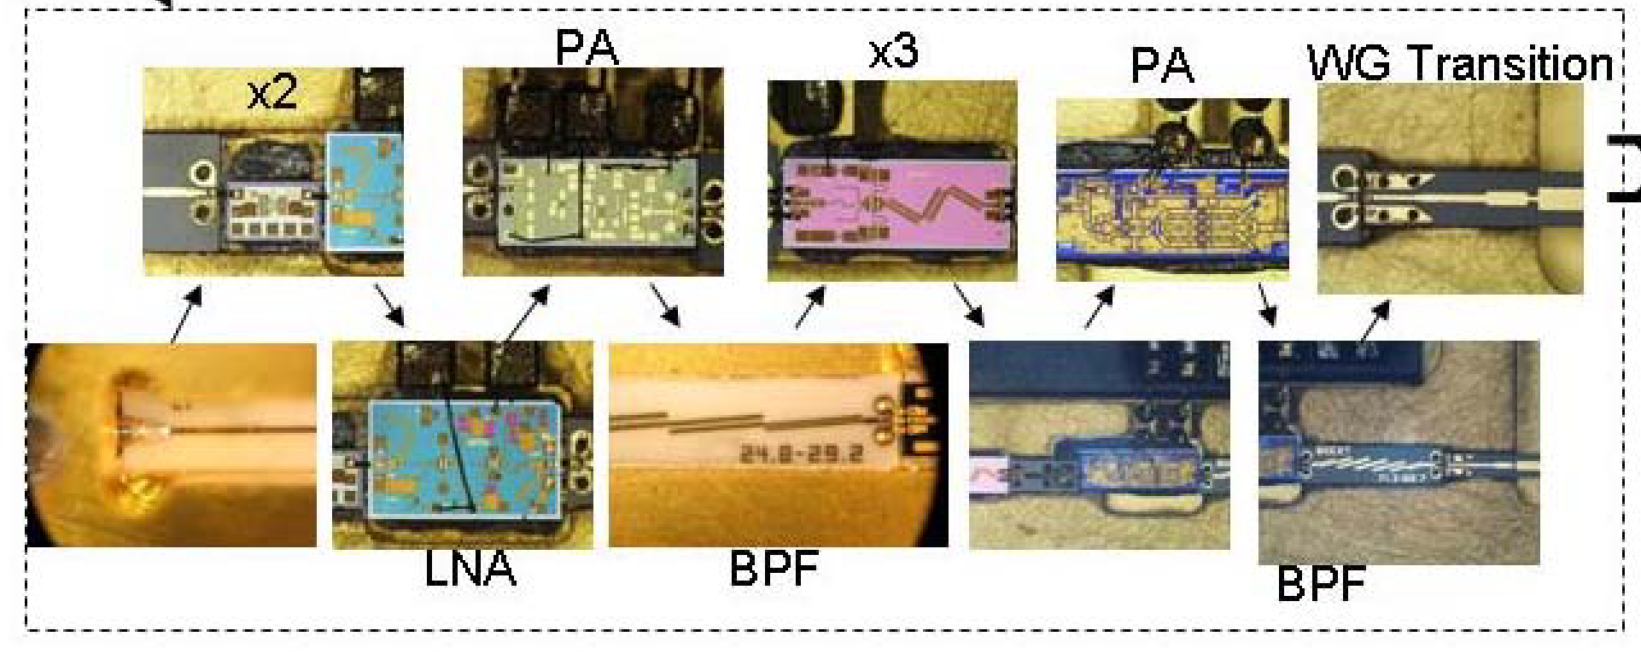
State of the art
YTO
[5] E. Bryerton, M. Morgan, D. Thacker, K. Saini, “Maximizing SNR in LO chains for ALMA single-ended mixers”

Slide 9
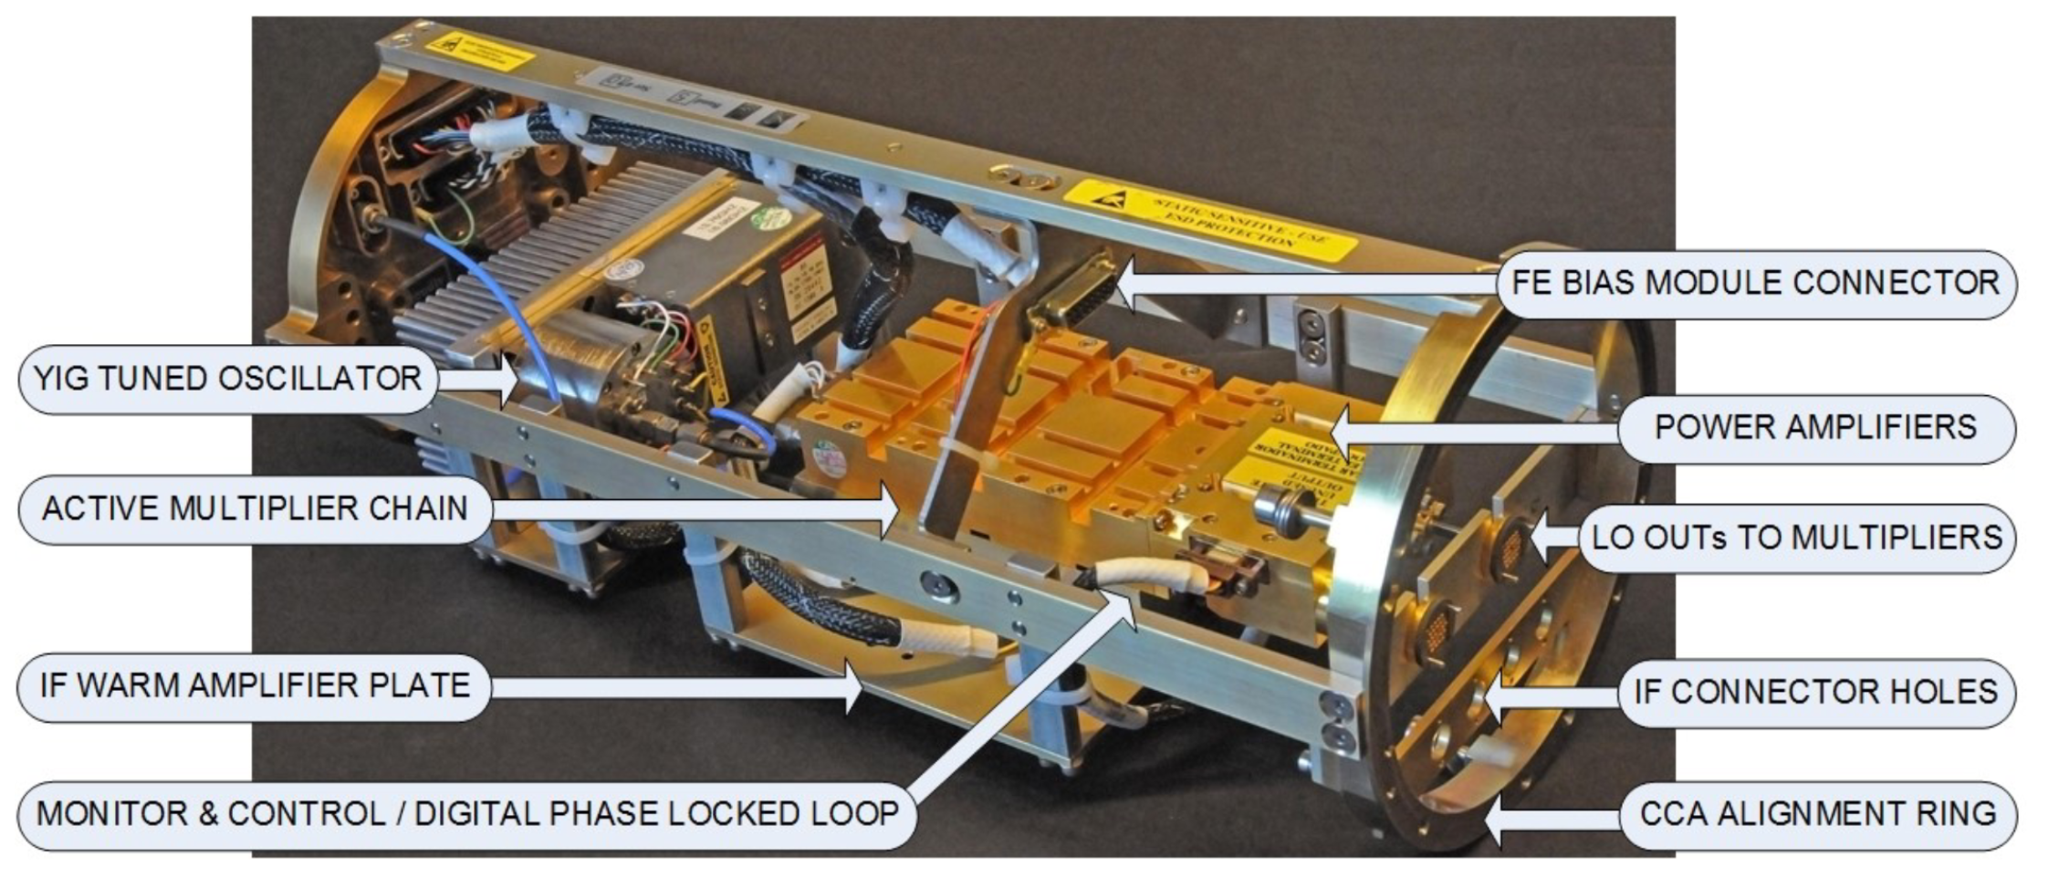
State of the art
[6] V. Belitsky, et al., “ALMA Band 5 receiver cartridge - Design, performance, and commissioning”, Astronomy & Astrophysics, Volume 611, Mar. 2018

Slide 10
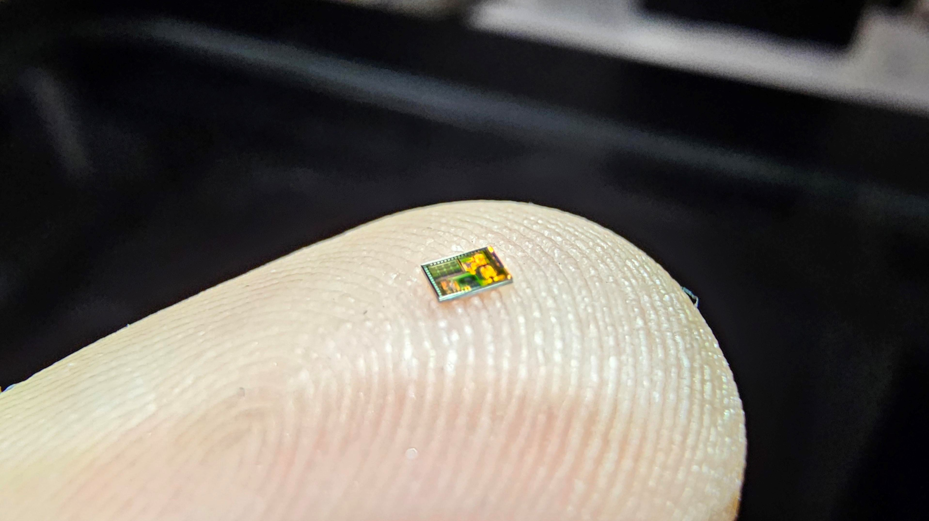
Our approach

Slide 11
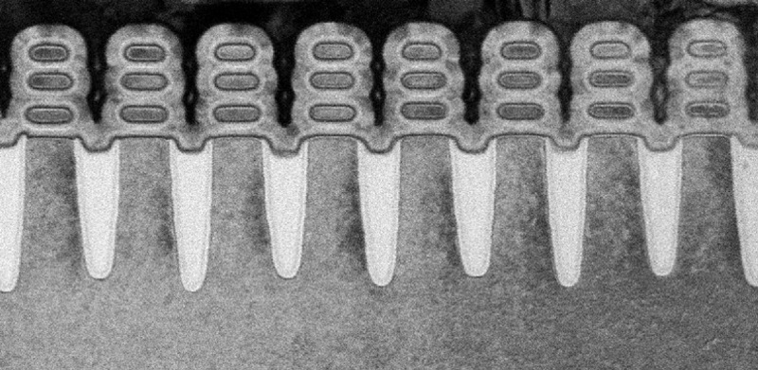
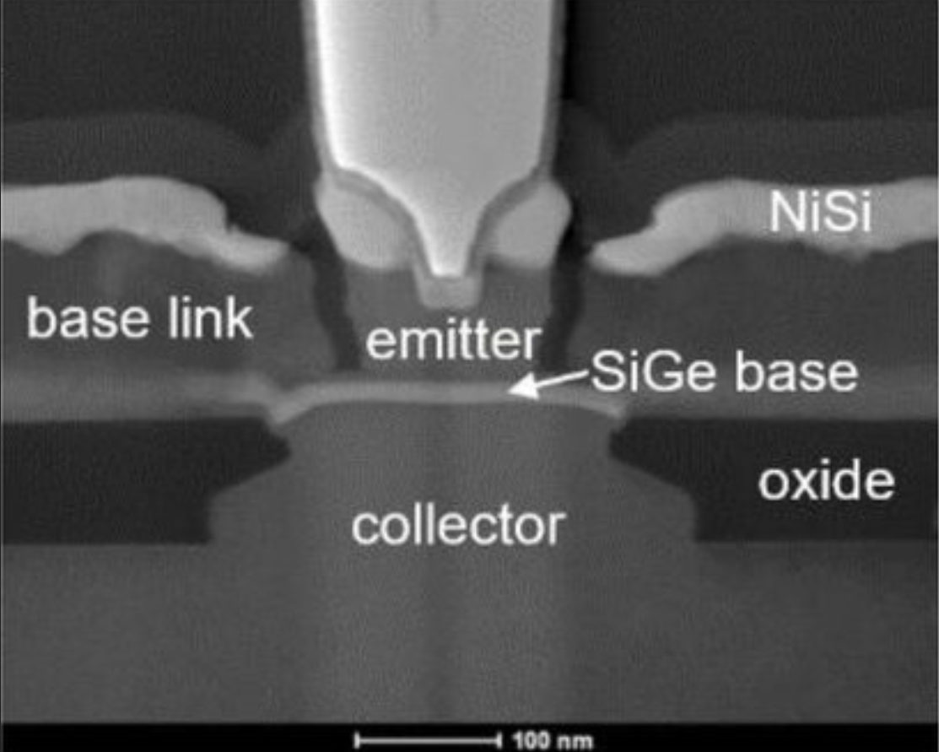
Our approach
5 nm transistor known from CPUs and other digital circuits
130 nm bipolar transistor for radio frequency applications
Integration Density
Speed
[7] https://www.top500.org/news/new-five-nanometer-transistor-unveiled-by-ibm-and-cohorts/
[8] T. Zimmer et al., "SiGe HBTs and BiCMOS Technology for Present and Future Millimeter-Wave Systems," in IEEE Journal of Microwaves, vol. 1, no. 1, Jan. 2021

Slide 12
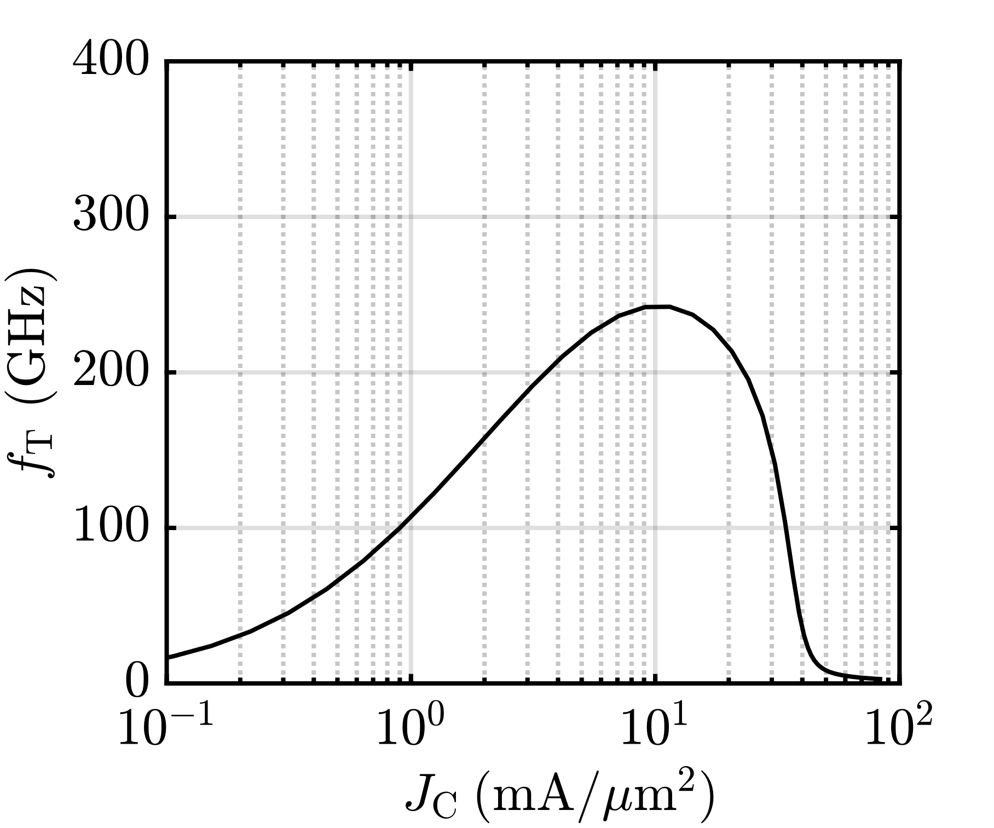
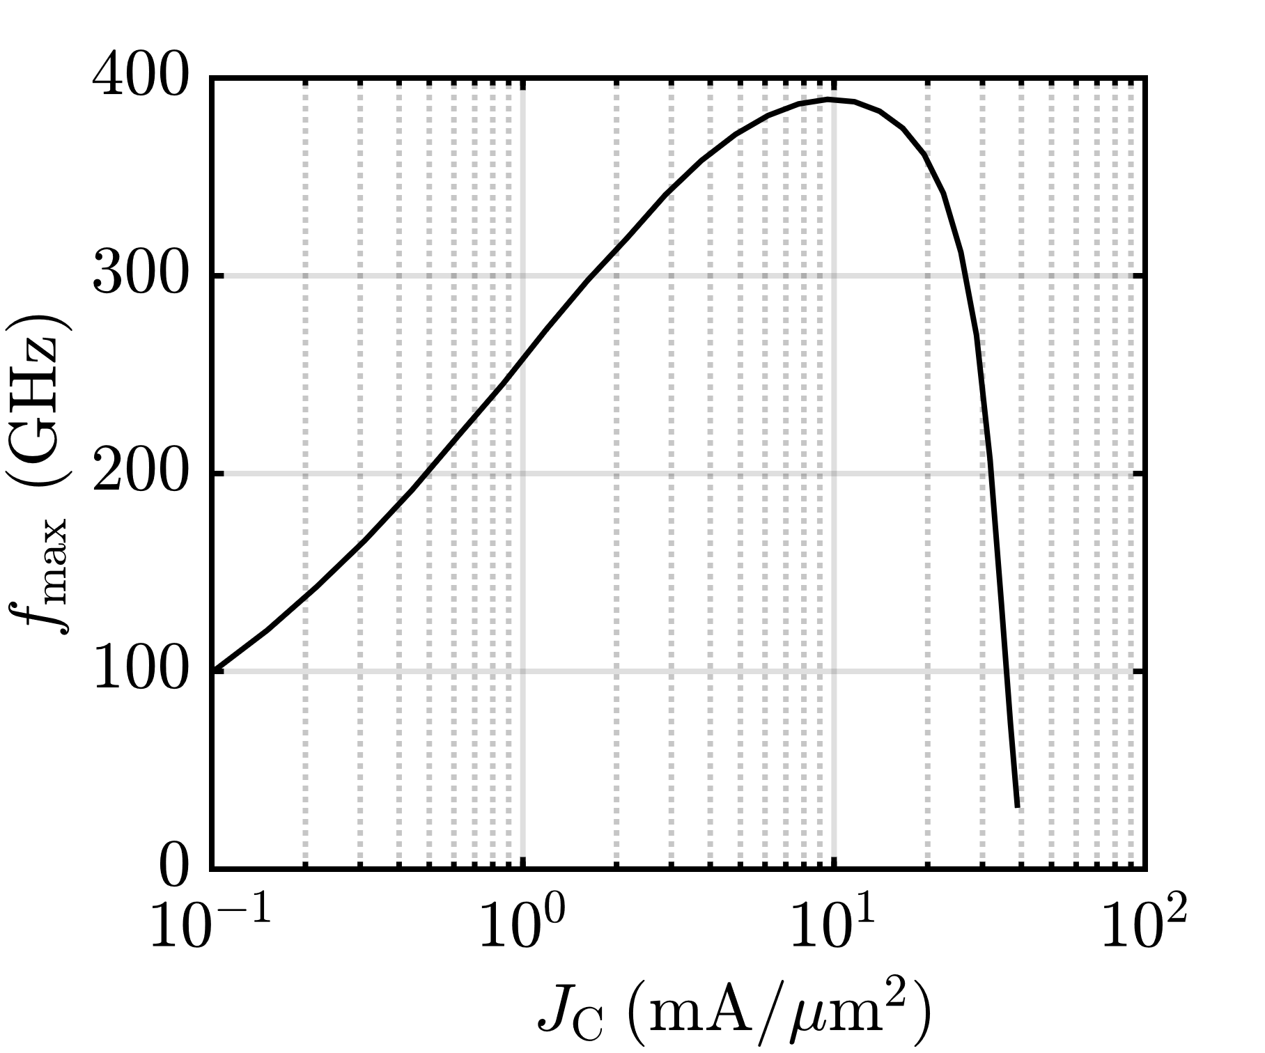
Our approach
$f_{T} →$ Current amplification = 1
$f_{max} →$ Power amplification = 1
SiGe-Technologies up to $f_{T}$ and $f_{max}$ of 470 GHz and 650 GHz available

Slide 13
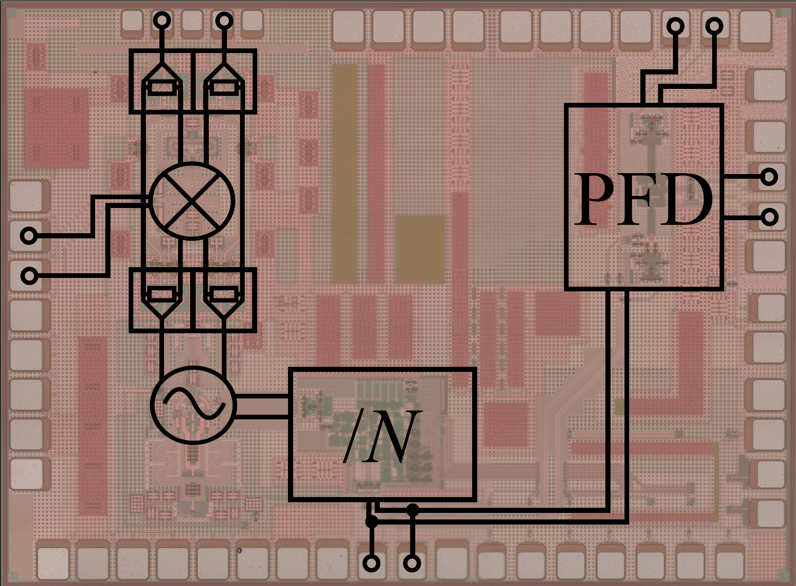
Our approach
Advantages:
All RF components on a chip with a size of 2 x 1.5 mm²
Includes the Voltage Controlled Oscillator (VCO), /N-divider, and Phase-Frequency-Detector (PFD)
Frequency tuning range of 60−90 GHz
Disadvantages:
VCO higher phase noise than YTO

Slide 14
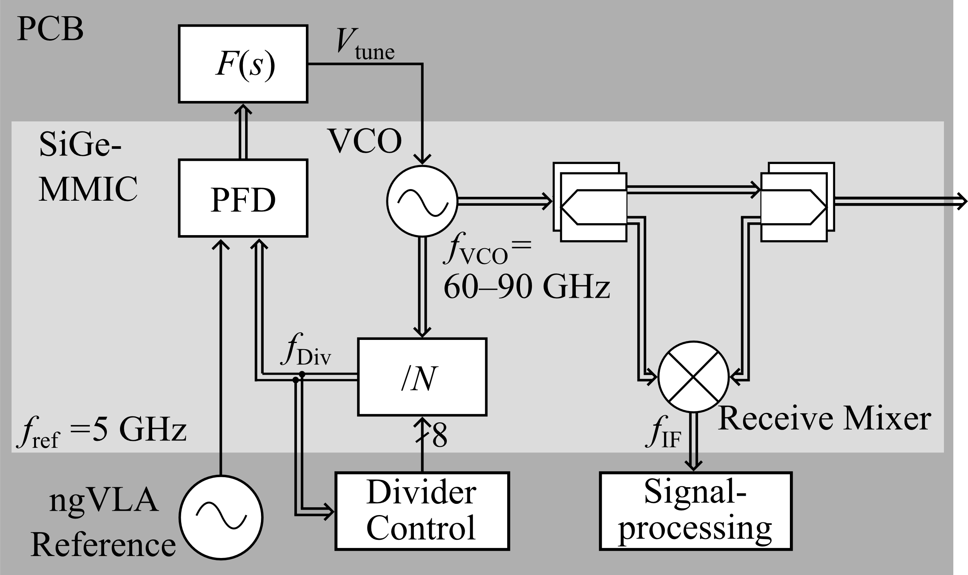
Our approach

Slide 15
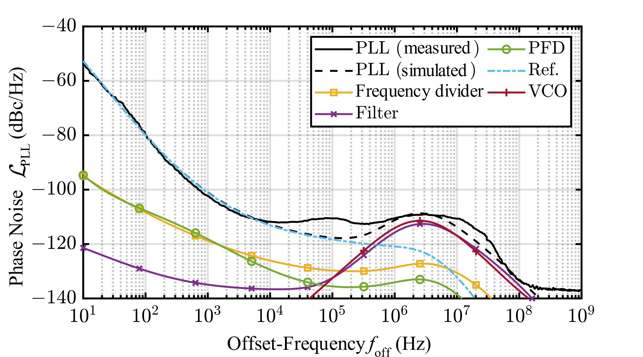
Our approach
Very low phase noise inside the loop bandwidth
Low enough to compensate disadvantages of VCO
Largely dominated by reference oscillator
High quality ngVLA reference signal not available
[9] T. T. Braun et al., “A phase-locked loop with a jitter of 50 fs for astronomy applications,” International Journal of Microwave and Wireless Technologies, 2023.

Slide 16
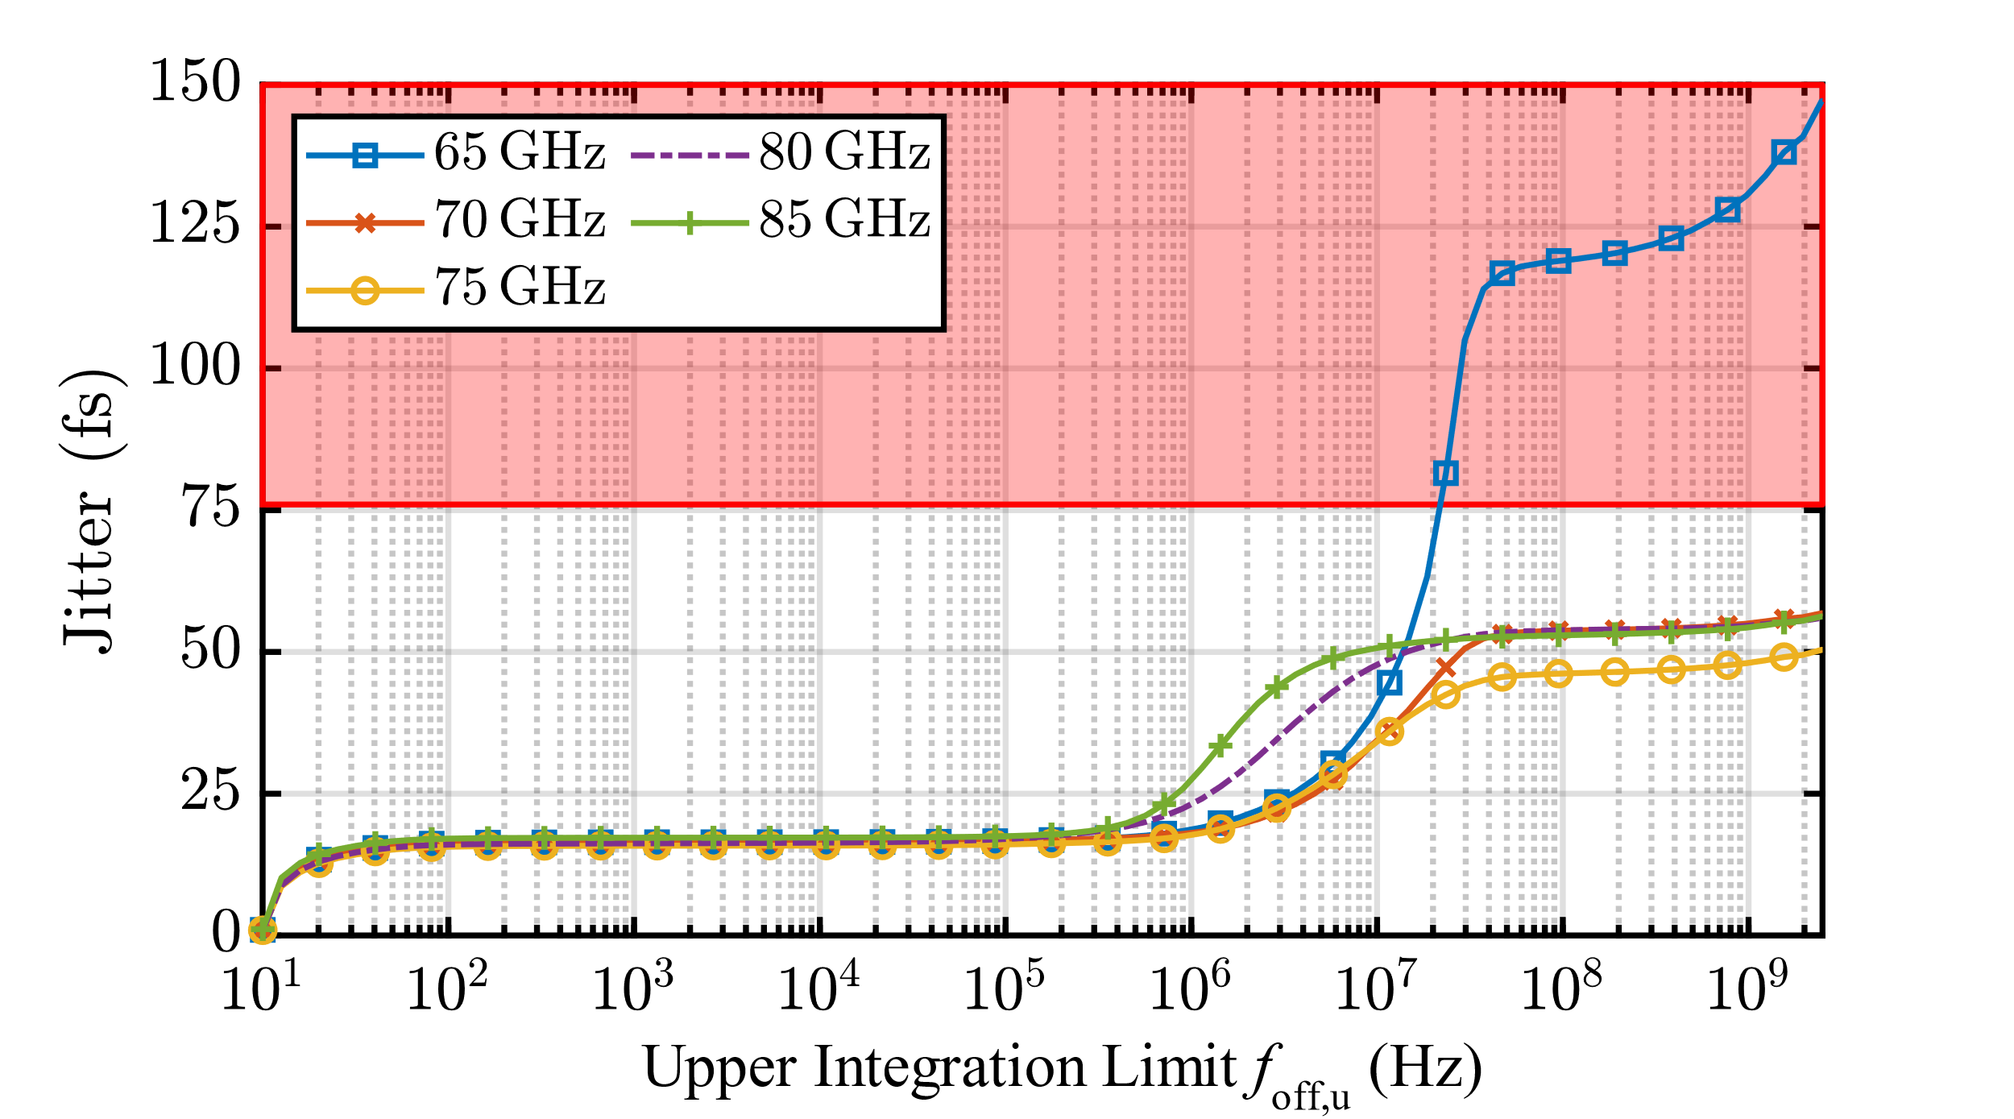
Our approach
Jitter as compact specification
Integrated phase noise normalized to output frequency
ngVLA designed with LO phase noise limit of 76 fs
Successfully achieved for the upper 2/3rds of the oscillator
[9] T. T. Braun et al., “A phase-locked loop with a jitter of 50 fs for astronomy applications,” International Journal of Microwave and Wireless Technologies, 2023.

Slide 17
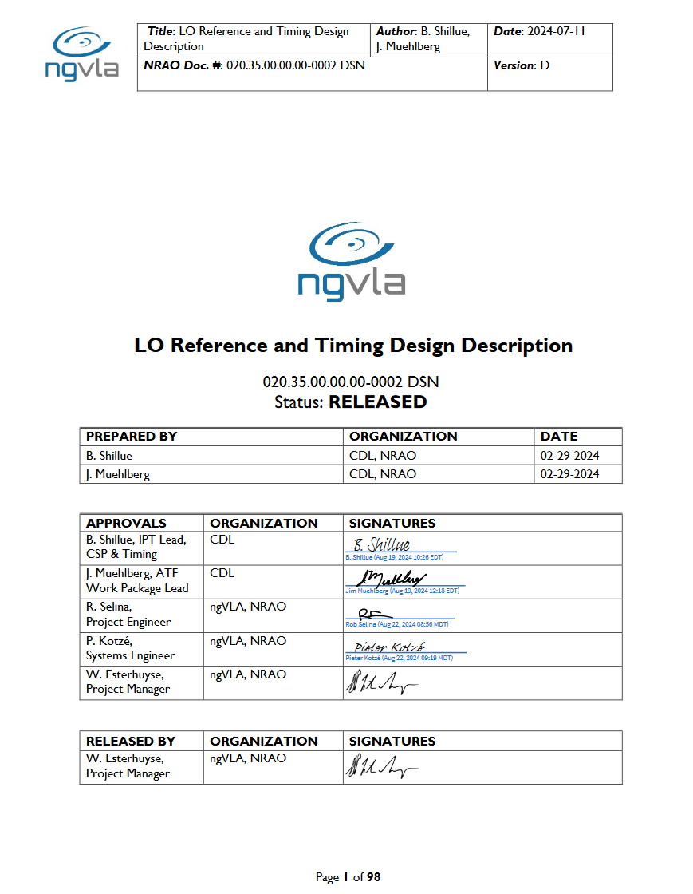
Our approach
“The device has considerable advantage in size, weight, and power. Preliminary measurements in Bochum have been confirmed at NRAO demonstrating less than 50 fs integrated phase noise at 84.1 GHz, easily meeting the ngVLA requirement of 76 fs.”

Slide 18
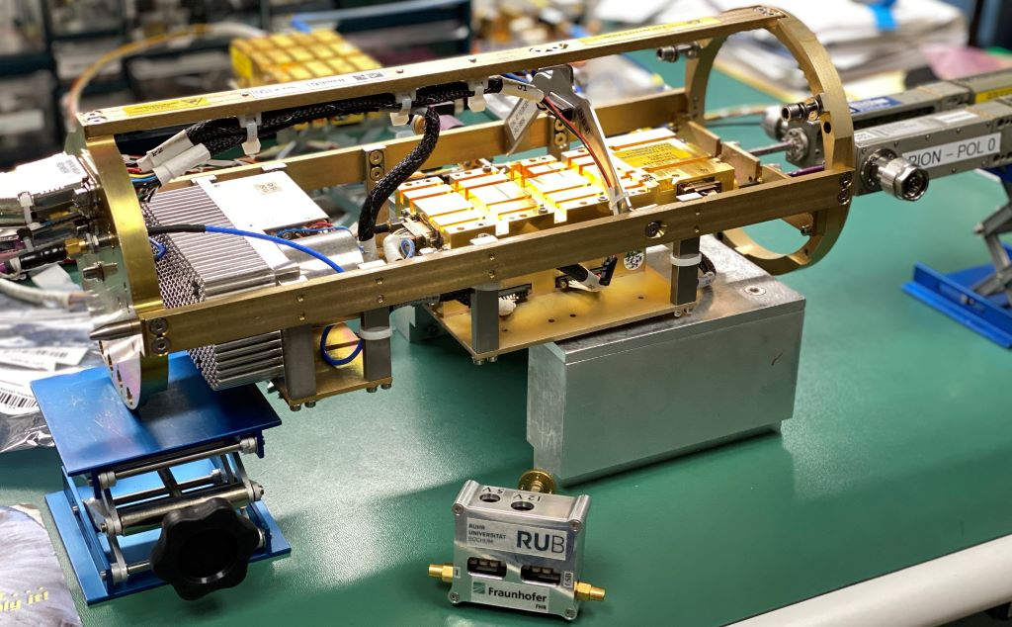
Summary
Outlook:
Covering the full frequency range
Replacing other components from ALMA, and others
Cooperating with European radio telescopes and interested universities
Full receiver for low-budget W-band imaging?
Radio camera at high frequencies?

