Slide 1
FlashCam camera Characterization searching for GRB’s
Anne Timmermans Supervisors: German Hermann, Jim Hinton
Astroparticle School
Obertrubach-Barnfals, 14.10.2024

Slide 2
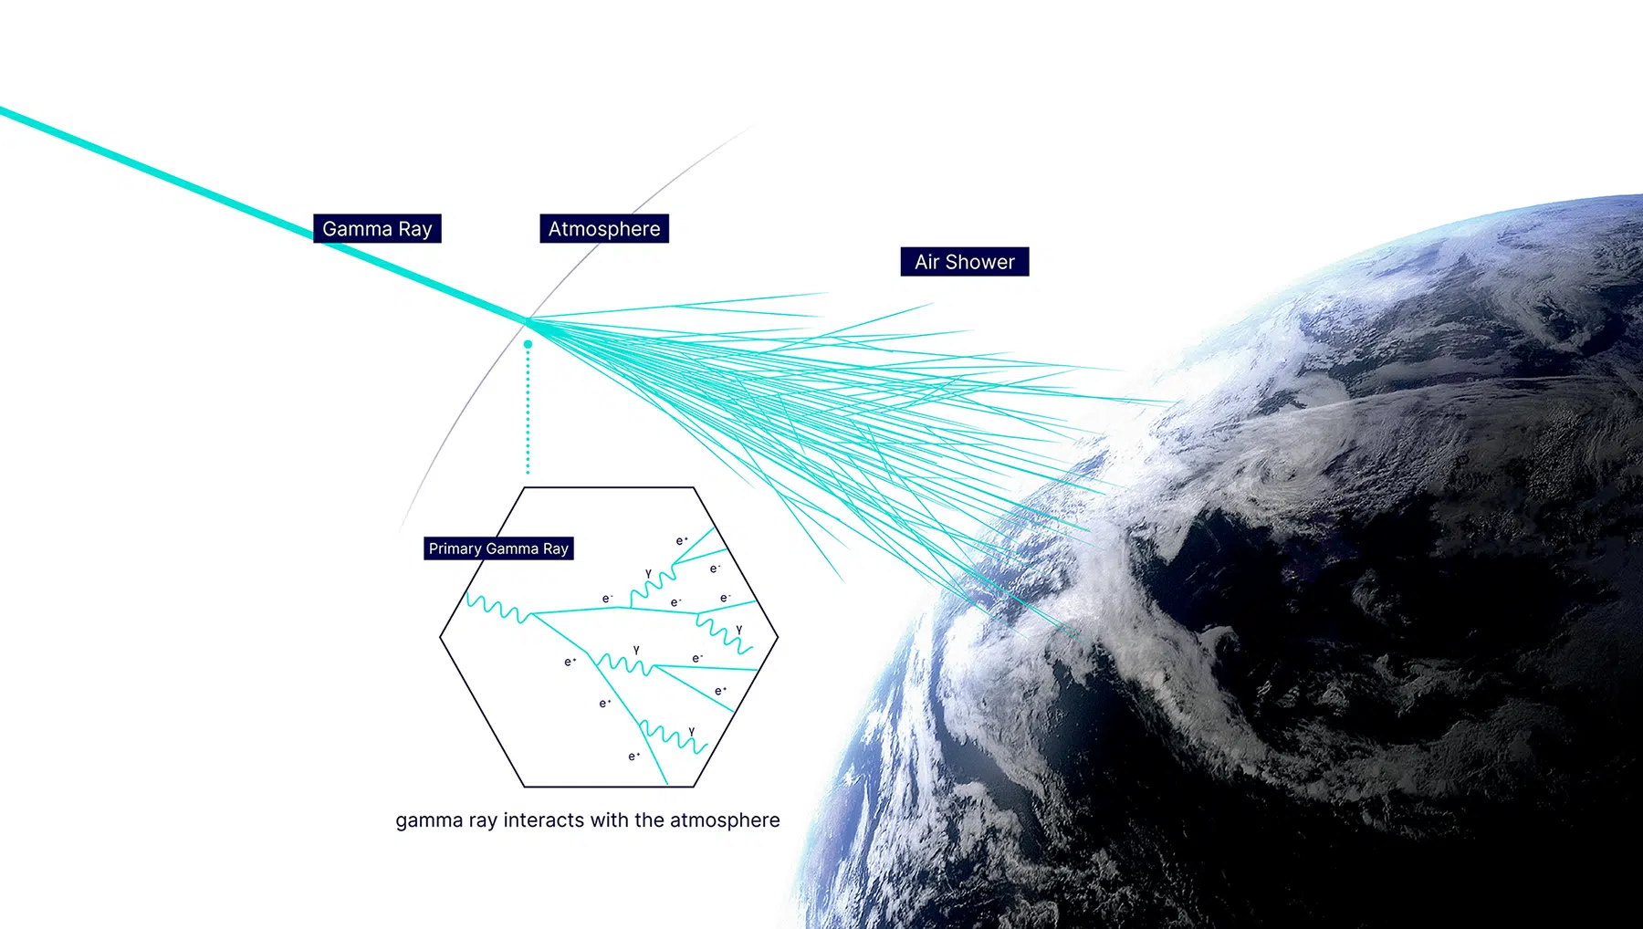
Ctao: gamma-ray observatory
2
https://www.ctao.org/emission-to-discovery/science/how-ctao-works/

Slide 3
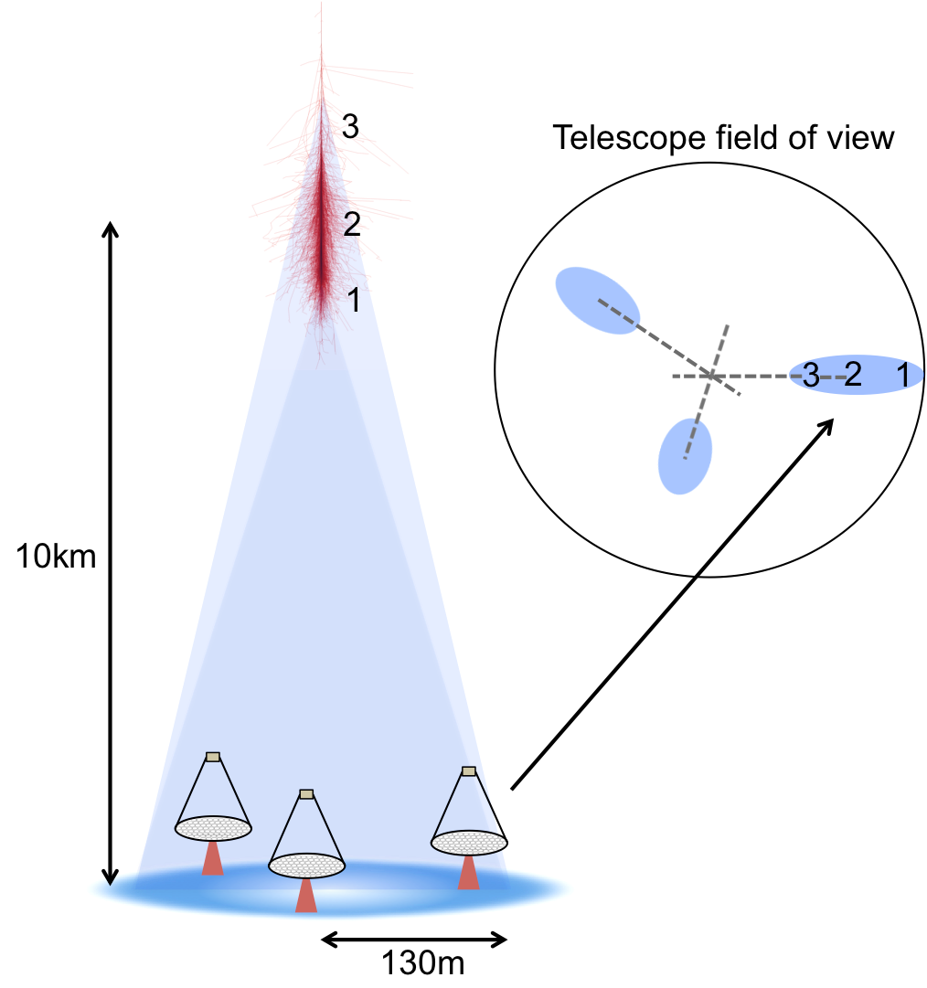
Cherenkov telescope principle
3
https://ar5iv.labs.arxiv.org/html/1510.05675

Slide 4
Cherenkov telescope principle
Timescale: 100 ns
3
https://ar5iv.labs.arxiv.org/html/1510.05675

Slide 5
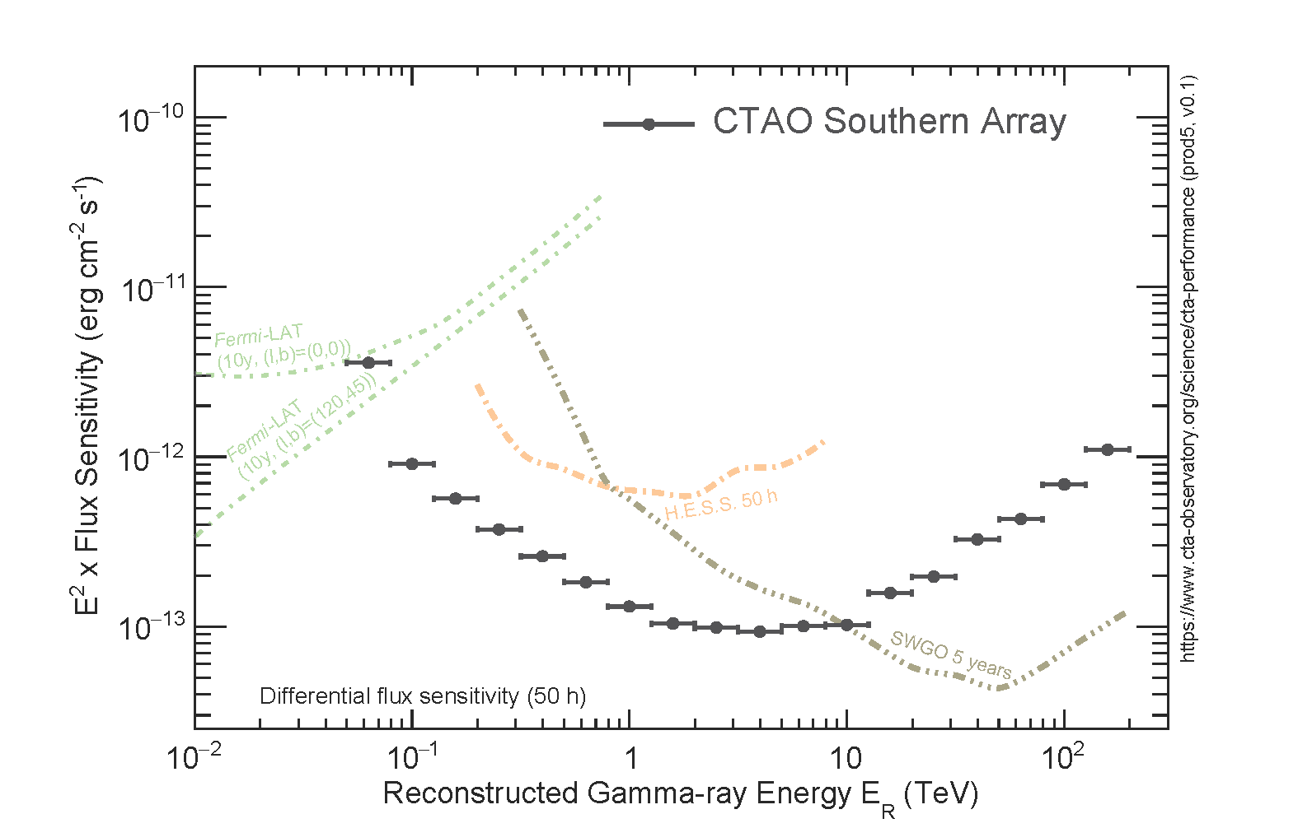
CTAO: A new Cherenkov Telescope Observatory
3 Detector types
Satellite → Fermi
ICTA → HESS
WCT → SWGO
4

Slide 6
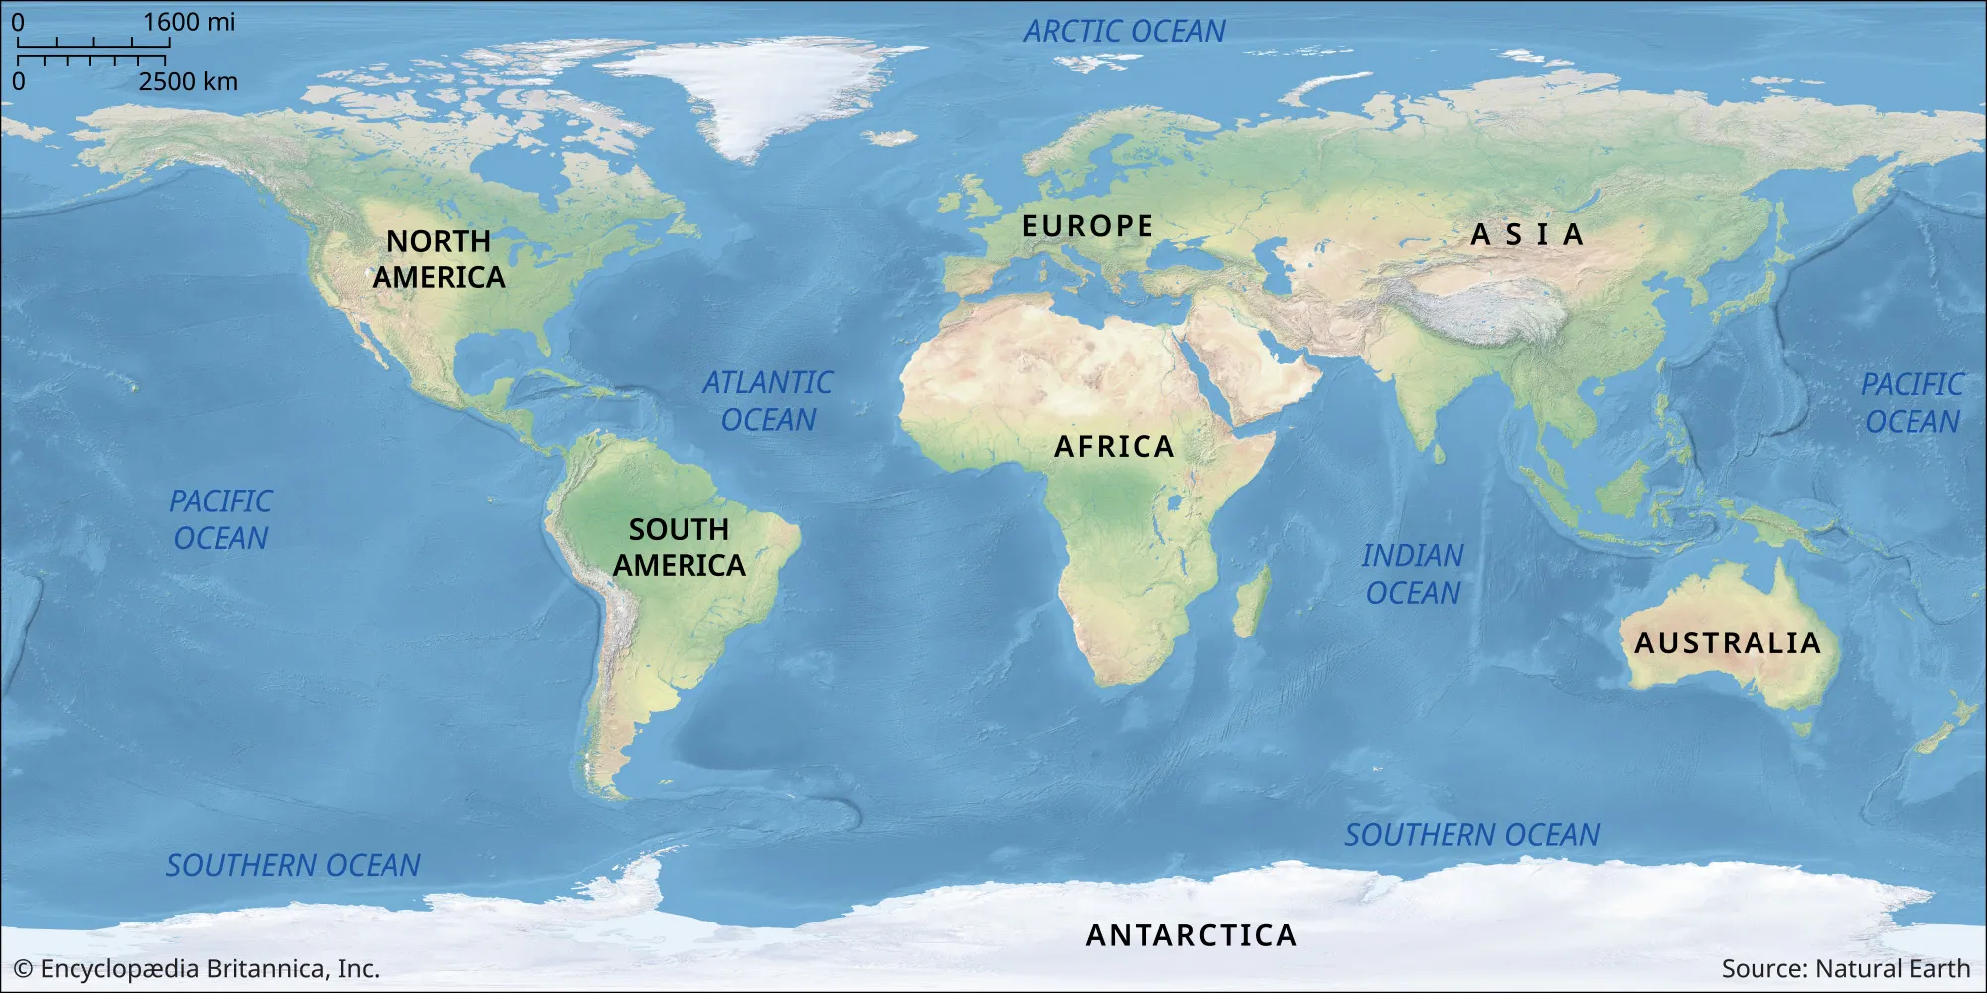
Cherenkov telescope array observatory
2 telescope arrays
La Palma
Atacama Desert, Chile
5
https://www.ctao.org/emission-to-discovery/array-sites/ctao-south/

Slide 7
Cherenkov telescope array observatory
2 telescope arrays
La Palma
Atacama Desert, Chile
6
https://www.ctao.org/emission-to-discovery/array-sites/ctao-south/

Slide 8
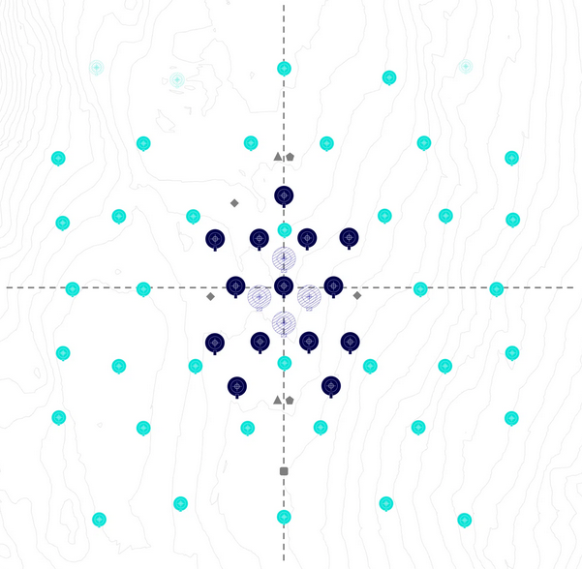
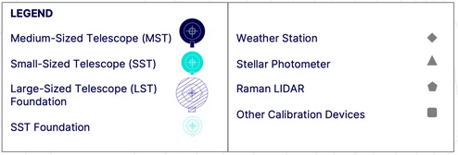
Cherenkov telescope array observatory
3 telescope types
SST (2 reflectors, 1st 4 m, 2nd 1.8 m)
MST (12 m diameter)
LST (23 m diameter)
~ 2 km
~ 2 km
7
https://www.ctao.org/emission-to-discovery/array-sites/ctao-south/

Slide 9
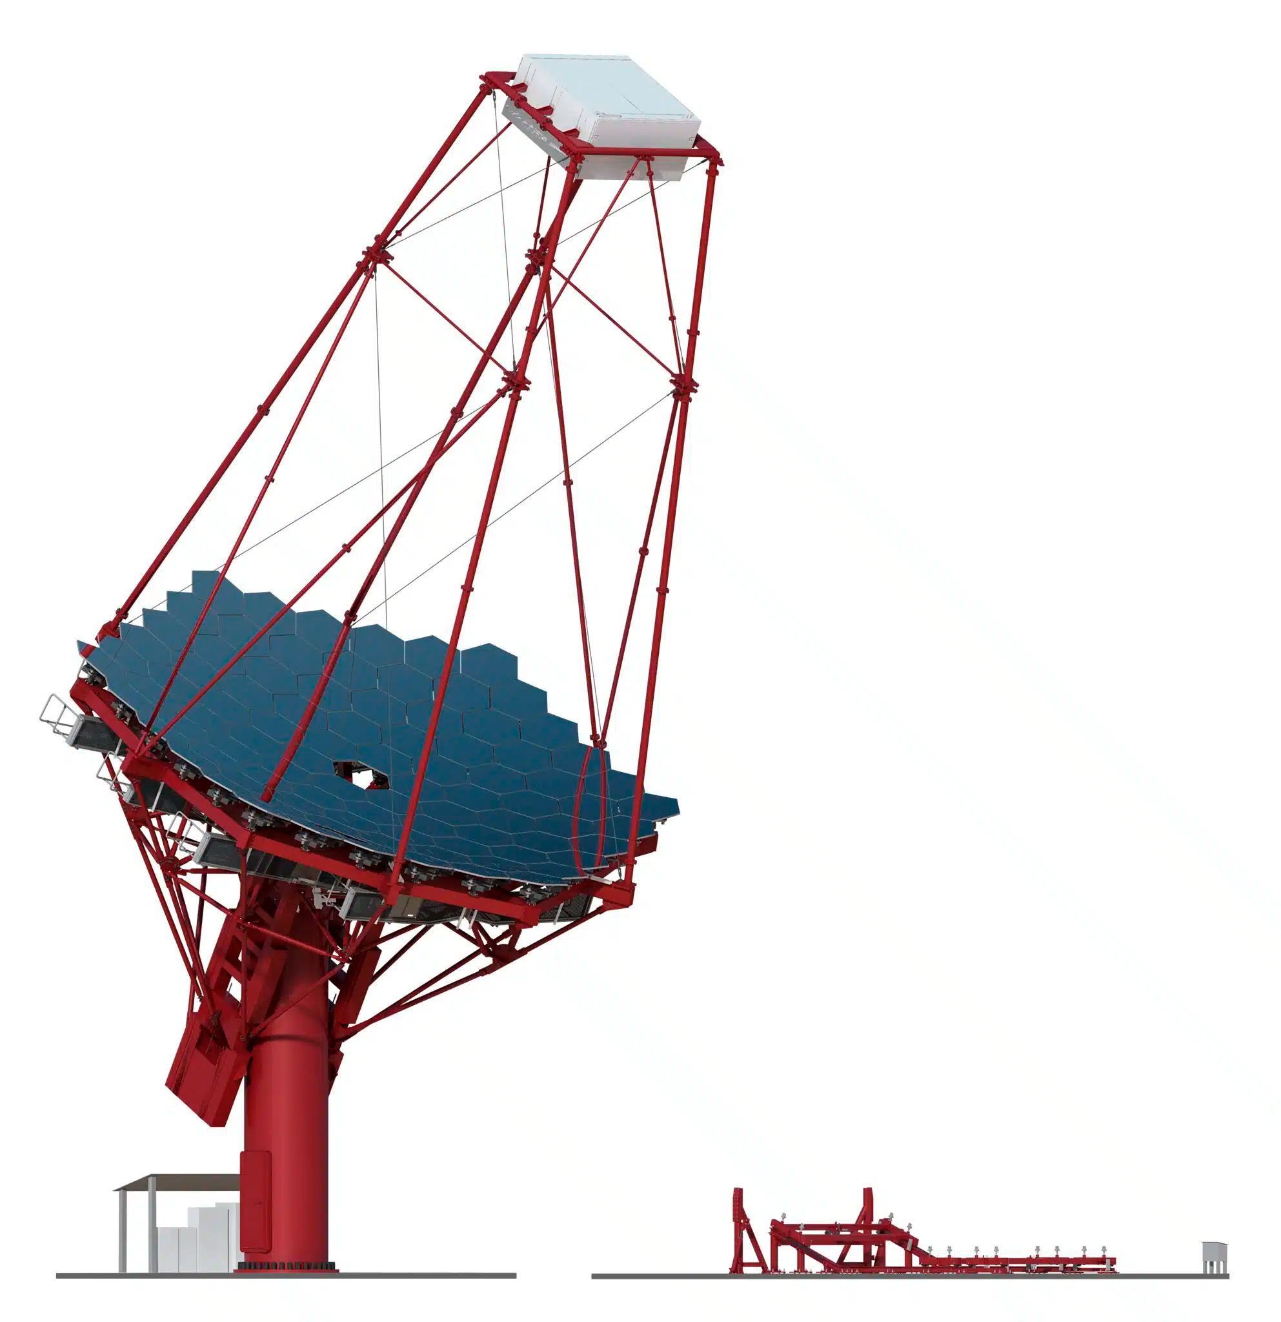
The medium sized telescope
27 m
FlashCam
8
https://www.ctao.org/emission-to-discovery/telescopes/mst/

Slide 10
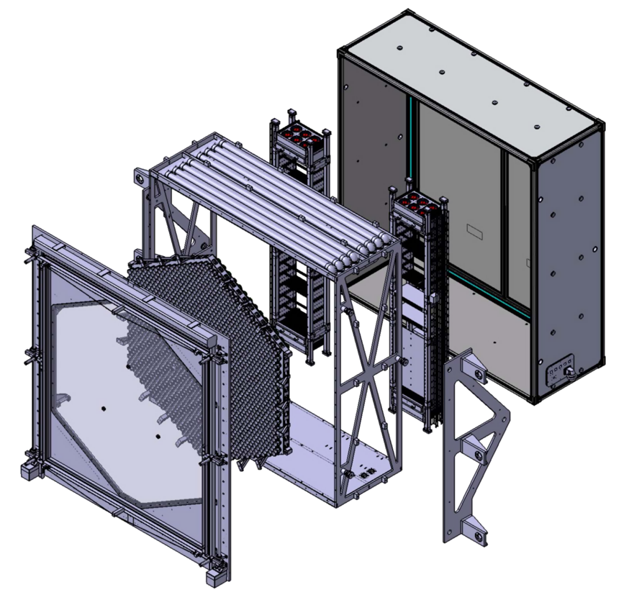
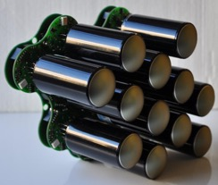
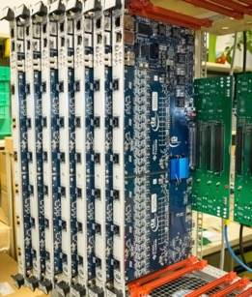
FlashCam Specifications
Thermal
insulation
3 m
Specifications
‘Walk-in’ camera
Horizontal architecture
Photon detection plane → 147 PDP modules → 12 PMT’s → 1761 pixels
Digitization of signal → sampling rate 250 MHz → identify ns long light traces
PDP module
readout electronics,
fully digital trigger
Window
& shutter
Ethernet-based
front-end readout
Mechanical structure
9
https://arxiv.org/pdf/1509.02434

Slide 11
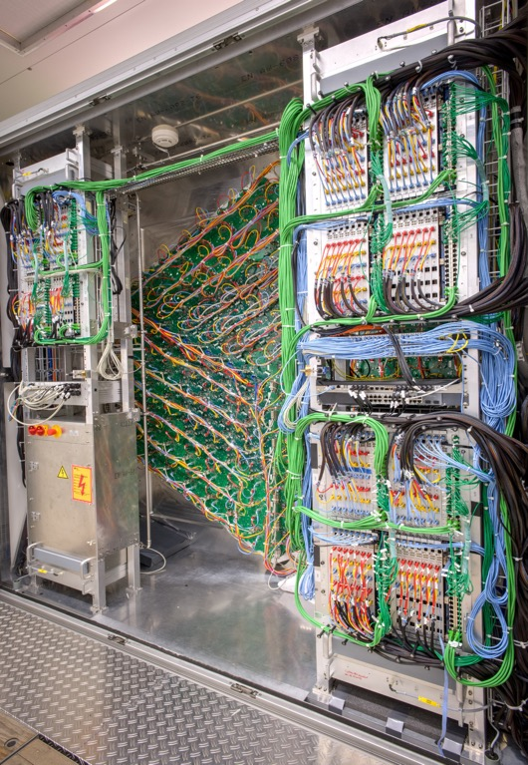
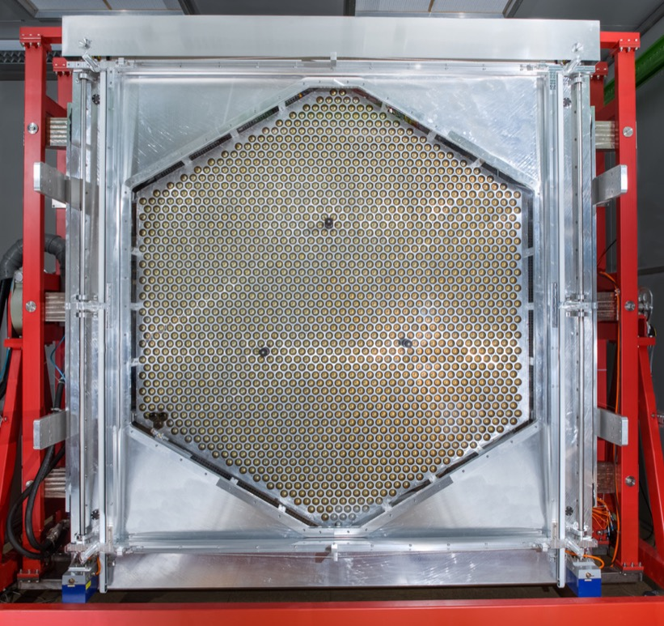
FlashCam
Tests
Full-size prototype in lab
Characterization of camera
Environmental tests
Lab calibration
10
https://www.mpi-hd.mpg.de/mpi/de/forschung/abteilungen-und-gruppen/nichtthermische-astrophysik/projekte/cta/flashcam

Slide 12
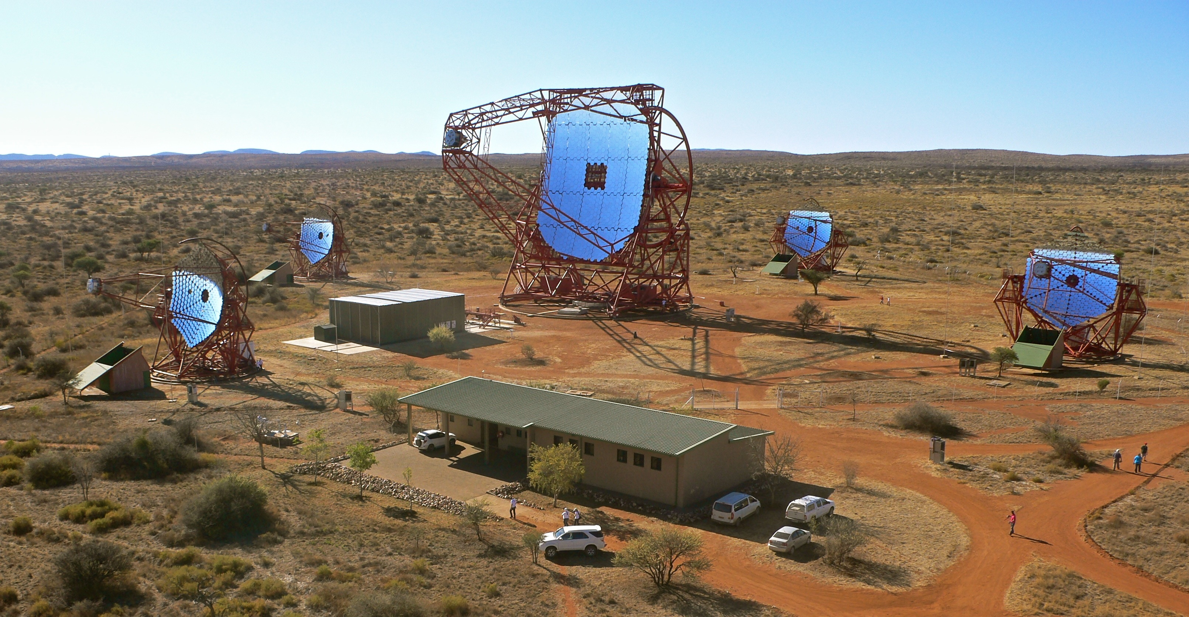
FlashCam in h.e.s.s.
H.E.S.S.
CT 1-4 → 12 m diameter → Higher energy range ~ 200 GeV – 100 TeV
CT 5 → 28 m diameter → Low energies ~ 10 GeV – 200 GeV → GRB’s
11

Slide 13
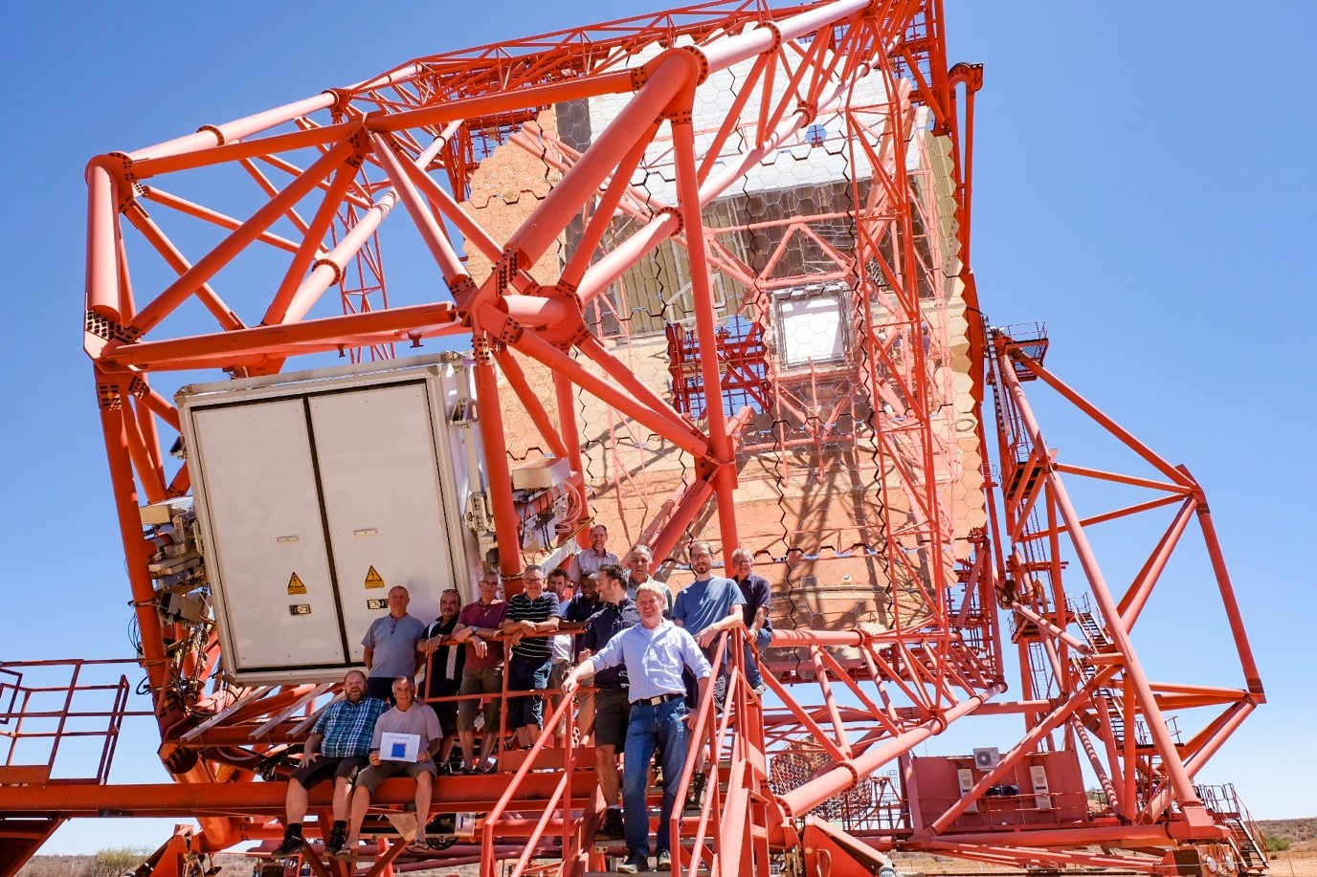
FlashCam in h.e.s.s.
Prototype of FlashCam
Implemented in CT 5
Running since December 2019
12
Image credit: C. Föhr/H.E.S.S. Collaboration

Slide 14
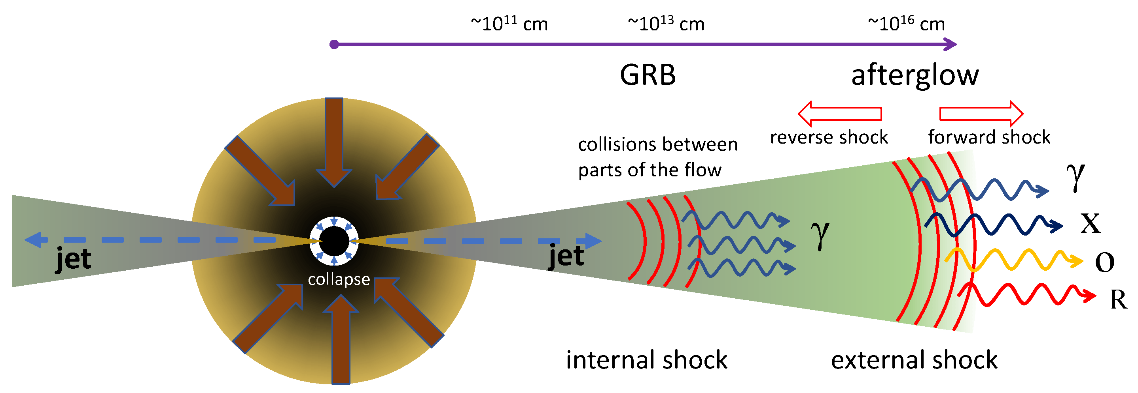
GRB’s
Gamma Rays from GRB’s
1. Prompt emission → Short GRB’s order of 0.1 seconds → Long GRB’s order of seconds
2. Interactions with relativistic ejecta and surrounding gas → Afterglow
Radiative signatures afterglow
1. Synchrotron emission
2. Inverse Compton scattering → Emission up to order TeV
13
https://www.mdpi.com/2218-1997/8/7/350

Slide 15
Searching for GRB’s
Measuring GRB’s
Alert from Fermi-Lat/Fermi-GBM/Swift-BAT
H.E.S.S. moves to position if available within 4 h → Afterwards expert on-call decides
Include CT5 in reconstruction → bridge gap between Fermi-LAT and CT1-4
Timescale: 100 ns
14
https://www.mpi-hd.mpg.de/hfm/HESS/pages/home/som/2020/10/

Slide 16
Summary
FlashCam
Characterization of camera
Environmental tests
Lab calibration
GRB’s with FlashCam (CT5) in H.E.S.S. → Bridge gap between Fermi-LAT and CT1-4
15

Slide 17
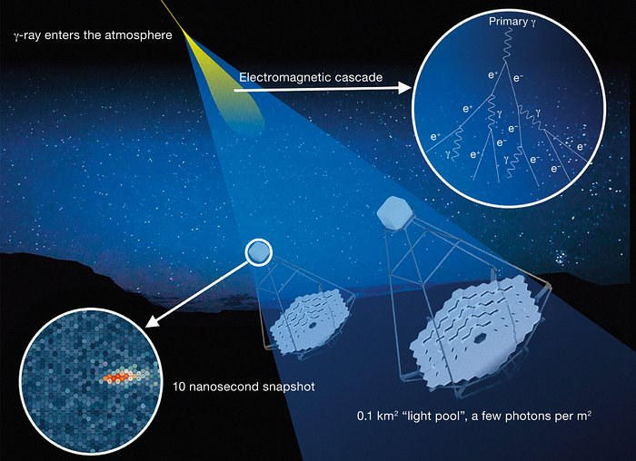
Cherenkov telescope array
16
https://www.eso.org/public/images/eso1841x/

Slide 18
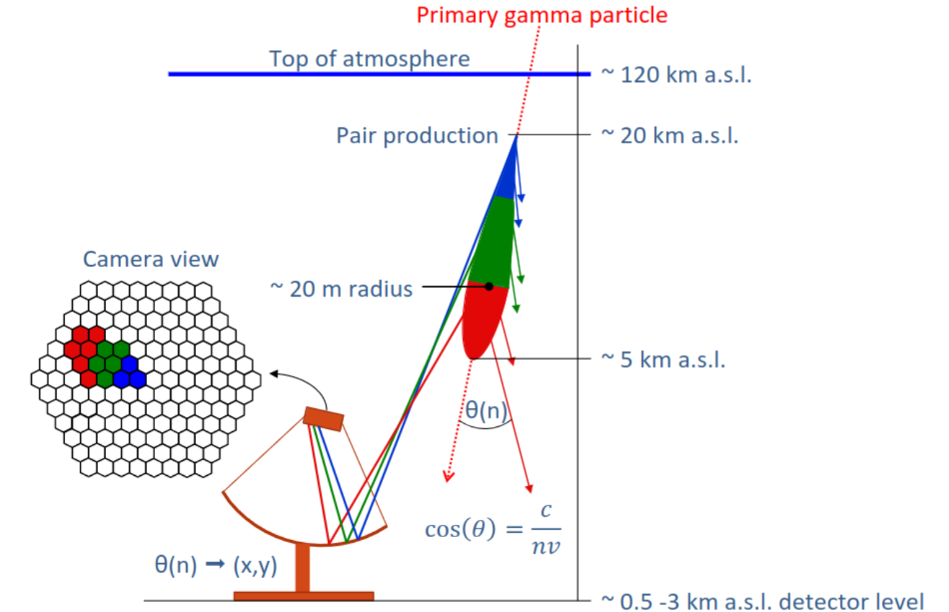
Cherenkov telescope principle
3
https://www.physik.uzh.ch/dam/jcr:d73c2f7c-635a-46e0-a924-569566367a6c/poster_32.pdf

Slide 19
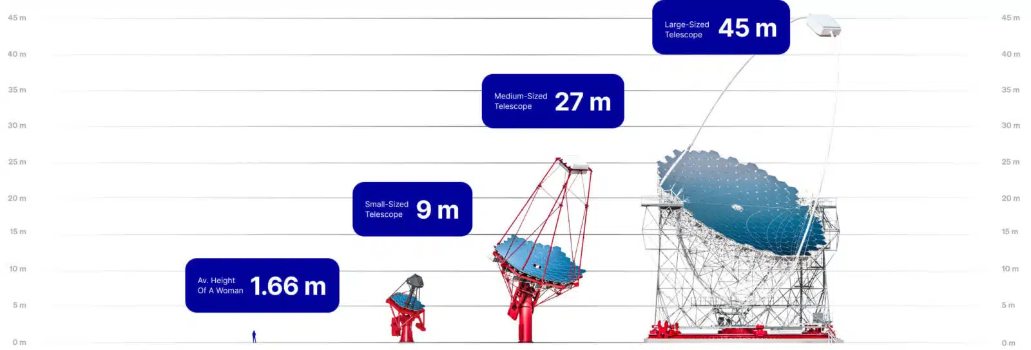
The telescopes
17
https://www.ctao.org/emission-to-discovery/telescopes/

Slide 20
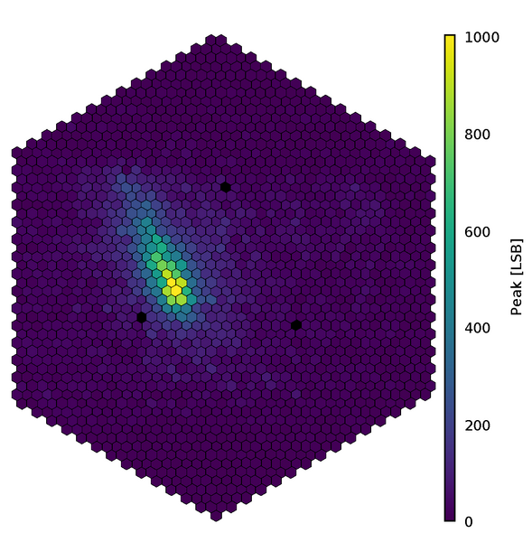
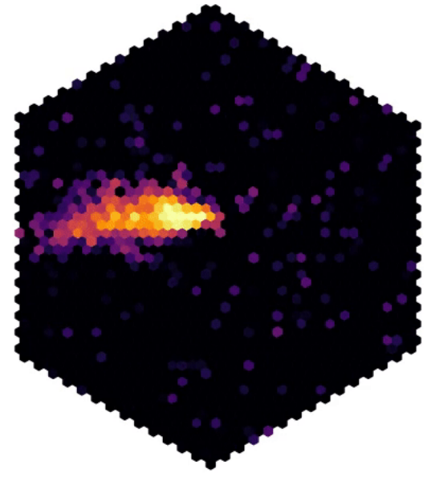
Data from flashcam
18
https://www.mpi-hd.mpg.de/mpi/en/public-relations/news/news-item/mit-flashcam-bestuecktes-teleskop-sieht-erstmals-tscherenkow-licht-aus-der-atmosphaere

Slide 21
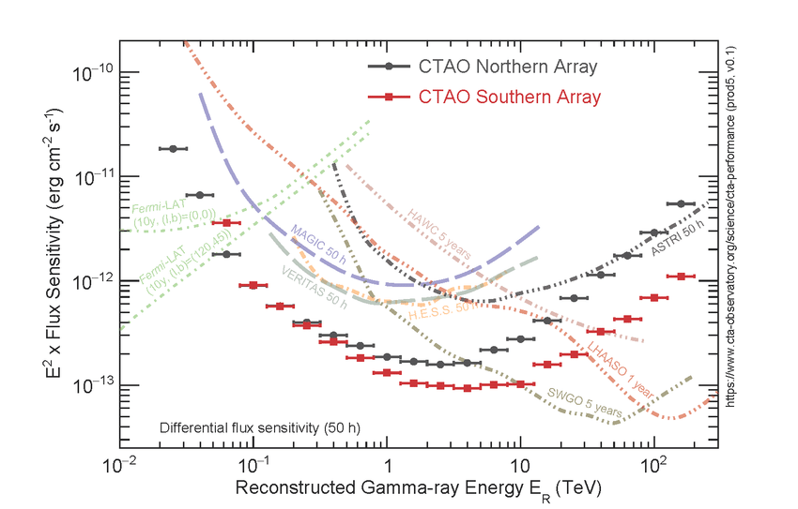
Sensitivity ctao
19
https://www.researchgate.net/figure/On-axis-differential-flux-sensitivity-for-point-like-sources-of-the-two-CTAO-arrays_fig2_355275037

