Slide 1
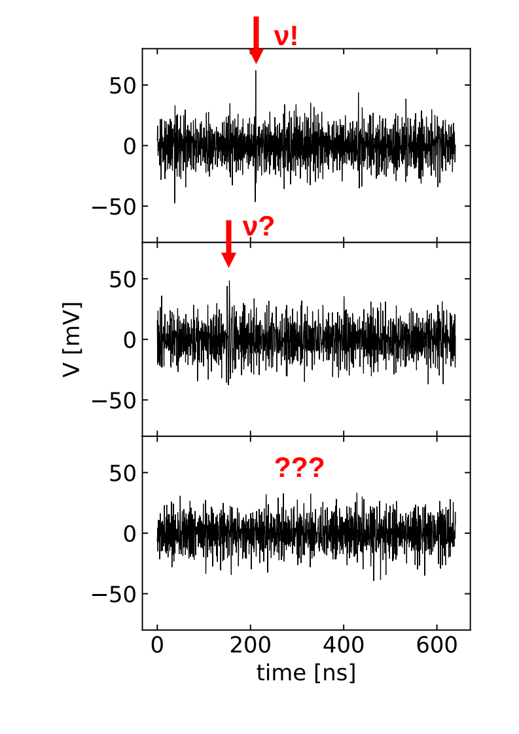
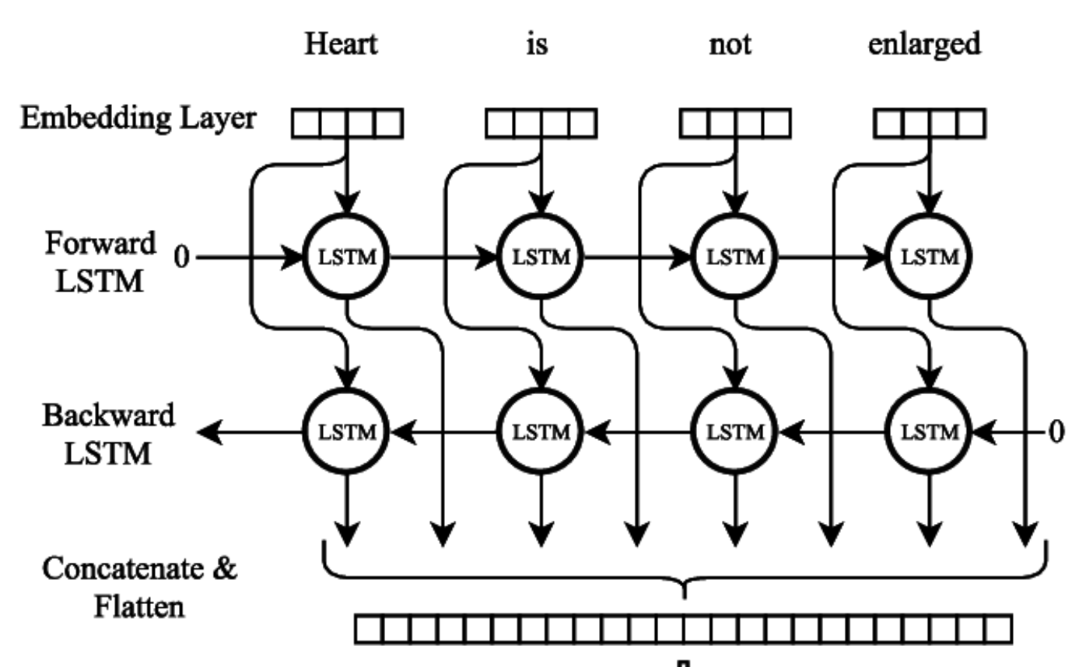
Identifying Radio Neutrino interactions
with Deep Learning
Luan Orion Baraúna, Sjoerd Bouma
🌖n & 👞rd
INPE - ECAP
Knowing if and where there is a neutrino pulse in a voltage trace is important for both reconstruction and background rejection.
Aim to use Deep Learning to improve on current (template correlation) approach.

