Slide 1
Using a time-based image cleaning approach for improving the low energy response of H.E.S.S.
Jelena Ćelić, Rodrigo Guedes Lang, Stefan Funk
High-energy astrophysics in the multi-messenger era
08.05.2023

Slide 2
What is image cleaning and
why do we need it?

Slide 3
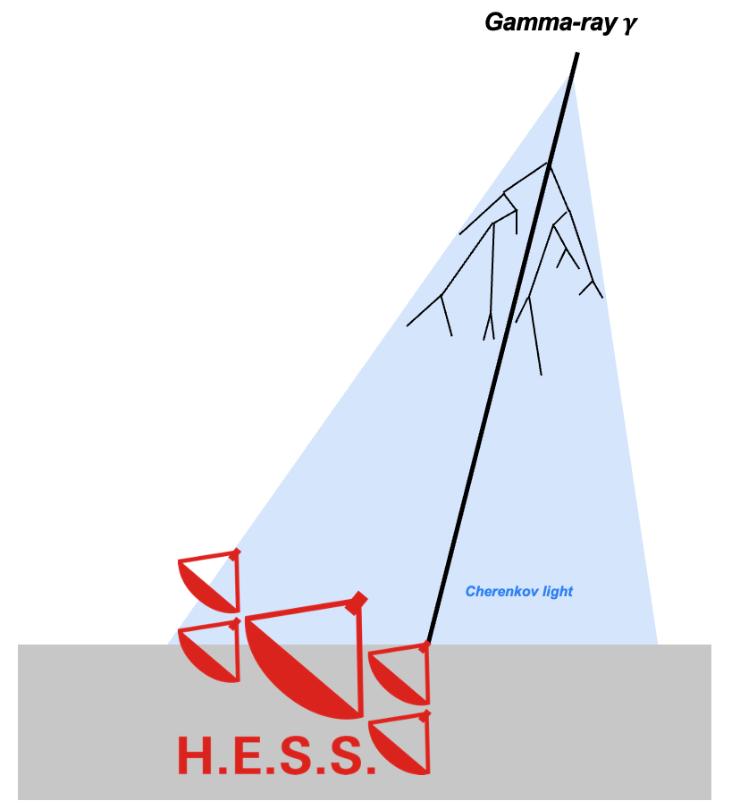
Image cleaning
The same procedure as every year (for 20 years)

Slide 4
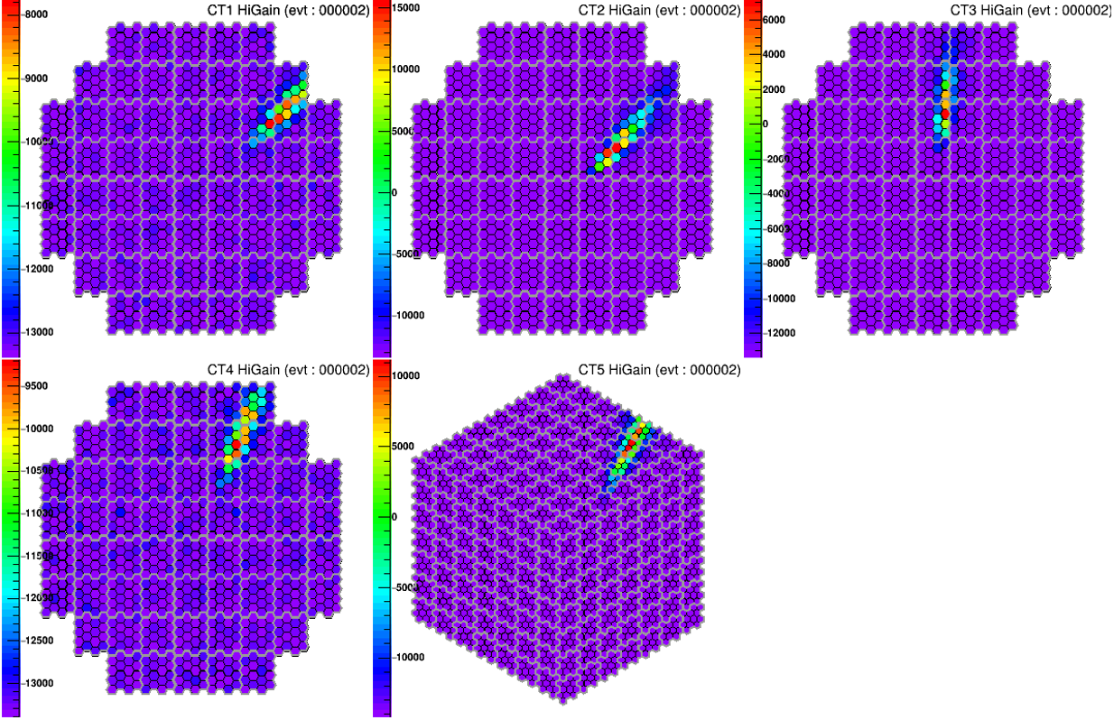
Image cleaning
The same procedure as every year (for 20 years)
Raw images = Signal + Noise

Slide 5
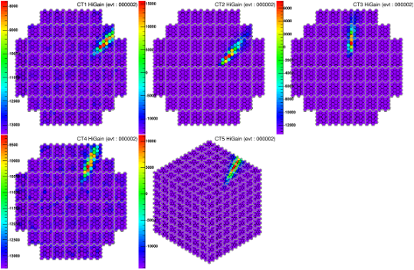
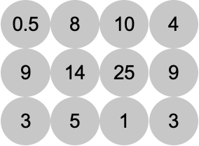
Image cleaning
The same procedure as every year (for 20 years)
Image cleaning
Tailcuts cleaning

Slide 6
Image cleaning
The same procedure as every year (for 20 years)
Image cleaning
Tailcuts cleaning

Slide 7
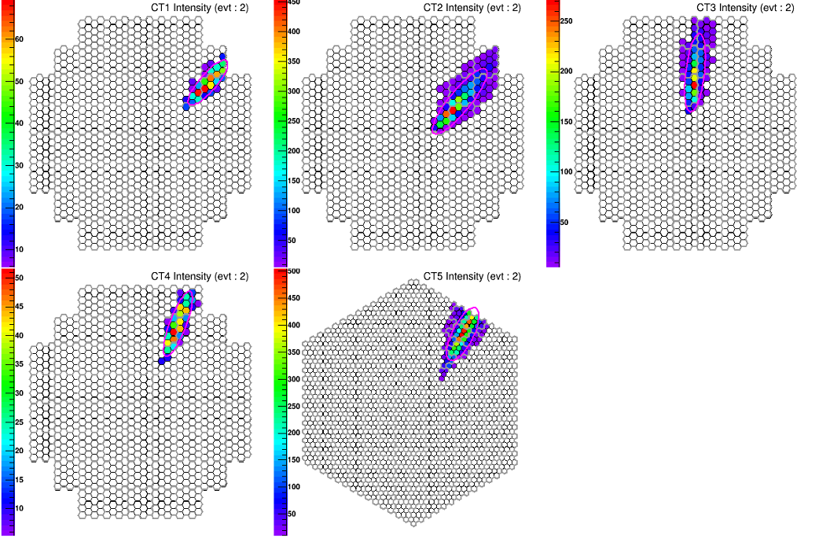
Image cleaning
The same procedure as every year (for 20 years)
Image cleaning

Slide 8
Time-based cleaning
Including timing information
of shower pixels
retaining more light
(beneficial for low energetic events)
Improvement of the low energy response of H.E.S.S.
Animations

Slide 9
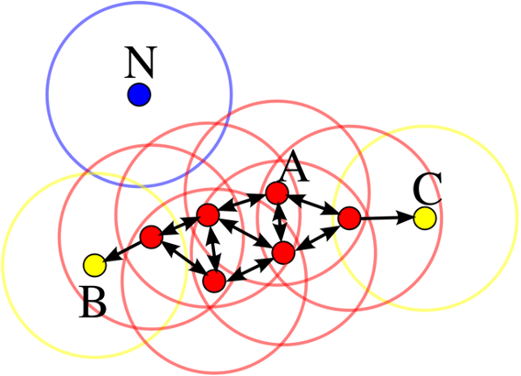
Time-based cleaning
Short description of implementation
DBScan = Density-Based Spatial Clustering of Applications with Noise
→ 2 parameters: minimum sample size and distance ϵ
[wikipedia]

Slide 10
Time-based cleaning
Short description of implementation
DBScan = Density-Based Spatial Clustering of Applications with Noise
→ 2 parameters: minimum sample size and distance ϵ
Our implementation requires 4 parameters:
Noise cut (=Precleaning step)
Time scale
Spatial scale
Cluster size
→ Optimization of time-based cleaning parameter is needed
→ NOT an easy task (very CPU time intensive)
→ Image cleaning study pipeline is needed
DBScan
[wikipedia]

Slide 11
Time-based cleaning
Short description of implementation
DBScan = Density-Based Spatial Clustering of Applications with Noise
→ 2 parameters: minimum sample size and distance ϵ
Our implementation requires 4 parameters:
Noise cut (=Precleaning step)
Time scale
Spatial scale
Cluster size
→ Optimization of time-based cleaning parameter is needed
→ NOT an easy task (very CPU time intensive)
→ Image cleaning study pipeline is needed
DBScan
[wikipedia]

Slide 12
Fundamental goals of image cleaning
New pipeline of optimization of image cleaning parameters
Image cleaning study
Goal of image cleaning
Keeping as much light of the shower as possible
Cleaning pure NSB pixels as good as possible away

Slide 13
Fundamental goals of image cleaning
New pipeline of optimization of image cleaning parameters
Image cleaning study
Image cleaning study pipeline
Only CT5 results
Goal of image cleaning
Keeping as much light of the shower as possible
Cleaning pure NSB pixels as good as possible away
Parameter Space
Image cleaning performance study
Size retainment
NSB survival rate
Understanding behaviour of parameters
Final estimate

Slide 14
Fundamental goals of image cleaning
New pipeline of optimization of image cleaning parameters
Image cleaning study
Image cleaning study pipeline
Only CT5 results
Goal of image cleaning
Keeping as much light of the shower as possible
Cleaning pure NSB pixels as good as possible away
Parameter Space
Finding the right balance
Image cleaning performance study
Size retainment
NSB survival rate
NSB
cleaning
Size retainment
Understanding behaviour of parameters
Final estimate

Slide 15
Fundamental goals of image cleaning
New pipeline of optimization of image cleaning parameters
Image cleaning study
Image cleaning study pipeline
Only CT5 results
Goal of image cleaning
Keeping as much light of the shower as possible
Cleaning pure NSB pixels as good as possible away
Parameter Space
Finding the right balance
Image cleaning performance study
Size retainment
NSB survival rate
NSB
cleaning
Size retainment
Understanding behaviour of parameters
Final estimate

Slide 16
Fundamental goals of image cleaning
New pipeline of optimization of image cleaning parameters
Image cleaning study
Image cleaning study pipeline
Only CT5 results
But how can we decide which parameter combinations fits the best for us?
Goal of image cleaning
Keeping as much light of the shower as possible
Cleaning pure NSB pixels as good as possible away
Parameter Space
Finding the right balance
Image cleaning performance study
Size retainment
NSB survival rate
NSB
cleaning
Size retainment
Final estimate

Slide 17
Fundamental goals of image cleaning
New pipeline of optimization of image cleaning parameters
Image cleaning study
Goal of image cleaning
Keeping as much light of the shower as possible
Cleaning pure NSB pixels as good as possible away
Distinguishing gammas from hadrons

Slide 18
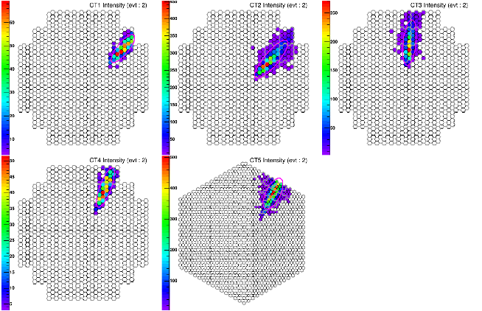
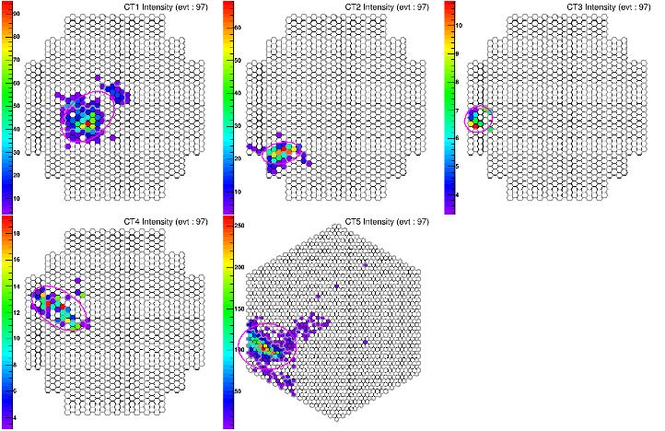
Fundamental goals of image cleaning
New pipeline of optimization of image cleaning parameters
Image cleaning study
Goal of image cleaning
Keeping as much light of the shower as possible
Cleaning pure NSB pixels as good as possible away
Gamma
Distinguishing gammas from hadrons
Proton

Slide 19
Fundamental goals of image cleaning
New pipeline of optimization of image cleaning parameters
Image cleaning study
New optimization pipeline
Goal of image cleaning
Keeping as much light of the shower as possible
Cleaning pure NSB pixels as good as possible away
Parameter Space
Image cleaning performance study
Size retainment
NSB survival rate
separation classifier output
Distinguishing gammas from hadrons
Final estimate
NEW METRIC

Slide 20
Separation classifier output
→ Gamma-Hadron separation is crucial step
1-D Anderson-Darling-Test
→ Maximizing the Output = distinguishable datasets

Slide 21
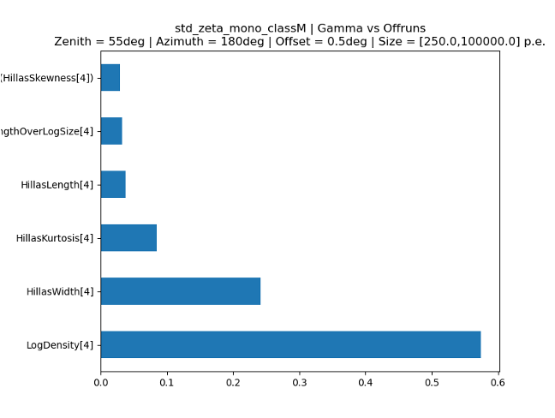
Separation classifier output
→ Gamma-Hadron separation is crucial step
1-D Anderson-Darling-Test
→ Maximizing the Output = distinguishable datasets
Input parameters inspired from BDT training
From Rodrigo Guedes Lang

Slide 22
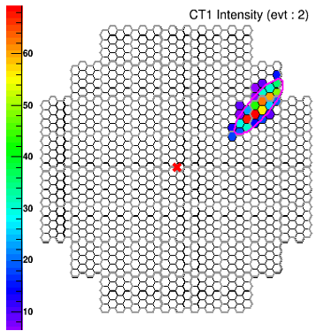
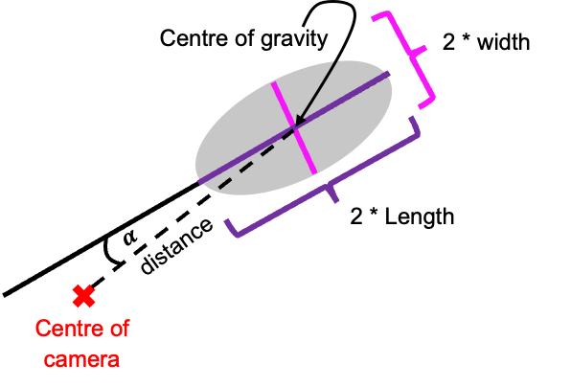
Separation classifier output
→ Gamma-Hadron separation is crucial step
1-D Anderson-Darling-Test
→ Maximizing the Output = distinguishable datasets
Input parameters inspired from BDT training
From Rodrigo Guedes Lang

Slide 23
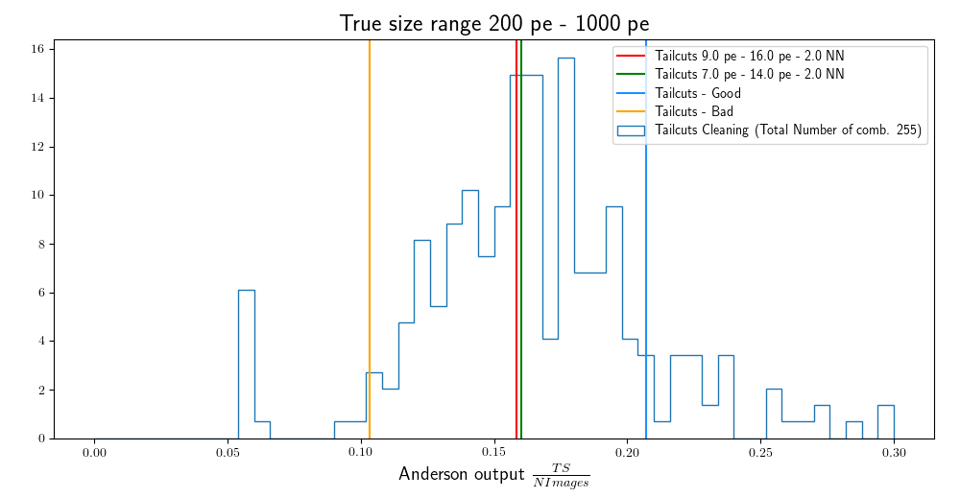
Image cleaning performance studies
Separation classifier output (Tailcuts cleaning)
Higher output → better separation
What’s next:
Just to be sure: BDT training with the 2 standard cleanings, one good combination and one bad combination
STD1: 7 pe - 14 pe - NN2
STD2: 9 pe - 16 pe - NN2
Good: 4 pe - 7 pe - NN2
Bad: 1 pe - 7 pe - NN5
Look at ROC and area under ROC
→ gives us a statement if this classifier works for us or not
Input data
Log(Density)

Slide 24
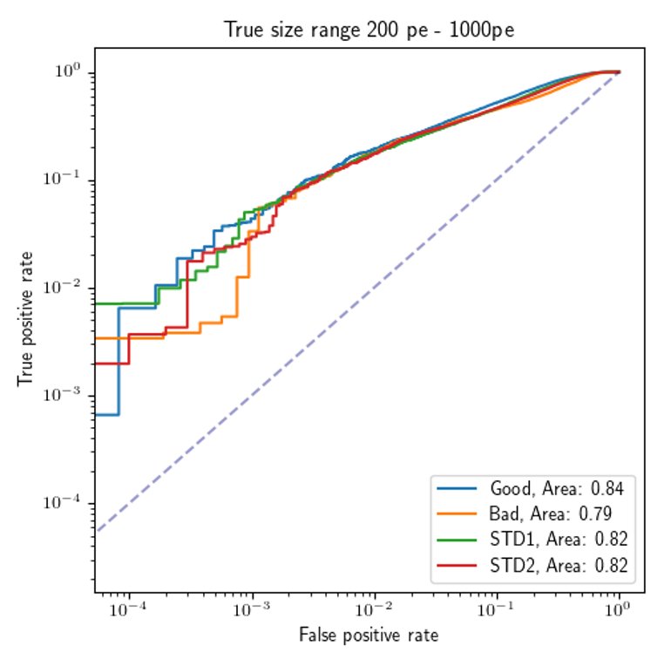
Image cleaning performance studies
BDT Training Output (Tailcuts cleaning)
Standard Cleanings:
7 pe – 14 pe – 2NN (STD1)
9 pe – 16 pe – 2NN (STD2)
worse performing than standard:
1 pe – 7 pe – 5NN (Bad)
better performing than standard:
4 pe – 7 pe – 2NN (Good)
→ With new pipeline found better performing tailcuts cleaning combination for CT5

Slide 25
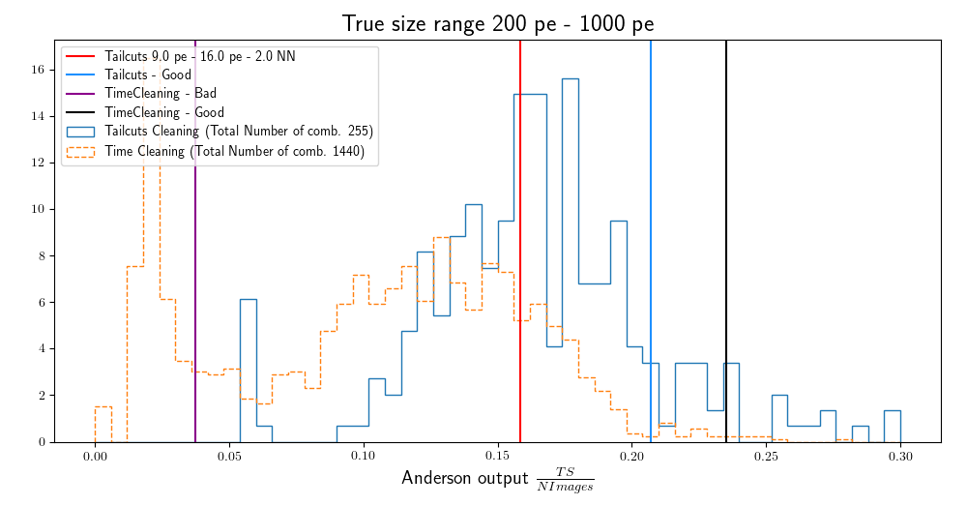
Image cleaning performance studies
Separation classifier output (Tailcuts cleaning + Time-based Cleaning)
In total 1440 different time-based cleaning combinations are tested
Time Cleaning combinations:
Good: 4.55 nc - 5.58 ns - 0.48m – 11pix
Bad: 2.3 nc – 4.08 ns - 0.72 m – 9 pix
Again BDT needed to confirm

Slide 26
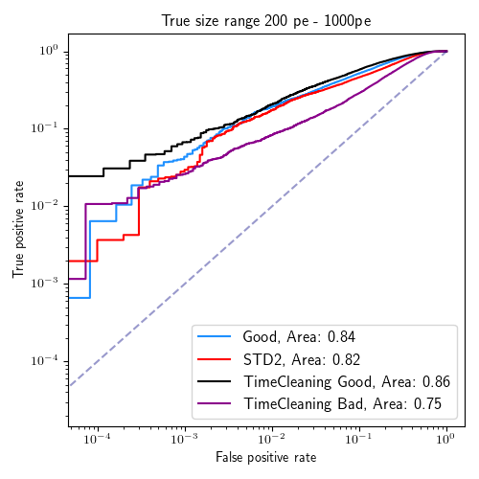
Image cleaning performance studies
BDT Training output (Tailcuts cleaning + Time-based Cleaning)
Tailcuts cleaning:
4 pe – 7 pe – 2NN (Good)
9 pe – 16 pe – 2NN (STD2)
Time Cleaning:
Good: 4.55 nc - 5.58 ns - 0.48m – 11pix
Bad: 2.3 nc – 4.08 ns - 0.72 m – 9 pix
→ Better performing time-based cleaning combination for CT5 (compared to standard cleaning)

Slide 27
Summary and outlook
Optimization pipeline focuses on the separation between gammas and hadrons
→ found slightly better performing tailcuts and time-based cleaning combinations for CT5
What’s next:

Slide 28
Summary and outlook
Optimization pipeline focuses on the separation between gammas and hadrons
→ found slightly better performing tailcuts and time-based cleaning combinations for CT5
What’s next:
Produce IRFs and sensitivity curves
Run pipeline for CT1-4

Slide 29
Summary and outlook
Optimization pipeline focuses on the separation between gammas and hadrons
→ found slightly better performing tailcuts and time-based cleaning combinations for CT5
What’s next:
Produce IRFs and sensitivity curves
Run pipeline for CT1-4
General outlook:
Apply time-based cleaning on event classes (for improving low energy response)
Event classes ++ (Rodrigo Guedes Lang, Jelena Celic, Tim Unbehaun)
Image cleaning study for different NSB levels
→ Applying a higher noise cut or redo optimization for different NSB levels

Slide 30
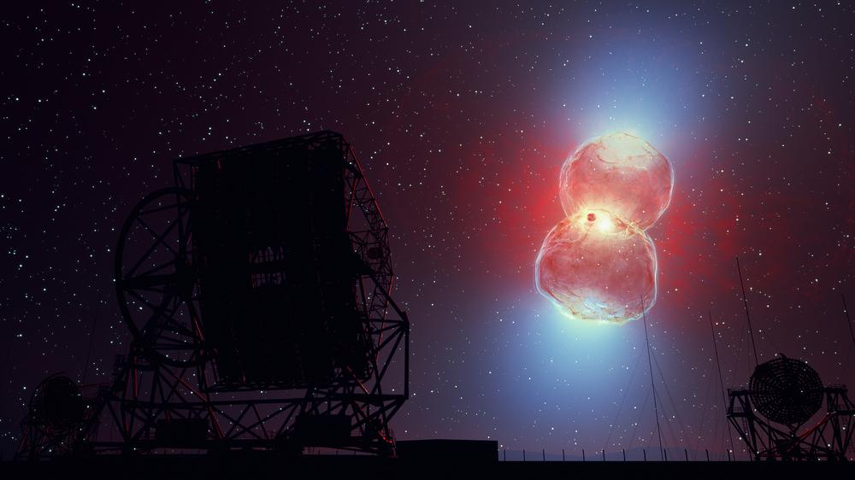
Summary and outlook
Optimization pipeline focuses on the separation between gammas and hadrons
→ found slightly better performing tailcuts and time-based cleaning combinations for CT5
What’s next:
Produce IRFs and sensitivity curves
Run pipeline for CT1-4
General outlook:
Apply time-based cleaning on event classes (for improving low energy response)
Event classes ++ (Rodrigo Guedes Lang, Jelena Celic, Tim Unbehaun)
Image cleaning study for different NSB levels
→ Applying a higher noise cut or redo optimization for different NSB levels
Science case: Novae observation
RS Oph

Slide 31
Thanks for your attention!
Any Questions?

Slide 32
Backup slides

Slide 33
Image cleaning performance study
Size retainment
NSB survival rate
Comparison between tailcuts cleaning and time-based cleaning
Only CT5 results
Only MC gamma
(pipeline looks also at mc proton)

Slide 34
Size retainment
How much of the shower is retained?
Do we lose information?

Slide 35
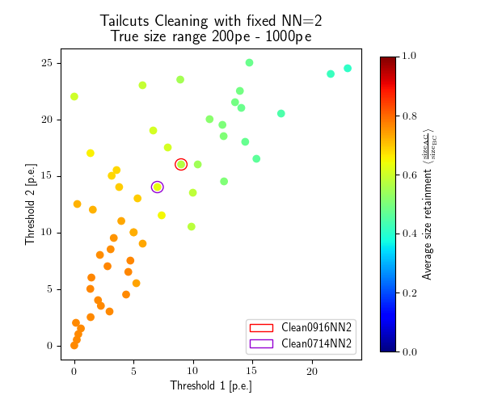
Image cleaning performance studies
Size retainment (Tailcuts cleaning)
Optimization true size range for CT5 200 pe - 1000 pe
Higher thresholds → lower size retainment
True Size = Sum of Image amplitudes of shower pixels

Slide 36
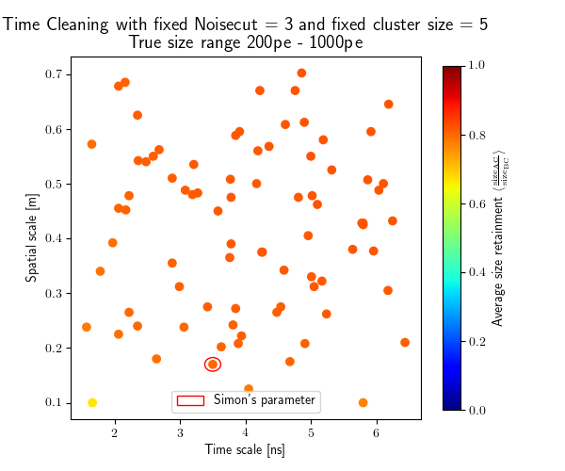
Image cleaning performance studies
Size retainment (Tailcuts cleaning + Time-based Cleaning)
Tailcuts Cleaning:
Higher thresholds → lower size retainment
Time-based cleaning:
Higher size retainment than tailcuts
The larger the time and spatial scales are the more light we keep
But: forced behaviour because of fixed parameters
Time-based cleaning
Tailcuts cleaning

Slide 37
NSB survival rate
How many pure NSB only pixels survive the image cleaning?

Slide 38
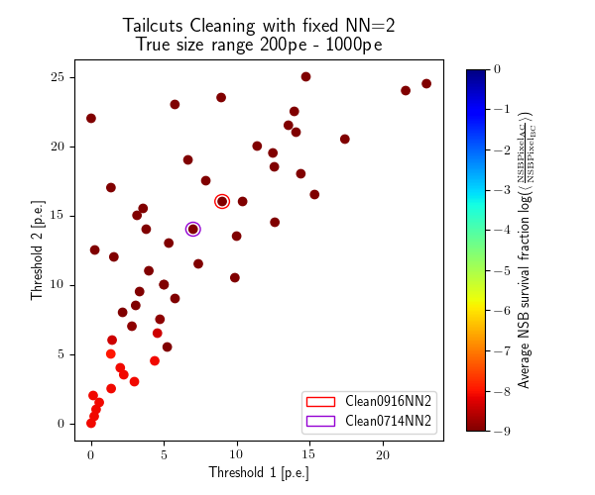
Image cleaning performance studies
NSB survival rate (Tailcuts cleaning)
Optimization true size range for CT5
200 pe - 1000 pe
Zero NSB survival rates = 1e-9
Tailcuts Cleaning:
Overall good NSB cleaning performance
loosening cut thresholds keeps more pure NSB pixels

Slide 39
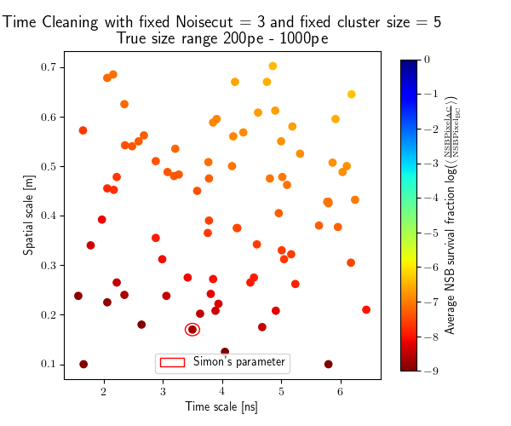
Image cleaning performance studies
NSB survival rate (Tailcuts cleaning + Time-based Cleaning)
Tailcuts Cleaning:
Overall good NSB cleaning performance
loosening cut thresholds keeps more pure NSB pixels
Time-based cleaning:
large time and spatial scale → higher NSB survival rate
Time-based cleaning
Tailcuts cleaning

