Slide 1
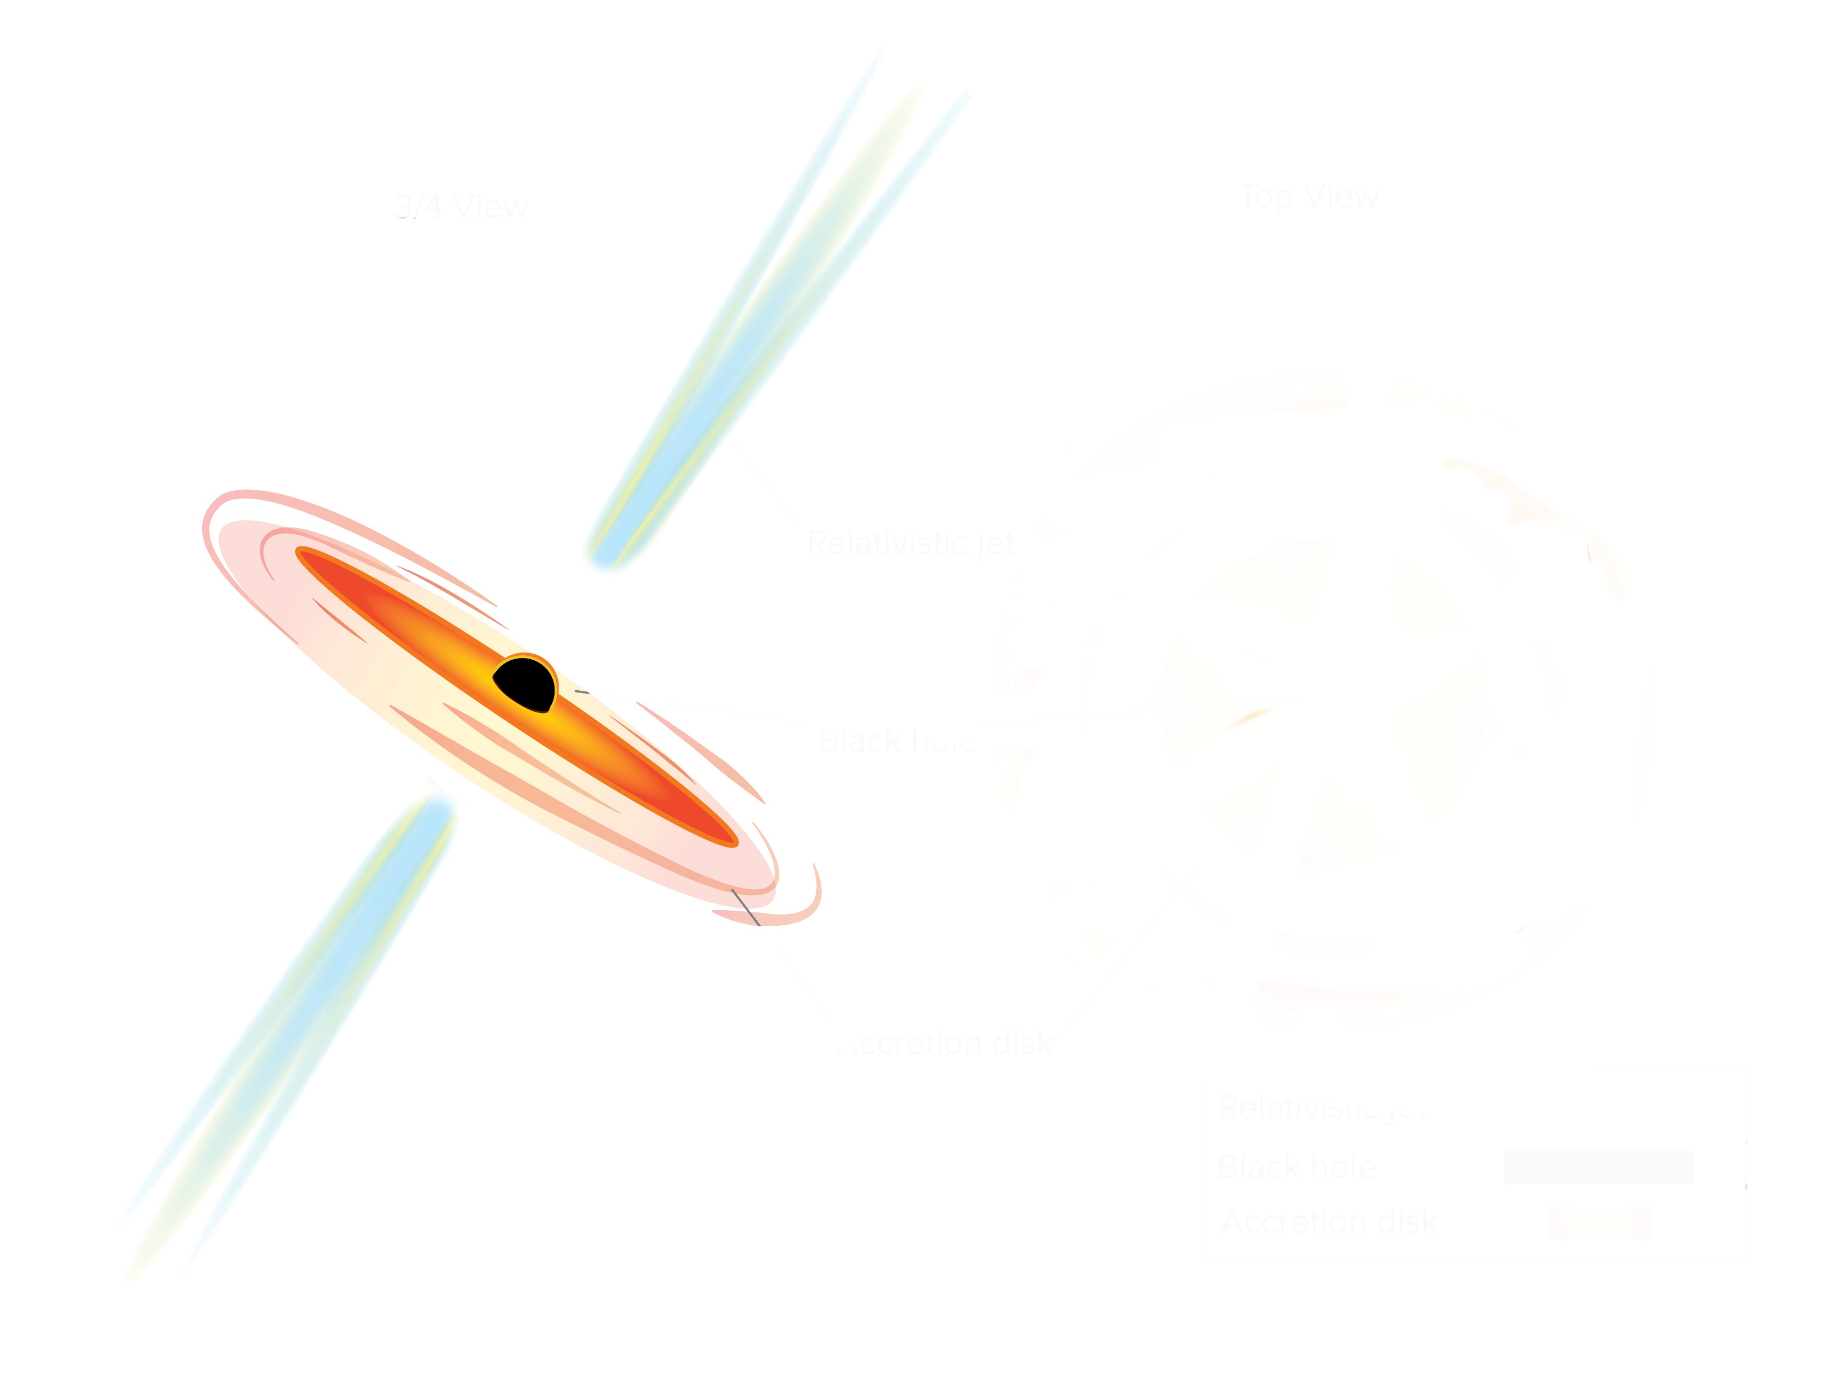
VLBI Probes of Jet Physics in Neutrino-Candidate Blazars
Florian Eppel
JMU Würzburg & MPIfR Bonn
©H. Pohl
$$ν$$
M. Kadler, E. Ros, J. Heßdörfer, F. Rösch, P. Benke, B. Boccardi, S. Buson, P. Edwards, C. Fromm, M. Giroletti, A. Gokus, J. L. Gomez, S. Hämmerich, D. Kirchner, Y. Y. Kovalev, T. P. Krichbaum, M. Lister, K. Mannheim, F. McBride, C. Nanci, R. Ojha, G. F. Paraschos, M. Perucho, A. Plavin, A. C. S. Readhead, J. Stevens, P. Weber, P. Torne
Credit: Sophia Dagnello, NRAO/AUI/NSF

Slide 2
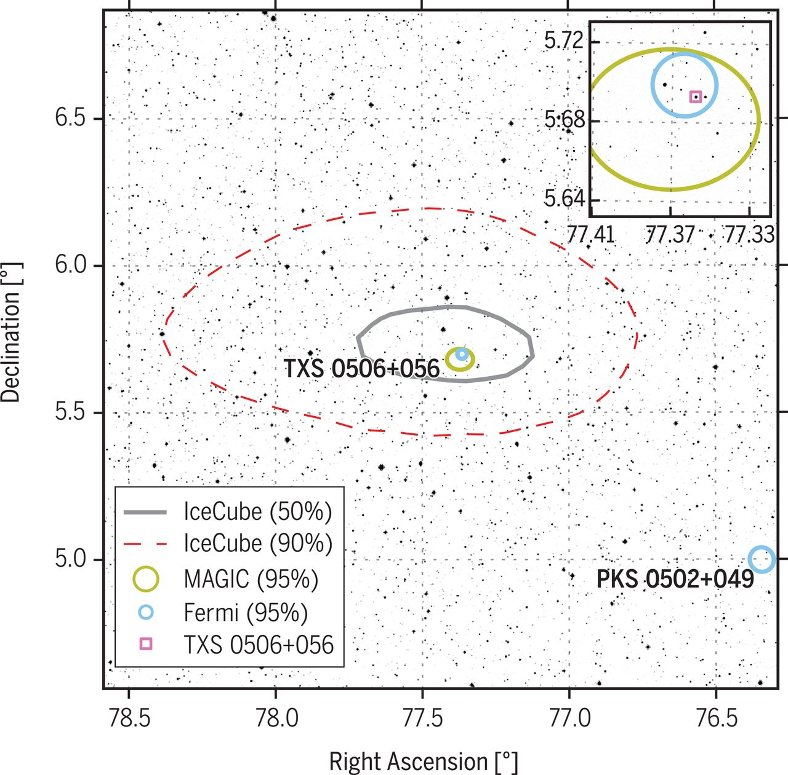
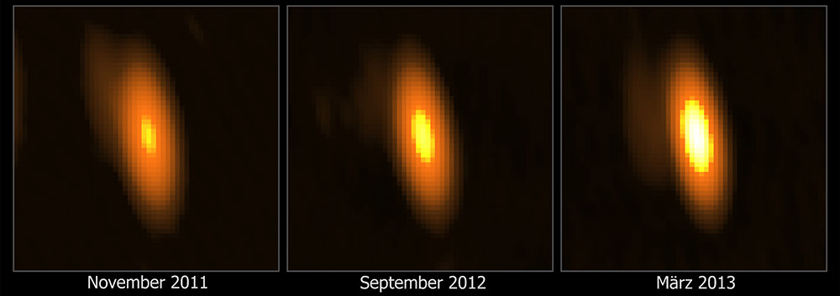
Blazars - A Source of High Energy Neutrinos?
Numerous attempts to find systematic associations between High-Energy Neutrinos and blazars
Only one reliable (i.e. 3 sigma) identification so far: TXS 0506+056
Several studies suggest connection between radio-bright AGN and high-energy neutrino emission (Plavin et al. 2020/21/22, Hovatta et al. 2020, Kadler et al. 2016)
Localization Region of IC170922A (IceCube Collaboration et al. 2018)
Radio Images of PKS 1424-418 before and after a possibly coincident (2$σ$) Neutrino Event (Kadler et al. 2016)
VLBI Probes of Jet Physics in Neutrino Candidate Blazars
2
- Florian Eppel -

Slide 3
Blazars - A Source of High Energy Neutrinos?
Lots of promising new candidate Neutrino-blazars connected with (radio-) flares at the time of neutrino emission in the last years/months
July 2019: IC190730A associated with a radio-flare in PKS 1502+106 but NO enhanced gamma-ray state (Taboada and Stein 2019)
October 2020: PKS 1725+123 found in radio-flaring state associated with IC201021A (Nanci et al. 2022)
December 2021: PKS 0735+178, simultaneous multi-waveband flare associated with a high-energy neutrino (IceCube & Baikal GVD)
February 2022: PKS 0215+015: Radio + Gamma-Ray Flare coincident with an IceCube Neutrino Event
Need for more statistics and individual case-studies to understand the physics of neutrino production
This list is not complete and still keeps growing!
VLBI Probes of Jet Physics in Neutrino Candidate Blazars
3
- Florian Eppel -

Slide 4
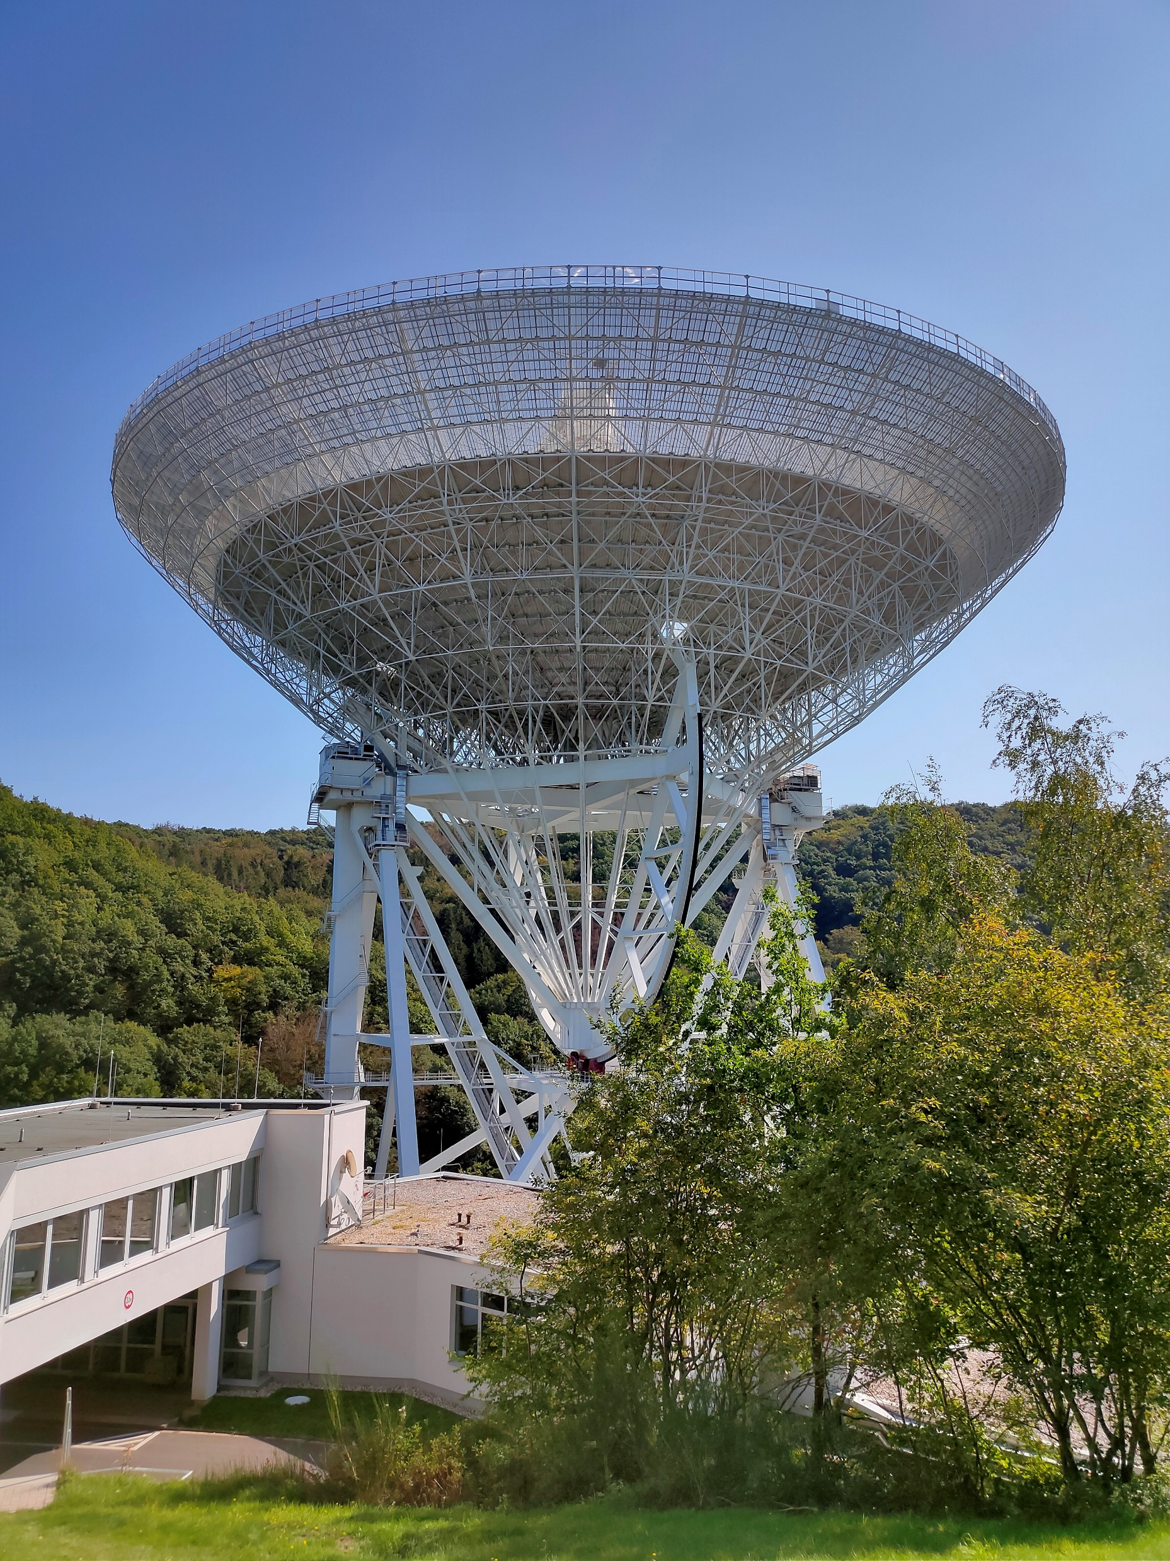
TELAMON
TeV Effelsberg Long-term Agn MONitoring
Est. Aug 2020
Monitoring radio spectra of TeV-Blazars and candidate neutrino-assoc. AGN
Sample of ~60 sources, mostly HBLs
High cadence monitoring observations
Every 2-4 weeks
From 5 GHz up to 45 GHz (45mm, 20mm, 14mm, 7mm)
Neutrino follow-up observations
©J. Heßdörfer
Effelsberg 100-m Telescope
Kadler et al. (2021, ICRC PoS), Eppel et al. (2023, in prep.)
VLBI Probes of Jet Physics in Neutrino Candidate Blazars
4
- Florian Eppel -

Slide 5
TELAMON
Main Goals (long term):
Investigate the AGN radio-$γ$ correlation (especially with upcoming CTA)
Covers fainter radio sources and higher frequencies than previous programs
Pin down neutrino sources by radio flaring activity
Trace dynamical processes in pc-scale jets related to flares or $ν$-detections.
Characterize variability and polarization properties to test different emission models
Publicly available data distributed via website: https://telamon.astro.uni-wuerzburg.de
VLBI Probes of Jet Physics in Neutrino Candidate Blazars
5
- Florian Eppel -

Slide 6
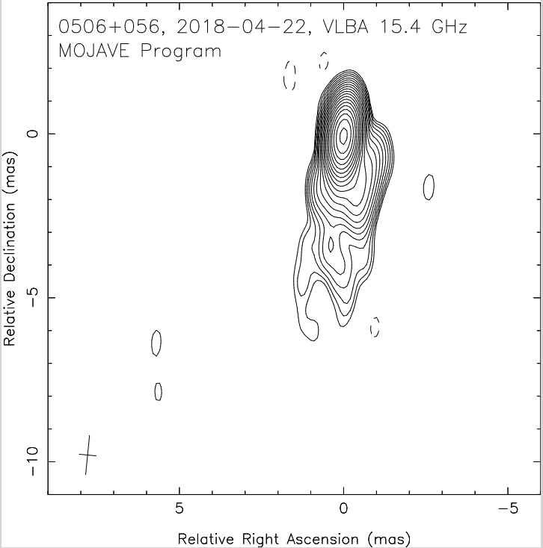
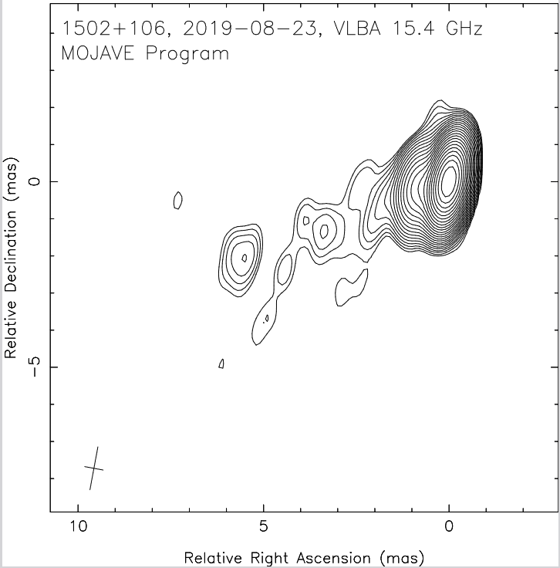
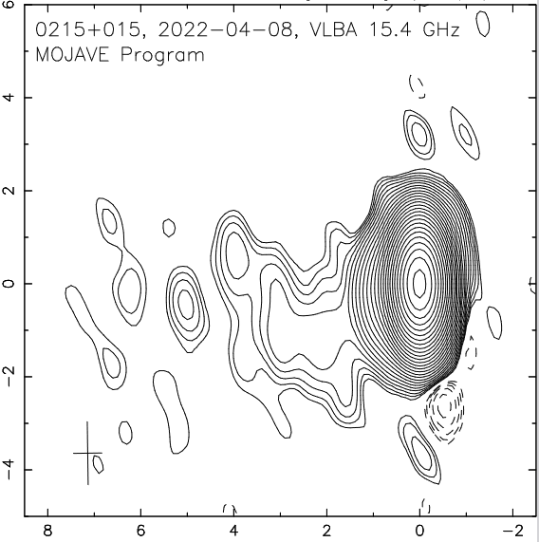
Good Things Come In Threes
TXS 0506+056
PKS 1502+106
PKS 0215+015
Relative Declination [mas]
Relative Declination [mas]
Relative Declination [mas]
Relative Right Ascension [mas]
Relative Right Ascension [mas]
Relative Right Ascension [mas]
IC170922A
IC190730A
IC220225A
All radio-flaring at time of neutrino event and followed up with VLBI ToO observations
VLBI Probes of Jet Physics in Neutrino Candidate Blazars
6
- Florian Eppel -

Slide 7
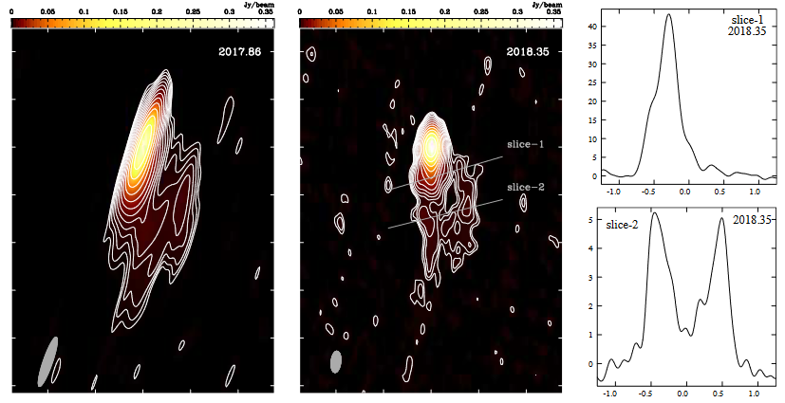
TXS 0506+056 (IC170922A)
Multiwavelength-Flare associated with Neutrino Event IC170922A
VLBA DDT/ToO Campaign (Oct 2017, Nov 2017 & May 2018)
32 MOJAVE observations at 15 GHz available in the archive
GMVA observations at 43 GHz & 86 GHz in Oct 2020 and Apr 2021
43 GHz VLBA images and surface brightness profiles of TXS 0506+056 after the associated neutrino event providing evidence of limb-brightening (Ros et al. 2020)
VLBI Probes of Jet Physics in Neutrino Candidate Blazars
7
- Florian Eppel -

Slide 8
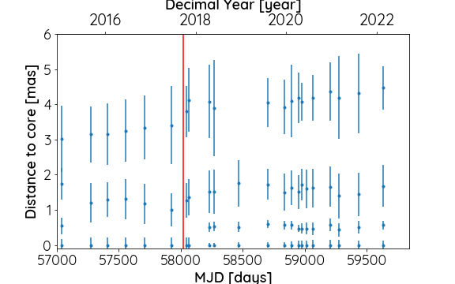
TXS 0506+056 (ongoing work)
Main Goals
Decimal Year [year]
Investigate super-luminal core-expansion found by Ros et al. 2020 with more VLBI epochs and at higher frequencies
Spectral-Index Analysis
Kinematic Analysis
Core-Shift Analysis
Investigate magnetic field and spine-sheath structure with polarization information
PRELIMINARY
MJD [days]
VLBI Components found in MOJAVE data at 15 GHz
Possible new jet component found
VLBI Probes of Jet Physics in Neutrino Candidate Blazars
8
- Florian Eppel -

Slide 9
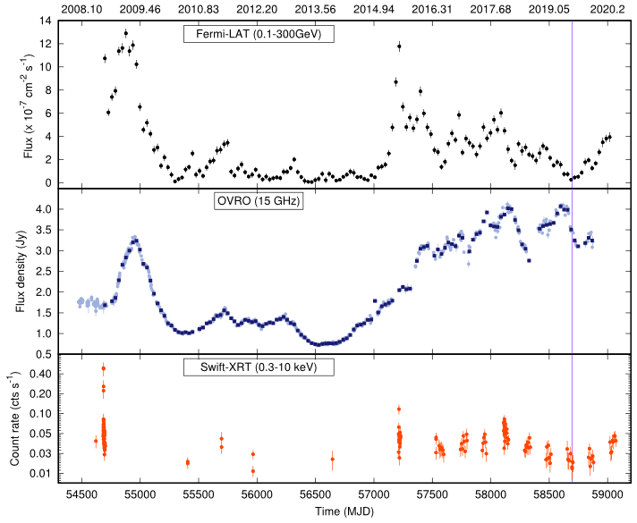
PKS 1502+106 (IC190730A)
Kun et al. 2021
Radio-Flare coincident with neutrino event IC190730A but NO gamma-ray flare
VLBA DDT/ToO Campaign (Aug 2019)
38 MOJAVE observations at 15 GHz available in the archive
GMVA observations at 43 GHz & 86 GHz in Oct 2020 and Apr 2021
VLBI Probes of Jet Physics in Neutrino Candidate Blazars
9
- Florian Eppel -

Slide 10
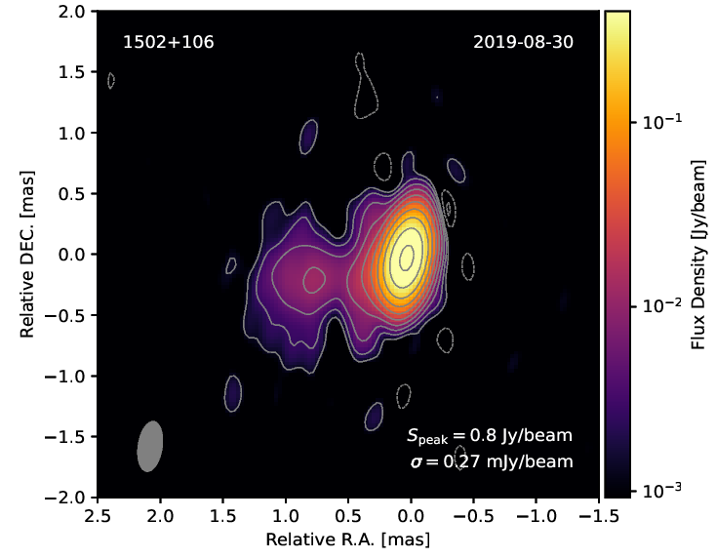
PKS 1502+106 (ongoing work)
Main Goals
PRELIMINARY
Study kinematics and evolution of EVPA after the neutrino event
Investigate possible EVPA swings which have been observed before
Spectral-Index Analysis
Core-Shift Analysis
Investigate spine-sheath structure in combination with lepto-hadronic SED models
43 GHz Image of PKS 1502+106 ~1 month after the Neutrino Event
VLBI Probes of Jet Physics in Neutrino Candidate Blazars
10
- Florian Eppel -

Slide 11
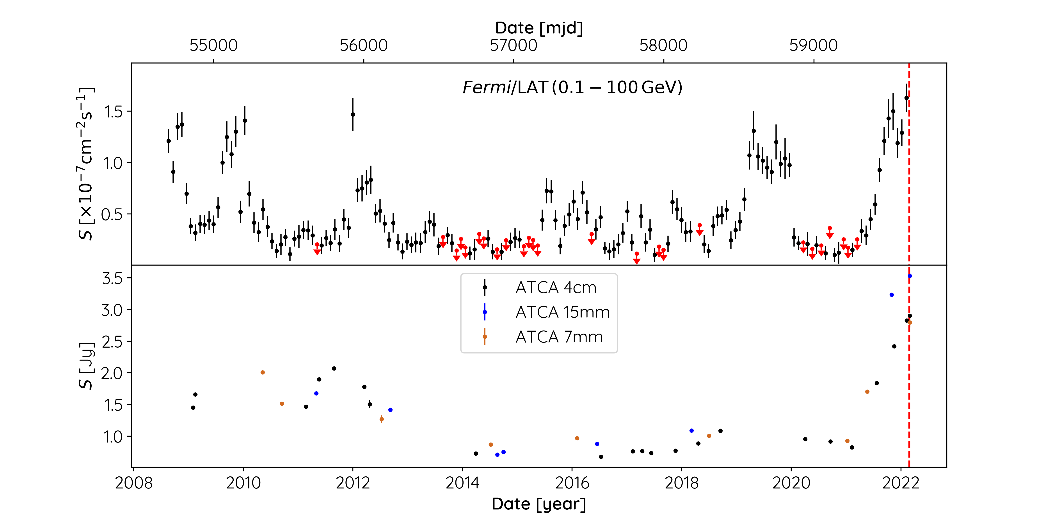
PKS 0215+015: A New Neutrino Emitter?
Eppel et al. 2023
VLBA ToO-Proposal
Total of 6 epochs after the neutrino event (1 per month)
Three-point spectral-index (20mm, 14mm, 7mm) and Faraday-rotation measurements
Probe jet kinematics
Search for characteristic similarities to TXS 0506+056 and other candidate neutrino-emitting blazars
→ First VLBA observation took place on March 24, 2022 (total of 6 epochs)
Gamma-ray and radio flaring of PKS 0215+015 in coincidence with the IceCube Neutrino Alert IC220225A
VLBI Probes of Jet Physics in Neutrino Candidate Blazars
11
- Florian Eppel -

Slide 12
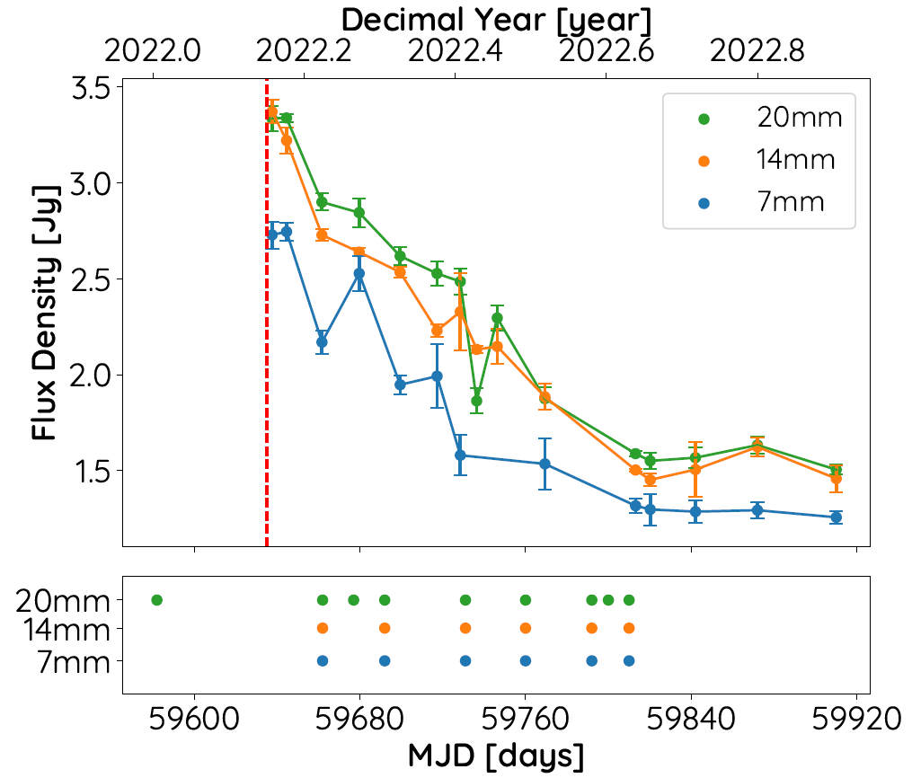
PKS 0215+015: A New Neutrino Emitter?
VLBA observations:
6 epochs with 20 mm, 14 mm and 7 mm
3 additional MOJAVE epochs with only 20mm available
Current Status:
All epochs calibrated in AIPS & rPICARD/CASA
Preliminary imaging and selfcal performed in DIFMAP
Neutrino
To Do:
Consistency check of final images
Modelfitting
Polarization calibration/imaging
VLBA
obs.
VLBI Probes of Jet Physics in Neutrino Candidate Blazars
12
- Florian Eppel -

Slide 13
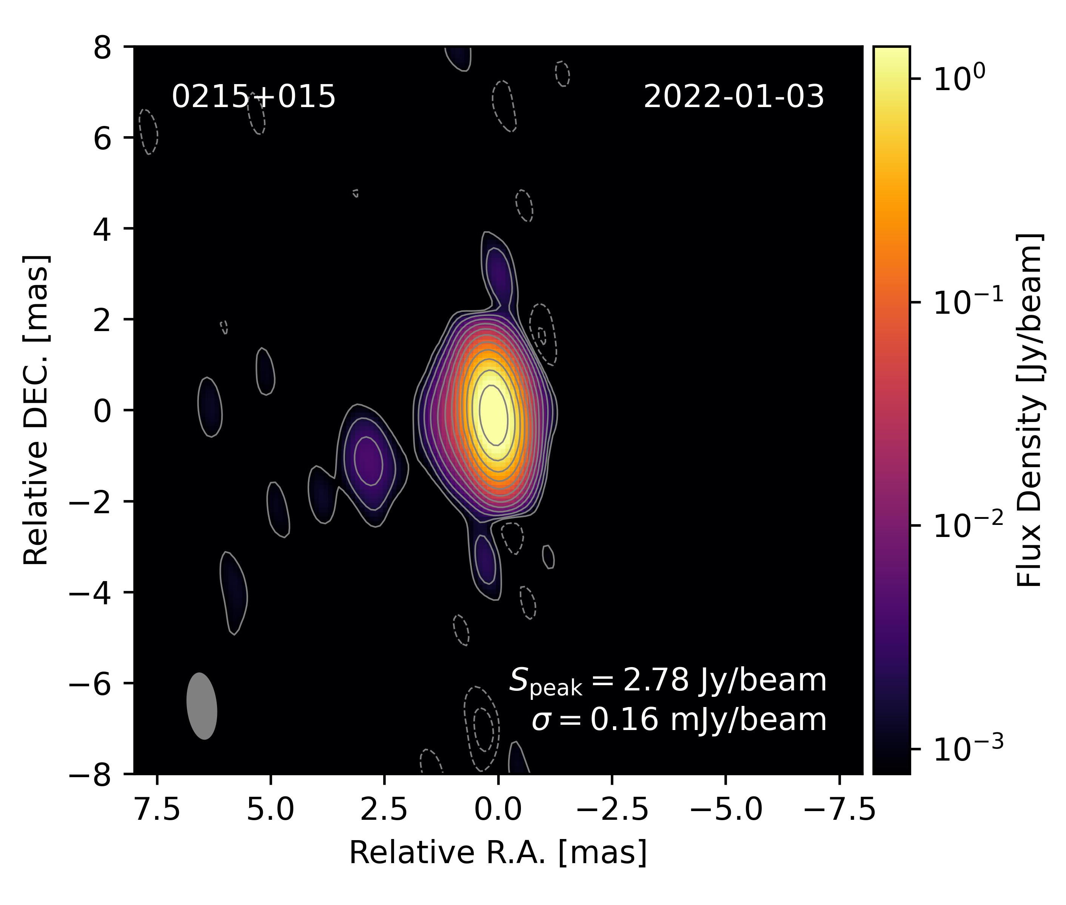
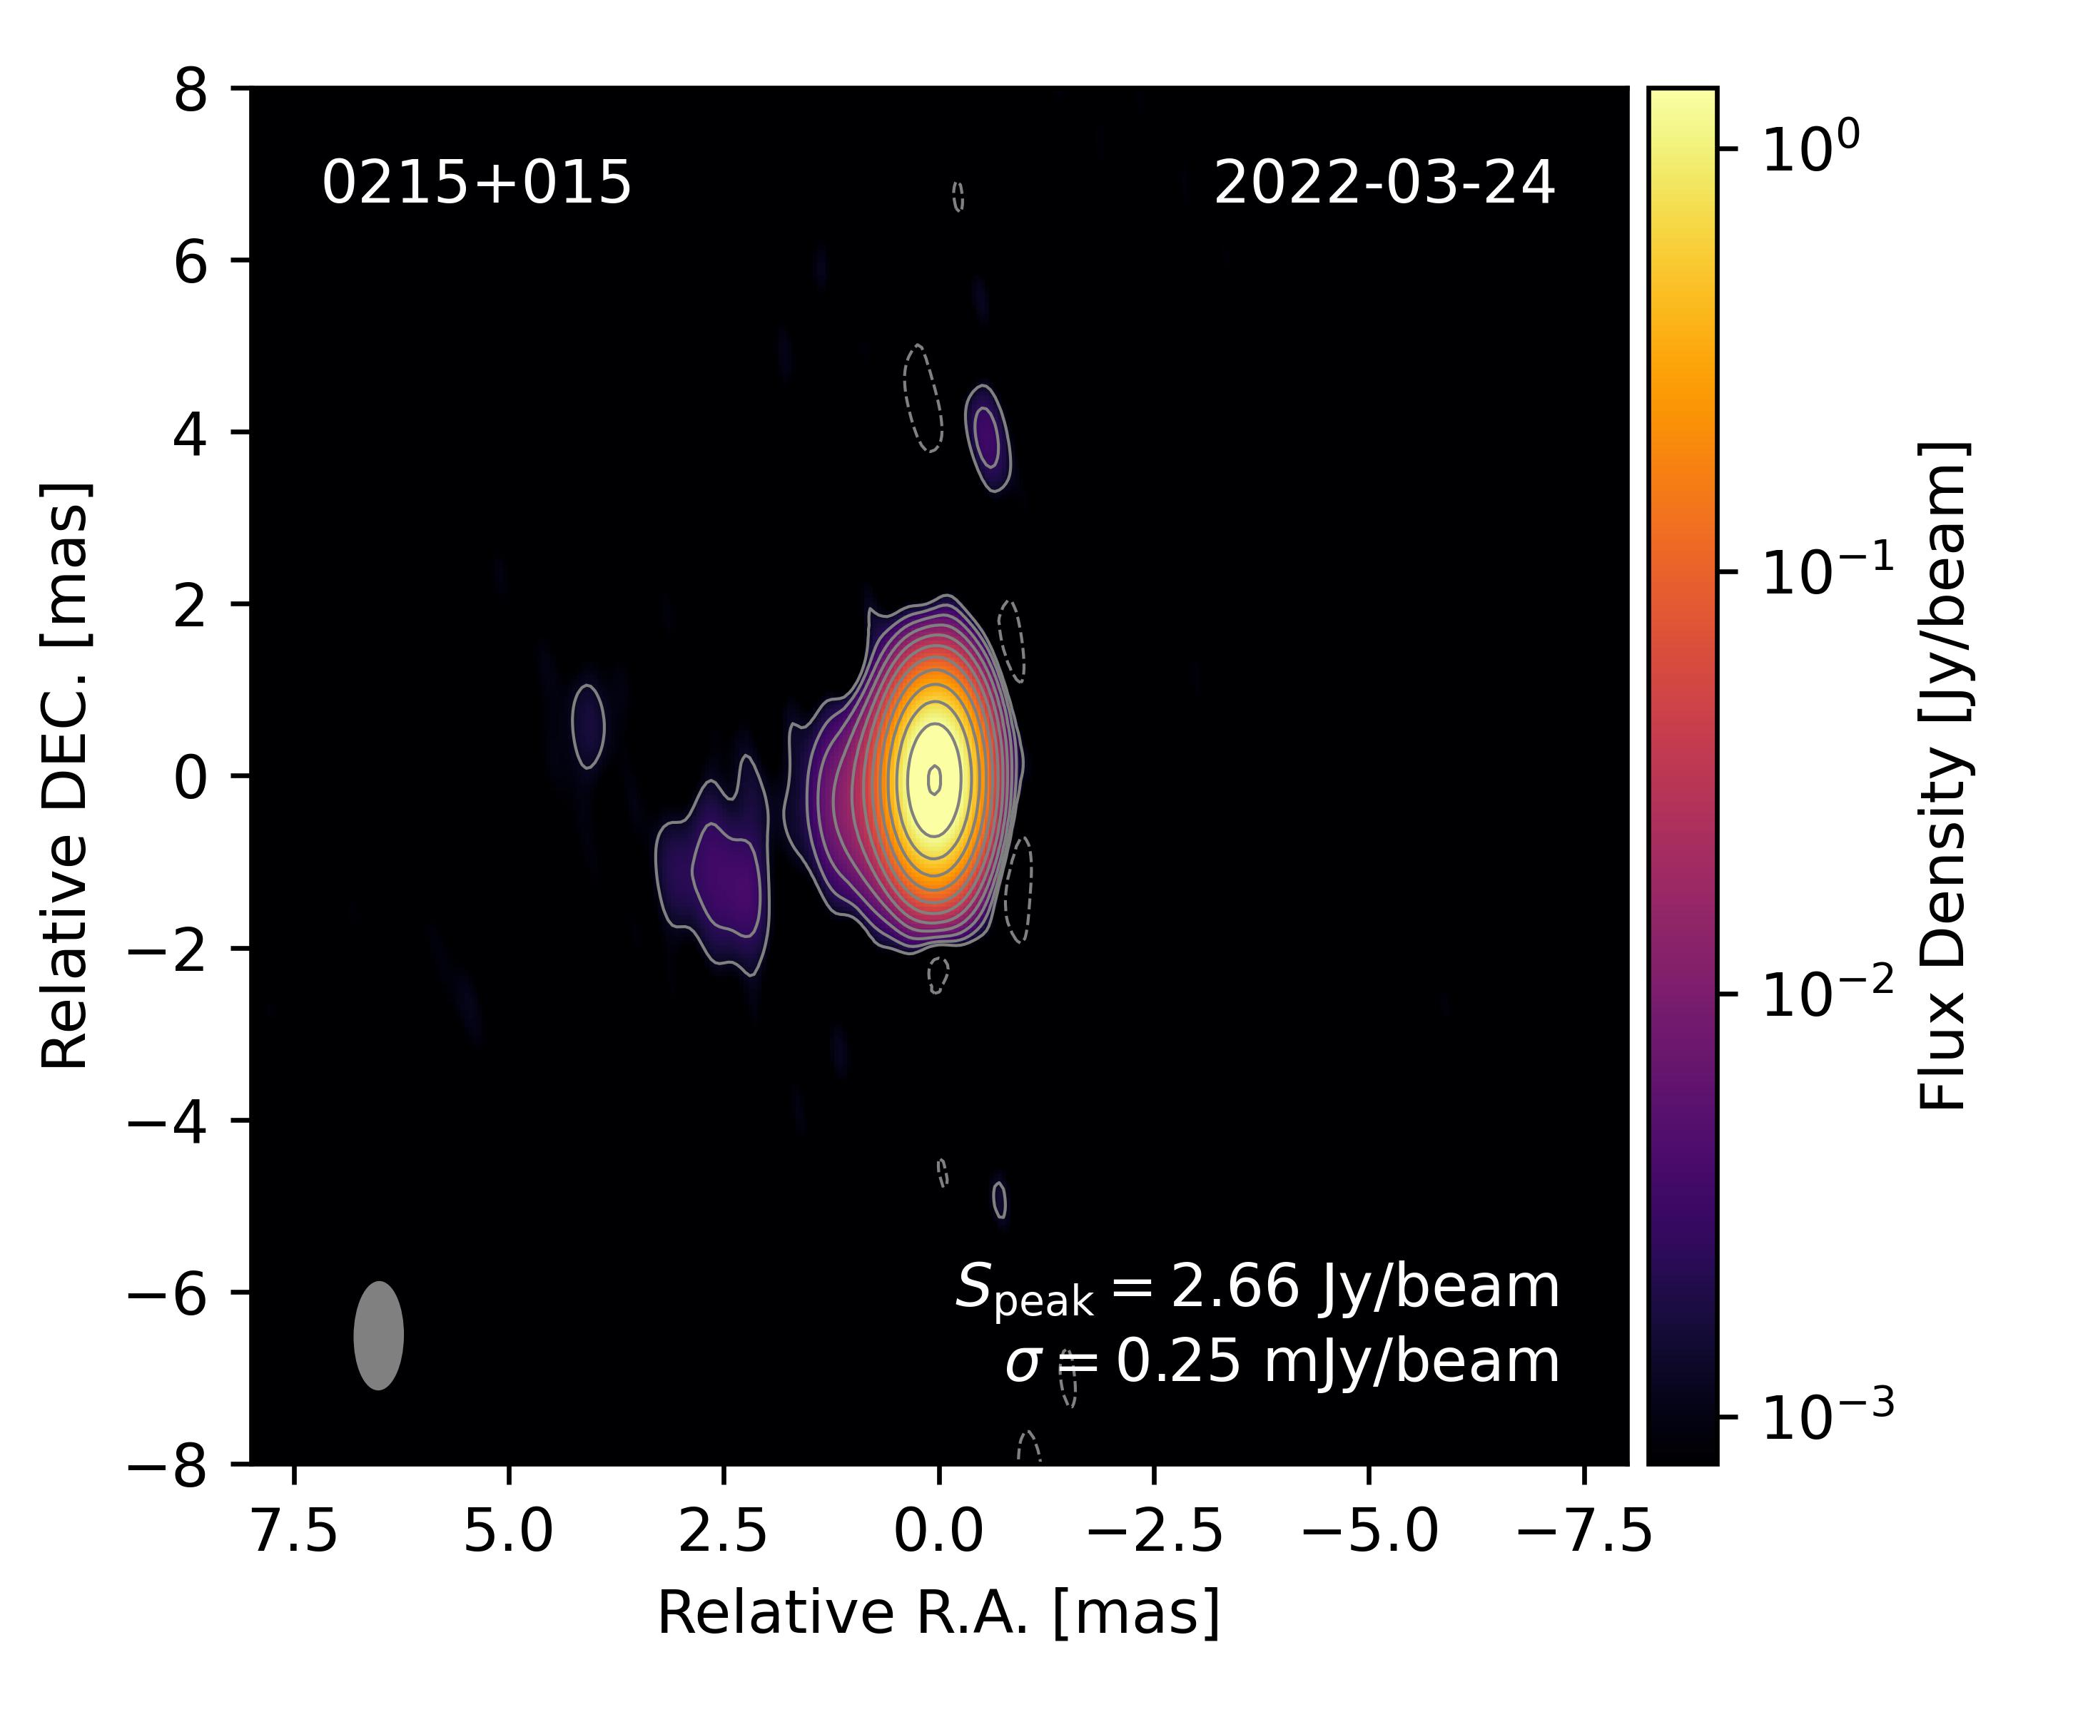
PKS 0215+015: First Look at 15 GHz
PRELIMINARY
2022-01-03 (MOJAVE) - pre-neutrino
2022-03-24 - post-neutrino
VLBI Probes of Jet Physics in Neutrino Candidate Blazars
13
- Florian Eppel -

Slide 14
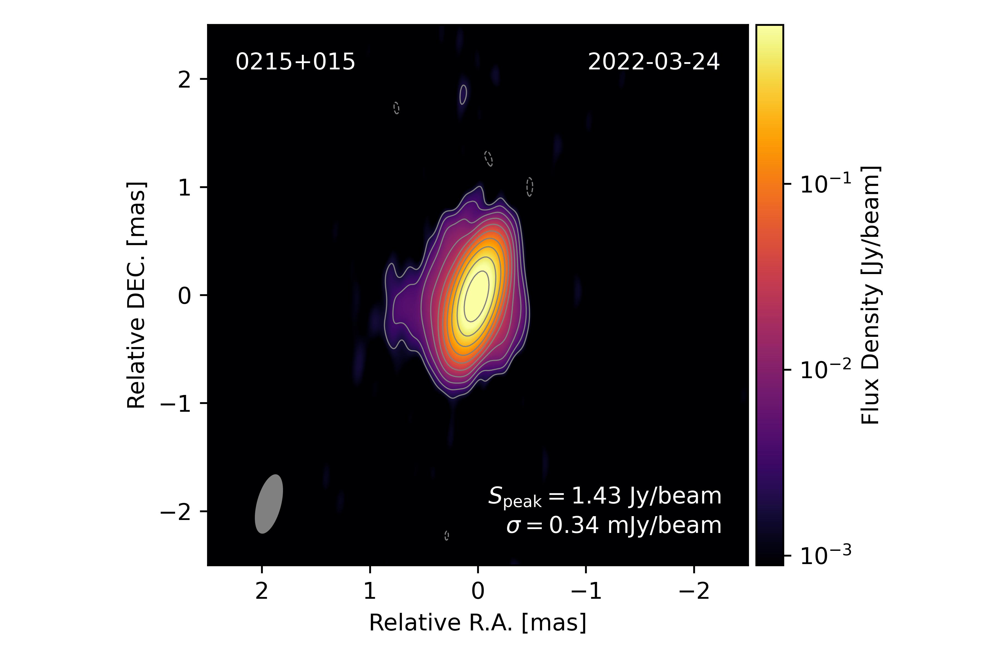
PKS 0215+015: First Look
PRELIMINARY
PRELIMINARY
PRELIMINARY
Ku-Band (15 GHz)
K-Band (23 GHz)
Q-Band (43 GHz)
VLBI Probes of Jet Physics in Neutrino Candidate Blazars
14
- Florian Eppel -

Slide 15
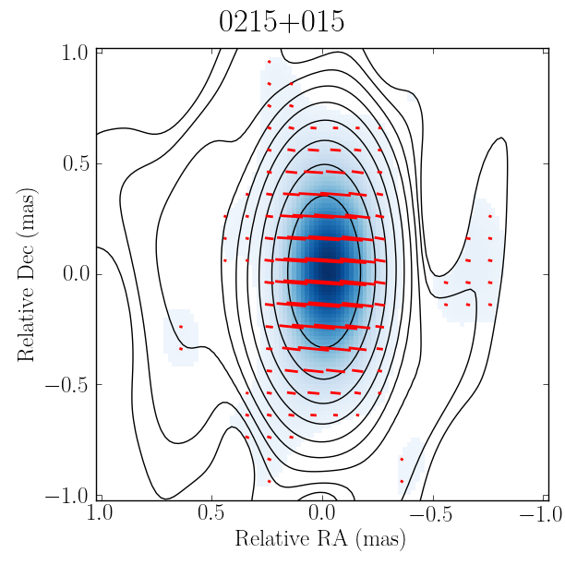
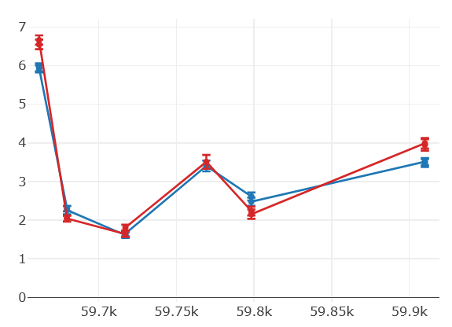
PKS 0215+015: First Look at Polarization
PRELIMINARY
TELAMON data shows elevated polarization state close to neutrino event
Preliminary VLBA polarization image produced in CASA with PolSolve (Marti-Vidal et al. 2020)
Polarized emission core dominated
Polarization Fraction [%]
MJD [days]
Linear Polarization Fraction of PKS 0215+015 after the associated Neutrino Event
K-Band (23 GHz) – 2022-03-24
VLBI Probes of Jet Physics in Neutrino Candidate Blazars
15
- Florian Eppel -

Slide 16
Summary & Outlook
TXS 0506+056, PKS 1502+106 & PKS 0215+015 exhibited radio flares coincident to high-energy neutrino events
We have triggered VLBA ToO observations to follow up the pc-scale structure of the jet in total intensity and polarization
Main Goal: Search for similarities/differences in order to understand the physics of neutrino production in blazars
We now have a unique data set at hand to investigate neutrino emission mechanisms in blazars
VLBI Probes of Jet Physics in Neutrino Candidate Blazars
16
- Florian Eppel -

Slide 17
Thank you!
Questions?
$$ν$$
VLBI Probes of Jet Physics in Neutrino Candidate Blazars
17
- Florian Eppel -

Slide 18
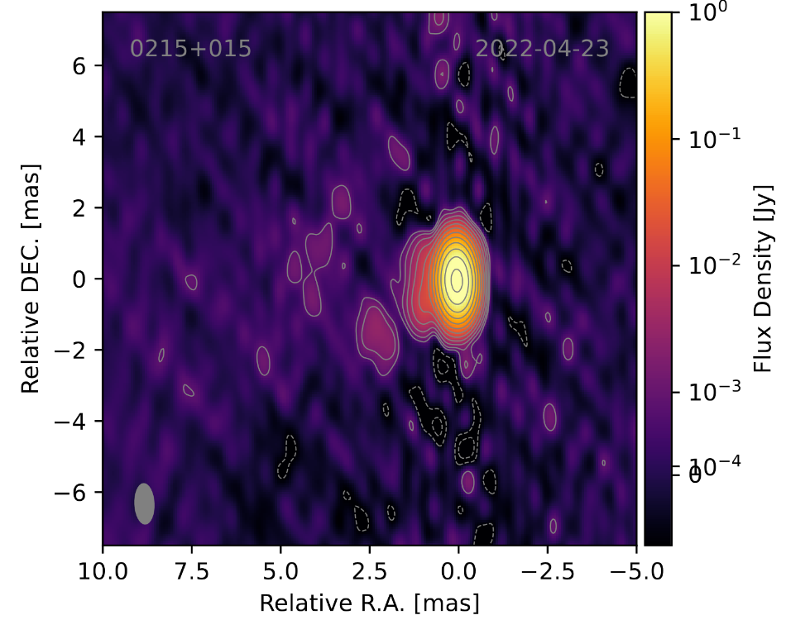
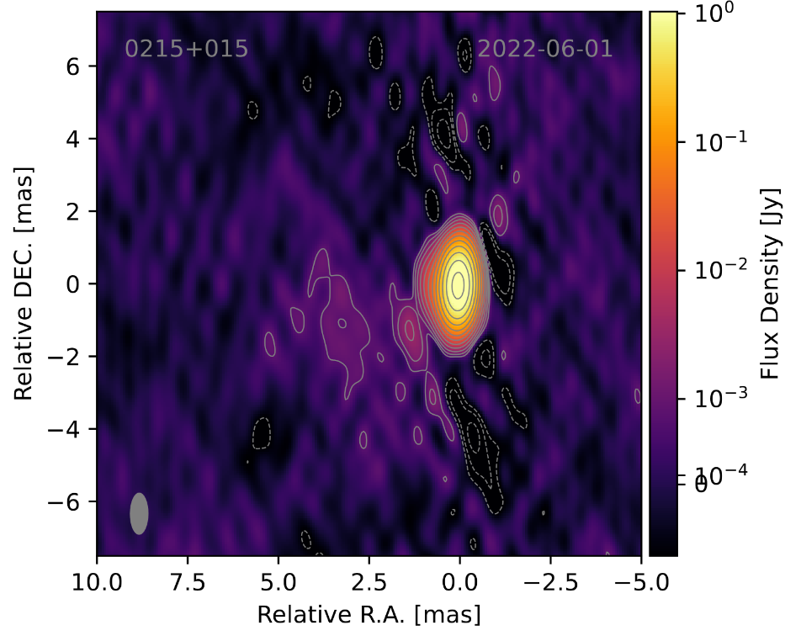
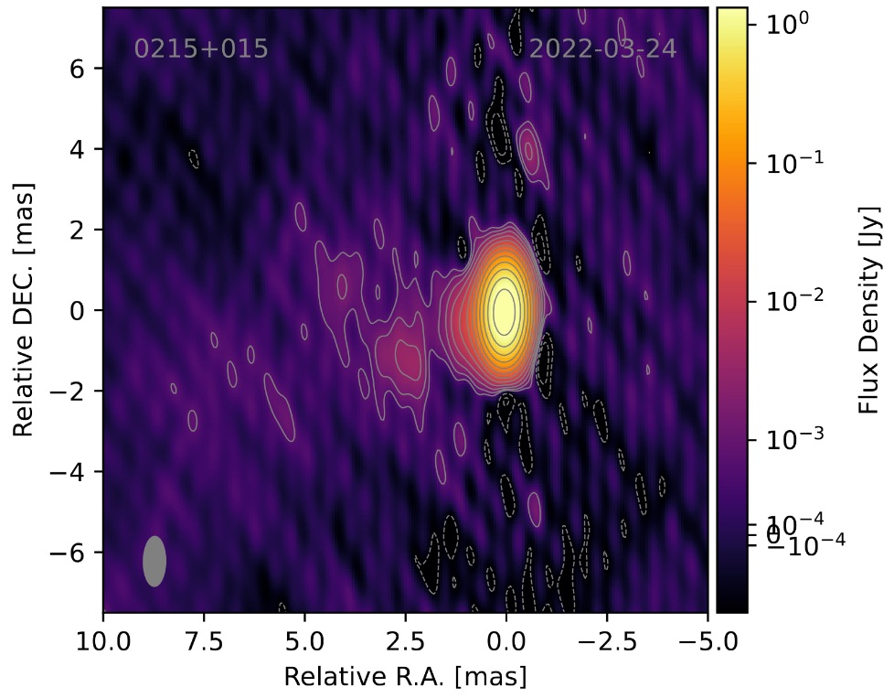
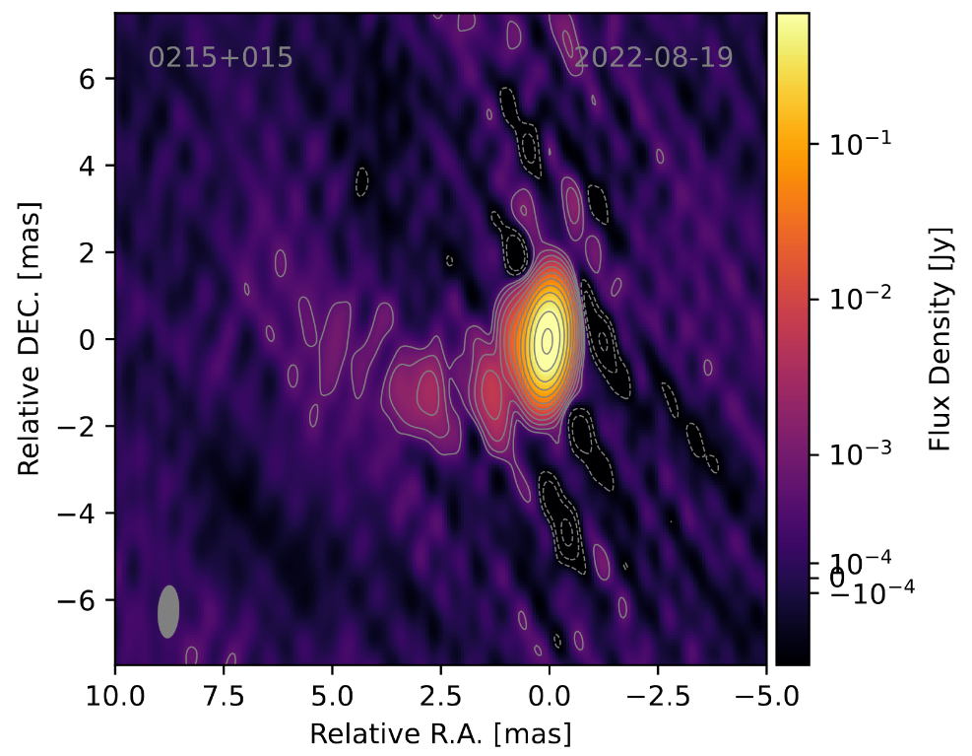
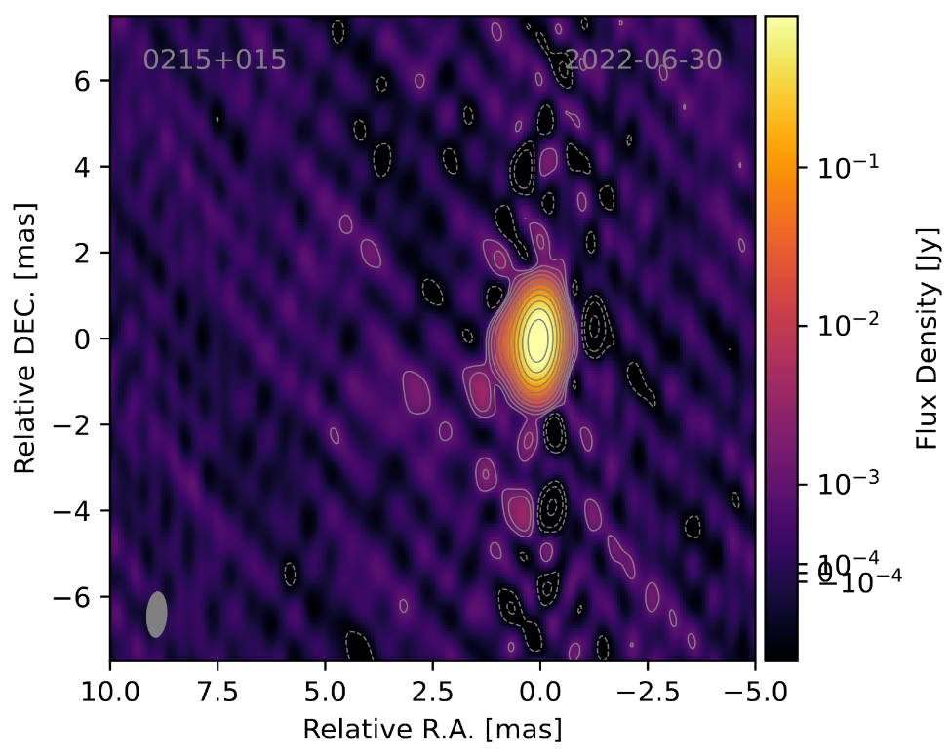
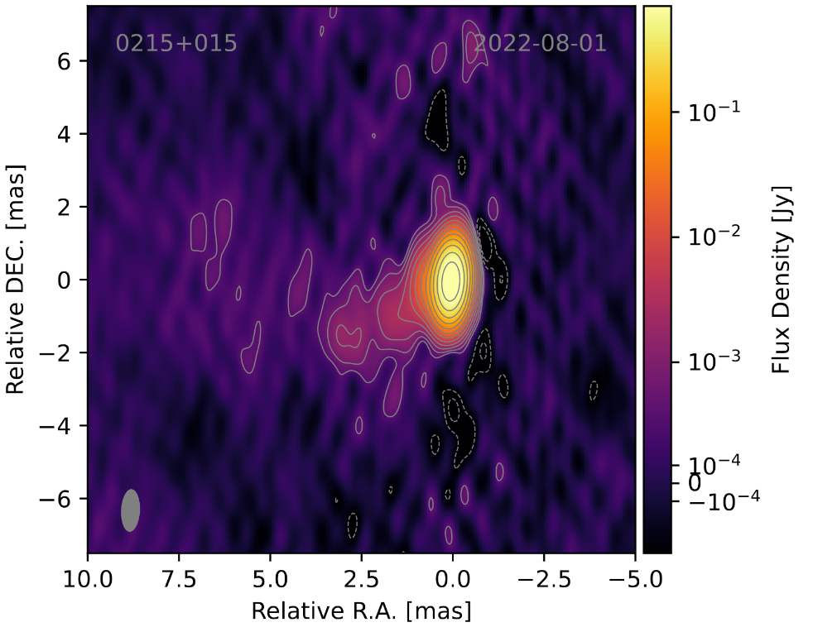
Ku-Images
PRELIMINARY
VLBI Probes of Jet Physics in Neutrino Candidate Blazars
16
- Florian Eppel -

Slide 19
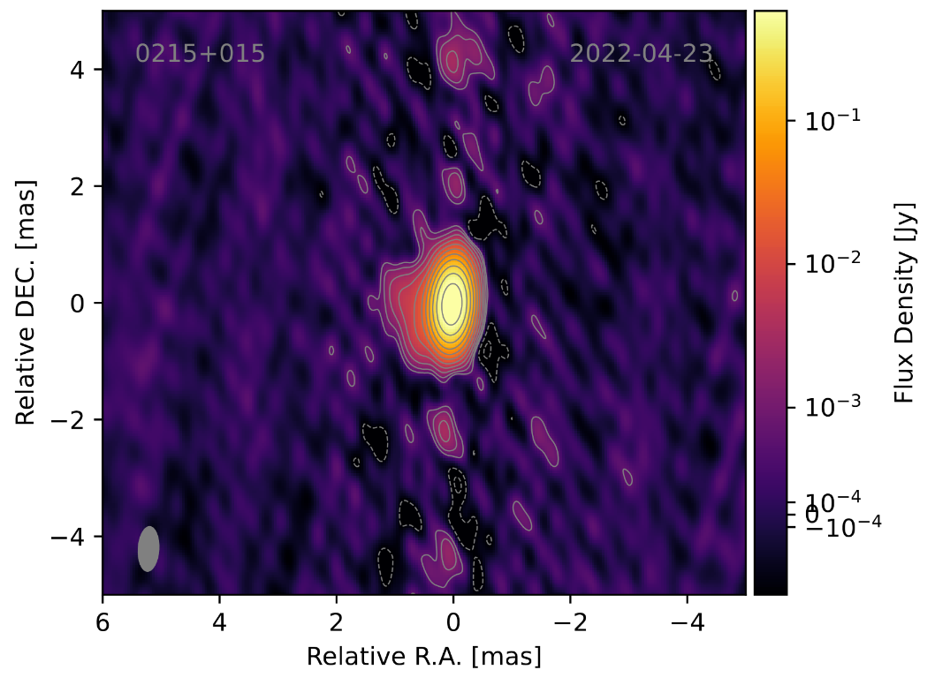
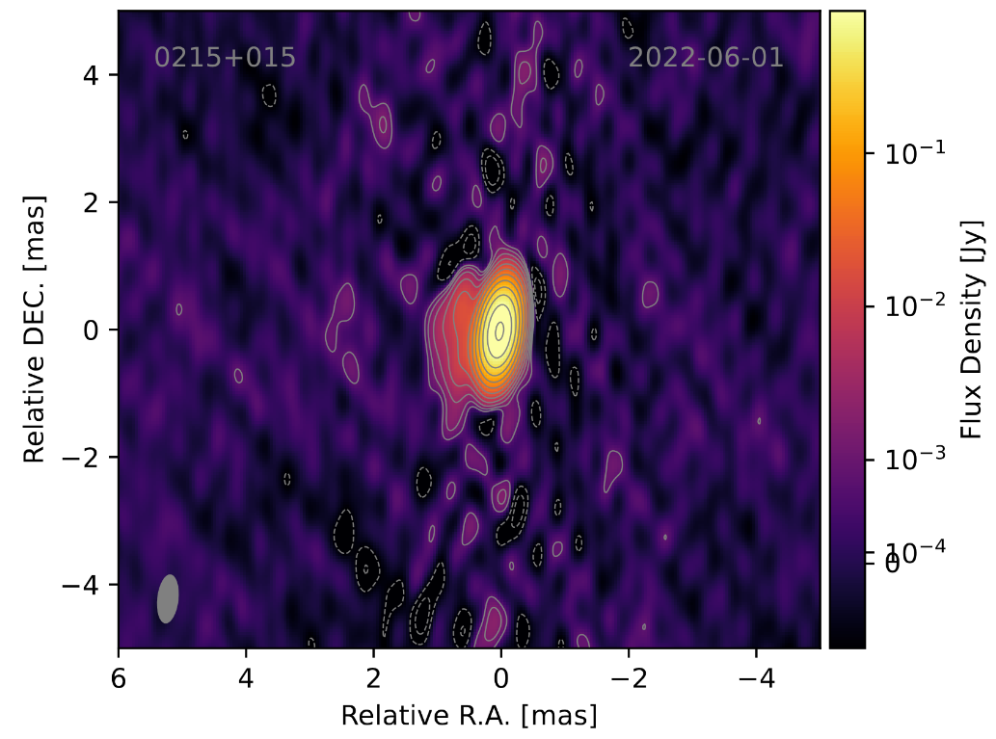
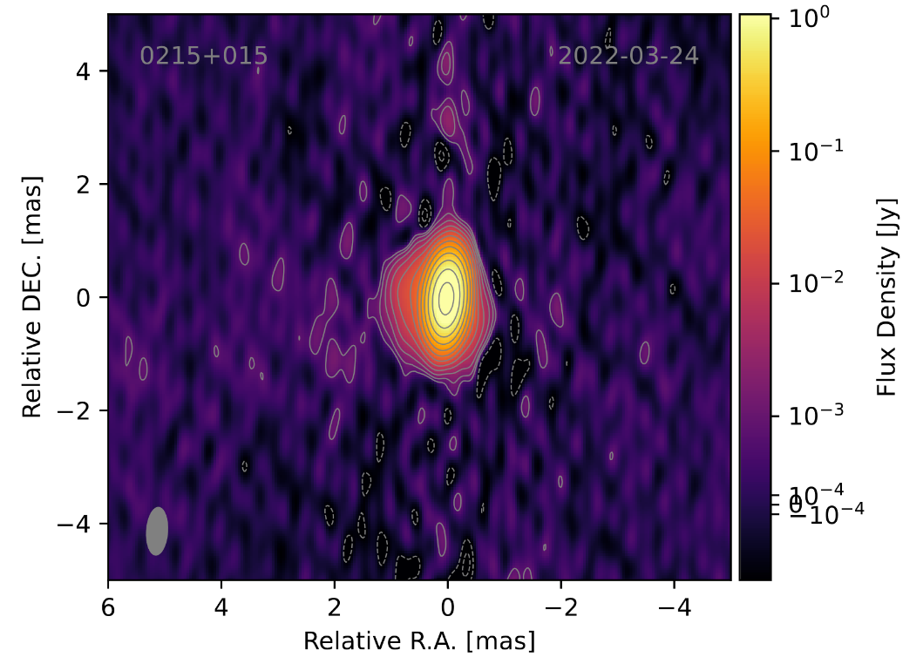
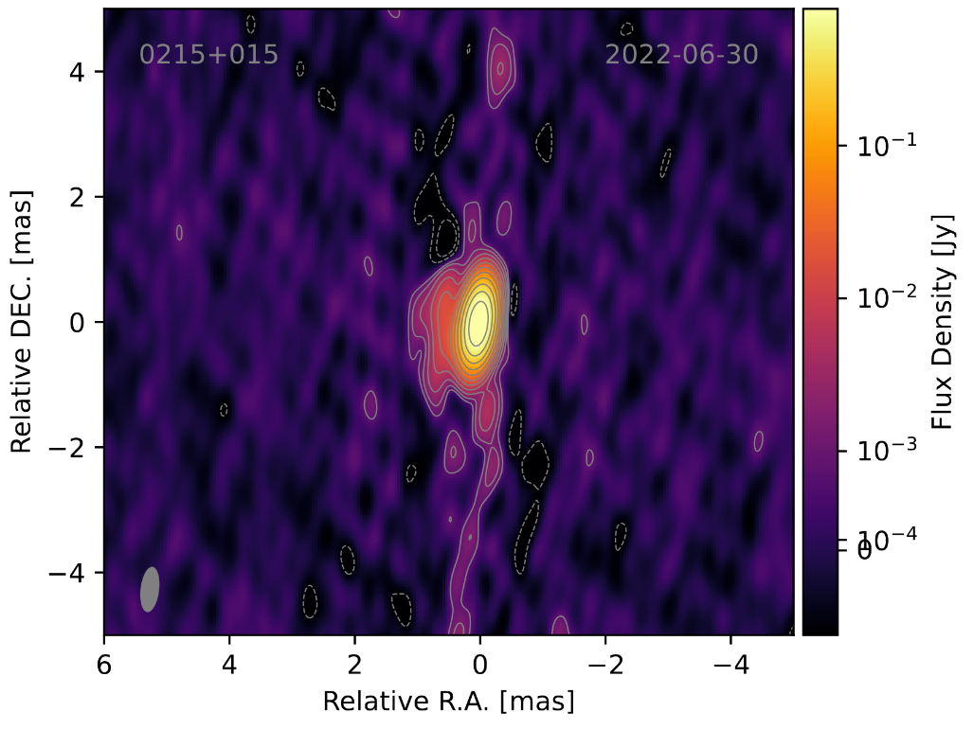
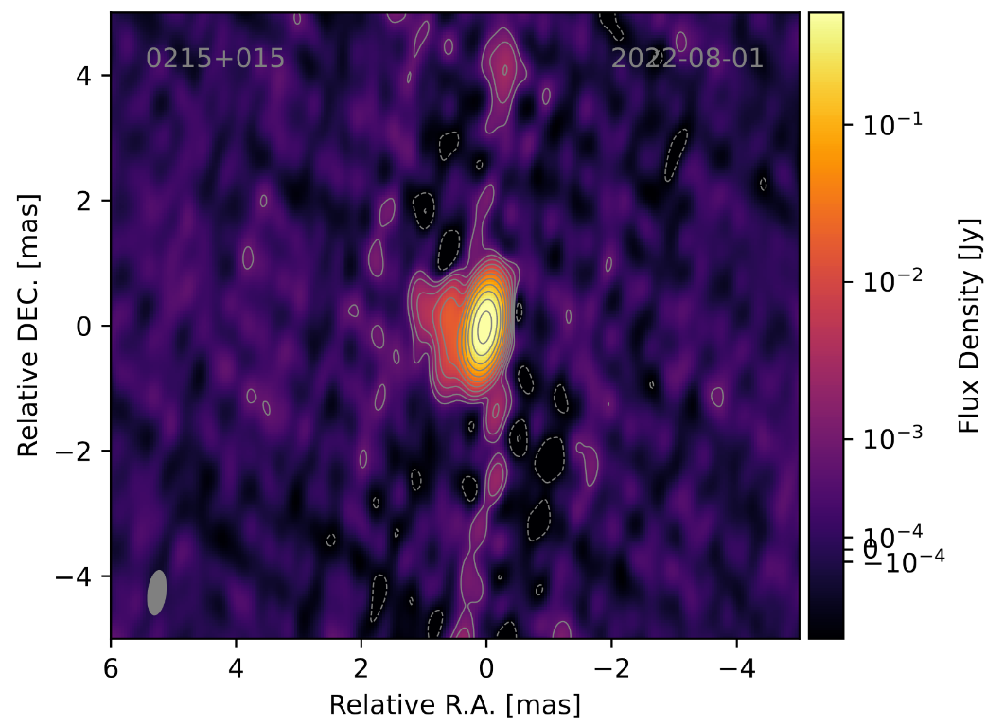
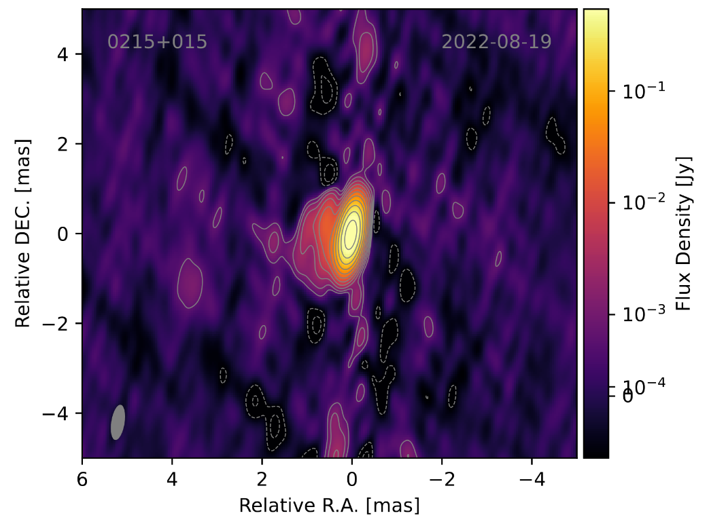
K-Images
PRELIMINARY
VLBI Probes of Jet Physics in Neutrino Candidate Blazars
17
- Florian Eppel -

Slide 20
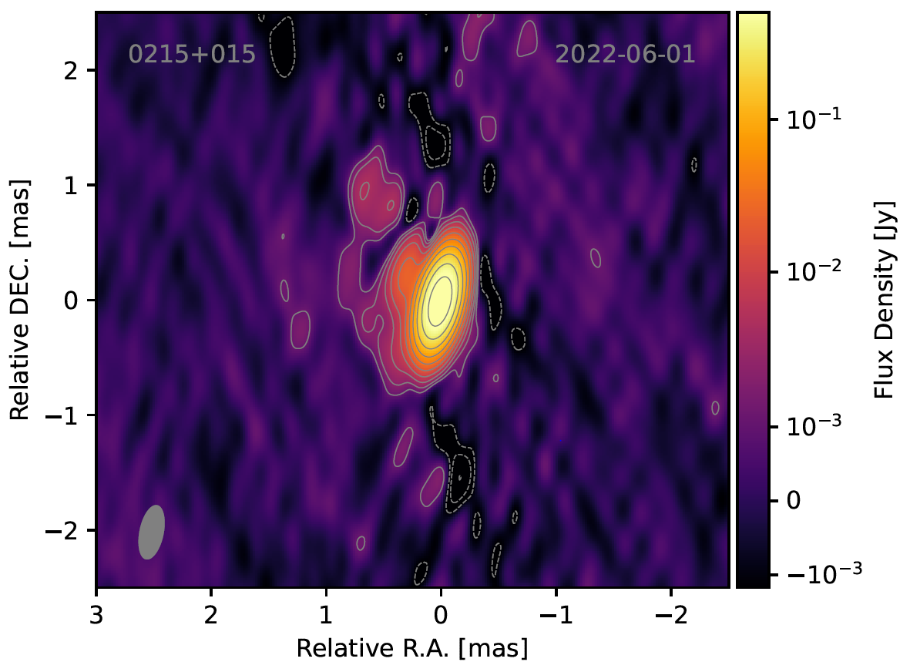
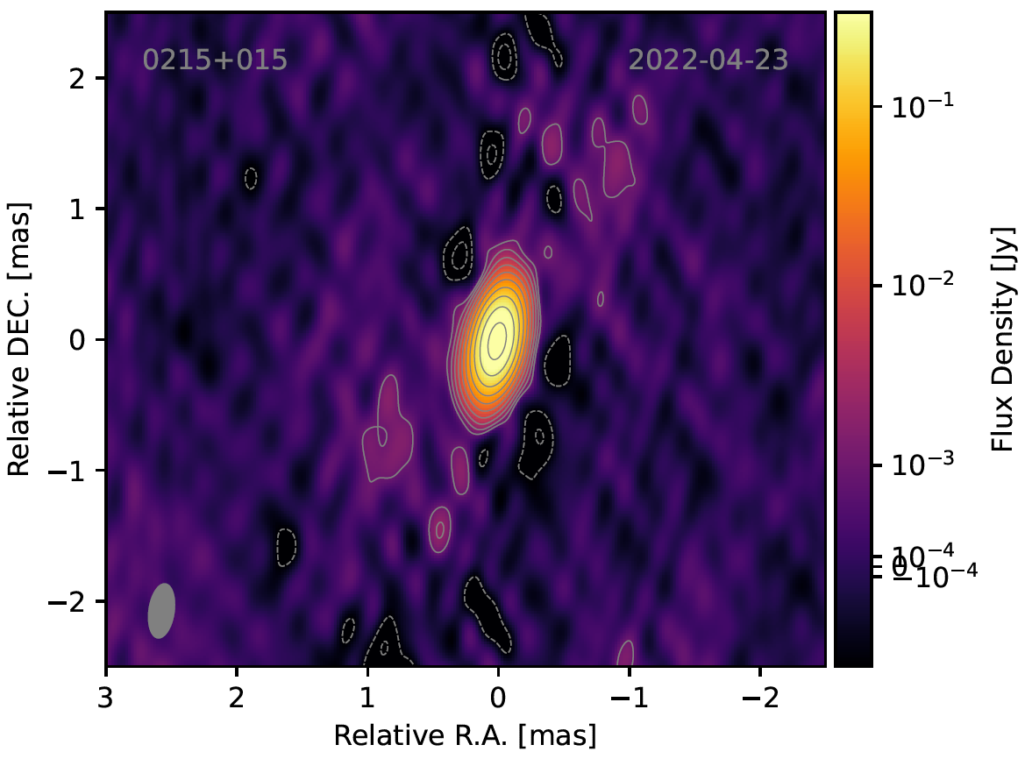
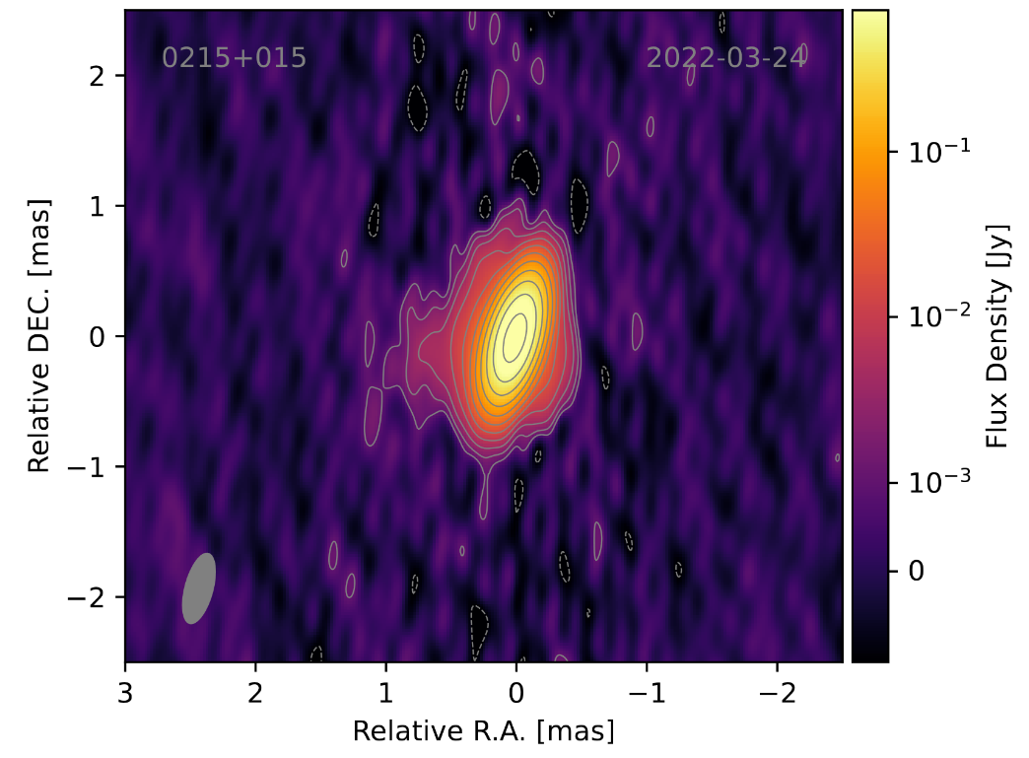
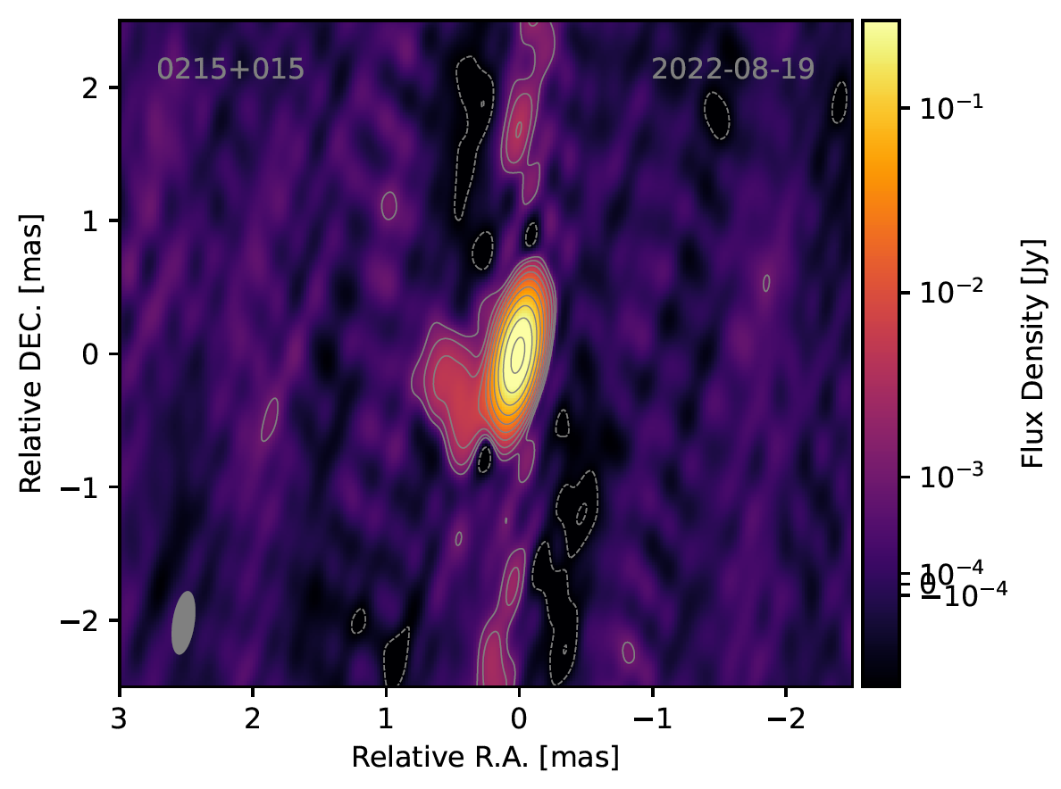
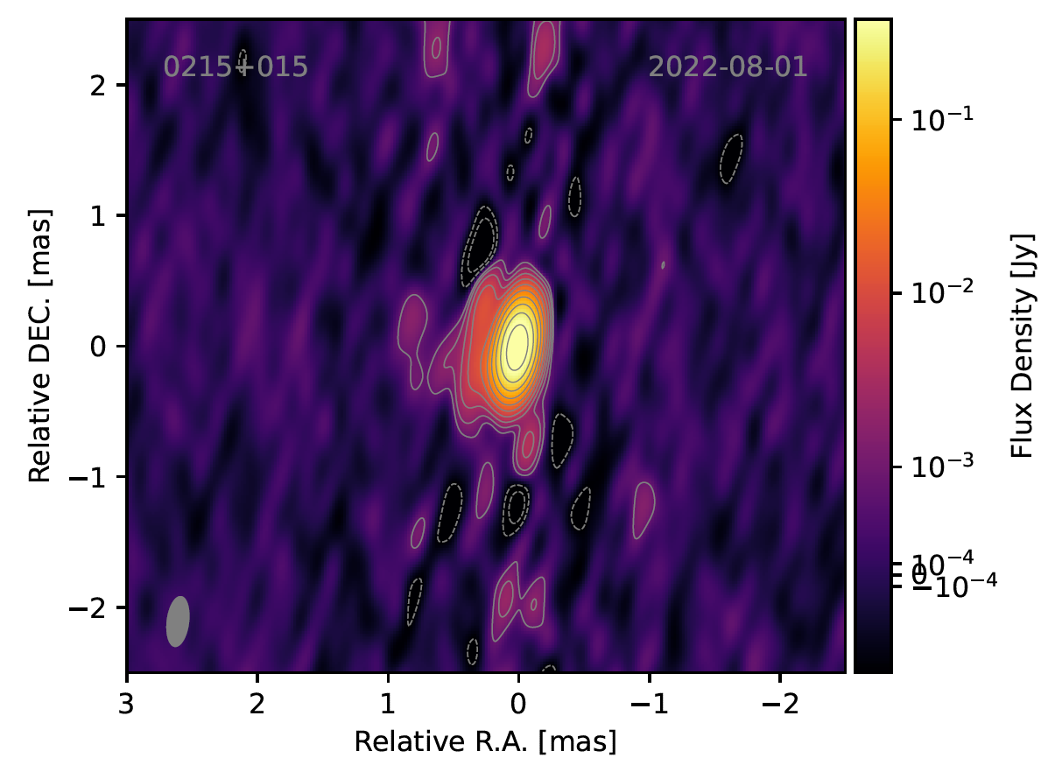
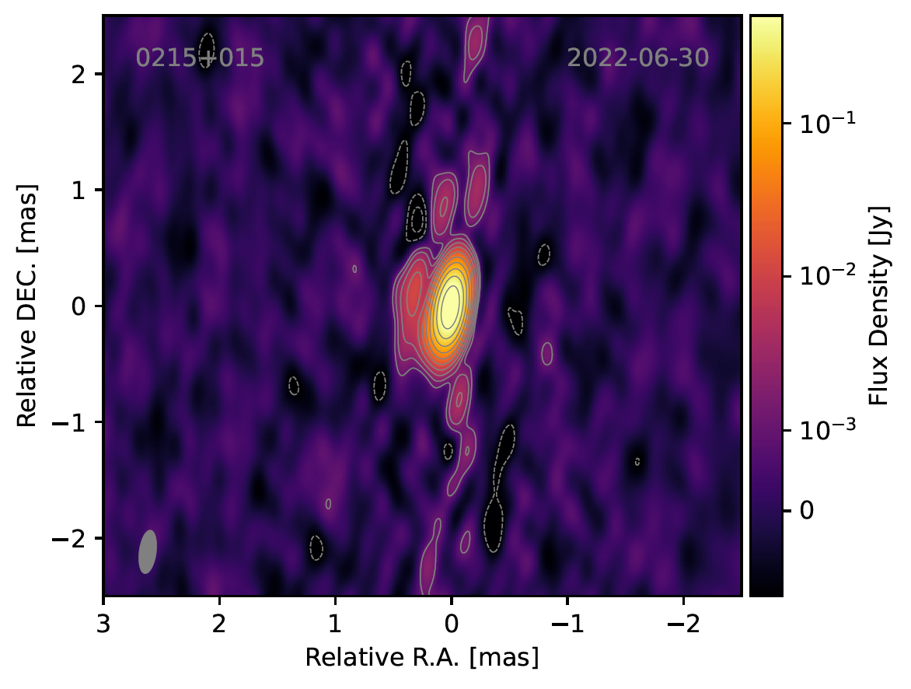
Q-Images
PRELIMINARY
VLBI Probes of Jet Physics in Neutrino Candidate Blazars
18
- Florian Eppel -

