Slide 1
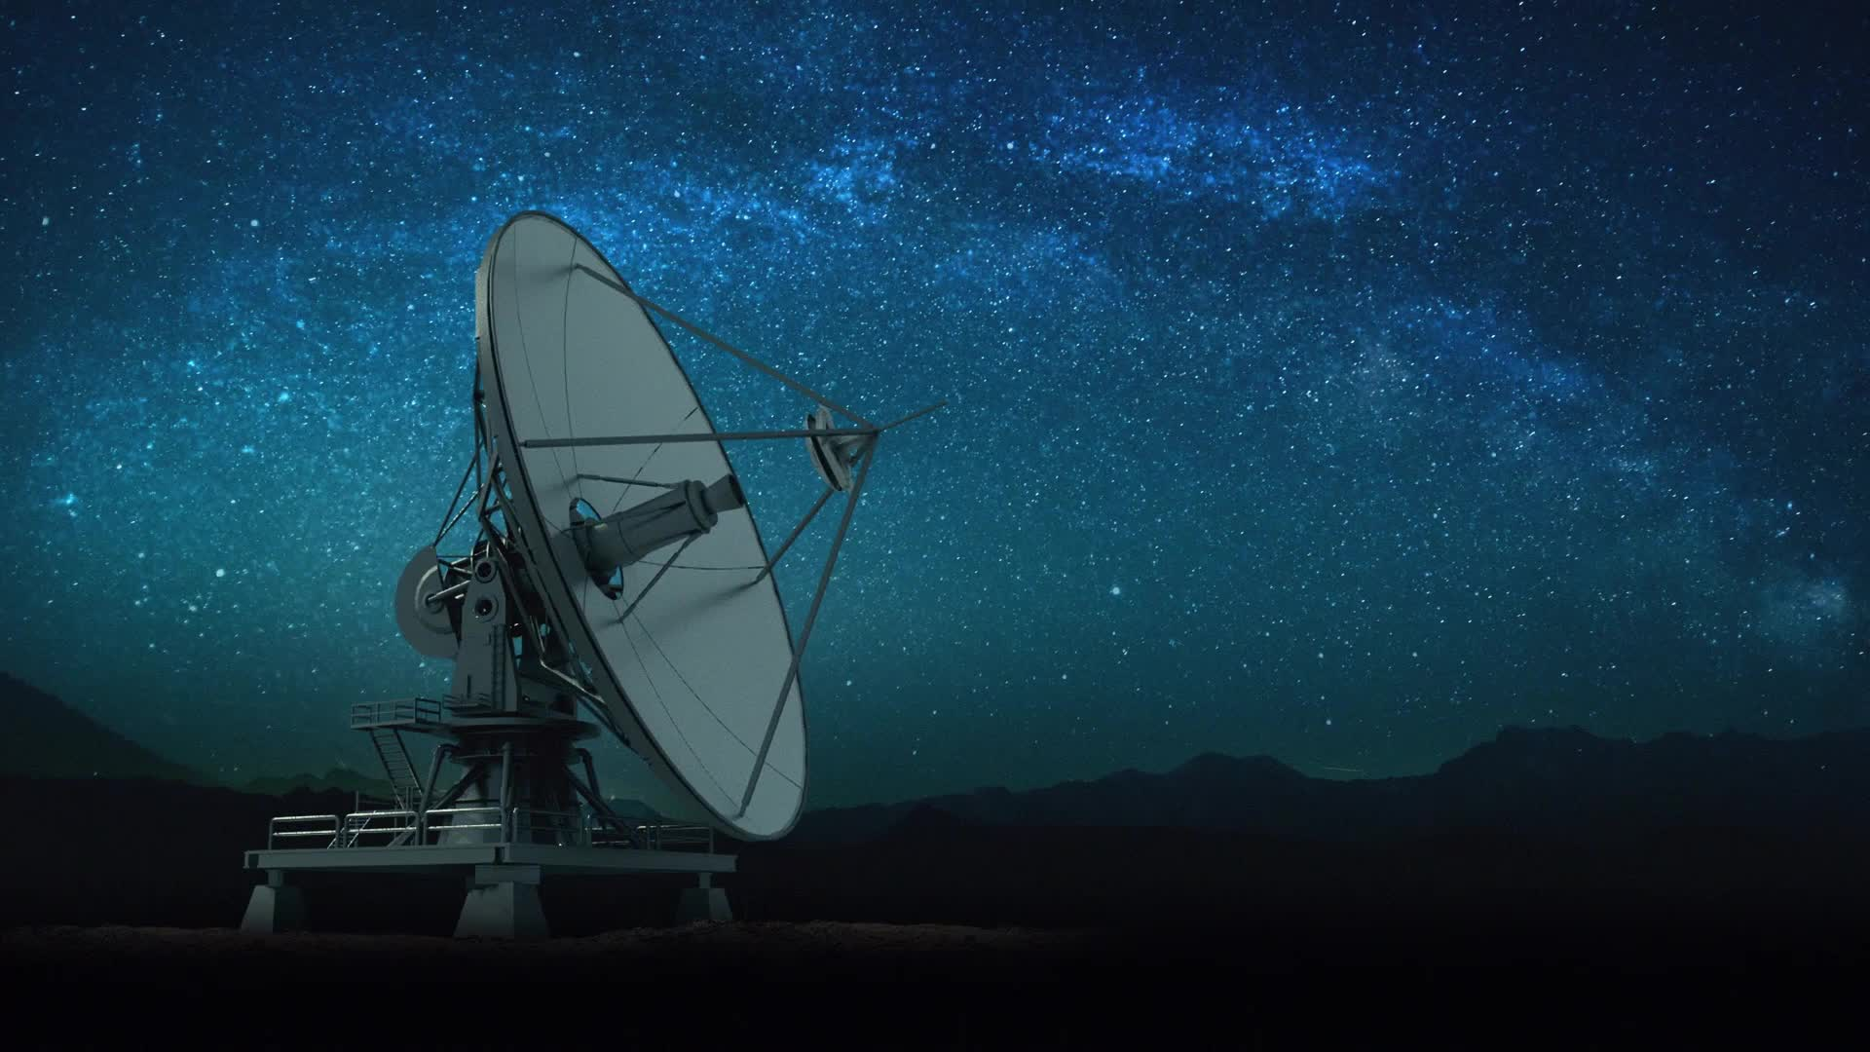
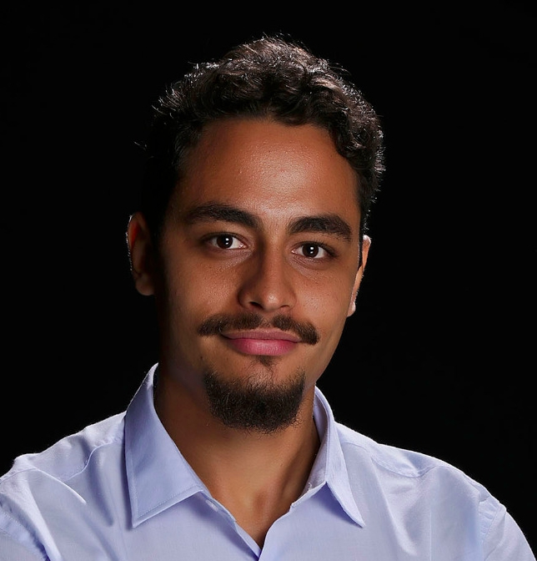




High-energy astrophysics in the multi-messenger era.
Ph.D. in Applied Computing
Luan Orion Baraúna
luan.ferreira@inpe.br
github.com/barauna-lo
Notes:
Apresentação da análise do Problema

Slide 2





Luan Orion Baraúna
Physicist - UFBA
Bachelor, Teacher degree and Master’s in physics (cosmology)
MBA in Data Science and Big Data – PUC Minas
Structure of the data, data clean, data analyze, data science pipe-line
PhD in Applied Computing - INPE
Emphasis in Artificial Intelligence in Time Series, Astronomical data analyses
Teacher
Elementary School, High School, College, Young Adult Special Education
Research
Cosmology, Deep Neural Network, Educational tools, time series data analyse
Collaborations
(Radio) BINGO Radio telescope - (Visible) LSST – (High Energy) ????
Free time
Sports, hiking, cycling, running, reading, video games

Slide 3
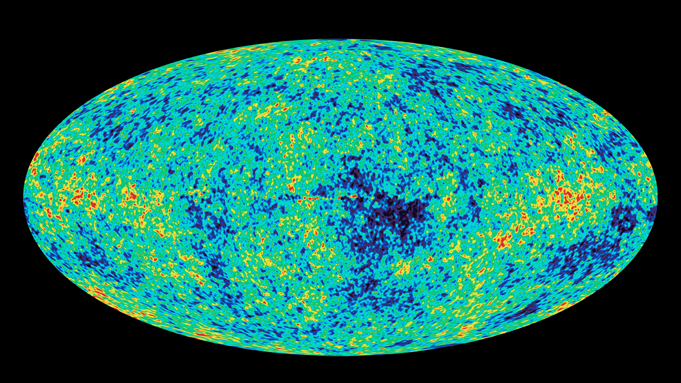
Cosmology

Slide 4
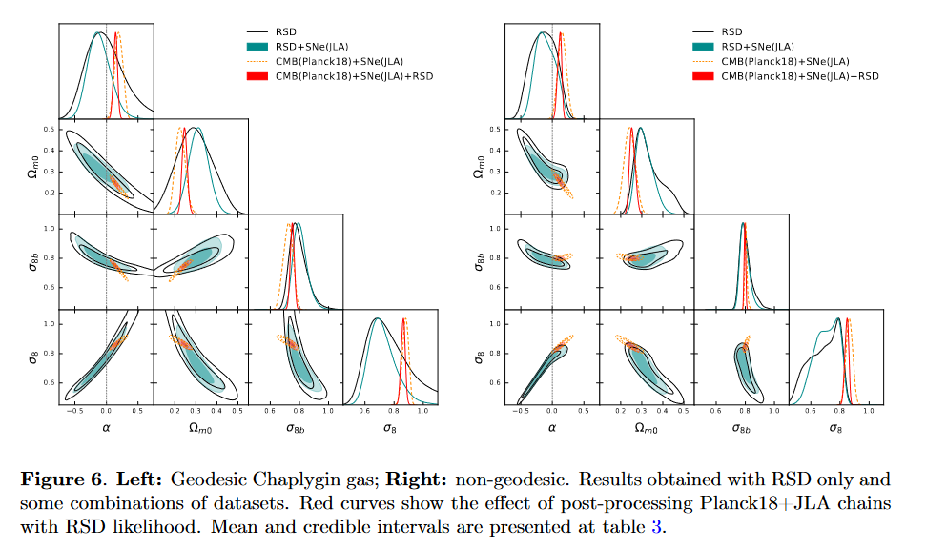
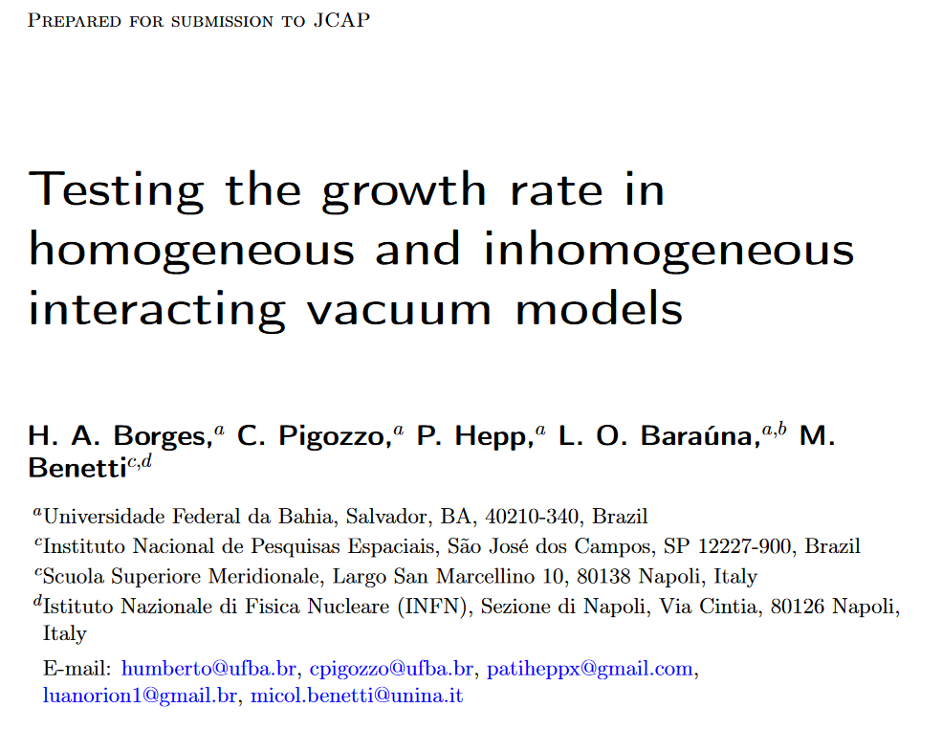
https://arxiv.org/abs/2303.04793

Slide 5
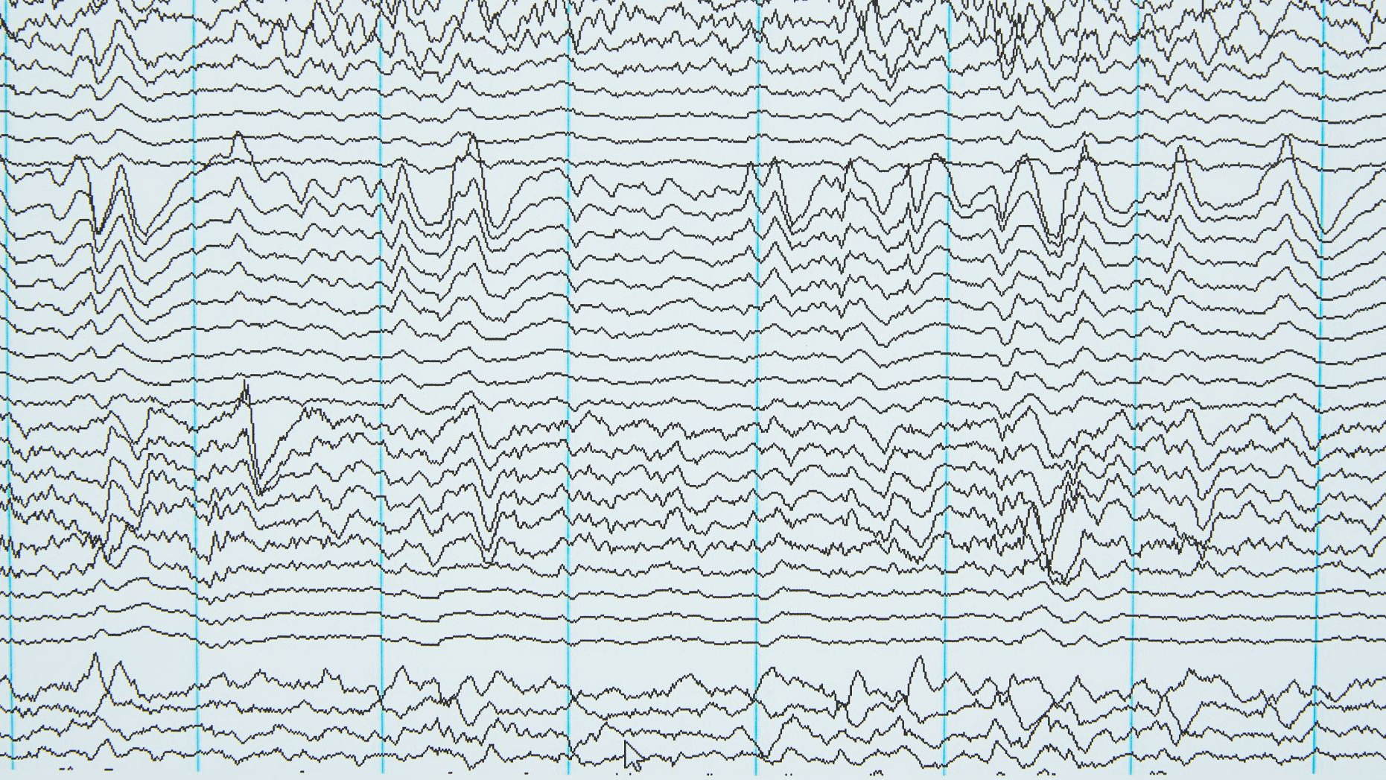
Colored Noise

Slide 6
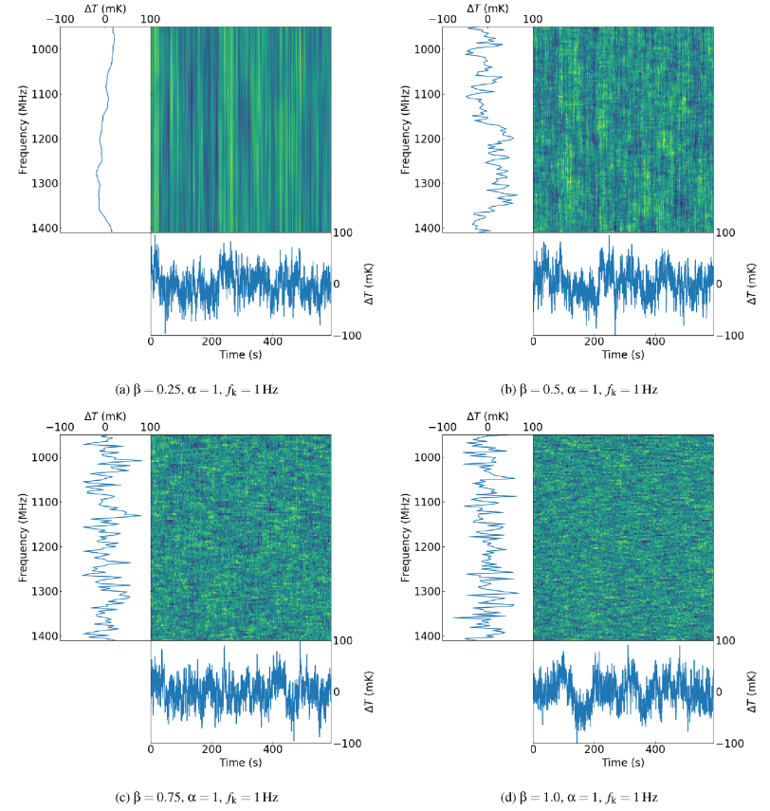
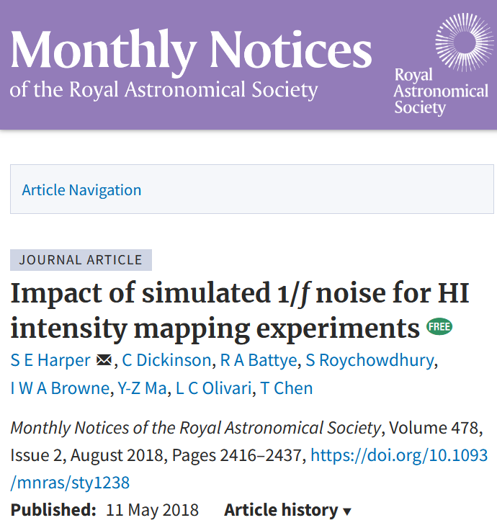


Why Study Noise
https://doi.org/10.1093/mnras/sty1238
Notes:
Time–frequency plots of 1/f noise generated using the simulation pipeline. (a) is example of highly correlated 1/f noise, β = 0.25, while (b) β = 0.5,
and (c) β = 0.75 are increasingly uncorrelated in frequency, and finally (d) β = 1 is an example of completely uncorrelated 1/f noise where each channel
has a unique noise realization. The images represent waterfall plots, with time along the x-axis and frequency along the y-axis. The parallel and vertical plots
associated with each image are slices along either a single channel or time interval, respectively. These figures do not include any white noise contribution.

Slide 7
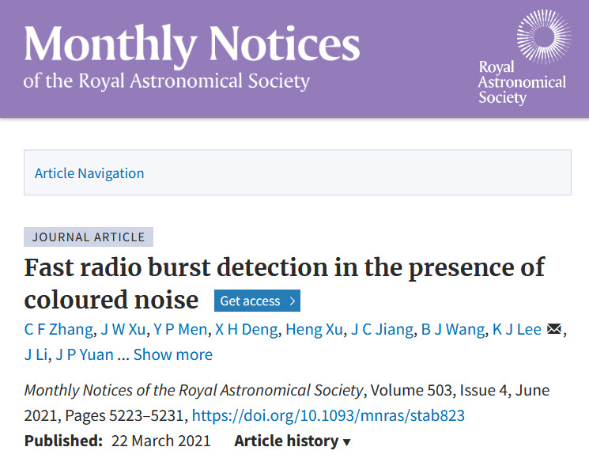
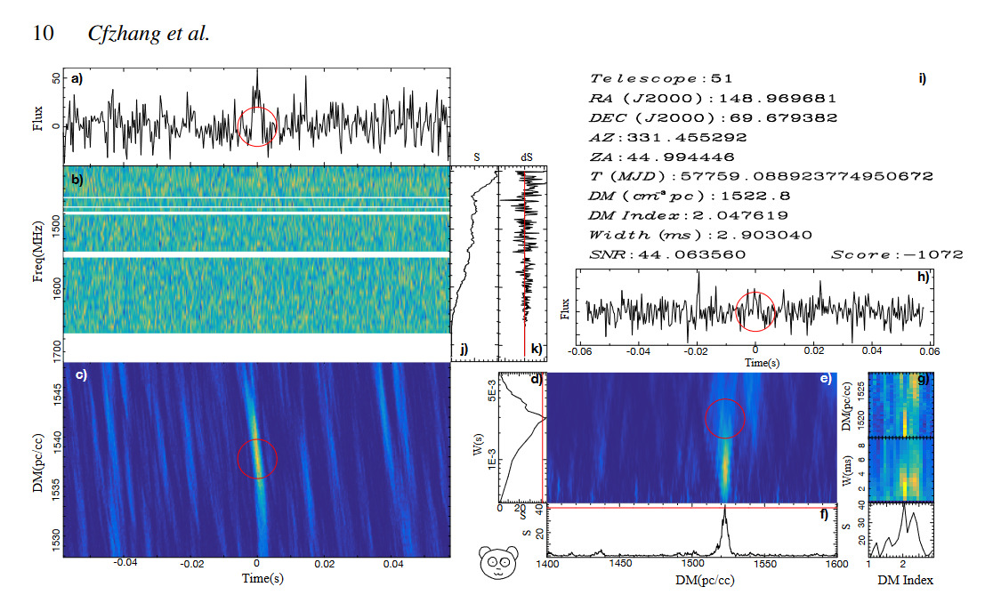

Why Study Noise
https://doi.org/10.1093/mnras/sty1238
Notes:
Time–frequency plots of 1/f noise generated using the simulation pipeline. (a) is example of highly correlated 1/f noise, β = 0.25, while (b) β = 0.5,
and (c) β = 0.75 are increasingly uncorrelated in frequency, and finally (d) β = 1 is an example of completely uncorrelated 1/f noise where each channel
has a unique noise realization. The images represent waterfall plots, with time along the x-axis and frequency along the y-axis. The parallel and vertical plots
associated with each image are slices along either a single channel or time interval, respectively. These figures do not include any white noise contribution.

Slide 8
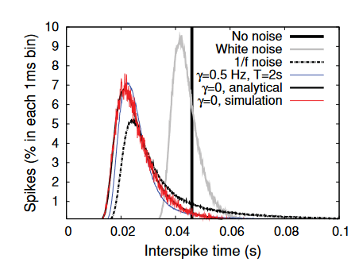
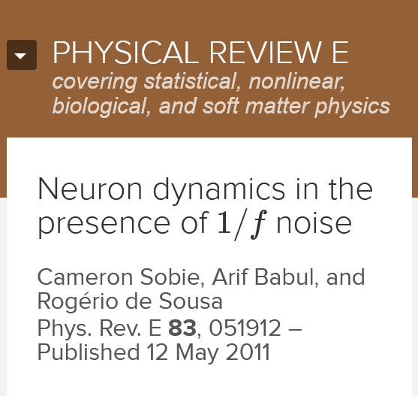
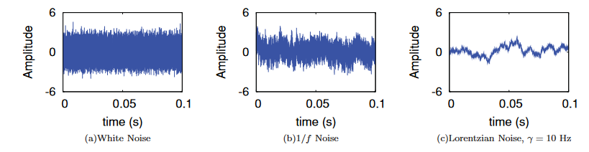
Why Study Noise
https://doi.org/10.1103/PhysRevE.83.051912

Slide 9
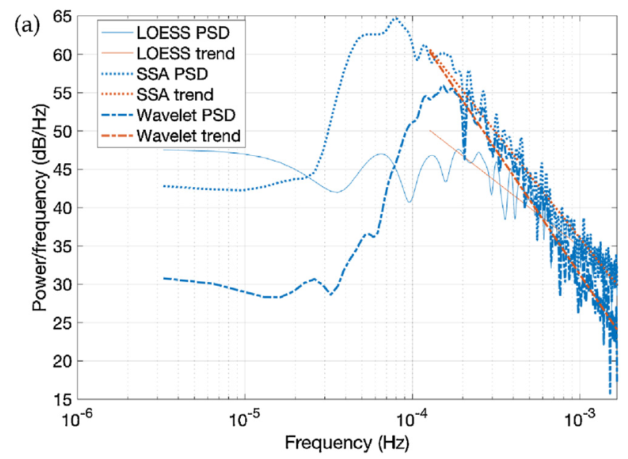
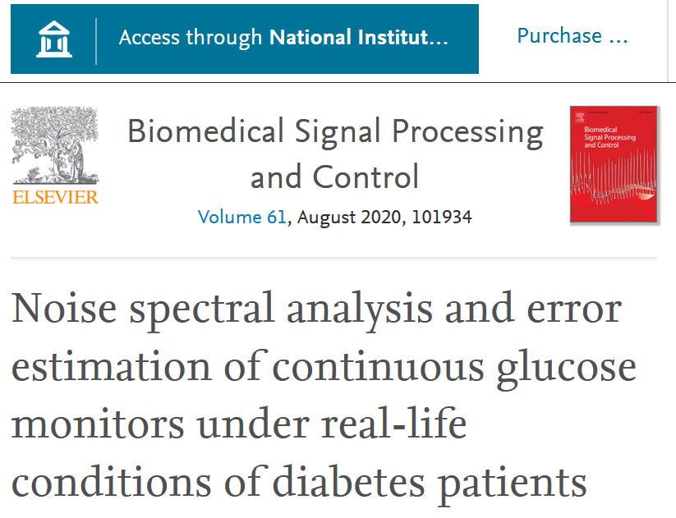
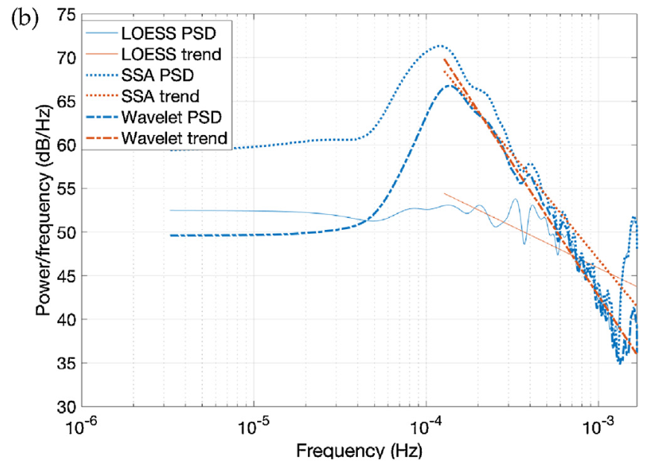


Why Study Noise
https://doi.org/10.1016/j.bspc.2020.101934
Notes:
Power spectral density of the LOESS, SSA and wavelet noises for patients P01
and P13. The linear fit was estimated using LMS regression in the range of frequencies
where power spectrum decays abruptly.

Slide 10
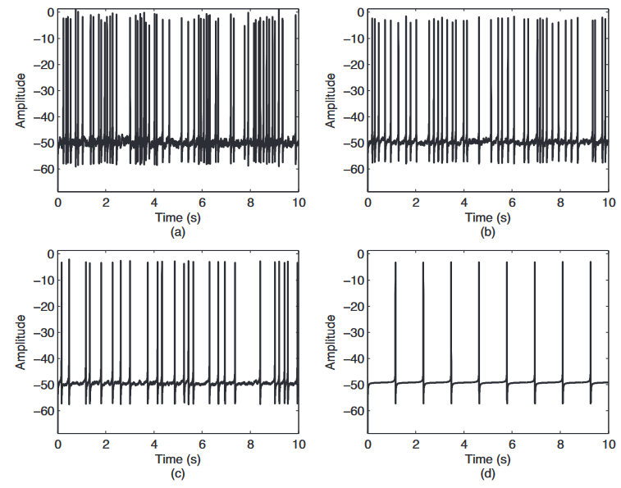
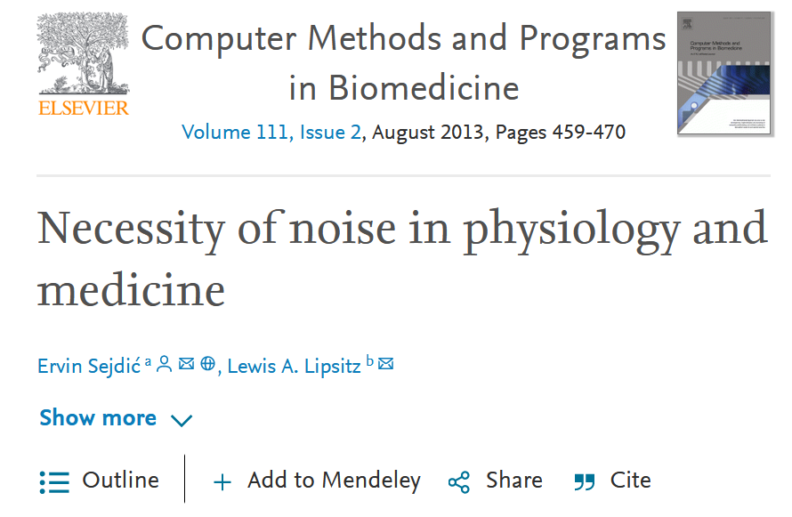


Why Study Noise
https://doi.org/10.1016/j.cmpb.2013.03.014

Slide 11
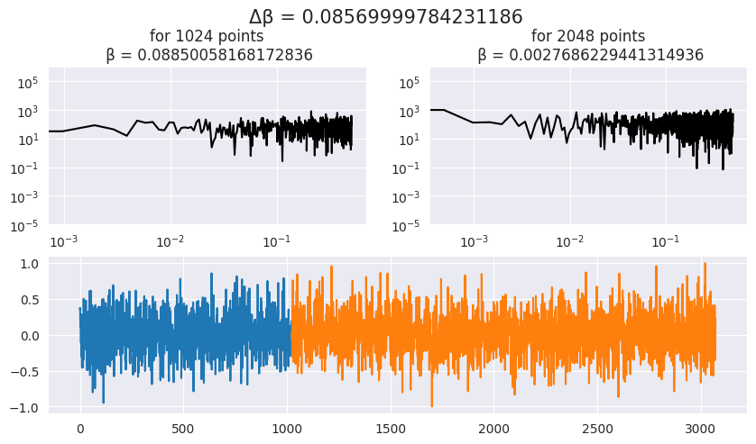
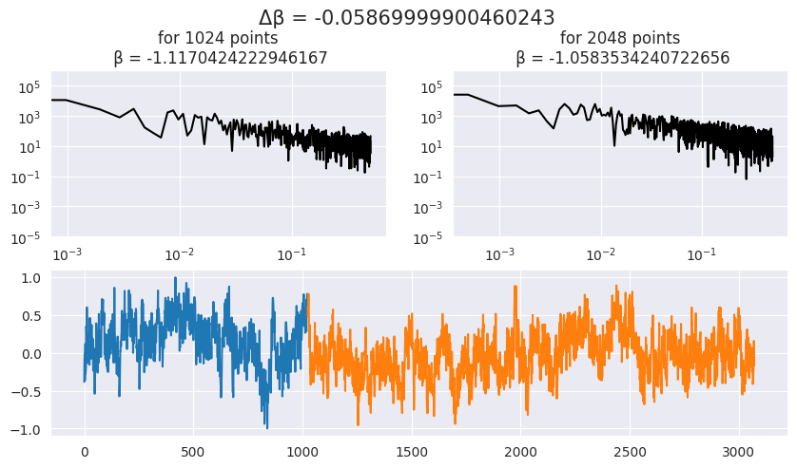
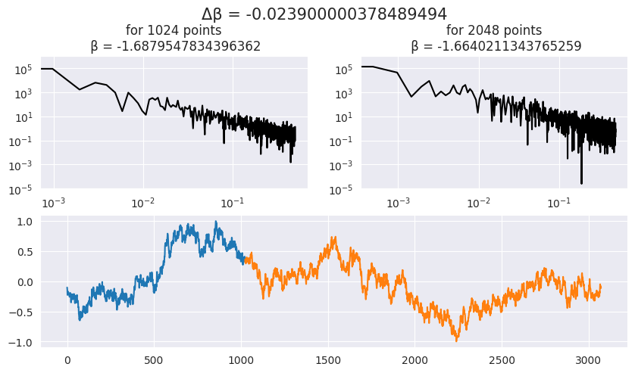
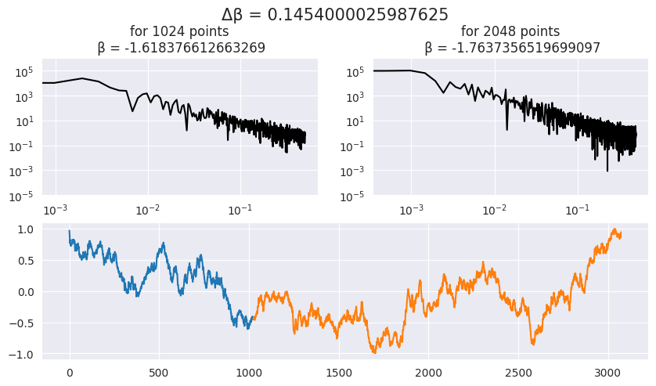
White Noise
Pink Noise
Turbulence Noise
Red Noise

Slide 12
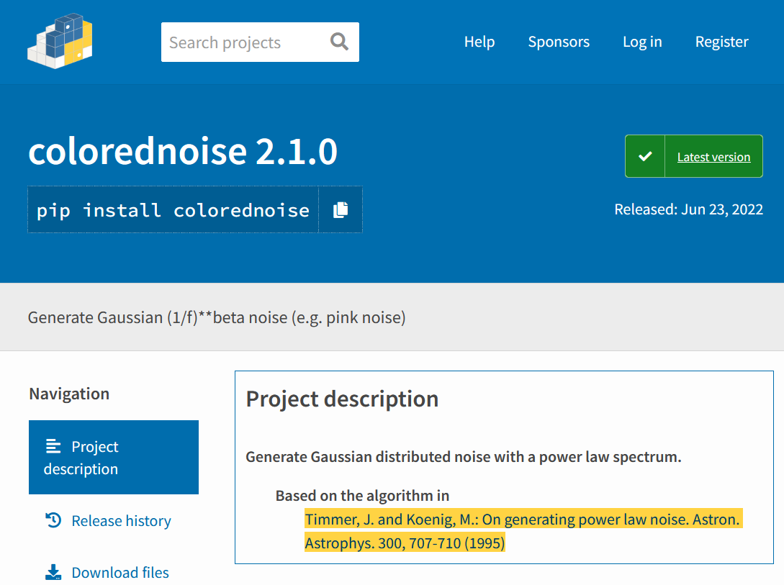
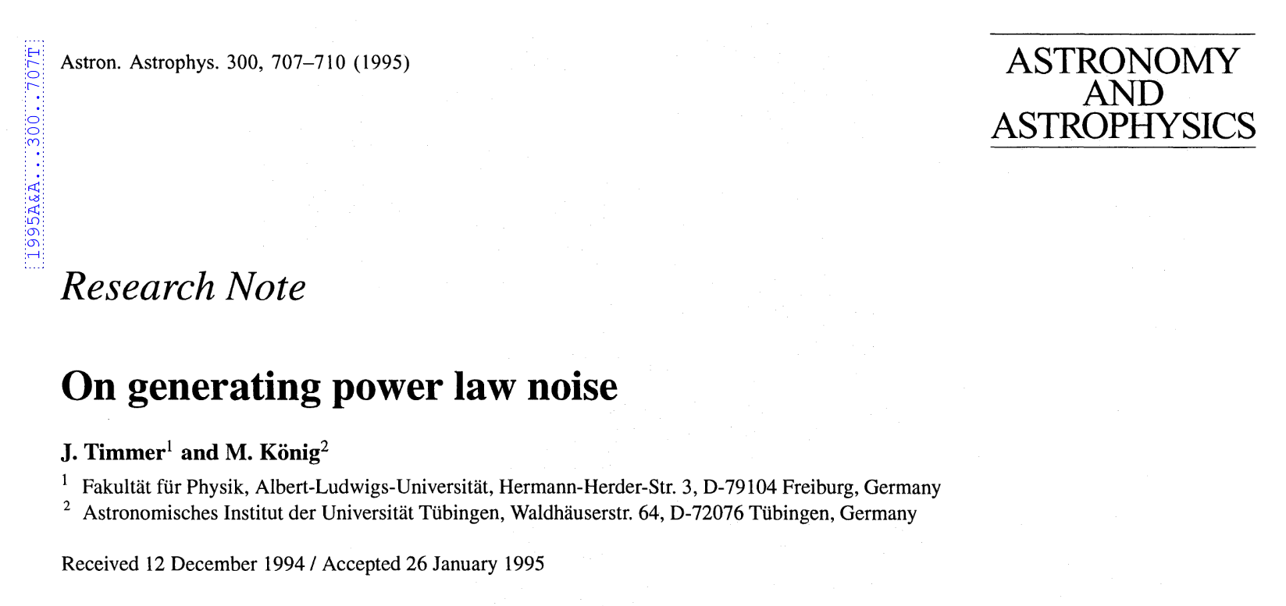

Generating Synthetic Colored Noise

Slide 13
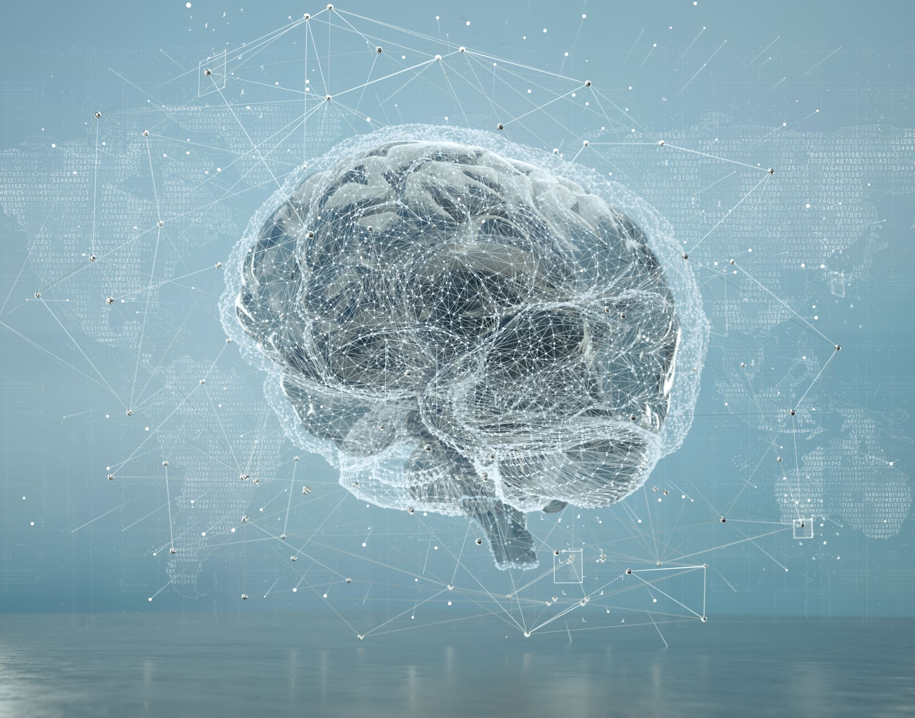
Artificial Neural Network

Slide 14
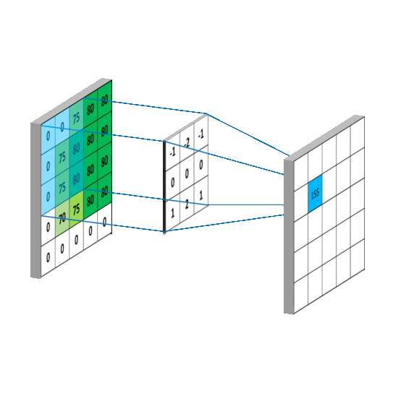
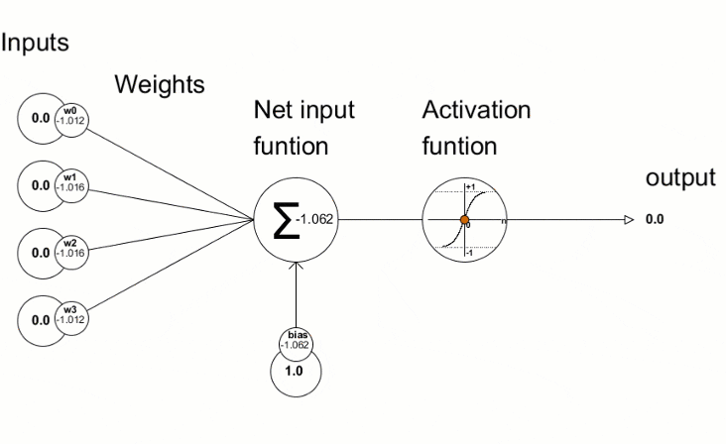

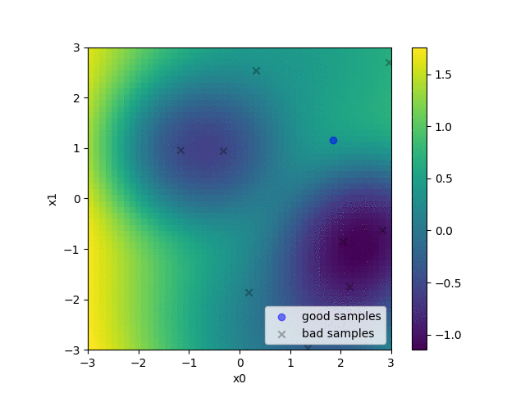
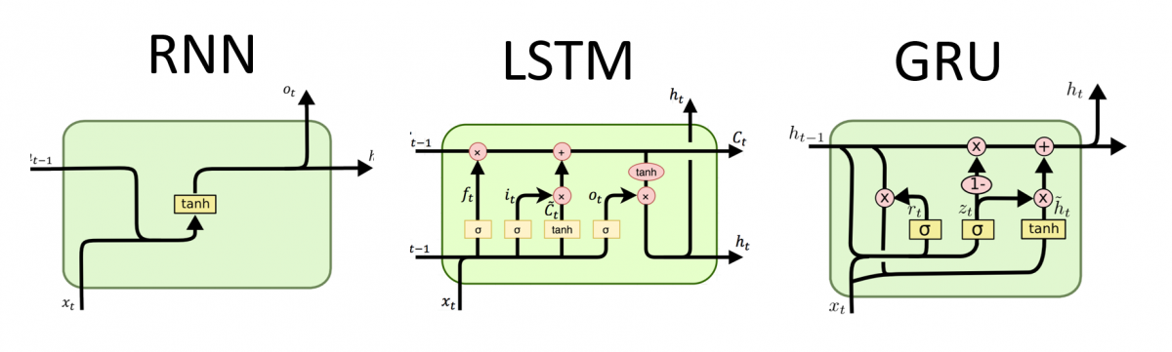
DNN Architectures
Convolutional Neural Network
Multilayer Perceptron

Slide 15
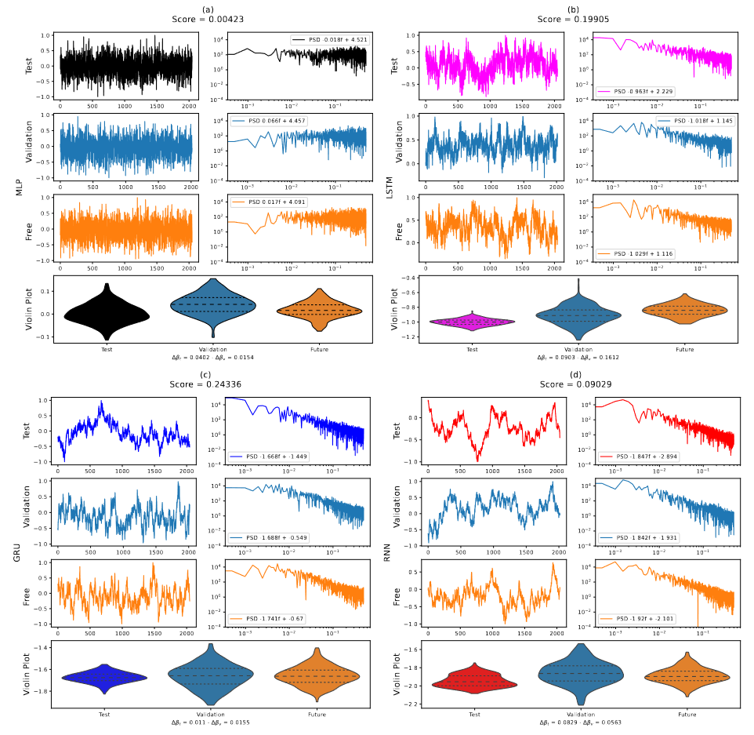
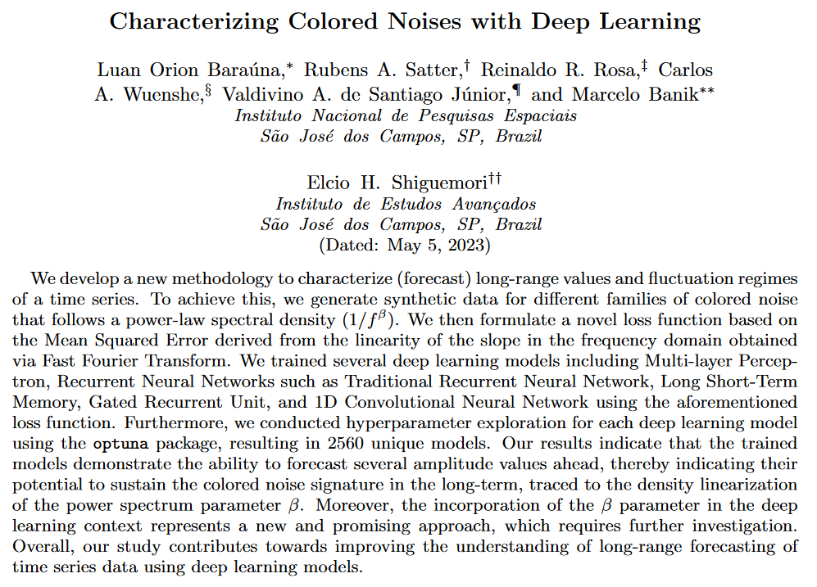
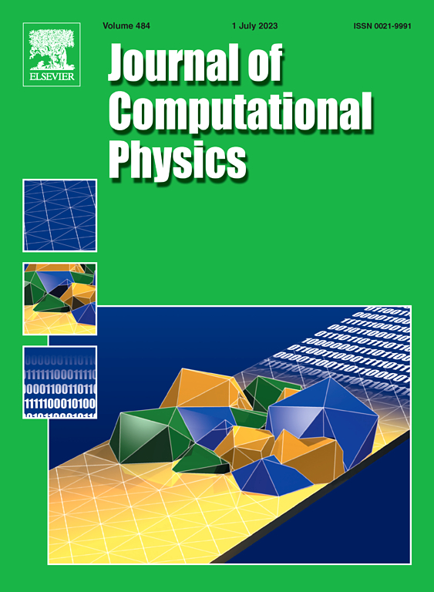

Slide 16
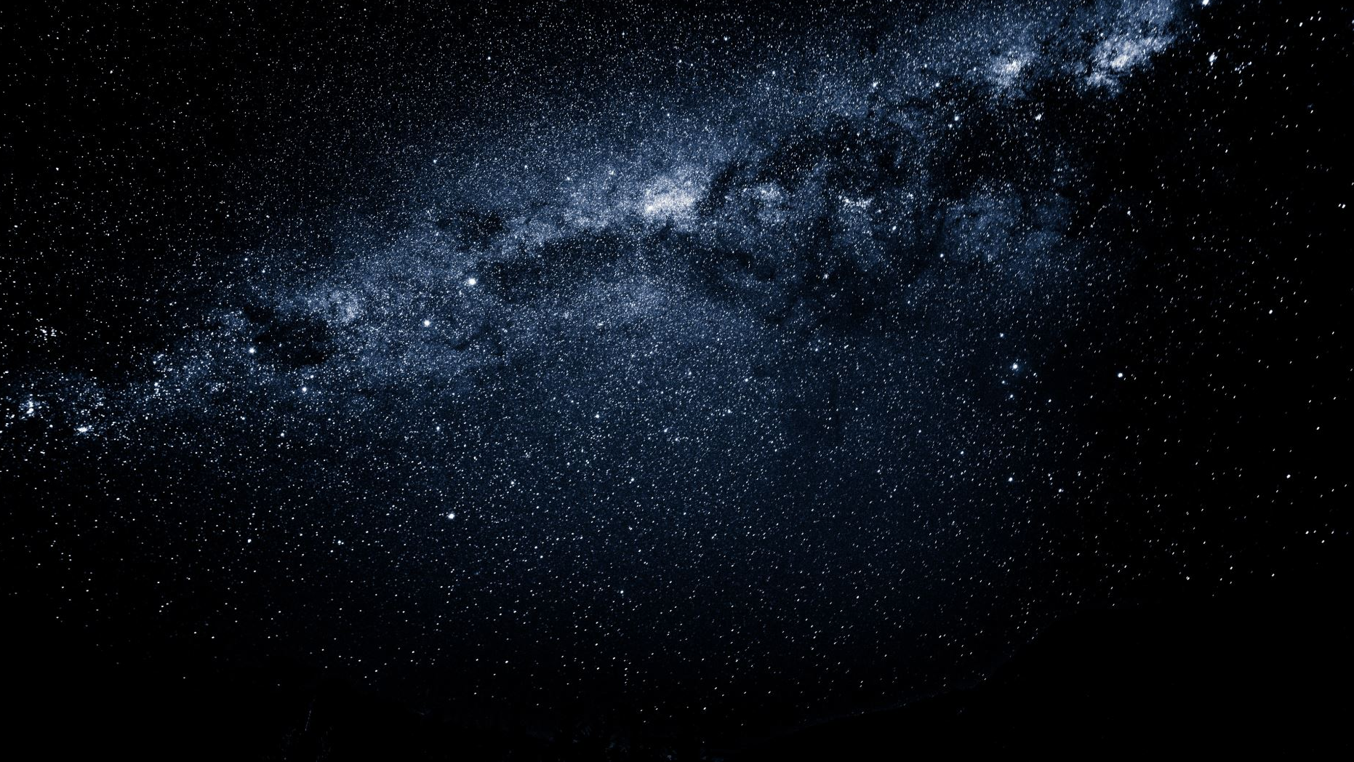
Astrophysics

Slide 17
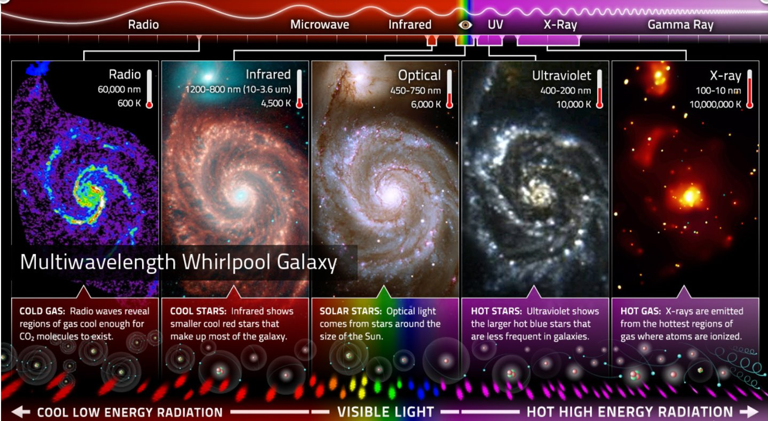

Slide 18
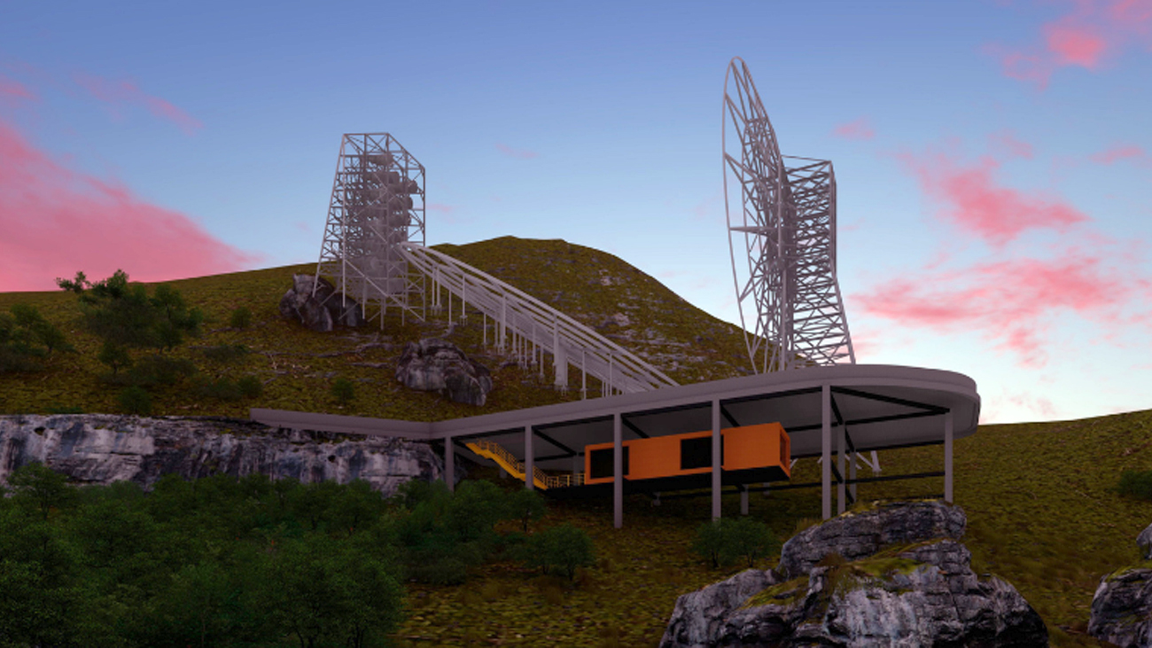
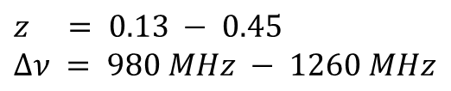
BINGO
$$z = 0.13 − 0.45$$
$$Δν = 980 MHz − 1260 MHz$$

Slide 19
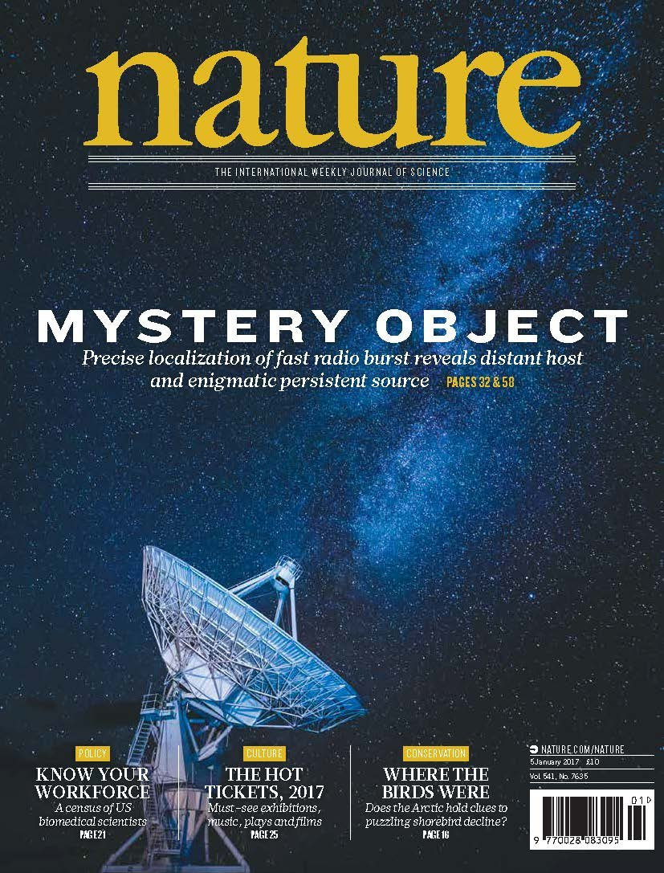
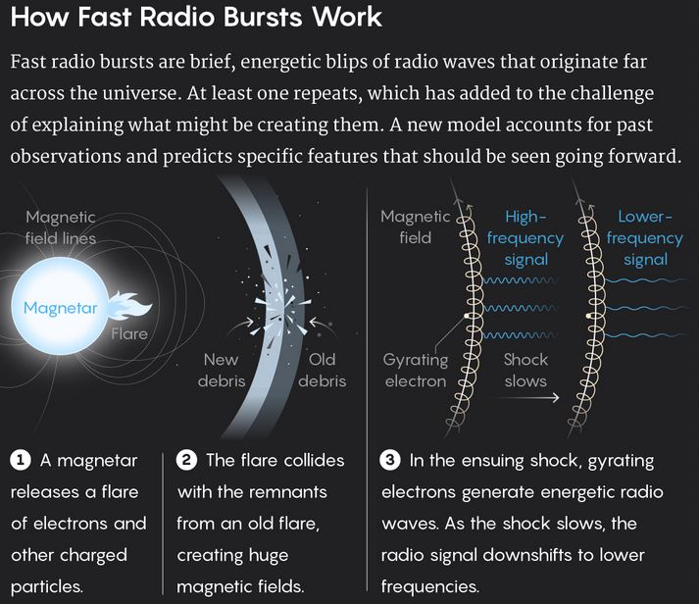
https://www.nature.com/articles/d41586-021-02836-5
https://www.civilsdaily.com/news/what-is-a-fast-radio-burst-frb/
Notes:
Apresentação da análise do Problema

Slide 20
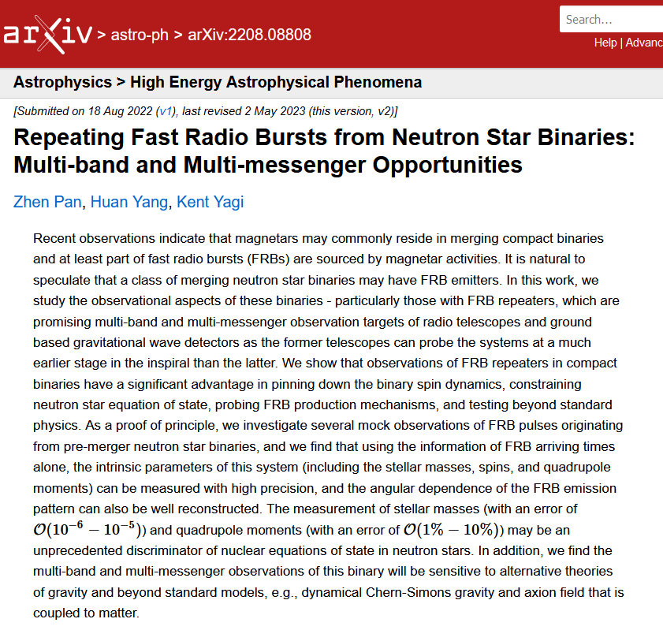
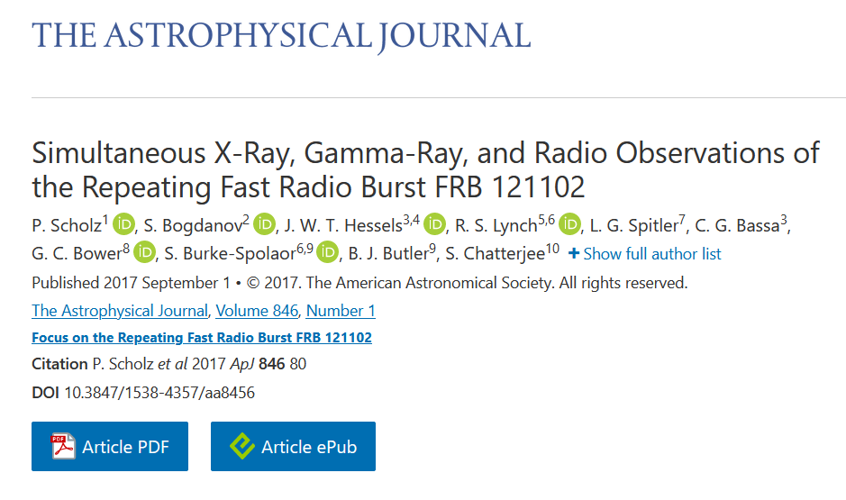
https://arxiv.org/abs/2208.08808
DOI 10.3847/1538-4357/aa8456

Slide 21
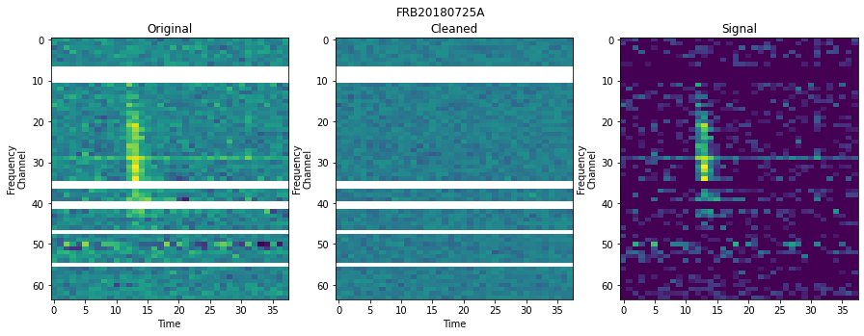
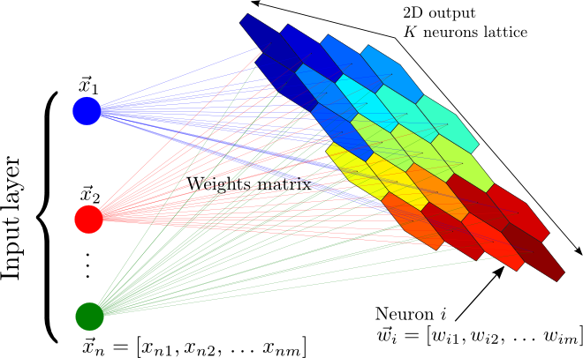
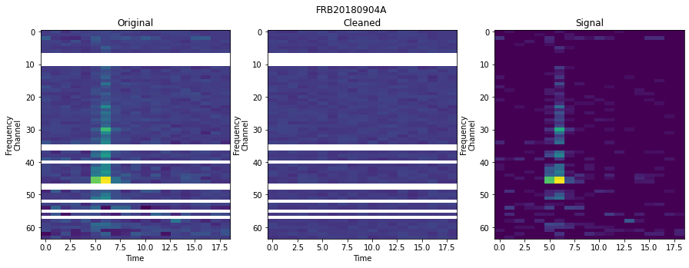
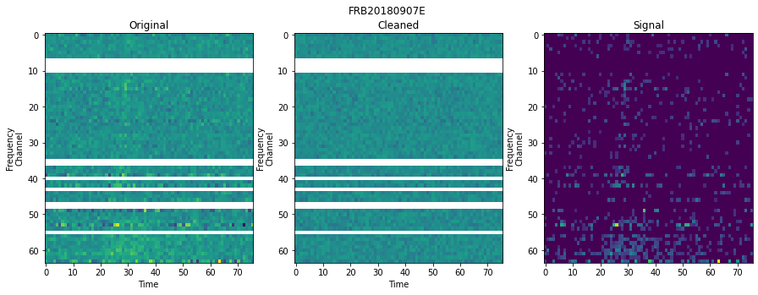

Slide 22
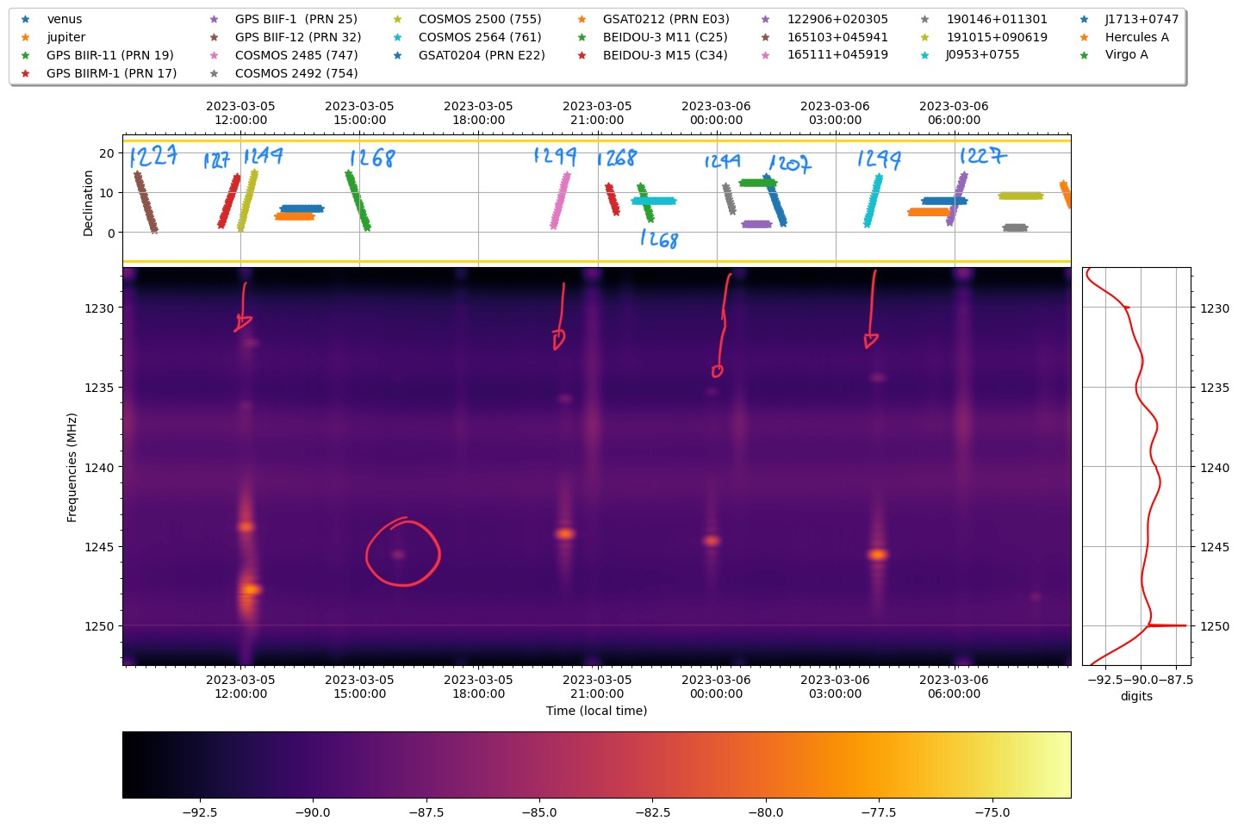

Slide 23
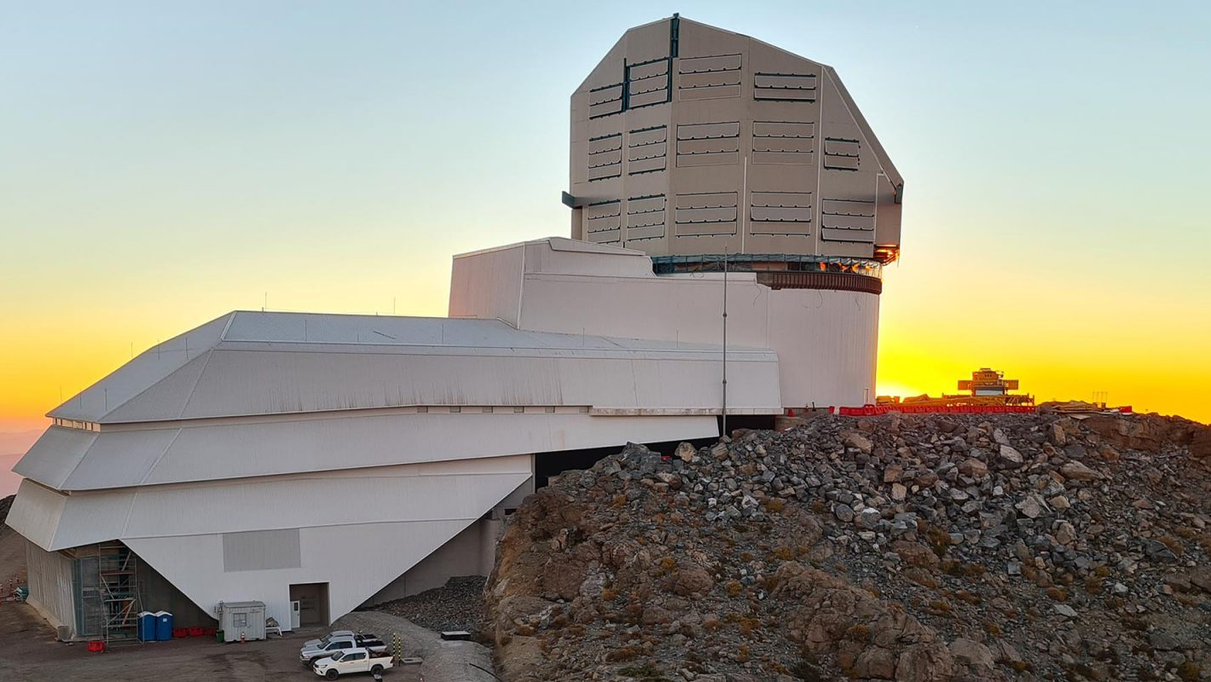

Vera C. Rubin Observatory
$$Δλ = 320–1060 nm$$

Slide 24
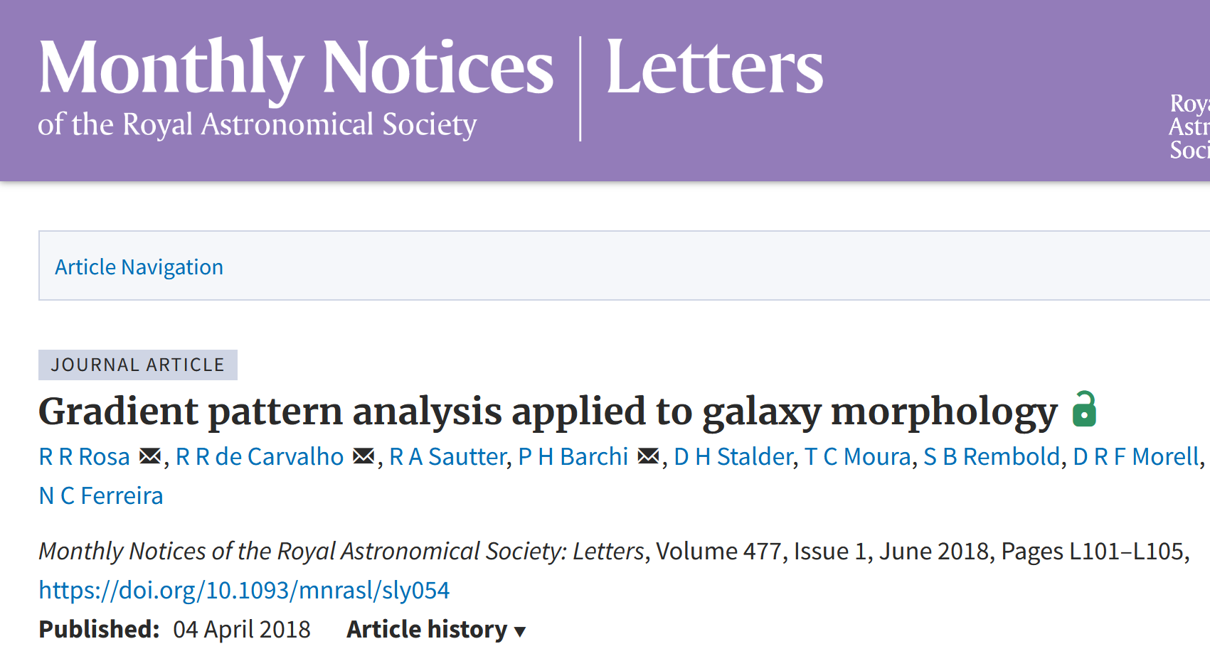
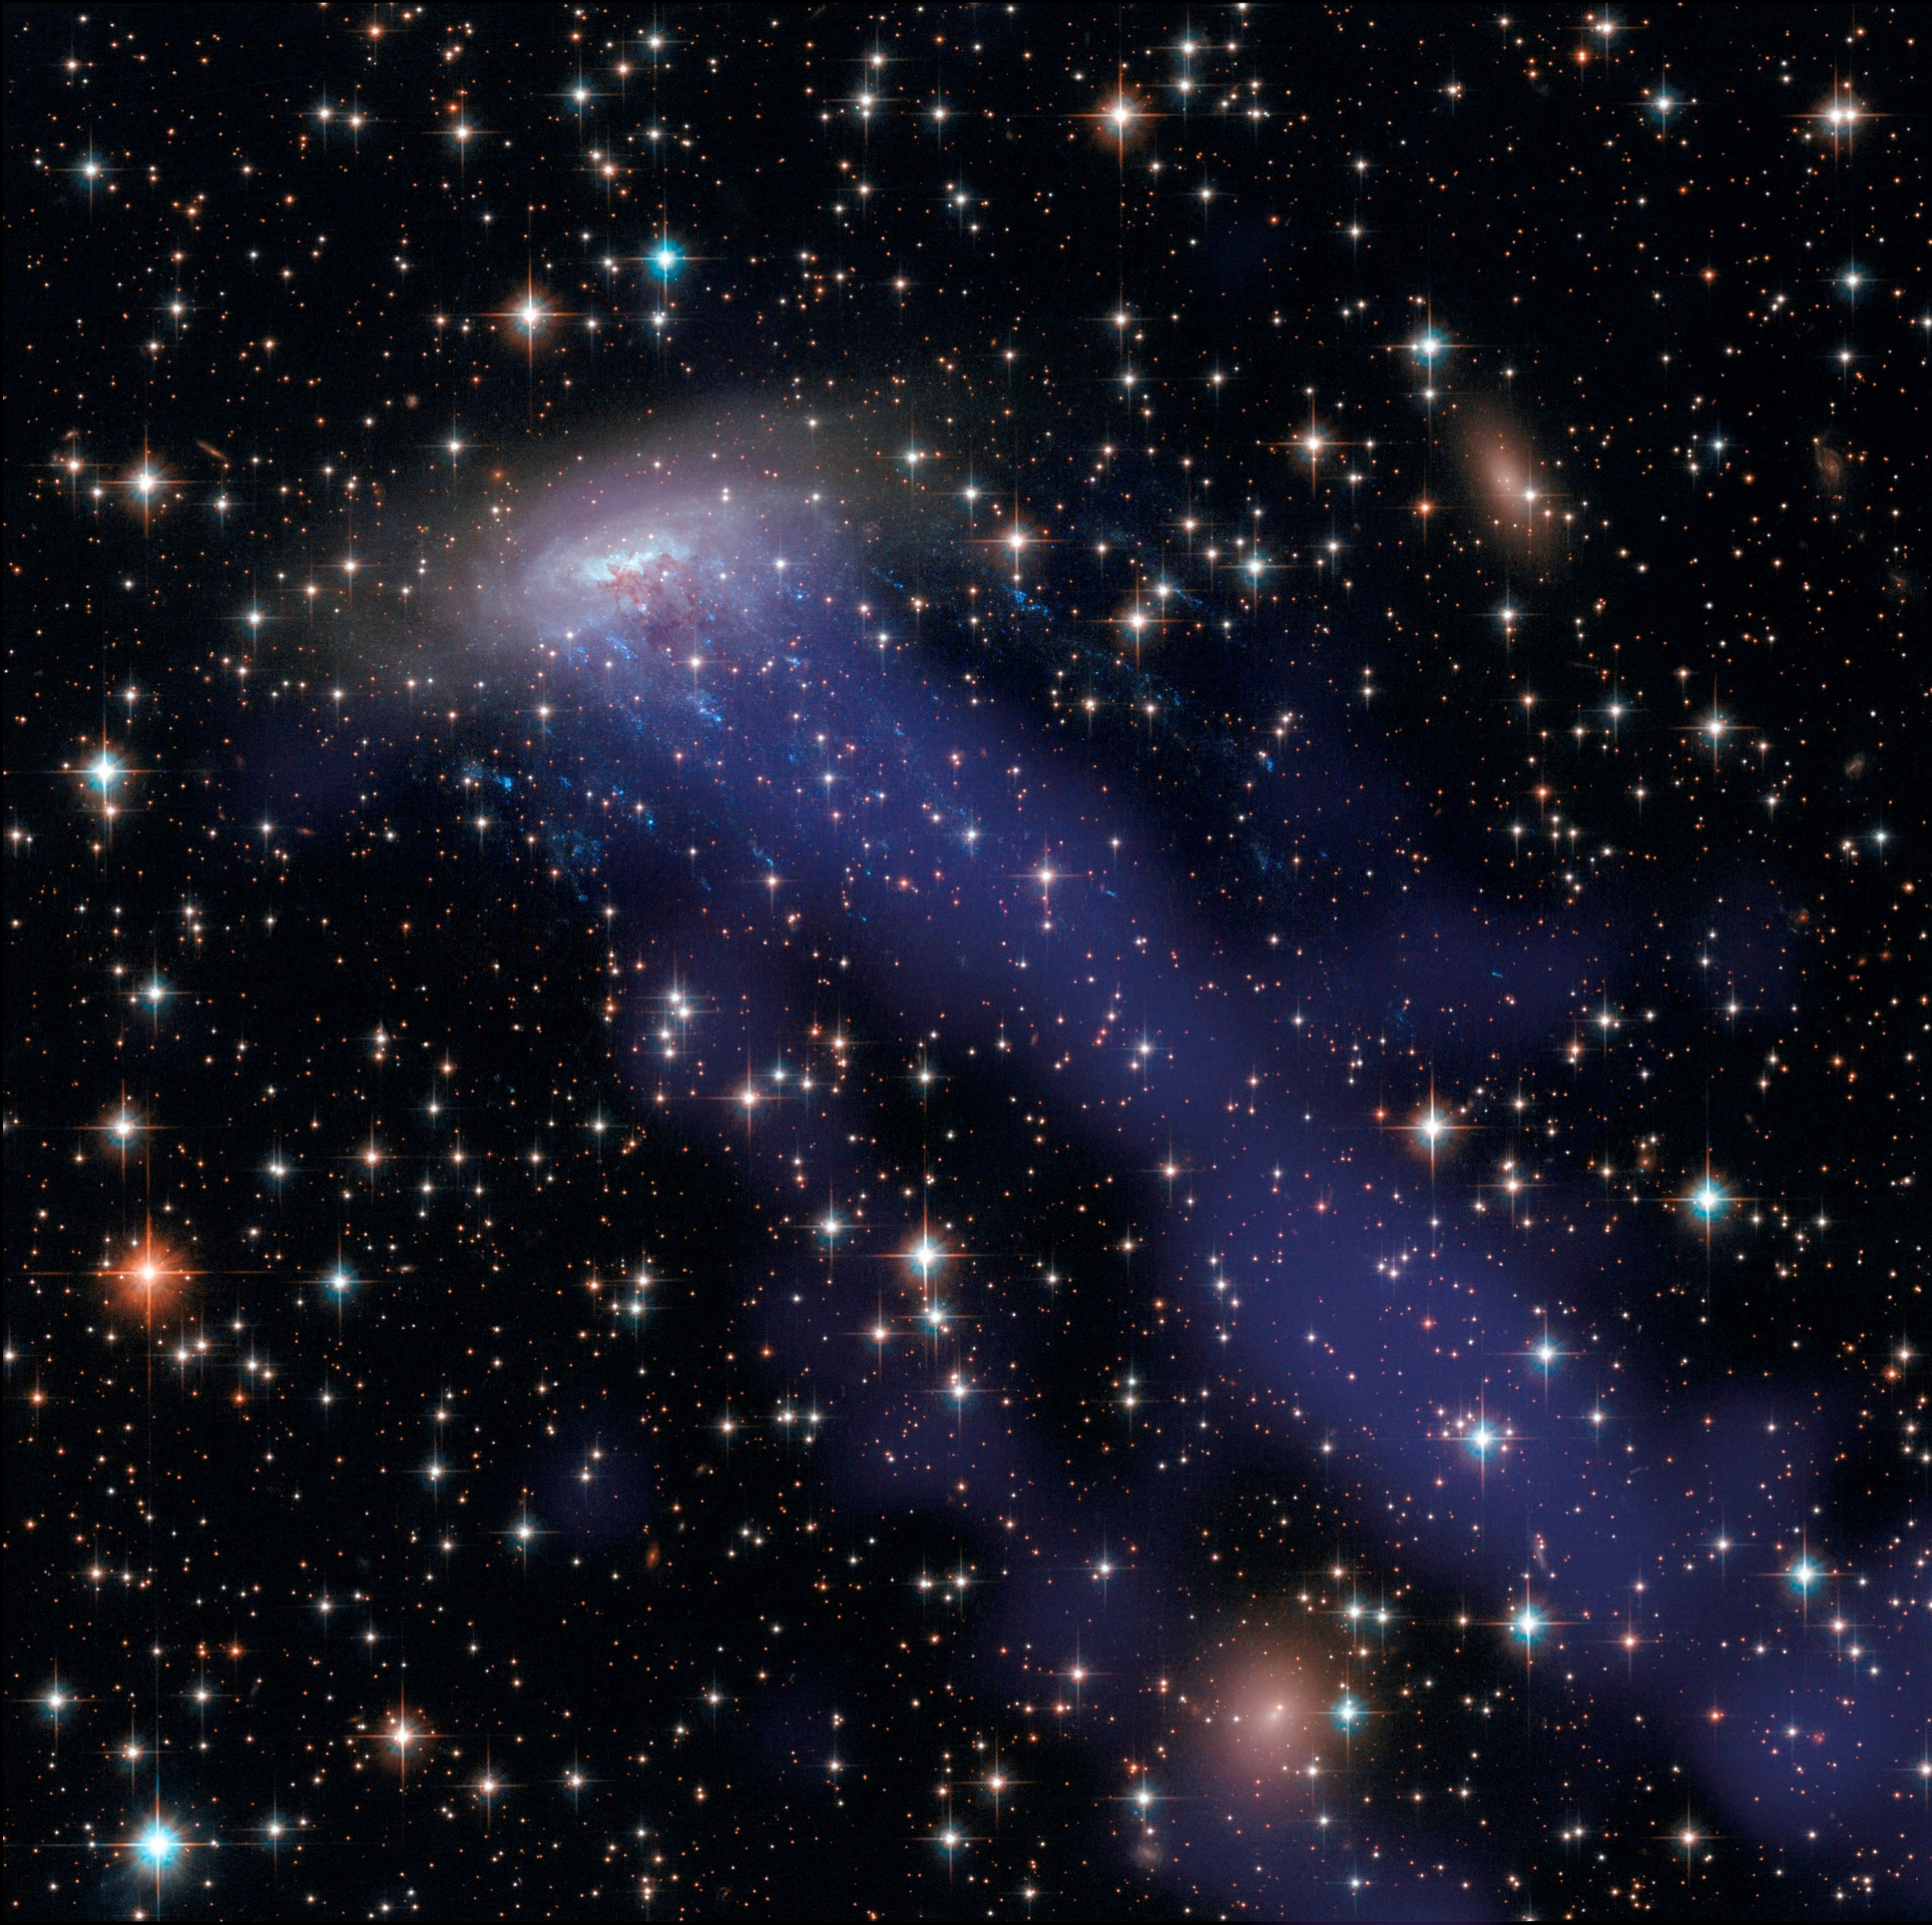
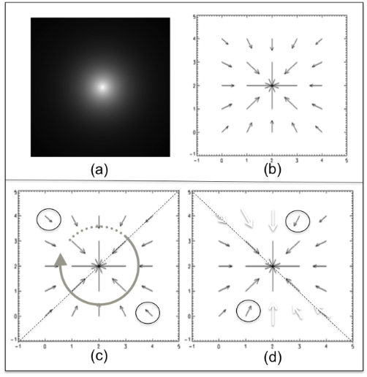
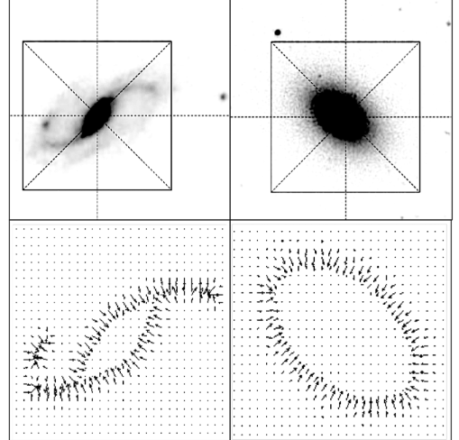


Slide 25




Slide 26


https://www.scielo.br/j/rbef/a/F85YZNVqmN6xJScnssmgGLB/

Slide 27













github.com/barauna-lo
linkedin.com/in/barauna-lo/
orcid.org/0000-0002-5214-2399
@orionba
luanorion1@gmail.com
luan.ferreira@inpe.br

Slide 28


Slide 29


Slide 30


Slide 31


Slide 32


Slide 33


Slide 34



Slide 35



Slide 36

Whats is FRB?
Cam
It changes in time;
It will might be observable by BINGO;
Where does it come from?
https://www.youtube.com/watch?v=EfkW8e1P-64
Notes:
Apresentação da análise do Problema

Slide 37
Whats is FRB?
Cam
It changes in time;
It will might be observable by BINGO;
Where does it come from?
Notes:
Apresentação da análise e tratamento dos dados

Slide 38


Why IA in Radio Astronomy?
Contact (1997)
https://www.seti.org/press-release/artificial-intelligence-helps-find-new-fast-radio-bursts
Notes:
04 - Como esta hipótese ajuda a responder à pergunta científica?
Com técnicas de Aprendizado de Máquina podemos obter dados de objets astrofísicos mascardos no limite observável do instrumento
reduzindo o tempo de processamento e o tempo da dos

Slide 39


Why Deep Learn?
Notes:
Justificativa do uso de técnicas de IA para Resolução do problema

Slide 40


Rise of AI
https://medium.com/swlh/artificial-intelligence-machine-learning-and-deep-learning-whats-the-real-difference-94fe7e528097
https://www.juanbarrios.com/inteligencia-artificial-y-salud-un-caso-practico-borrador/

Slide 41

The Waterfall
https://fathom.info/notebook/10851/

Slide 42


Slide 43


Slide 44


Slide 45


Slide 46


Slide 47


Slide 48


Slide 49


Slide 50

2. Where is FRB?

Slide 51


3. Something will appear within range of the BINGO Radio Telescope?
Notes:
Htf5 JSON .fits

Slide 52

3. Something will appear within range of the BINGO Radio Telescope?

Slide 53

3. Something will appear within range of the BINGO Radio Telescope?
7 FRB 20110220A
11 FRB 20120127A
21 FRB 20140514A
25 FRB 20150418A
64 FRB 20170906A
66 FRB 20171003A
67 FRB 20171004A
69 FRB 20171020A
70 FRB 20171116A
72 FRB 20171213A
75 FRB 20180119A
88 FRB 20180430A
92 FRB 20180714A
135 FRB 20180923B
562 FRB 20190520B
660 FRB 20190714A
688 FRB 20191107B
760 FRB 20200906A
770 FRB 20210117A

Slide 54












3. Something will appear within range of the BINGO Radio Telescope?
7 FRB 20110220A
11 FRB 20120127A
21 FRB 20140514A
25 FRB 20150418A
64 FRB 20170906A
66 FRB 20171003A
67 FRB 20171004A
69 FRB 20171020A
70 FRB 20171116A
72 FRB 20171213A
75 FRB 20180119A
88 FRB 20180430A
92 FRB 20180714A
135 FRB 20180923B
562 FRB 20190520B
660 FRB 20190714A
688 FRB 20191107B
760 FRB 20200906A
770 FRB 20210117A
Notes:
http://simbad.cds.unistra.fr/simbad/sim-id-refs?Ident=LEDA%20%20971952&Name=LEDA%20%20971952

Slide 55

3. Something will appear within range of the BINGO Radio Telescope?
7 FRB 20110220A
11 FRB 20120127A
21 FRB 20140514A
25 FRB 20150418A
64 FRB 20170906A
66 FRB 20171003A
67 FRB 20171004A
69 FRB 20171020A
70 FRB 20171116A
72 FRB 20171213A
75 FRB 20180119A
88 FRB 20180430A
92 FRB 20180714A
135 FRB 20180923B
562 FRB 20190520B
660 FRB 20190714A
688 FRB 20191107B
760 FRB 20200906A
770 FRB 20210117A
69 FRB 20171020A

Slide 56

3. Something will appear within range of the BINGO Radio Telescope?
7 FRB 20110220A
11 FRB 20120127A
21 FRB 20140514A
25 FRB 20150418A
64 FRB 20170906A
66 FRB 20171003A
67 FRB 20171004A
69 FRB 20171020A
70 FRB 20171116A
72 FRB 20171213A
75 FRB 20180119A
88 FRB 20180430A
92 FRB 20180714A
135 FRB 20180923B
562 FRB 20190520B
660 FRB 20190714A
688 FRB 20191107B
760 FRB 20200906A
770 FRB 20210117A
FRB 20171020A

Slide 57

3. Something will appear within range of the BINGO Radio Telescope?
7 FRB 20110220A
11 FRB 20120127A
21 FRB 20140514A
25 FRB 20150418A
64 FRB 20170906A
66 FRB 20171003A
67 FRB 20171004A
69 FRB 20171020A
70 FRB 20171116A
72 FRB 20171213A
75 FRB 20180119A
88 FRB 20180430A
92 FRB 20180714A
135 FRB 20180923B
562 FRB 20190520B
660 FRB 20190714A
688 FRB 20191107B
760 FRB 20200906A
770 FRB 20210117A
70 FRB 20171116A

Slide 58

3. Something will appear within range of the BINGO Radio Telescope?
7 FRB 20110220A
11 FRB 20120127A
21 FRB 20140514A
25 FRB 20150418A
64 FRB 20170906A
66 FRB 20171003A
67 FRB 20171004A
69 FRB 20171020A
70 FRB 20171116A
72 FRB 20171213A
75 FRB 20180119A
88 FRB 20180430A
92 FRB 20180714A
135 FRB 20180923B
562 FRB 20190520B
660 FRB 20190714A
688 FRB 20191107B
760 FRB 20200906A
770 FRB 20210117A
660 FRB 20190714A

Slide 59

3. Something will appear within range of the BINGO Radio Telescope?
7 FRB 20110220A
11 FRB 20120127A
21 FRB 20140514A
25 FRB 20150418A
64 FRB 20170906A
66 FRB 20171003A
67 FRB 20171004A
69 FRB 20171020A
70 FRB 20171116A
72 FRB 20171213A
75 FRB 20180119A
88 FRB 20180430A
92 FRB 20180714A
135 FRB 20180923B
562 FRB 20190520B
660 FRB 20190714A
688 FRB 20191107B
760 FRB 20200906A
770 FRB 20210117A
660 FRB 20190714A

Slide 60

3. Something will appear within range of the BINGO Radio Telescope?
7 FRB 20110220A
11 FRB 20120127A
21 FRB 20140514A
25 FRB 20150418A
64 FRB 20170906A
66 FRB 20171003A
67 FRB 20171004A
69 FRB 20171020A
70 FRB 20171116A
72 FRB 20171213A
75 FRB 20180119A
88 FRB 20180430A
92 FRB 20180714A
135 FRB 20180923B
562 FRB 20190520B
660 FRB 20190714A
688 FRB 20191107B
760 FRB 20200906A
770 FRB 20210117A
660 FRB 20190714A

Slide 61

3. Something will appear within range of the BINGO Radio Telescope?
7 FRB 20110220A
11 FRB 20120127A
21 FRB 20140514A
25 FRB 20150418A
64 FRB 20170906A
66 FRB 20171003A
67 FRB 20171004A
69 FRB 20171020A
70 FRB 20171116A
72 FRB 20171213A
75 FRB 20180119A
88 FRB 20180430A
92 FRB 20180714A
135 FRB 20180923B
562 FRB 20190520B
660 FRB 20190714A
688 FRB 20191107B
760 FRB 20200906A
770 FRB 20210117A
760 FRB 20200906A

