Slide 1
Open questions in high-energy astrophysics
Karl Mannheim
High-energy astrophysics in the multi-messenger era
ECAP, 08.05.2023

Slide 2
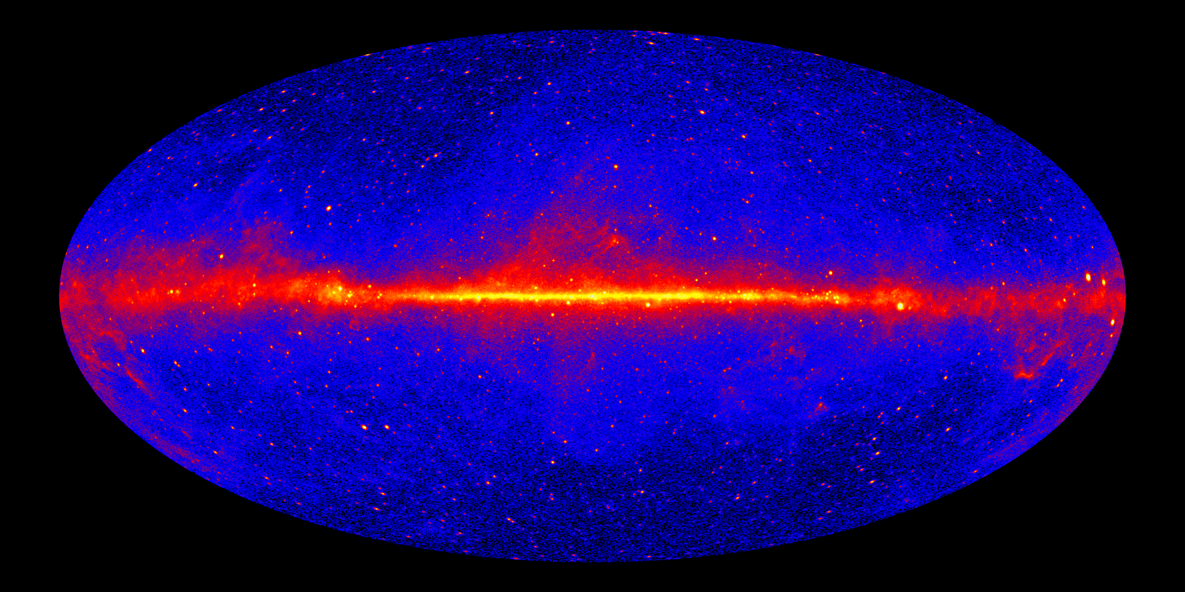
As many open questions as sources on the sky
Credit: NASA/DOE/Fermi LAT Collaboration

Slide 3
As many open questions as open minds
How can we understand the robustness and efficiency of particle acceleration?
  3d-transport equation (diffusion approximation may not hold)
  Magnetic field amplification, i.e. wave-particle and wave-wave interactions
  Role of plasma composition, including charged dust grains
  Relativistic shock waves and relativistic reconnection in collisionless plasma
  Shock structure (subshock, precursor, cosmic-ray feedback)
  Filamentary magnetic fields
  Injection from thermal pool
  Resistivity / magnetic diffusivity from 1st principles at kinetic theory level
  Need major effort in theoretical plasma astrophysics (solar energetic particles and their in situ measurements, astrophysical plasma experiments, PIC/GRPIC simulations, fundamental plasma theory)

Slide 4
As many open questions as open minds
Pevatrons (PWN, colliding winds, microquasars, SNR, GC black hole): How do they shape Galactic Cosmic Ray spectrum?
What are the sources of UHE Cosmic Rays: (spinning black holes of extragalactic jets in AGN and GRBs, pulsars, massive relic particles)
Why are short-time variable gamma-ray sources (blazars, GRBs, …) optical thin to pair production?
Blazars: Can you exlain the Doppler crisis? Which parameters govern the blazar SED (blazar sequence)? Where are the neutrinos?
How do shock acceleration and magnetic reconnection work together?
Where are the emissions due to massive relics of the big bang ?
Are black holes the cold dark matter?
Can we find the Hawking radiation from primordial black holes?
Do intergalactic magnetic field exist?
How do cosmic rays affect star formation?
What is the role of cosmic rays for interstellar chemistry?
To which extent Cosmic Rays heat the ISM ?
What are the CR spallation yields of light elements like Li, Be, and Bo?
…

Slide 5
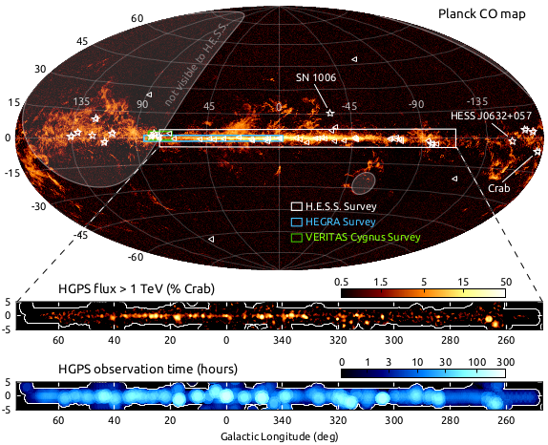
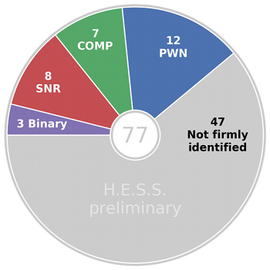
As many open questions as there are sources in the Galaxy

Slide 6
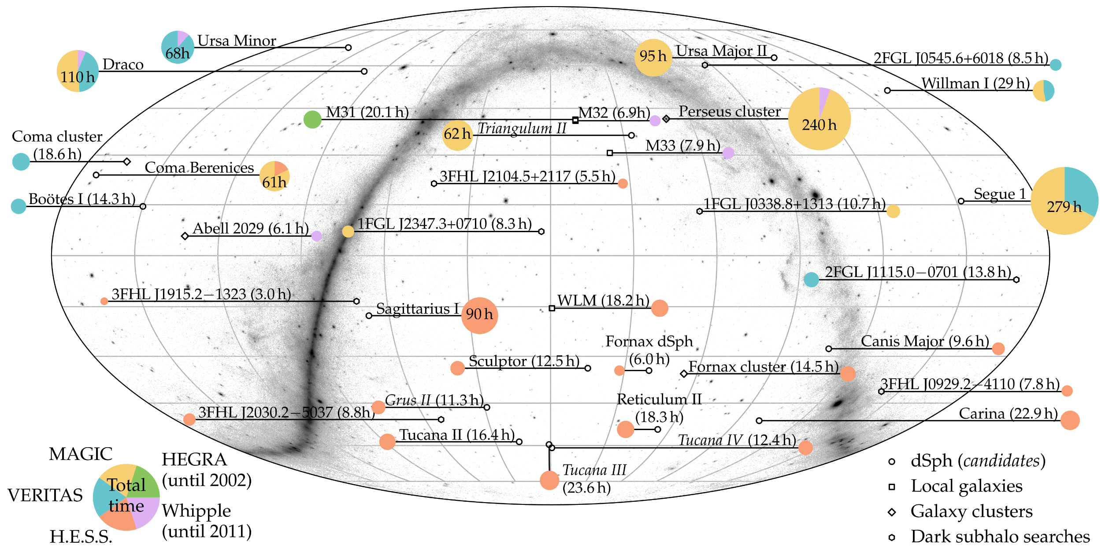
As many open questions as unseen dark matter halos / subhalos….
Hütten & Kerszberg (2022)

Slide 7
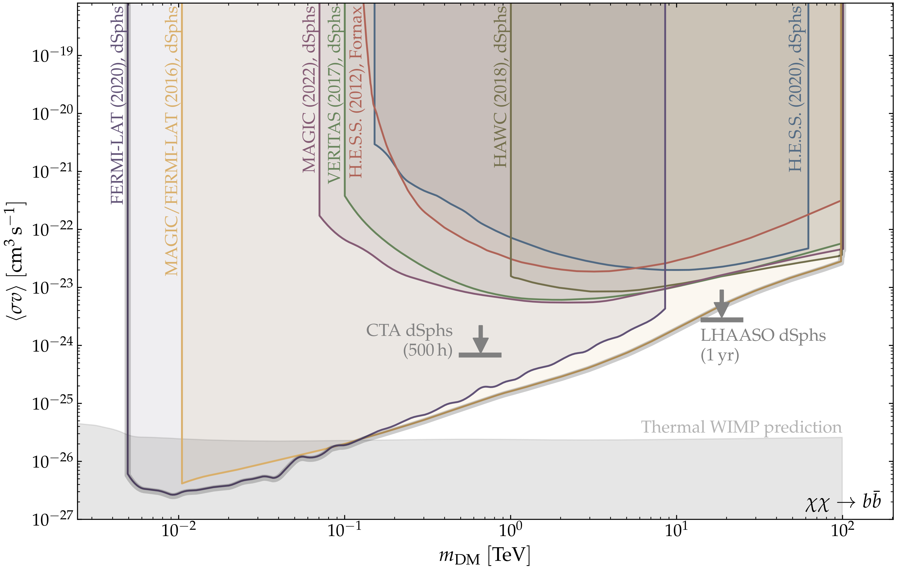
As many open questions as unseen dark matter halos / subhalos….
Hütten & Kerszberg (2022)

Slide 8
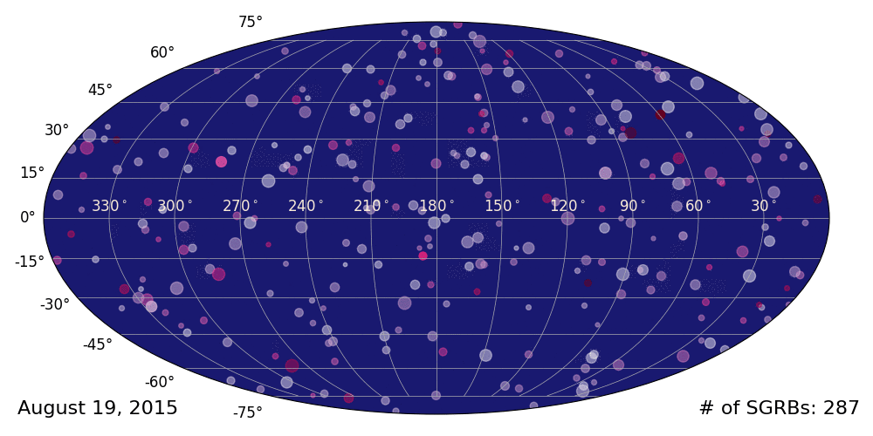
As many open questions as transient multimessenger phenomena….
Fermi-GBM: 350 short GRBs until GRB170817A along with GWs (blue). Credit: Adam Goldstein (USRA)

Slide 9
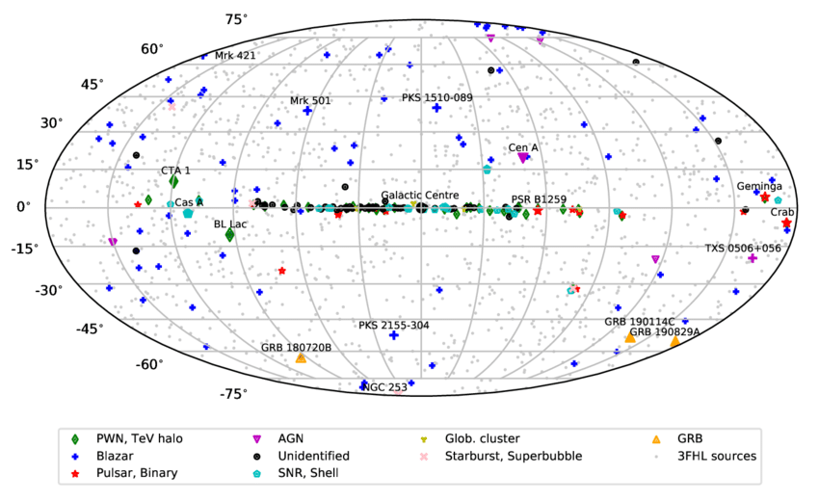
As many open questions as extragalactic objects – mostly blazar-type AGN
Hinton & Ruiz-Velasco (2020)

Slide 10

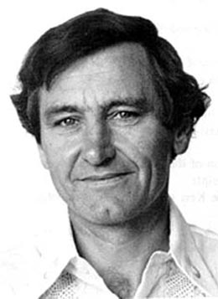
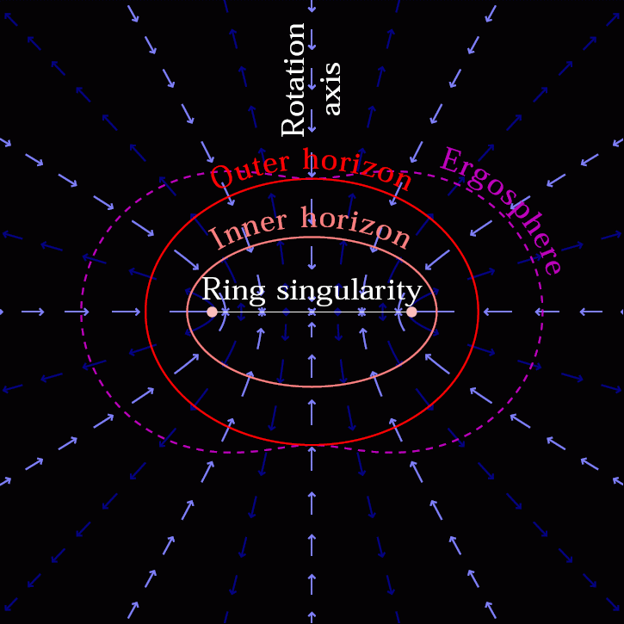

Vacuum solutions of Einstein‘s equations
R = GM

Slide 11
The black hole machine
(Lovelace, Nature, 1976)
Unipolar inductor with 10²⁰ eV potential drop and current 10¹⁸ A
Ultra-relativistic proton beam: photo-production of secondaries
Magnetically insulated transmission-line with dissipation of Poynting flux where anomalous resistivity leads to breakdown of insulation (Lovelace & Kronberg 2013)

Slide 12
Unipolar induction
Spinning black hole with plasma-filled ergosphere
EMF = 10²⁰ eV (a/M) (B/10⁴G) (M/10⁸M_{S})
Energy of highest energy cosmic rays
Particle interactions → gamma rays and neutrinos
Black hole formation observable at high energies

Slide 13
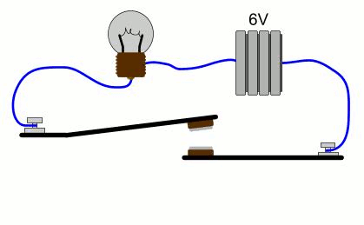

Slide 14
High-energy neutrinos from extragalactic jets
Conjecture:
„… A striking similarity exists between the energy fluxes of diffuse y-rays above 100 MeV and cosmic ray protons above the ankle … The corresponding prediction of a neutrino flux therefore rests on a firm basis.”
KM, Astroparticle Physics 3, 295-302 (1995)

Slide 15
High-energy neutrinos from extragalactic jets
Learned & Mannheim (2000)
pp
pγ
-
IceCube 2013
KM, Aph 3 (1995); JL&KM, Ann.Rev. (2000)

Slide 16
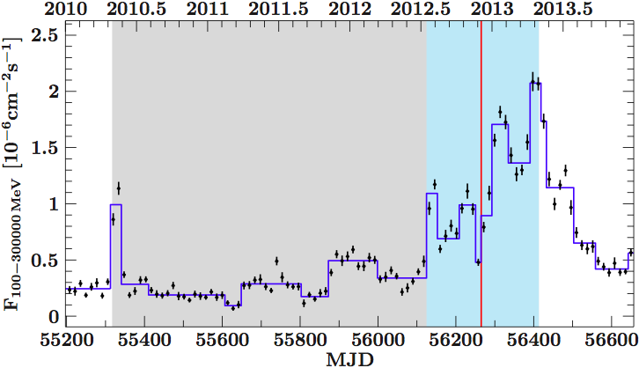
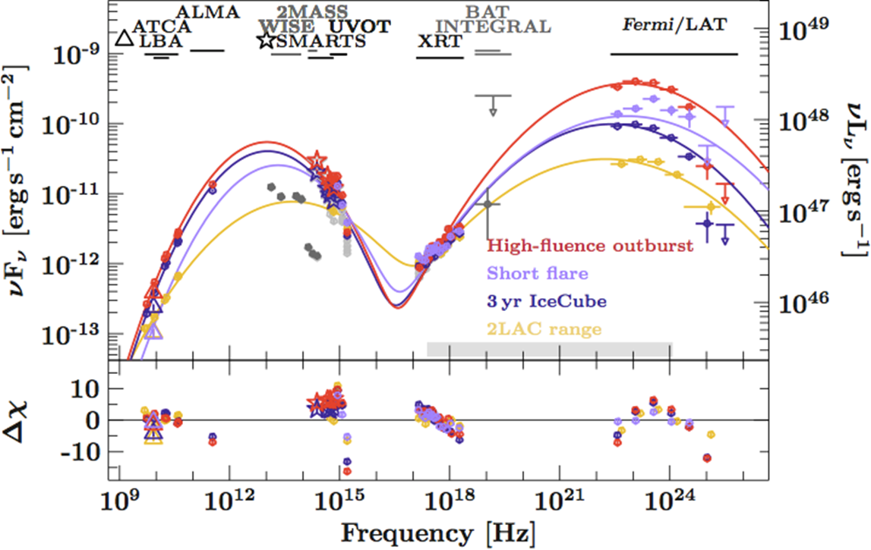
PKS B1424-418 Outburst (Kadler et al., Nature Phys. 2016):
5% chance probability for the brightest blazar outburst at the position of the most energetic neutrino event

Slide 17
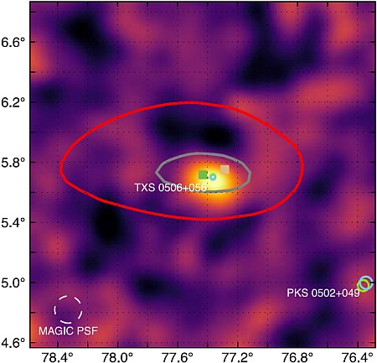
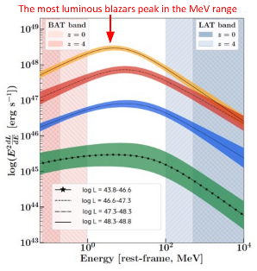
MAGIC Detection of gamma-ray emitting black hole TXS 0506+56 in outburst associated with IceCube 400 TeV neutrino
Science 361 (2018)
Extragalactic jets sources in the Cosmic Dawn era: High-density environment
(Marcotulli et al.)

Slide 18
Wald‘s solution
(BA thesis of Raoul Kinadeter)
Maxwell-components in Boyer-Lindquist coordinates
B
E

Slide 19
Vacuum solution:
Electrons accelerated along E-field
Synchroton brightness follows pitch angle with B-field
Polarization follows wound up azimuthal B-field (not shown)
→ Ring of high intensity (red)
Mass-loaded solution:
Ring widens to light cylinder (~5r_{g})
Force-free GRMHD solution:
Isotropic electron distribution and ad hoc heating (….contrary to observed strong magnetic field).
Ring resulting from ray-tracing

Slide 20
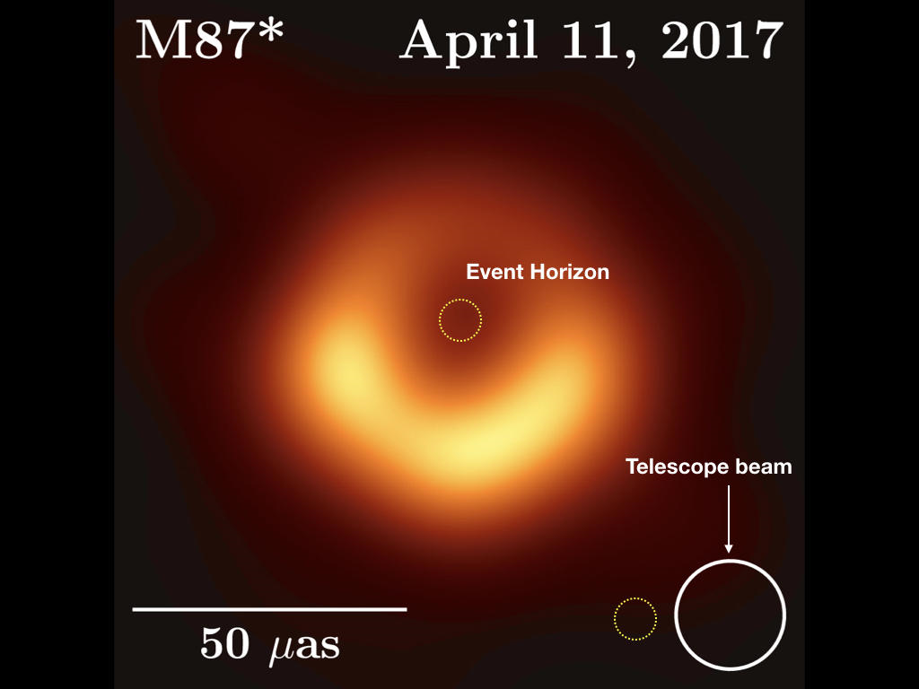
L. Foschini, priv. comm.
Original image: EHT Collaboration, 2019

Slide 21
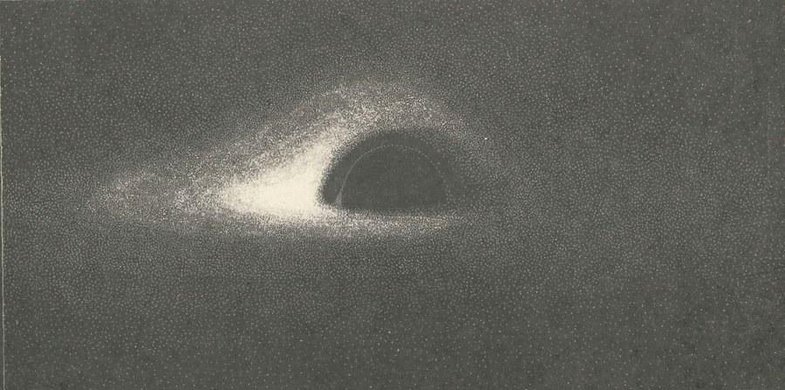
Komissarov 2004
Jet emission:
Outer light surface r_{lc} = c/Ω
Disk emission:
Photon sphere r_{ps} = 3 r_{g}
Shadow r_{sh} = 3^{1/2} r_{ps}
Jean-Pierre Luminet (1978)

Slide 22
Neronov et al. (2012)

Slide 23
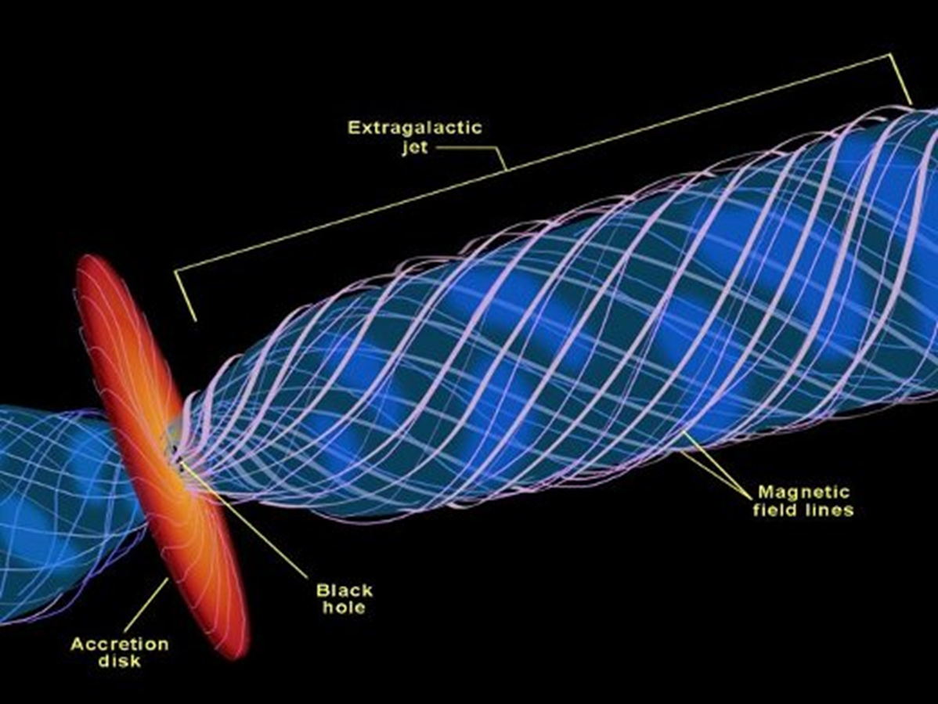
Blandford-Znajek Mechanismus
Blandford-Znajek Mechanism
S. Koide et al. (Science 2002, vol. 295, p. 1688)
.

Slide 24
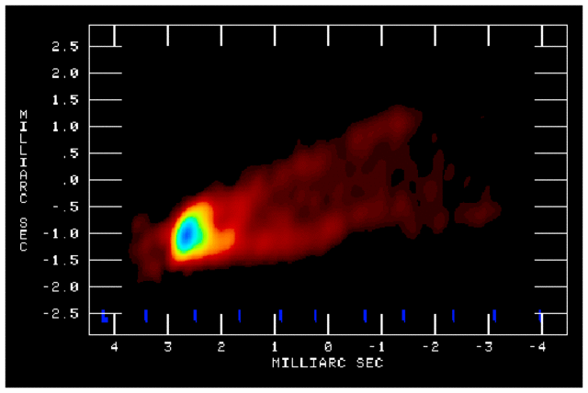
Walker et al. (2018)

Slide 25
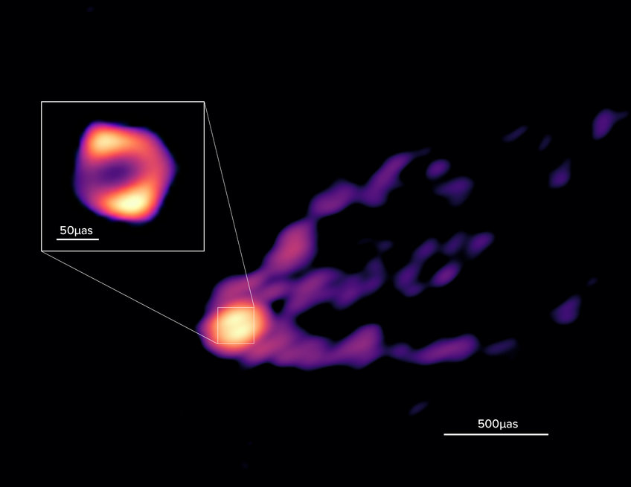
GMVA+ALMA image of the central black hole region in Messier 87 obtained on April 14-15, 2018 at 3.5 mm… [more]
© R. Lu et al, Nature 2023

Slide 26
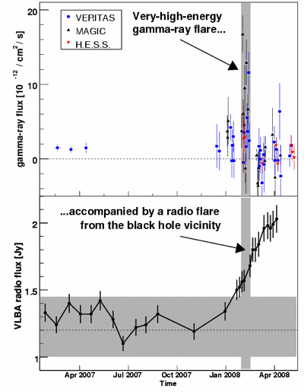
Dissipation close to M87 black hole
Gamma-ray variability ~ horizon light travel time (1 day)
50 day delay until peak arives at radio frequencies
    Limb-brightened jet within central 200 r_{g}
    Poynting flux dominance on jet axis at ~5 r_{g}
    Short-term variability of TeV gamma rays
    Cannot be due to shocks
    Reconnection cannot tap entire Poynting flux
Acciari et al. , & KM, Science, 325, 444, 2009

Slide 27

IC scattered photons produce pairs
→ integro-differential equation describe self-consistently gap height H and pair multiplicity
(Beskin et al. 1992, Hirotani & Okamoto 1998)

Slide 28
Density < Goldreich-Julian density
Mrk501 MAGIC observations of intermittent 3 TeV bump: Gap-accelerated beam interacts with emission-line clouds dissipating P_{i} = 0.001 P_{BZ}
Agrees with Levinson & Cerutti (2018): fraction 0:001 of P_{BZ} dissipated in time 3.5 r_{S}/c after initial discharge of a gap
Wendel, Gonzales, Paneque, KM, A&A 2021

Slide 29
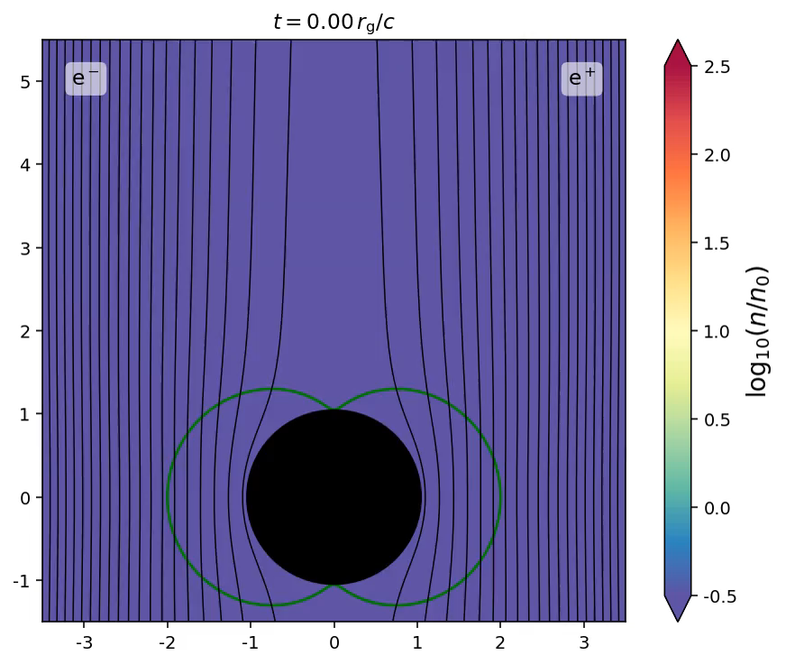

Slide 30
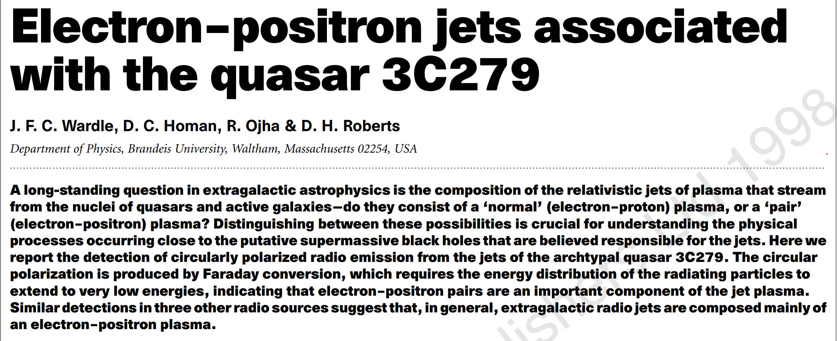




ESO 137-006. Credit: Rhodes University, INAF and SARAO
Nature volume 395, pages457–461 (1998)

Slide 31
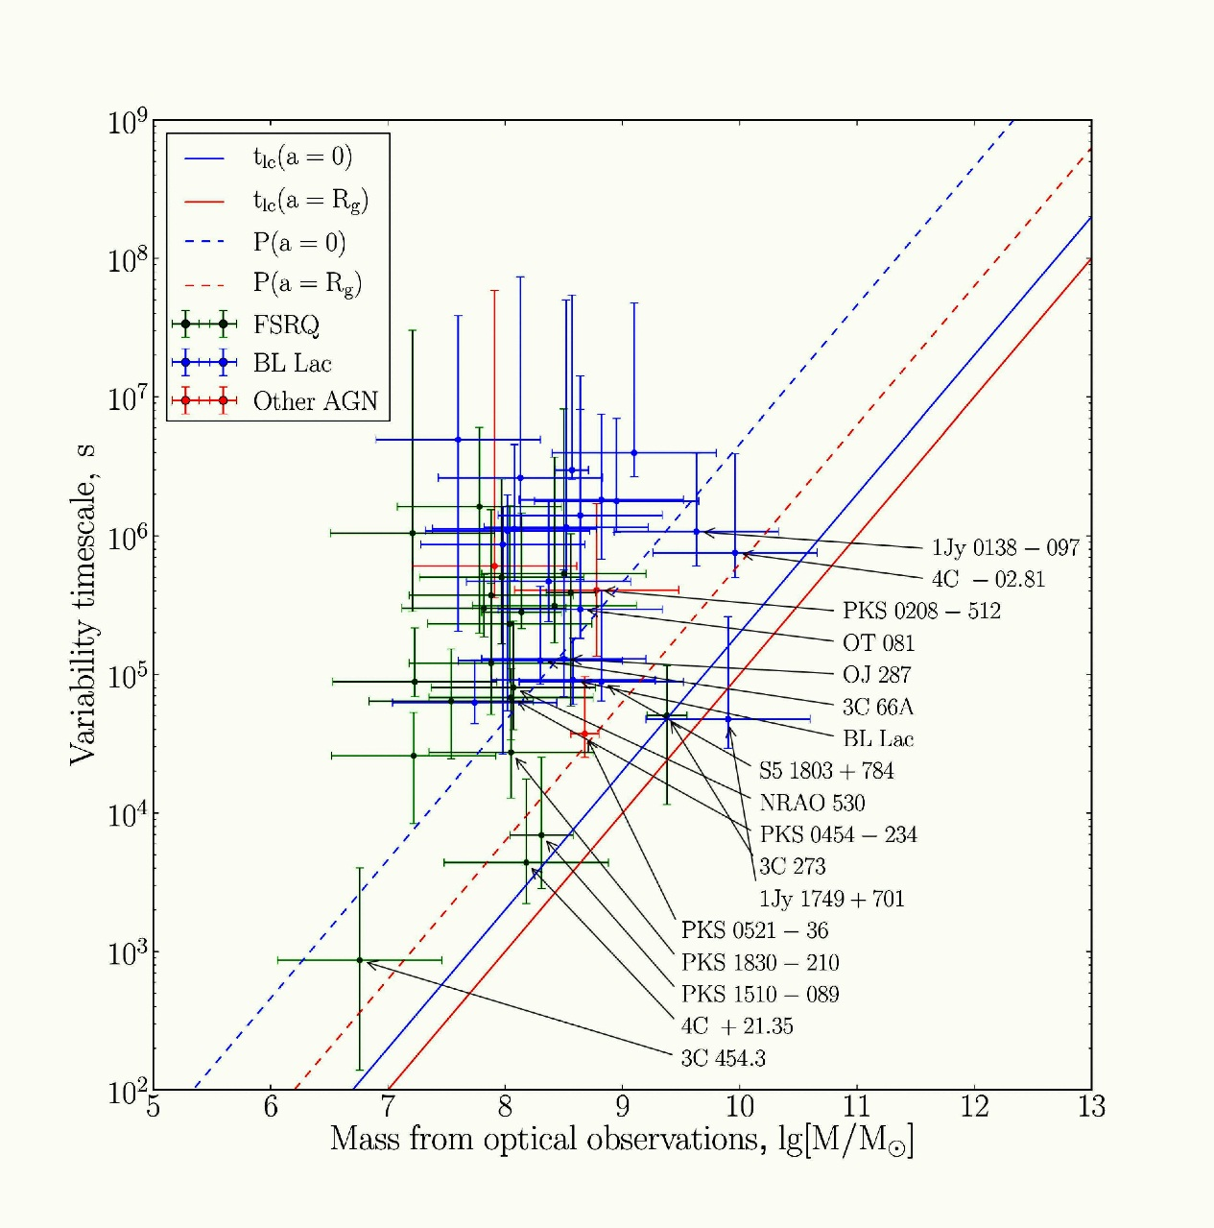
Vovk & Neronov 2013
Fermi-LAT
Δt > m
Schwarzschild
variability time scale
τ_{γγ} = 200
for L=L_{E}
KM, 1997
Kerr
mass

Slide 32
Minute-scale variability
MAGIC observations of minute-scale high-amplitude variability:
  Radio galaxy IC310 (Aleksić et al., &KM 2014)
  FSRQ PKS 1222+21 (Aleksić et al., & KM 2011)
  Markarian 501 (Albert et al., & KM 2007)
Fermi-LAT: CTA 102 (Shukla & KM, et al. 2018), 3C279 (Hayashida & Madejski et al., 2016)
HESS: PKS 2155-304 (Aharonian et al. 2007)
Associated optical polarization swings indicating changes in a coherent magnetic field topology of the dissipation region (Marsher et al. 2008, Abdo et al. 2010, Blinov et al. 2015, Kiehlmann et al. 2018)
Crab PWN gamma-ray variability (Abdo et al. 2011)
Short time-scale variability but absence of pair absorption? Strong anisotropy (E-field acceleration)
CTA102

Slide 33
Vuillaume, Henri, & Petrucci (2018)
Pair absorption in 3C273 for isotropic (!) BLR/dust torus
Plane-parallel solution of radiation transport equation yields escape probability
MeV Blazars?
Same conclusion for hadronic modeling, cf. KM, PRD 48(1993)

Slide 34
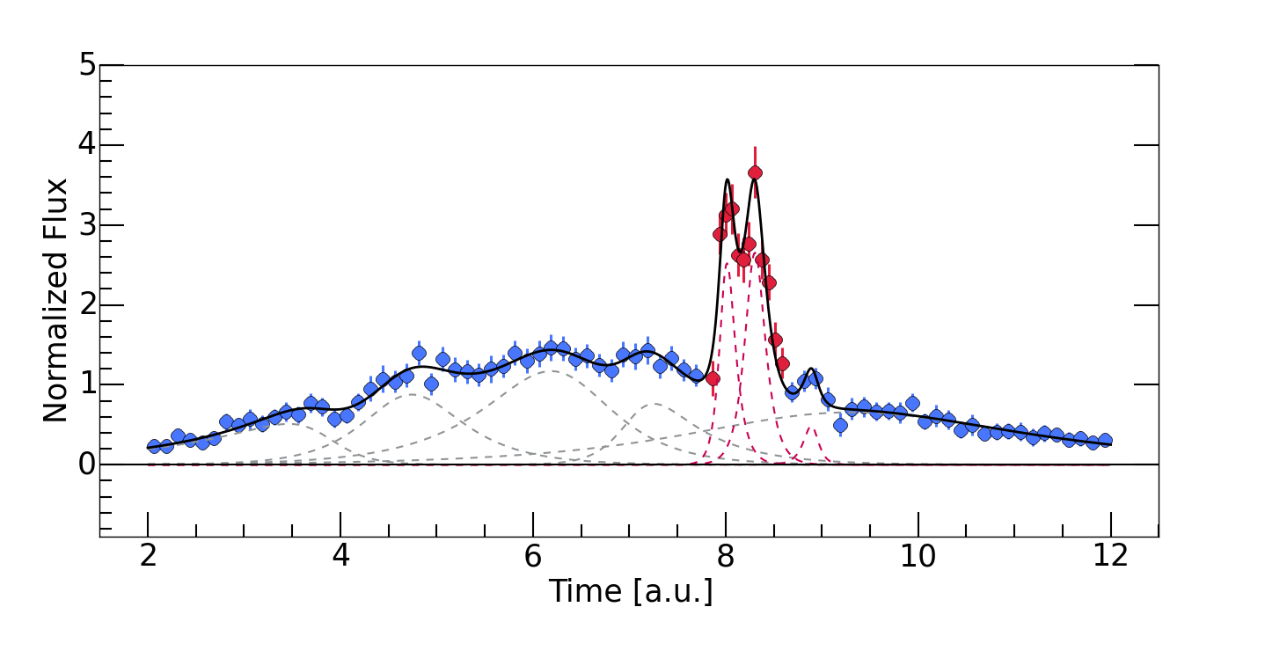
Peak-in-peak structured lightcurves from relativstic reconnection
Shukla & KM, Nat.Comm. (2020)

Slide 35
Energy flow
(Shukla & KM, Nat.Comm. 2020)

Slide 36
GMHD simulations of BZ-driven Jets
Mirzuno et al. (2014)
Toroidal magnetic field subject to m=1 kink instability (McKinney & Blandford 2016)
2d-section: Plasmoids
Prone to relativistic reconnection

Slide 37
Development of electric current layer with 10⁻⁴ u_{B}
Electric field growth E~exp(ω_{i}ct/L)
E<B due to advection of B-field
Yajie Yuan,
Krzysztof Nalewajko,
Jonathan Zrake,
William East, &
Roger Blandford
ApJ 828, 92 (2016)

Slide 38

Tracking energetic particles in the kinetic simulation:
Formation of mini-jets due to the beams of accelerated particles emerging from the electric current layers

Slide 40
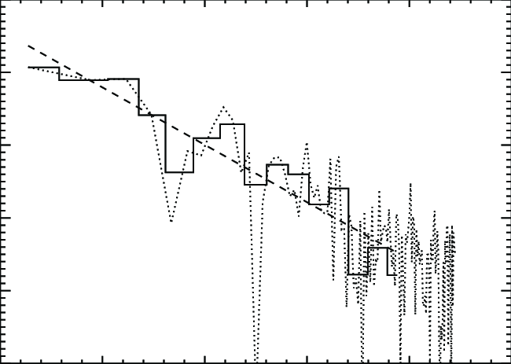
Yuan et al. (2016)
High-energy
Low-energy
Music
3C279
Hayashida et al. (2012)

Slide 41
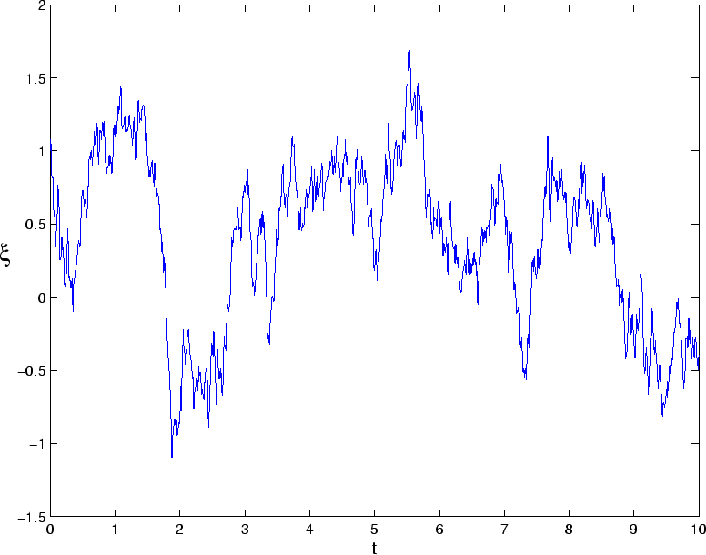
Model for velocity of Brownian particle under the influence of friction (Leonard Ornstein & George Eugene Uhlenbeck, 1930): Fluctuations of resisitivty are colored noise

Slide 42
Lightcurves after turbulence has developed:
Exponential Ornstein-Uhlenbeck process
Parameters cover narrow regions in parameter space: Self-regulation of resistivity fluctuations

Slide 44
Density > Goldreich-Julian density
Super-Flare from gamma-ray 3C279
Spectral fit with pair cascade model
Shows tentative evidence of interaction with emission-line clouds at the edge of the BLR
Dissipation of GRMHD jet far from BH where recombination-line emitting clouds interacting with jet introduce anomalous resistivity leading to a breakdown of the magnetic insulation (cf. Schopper, Birk, & Lesch, Aph, 2002)
Wendel, Shukla , & KM, ApJ, 2021

Slide 45
(Poynting) beam dissipation
Low accretion rate → E-fields due to uncompensated charge carriers (<Goldreich-Julian) → dissipation by gap acceleration
(Rieger & Levinson, Wendel et al. 2021)
High accretion rate → no E-fields → dissipation far from BH where recombination-line emitting clouds interacting with jet introduce anomalous resistivity leading to a breakdown of the magnetic insulation (cf. Schopper, Birk, & Lesch, Aph, 2002)

Slide 47
Mass loading of jets:
Dissipation of Poynting flux associated with pair production
Baryonic mass loading through
  Flares in the disk
  Turbulent entrainment of wind, cloud, ambient gas particles
Pair cascades
  Acceleration of electrons in vacuum gap (low accretion rate)
  Acceleration of electrons by magnetic reconnection in turbulent zone (high accretion rate)
  Acceleration of protons and pair cascades initiated by pion production and decay
MHD approach:
Heavy wind sheath + light BZ spine simulation with
non-thermal electron and proton sub-grid model
(ii) UHE proton test particle propagation

Slide 48
From: Martin Kolos, Arman Tursunov, Berenika Cermakova (2022)

Slide 49
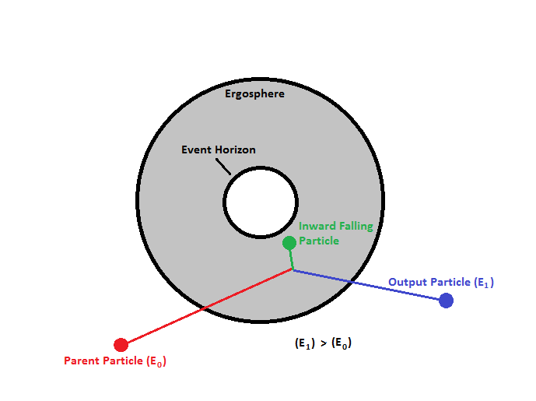
Vacuum solutions of Einstein‘s equations
Penrose-process
The outgoing particle gains energy at the expense of the rotational energy of the Black Hole.

Slide 50
From: Martin Kolos, Arman Tursunov, Berenika Cermakova (2022)

Slide 51
From: Martin Kolos, Arman Tursunov, Berenika Cermakova (2022)

Slide 52
Still there are open questions…
To many questions answers will rely on a massive theory effort:
  Theory center
  Preparation for Multimessenger/Multifrequency era (CTA, IceCube+, PAO+, ET, SKA, COSI …)
  Advanced modeling techniques (e.g., hybrid GR-MHD, GR-PIC)
  Connection with optical spectroscopy diagnostics of velocity fields and charge transfer reactions: interplay between non-thermal particles and thermal gas
  ML-augmented nonlinear model testing
  Transient phenomena pipelines

Slide 53
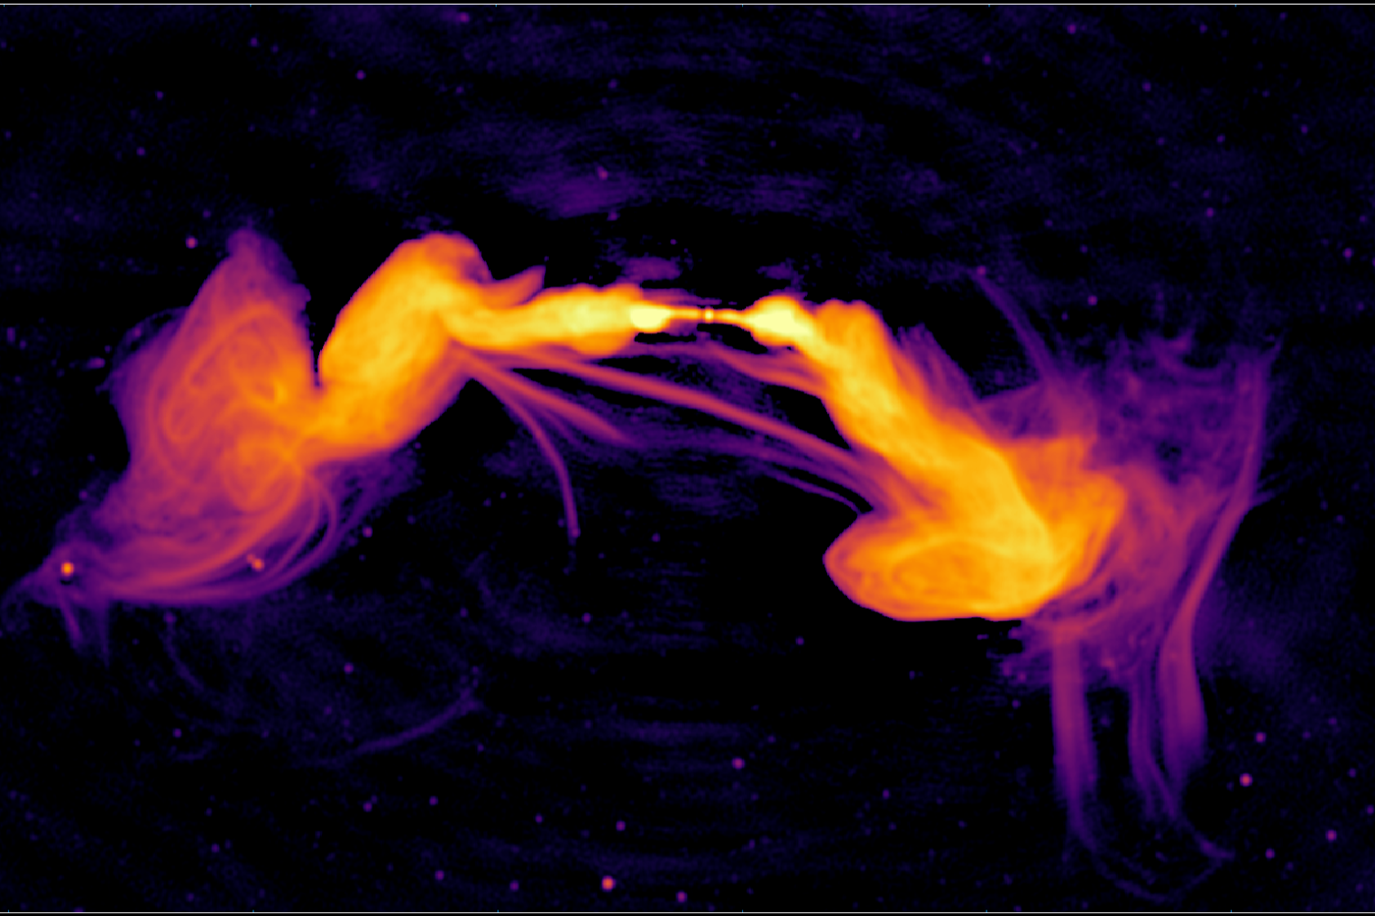
ESO 137-006. Credit: Rhodes University, INAF and SARAO (MeerKAT)

Slide 54
Particle acceleration by black holes
High-energy observations
  Multi-TeV energies required to explain gamma-ray observations (KN regime…)
  PeV energies required to explain IceCube neutrinos (10 PeV proton beam interacts with UV field)
  100 EeV energies required to explain cosmic coincidence of extragalactic gamma ray, neutrino, and UHECR intensities from pion decay (KM, Astropar. Phys. 1995)
  Rapid variability (minutes: sub-horizon time scales)
  Stochastic variability (Ornstein-Uhlenbeck process, Burd et al. 2021)
  Dynamical prcoesses (absence of skewness in distribution of flare asymmetries)
  Dissipation correlates with transition from magnetic to kinetic energy dominance and morphology change from parabolic to conical (free) shape
Black hole machine
  Black Holes aquire weak positive electric charge
  Negative charge (electrons) affected by photon pressure
  Proton beam acceleration by magnetic/electric Penrose effect

