Slide 1
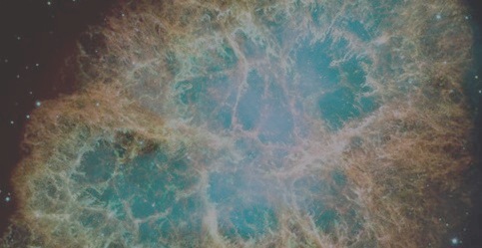
Supernova neutrino detection with dual-phase xenon TPCs
Sayan Ghosh
ghosh116@purdue.edu
Astroparticle School 2023, Obertrubach-Bärnfels

Slide 2
Introduction
Coherent Elastic Neutrino Nucleus Scattering (CEνNS)
All flavors
(Nuclear Recoils)
Recoil Energies ≈ 1 – 20 keV
ν_{e}s only
ν of all flavours
Energies ≈ few to few tens of MeV
Inverse Beta decay
High thresholds
Large volume
Dark Matter Detectors with
super low thresholds
Traditional neutrino detectors
High threshold!!!!

Slide 3
XENONnT detector
Total of 8.5 tons of xenon
6 tons of active mass of liquid xenon
~700 tons of water for vetoing muons and neutrons.

Slide 4
Signals in liquid xenon TPCs
Hit pattern on the top PMT from the S2 signal gives the X-Y position.
The time difference between the S1 and S2 signal yields the Z coordinate.

Slide 5
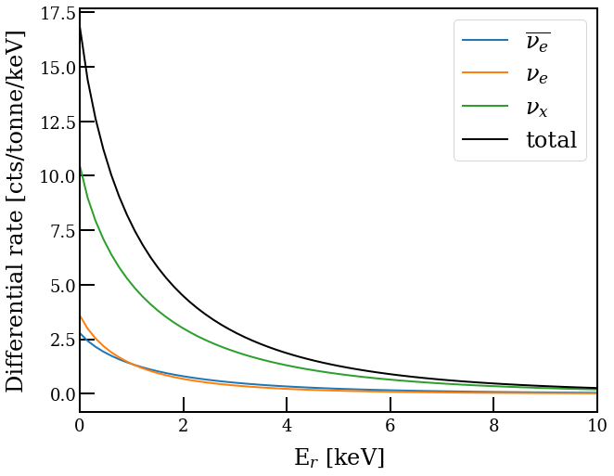
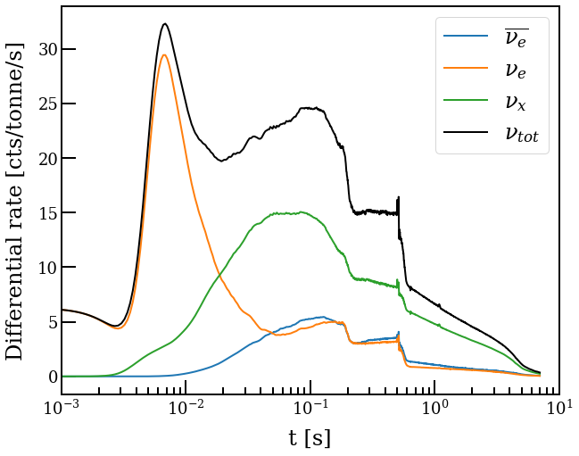
CEνNS
CEνNS process has an $A^{2}$ enhancement Xe a suitable target (A~131.2).
Reference supernova model 11 M⊙ at a distance of 10 kpc (Ref:-Mirizzi et al. Rivista del Nuovo Cimento Vol 39 N. 1-2 (2016))
At a distance of 10 kpc, a typical SN can generate ~100 CEνNS interactions in the target of $\sim$5.9 tons of liquid xenon.
SNAX
snewpy

Slide 6
Signals in detector
Signals and background without cuts
Signals and background after cuts
We put cuts on peak features like
Peak area, width, rise time, x-y position, etc.
Background-only
Background-only
SN Signals (Simulated)
SN Signals (Simulated)

Slide 7
Detection Significance
Background and signal counts before and after cuts
Integration time = $\sim 7−10$ sec
Melih Kara
(SNvD 2023@LNGS: International Conference on Supernova Neutrino Detection)

Slide 8
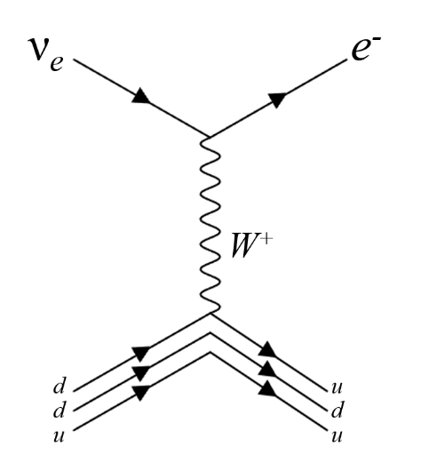
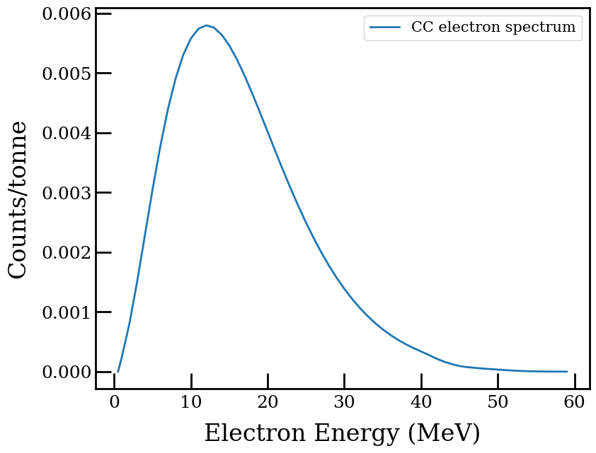
CC interactions of SN neutrinos (a limitation?)
The CC interactions lead to emission of electrons and a daughter nucleus in an excited state (¹³²Cs* in case of ¹³²Xe).
Time integrated spectrum of electrons from CC interaction of SN neutrinos for the entire supernova burst.
P. Bhattacharjee, A. Bandopadhyay, S. Chakroborty, S. Ghosh, et. al., Phys.Rev.D 106 (2022) 4, 043029.
For 11 M⊙ model : 0.7 electrons at 10 kpc are expected in XENONnT.

Slide 9
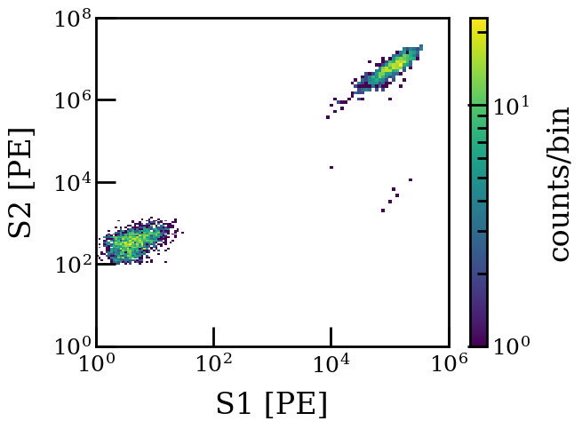
Signal sizes for CC electrons
Large signal sizes saturate PMTs and DAQs dead time ($\sim$ ms).
For 11 M⊙ model, we will have 1 CC electron at a distance of 8.3 kpc.
CC e⁻s
CEνNS

Slide 10
Implications on future detectors
Lower bound on the supernova distance due to the CC electrons?
Implications on design of future generation detectors like DARWIN/XLZD.
Distance for 1 CC electron

Slide 11
Summary
Dual phase xenon TPCs can detect supernova neutrinos.
$A^{2}$enhancement makes xenon a suitable target for CEνNS.
Custom cuts can significantly enhance detection significance.
CC interactions may pose an issue to CEνNS detection depending on the distance.

