Slide 1












Impact of a ΛCDM extension on UHECR propagation
Obertrubach 2023
10th of October
Janning Meinert
meinert@uni-wuppertal.de

Slide 2
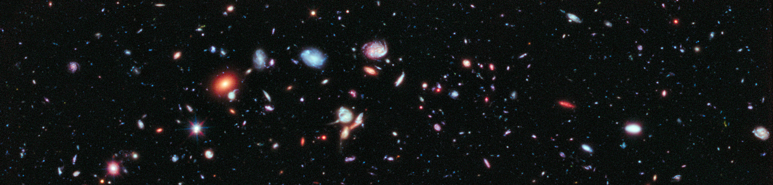
Impact of a ΛCDM extension on UHECR propagation
Cosmology
Obertrubach 2023
10th of October
Janning Meinert
meinert@uni-wuppertal.de

Slide 3
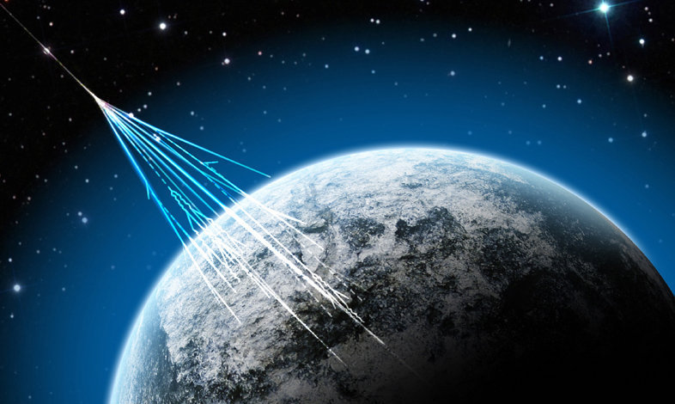
Impact of a ΛCDM extension on UHECR propagation
Cosmology
Astroparticlephysics
Obertrubach 2023
10th of October
Janning Meinert
meinert@uni-wuppertal.de

Slide 4
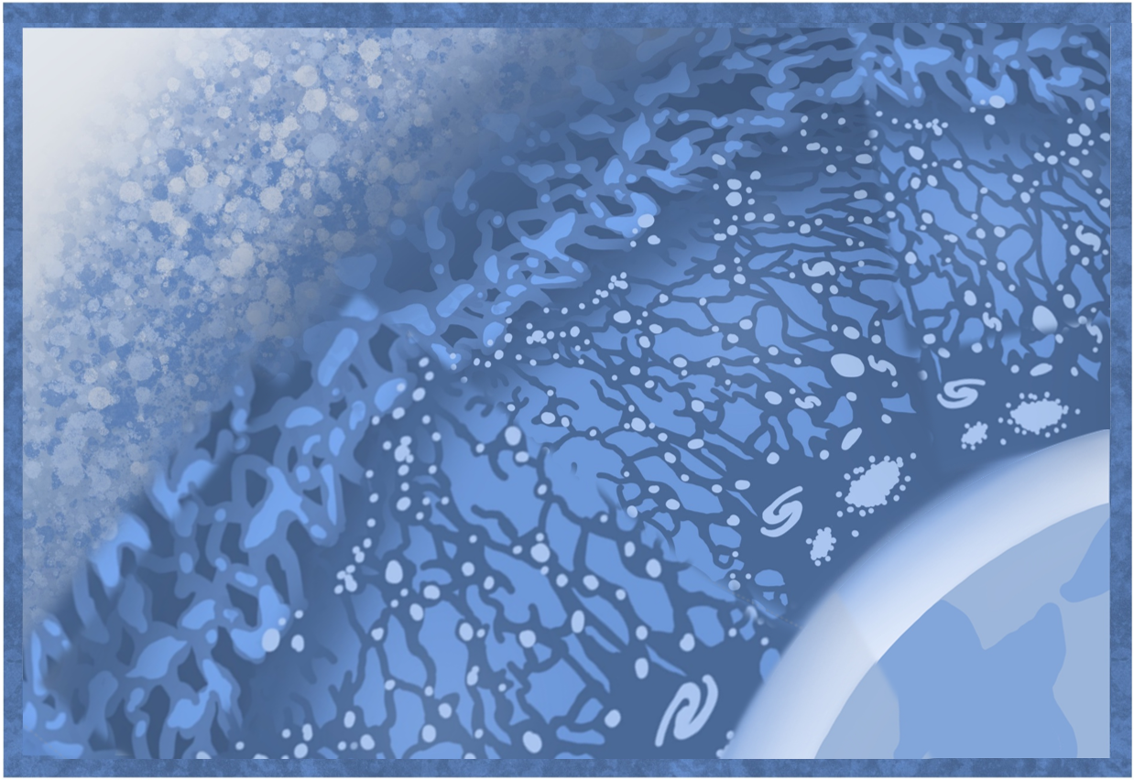
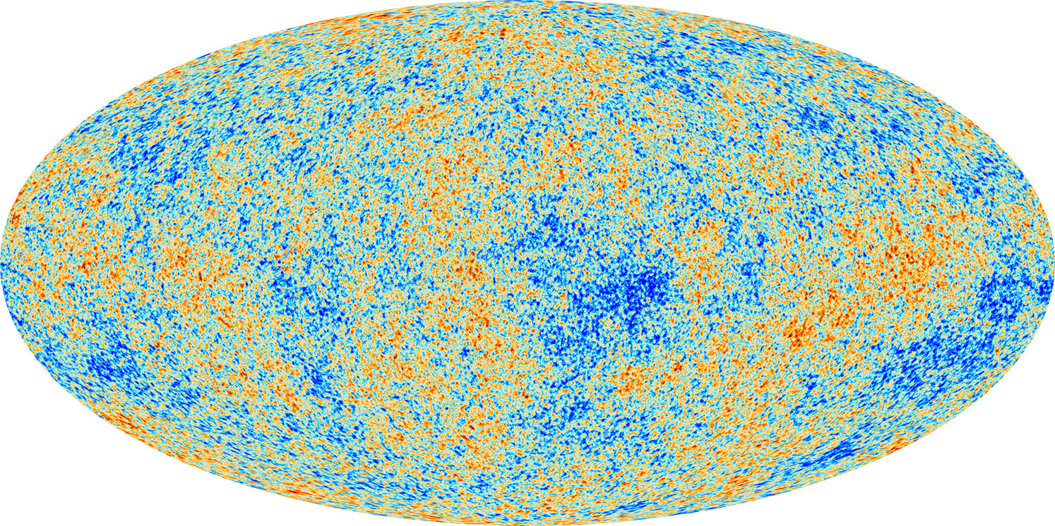
Epochs of the Universe
Big Bang
Dense Baryonic Matter
Cosmic Microwave Background
Dark Ages
Galaxy Formation
Earth
1
© Jessie Muir (modified)

Slide 5



Epochs of the Universe
¹
Hofmann 2013 Nature Phys.
10.1038/nphys2793
SU(2) Postulate¹
Cosmic Microwave Background
1
© Jessie Muir (modified)

Slide 6
∞
1089
1
0
redshift [z]
¹
Hofmann 2013 Nature Phys.
10.1038/nphys2793
SU(2) Postulate¹
ΛCDM
~3000
2.725
1
CMB Temperature [K]
© Jessie Muir (modified)

Slide 7
∞
1751
1089
1
0
redshift [z]
¹
Hofmann 2013 Nature Phys.
10.1038/nphys2793
SU(2) Postulate¹
ΛCDM
SU(2)_{CMB}
Changed T(z)
~3000
2.725
1
CMB Temperature [K]
© Jessie Muir (modified)

Slide 8
∞
1751
1089
1
0
redshift [z]
¹
Hofmann 2013 Nature Phys.
10.1038/nphys2793
SU(2) Postulate¹
ΛCDM
SU(2)_{CMB}
Changed T(z)
~3000
2.725
1
CMB Temperature [K]
© Jessie Muir (modified)

Slide 9

∞
1751
1089
1
0
redshift [z]
¹
Hofmann 2013 Nature Phys.
10.1038/nphys2793
SU(2) Postulate¹
ΛCDM
SU(2)_{CMB}
³
Planck Collaboration
arXiv: 1807.06209
H₀ ≈ 67.4 ³
~3000
H₀ ≈ 73 ²
km s⁻¹Mpc⁻¹
²
Riess et al. 2021
arXiv: 2112.04510
2.725
1
CMB Temperature [K]
© Jessie Muir (modified)

Slide 10



∞
1751
1089
1
0
redshift [z]
¹
Hofmann 2013 Nature Phys.
10.1038/nphys2793
SU(2) Postulate¹
ΛCDM
SU(2)_{CMB}
³
Planck Collaboration
arXiv: 1807.06209
H₀ ≈ 67.4 ³
~3000
H₀ ≈ 74.2 ⁴
⁴
Hahn et al. 2018
MNRAS
arXiv: 1810.01253
H₀ ≈ 73 ²
km s⁻¹Mpc⁻¹
²
Riess et al. 2021
arXiv: 2112.04510
Local agreement ⁵
with SU(2)_{CMB}
⁵
⁵
Hofmann+JM+Balaji 2023, AdP.
arXiv: 2205.11450
2.725
Ω_{m} σ₈
1
Ω_{b}
CMB Temperature [K]
© Jessie Muir (modified)

Slide 11


∞
1751
1089
1
0
redshift [z]
¹
Hofmann 2013 Nature Phys.
10.1038/nphys2793
SU(2) Postulate¹
ΛCDM
SU(2)_{CMB}
Longer CR propagation length
~3000
Diluted CMB
photon density
2.725
2
CMB Temperature [K]
© Jessie Muir (modified)

Slide 12
∞
1751
1089
1
0
redshift [z]
¹
Hofmann 2013 Nature Phys.
10.1038/nphys2793
SU(2) Postulate¹
ΛCDM
SU(2)_{CMB}
Longer CR propagation length
ν
~3000
Slightly more cosmo- genic neutrinos
Diluted CMB
photon density
ν
ν
Shallower CR source evolution in comparison with ΛCDM
ν
ν
2.725
2
CMB Temperature [K]
© Jessie Muir (modified)

Slide 13
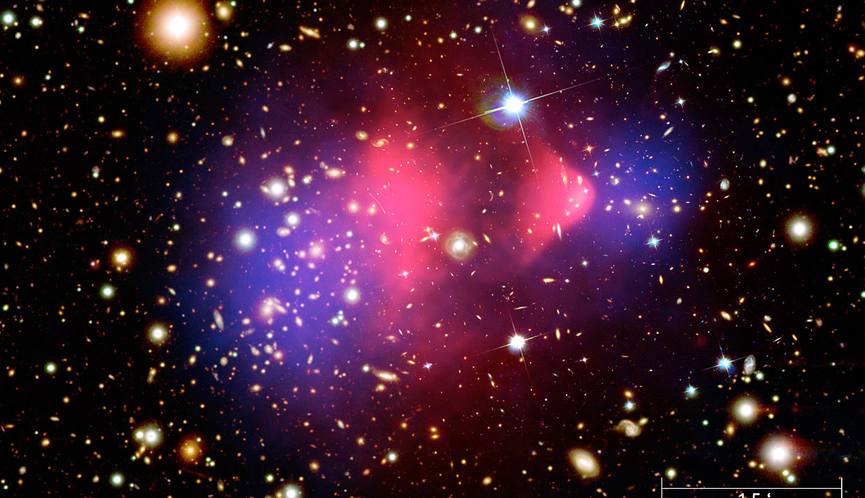
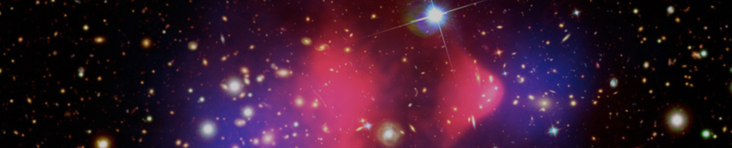

How is T(z) modiefied?
Notes:
3, 8, 10, 30, and 90 GHz ----------- COBE-FIRAS (Fixsen & Mather 2002)

Slide 14
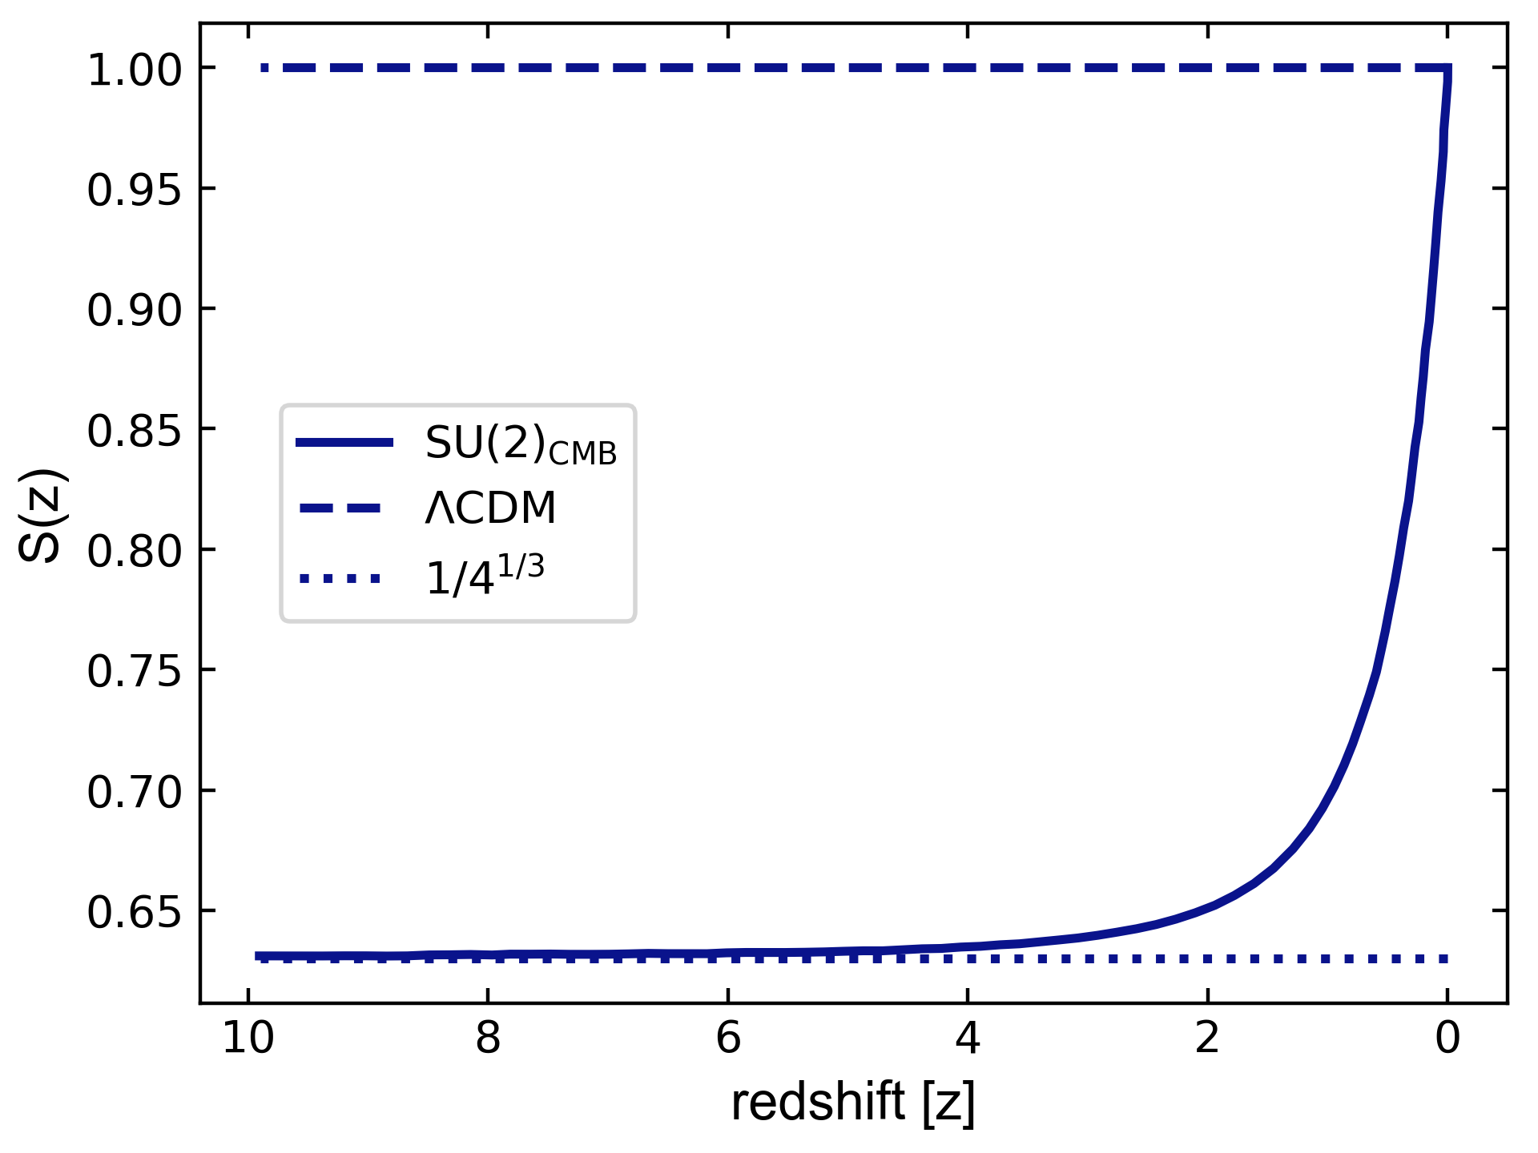
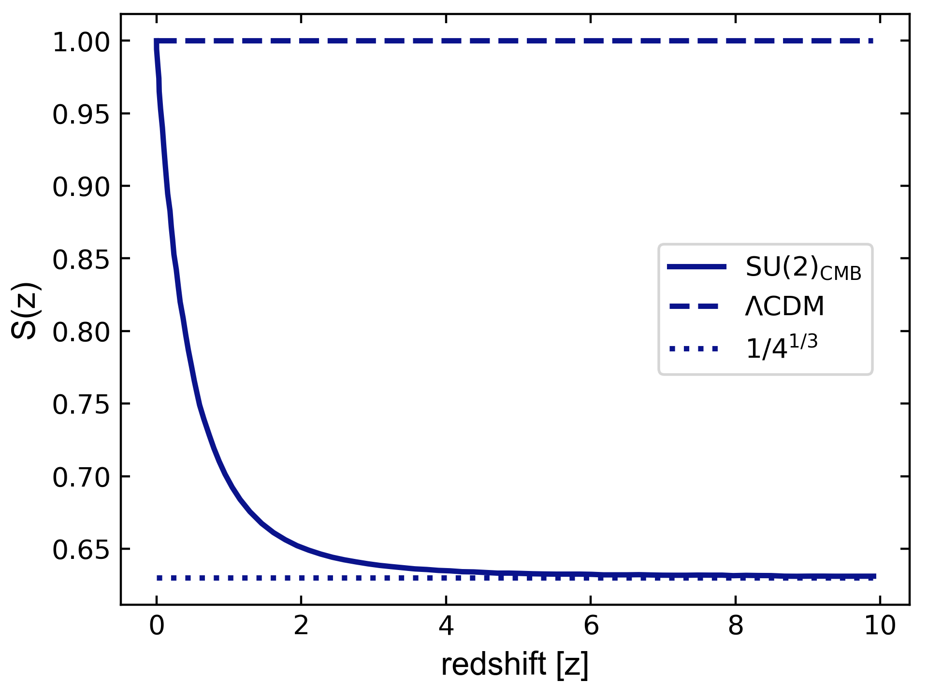
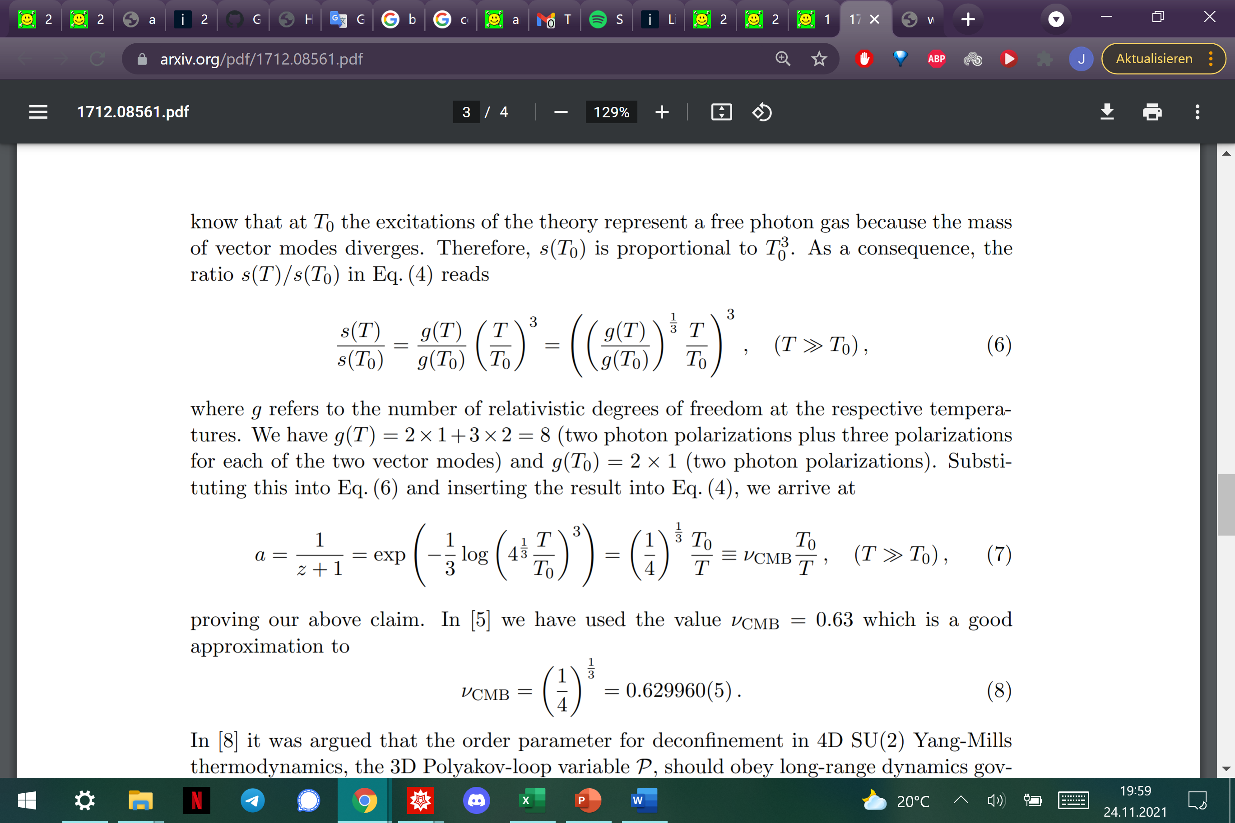
How do we change T(z) = S(z) (1+z) T₀
≈
3

Slide 15
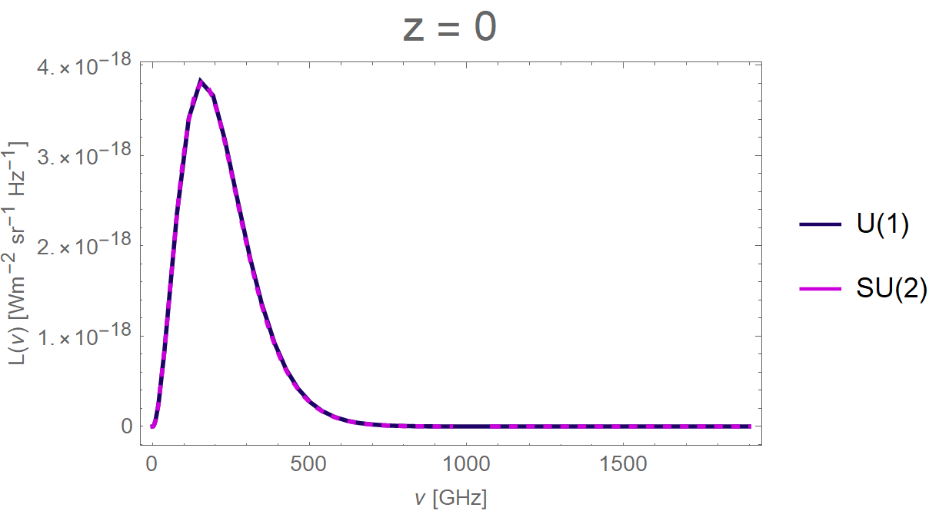

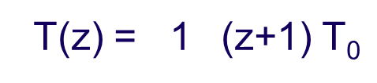
CMB Evolution
T(z) = 1 (z+1) T₀
$\text{T}\text{(}\text{z}\text{)} \text{=} \text{S}\text{(}\text{z}\text{)(}\text{z}\text{+1)} \text{T}\text{0}$
4

Slide 16
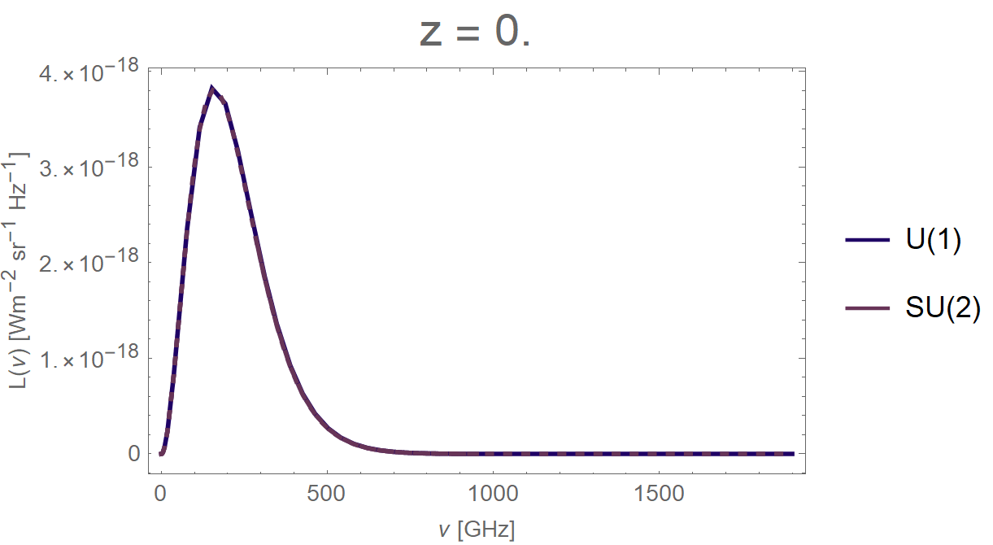
CMB Evolution
4

Slide 17
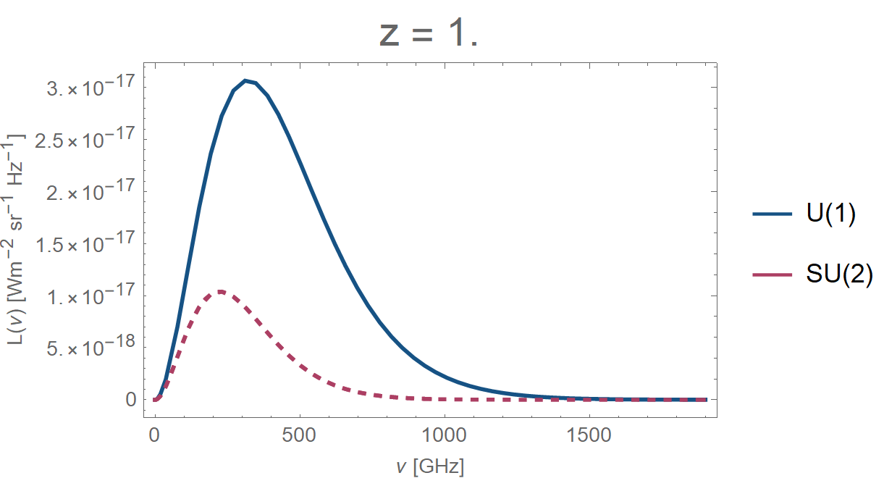
CMB Evolution
4

Slide 18
Propagation of UHECRs
Notes:
3, 8, 10, 30, and 90 GHz ----------- COBE-FIRAS (Fixsen & Mather 2002)

Slide 19

redshift [z]
1715
1089
2
1
0
Diluted CMB
photon density
SU(2)
U(1)
SU(2)_{CMB}
ΛCDM
5

Slide 20
redshift [z]
1715
1089
2
1
0
SU(2)
n
p
U(1)
n
p
SU(2)_{CMB}
ΛCDM
5

Slide 21
redshift [z]
1715
1089
2
1
0
ν
SU(2)
ν
ν
n
p
ν
U(1)
ν
n
p
SU(2)_{CMB}
ΛCDM
5

Slide 22
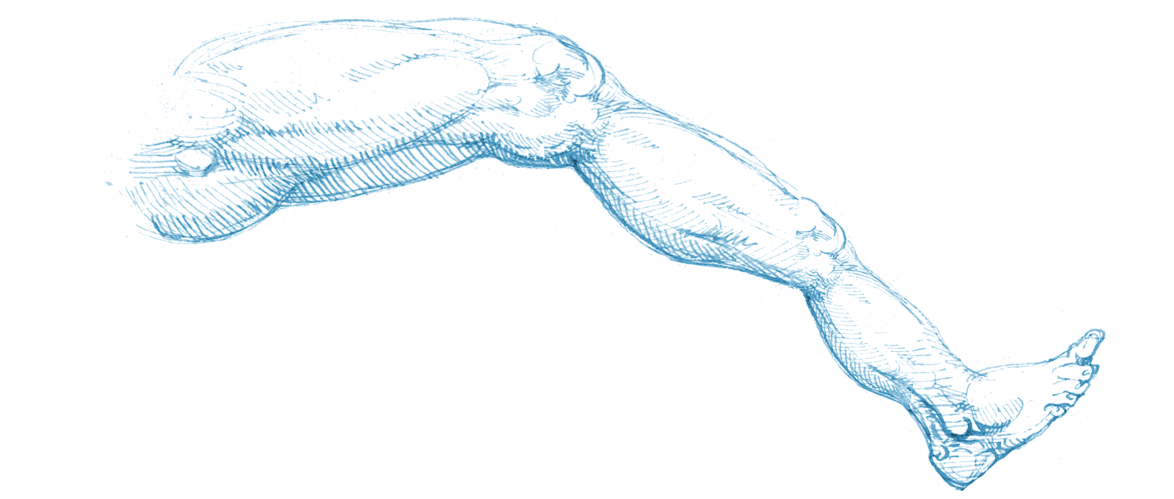
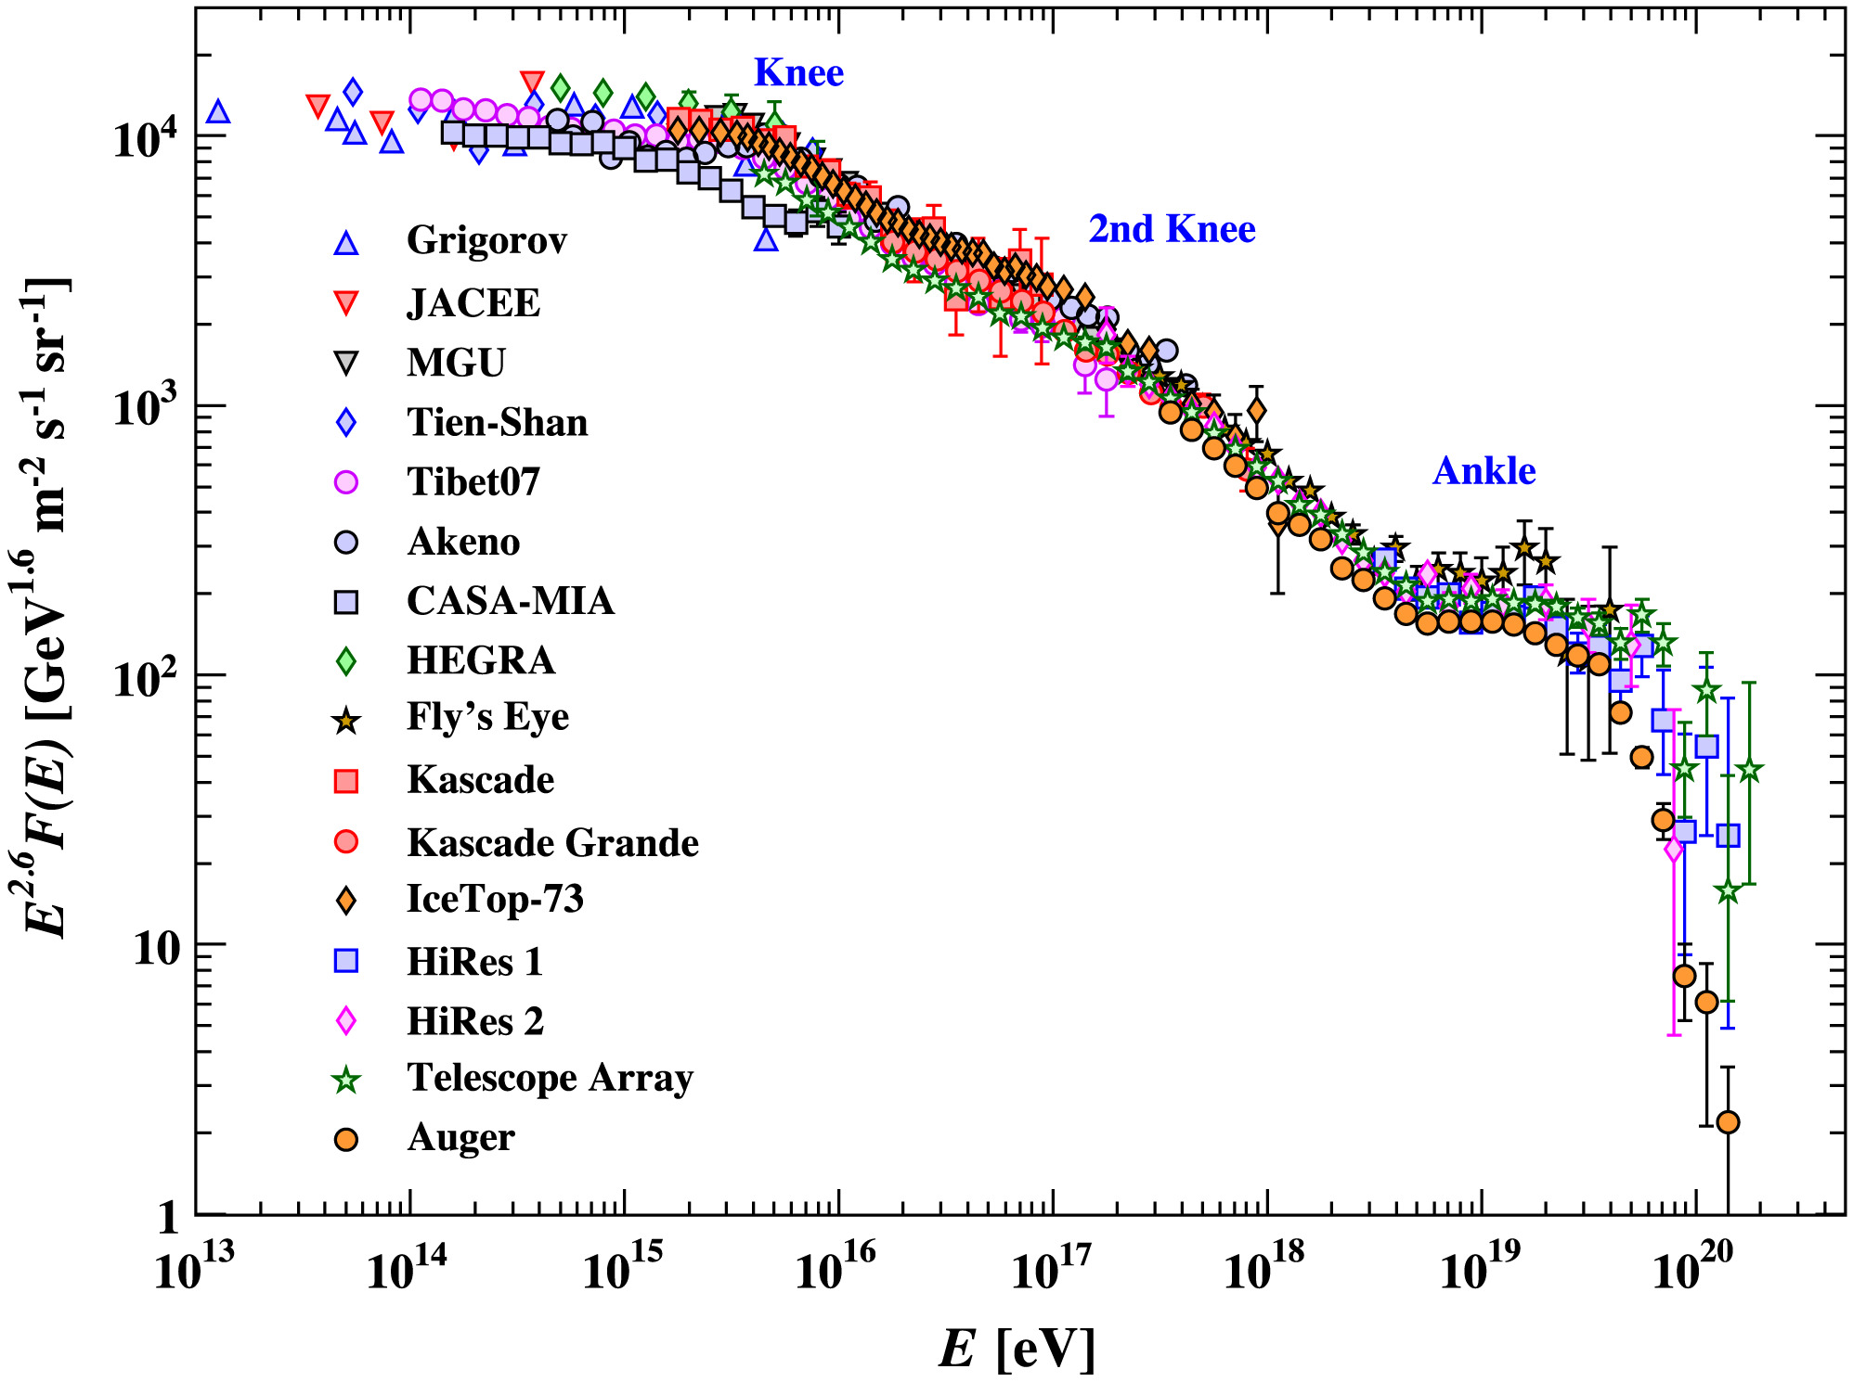
CR spectrum
1st Knee
2nd Knee
Ankle
6
Patrignani et al., 2016

Slide 23
CR spectrum
1st Knee
2nd Knee
Ankle
galactic
origin
?
extra-galactic
origin
6
Patrignani et al., 2016

Slide 24
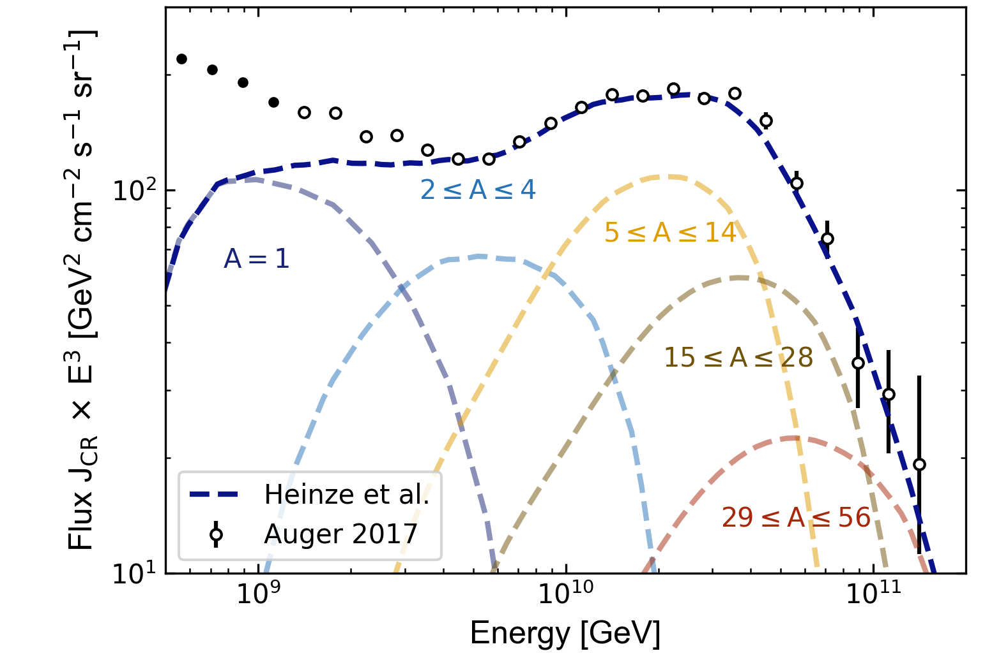
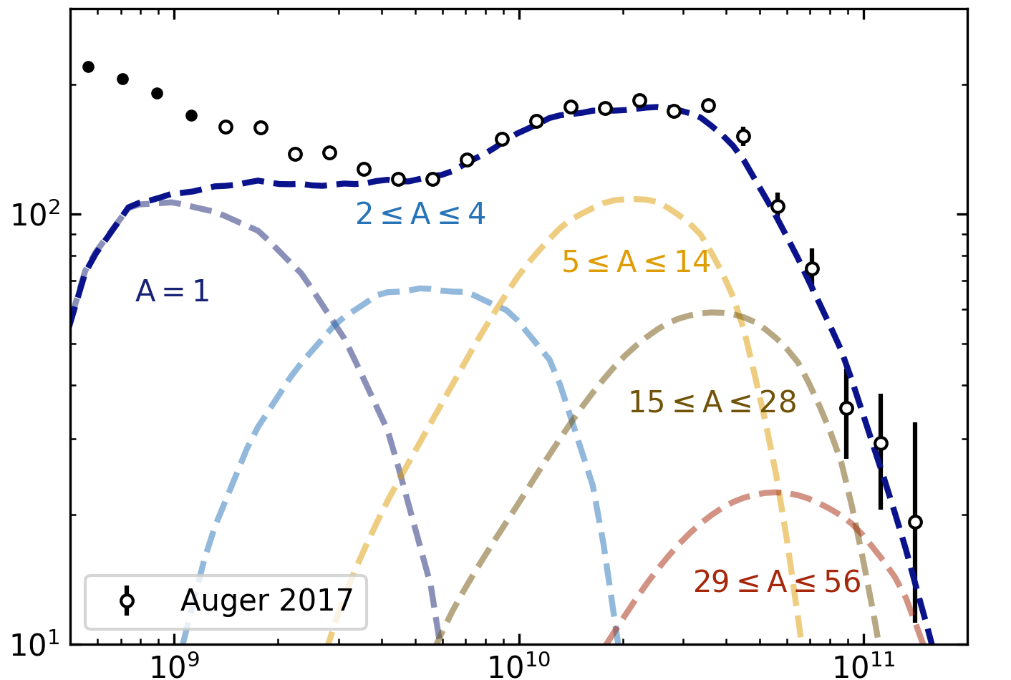
UHECR propagation with Prince-CR
Use Prince-CR by Heinze et al.¹
1D propagation simulation
Reproduced compositional fit
¹
Heinze et al 2019 Ap.J. 873 no.1, 88
arXiv: 1901.03338
7

Slide 25
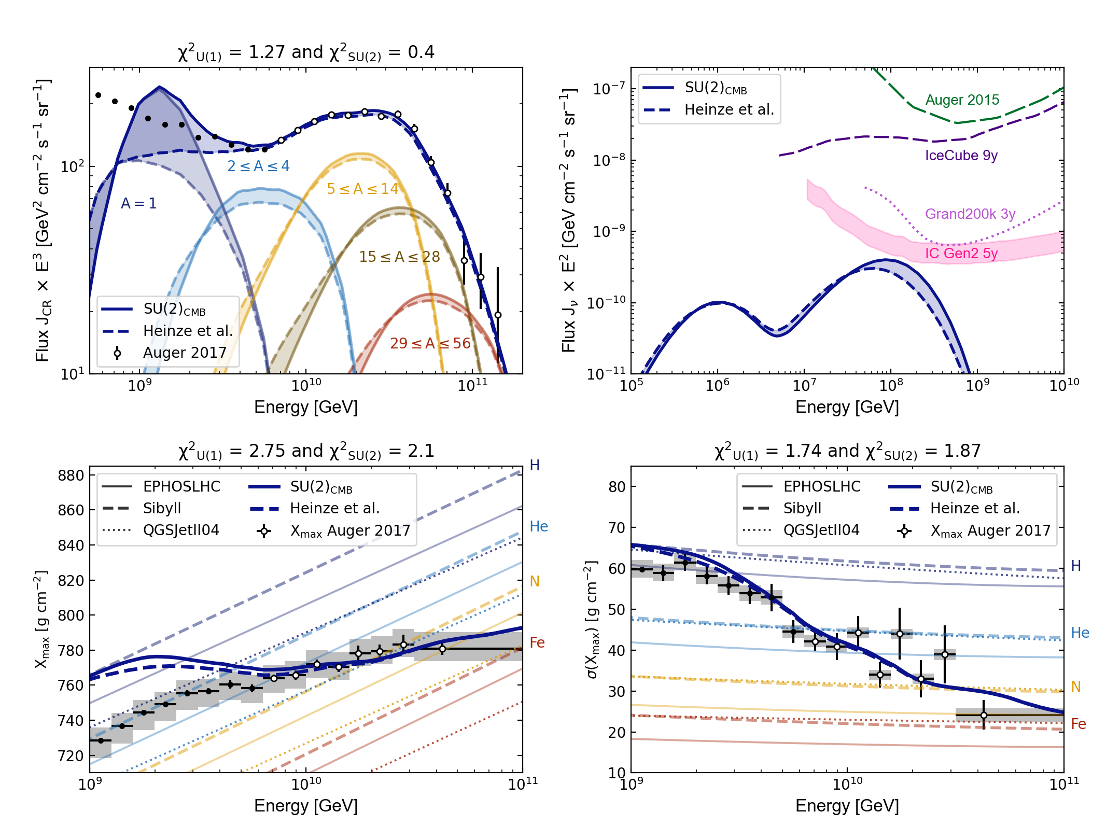
UHECR propagation
CR travel further under changed T(z)
Higher flux of heavy elements
Pile-up of protons below the ankle
7

Slide 26


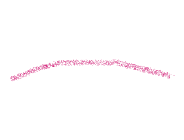

UHECR propagation
(1+z)^{m}
7

Slide 27
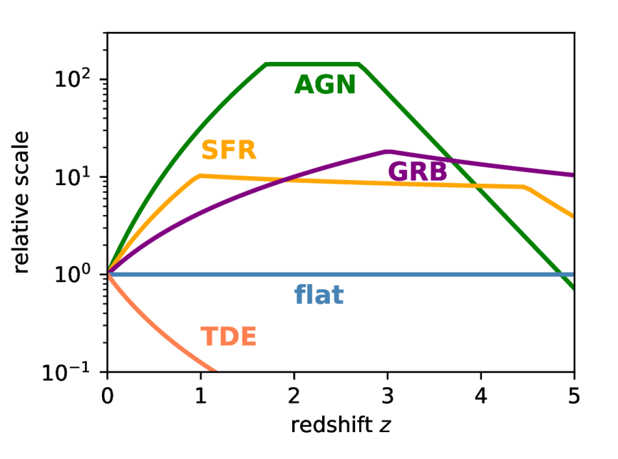
(1+z)^{4.2}
(1+z)^{2.4}
CR source distribution
Relative flux density
Heinze et al. (2019) 1901.03338
8

Slide 28
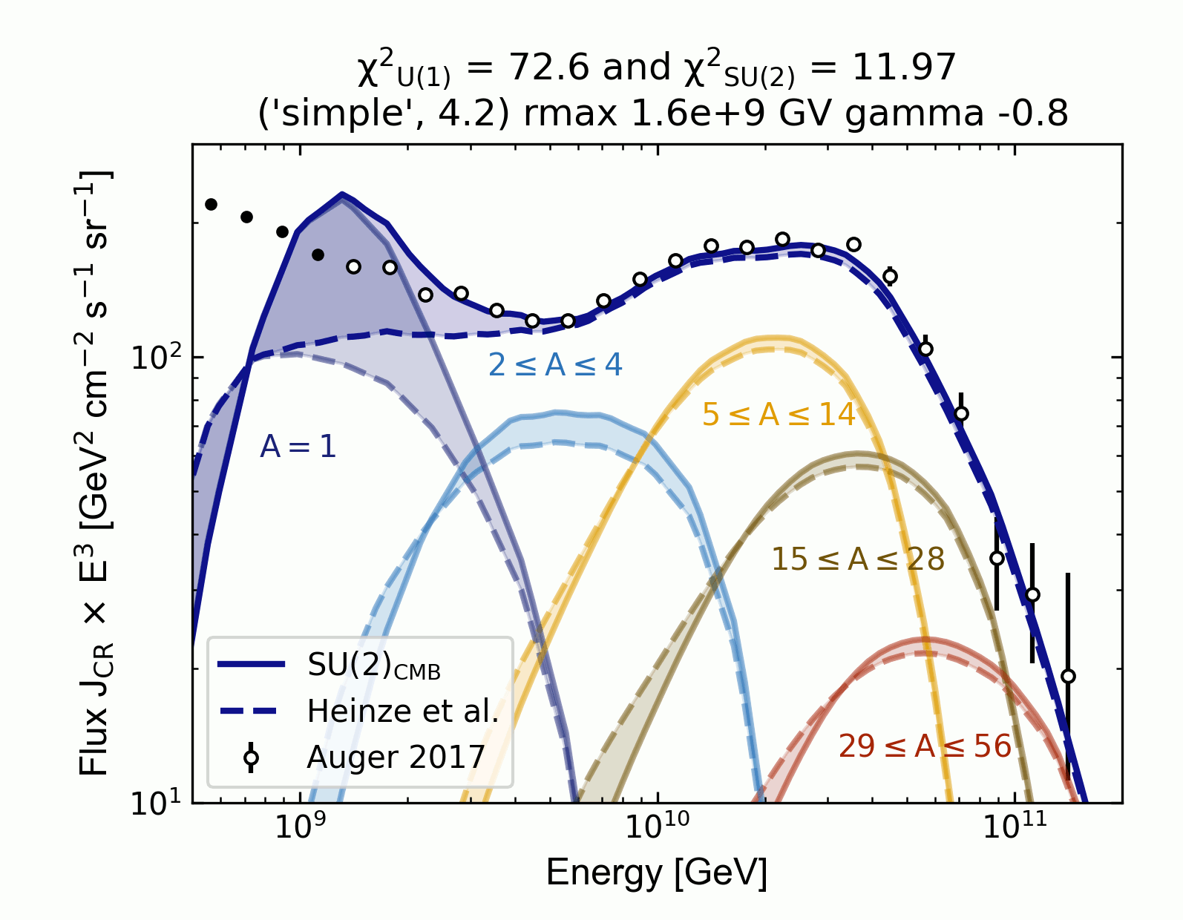


UHECR propagation
(1+z)^{m}
9

Slide 29
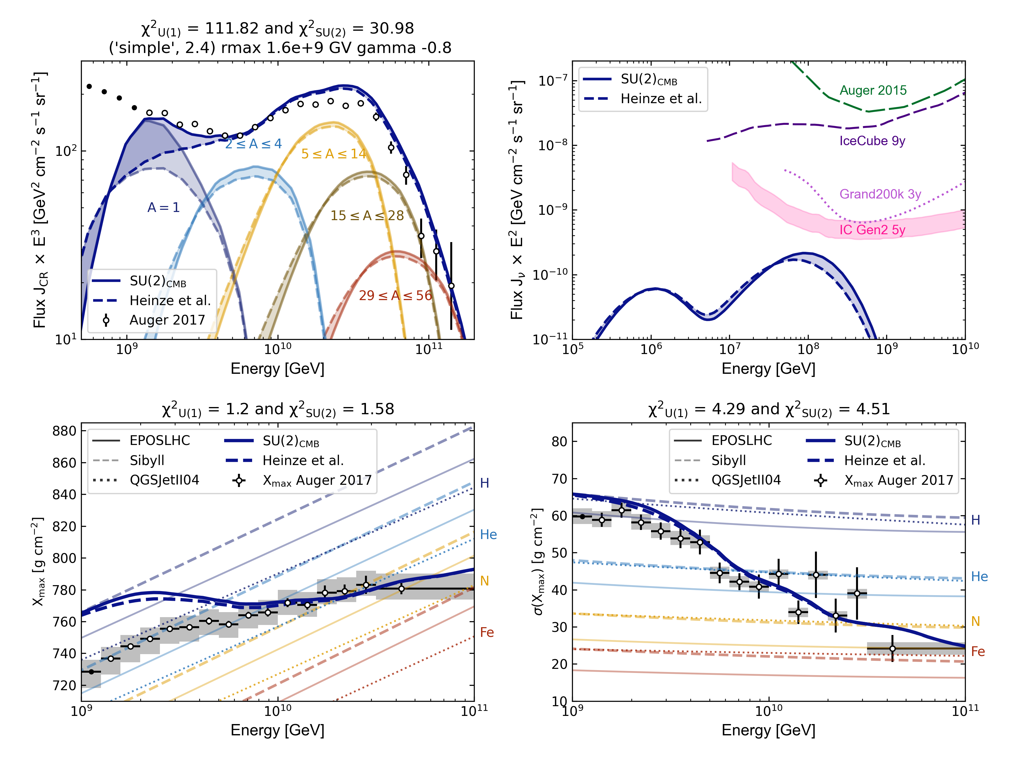
UHECR propagation
(1+z)^{m}
Lower CR source density
shallower CR source evolution
Lower flux below the ankle
Higher flux above the ankle
9

Slide 30
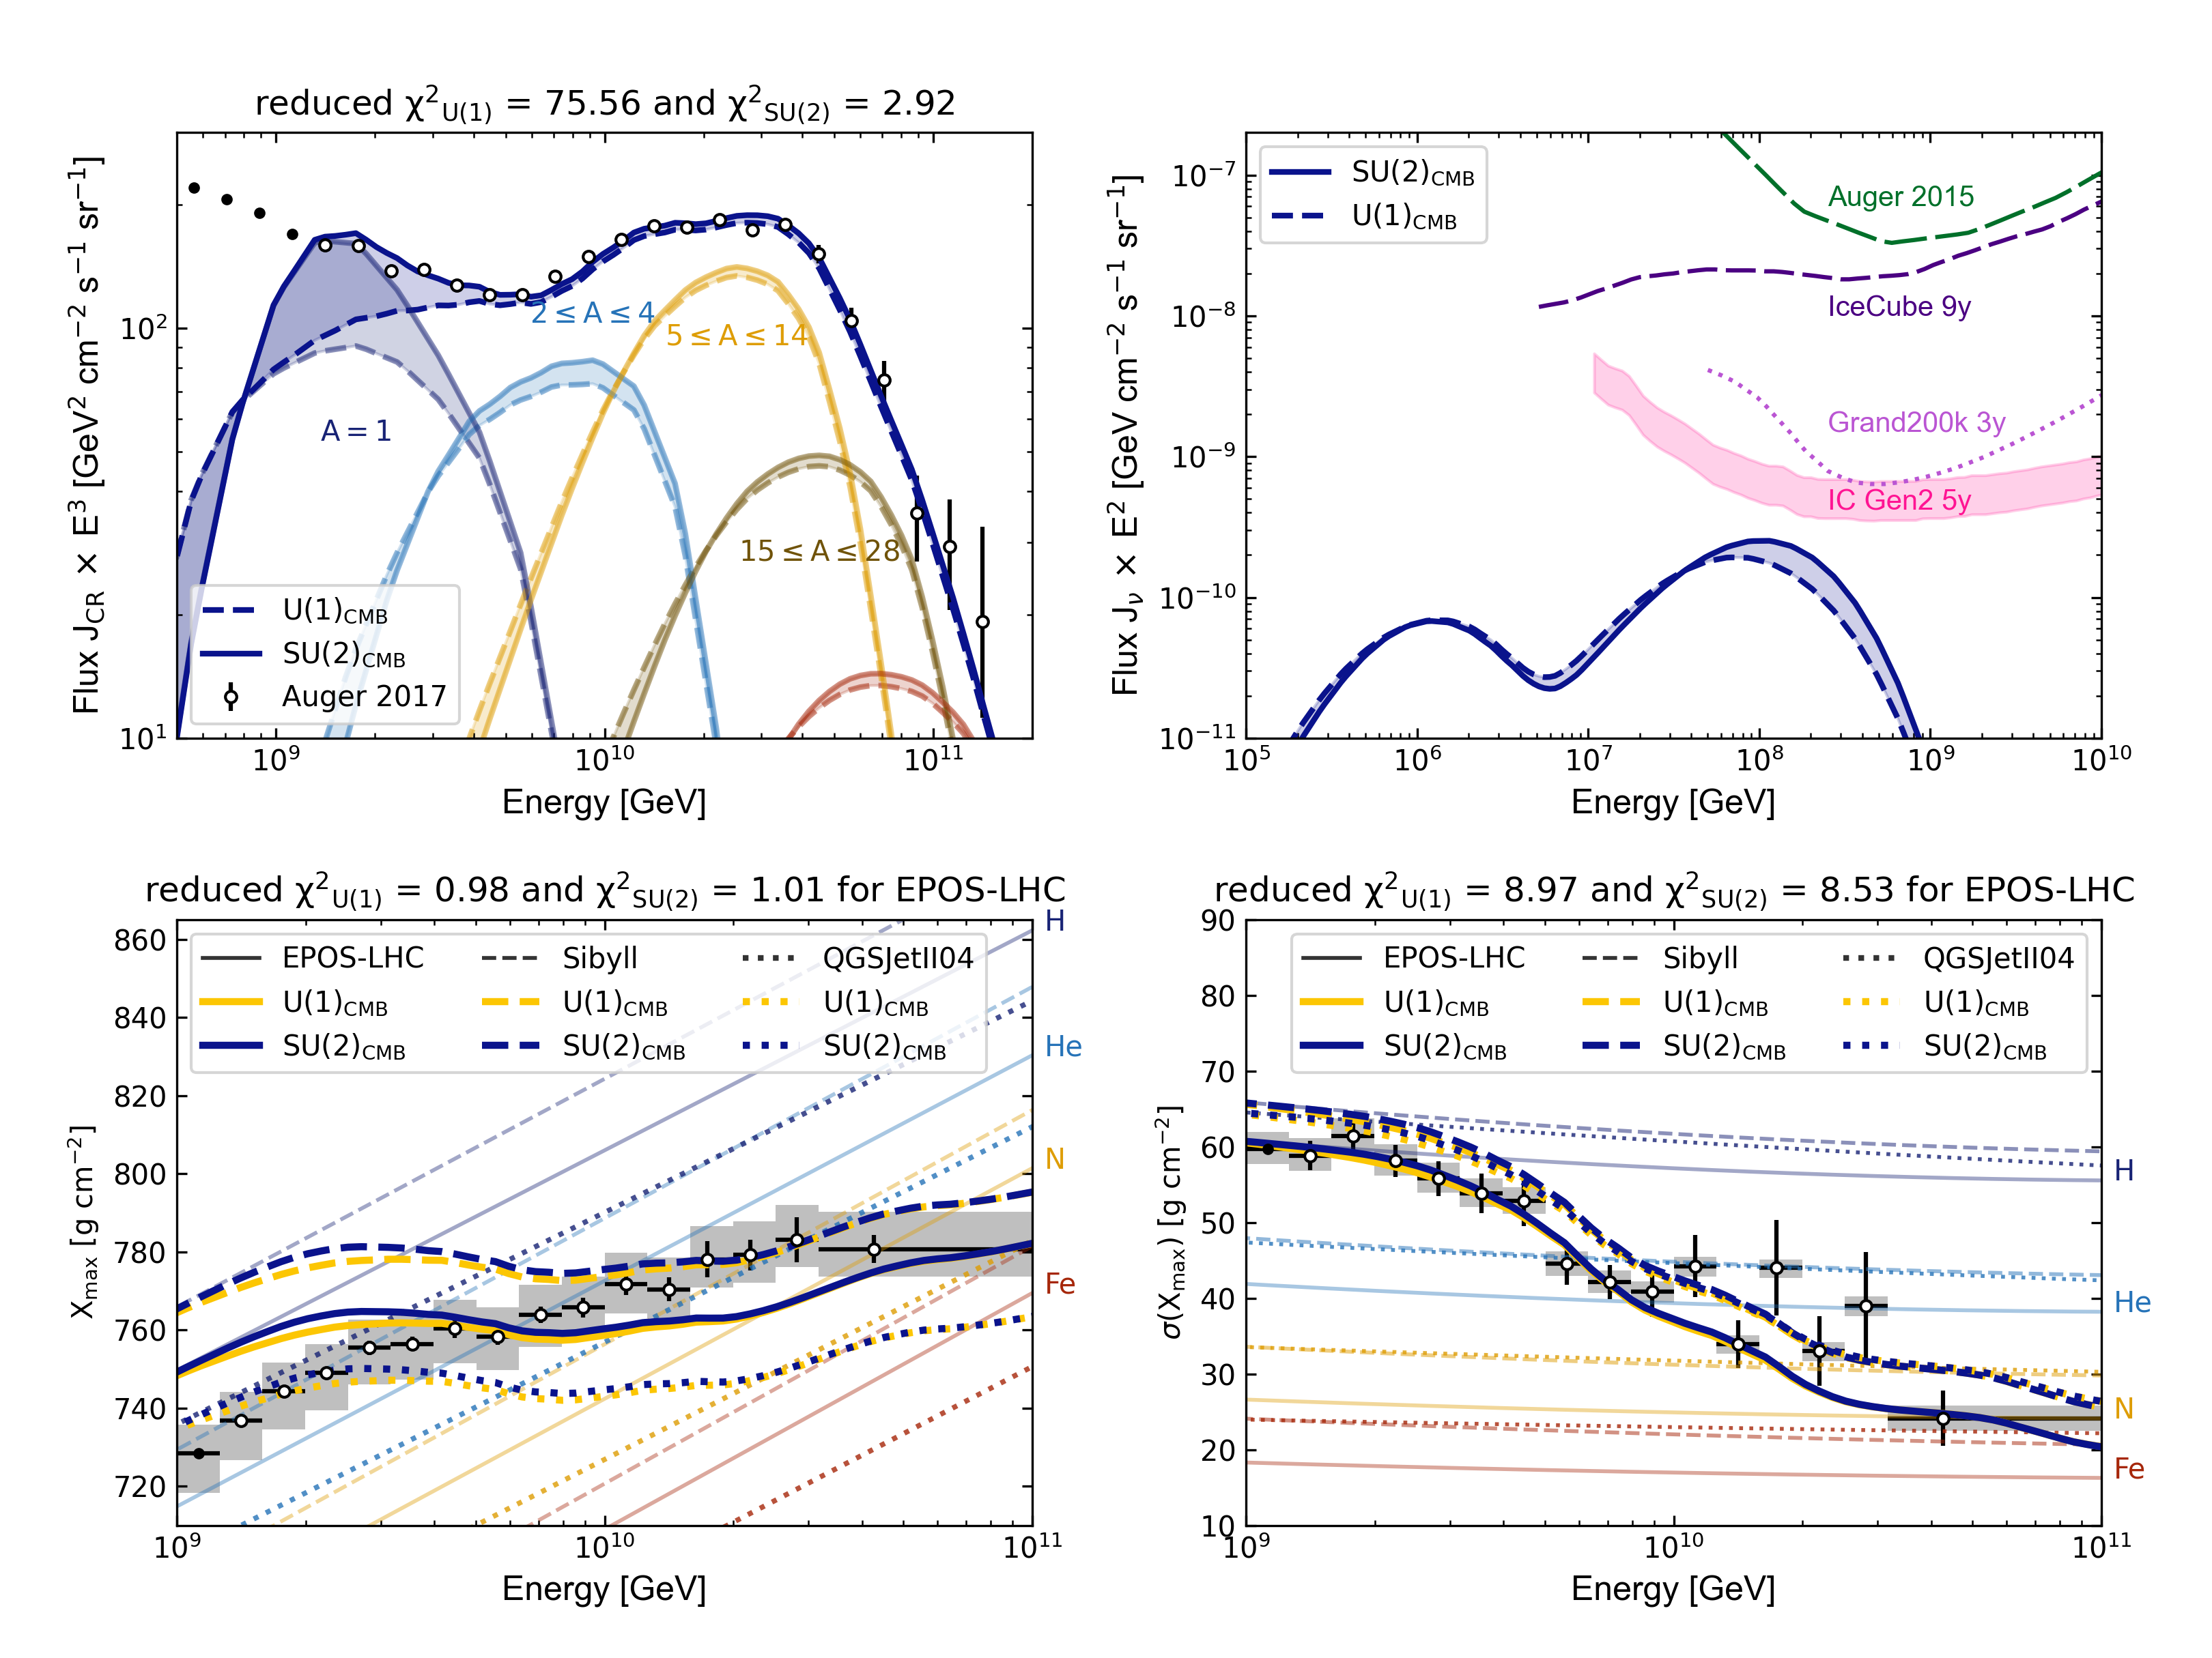





UHECR propagation
(1+z)^{m}
Gradient descent
9

Slide 31
(1+z)^{4.2}
(1+z)^{2.4}
CR source distribution
Relative flux density
Heinze et al. (2019) 1901.03338
8

Slide 32
Cosmogenic neutrinos
Notes:
3, 8, 10, 30, and 90 GHz ----------- COBE-FIRAS (Fixsen & Mather 2002)

Slide 33
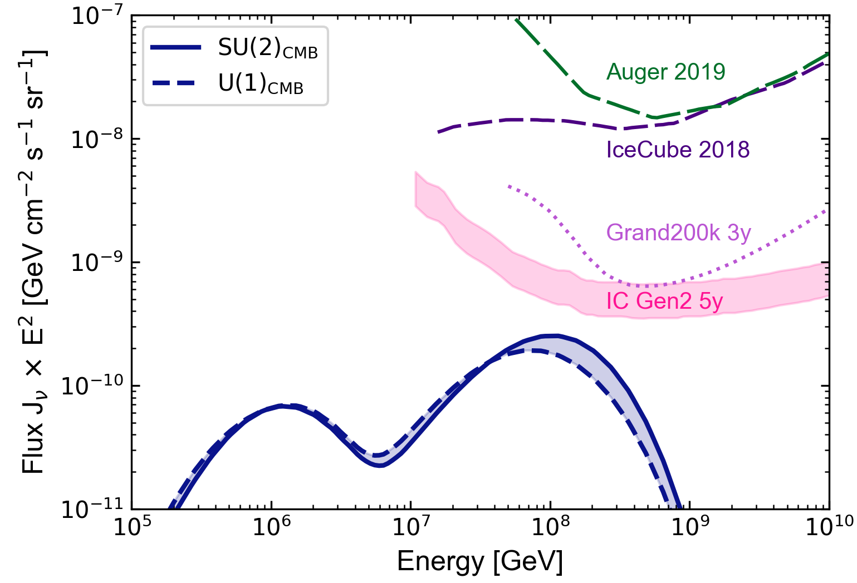
Cosmogenic Neutrinos
10

Slide 34
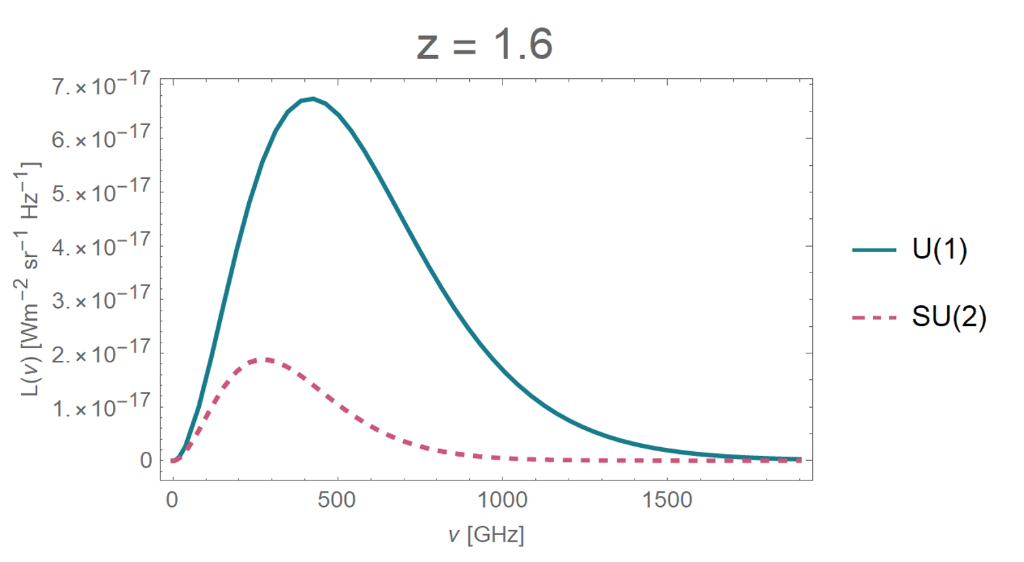
CMB Evolution
4

Slide 35
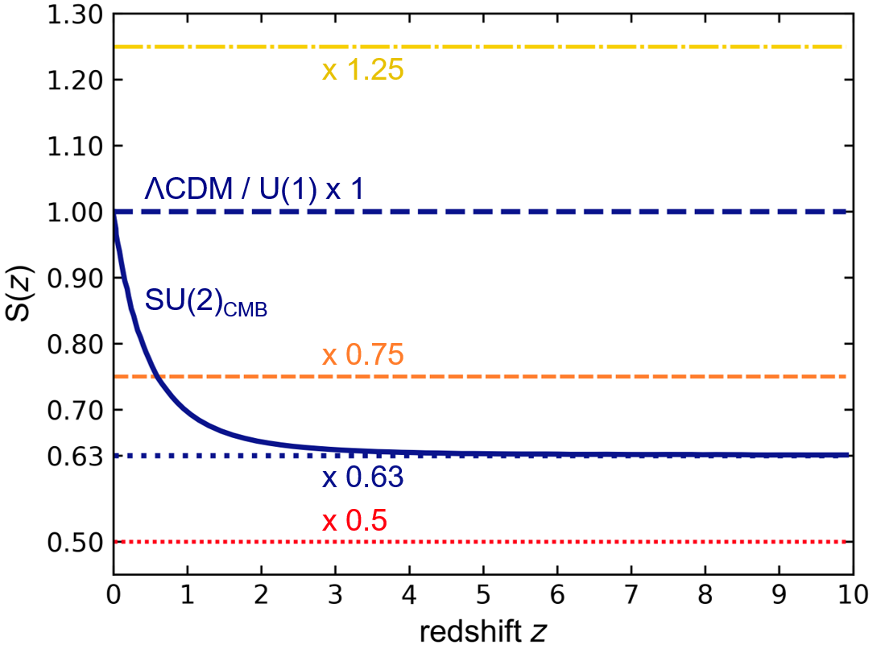
How do we change T(z) = S(z) (1+z) T₀
11

Slide 36
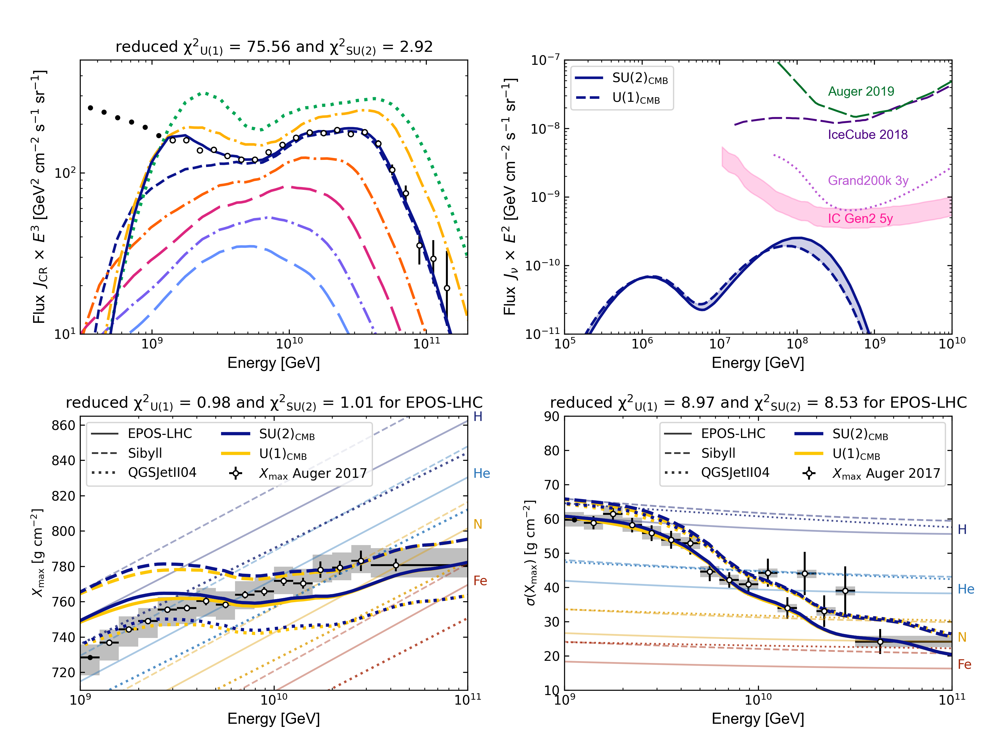
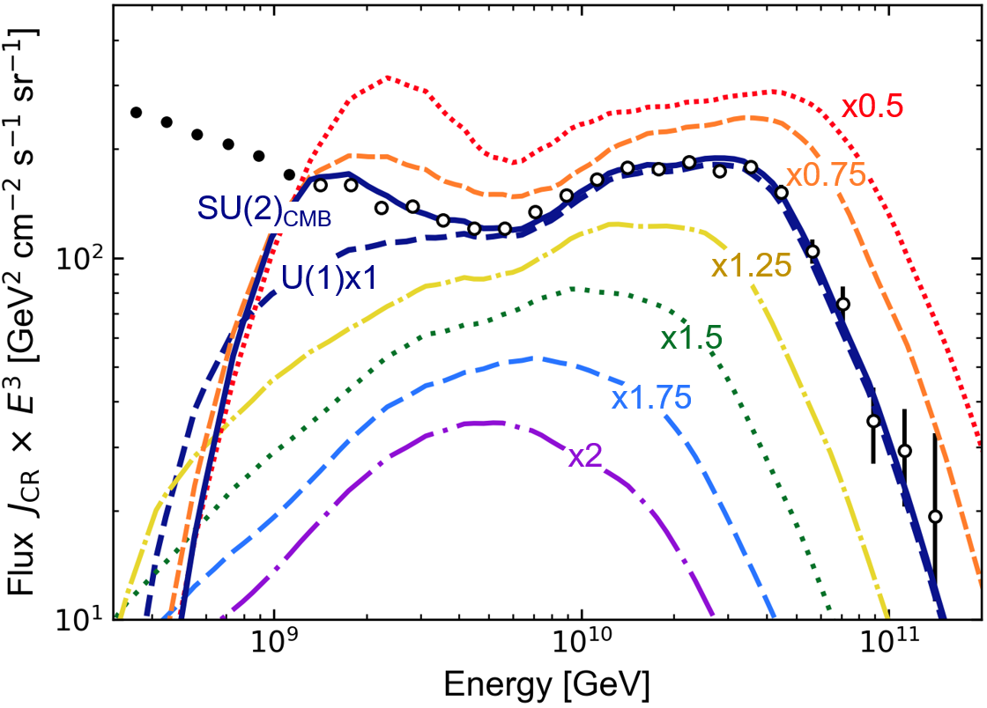
Overview of different T(z)
0.5
0.75
SU(2)
1.5
U(1)
2
12

Slide 37
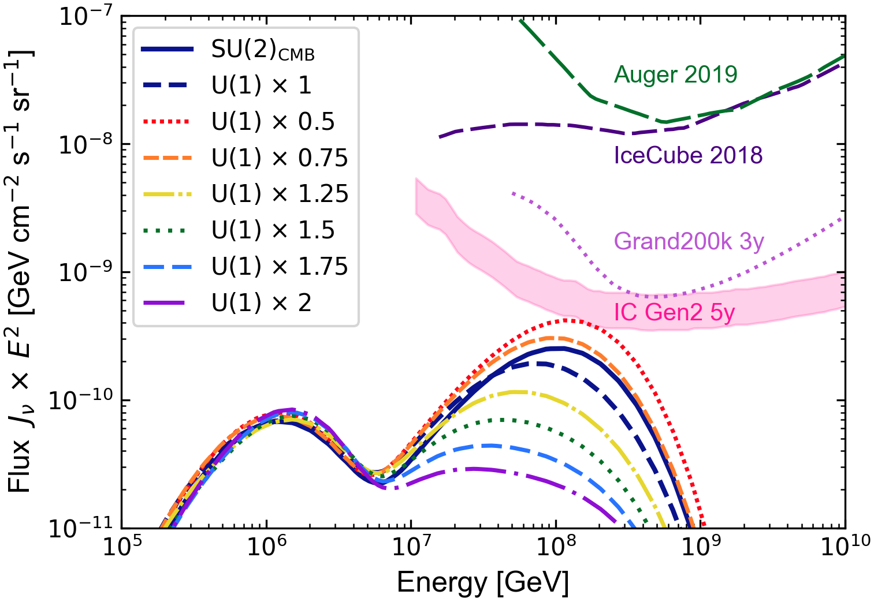
Overview of different T(z)
0.5
0.75
SU(2)
1.5
U(1)
2
13

Slide 38
Summary
SU(2) Postulate
ΛCDM
SU(2)_{CMB}
Changed T(z)
Diluted CMB
photon density
Shallower CR source distribution
23
JM et al. (2023) 2309.08451
© Jessie Muir (modified)

Slide 39

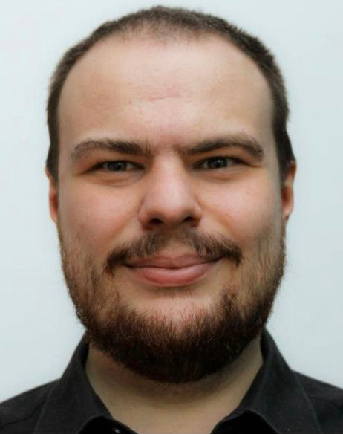
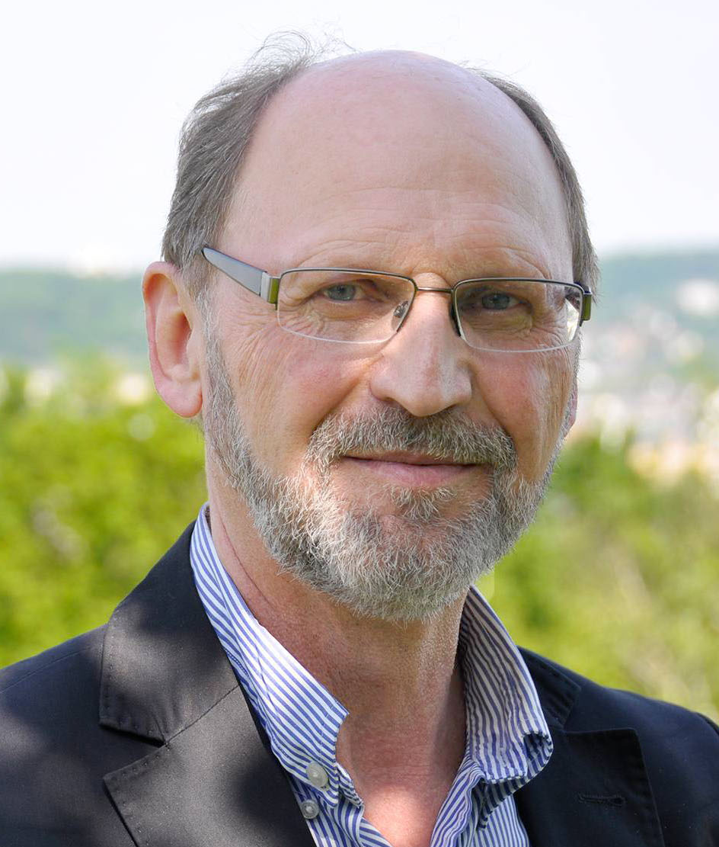
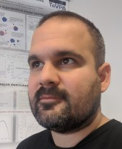
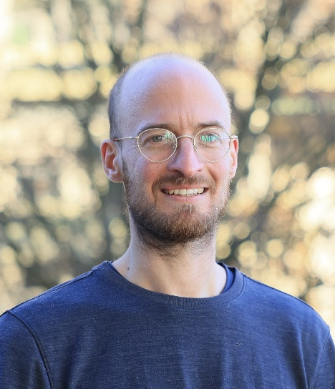


Thank you!
Dr. Leonel Morejón
Dr. Alexander Sandrock
Dr. Björn Eichmann
M.Sc. Jonas Kreidelmeyer
Prof. K.-H. Kampert
Supported by SFB 1491
And the Vector Foundation under Grant number P2021-0102

Slide 40
Extra slides
Notes:
3, 8, 10, 30, and 90 GHz ----------- COBE-FIRAS (Fixsen & Mather 2002)

Slide 41
How is T(z) modiefied?
Notes:
3, 8, 10, 30, and 90 GHz ----------- COBE-FIRAS (Fixsen & Mather 2002)

Slide 42
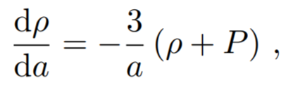
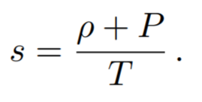
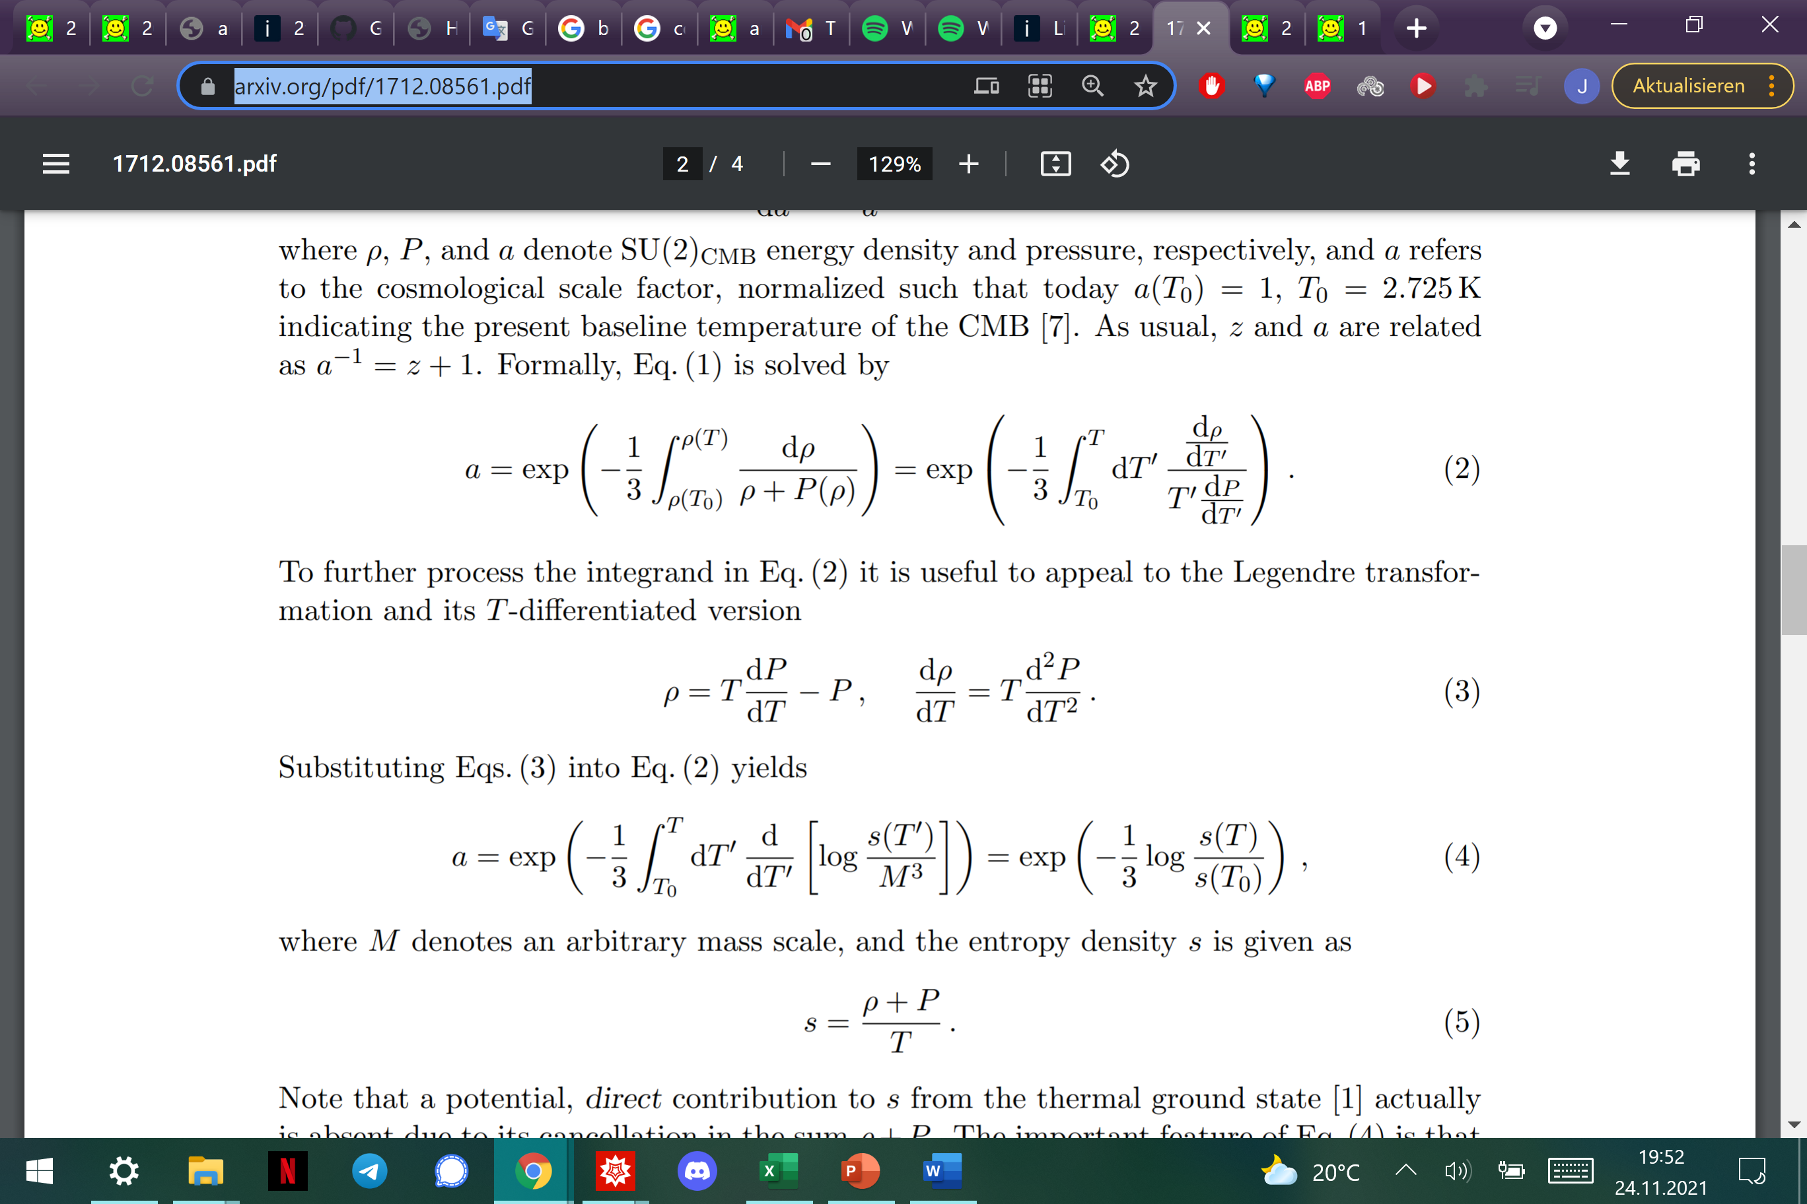
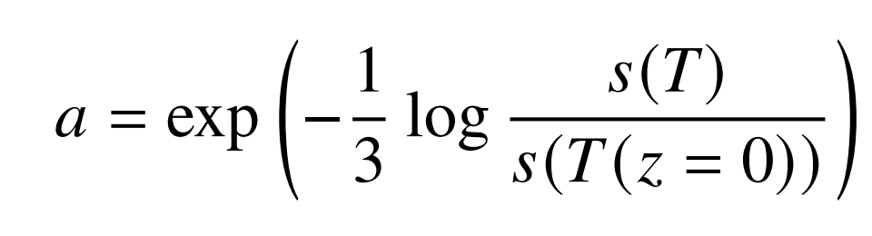
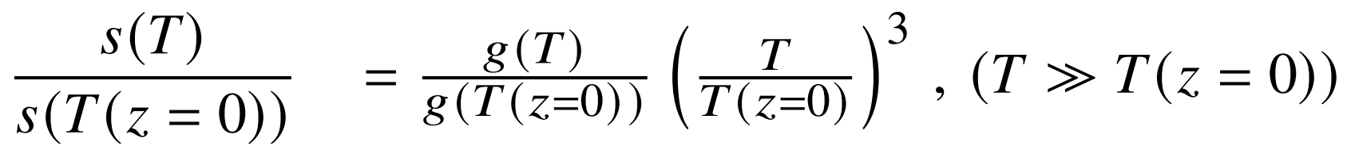
Friedmann-Lemaître-Robertson-Walker Universe
energy pressure
energy density
continuity eq.:
8
2
Changed T(z)
8
arxiv.org/pdf/1712.08561.pdf
Notes:
Demanding energy conservation in an FLRW universe the following equation is to be considered
a refers to the cosmological scale

Slide 43
Isn‘t T(z) measured already?
Notes:
3, 8, 10, 30, and 90 GHz ----------- COBE-FIRAS (Fixsen & Mather 2002)

Slide 44
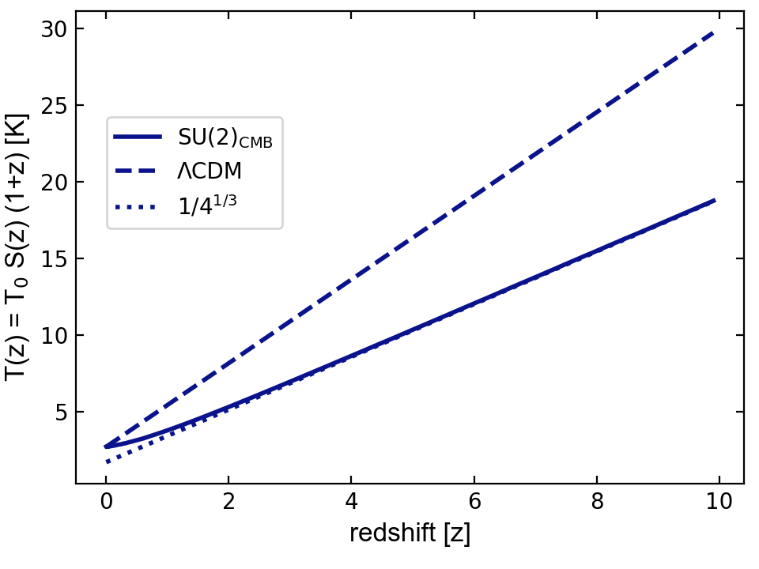
How do we measure T(z)?
absorber cloud
CMB
11

Slide 45
How do we measure T(z)?
absorber cloud
!
T(z) = ν(z)
γ
CMB
b.b.
ν
Hofmann + JM 2023 MDPI submitted
arXiv: 2303.16744
11

Slide 46
Hadronic interactions
Notes:
3, 8, 10, 30, and 90 GHz ----------- COBE-FIRAS (Fixsen & Mather 2002)

Slide 47
Hadronic Interaction models
17

Slide 48
Hadronic Interaction models
18

Slide 49
Cosmologigal Parameters

Slide 50
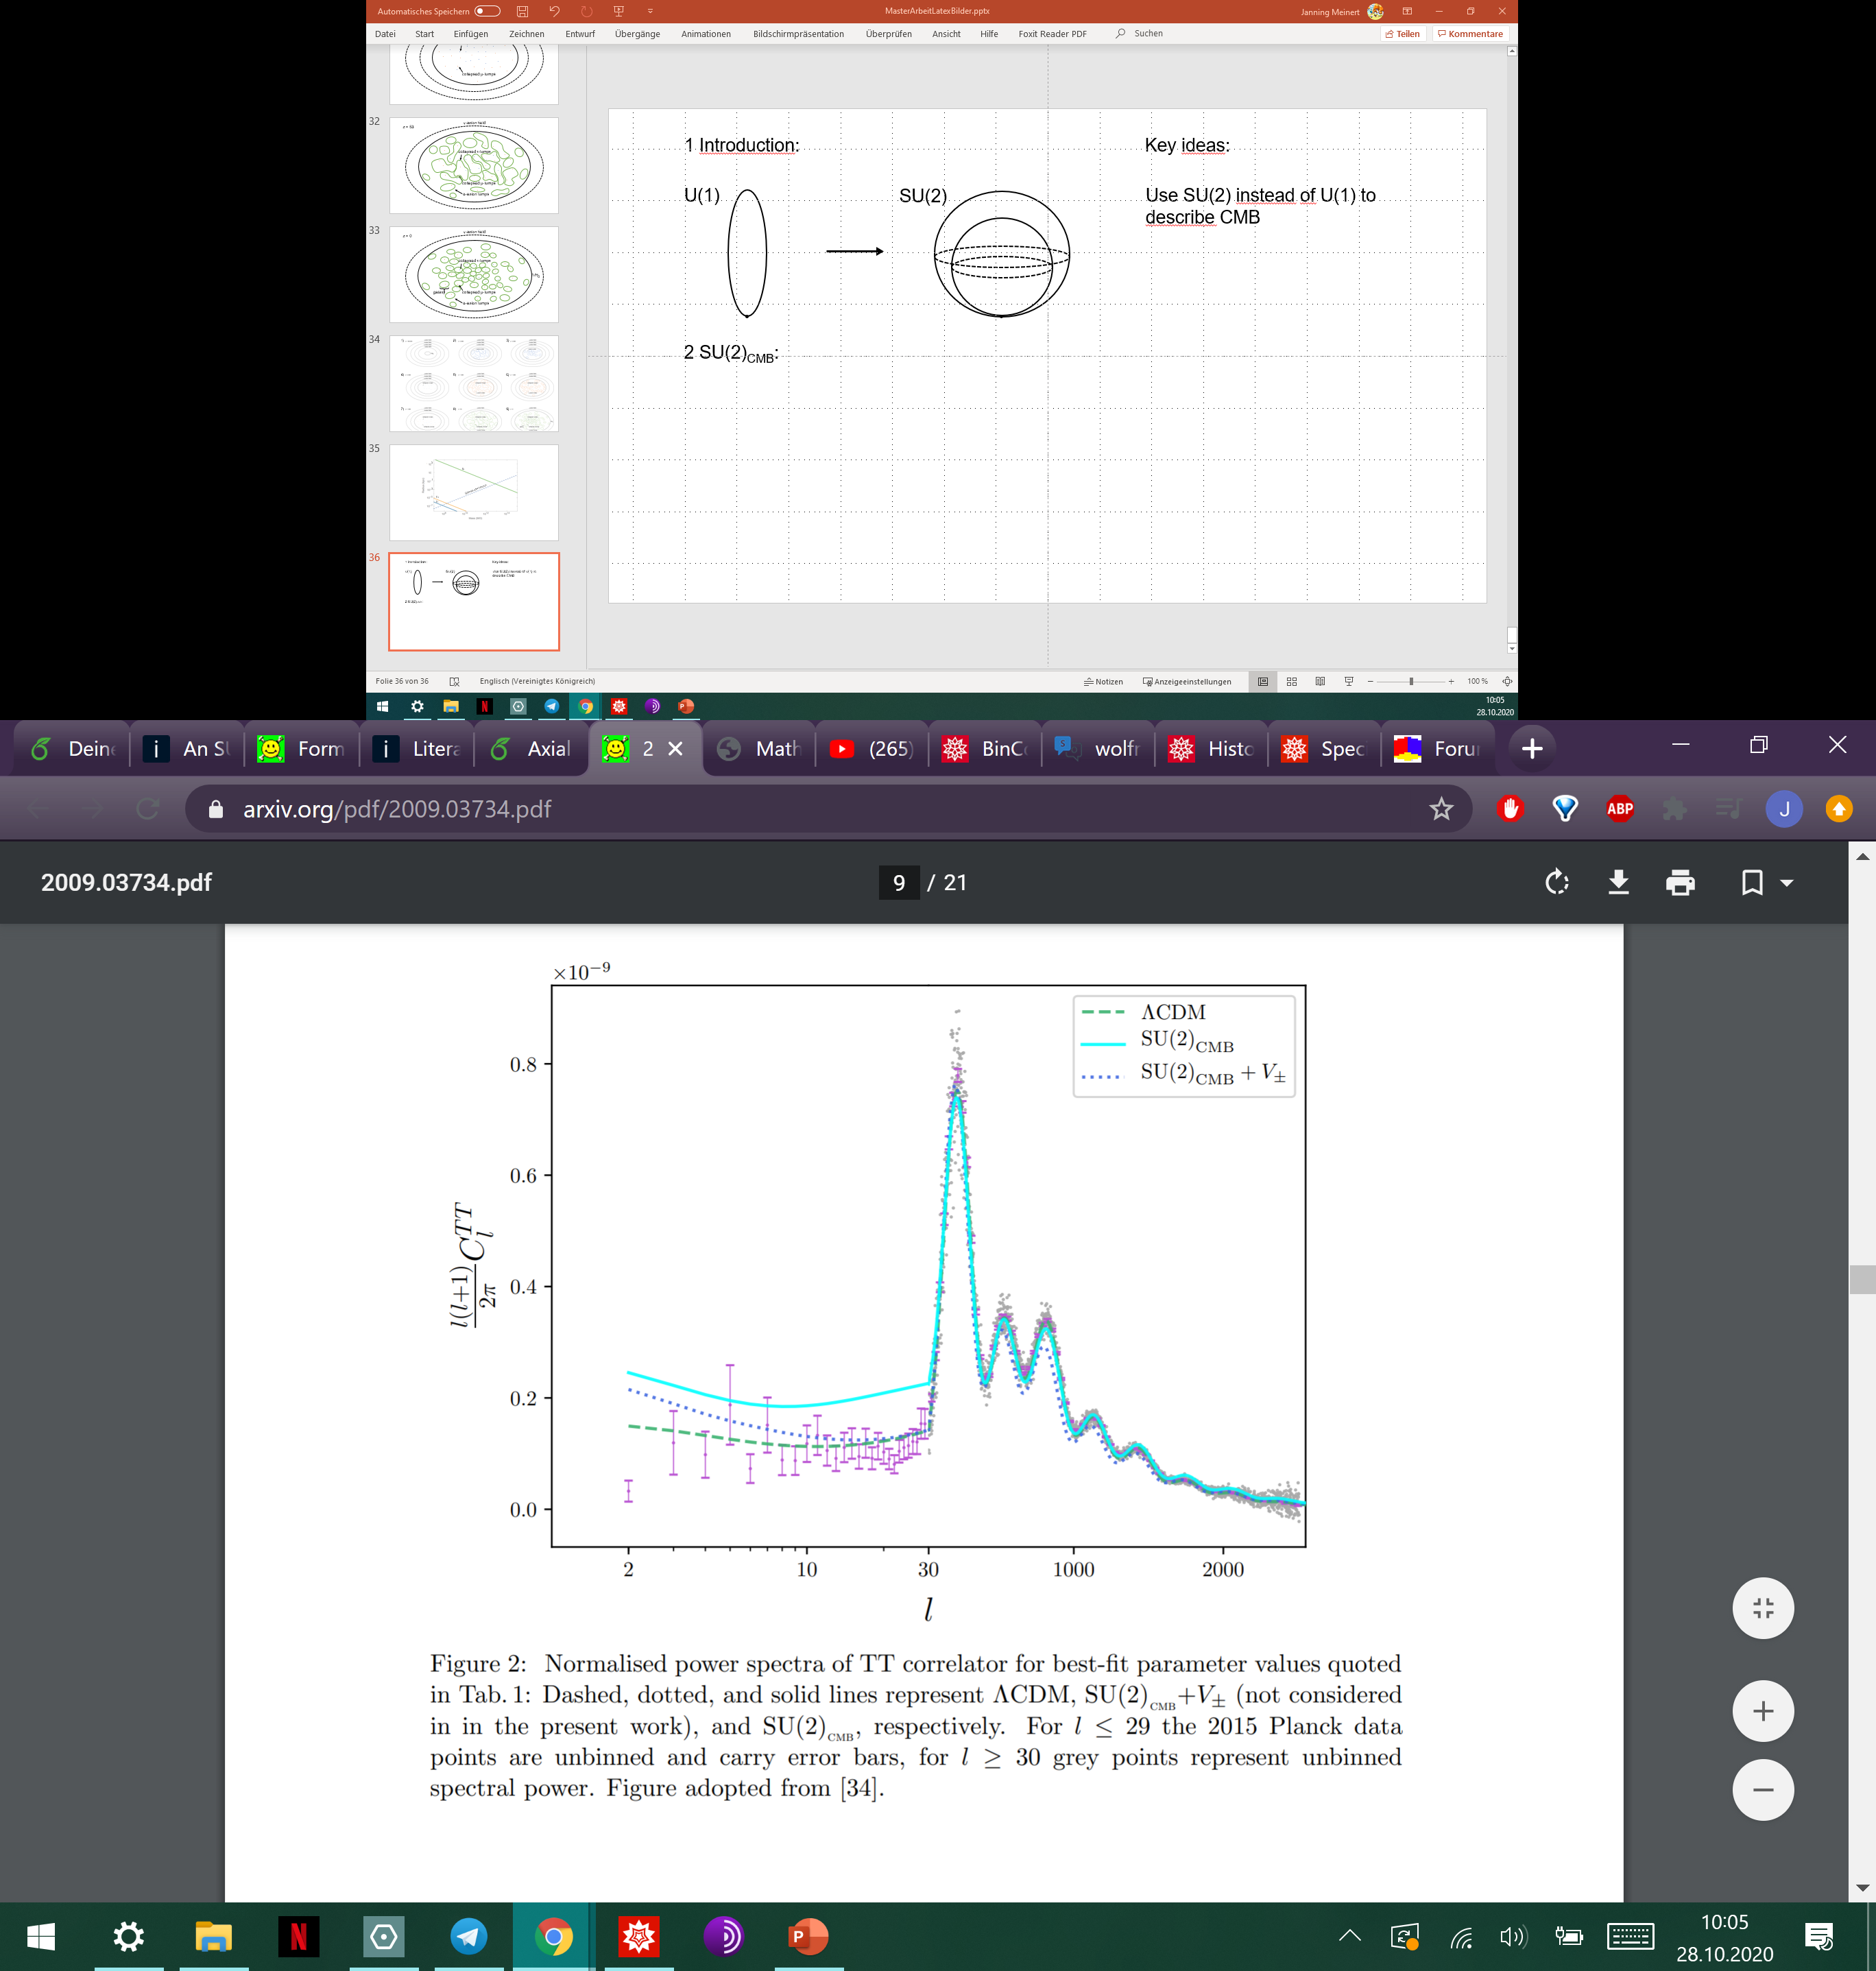

SU(2)_{CMB} Fit
2
Hahn + Hofmann 2018, MNRAS, arxiv:1810.01253

Slide 51
Cosmological parameters
↯BBN?
3
Hahn + Hofmann 2018, MNRAS, arxiv:1810.01253
arxiv.org/pdf/1810.01253

Slide 52
Screening effects due to massive
gauge modes

Slide 53
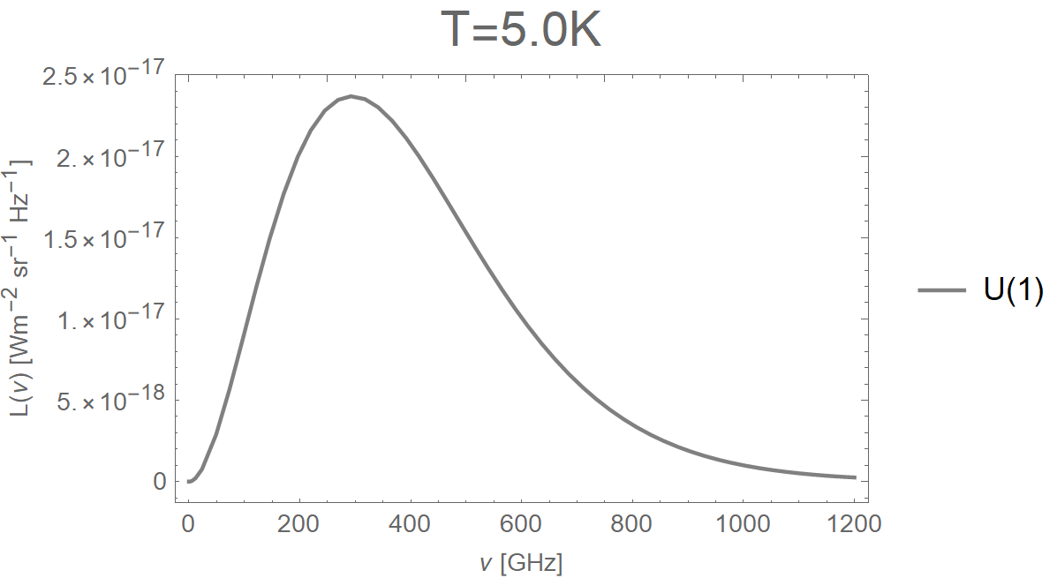
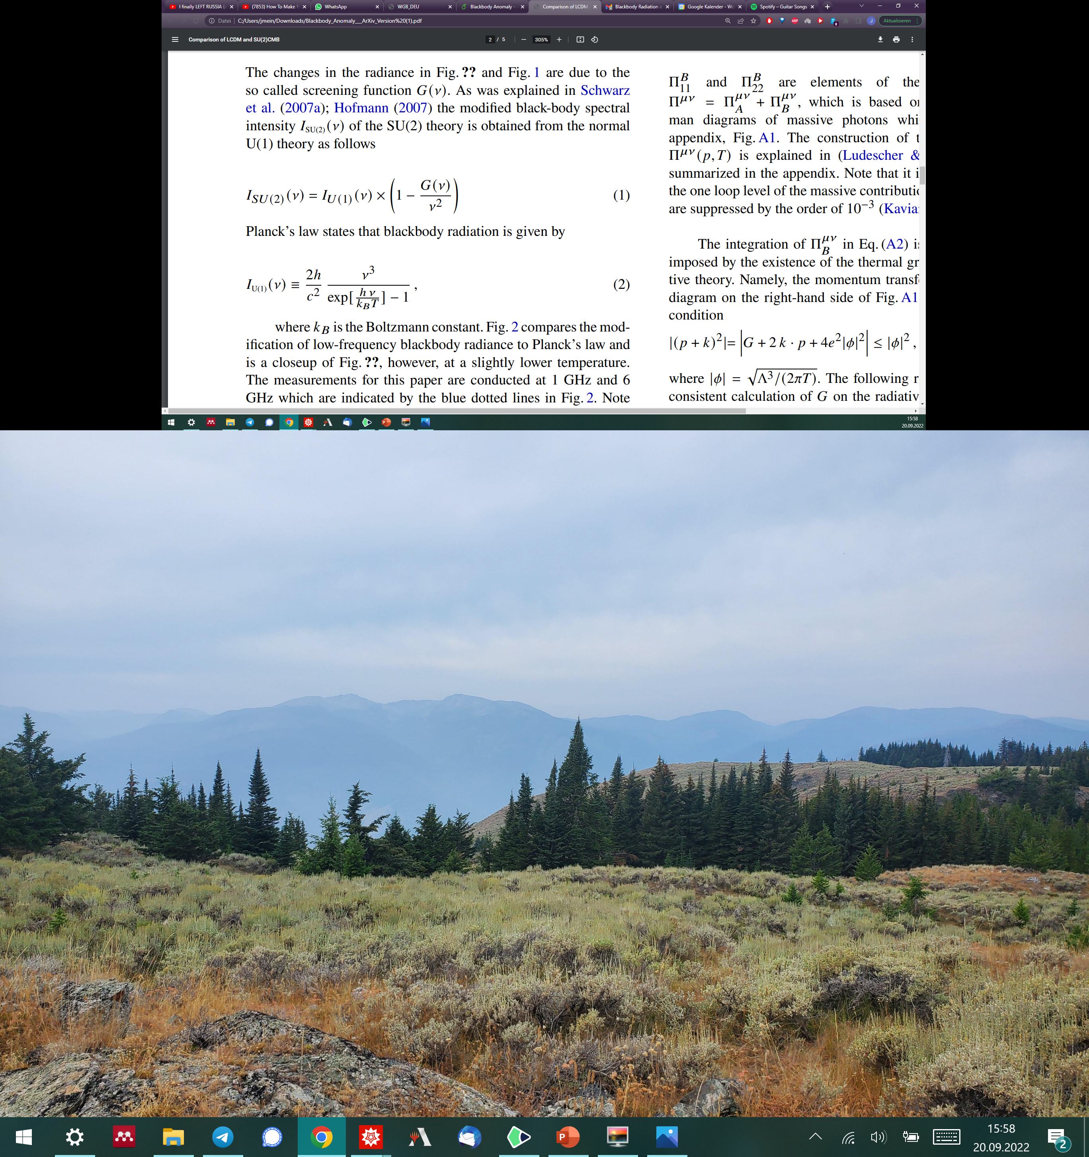
12

Slide 54
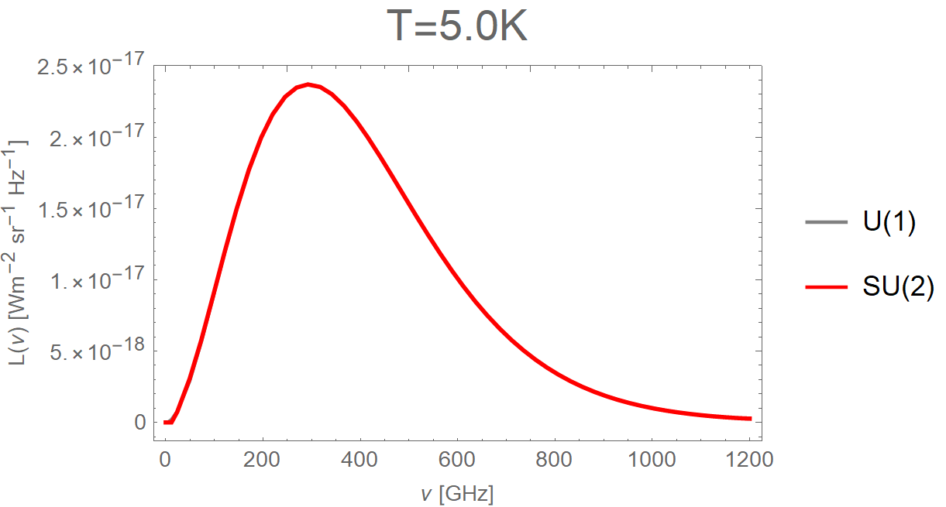
12

Slide 55
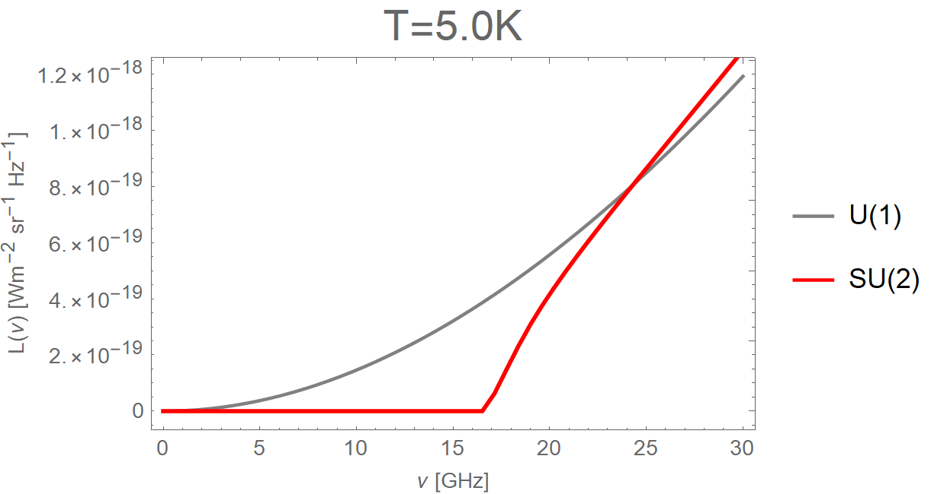
12

Slide 56
Screening function
12

Slide 57
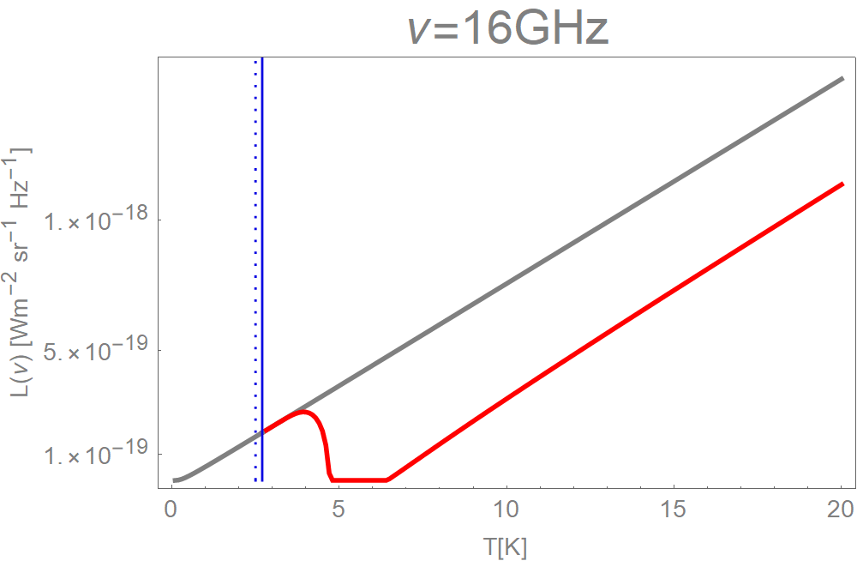

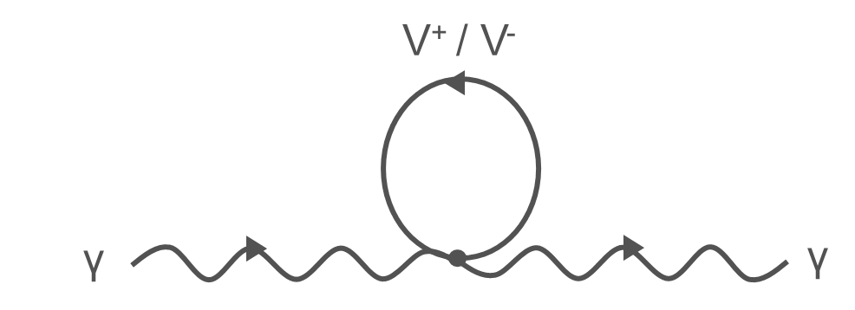
SU(2)
16 GHz
III
II
I
caloron
V⁺ / V⁻
monopoles
gap
supression

Slide 59
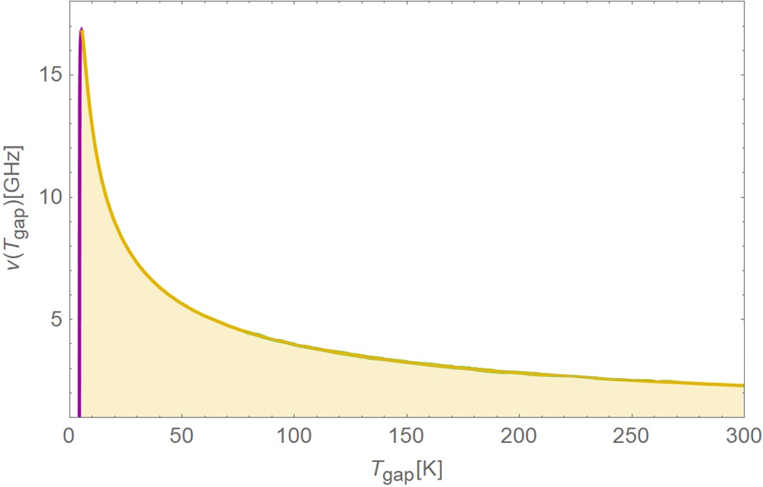

INRiM
T_{open}
∝$1/\sqrt{T}$
T_{close}
gap closed
gap open

Slide 60
S8 tension

Slide 61
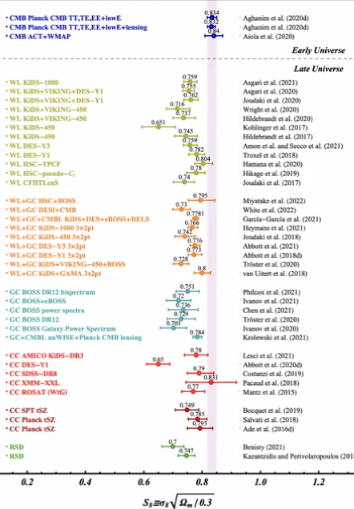
S8 Tension

Slide 62
BBN??

Slide 63
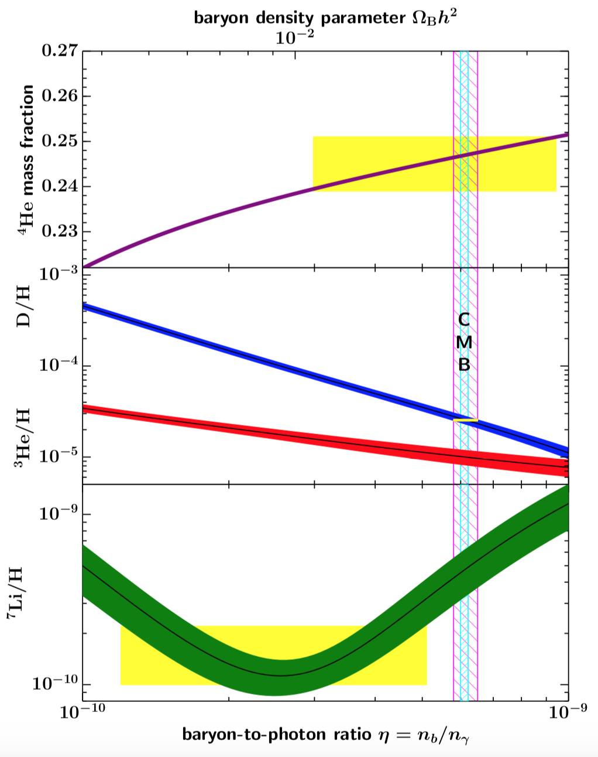
Tanabashi+ PRD 2018

Slide 64
Why SU(2)CMB?
Notes:
3, 8, 10, 30, and 90 GHz ----------- COBE-FIRAS (Fixsen & Mather 2002)

Slide 65
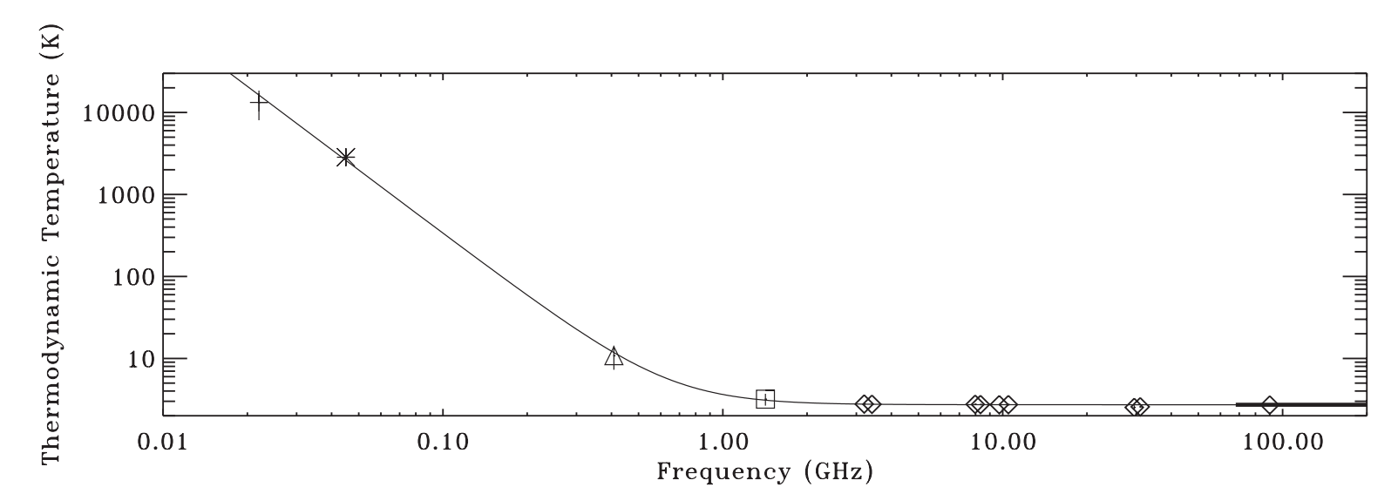
CMB radio excess
Roger et al. (1999)
Maeda et al. (1999)
Haslam et al. (1982)
Fixsen & Mather (2002)
Reich & Reich (1986)
Fixsen et al. (2011)
Seiffert et al. (2011)
5
Notes:
3, 8, 10, 30, and 90 GHz ----------- COBE-FIRAS (Fixsen & Mather 2002)

Slide 66


ARCADE 2
T_{c}
D. J. Fixsen et al 2011 ApJ 734 5
arxiv.org/pdf/0901.0546.pdf
6
Notes:
3, 8, 10, 30, and 90 GHz -> Fehler sehr klein, 6 Sigma!!

Slide 67

Motivation for SU(2)
?
How to exclude it
7

Slide 68
Isn‘t T(z) measured already?
Notes:
3, 8, 10, 30, and 90 GHz ----------- COBE-FIRAS (Fixsen & Mather 2002)

Slide 69

e-Print: 2303.16744 [hep-th]

Slide 70
Energy loss length

Slide 71


Changed Energy Loss Length
SU(2)
U(1)

Slide 72
Lensing

Slide 73

Cosmological parameters
KiDS Collaboration arxiv.org/pdf/2007.15633
arxiv.org/pdf/1810.01253

Slide 74

σ₈ tension
global
local
https://kids.strw.leidenuniv.nl/cosmicshear2016.php

Slide 75


H₀ tension
Hubble Constant over time
distance ladder
+ ΛCDM
Freedman et al. / Astrophysical Journal

Slide 76
∞
1751
1089
1
0
redshift [z]
¹
Hofmann 2013 Nature Phys.
10.1038/nphys2793
SU(2) Postulate¹
ΛCDM
SU(2)_{CMB}
³
Planck Collaboration
arXiv: 1807.06209
H₀ ≈ 67.4 ³
~3000
H₀ ≈ 73 ²
km s⁻¹Mpc⁻¹
²
Riess et al. 2021
arXiv: 2112.04510
2.725
1
CMB Temperature [K]
© Jessie Muir (modified)

Slide 77
(1+z)^{4.2}
(1+z)^{2.7}
CR source distribution
ΛCDM
SU(2)_{CMB}
Relative flux density
Tendency for shallower source evolution in SU(2)_{CMB}
Heinze et al. (2019) 1901.03338
15

Slide 78
How do we change T(z) = S(z) (1+z) T₀
10

Slide 79
Summary of T(z) effect
Notes:
3, 8, 10, 30, and 90 GHz ----------- COBE-FIRAS (Fixsen & Mather 2002)

