Slide 1
GRB observations with H.E.S.S
Jean
Astroparticle school- 05-13, 2021
Obertrubach-Bärnfels

Slide 2
Outline
Basic introduction of GRBs
H.E.S.S. Telescope
H.E.S.S. GRB program
Search for correlation between X-ray and VHE emission from GRBs observed by H.E.S.S.
Conclusion
Reference
‹#›
|Astroparticle School|Obertrubach-Bärnfels | by Jean| 2022.10.05-13

Slide 3
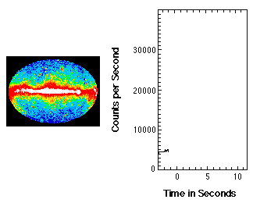
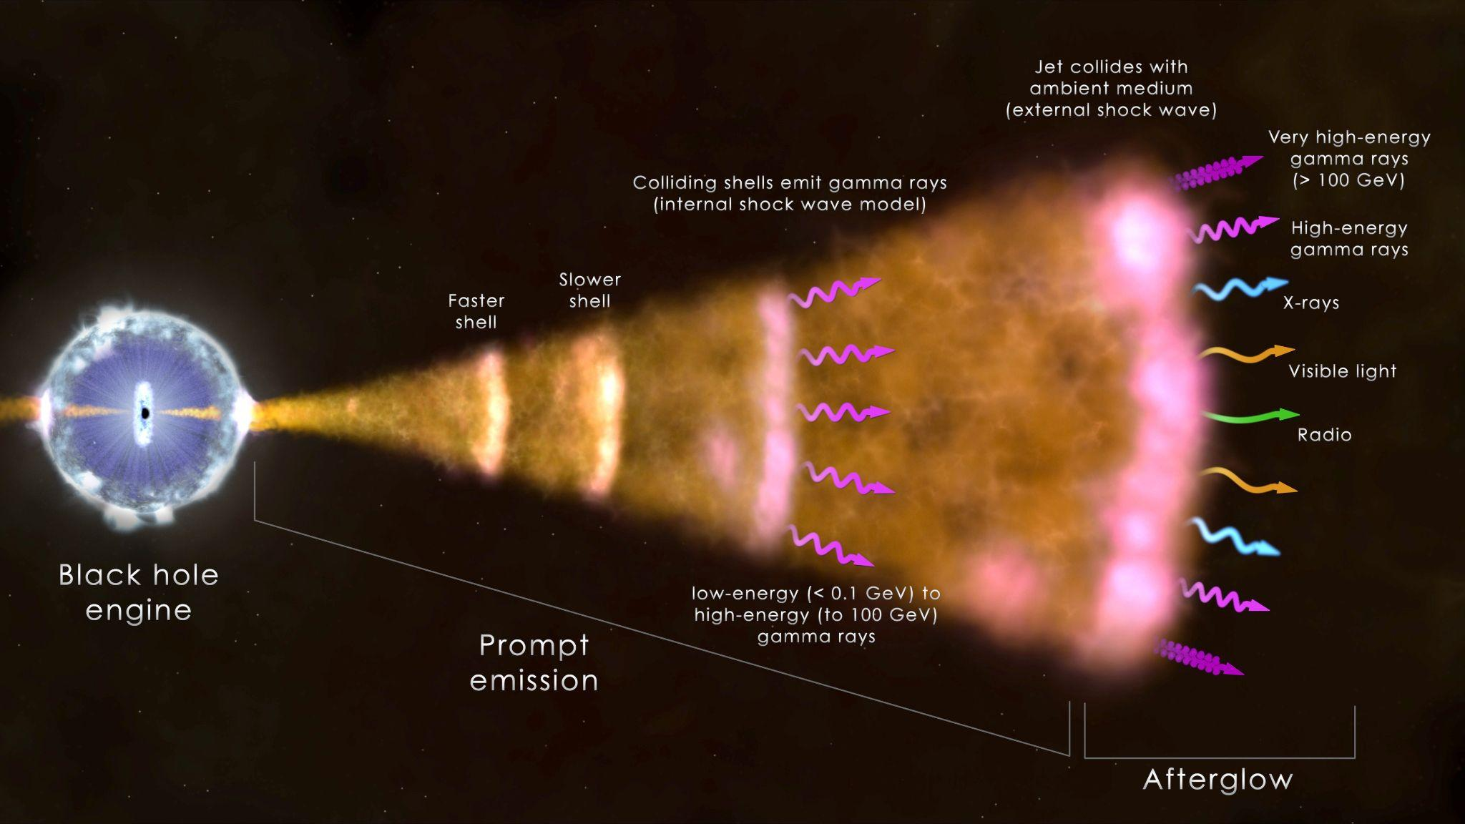
Gamma-ray Bursts (GRBs)
Prompt Emission
Extremely bright sources in the universe.
GRBs have two phases, the prompt phase that last few milliseconds to thousands of seconds and Afterglow phase that last for several days.
Afterglow emission
A relativistic shock would propagate into the ambient medium and accelerate particles EM radiation in all wavelengths lasting for days.
Several GRBs afterglow emission have been also observed from radio to gamma-ray energies
Question: In the afterglow phase, are GRBs emitting very high energy gamma-rays (VHE; > 100 GeV) ?
‹#›
|Astroparticle School|Obertrubach-Bärnfels | by Jean| 2022.10.05-13

Slide 4
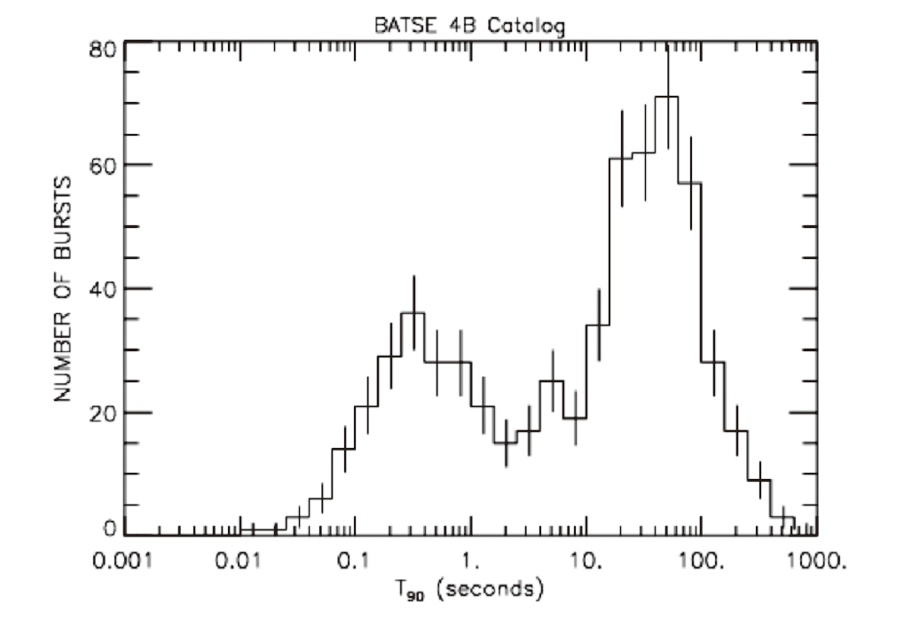
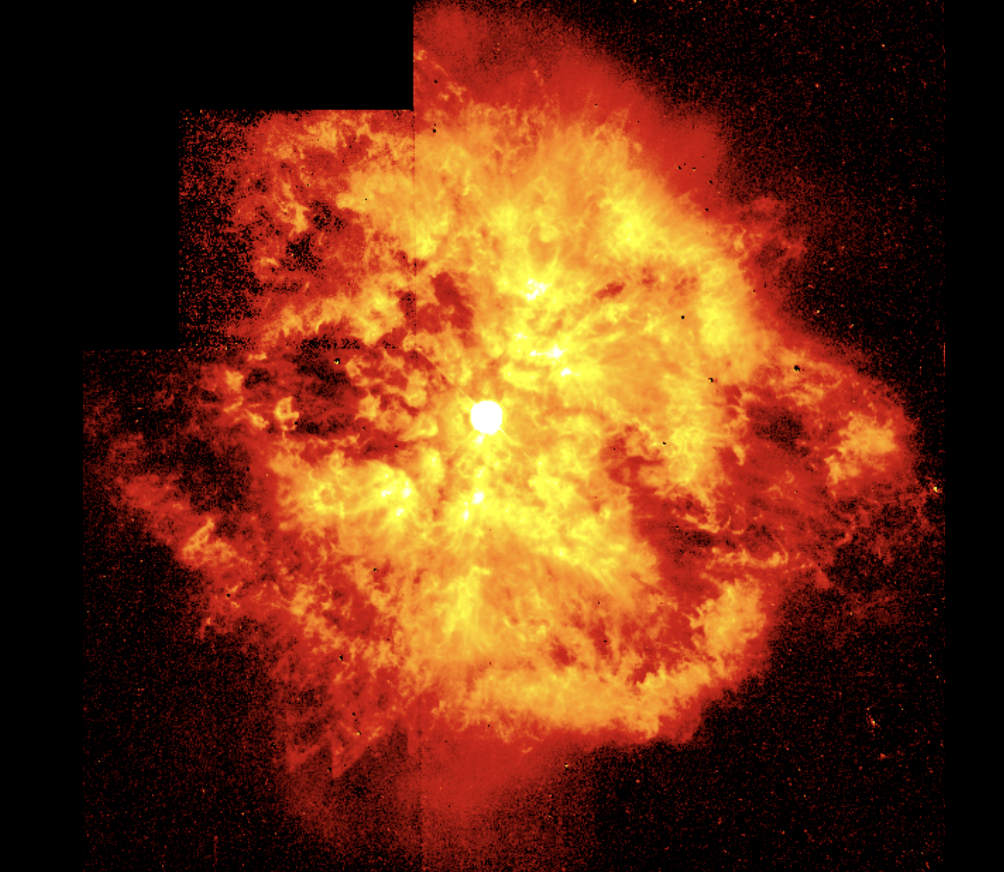
Introduction: Classification and Properties
Ex: WR 124
LGRB
SGRB
No link with star forming
Produced by mergers of compact objects
Duration distribution of GRBs
Majority of observed GRBs
Linked with core-collapse SN
Associated with the deaths of massive stars.
Isotropic γ-ray luminosity: 10⁵¹ – 10⁵³ erg/s
Event rate: 1 per Gpc³ per day
‹#›
|Astroparticle School|Obertrubach-Bärnfels | by Jean| 2022.10.05-13

Slide 5
High Energy Stereoscopic System (H.E.S.S)
Location: Windhoek, Namibia (1.8 km a.s.l)
Technique: Imaging Atmospheric Cherenkov Technique
Telescopes: 5
Key features: > 50 GeV; slew 100°/minute .
Credit: LSW, Uni. Heidelberg; H.E.S.S.
H.E.S.S. has detected VHE gamma-rays from more than 130 sources including 2 TeV GRBs at more than 5 sigma.
‹#›
|Astroparticle School|Obertrubach-Bärnfels | by Jean| 2022.10.05-13

Slide 6
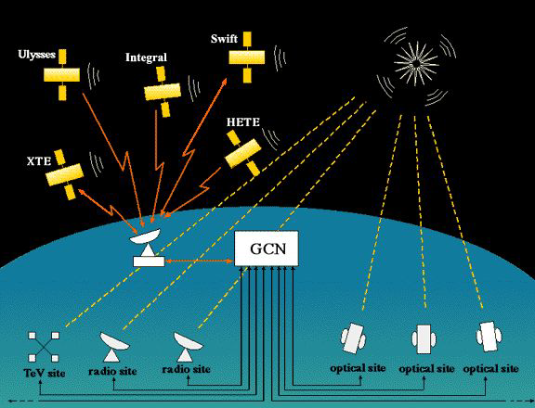
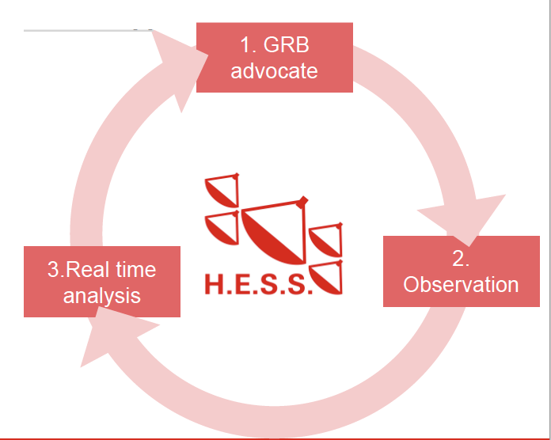
H.E.S.S GRB Program
An active program within H.E.S.S. collaboration
since 2003 (~100 hours / year dedicated for GRB observations).
The Gamma-ray Coordinates Network ( prompt or afterglow alert)
Most of the GRB observations are automated (to reduce follow-up delay)
The GRB advocate decides on the continuation of observation (based on real time analysis and available multi-wavelength information).
Two significant detections are:
GRB 180720B
GRB 190829A
‹#›
|Astroparticle School|Obertrubach-Bärnfels | by Jean| 2022.10.05-13

Slide 7
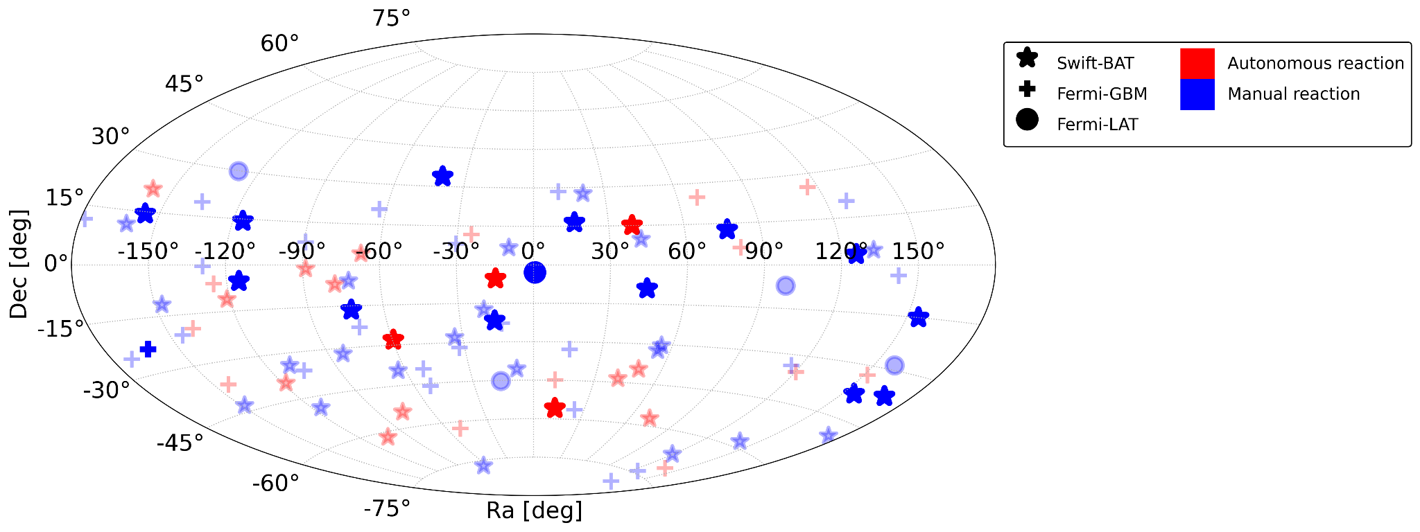
H.E.S.S GRB Program: Observed GRBs
Preliminary
Two GRB detected (GRB 180720B & GRB 190829A) in VHE at > 5 sigma
More than 120 GRBs have been observed till 2021 so far but only two detected.
Dimmed color are GRBs with no redshift
‹#›
|Astroparticle School|Obertrubach-Bärnfels | by Jean| 2022.10.05-13

Slide 8
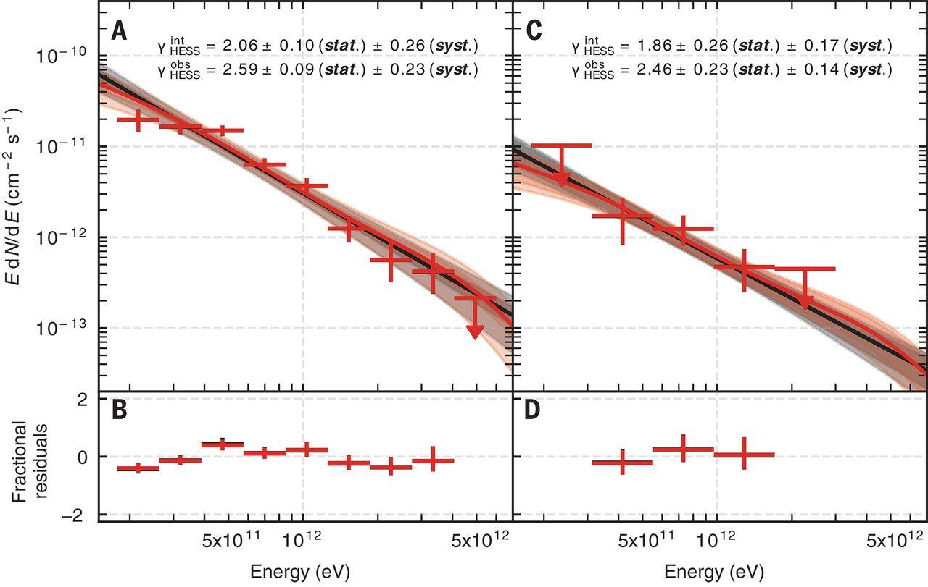
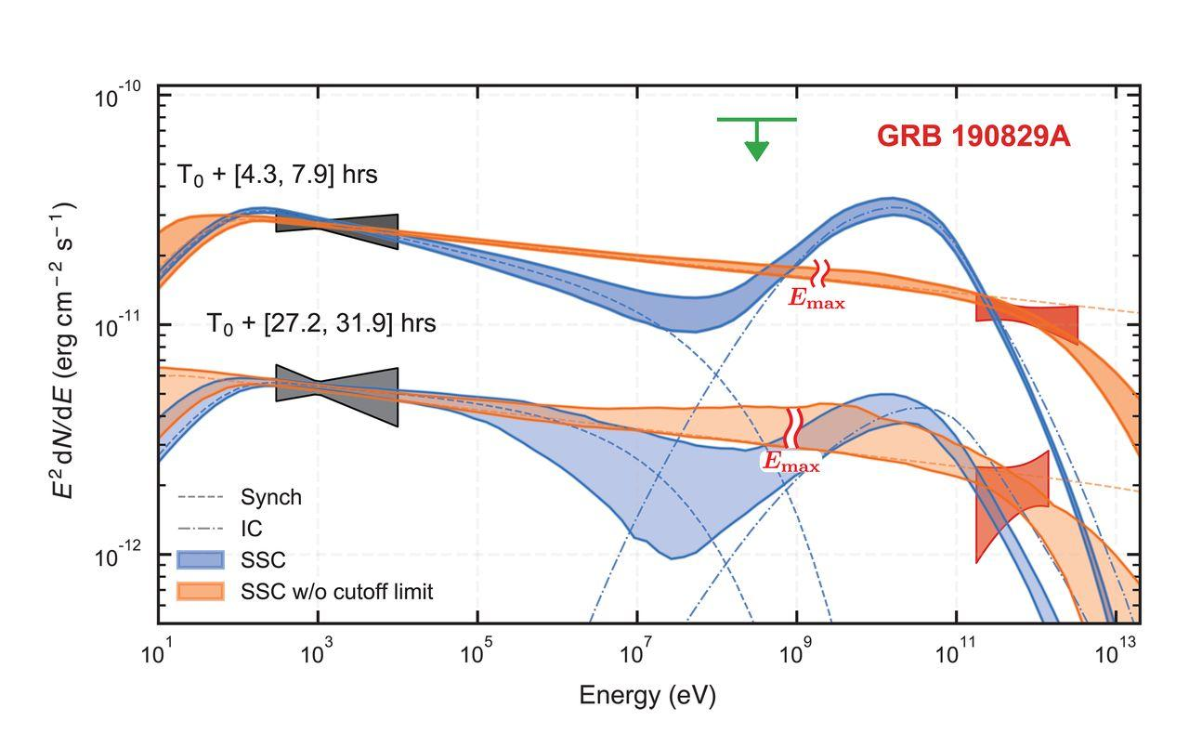
H.E.S.S GRB Program: Detected GRBs (Cont’...)
GRB 190829A
A cosmic experience - Gamma-ray Burst GRB 190829A
Redshift: z = 0.0785
This result supports synchrotron dominant emission model
Synchrotron
self-Compton
First night
Second night
Synchrotron
dominate
Credit: Science 372, 6546, 1081-1085 (2021)
|Astroparticle School|Obertrubach-Bärnfels | by Jean| 2022.10.05-13
‹#›

Slide 9
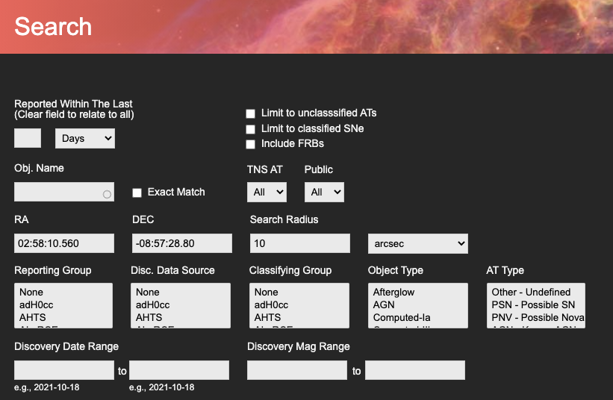
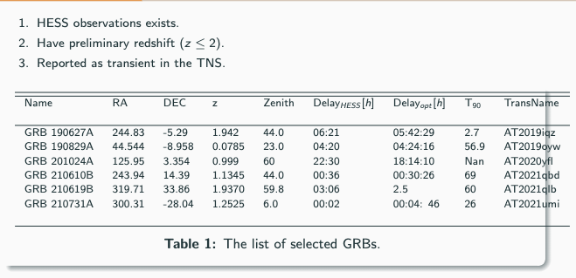
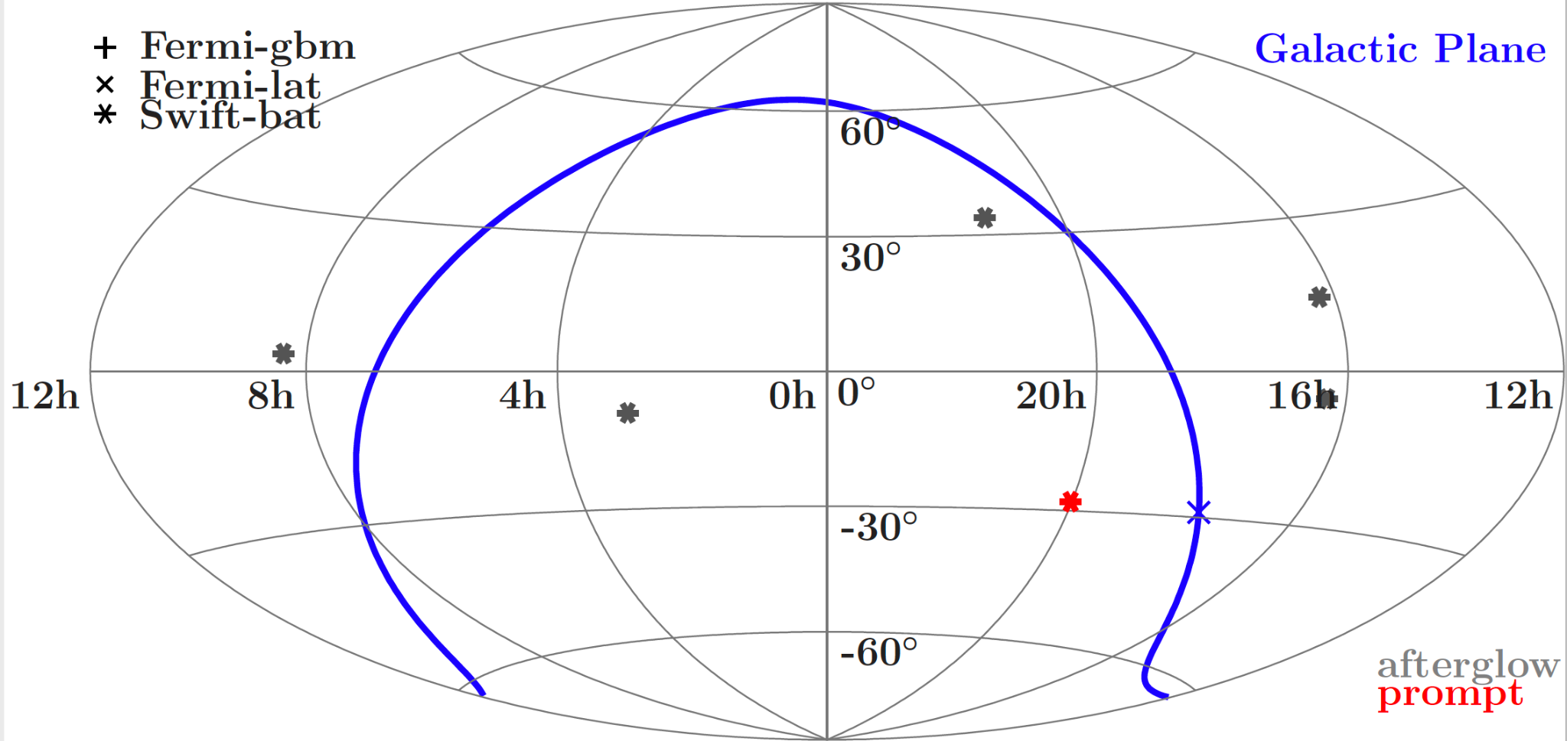
Searching for X-ray/VHE correlation
Preliminary
Sample selection
What can we learn from the simultaneous optical / X-ray data and the VHE upper-limits from H.E.S.S GRBs?
|Astroparticle School|Obertrubach-Bärnfels | by Jean| 2022.10.05-13
‹#›

Slide 10
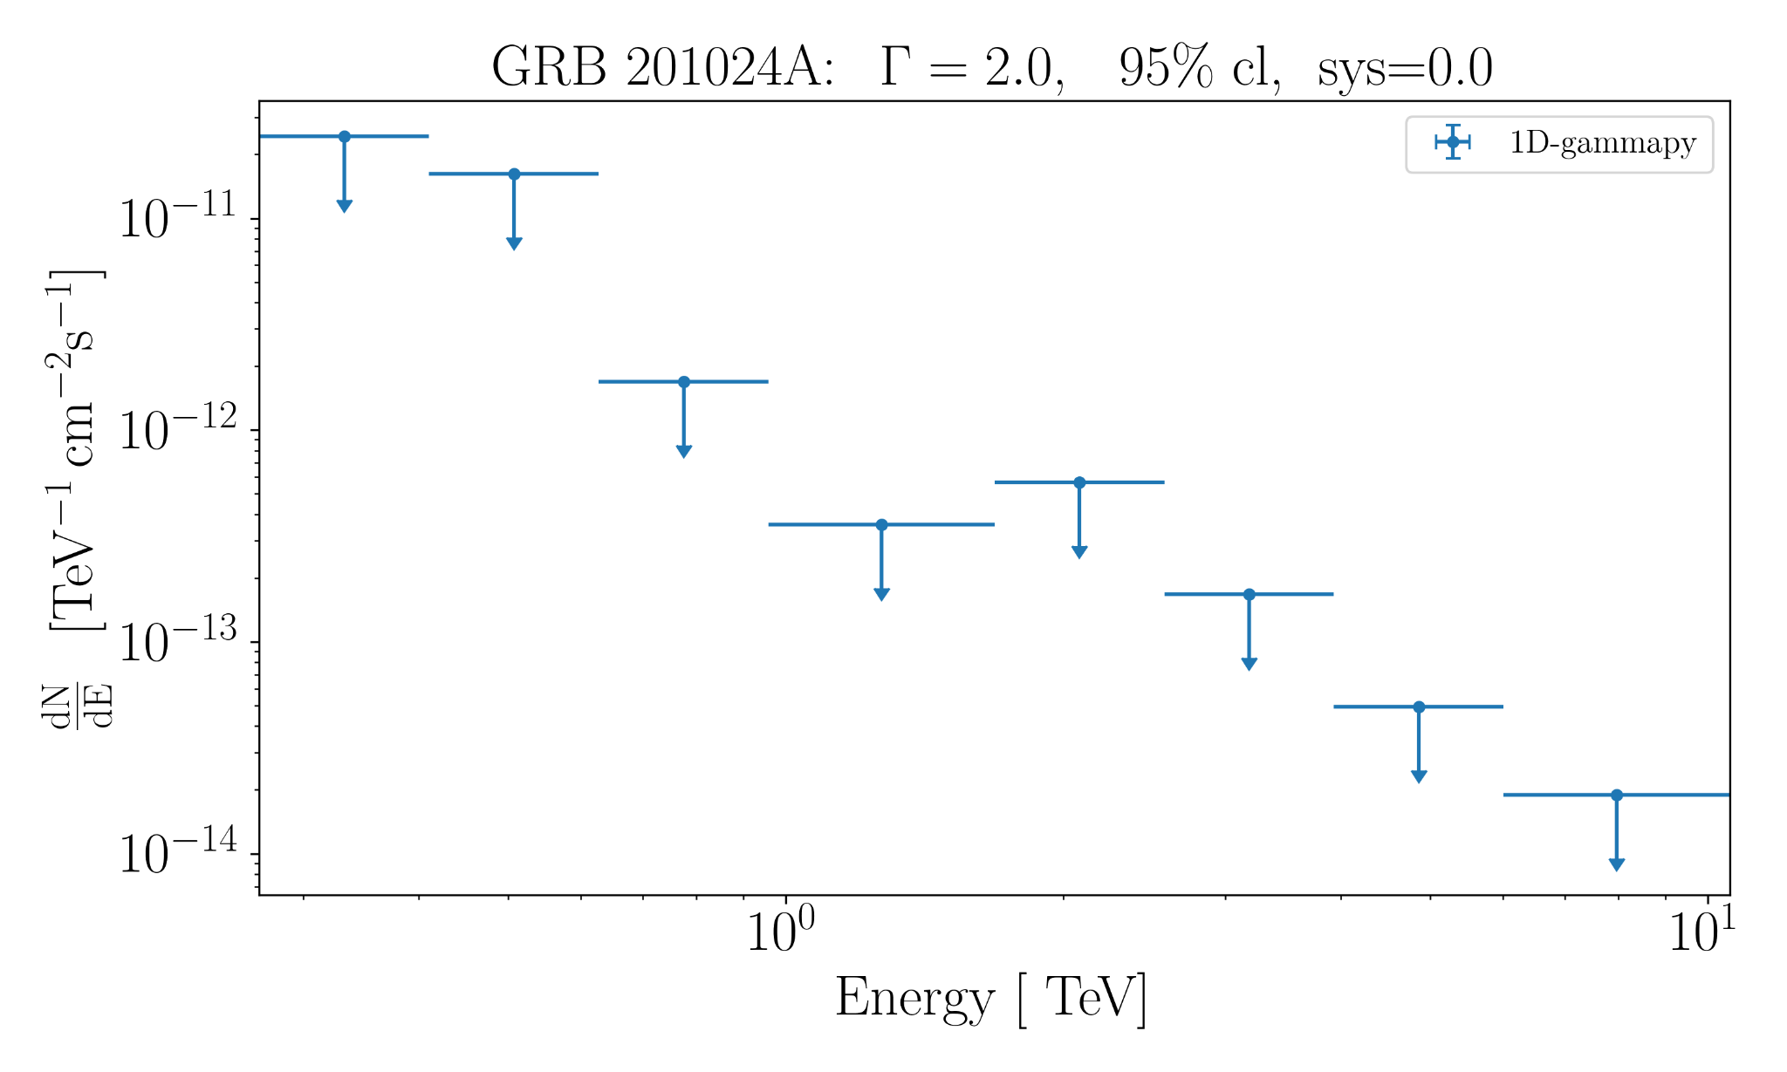
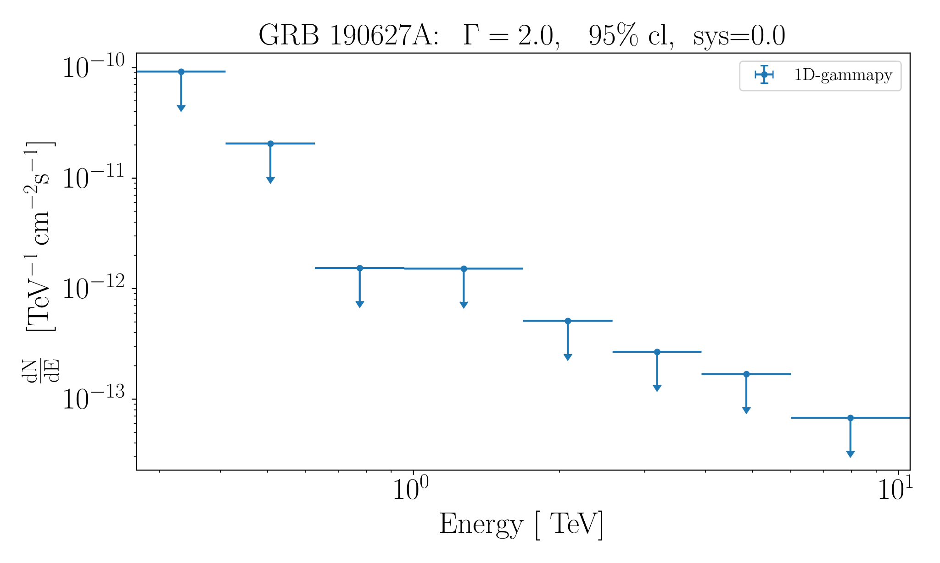
Searching for X-ray/VHE correlation
Differential Upper Limits
Preliminary
Preliminary
Preliminary
Preliminary
‹#›
|Astroparticle School|Obertrubach-Bärnfels | by Jean| 2022.10.05-13

Slide 11
Next Steps
Finish the HESS analysis with all GRBs in the sample (1 remaining)
Do X-ray analysis for the selected sample.
Start the modelling of the selected GRBs taking GRB 190829A as a reference.
‹#›
|Astroparticle School|Obertrubach-Bärnfels | by Jean| 2022.10.05-13

Slide 12
Conclusions
In the afterglow phase, GRBs are emitting very high energy gamma-rays but Is it true for all the GRBs?
The H.E.S.S. GRB observation strategy is successful in observing GeV - TeV afterglow emission from two GRBs so far which motivates to improve the strategy to search for more GRBs.
The GRB afterglow emission model could be: Synchrotron self-Compton or Synchrotron dominant . More GRBs should be observed to understand the emission model.
Could this model be used to explain the afterglow emission from GRBs non-detected by H.E.S.S.?
‹#›
|Astroparticle School|Obertrubach-Bärnfels | by Jean| 2022.10.05-13

Slide 13
References and Some readings
Revealing x-ray and gamma ray temporal and spectral similarities in the GRB 190829A afterglow
Extreme emission seen from γ-ray bursts
A very-high-energy component deep in the γ-ray burst afterglow
The Gamma-ray Coordinates Network (GCN)
HESS WG: Multiwavelength Observations
TeVCat 2.0
Teraelectronvolt Astronomy
GMS: A New Era in Gamma-ray Science
‹#›
|Astroparticle School|Obertrubach-Bärnfels | by Jean| 2022.10.05-13

Slide 14
End
Thank you for your kind attention !
‹#›
|Astroparticle School|Obertrubach-Bärnfels | by Jean| 2022.10.05-13

Slide 15
Backup slides
Question: In the afterglow phase, are GRBs emitting very high energy gamma-rays (VHE; > 100 GeV) ?
Note: Due to extragalactic background light (EBL) absorption, VHE gamma-rays tend to have a softer spectrum (Need to be in backup)
‹#›
|Astroparticle School|Obertrubach-Bärnfels | by Jean| 2022.10.05-13

Slide 16
|Astroparticle School|Obertrubach-Bärnfels | by Jean| 2022.10.05-13
Notes:
This is A schematic overview of the standard picture of a cosmic accelerator. High-energy electrons and hadronic cosmic-rays are accelerated in a source. The messengers received at Earth can be either these charge particles directly propagating from the source, or neutral secondaries (photons or neutrinos) produced in pion decay or inverse Compton scattering within the source.

Slide 17
|Astroparticle School|Obertrubach-Bärnfels | by Jean| 2022.10.05-13
Notes:
Cherenkov radiation
— Additional processes play a significant role in the shower development, mainly at low energy:
Multiple scattering of charged particles, leading to shower broadening;
Energy losses of e± by ionization and atomic excitation, leading to rapid extinction of the shower when the energy of the charged particles in the shower pass below the so-called “critical energy” ( Ec = 83 MeV in the air);
Electron scattering and positron annihilation that lead to an excess of ∼ 10 % of electrons compared to positrons (“charge excess”), which in turn can produce a significant radio emission signal
The Earth's magnetic field, which broadens the shower in the East–West direction.
The number of shower particles reaches a maximum at about 10 km height, and the shower dies out deeper in the atmosphere.
Since the shower particles move at essentially the speed of light, they emit Cherenkov light, a faint blue light.
The Cherenkov light is beamed around the direction of the incident primary particle and illuminates on the ground an area of about 250 m diameter, often referred to as the Cherenkov light pool.
For a primary photon at TeV energy (1012 eV), only about 100 photons per m2 are seen on the ground. They arrive within a very short time interval, a few nanoseconds.
On Left: the Cherenkov light emitted by the charged particles in the shower is collected by several dishes.
On Right: The shower angular image is projected into the camera focal plane.

Slide 18
|Astroparticle School|Obertrubach-Bärnfels | by Jean| 2022.10.05-13

Slide 19
|Astroparticle School|Obertrubach-Bärnfels | by Jean| 2022.10.05-13

Slide 20
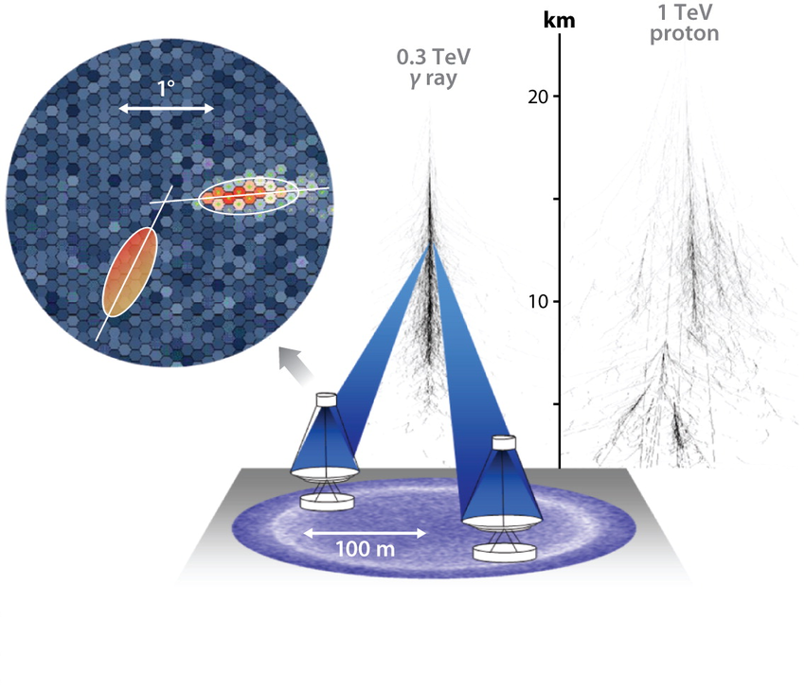
Credit: Hinton, 2009
|Astroparticle School|Obertrubach-Bärnfels | by Jean| 2022.10.05-13
Notes:
Geometric reconstruction of shower direction and impact in stereoscopic mode.
Left: In the camera frame, the main axis of the shower corresponds to a plane that contains the actual shower track and the telescope. The primary particle direction corresponds to a point on this main axis.
Middle: The intersection of the main axis of the images recorded by the different telescopes immediately provides the primary particle direction.
Right: Direct intersection of the planes containing the shower tracks and the telescopes provides the shower impact on the ground.

