Slide 1
Event reconstruction in neutrino telescopes using sparse neural networks
Astroparticle School 2022
Felix Yu, felixyu@g.harvard.edu

Slide 2
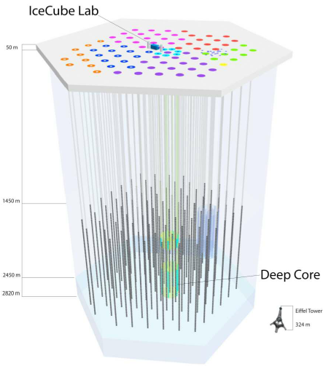
Event Reconstruction
Being able to accurately reconstruct events in IceCube can help improve detector sensitivity
It can be a challenging task to do efficiently
Towards this end, recent advances in machine learning have prompted physicists to adopt this tool for reconstruction
IceCube Collaboration. Journal of Parallel & Distributed Computing 75:198,2015

Slide 3
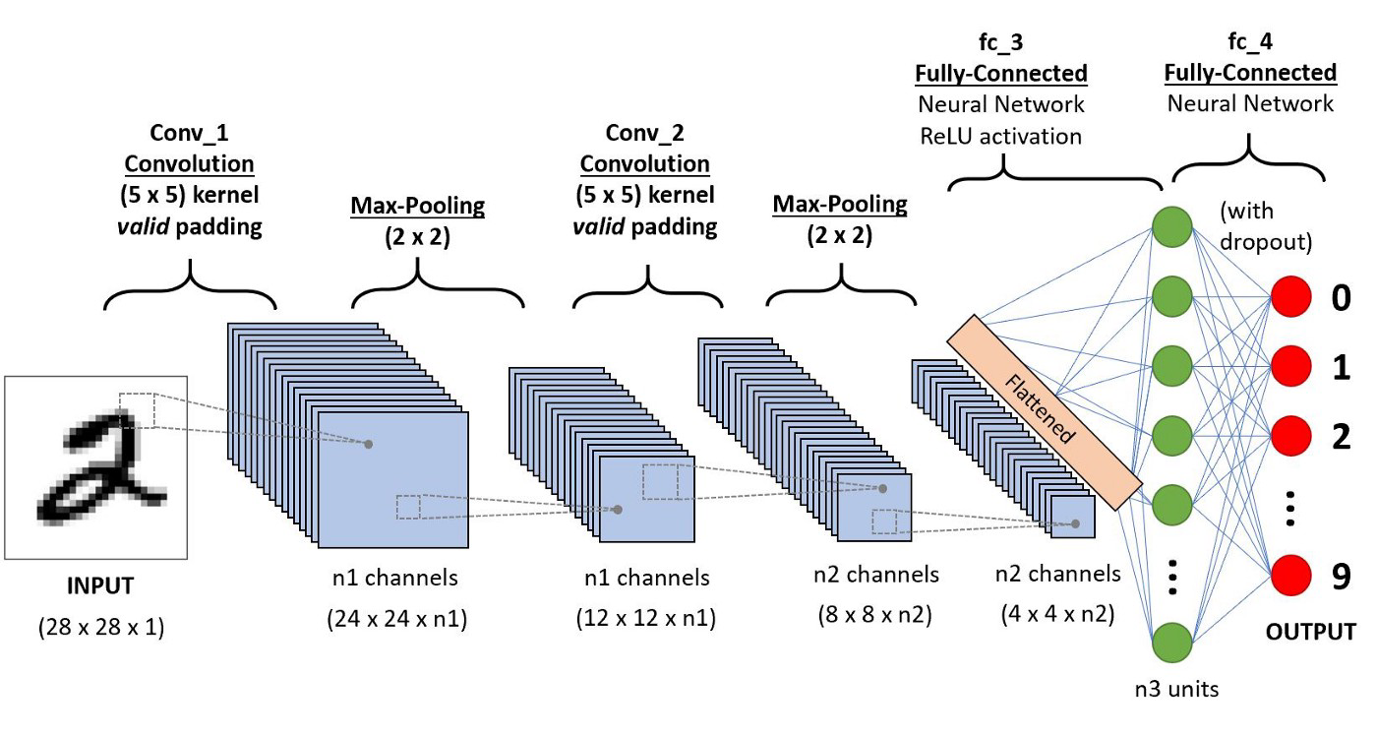
Convolutional Neural Networks
Convolutional neural networks (CNNs) are a staple for image-like data
Convolutions excel at feature extraction, which is done using kernels, and stacking layers to form a network
Reference

Slide 4
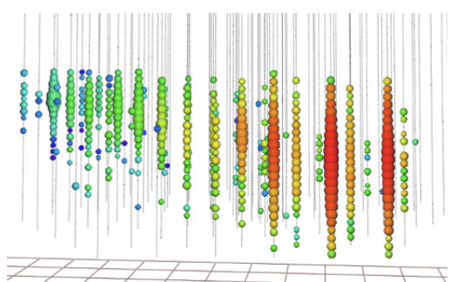
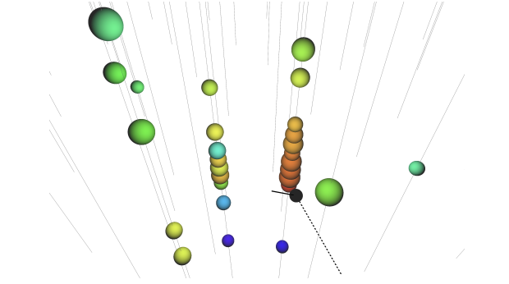
Challenges and Motivations
Numerous issues arise in a naïve application of CNNs to neutrino telescope data
Non-regular geometry
Sparsity: on average in simulation dataset, ~103 of the 5160 DOMs are hit
High dimensionality: IceCube is cubic-kilometer in size, and events can take up to 7500 ns
Solution: sparse submanifold convolutions! They eliminate many inefficiencies and run orders of magnitude faster on GPU/CPU
IceCube Collaboration. Eur. Phys. J. C (2022) 82: 807

Slide 5
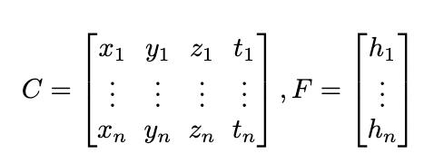
Sparse Submanifold Convolutions
Potential solution: sparse submanifold convolutions
Convolutional kernel is only applied when centered on a nonzero element
Input becomes a list of coordinates of nonzero elements, and their corresponding values (features)
arXiv:1706.01307

Slide 6
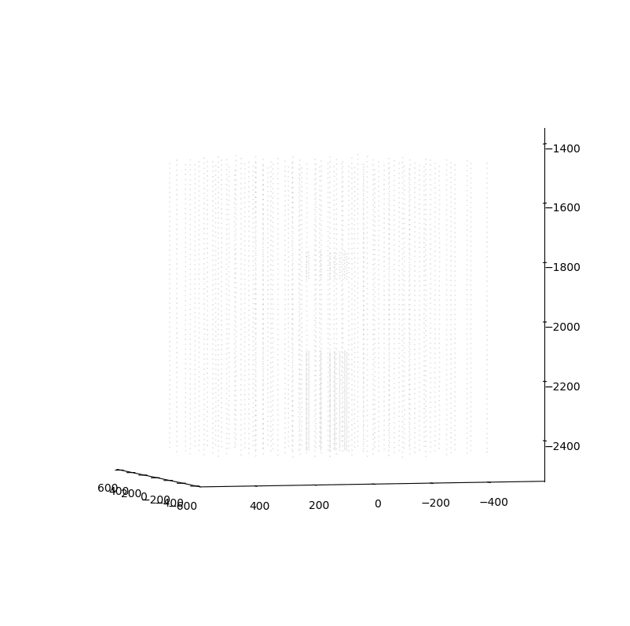
Data and Simulations
Currently using simulated muon neutrino events (track-like) in the IceCube detector geometry
Generated using a new open-source MC created by group members called Prometheus
Each event is a list of space-time coordinates where a photon hit was recorded: almost no pre-processing necessary!

Slide 7
Expectations/Future Directions
Based on sparse submanifold CNNs used on similarly sparse datasets, we can expect ~10x-100x speedup in runtime on both CPUs and GPUs compared to regular “dense” CNNs
Goal is to get comparable performance to CNNs/traditional methods
Generating lots of training data, network architecture optimizations, data normalizations, hyperparameters tuning etc.

Slide 8
Take Home
Sparse submanifold CNNs naturally resolve inefficiencies associated with sparse data, which allows us to run super fast CNNs on high-dimensional neutrino telescope data
They also eliminate need for significant pre-processing, and can be run almost directly on space-time coordinates of the photon hits
I would like to thank Jeffrey Lazar and Carlos Argüelles as my collaborators and mentors on this project.
Email: felixyu@g.harvard.edu
Thank you!

