Slide 1
Development of a new trigger for exotic particle searches with IceCube
Timo Stürwald
05.10.2022

Slide 2
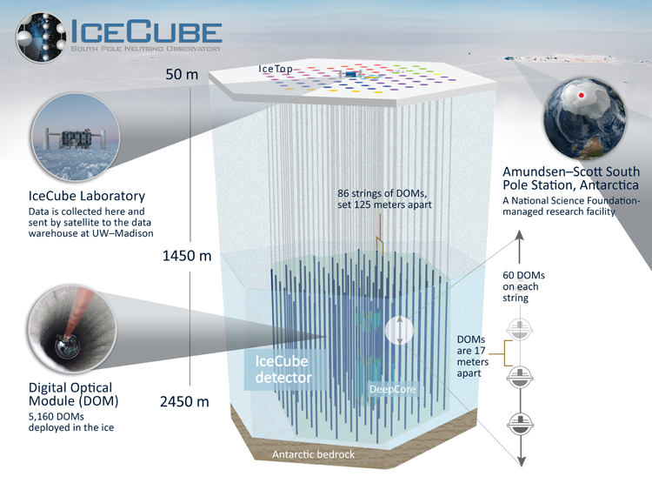
The IceCube Neutrino Observatory
The IceCube experiment detects high energy neutrinos via Cherenkov light
IceCube also searches for particles beyond the standard model including fractionally charged particles
≈1 km³ of instrumented ice
The main component of the DOMs are photomultiplier tubes (PMT)

Slide 3
Local Coincidence condition
If a PMT is triggered digitization modules are launched
available information for each hit: time, position and coincidence label
Coincidence condition for DOMs on the same string:
Hard Local Coincidence (HLC): in a time frame of ± 1 µs around the own launch a neighboring DOM is launched -> correlated hit pair
HLC rate: 77 kHz
Soft Local Coincidence (SLC): no local coincidence signal received -> single hit
SLC rate: 2.7 MHz
± 1µs

Slide 4
Local Coincidence condition
Muon 100 TeV (≈ 3 µs through the detector)
Example of a muon that dominantly produces HLC hits
All IceCube triggers work on HLC hits
For signatures of dim exotics SLCs are the main hit type
Goal: Build a new trigger for dim exotic signatures that also uses SLC hits
± 1µs

Slide 5
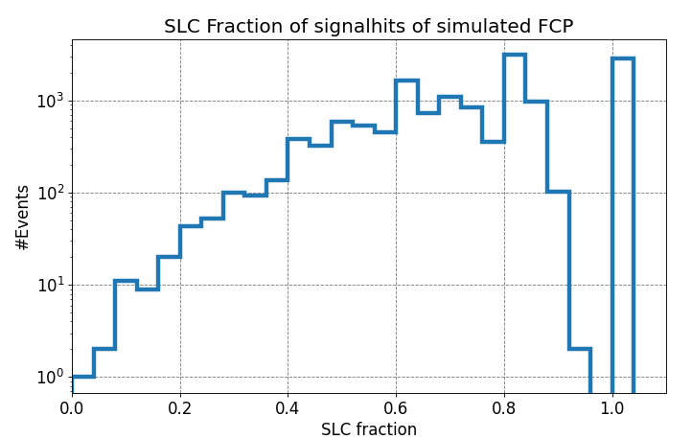
Fractionally charged particles (FCPs)
Assumptions
Charge in fractions of e: 1/3
Behave leptonically like muons
Stable particles
Mass: 1 TeV
Produced Cherenkov photons scale with z²
looks in the detector like dim throughgoing muon tracks
$SLC Fraction=\frac{\#SLChits}{\#SLChits+\#HLChits}$
FCPs dominantly produce SLC hits
$≈11000$events that satisfy a quality criterion of producing at least 10 signal hits in the detector
Only SLC hits
Only HLC hits

Slide 6
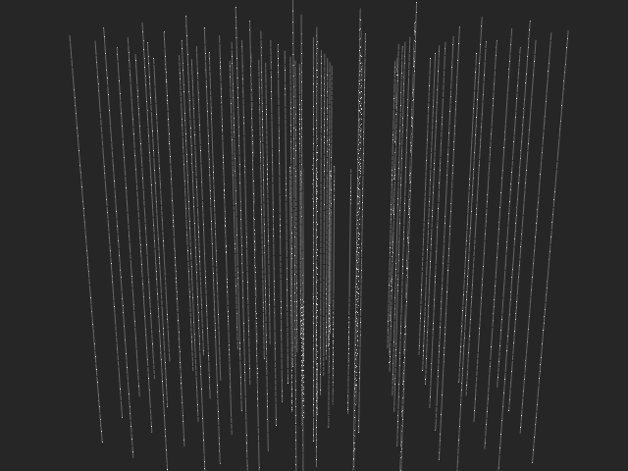
FCP simulation example
FCP: with and without detector noise
Energy close to detector entry
Detector noise dominantly produces random SLCs
The signal part produces dominantly SLCs along the track that are velocity and directional consistent
Detector noise is separatable by velocity and directional consistency of the hits
FCP: q = 1/3, m= 1 TeV E = 10 TeV

Slide 7
Trigger structure
2.7 MHz SLC can not be processed by the DAQ and is reduced to 1.35 MHz
Part of the detector noise hits occur in bursts on the same PMT
Select PMTs that were hit once on the large time scale window of 100 µs and apply a sliding time window
Sliding time window with 3000ns length is evaluated every 800ns
Calculate 4 cut variables in each time window
TW1
TW2
TW3
Remove detector noise and too bright signatures
Remove detector noise by velocity (or directional) hit consistency
Increase purity of dim signatures
1
2
3
4
#Velocity consistent hit pairs
#Velocity consistent combinations of three hits or clustering of
hit pairs
Hit count
Cut on SLC fraction

Slide 8
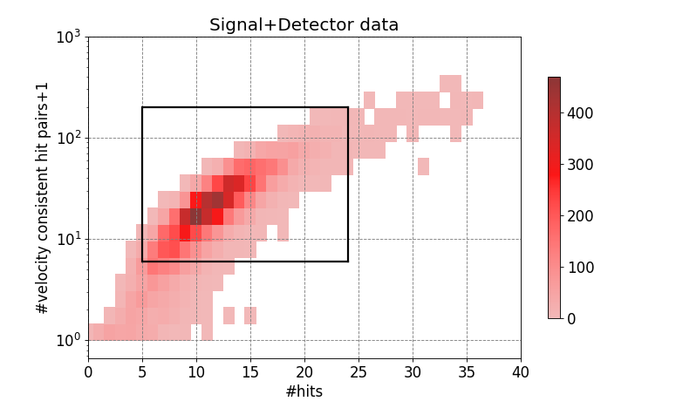
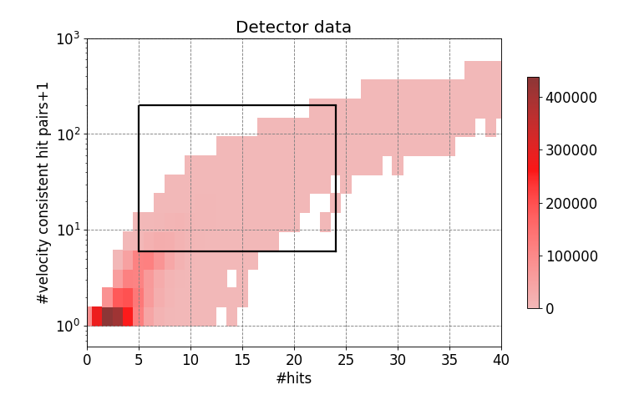
Cuts 1. and 2.
On the x-axis is the hit count in the time window
The y-axis shows the count of hit pairs that satisfy a signal like velocity cut in the time window
Detector data dominantly produce less #hits and produces a lower number of velocity consistent hit pairs
Cut on #hits: 5≤#hits ≤ 24
Cut on #velocity consistent 5≤ #hitpairs ≤ 200
Detector noise

Slide 9
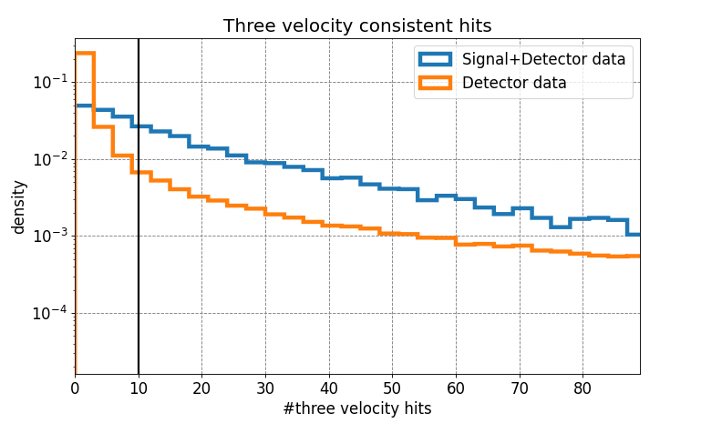
Cut 3.
Out of the remaining hit pairs, velocity consistent combinations of three hits are formed
Detector data peak at a lower number of velocity consistent combinations
10≤#three velocity consistent hits≤90
An alternative for this cut looks for the directional clustering of hit pairs with comparable results

Slide 10
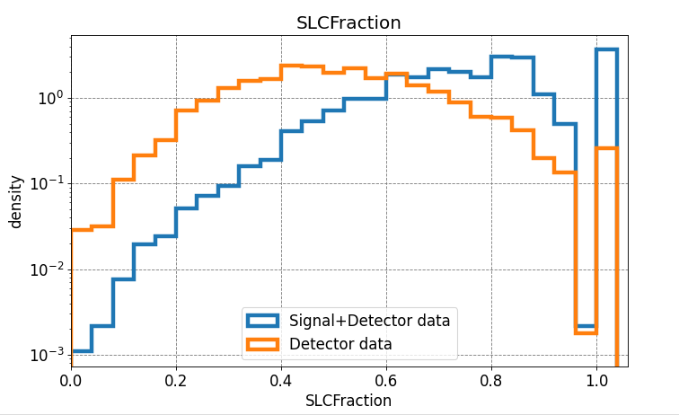
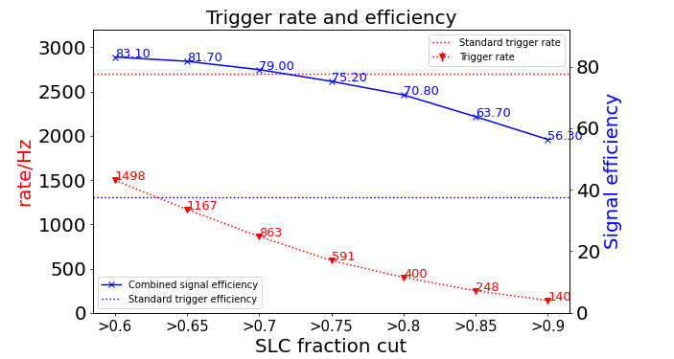
Cut 4. and trigger rate/efficiency
SLC Fraction after the third cut
Combined signal efficiency: standard triggered events + additional events triggered by the new trigger fraction
Standard trigger efficiency 37.5% at $≈$2700 Hz
At SLC fraction cut >0.8: 70.8% combined signal efficiency at $≈$400 Hz
Relative signal efficiency gain: 1.89

Slide 11
Results
Different input hit rates allow for scaling the computational resources and rate
IceCube DeepCore is a subset of 20 strings
Computational time is driven by calculating hit pairs, which has a flexibility of two orders magnitude
Testing this at the IceCube test DAQ will put constraints on the different parameters to match CPU restrictions
Large time scale window size/µs | Input hit rate/MHz | Relative signal efficiency gain | Trigger Rate/Hz | Cycles per hit pair with 3 GHz
100 | 1.36 | 1.89 1.70 | 400±9 248±7 | 272
500 | 0.89 | 1.80 1.68 | 340±3 216±3 | 1500
- | 0.6 (All DeepCore hits) | 1.54 | 98±6 | 20000

Slide 12
Summary
Presented a new trigger for faint exotic signatures in IceCube
Here presented the study for fractionally charged particles
Different versions allow for scaling the trigger rate and computational resources
Significant efficiency gain ranging between 1.54 – 1.89 (100 – 400 Hz)
Outlook
Test code at the test DAQ of IceCube
Thank you for your attention
stuerwald@uni-wuppertal.de

Slide 13
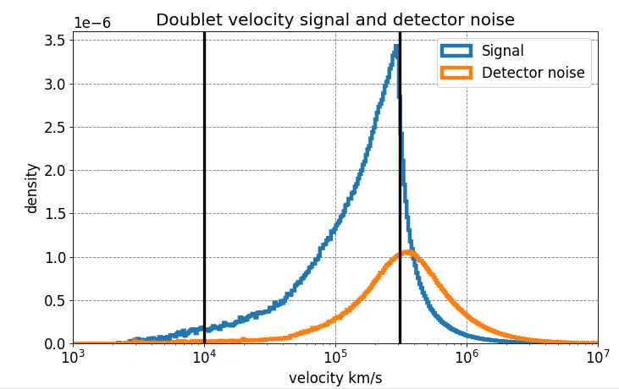
Hit pair velocity
Create all hit pair combinations per time window and calculate the velocity between them
Cut on velocity 10000-310000 km/s
The surviving hit pairs per time window are counted

Slide 14
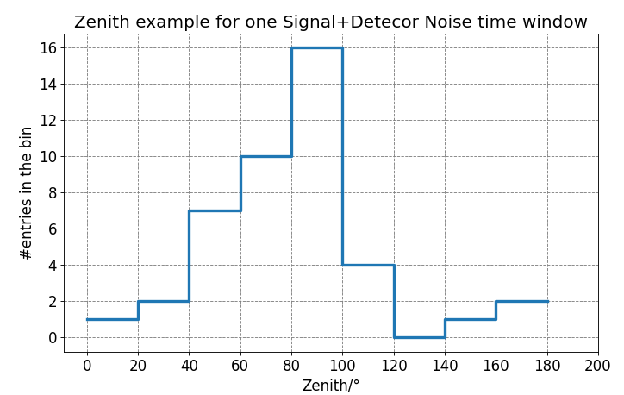
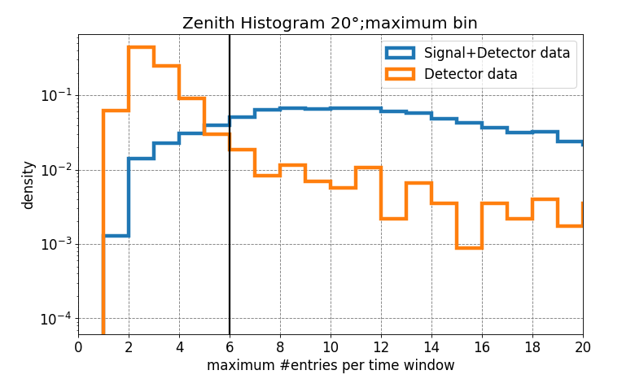
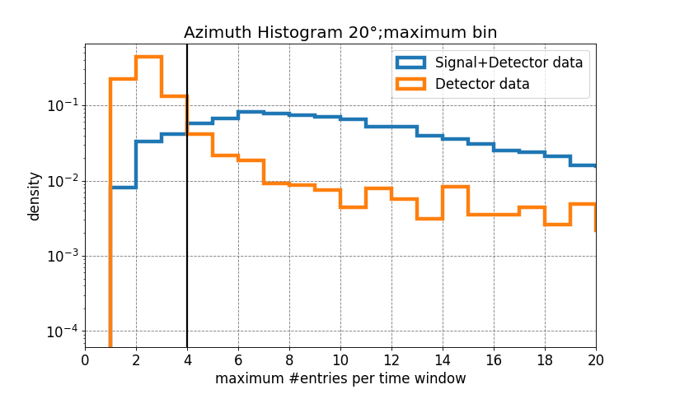
Alternative for Cut 3.
Calculate the direction for all remaining hit pairs per time window
For detector noise there should be no preferred direction
Histogram per time window the direction in 20° bins
Look for bins with the maximum #entries
Top: example for one time window of a signal+Detector data event (simulated zenith 80.5°)
The zenith and azimuth cut (>6 and >4) have to be satisfied by the time window

Slide 15
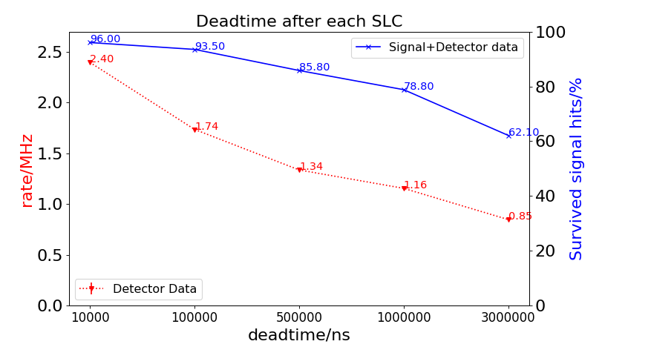
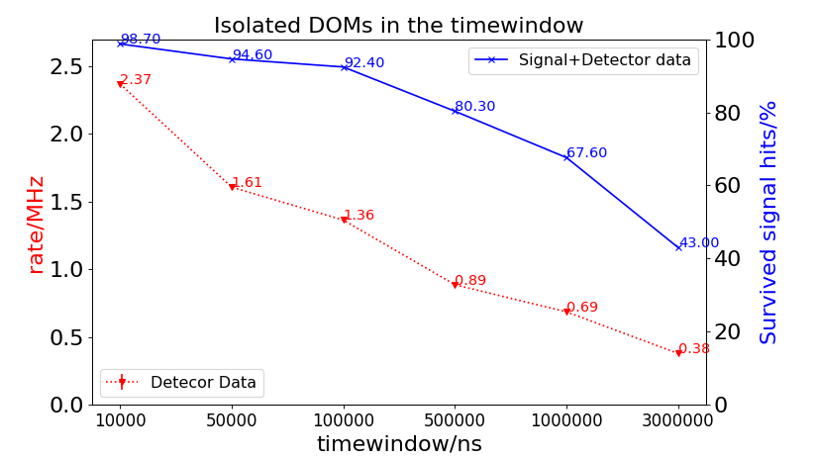
Methods to reduce the hit rate
Comparison of two methods to reduce the SLC hit rate ($≈2.7 MHz)$
1. Apply for each DOM a deadtime after each SLC
2. Take time windows of x ns and look for DOMs that were only hit once („Isolated DOMs“)
Isolated DOMs method shows better results
In the following plots for a 100.000 ns large timescale window are shown

Slide 16
Muon simulation example
Muons: without detector noise
Energy close to detector entry
Muons are a main background source for fractionally charged particles
The high energy muon produces many hits and dominantly HLC hits
Separatable by the number of hits and SLC fraction
The low energetic muon produces SLCs and HLCs in equal portions
The low energetic muons fall within the parameter space of the fractionally charged particles
Muon 100 TeV
Muon 500 GeV

Slide 17
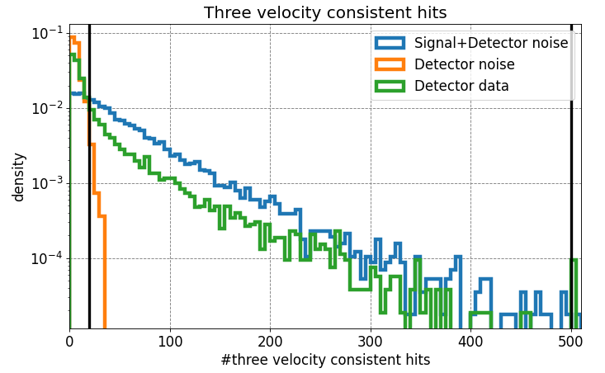
3.3 Cut 3. (Input hit rate 2.7 MHz)
Out of the remaining hit pairs, velocity consistent combinations of three hits are formed
Detector data peak at a lower number of velocity consistent combinations
20<#three velocity consistent hits<500

Slide 18
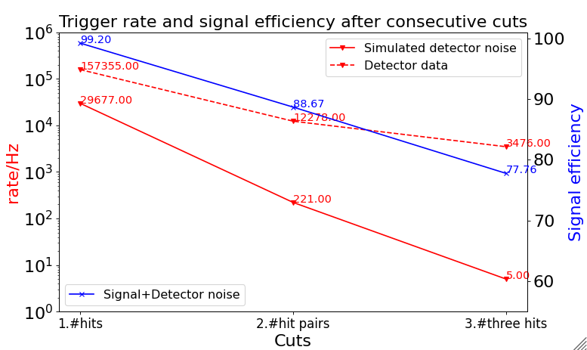
3.4 Signal efficiency and trigger rate after cuts 1,2 and 3
Apply the sliding time window to the Signal+Detector noise, Detector noise simulation and Detector data
The triggered events are counted if the trigger window overlaps with the part of the event that contains the signal
The detector noise is reduced to 5 Hz
The three cuts result in a signal efficiency of 77.76% and a trigger rate of 3475 Hz

Slide 19
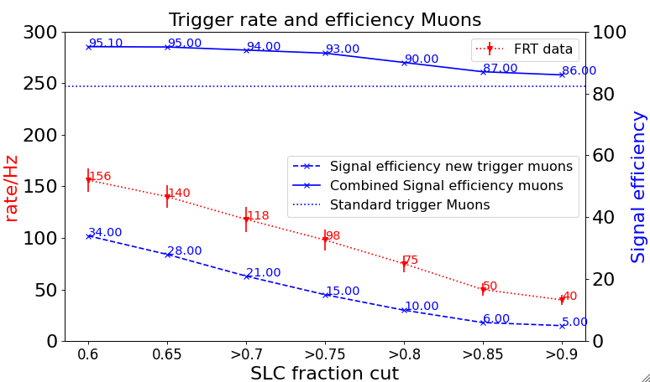
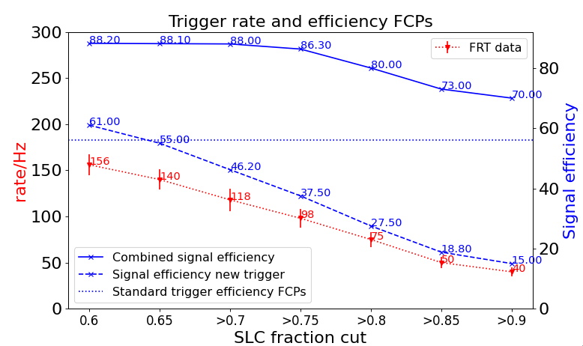
Signal efficiency and trigger rate for FCPs and low energy muons DC
The signal efficiency of the new trigger drops fast with an increasing SLC fraction for FCPs and muons
Combined signal efficiency: standard triggered events + additional events triggered by the new trigger
The combined trigger efficiency is “stable” up to a cut of >0.75
(additional triggered events have a high SLC fraction)
DC
For FCPs there is an increase in signal efficiency of 30% for a rate $≈$100 Hz at a final cut of >0.75
For the muons there is a 11% increase in the signal efficiency
+ would be much easier to start to implement this version
Whole Detector
For the whole detector the combined trigger efficiency is 86% which improves the standard trigger efficiency by a factor of 2 at a rate of $≈4$00 Hz

Slide 20
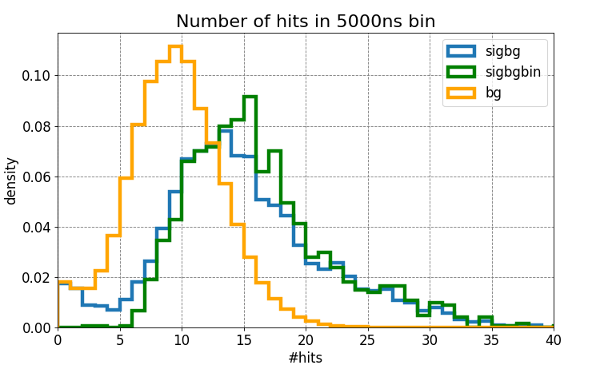
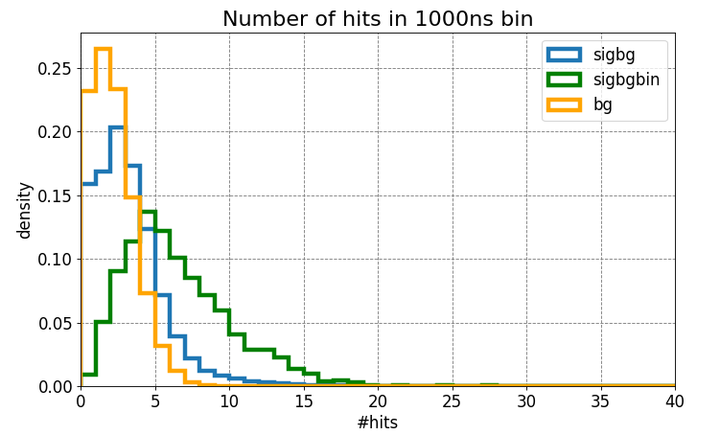
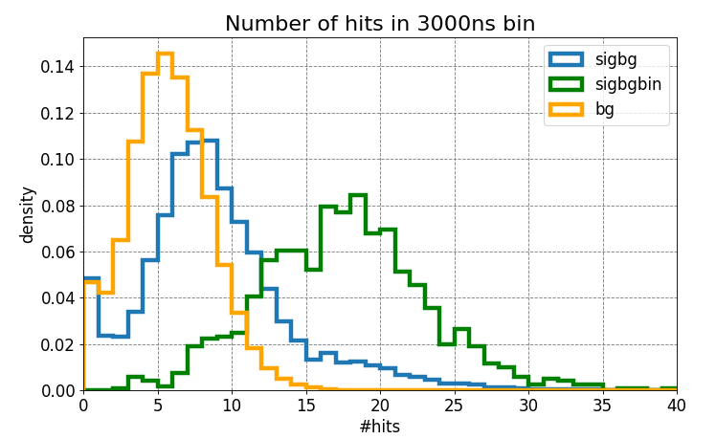
Fixing the time window
Varying the time window between 1000-5000ns (eventlength of pure signal up to that values)
Expectation: If the time window is too small then the excess of hits will not be visible
If the bin is too large a lot of background hits are included in the signal bin
Best sepparation at a time window of 3000ns

Slide 21
IceCube standard Triggers and Filtering
One major limitation:
Global time sorting
algorithm can not
handle the SLC launch
rate
Last slides: Options how to get SLCs at trigger level
Simple Multiplicity Trigger
Ice: ≥ 8 hits in 5000 ns, 2100 Hz
Forward globally time sorted HLC hits to the triggers (77 kHz)
DC ≥ 3 hits in 2500 ns, 250 Hz
Global Trigger and Event Builder
Cached time sorted SLC and HLC hits per string
Analysis specific filters on HLC + SLC pulses in the trigger time window
Volume trigger: ≥ 3 hits in 1000ns and cylinder r=175m h=75m, 3700 Hz
String trigger, 2200 Hz
Goal: Develop a new trigger for dim exotic signatures in IceCube(that also uses SLC hits) or adjust the existing triggers (HLC based trigger)
SLOP trigger, 12 Hz
Readout request of HLC and SLC hits for the corresponding time windows

Slide 22
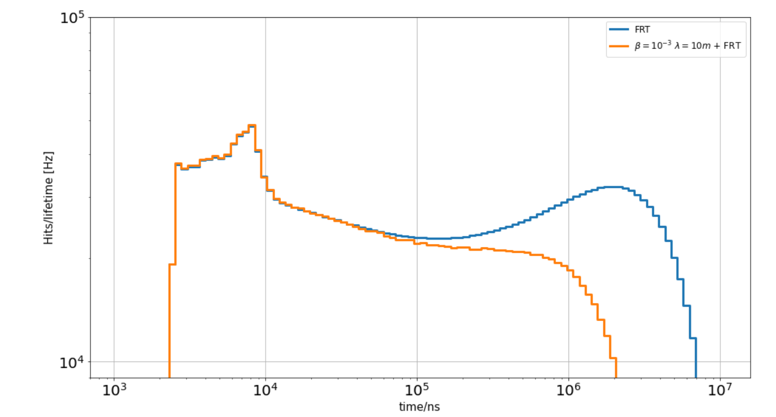
Background time scales
FRT (fixed rate trigger)data: Whole detector is readout every 5 minutes for 10ms
Uncorrelated
Radioactive decay of ⁴⁰K (low abundance in the cover of the pressure vessel)
Thermal hits (sub dominant)
Correlated
scintillation hits: daughter particles of radioactive decay excite elements in the pressure sphere
Afterpulses
Time differences between subsequent hits on the same DOM summed over all DOMs

