Slide 1
Satellite trails in H.E.S.S.
Thomas Lang, supervised by Dr. Alison Mitchell, Dr. Samuel Spencer
thomas.m.lang@fau.de
Bamberg, 01 August 2022

Slide 2
Satellites impacting astronomical imaging
Image from Lowell Observatory on 25 May 2019, the day after the first Starlink launch
Cause for major concern for ground-based astronomy
IAU Commission B7: Protection of Existing and Potential Observatory Sites
Image Credit: Victoria Girgis/Lowell Observatory

Slide 3
Satellites impacting astronomical imaging
Image from Lowell Observatory on 25 May 2019, the day after the first Starlink launch
Cause for major concern for ground-based astronomy
IAU Commission B7: Protection of Existing and Potential Observatory Sites
Increase of affected images already quantifiable in Sept. 2021 with only ~ 1600 Starlink satellites in orbit
Image Credit: P.Mróz et al. 2022

Slide 4
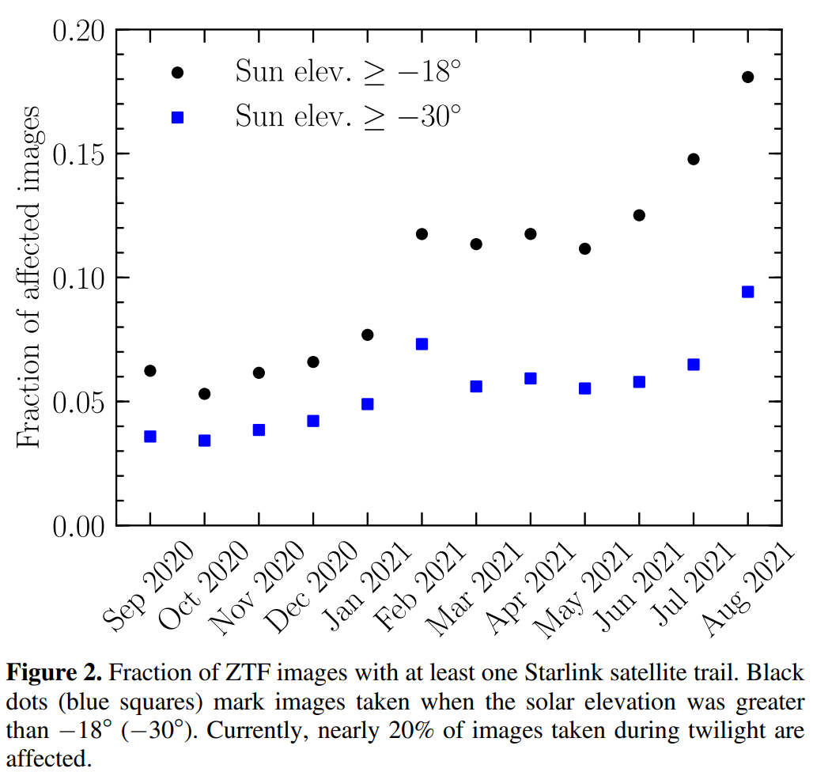
Satellites impacting astronomical imaging
Image from Lowell Observatory on 25 May 2019, the day after the first Starlink launch
Cause for major concern for ground-based astronomy
IAU Commission B7: Protection of Existing and Potential Observatory Sites
Increase of affected images already quantifiable in Sept. 2021 with only ~ 1600 Starlink satellites in orbit
Images at twilight and dawn and high zenith angles most affected
Image Credit: P.Mróz et al. 2022

Slide 5
Satellites impacting astronomical imaging
Image from Lowell Observatory on 25 May 2019, the day after the first Starlink launch
Cause for major concern for ground-based astronomy
IAU Commission B7: Protection of Existing and Potential Observatory Sites
Increase of affected images already quantifiable in Sept. 2021 with only ~ 1600 Starlink satellites in orbit
Images at twilight and dawn and high zenith angles most affected
8580 satellites in space, 2604 of those from Starlink
Total satellites planned by Starlink alone: 42,000
Image Credit: P.Mróz et al. 2022

Slide 6
High Energy Stereoscopic System (H.E.S.S.)
A quick introduction into Imaging Air Cherenkov Telescopes (IACTs)
CT 5
CT 3
CT 2
CT 1
CT 4
Image Credit: Clementina Medina/Irfu-CEA

Slide 7
High Energy Stereoscopic System (H.E.S.S.)
A quick introduction into Imaging Air Cherenkov Telescopes (IACTs)
High energy particle interacts with atmosphere, creating a cascade of particles
Image Credit: MPIK

Slide 8
High Energy Stereoscopic System (H.E.S.S.)
A quick introduction into Imaging Air Cherenkov Telescopes (IACTs)
High energy particle interacts with atmosphere, creating a cascade of particles
Radiation of Cherenkov light
Multiple telescopes on ground (CT 1-5) allowing stereoscopic imaging
Image Credit: MPIK

Slide 9
High Energy Stereoscopic System (H.E.S.S.)
A quick introduction into Imaging Air Cherenkov Telescopes (IACTs)
High energy particle interacts with atmosphere, creating a cascade of particles
Radiation of Cherenkov light
Multiple telescopes on ground (CT 1-5) allowing stereoscopic imaging
So called Hillas parameters used to classify and reconstruct an event
Image Credit: MPIK

Slide 10
Distinguish ɣ-rays from other CRs
ɣ-rays: only leptonic interactions
Mostly contained EM-shower
Muons: Interactions less likely
Cherenkov cone visible as rings or partial rings
Protons: Hadronic and leptonic interactions
Broader, more irregular showers, may also contain muons
Electrons: interact multiple times via Bremsstrahlung
Multiple subshowers at higher altitudes
Image Credit: MPIK

Slide 11
Night sky background (NSB)
Ambient light from various sources such as stars, moon, satellites, etc.
Increase of trigger threshold and pedestal for event measurements accordingly
Next generation Cherenkov Telescope Array even more affected by satellite trails than H.E.S.S.
On right: NSB simulation over CTA south site
NSB of CT 1-4 measured every ~ 10-15 s, CT 5 every 0.1 s
CT 5 best suited for satellite trail detection
Image Credit: Samuel Spencer, Matthias Büchele, 2021

Slide 12
NSB measurement and trail detection
MHz
Images from H.E.S.S. web summary

Slide 13
…and when explicitly searching for them
Elevation angle: 16.9173°, UTC: 03:53:01
MHz
Three satellites, each ~ 6 s - 10 s duration
One fast meteorite, < 1 s duration
Satellites and meteorites can be around the same brightness as stars, or even brighter

Slide 14
Questions this work aims to answer
Can trails found by CT 5 be seen in CT 1-4 at corresponding times?
Statistical analysis of satellite trails:
What are the general properties of satellite trails (speed, direction, brightness, etc.)
Which observation times and directions are affected the most?
How have trails increased of over time and what can be expected for the planned satellite constellations?
How much are the Hillas parameters in the event reconstruction affected?
Is it or will it be necessary to adjust the observation schedule for bright satellites?

Slide 15
Thank you for your attention!

Slide 16
Sources
https://iau.org/public/images/detail/ann19035a/
F
F
https://www.mpi-hd.mpg.de/hfm/HESS/pages/about/telescopes/
S. Spencer “Advanced Analysis Methods for Imaging Atmospheric Cherenkov Telescope Data with SSTCAM and VERITAS”, 2021
H.E.S.S. web summary

