Slide 1
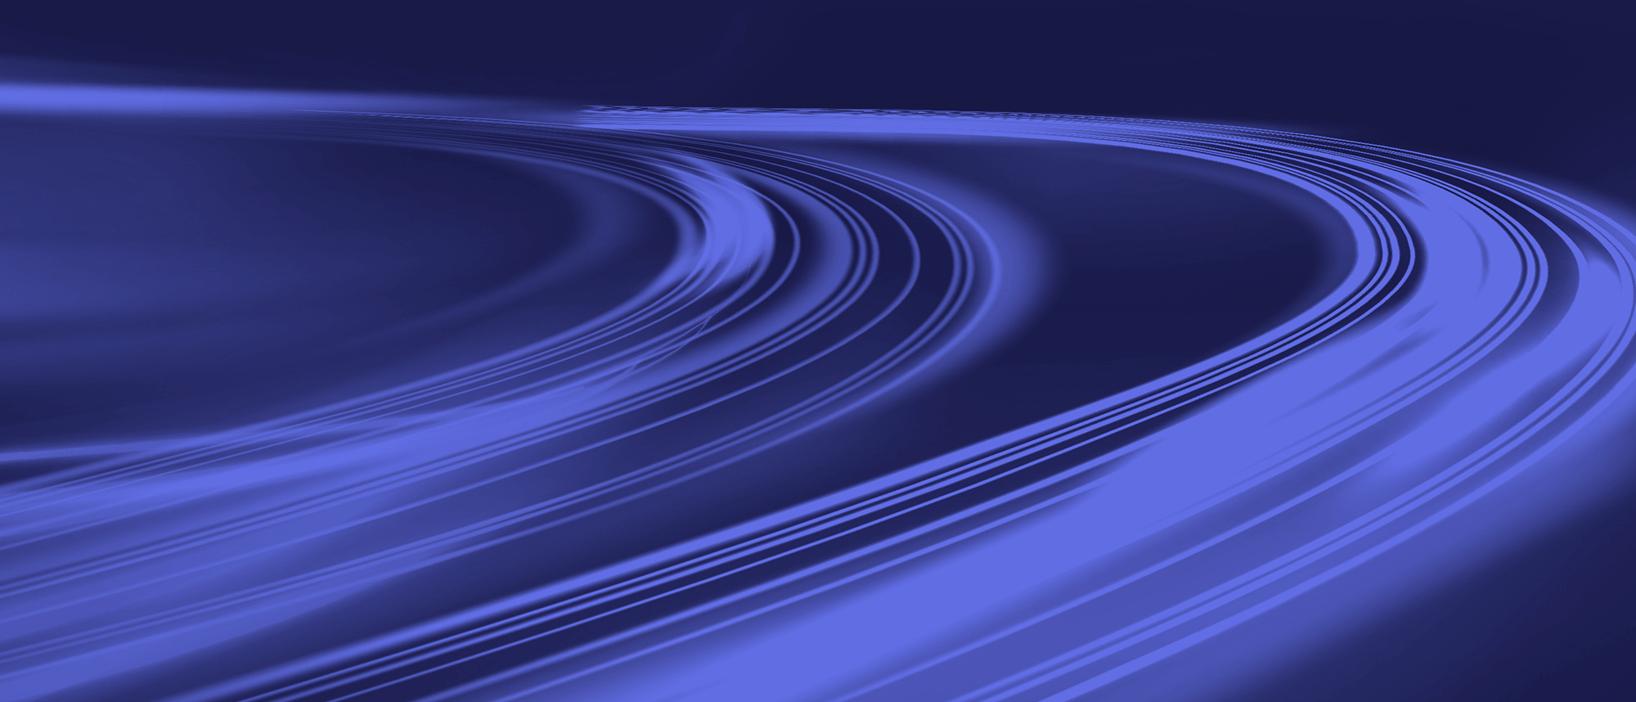
Neutrino Astronomy @ ECAP
Uli Katz & Anna Nelles
Visit Xavier Barcons, ESO

Slide 2
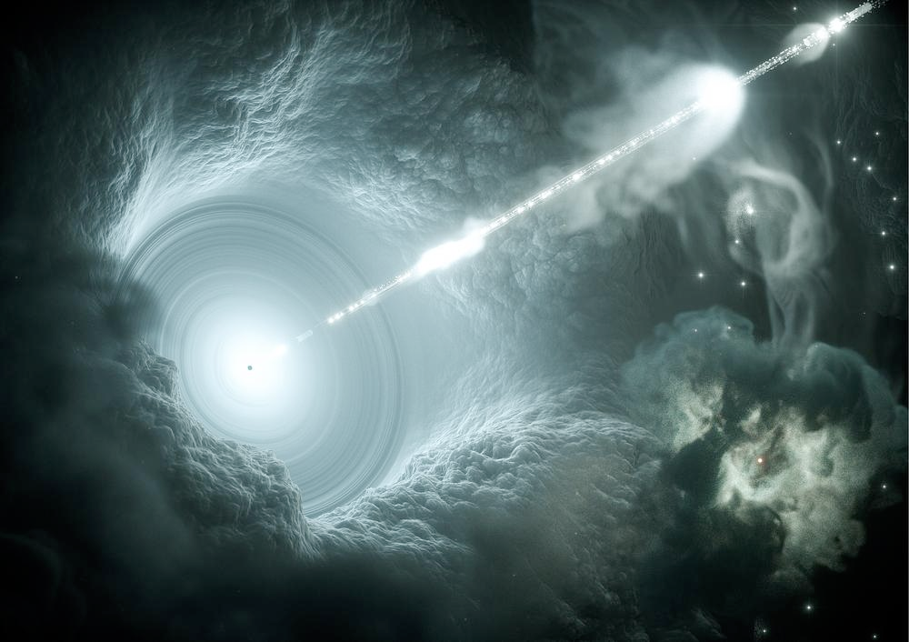
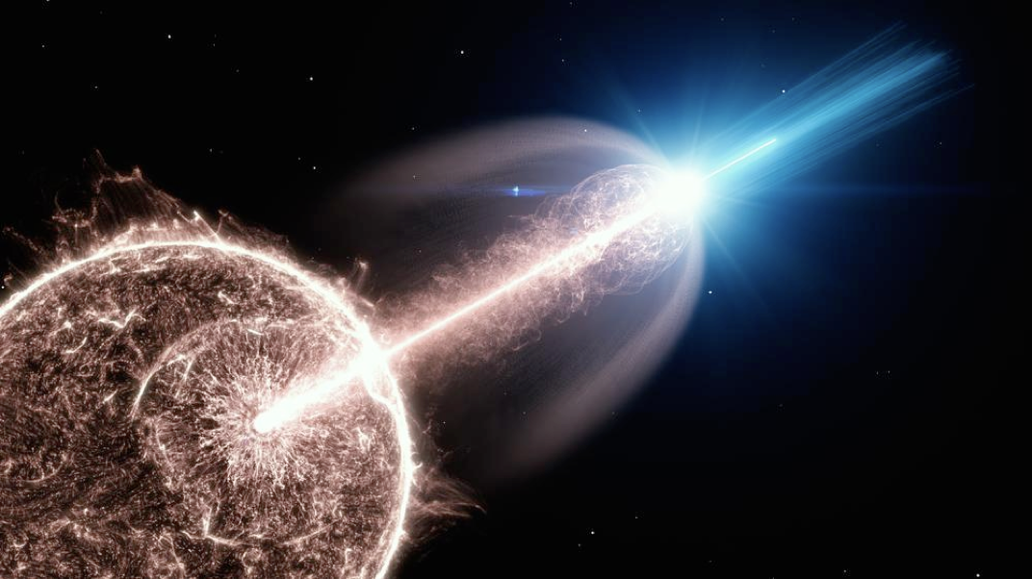
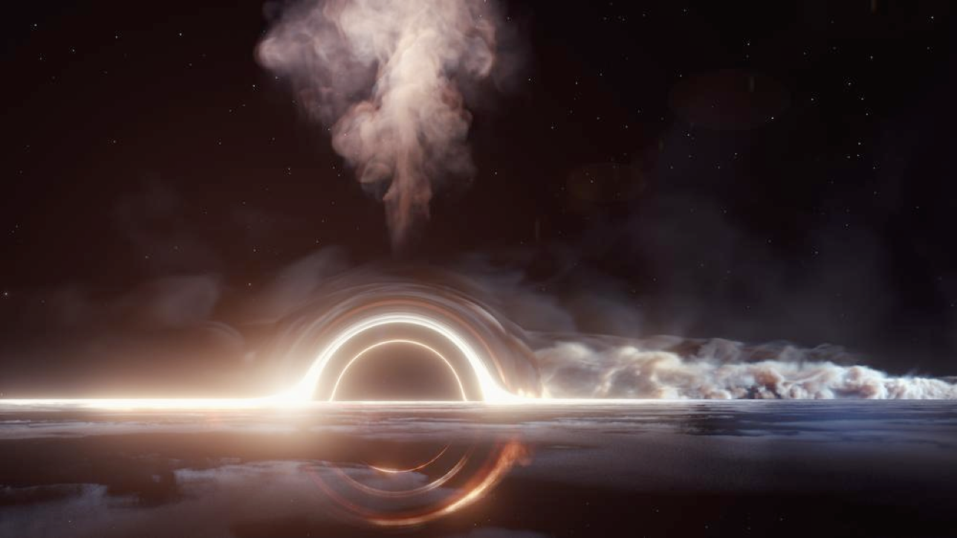
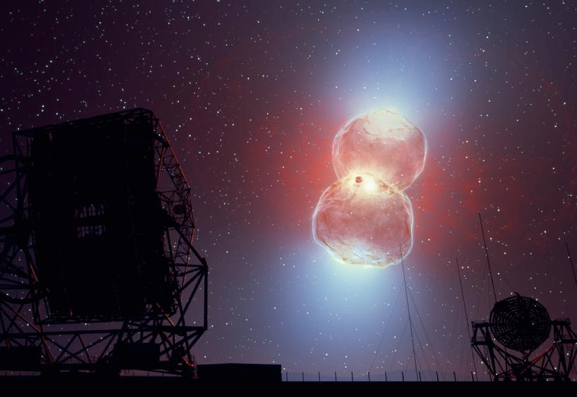
Neutrino Astronomy
A tiny introduction
Cosmic Rays
Interstellar / Intergalactic
Magnetic Fields, Dust, Gas, Cosmic Background Radiation, …
Neutrinos
Unknown sources
Photons
Neutrinos unique signature of hadronic acceleration processes

Slide 3
The multi-messenger picture
Cosmic-rays, Gamma-rays and neutrino likely connected
More gamma-rays at highest energies
Identify potential sources for cosmic-rays and neutrinos
More neutrinos at highest energies
Confirm sources (AGN, Blazars, GRBS, NS-NS mergers, TDEs, …?)
Higher precision cosmic rays
Improve composition measurements
Use for improved source modeling

Slide 4
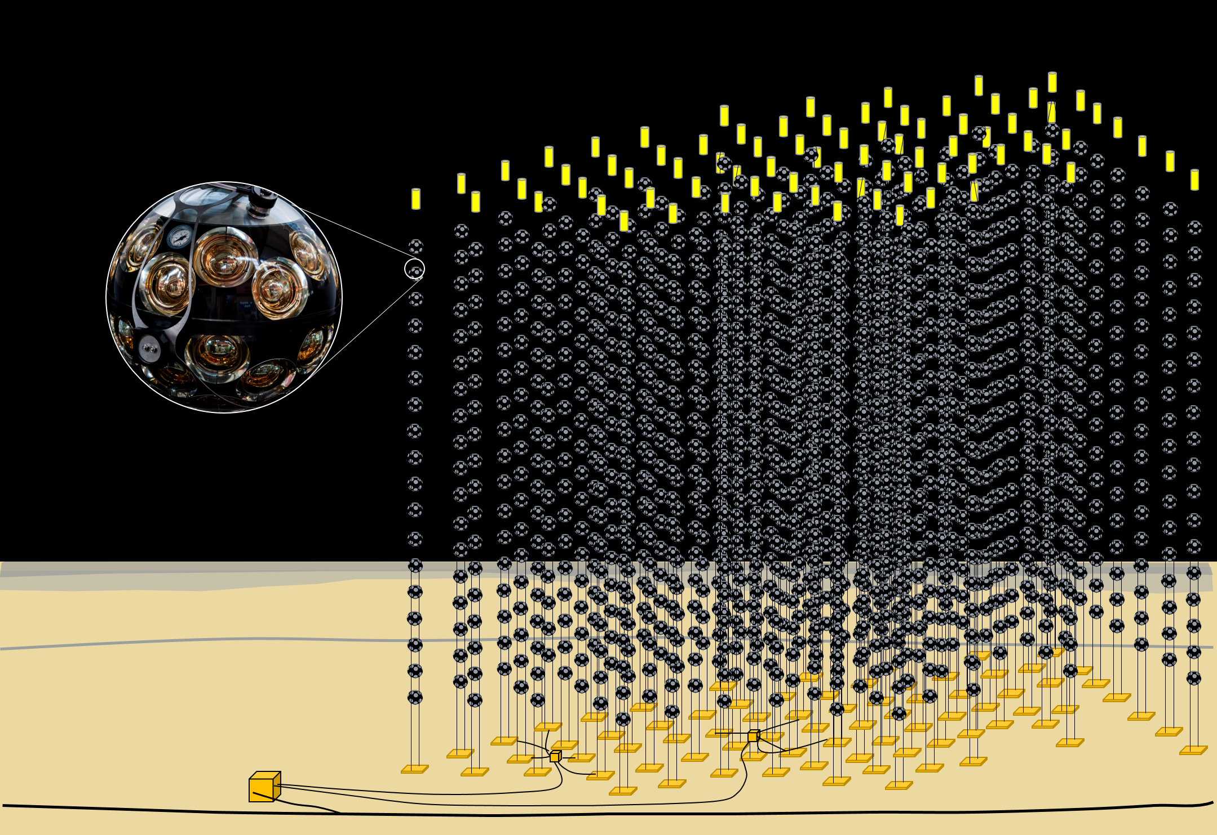
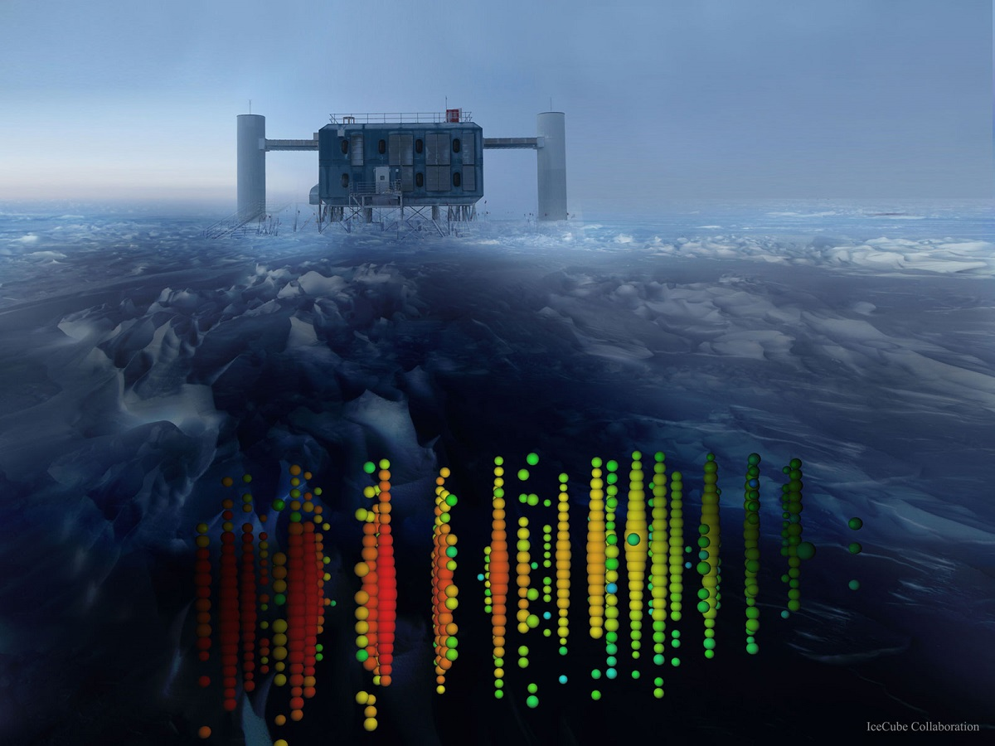
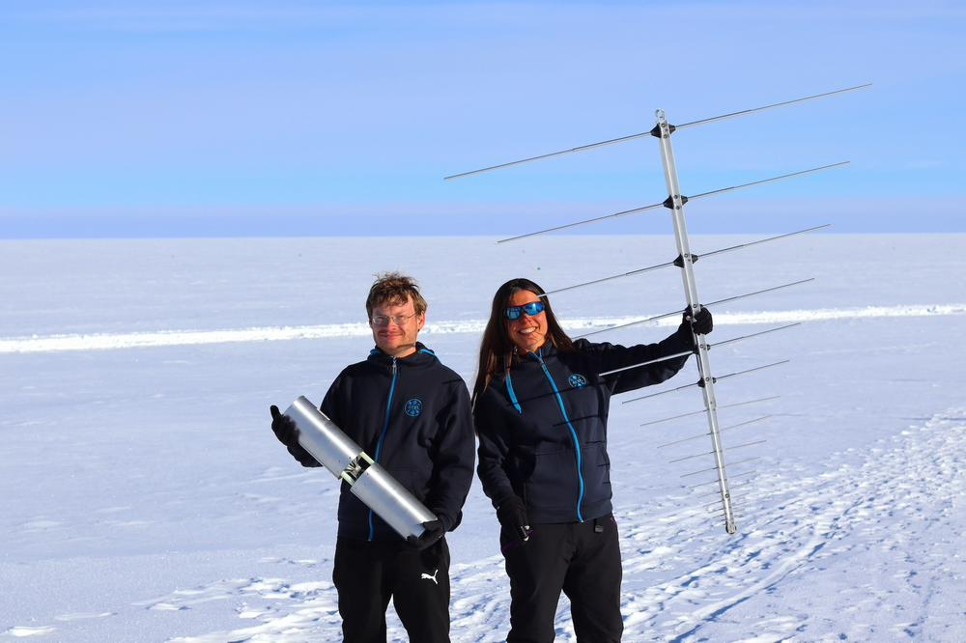
Neutrino Astronomy
A tiny introduction
Detect neutrinos by:
Detecting Cherekov light following their interaction in water
Such as KM3NeT in Mediterranean Sea
Neutrinos
Detecting Cherekov light following their interaction in ice
Such as IceCube at South Pole
Detecting Radio Emission following their interaction in ice
Such as RNO-G in Greenland

Slide 5
Current projects (on-going and under construction)

Slide 6
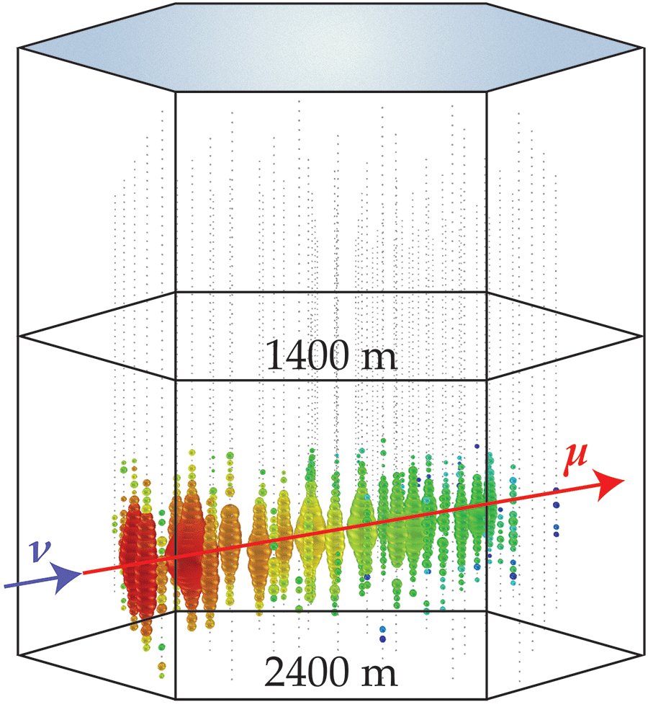
Optical detection of neutrinos
KM3Net and IceCube
Use naturally occurring media of large quantities for largest detector volumes: Neutrino flux at the highest energies is very low.
After a neutrino interaction, super-luminous particles are created that deposit light deep in the ice.
Requires very sensitive light collectors that can withstand extreme environmental conditions, such as at South Pole or at great depth in the Ocean.
3D grid of signals is used to reconstruct neutrino arrival direction, energy and flavor
KM3NeT (under construction) and IceCube are/ will be the two leading neutrino experiments

Slide 7
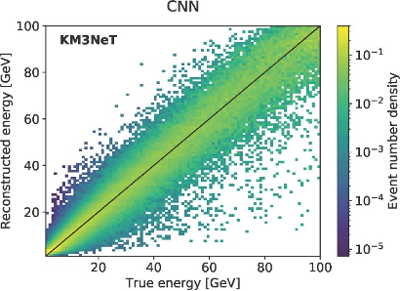
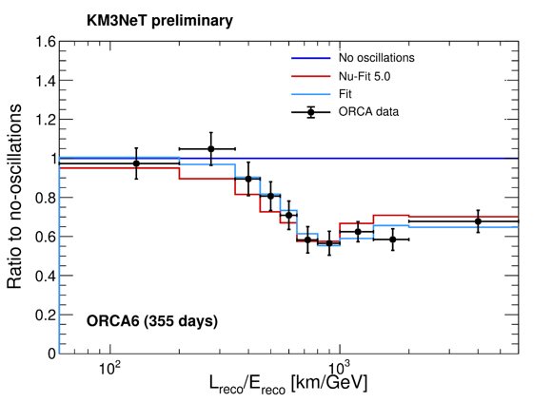
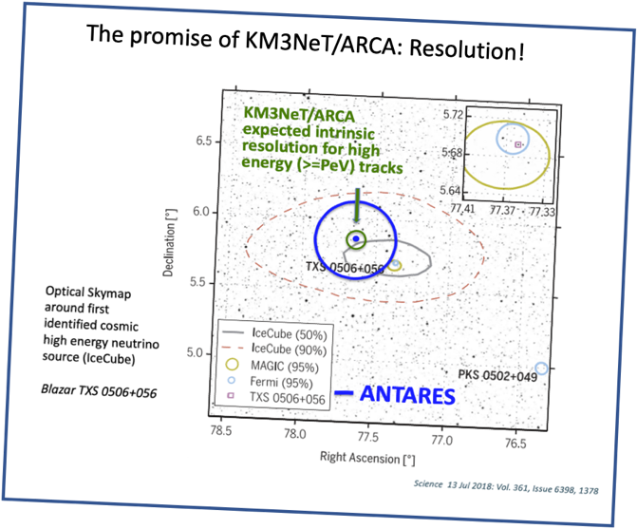
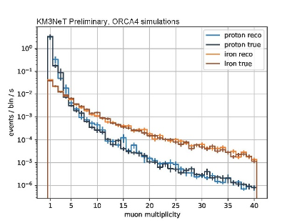
Science with KM3NeT
What is done at ECAP?
Regression with Deep Learning
KM3NeT /ORCA:
Neutrino oscillations!
Neutrino physics (particle physics):
  Focus on tau neutrinos
  Neutrino decoherence effects
  Calibration: Water property measurements
Neutrino astronomy:
  Cosmic-ray composition measurements
  Periodic sources (below detection threshold)
Special focus:
  Deep Learning (event classification, regression)
KM3NeT preliminary
JINST 15 (2020)
ICRC 2021
The promise of KM3NeT/ARCA: Resolution!
Cosmic-ray Composition
VLVnT 2021

Slide 8
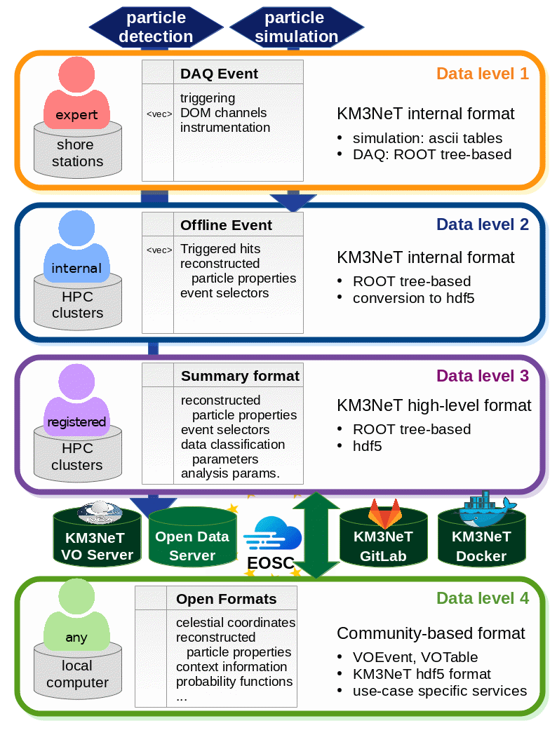
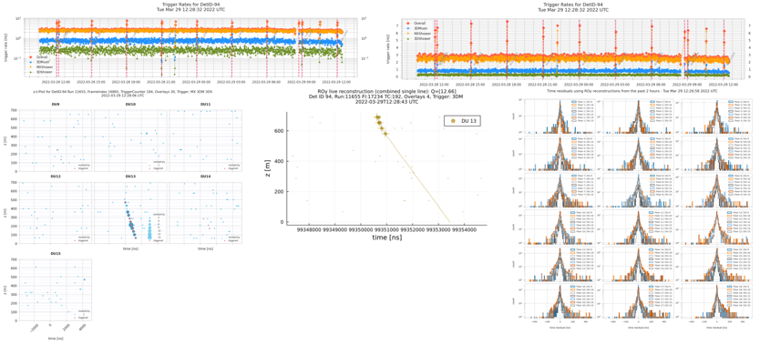
ICT, Data and Software
ECAP contributions to KM3NeT
Open Science (ESCAPE and EOSC-Future project)
IT Services (hosting, administrative support)
Computing and software coordination
  Software development (python framework, neutrino generators)
  Workflow development (mainly Tier-0, Tier-1 computing)
  New: Tier-2 data centre in ECAP Laboratory
  Detector monitoring:
Tier-0
Tier-1
Tier-2

Slide 9
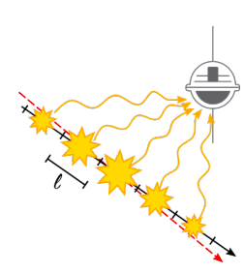
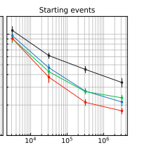
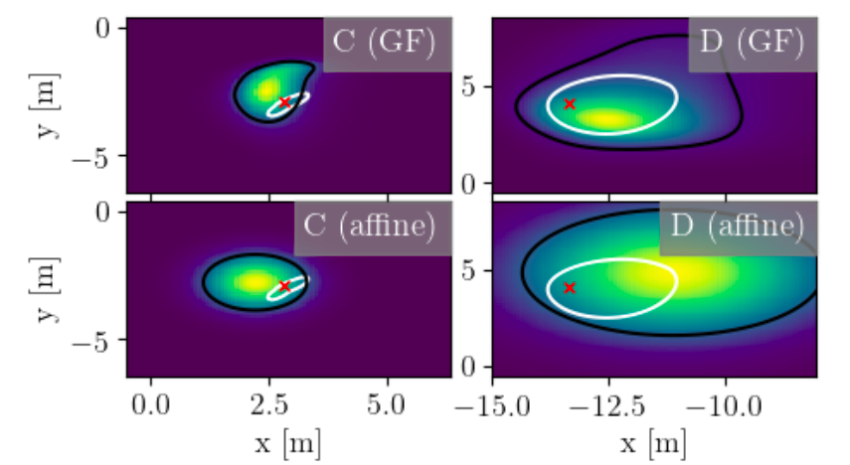
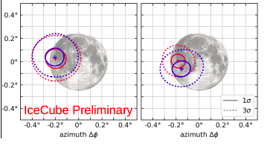
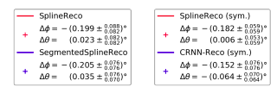
Science with IceCube
What is done at ECAP?
Focus on event reconstruction methodology to improve angular reconstruction, which is important for astronomical cases
Combination of ‘classical’ methods with ‘modern’ machine learning
The most precise Muon “classical” likelihood reconstruction in IceCube
1 deg
default
new
0.1 deg
Energy (eV)
precise muon neural network reconstruction - benchmarked with the
moon shadow
Modern machine learning techniques
that approximate PDFs

Slide 10
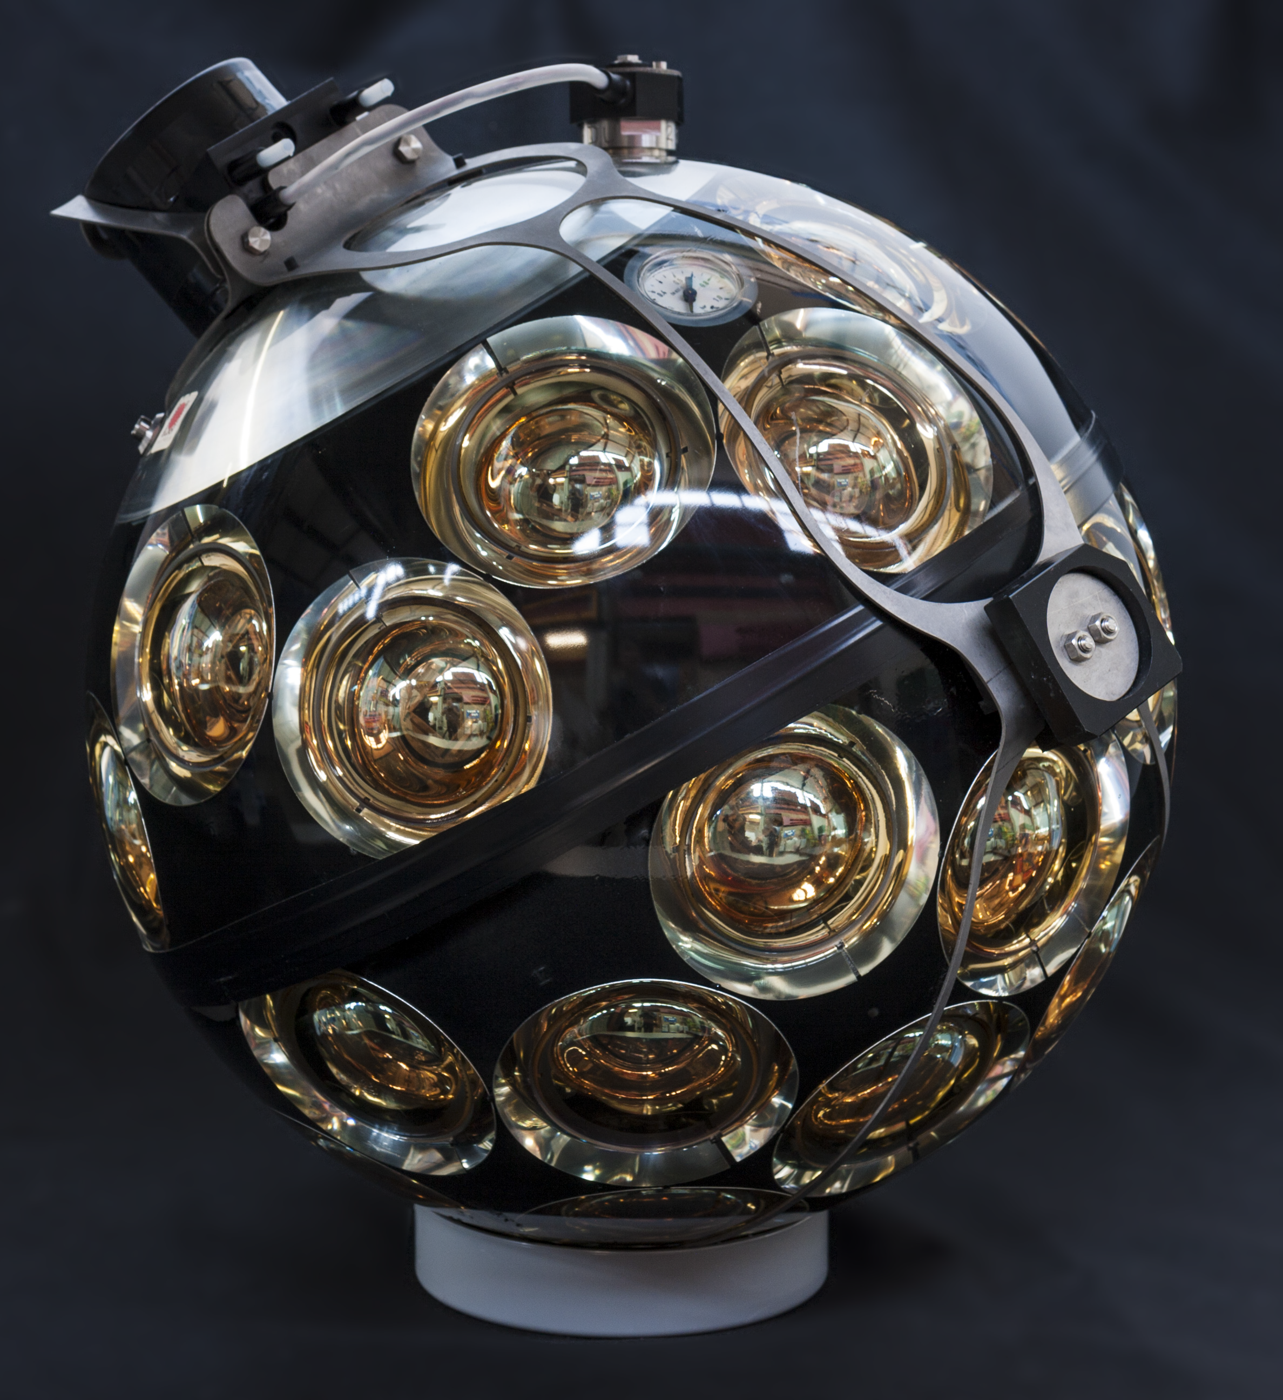
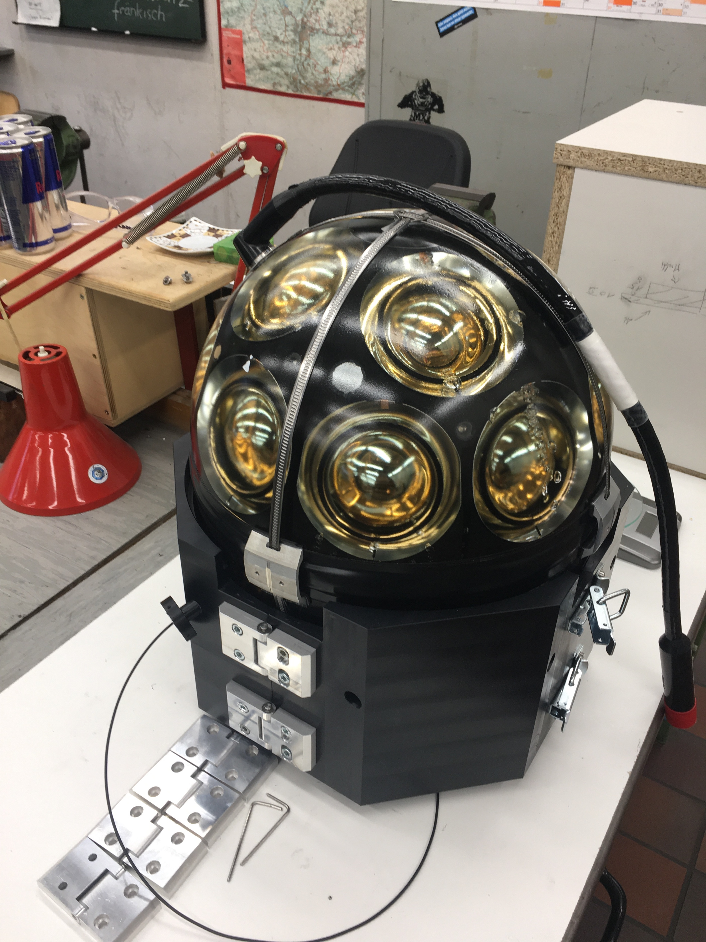
Hardware for optical neutrino telescopes
The multi-PMT concept from ECAP for KM3NeT and IceCube
The multi-PMT concept has a strong heritage in Erlangen for KM3NeT; adapted for IceCube
Erlangen is one of eight KM3NeT DOM integration sites , being fully responsible for the delivery
For IceCube:
  Characterization and calibration measurements of Photomultiplier tubes + electronics used in the mDOM,
  Development of a test bench for linearity and timing measurements of PMTs in integrated mDOMs as part of final acceptance tests

Slide 11
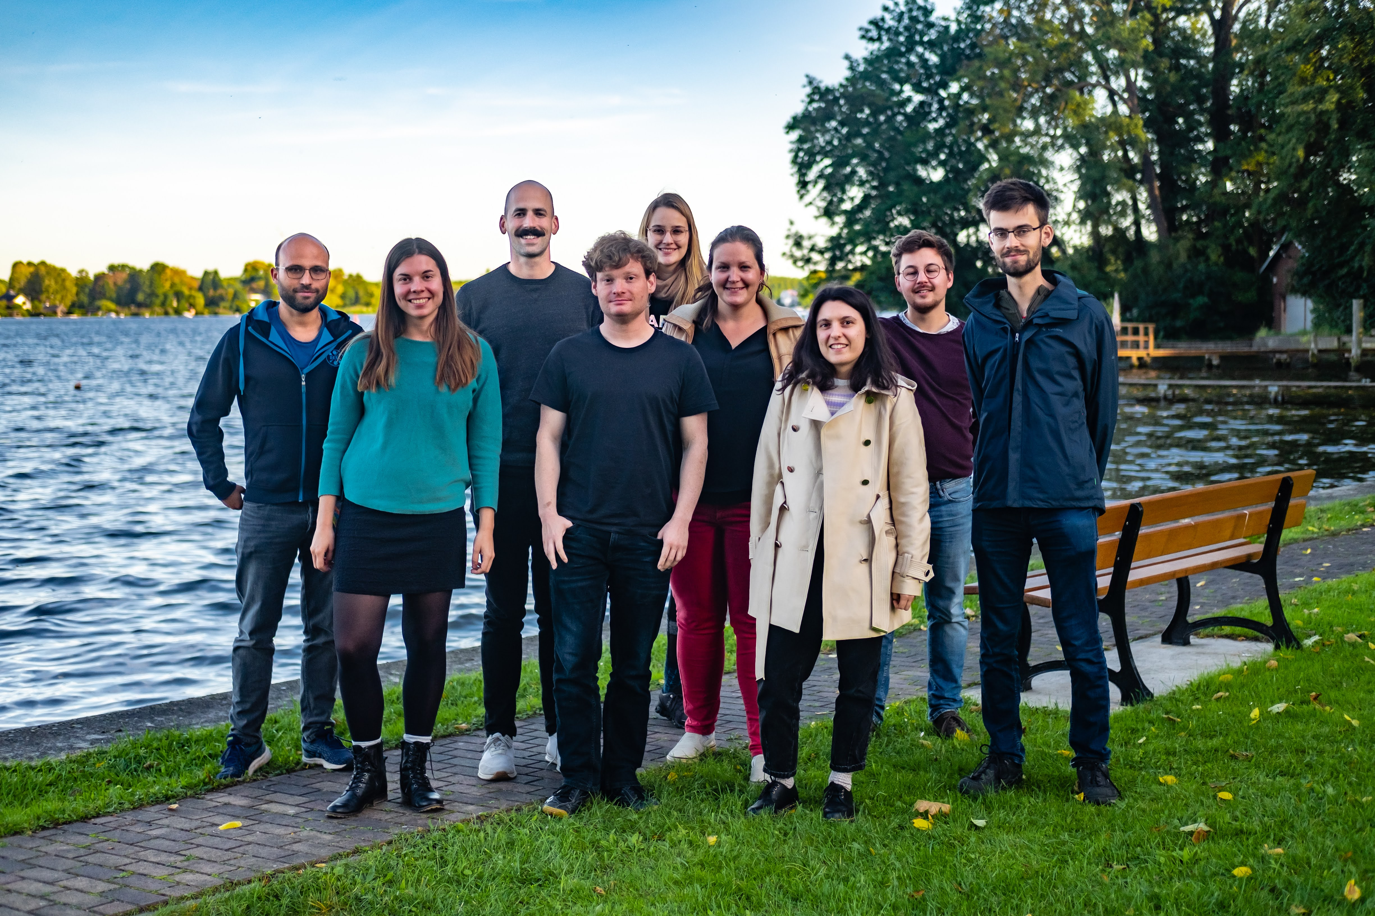
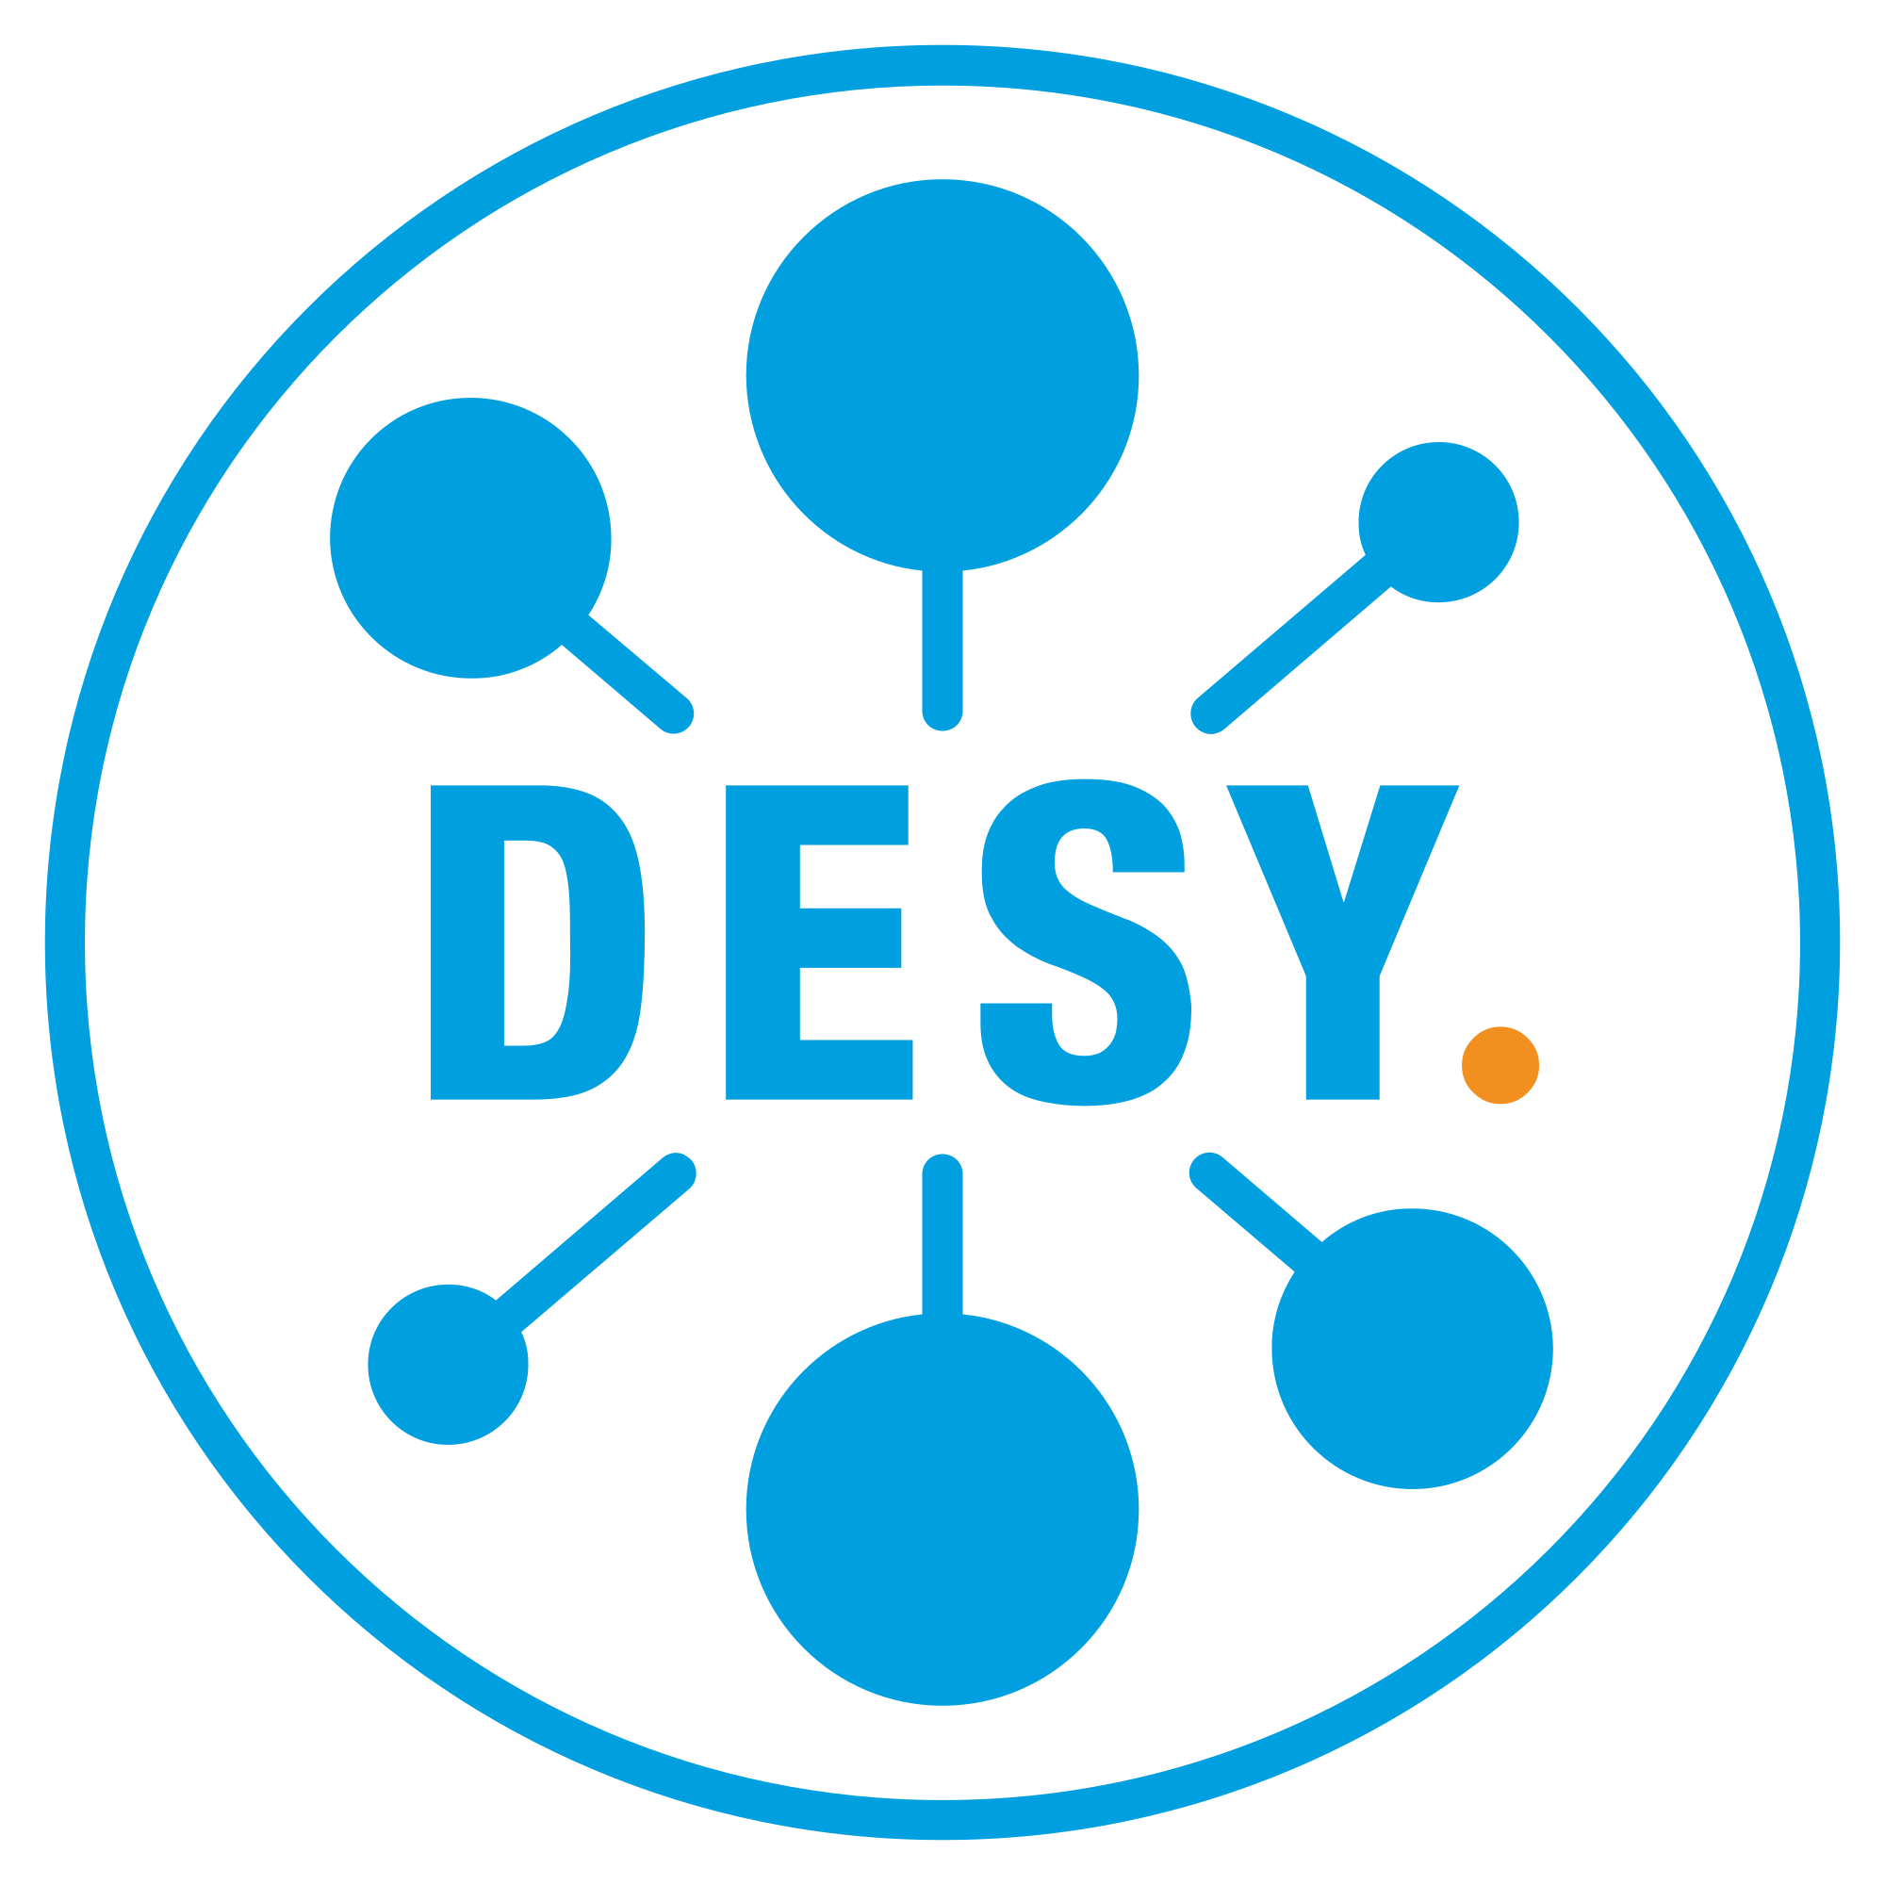
Radio detection
Of Neutrinos, Cosmic Rays and other (local) phenomena
  Building, testing and calibrating instrumentation for radio detectors
  Software for particle simulations and reconstruction frameworks
Neutrinos above PeV energies
Yet to be discovered messengers from the distant Universe
  Radio Neutrino Observatory Greenland (RNO-G), under construction
  IceCube-Gen2, planned
Cosmic-rays at the transition region
Galactic -> Extra-galactic, 10¹⁶ – 10¹⁸ eV
  Cosmic ray measurements with LOFAR -> Square Kilometre Array
Lightning observations
  Use LOFAR as lightning interferometer
  (e.g. Hare et al. (AN) Nature 568, pages 360–363 (2019), Phys. Rev. Lett. 124, 105101 (2020)
Anna Nelles sends apologies, currently (with most of her group) on-route to Chicago to discuss and test instrumentation for RNO-G
Joint group with

Slide 12
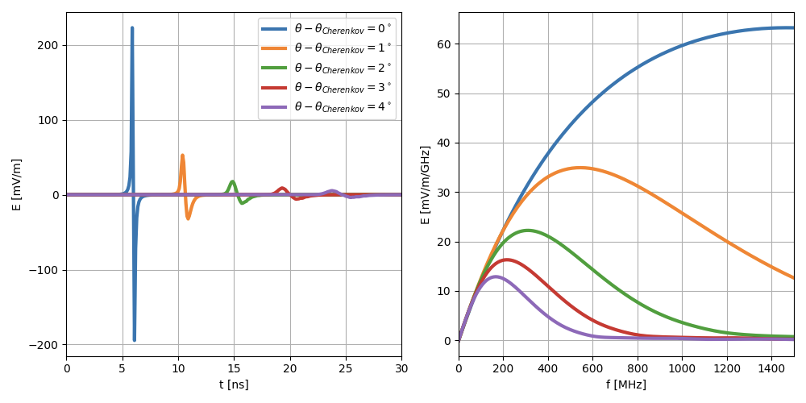
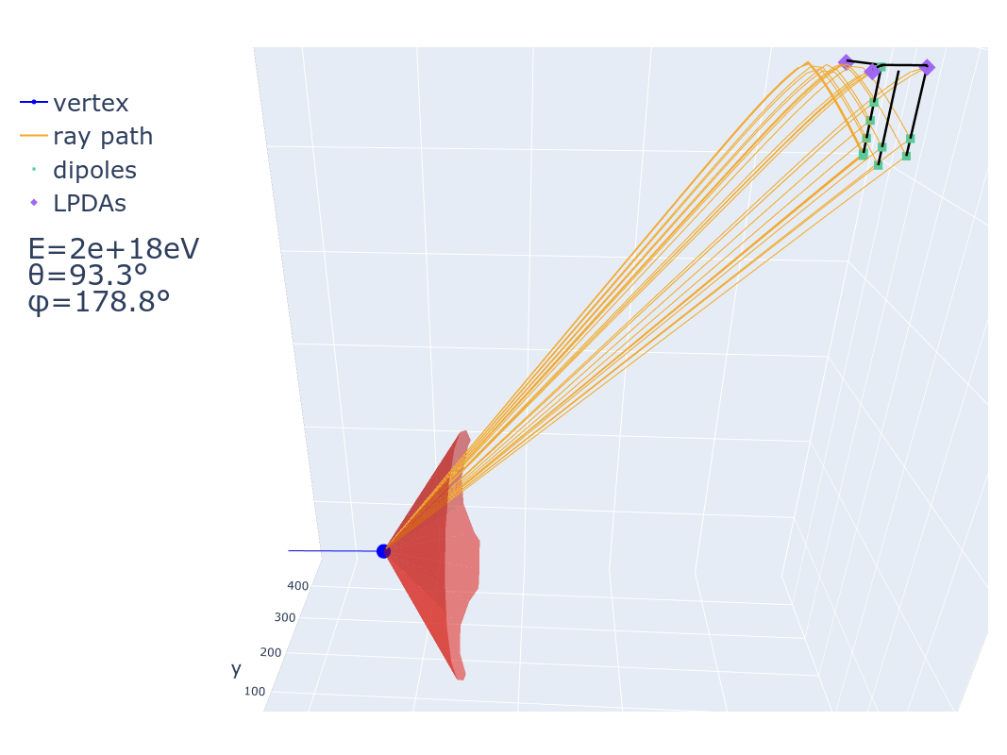
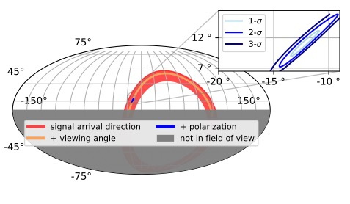
Radio detection of neutrinos
Not standard technology (yet) - How does this work?
Neutrino interacts in ice, creates particle shower
Particle shower accumulates negative charge from ice, negative charge creates Coherent radio emission (Askaryan effect)
Detectable for energies above 10 PeV
Compact radio station is used to determine neutrino energy and arrival direction

Slide 13

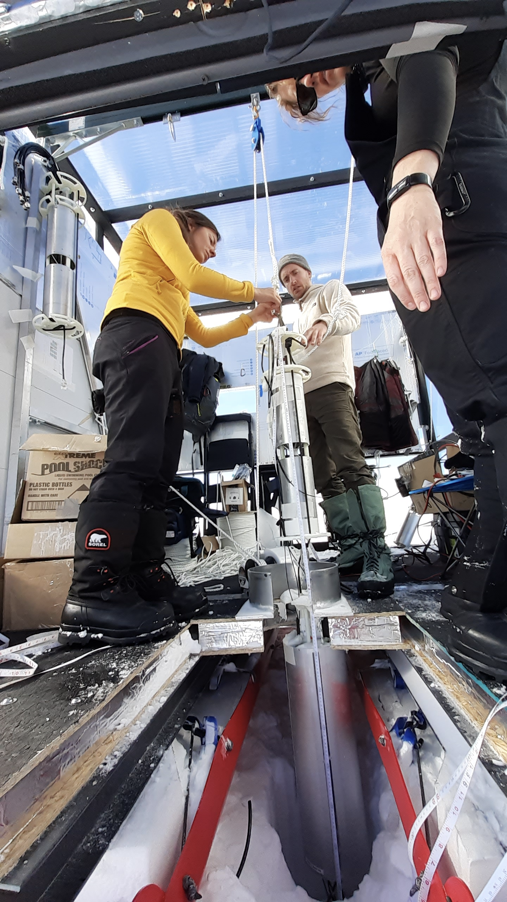
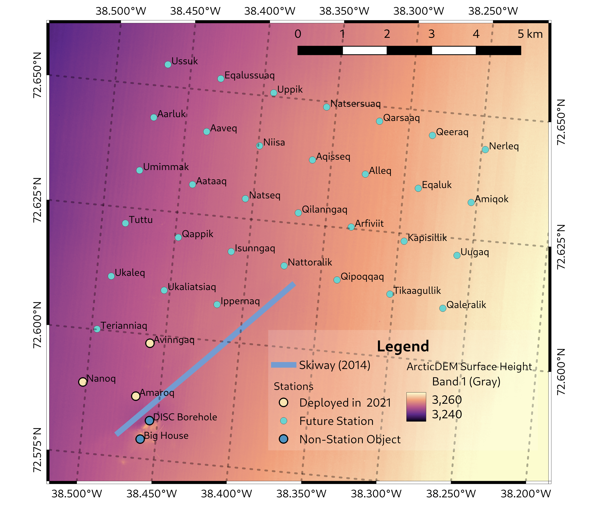
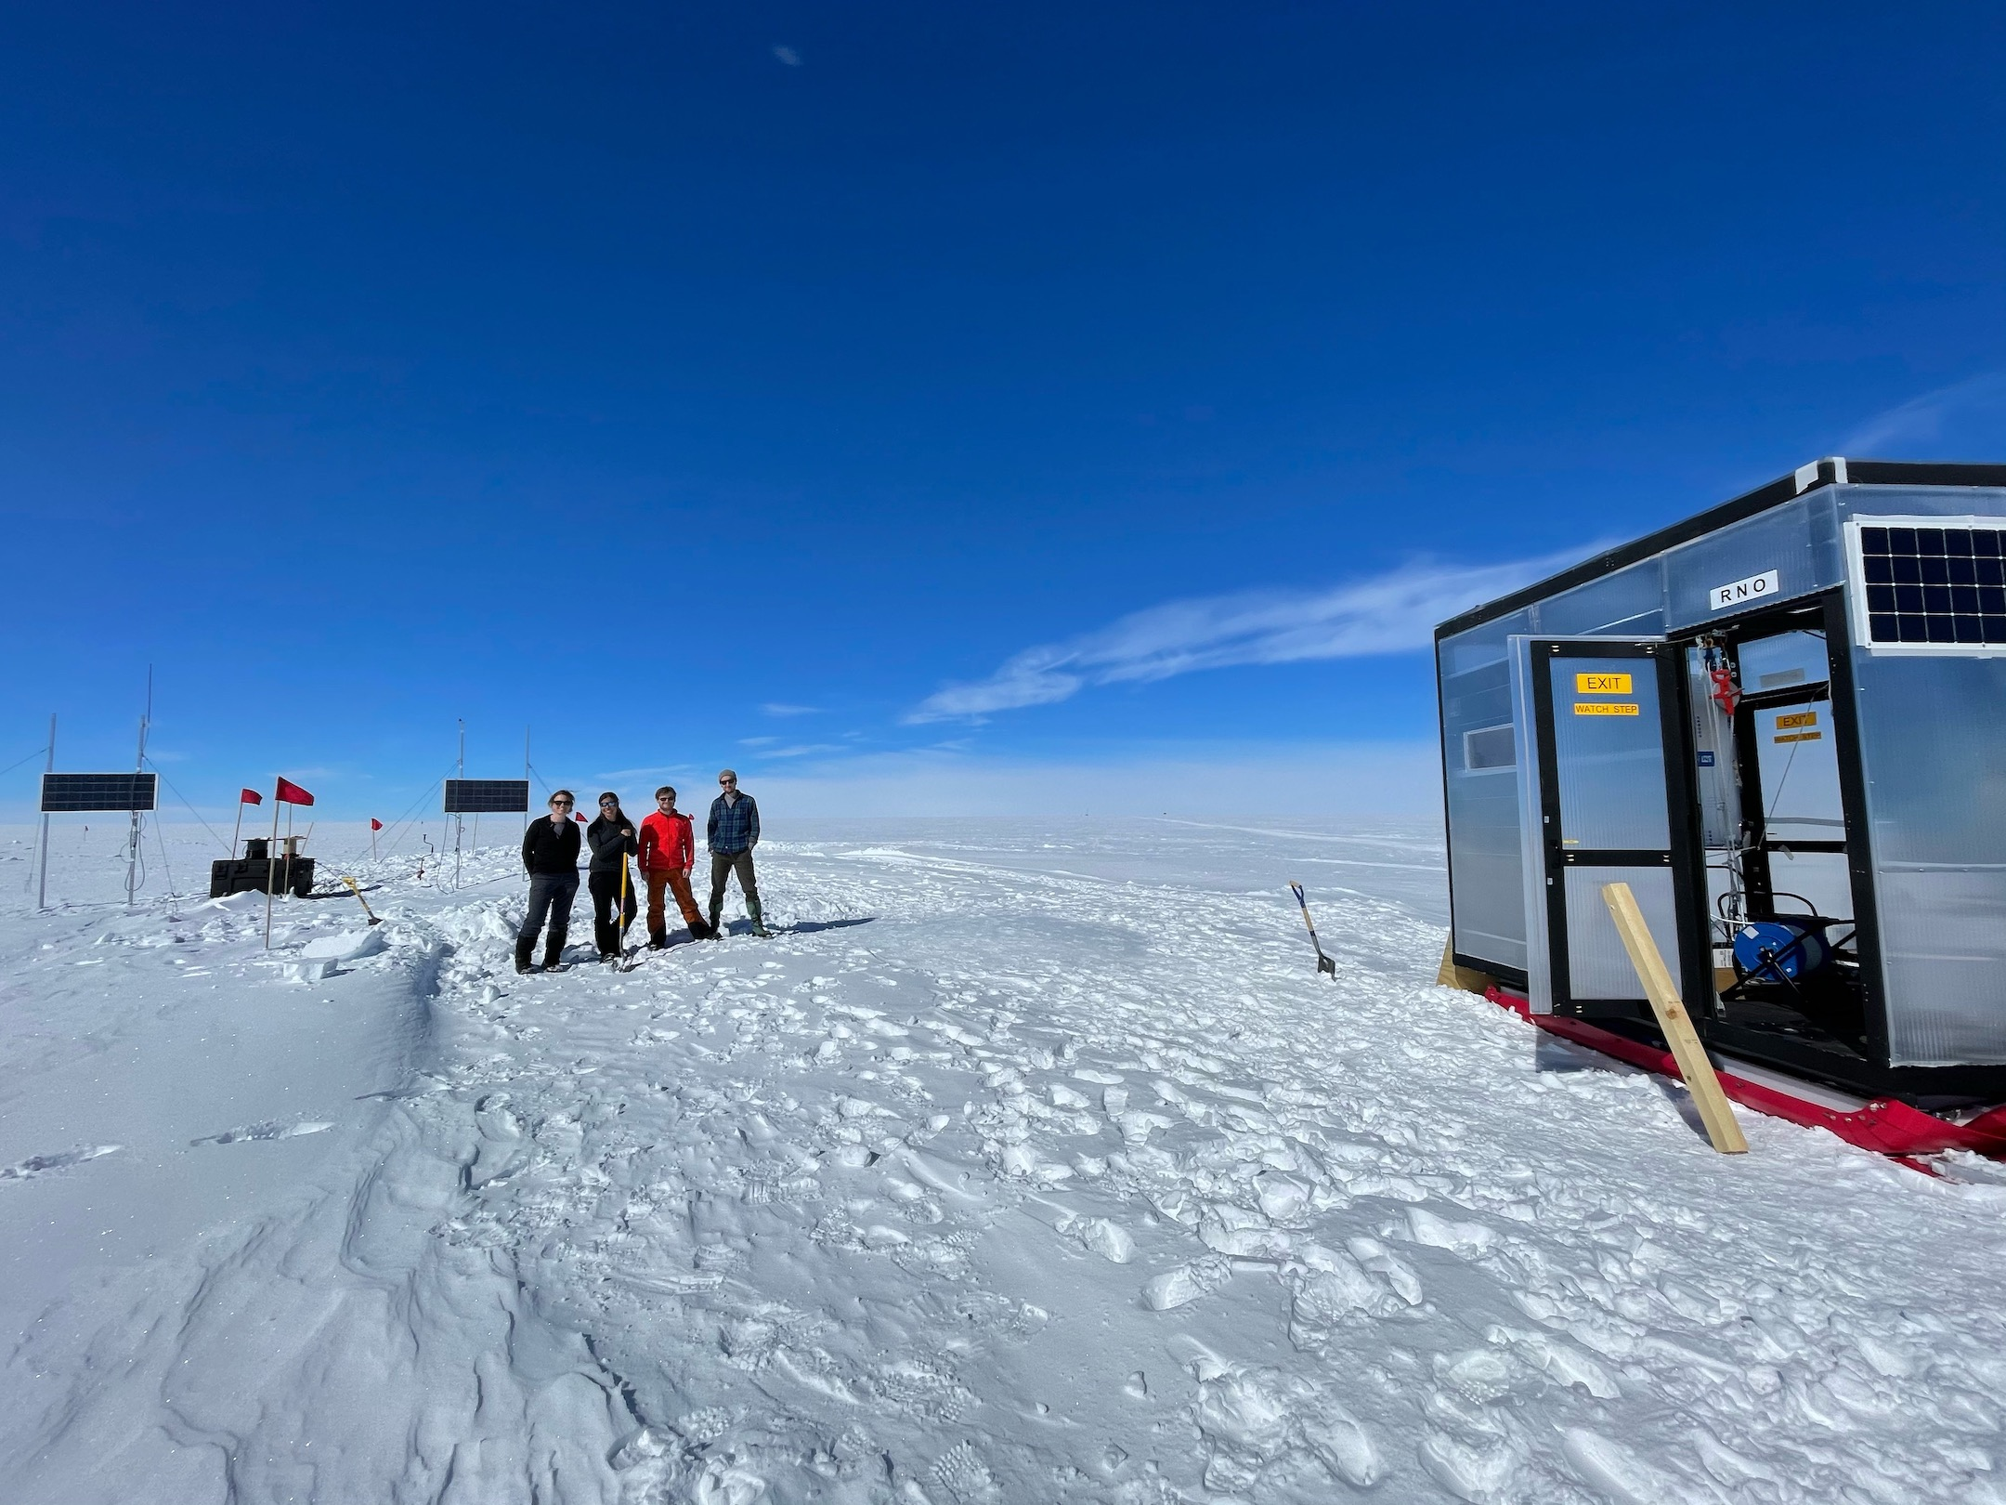
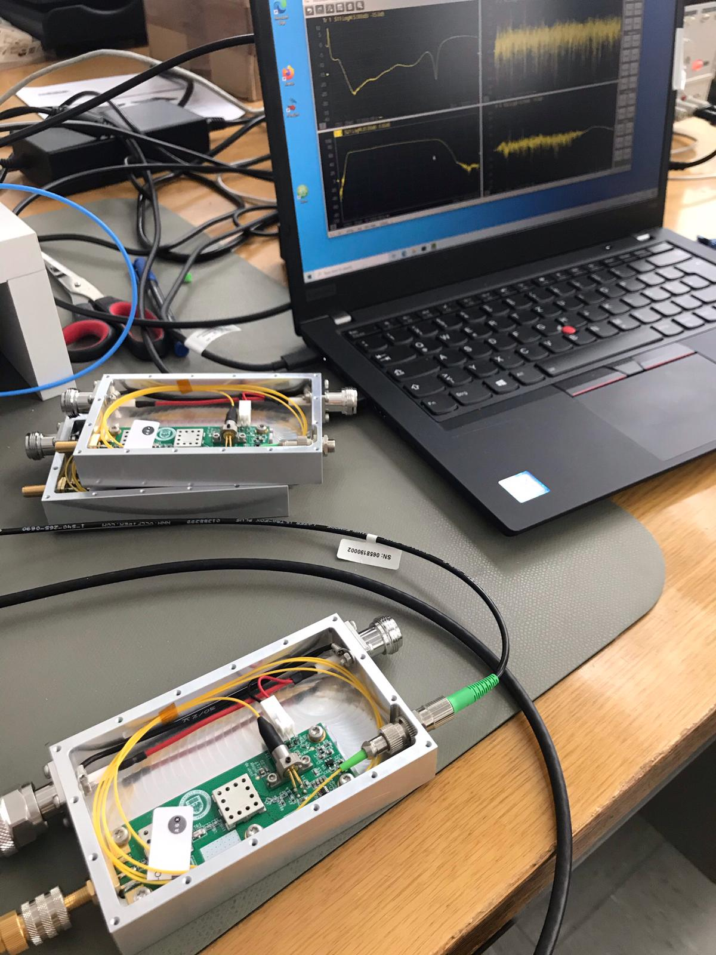
Radio Neutrino Observatory (RNO-G)
What is done at ECAP?
Radio Neutrino Observatory (RNO-G) currently under construction
Workshop provided all amplifier and RF-over-fibre signal units
Two graduate students participated in deployment effort, Master and Bachelor Projects in defining deployment tools
Completion anticipated for 2025

Slide 14
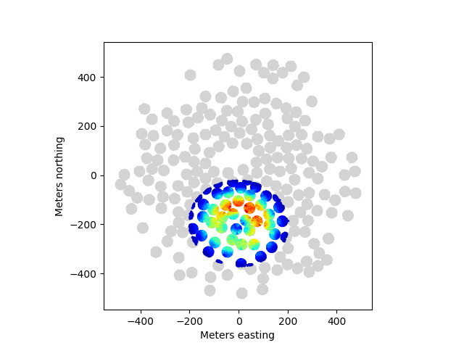
Other radio projects
A little fun on the side
World's most detailed image of a lightning strike with LOFAR
Air shower LOFAR
(simulation)
Distributed radio telescopes such as LOFAR and (in the future) SKA allow for interferometric imaging of air showers and lightning strikes
For air showers: Use these interferometric images to resolve (unknown) details of shower development, improve composition measurement and learn about particle physics
For lightning: Every new recorded lightning reveals more about unknown territory.
Currently neither lightning initiation, nor lightning propagation, nor lightning discharge is (fully) understood.
Air shower SKA
(simulation)
Hare et al. (AN) Nature 568, 360–363 (2019)

Slide 15
Future Projects

Slide 16
IceCube-Gen2
The Window to the Extreme Universe – the next step in neutrino astronomy
Project is currently taking shape; TDR in progress
US-lead, German contribution O(40 MEUR) proposed for consortium of German universities (+DESY, KIT)
IceCube-Gen2 will combine optical and radio technology to an instrument that covers the full energy range from 100 TeV to 100 EeV with unprecedented sensitivity
Whitepaper, J.Phys.G 48 (2021) 6, 060501

Slide 17
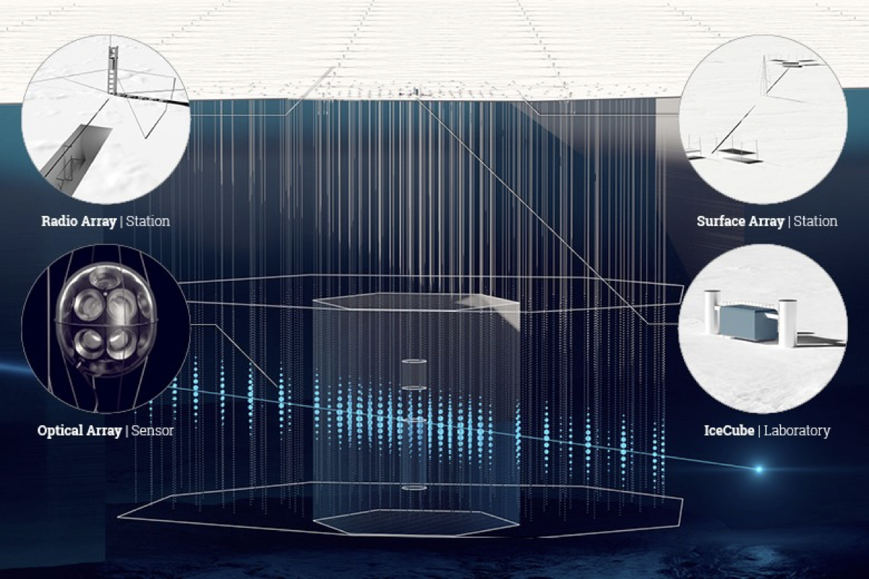
IceCube-Gen2
The Window to the Extreme Universe – the next step in neutrino astronomy

