Slide 1
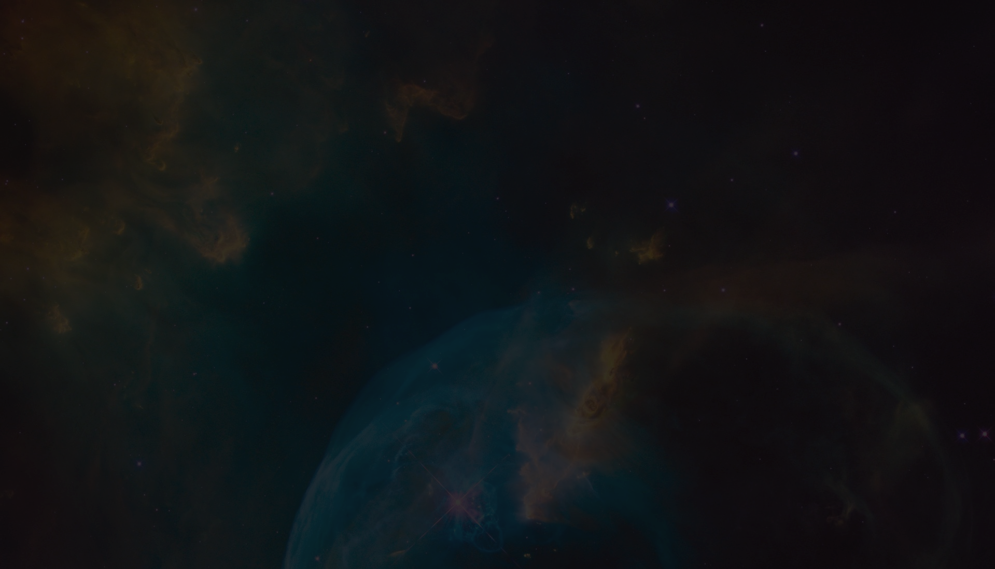


Transitioning Between Theory and Observations of Strongly Magnetized Accreting Neutron Stars
Nur Schettino
Supervisor: Dr. Ekaterina Sokolova-Lapa
Friedrich-Alexander University Erlangen-Nuremberg Karl-Remeis Sternwarte
Image credit: NASA, ESA, Hubble Heritage team

Slide 2
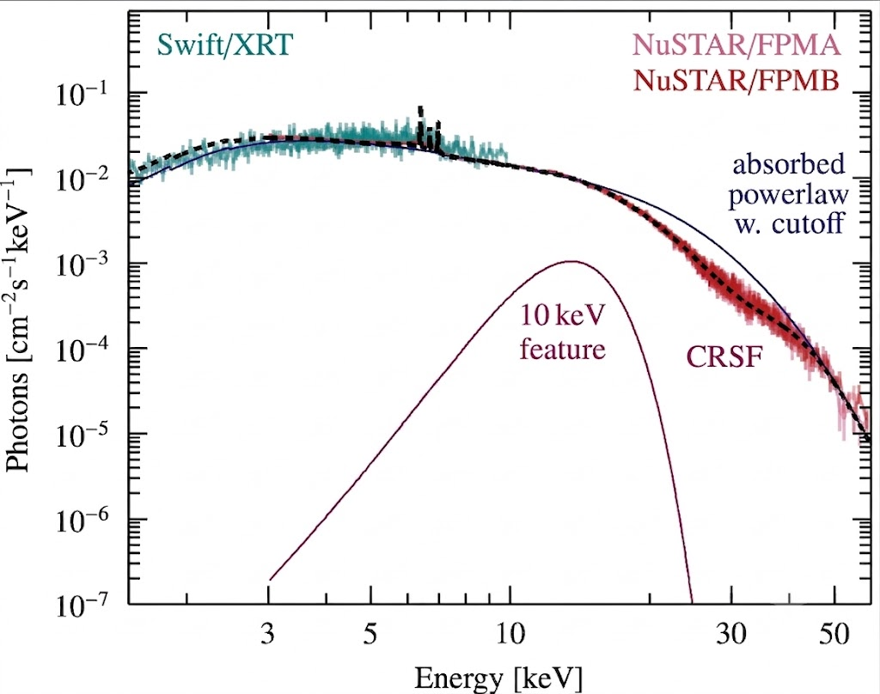
Where to bridge the gap?
Is this spectral feature real?
Is it artifactual?
Sample spectrum (Cen X-3):
  10 keV feature: mysterious
  CRSF: cyclotron resonant
  scattering feature
  Continuum: powerlaw + cutoff
So what was my project?
Modified after Pottschmidt et al., submitted; spectrum generated by Aafia Zainab
Image credit: NASA, ESA, Hubble Heritage team

Slide 3
What I Thought I Signed Up For
Blinded spectral analysis of nine sources
Data taken with NuSTAR
(X-ray telescope, 3-79 keV)
Unbiased spectral characterization
Experience working with point sources; zero with XRPs
What I Actually Signed Up For
Five of nine sources synthetic
Generated with a slab physical model (homogeneous atmosphere, vacuum + plasma, angle integrated)
Known input parameters vs. phenomenological fit parameters
Physical parameter recoverability through fit?
Image credit: NASA, ESA, Hubble Heritage team

Slide 4
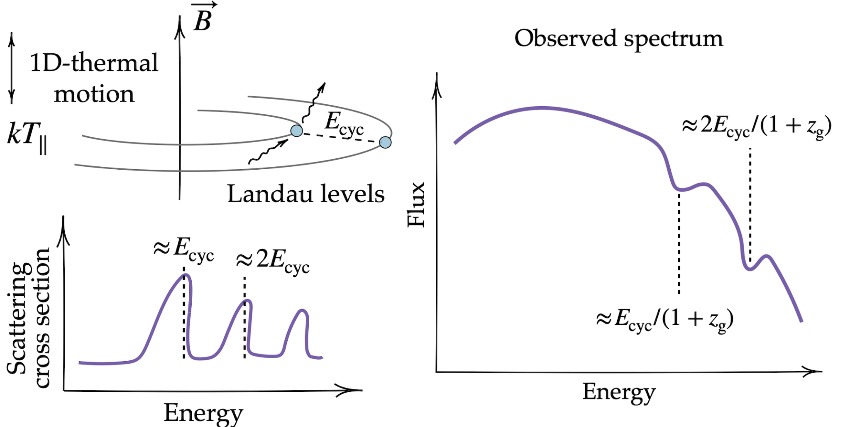

Cyclotron Lines
Resonant scattering features
Quantized energy levels
A direct proxy for B:
(Staubert et al. 2019)
Figure 6 from Ludlam et al. (2023); modified.
Image credit: NASA, ESA, Hubble Heritage team

Slide 5
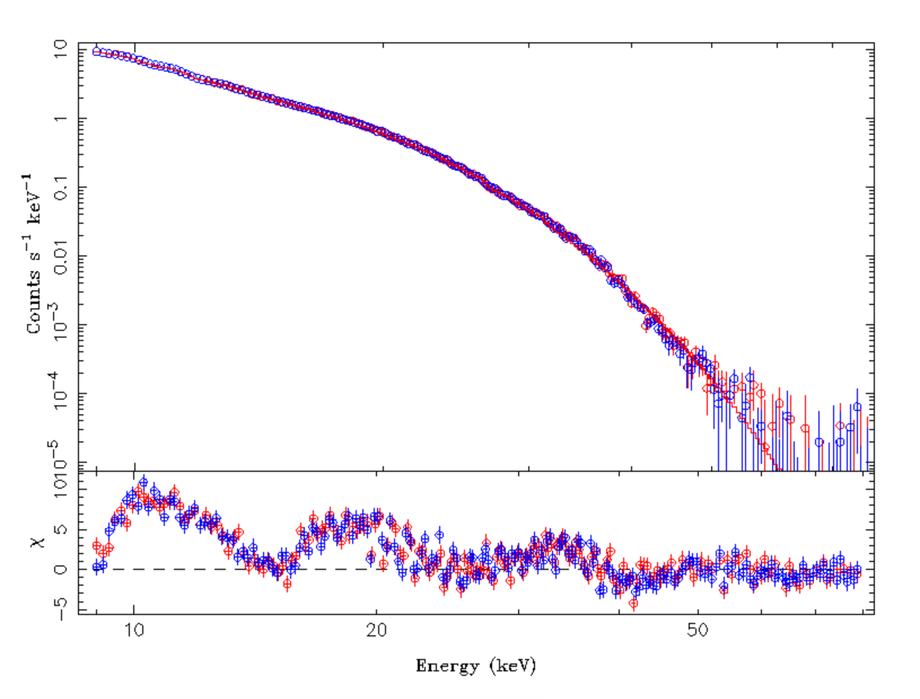
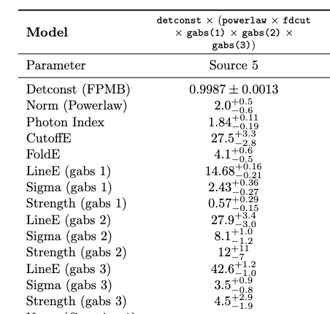
Results: First Synth Spectrum (Source 5)
Image credit: NASA, ESA, Hubble Heritage team

Slide 6
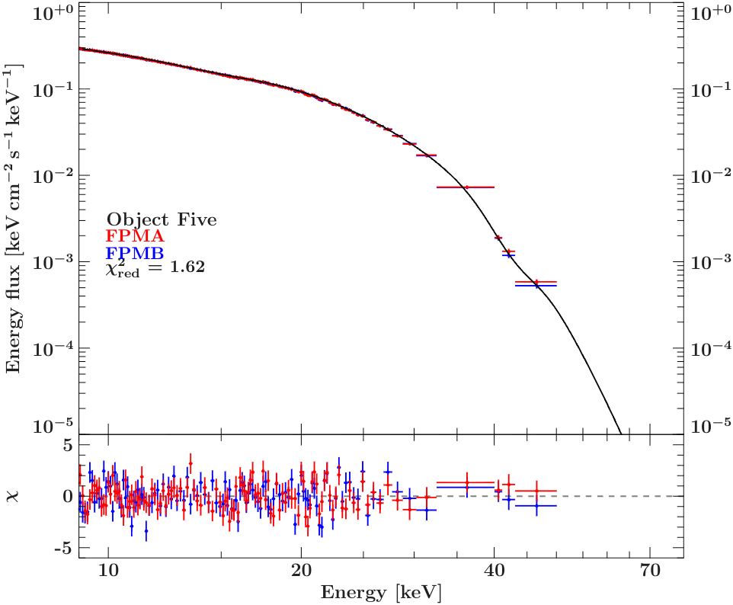
Results: First Synth Spectrum (Source 5)
Image credit: NASA, ESA, Hubble Heritage team

Slide 7
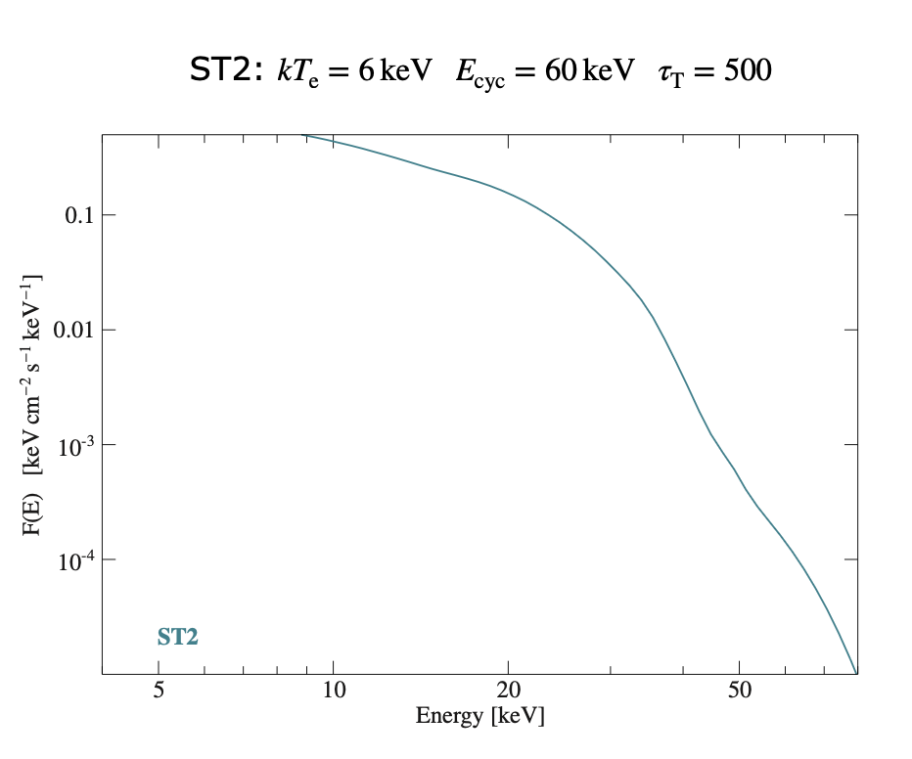
Results: First Synth Spectrum (Source 5)
The input model parameters are electron temp, cyclotron line energy, and optical depth
Image credit: NASA, ESA, Hubble Heritage team

Slide 8
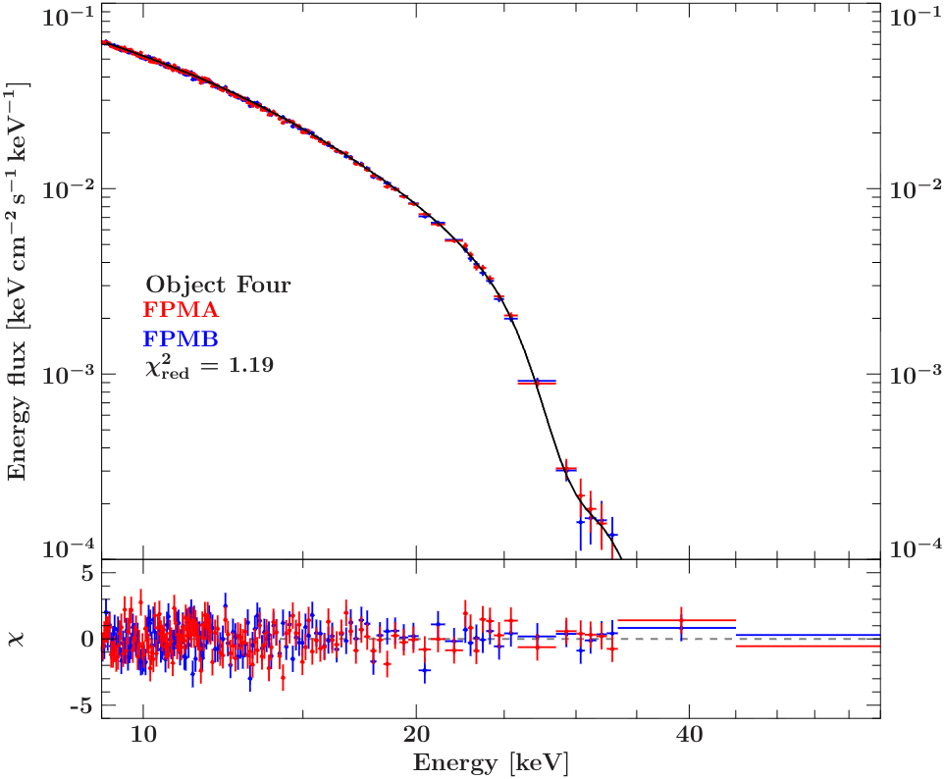
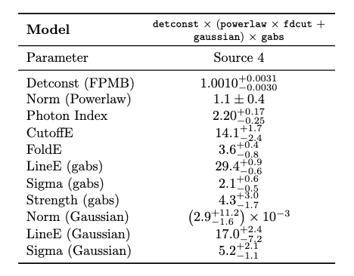

Results: Second Synth Spectrum (Source 6)
The input model parameters: electron temperature, cyclotron line energy, and optical depth
Image credit: NASA, ESA, Hubble Heritage team

Slide 9
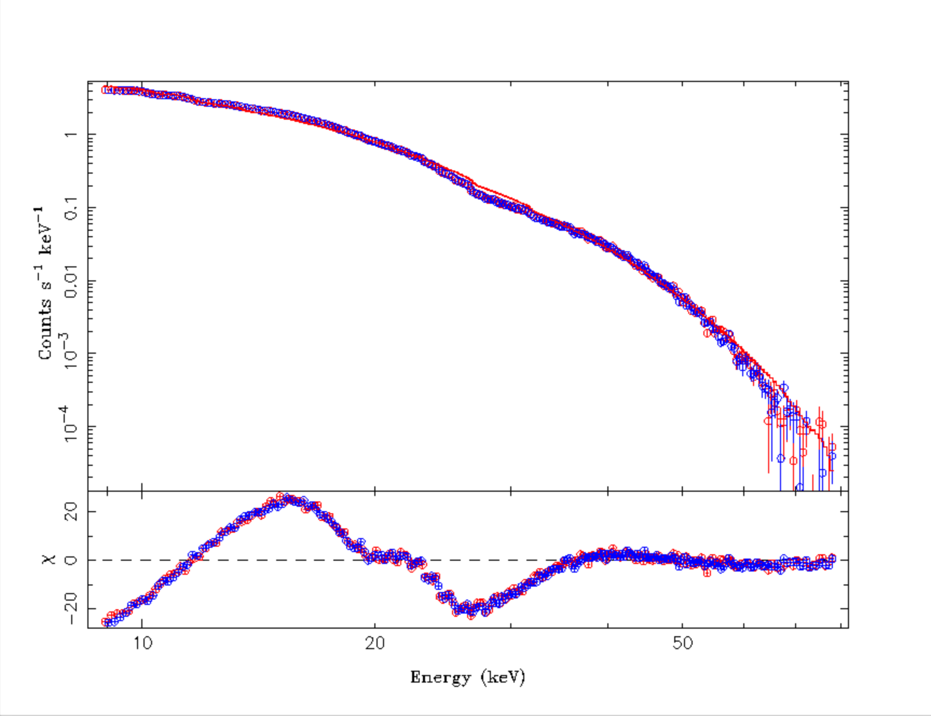
Results: Second Synth Spectrum (Source 6)
The input model parameters: electron temperature, cyclotron line energy, and optical depth
Image credit: NASA, ESA, Hubble Heritage team

Slide 10
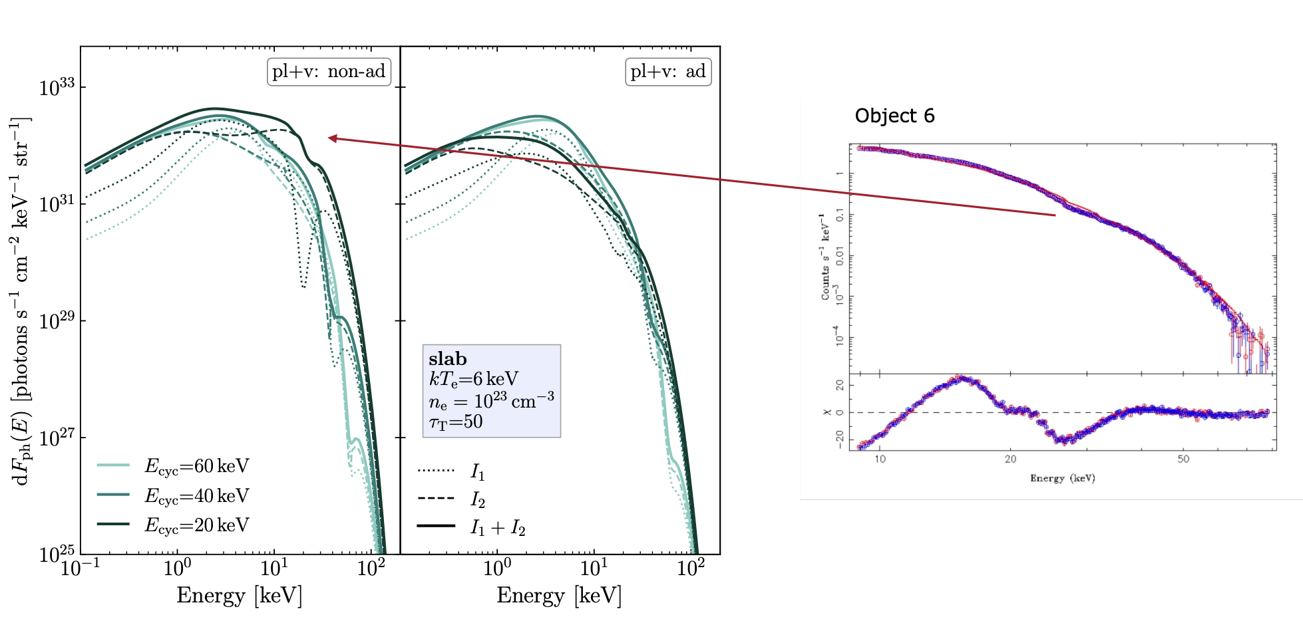
Results: Second Synth Spectrum (Source 6)
Source: Dr. Ekaterina Sokolova-Lapa
Image credit: NASA, ESA, Hubble Heritage team

Slide 11
Conclusions
Is this spectral feature real? Is it artifactual?
Fitting often required artifactual features
Phenomenological fitting alone is insufficient
Physical models are vital to understanding the physics of spectra
Image credit: NASA, ESA, Hubble Heritage team

Slide 12
Thank you!
Image credit: NASA, ESA, Hubble Heritage team

Slide 13
Bibliography
Ludlam, R. M., et al. 2023, Front. Astron. Space Sci., 10, 1292500
Staubert, R., et al. 2019, A&A, 622, A61
Image credit: NASA, ESA, Hubble Heritage team

Slide 14

Electron temperature from fit
Doppler broadening equation
Deriving electron temperature kT from line width?
Fit parameters (gabs sigma) yields kT_e up to 3 times too high
Image credit: NASA, ESA, Hubble Heritage team

Slide 15
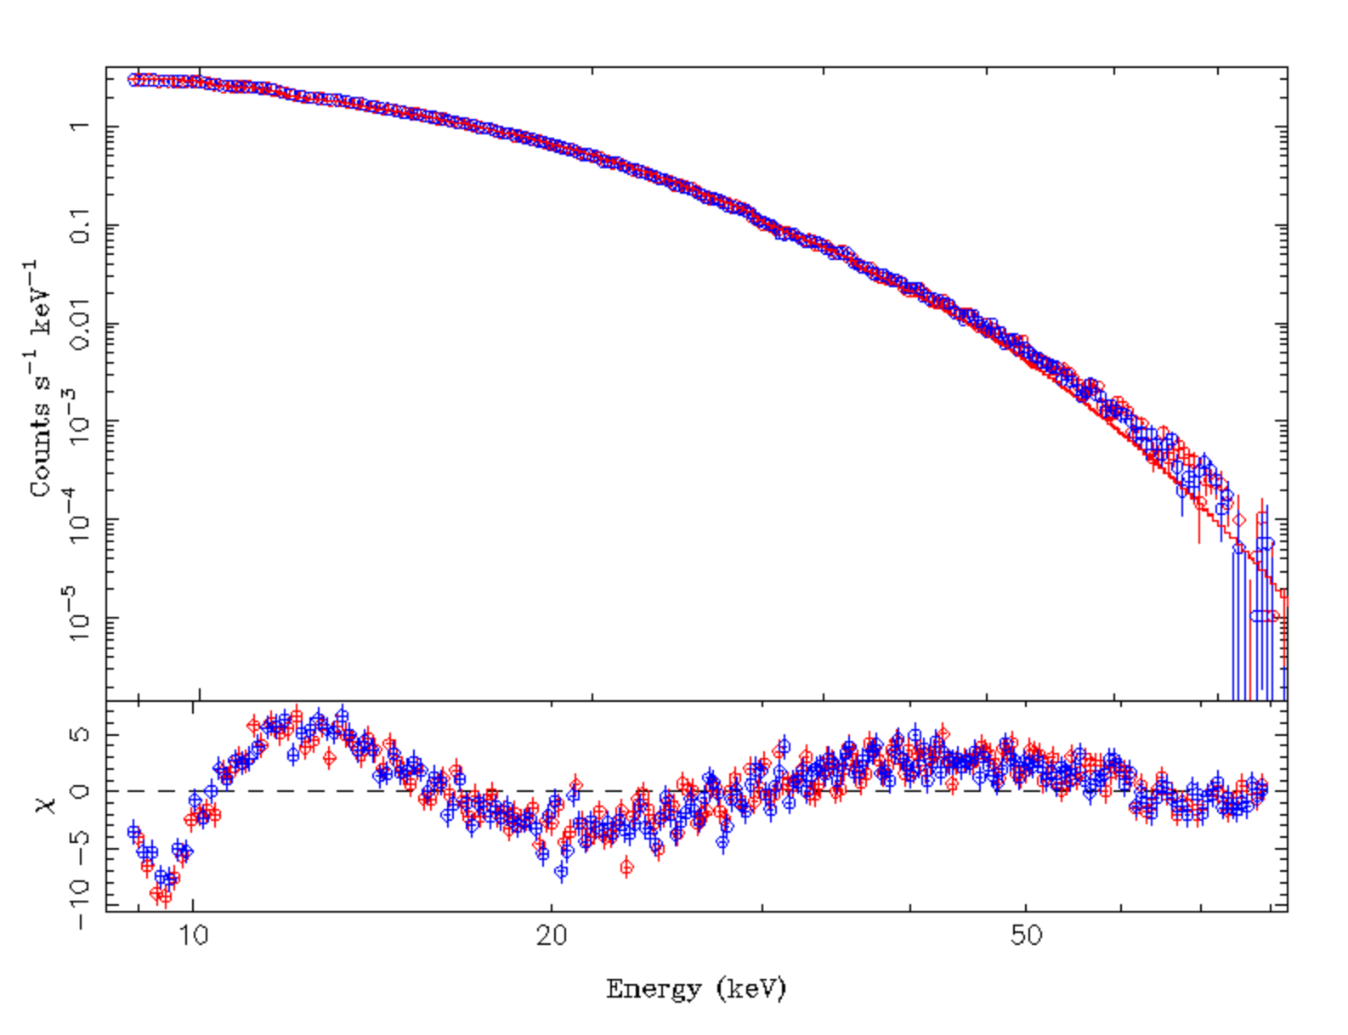
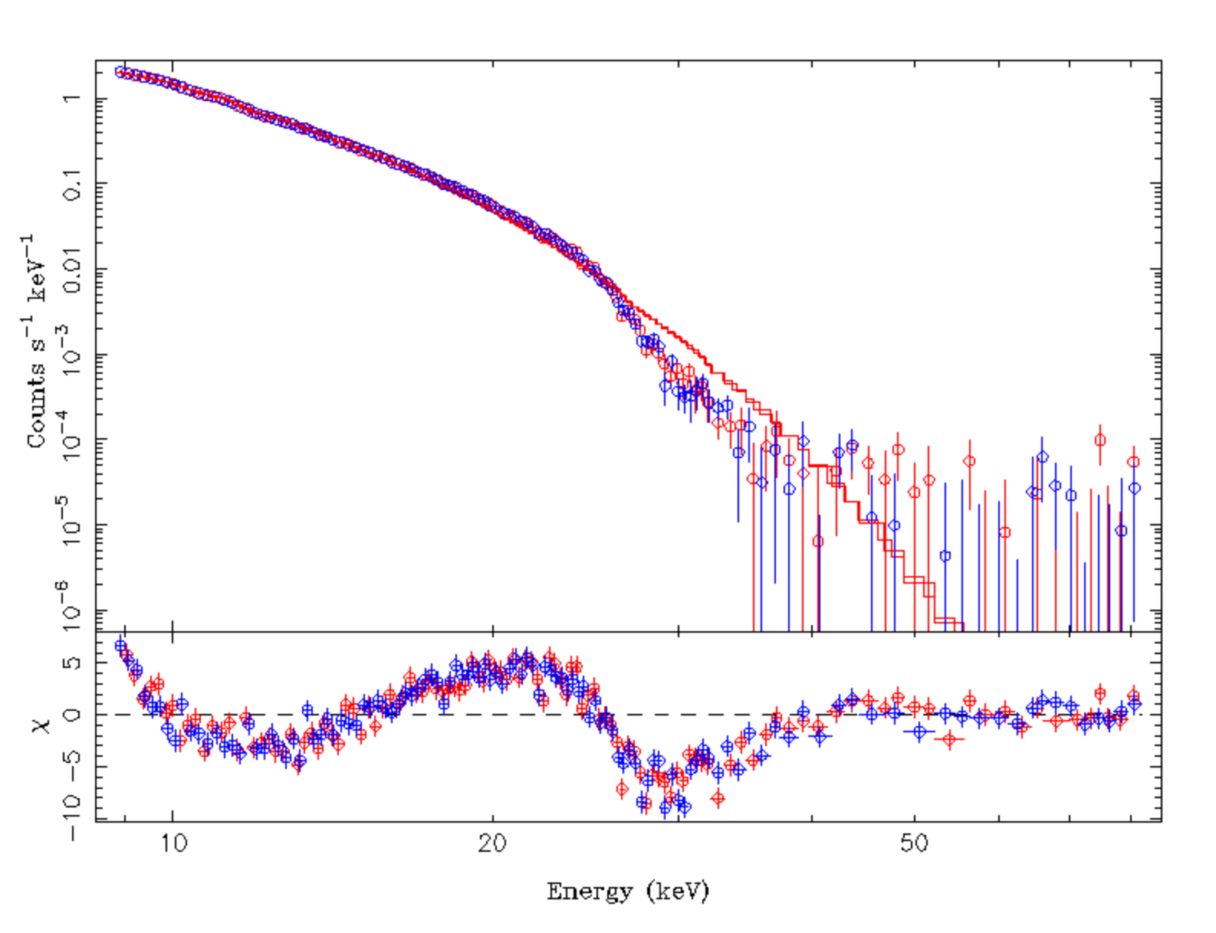
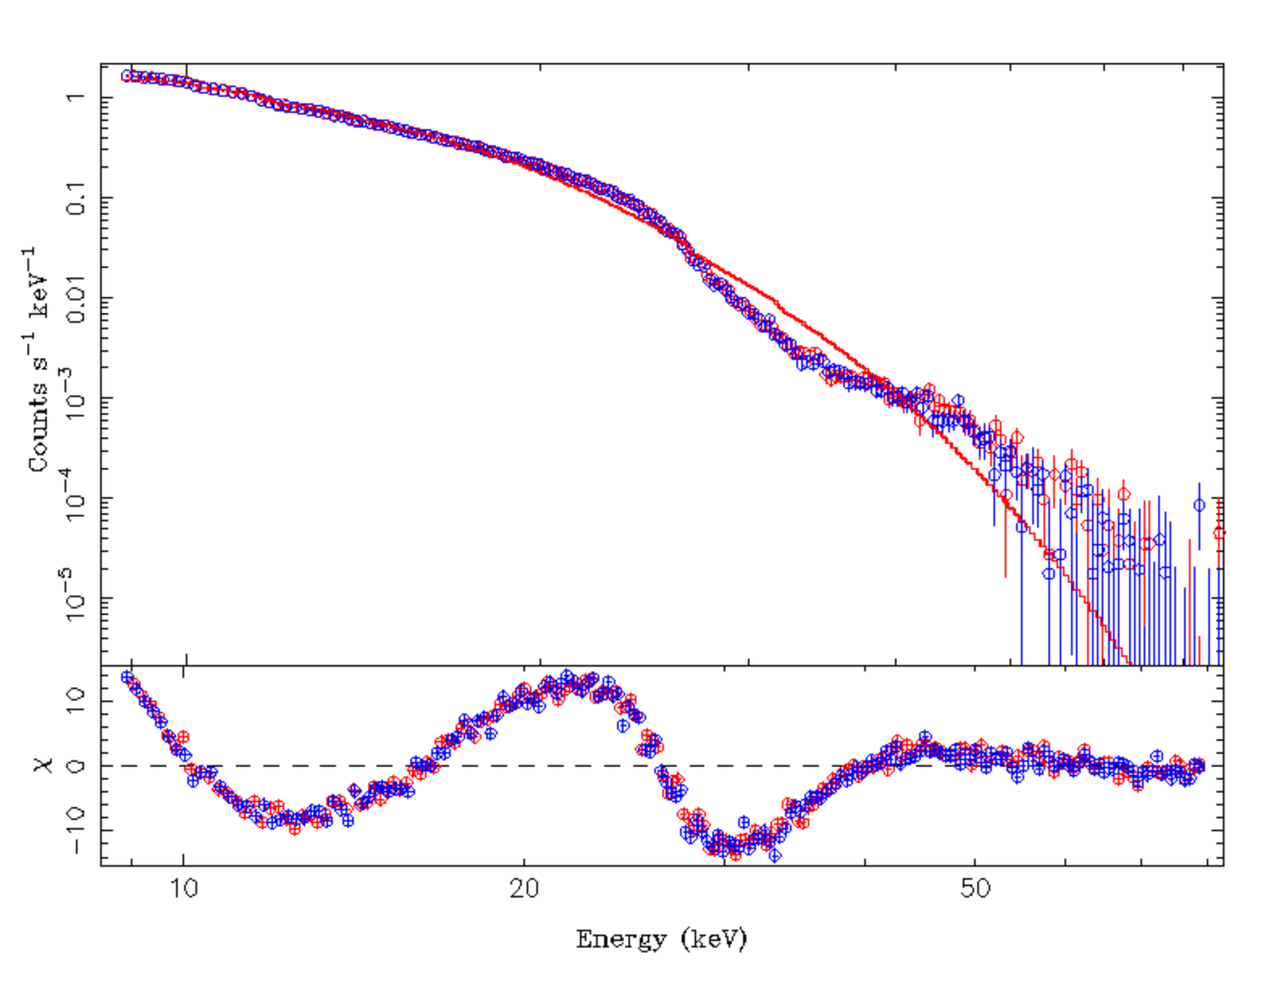
Red wing confusion: more examples
Source 8
Source 4
Source 9
All three spectra fit only with a simple cutoff powerlaw model: no gaussian emission or absorption.
Image credit: NASA, ESA, Hubble Heritage team

Slide 16
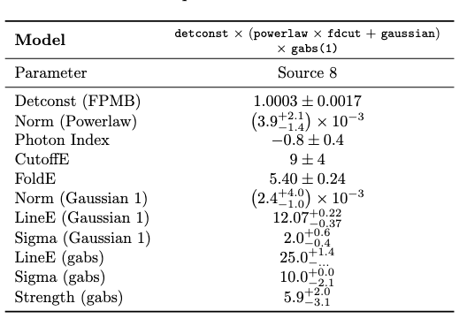
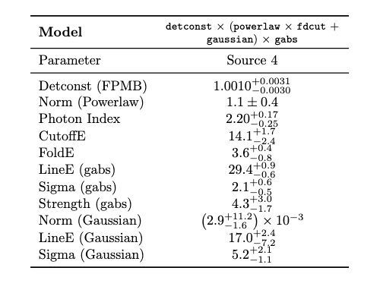
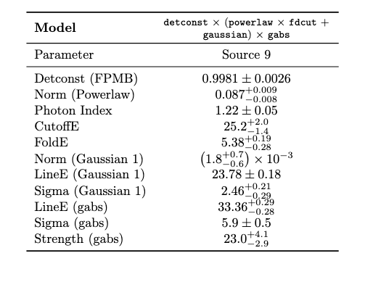
Red wing confusion: more examples
Source 8
Chi^2_red = 1.77
Source 4
Chi^2_red = 1.19
Source 9
Chi^2_red = 1.36
All three spectra fit only with a simple cutoff powerlaw model: no gaussian emission or absorption.
Image credit: NASA, ESA, Hubble Heritage team

Slide 17
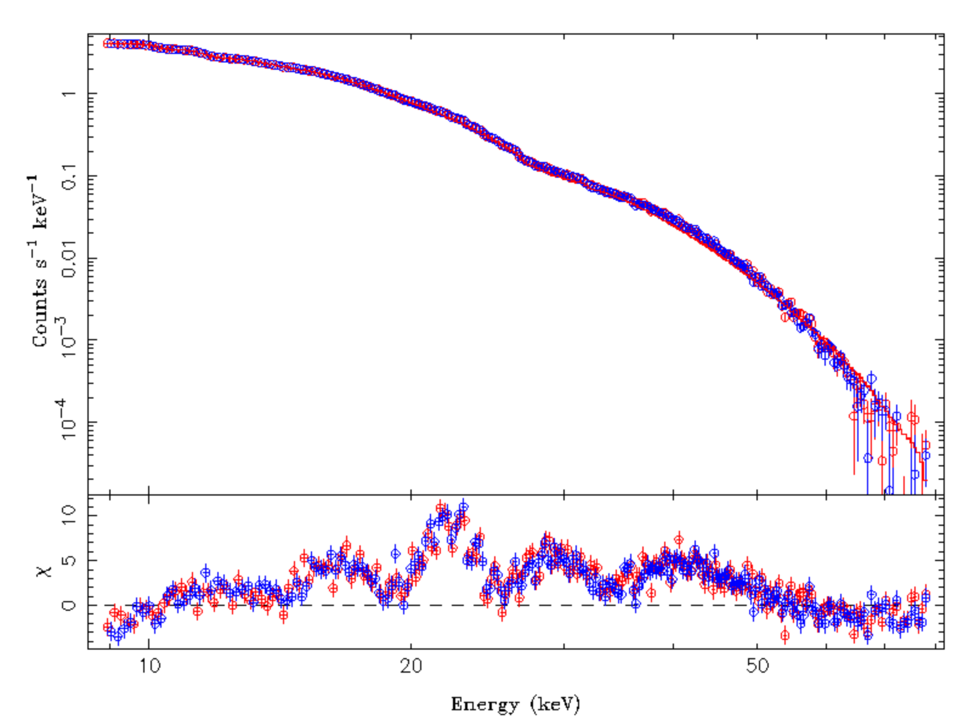
Source 6: Middle Finger Residuals
The above is a cutoff powerlaw + gaussian absorption
Image credit: NASA, ESA, Hubble Heritage team

Slide 18
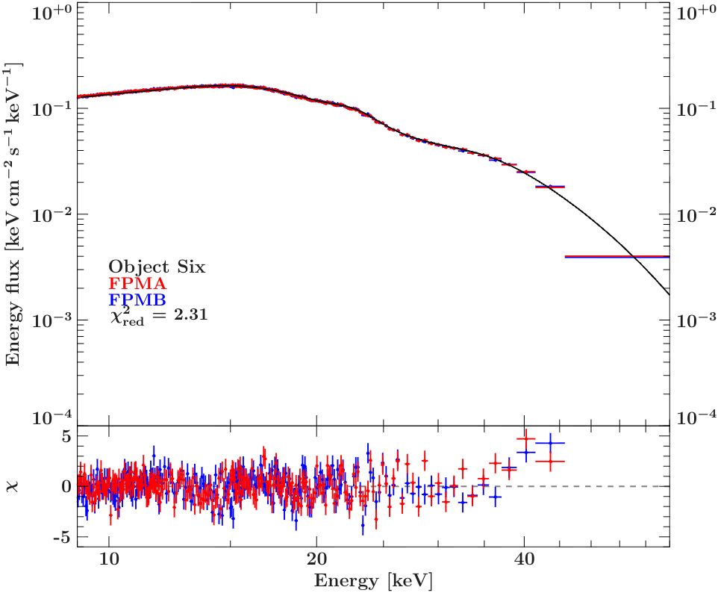
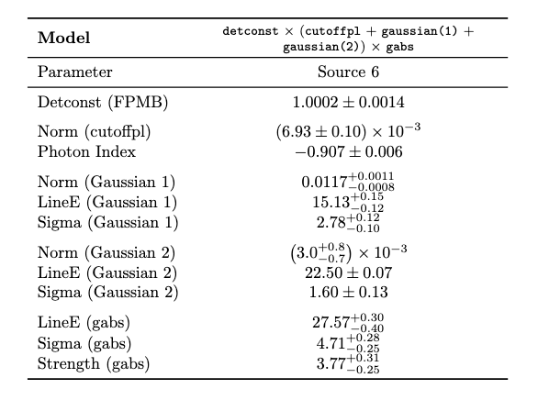
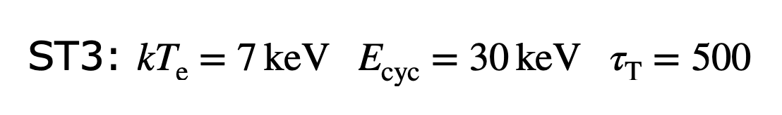
Source 6: Middle Finger Residuals
Final spectrum
Image credit: NASA, ESA, Hubble Heritage team

