Slide 1
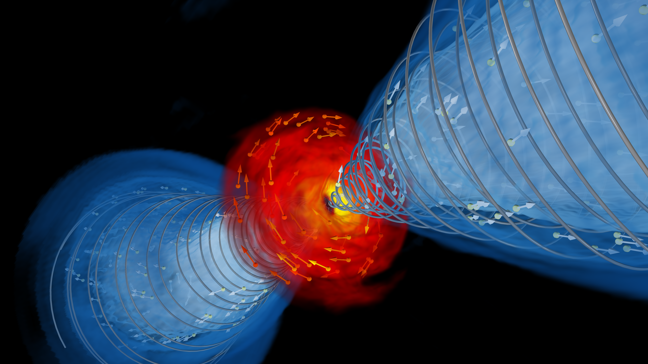

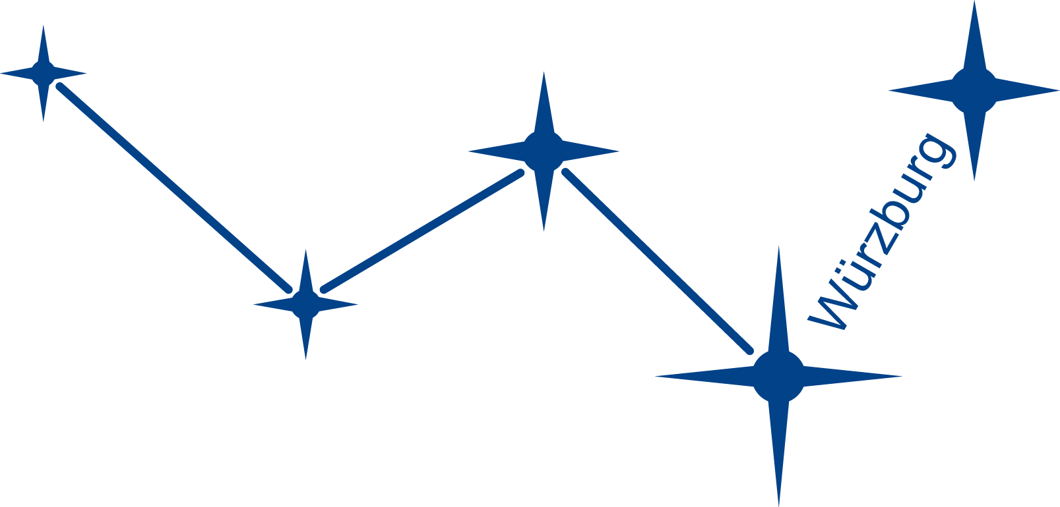

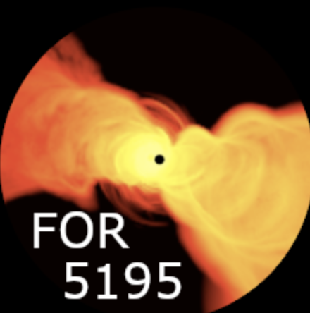
Probing the physics of jet launching and propagation through numerical simulations
Ainara Saiz-Pérez
Christian M. Fromm, Felix Glaser,
Raoul Kinadeter, Matthias Nägele

Slide 2
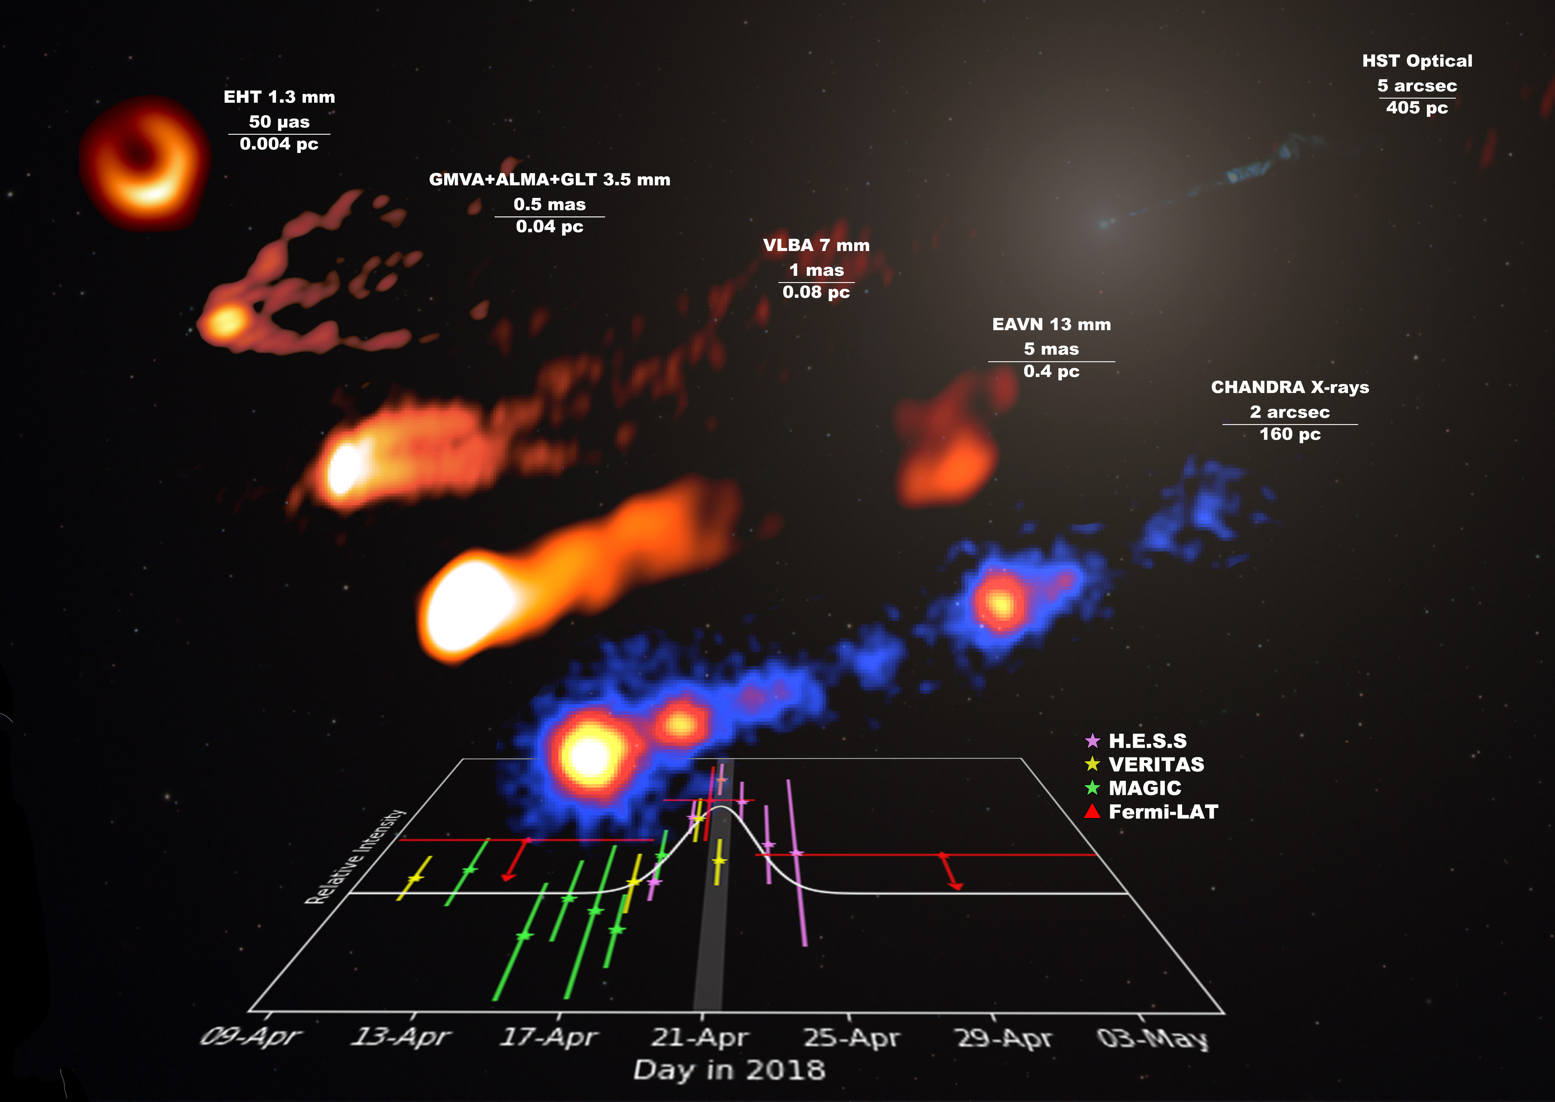
Motivation

Slide 3
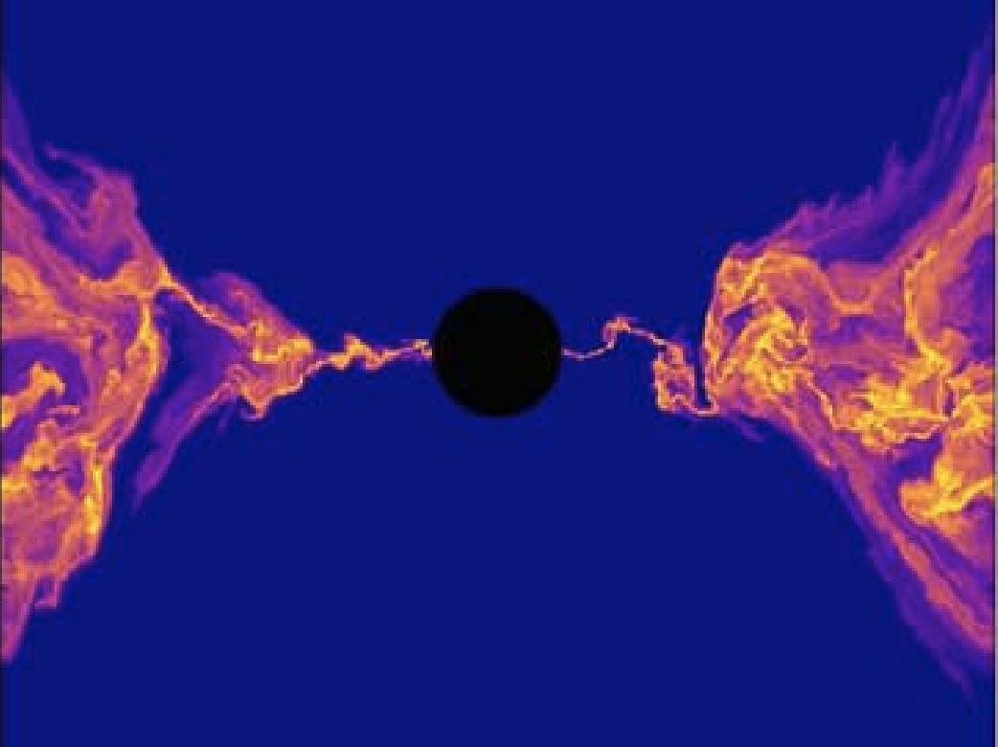
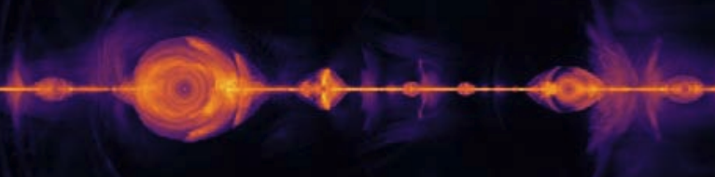
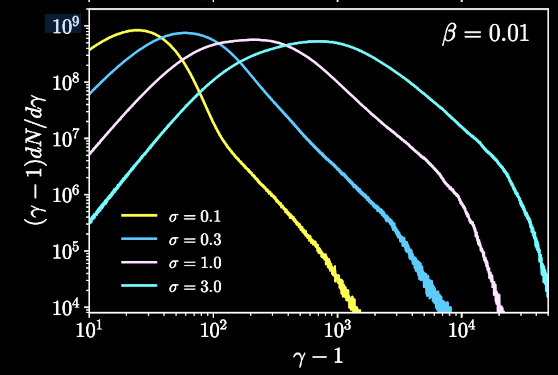
Theory: GRMHD + PIC simulations
Render: Christian M. Fromm
Images: Hakobyan et al. (2023), Ripperda et al. (2022)

Slide 4
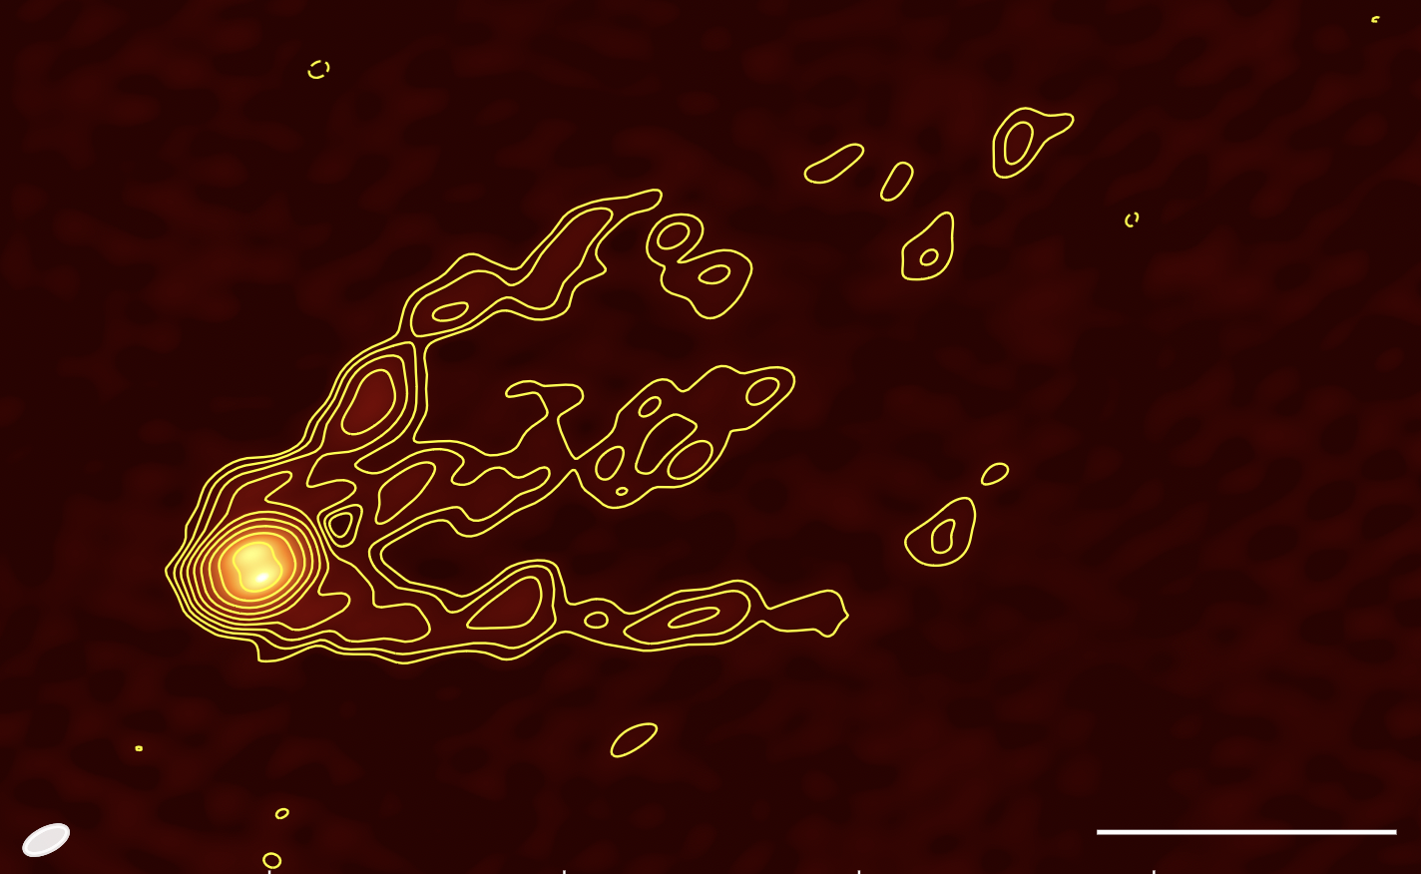
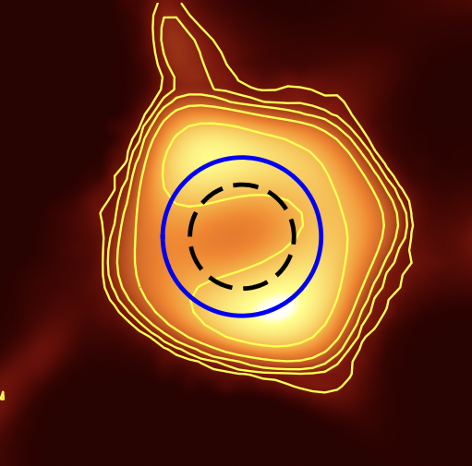
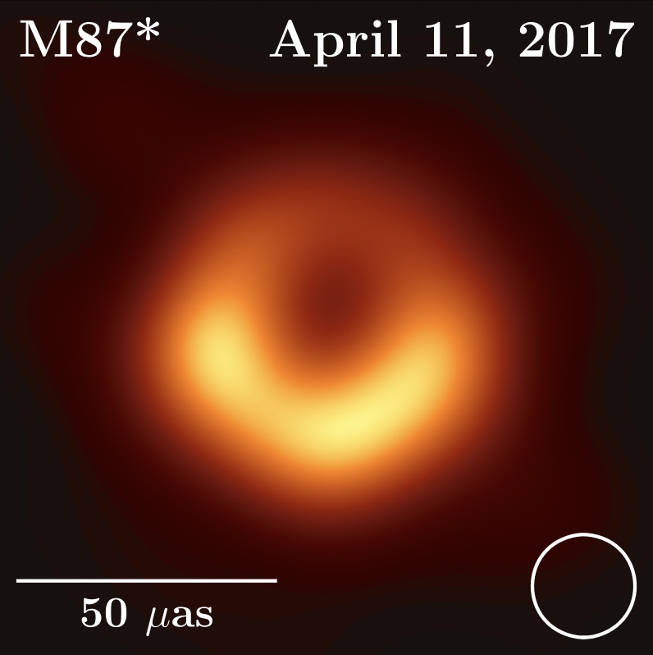
M87: evidence for particle acceleration?
86 GHz
86 GHz
50 μas
0.5 mas
230 GHz
Ring diameter at 86 GHz (GMVA + GLT + ALMA):
+4
64 μas
-8
Ring diameter at 230 GHz (EHT):
42 ± 3 μas
Images: Lu et al. (2023), EHT Collaboration (2019)

Slide 5
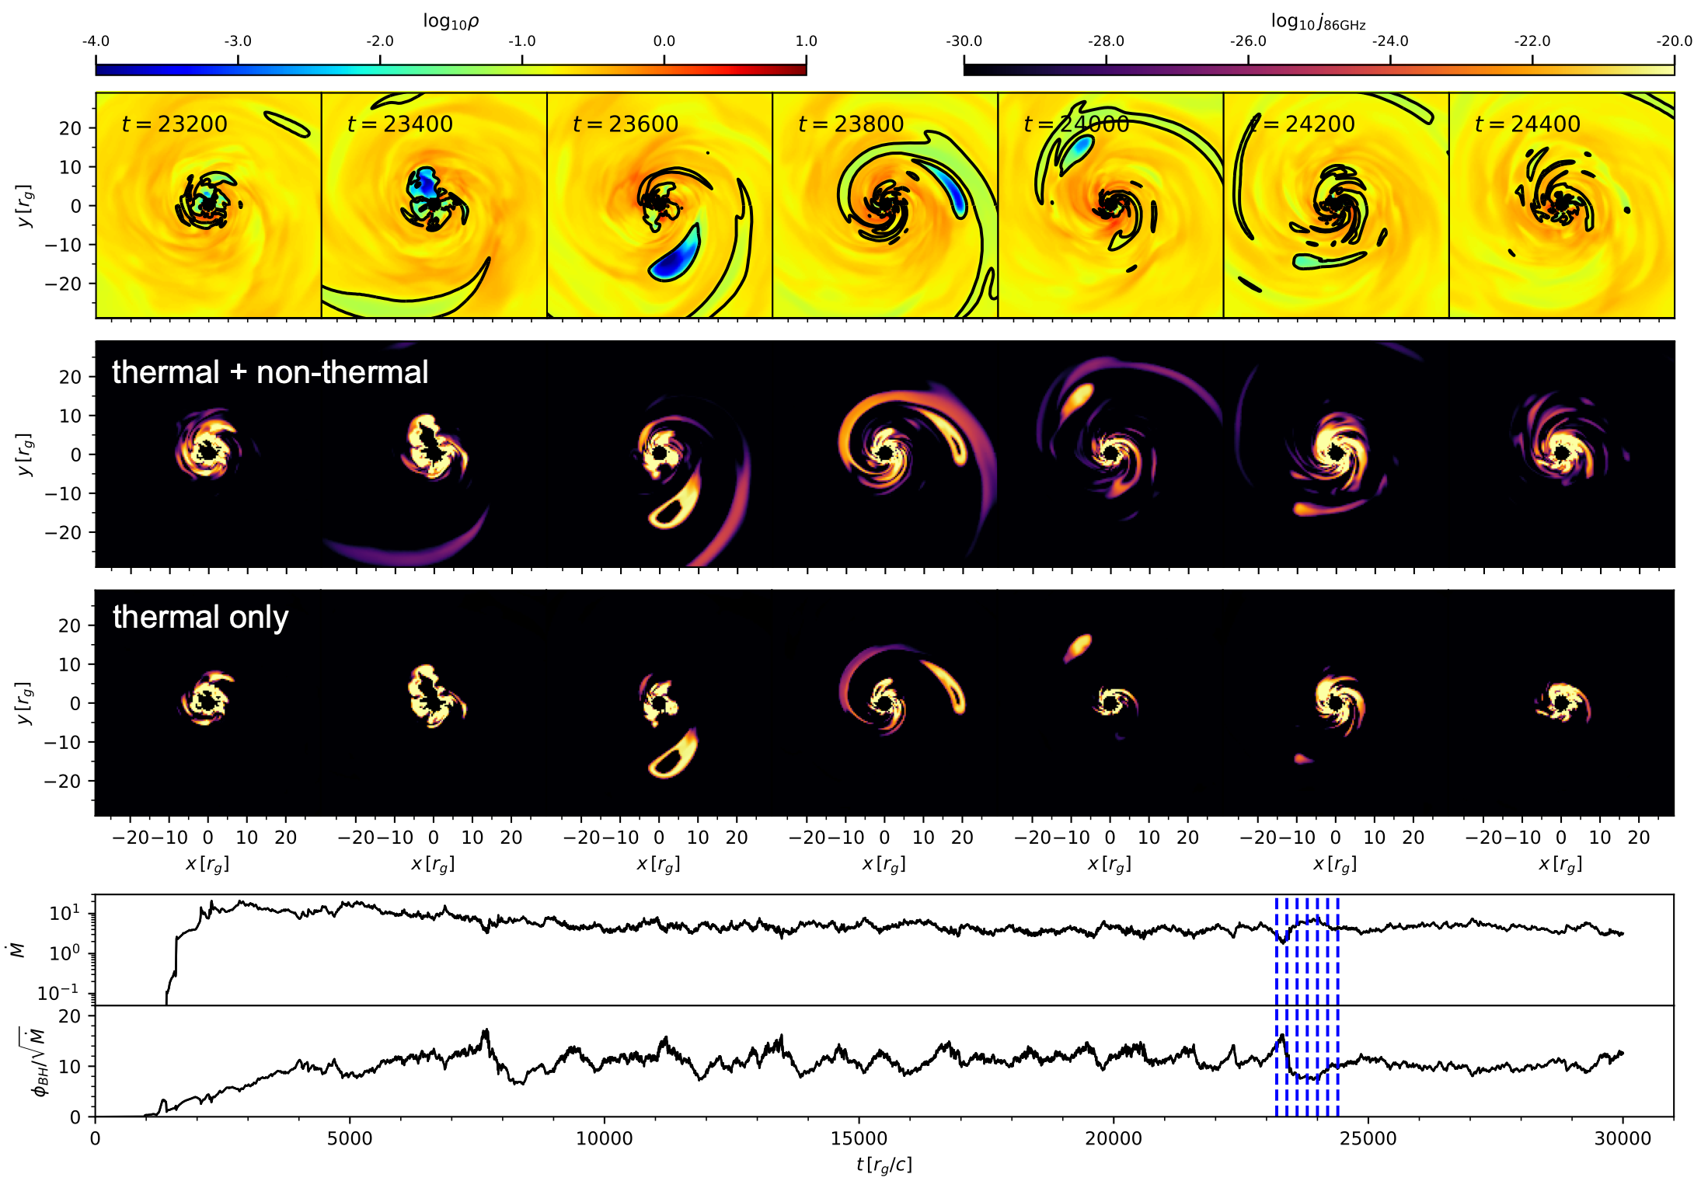
Zones of particle acceleration
—> role of MAD flares (ejection of material). Highly magnetised regions where reconnection-driven acceleration takes place
log10ρ
log10 j86GHz
-4.0
-3.0
-2.0
-1.0
0.0
1.0
-30.0
-28.0
-26.0
-24.0
-22.0
-20.0
Saiz-Pérez et al. (2026)

Slide 6
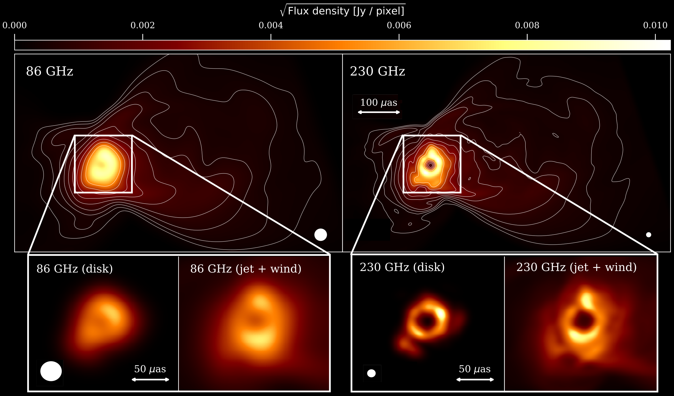
Jet-Disk Coupling
—> Increased size at 86 GHz due to the combined effect of particle
acceleration and opacity
Saiz-Pérez et al. (2026)

Slide 7
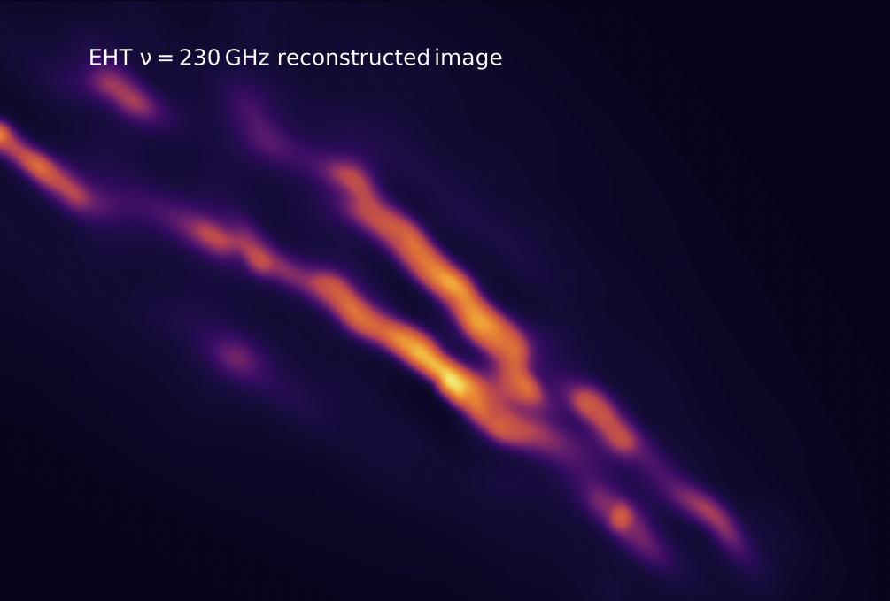

The case of Centaurus A
Does extreme
edge-brightening
provide insight into
nonthermal
acceleration
processes?
Felix Glaser
Glaser et al. (2026) (accepted)

Slide 8
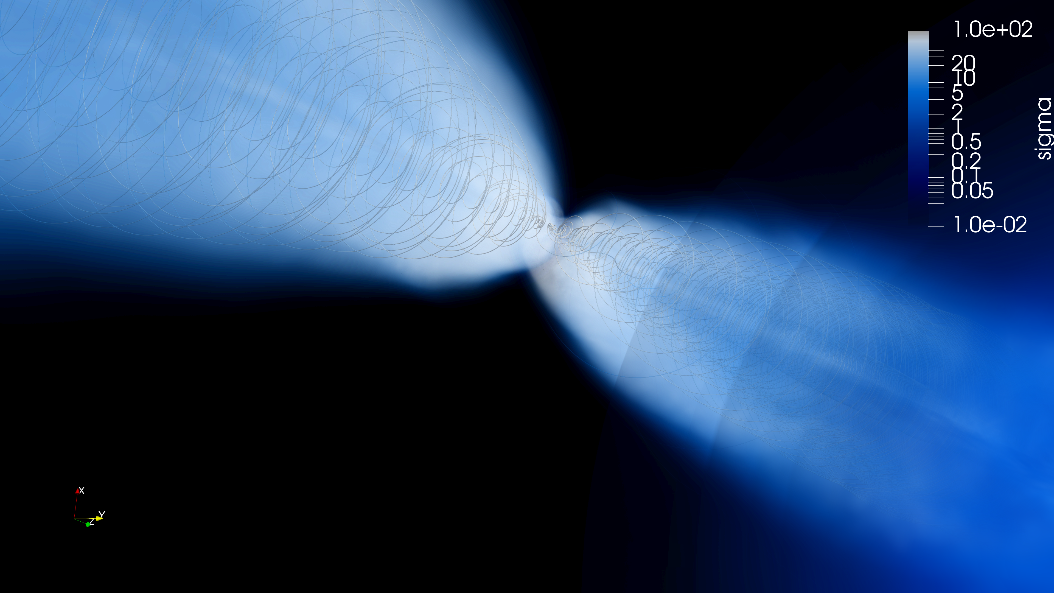





Anisotropic emission
Line of sight
$$B-field,projected$$
$θ_{B}$ close to 90° in „jet spine“
$$B$$
$θ_{B}$ closer to 180° in „jet sheath“
$$B$$
$θ_{B}$ closer to 0°
Line of sight
$$θ_{B}$$
$$B$$
Pitch angle
parallel/anti-parallel to B
$$\overset{̂}{=}$$
maximal emissivity
Credit: Felix Glaser
$θ_{B}$ closer to 0°

Slide 9
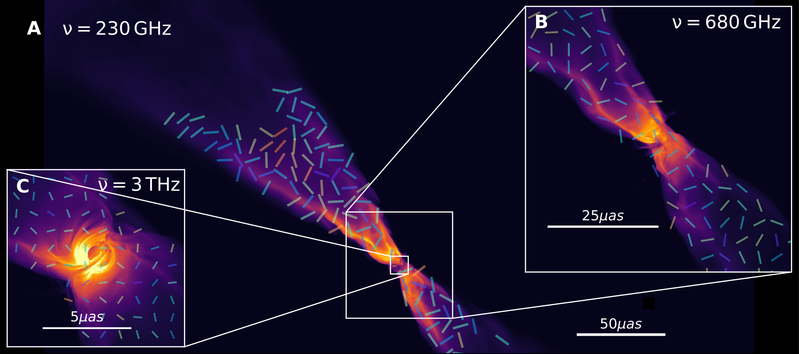
Radiation Microphysics and PIC simulations
mag. reconnection leads to anisotropic distribution of emitting particles
—> strong edge-brightening of jets and “empty” jet spines
Best fit CenA model at different frequencies on the Fourier plane
Opacity effects —> photon ring predicted visible in the far-infrared
Glaser et al. (2026) (accepted)

Slide 10
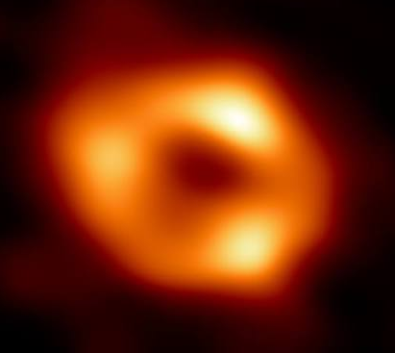
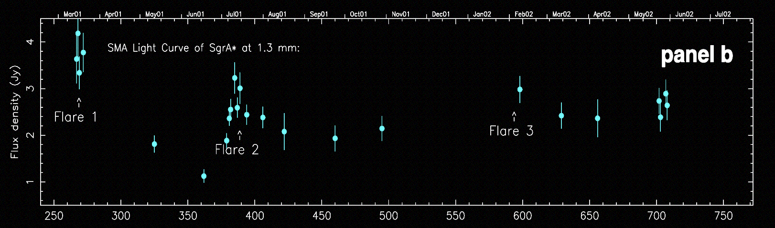

SgrA* and flaring
Flaring emission over the entire electromagnetic spectrum, but
no clear evidence of significant
jet emission
“Killing” and re-launching a jet
to explain variable particle
acceleration?
Raoul Kinadeter
Zhao et al. (2003)

Slide 11
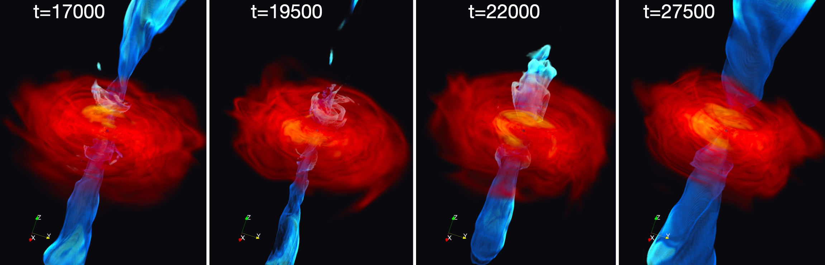
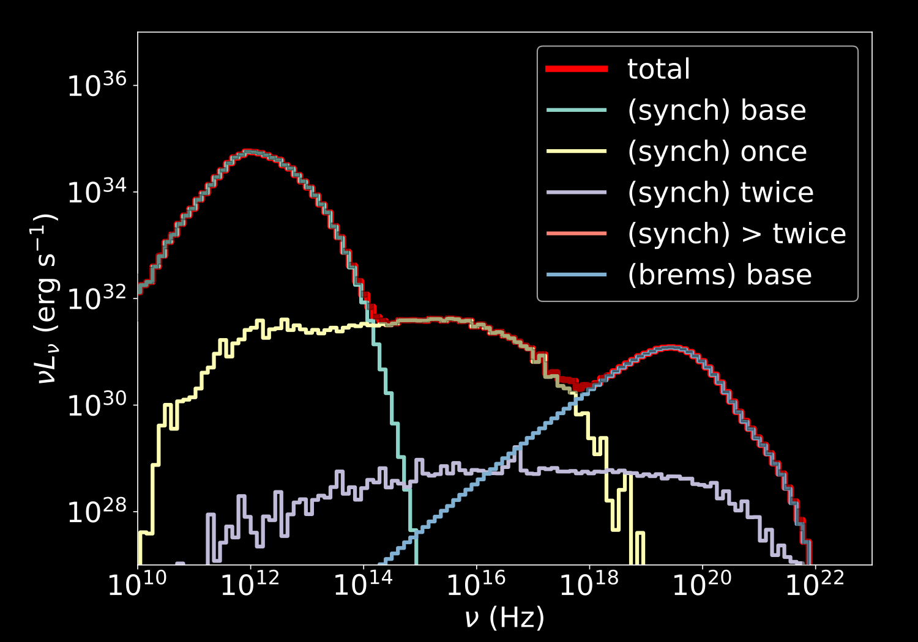
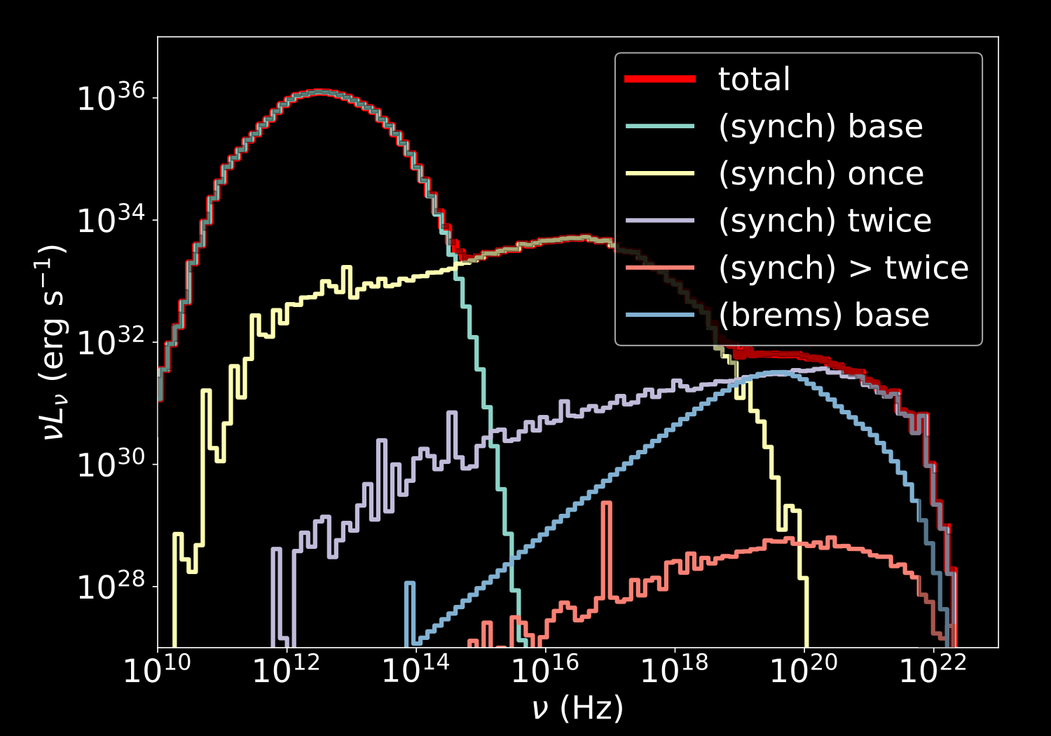
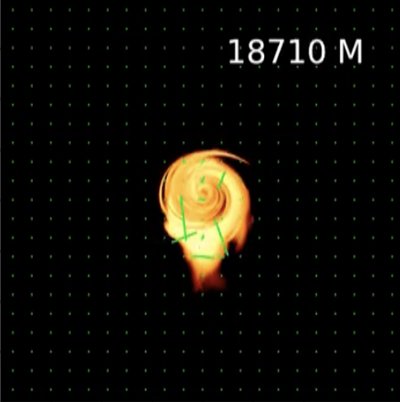
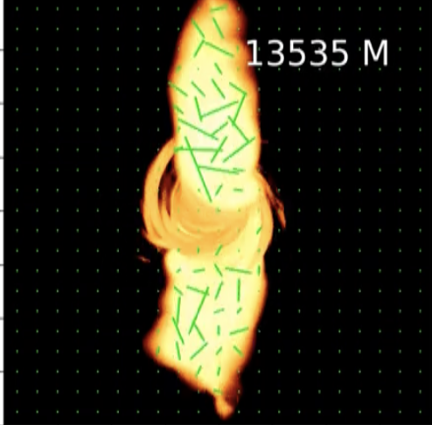

Black Hole Accretion and Flares
quiescent state (no jet)
active state (strong jet)
—> jet formation/propagation connect to high-energy flares
Kinadeter at al. (2026) (submitted)
Fendt & Fromm

Slide 12
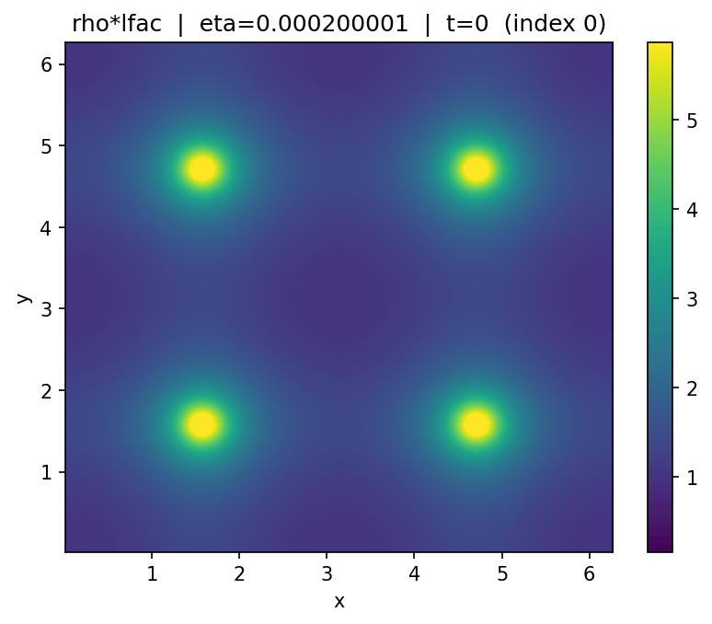

Physics informed neural networks
Simulations are expensive and limited to explore parameter spaces
—> ML techniques?
PINN solve the equations of full-resistive RMHD
Orszag-Tang vortex:
test of
numerical MHD
Matthias Nägele
Credit: Matthias Nägele

Slide 13
Physics informed neural networks
Neural networks in which conservation equations are used for the loss terms:
NOT trained on images, but on the physics!
Credit: Matthias Nägele

Slide 14
Conclusions
Incorporating particle-in-cell results into (G)RMHD and radiative transfer provides essential insight into the origin
of non thermal radiation in the Universe
Exploration of different physics: opacity effects, magnetic
reconnection, anisotropic emission, variable accretion…
Physics-informed neural networks may make it possible
to explore the parameter space efficiently
Upscattering connects the entire electromagnetic
spectrum. Next step: neutrinos.

Slide 15
Thanks for your attention!
Ainara Saiz-Pérez
Christian M. Fromm, Felix Glaser,
Raoul Kinadeter, Matthias Nägele

Slide 16
