Slide 1

Parametrization of the Primordial Power Spectrum in Loop Quantum Cosmology
Antonio Vicente-Becerril
Instituto de Estructura de la Materia, CSIC
In collaboration with Almudena Guillén, Kai Langer,
Guillermo A. Mena Marugán and Niklas Rodenbücher
Loops'26 International Conference on Quantum Gravity, 24th- 29th May
FAU² WORKSHOP

Slide 2
INTRODUCTION
The Cosmic Microwave Background (CMB) marked a milestone in our understanding of the early universe.
Existence of certain tensions and possible anomalies within the standard ΛCDM model.
A possible mechanism to alleviate those tensions is the introduction of power suppression at large scales.
In the context of Loop Quantum Cosmology (LQC) this power suppression appears naturally due to quantum gravity effects during the Early Universe.
Our goal is to simplify the primordial power spectrum in the context of LQC as much as possible by introducing a parametrization and then compare it with the Planck data.
FAU² WORKSHOP

Slide 3



EFFECTIVE LQC DYNAMICS
LQC has been developed through the application of LQG techniques to symmetry reduced models such as cosmology.
The cosmic singularity disappears in LQC leading to a Big Bounce instead.
In a FLRW universe, the effective LQC dynamics can be written:
$$ρ=\frac{1}{2}{\dot{φ}}^{2}+V\left(φ\right),$$
$${\left(\frac{\dot{a}}{a}\right)}^{2}=\frac{8π}{3}ρ\left(1−\frac{ρ}{ρ_{c}}\right)$$
The matter content is described by:
where
$ρ_{c}=3/\left(8πγ^{2}Δ\right) ≡$ maximum energy density at the bounce
Immirzi parameter
Area gap in LQG
FAU² WORKSHOP

Slide 4
EFFECTIVE LQC DYNAMICS:
Quantum bounce epoch
Classical kinetic epoch
Slow roll epoch
Quantum corrections are dominant.
Inflaton potential is negligible .
Quantum corrections are negligible.
Inflaton potential still negligible.
Quantum corrections still negligible.
Inflaton potential becomes dominant.
Bouncing dynamics
Classical regime
Classical regime
Kinetic domination
Kinetic domination
Slow Roll domination
FAU² WORKSHOP

Slide 5
COSMOLOGICAL PERTURBATIONS: QUANTIZATION APPROACHES
Hybrid quantization approach
[Castelló Gomar, Martín-Benito, Mena Marugán, '16]
Dressed metric quantization approach
[Agullo, Ashtekar, Nelson, '11]
Simultaneous quantization of the background and the perturbations as a constrained canonical system.
The resulting truncated Hamiltonian is quantized combining a background quantization à la Loops and Fock quantization of the perturbations.
Evolution equations for the linear perturbations can be then derived, but the effective masses are different from those in GR.
Separately quantization of the background geometry, using Loops technics and the perturbations.
We dress the phase space of the perturbations with a metric with quantum corrections.
The resulting equations of the linear perturbations are the same to those in GR but the background geometry differs.
FAU² WORKSHOP

Slide 6

INITIAL CONDITIONS: VACUUM CHOICE – NOAHD VACUUM
To obtain a modes solution We solve the modes equation in each of the different epochs.
… we need some initial conditions!
Main goal: Choose a criterion such that it is motivated by fundamental arguments and can potentially lead to a power spectrum with non-oscillating properties.
We adopt the Non-Oscilating and Asympotically Diagonal Hamiltonian vacuum (NOAHD).
The vacuum state is associated with a set of annihilation and creation operators, with an evolution that depends on the background, and which is directly governed by an asymptotically diagonal Hamiltonian.
In this diagonal Hamiltonian, all interacting terms between the perturbations have been systematically eliminated in the ultraviolet regime $k→+∞$.
FAU² WORKSHOP

Slide 7

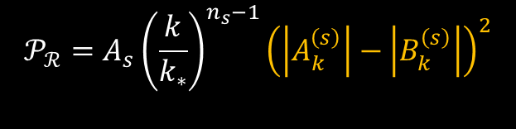

PRIMORDIAL POWER SPECTRUM: DEFINITION
We evaluate the Primordial Power Spectrum (PPS) at the time $η_{f}$ when all the modes in a given observable window of the CMB have frozen. Using the Slow roll approximation we obtain:
$$𝒫_{ℛ}=A_{s}{\left(\frac{k}{k_{∗}}\right)}^{n_{s}−1}{\left(\left|A_{k}^{\left(s\right)}\right|−\left|B_{k}^{\left(s\right)}\right|\right)}^{2}$$
The constants modes of the Slow-roll mode solution, $A_{k}^{\left(s\right)}$ and $B_{k}^{\left(s\right)}$, can be computed analytically !
They depend on the evolution of the modes through the bounce epoch, kinetic domination epoch and slow-roll epoch
…and on the choice of the vacuum state!
FAU² WORKSHOP

Slide 8





PRIMORDIAL POWER SPECTRUM: PARAMETRIZATION
In the resulting PPS there exist 3 different scales:
  Quantum bounce scale : $k_{0}=a_{0}H_{0}$
  Kinetic domination scale : $k_{i}=a_{i}H_{i}$
  Slow roll scale : $k_{e}=1/\left(η_{e}−η_{i}\right)≈a_{i}H_{i}$
$$k_{0} ≈ \sqrt{\frac{8πρ_{c}}{3a_{0}^{4}}}$$
In addition, $H_{i}≪H_{0}$
The scalar slow roll constant modes : $A_{k}^{\left(s\right)}$ = $A_{k}^{\left(s\right) }({ ρ}_{c},a_{0})$ and $B_{k}^{\left(s\right)}$ =$B_{k}^{\left(s\right)}({ ρ}_{c},a_{0})$
The PPS yields:
$$k_{i},k_{e}≪k_{0}$$
$$𝒫_{ℛ}=g (ρ_{c},a_{0}) ×A_{s}{\left(\frac{k}{k_{∗}}\right)}^{n_{s}−1}$$
FAU² WORKSHOP

Slide 9
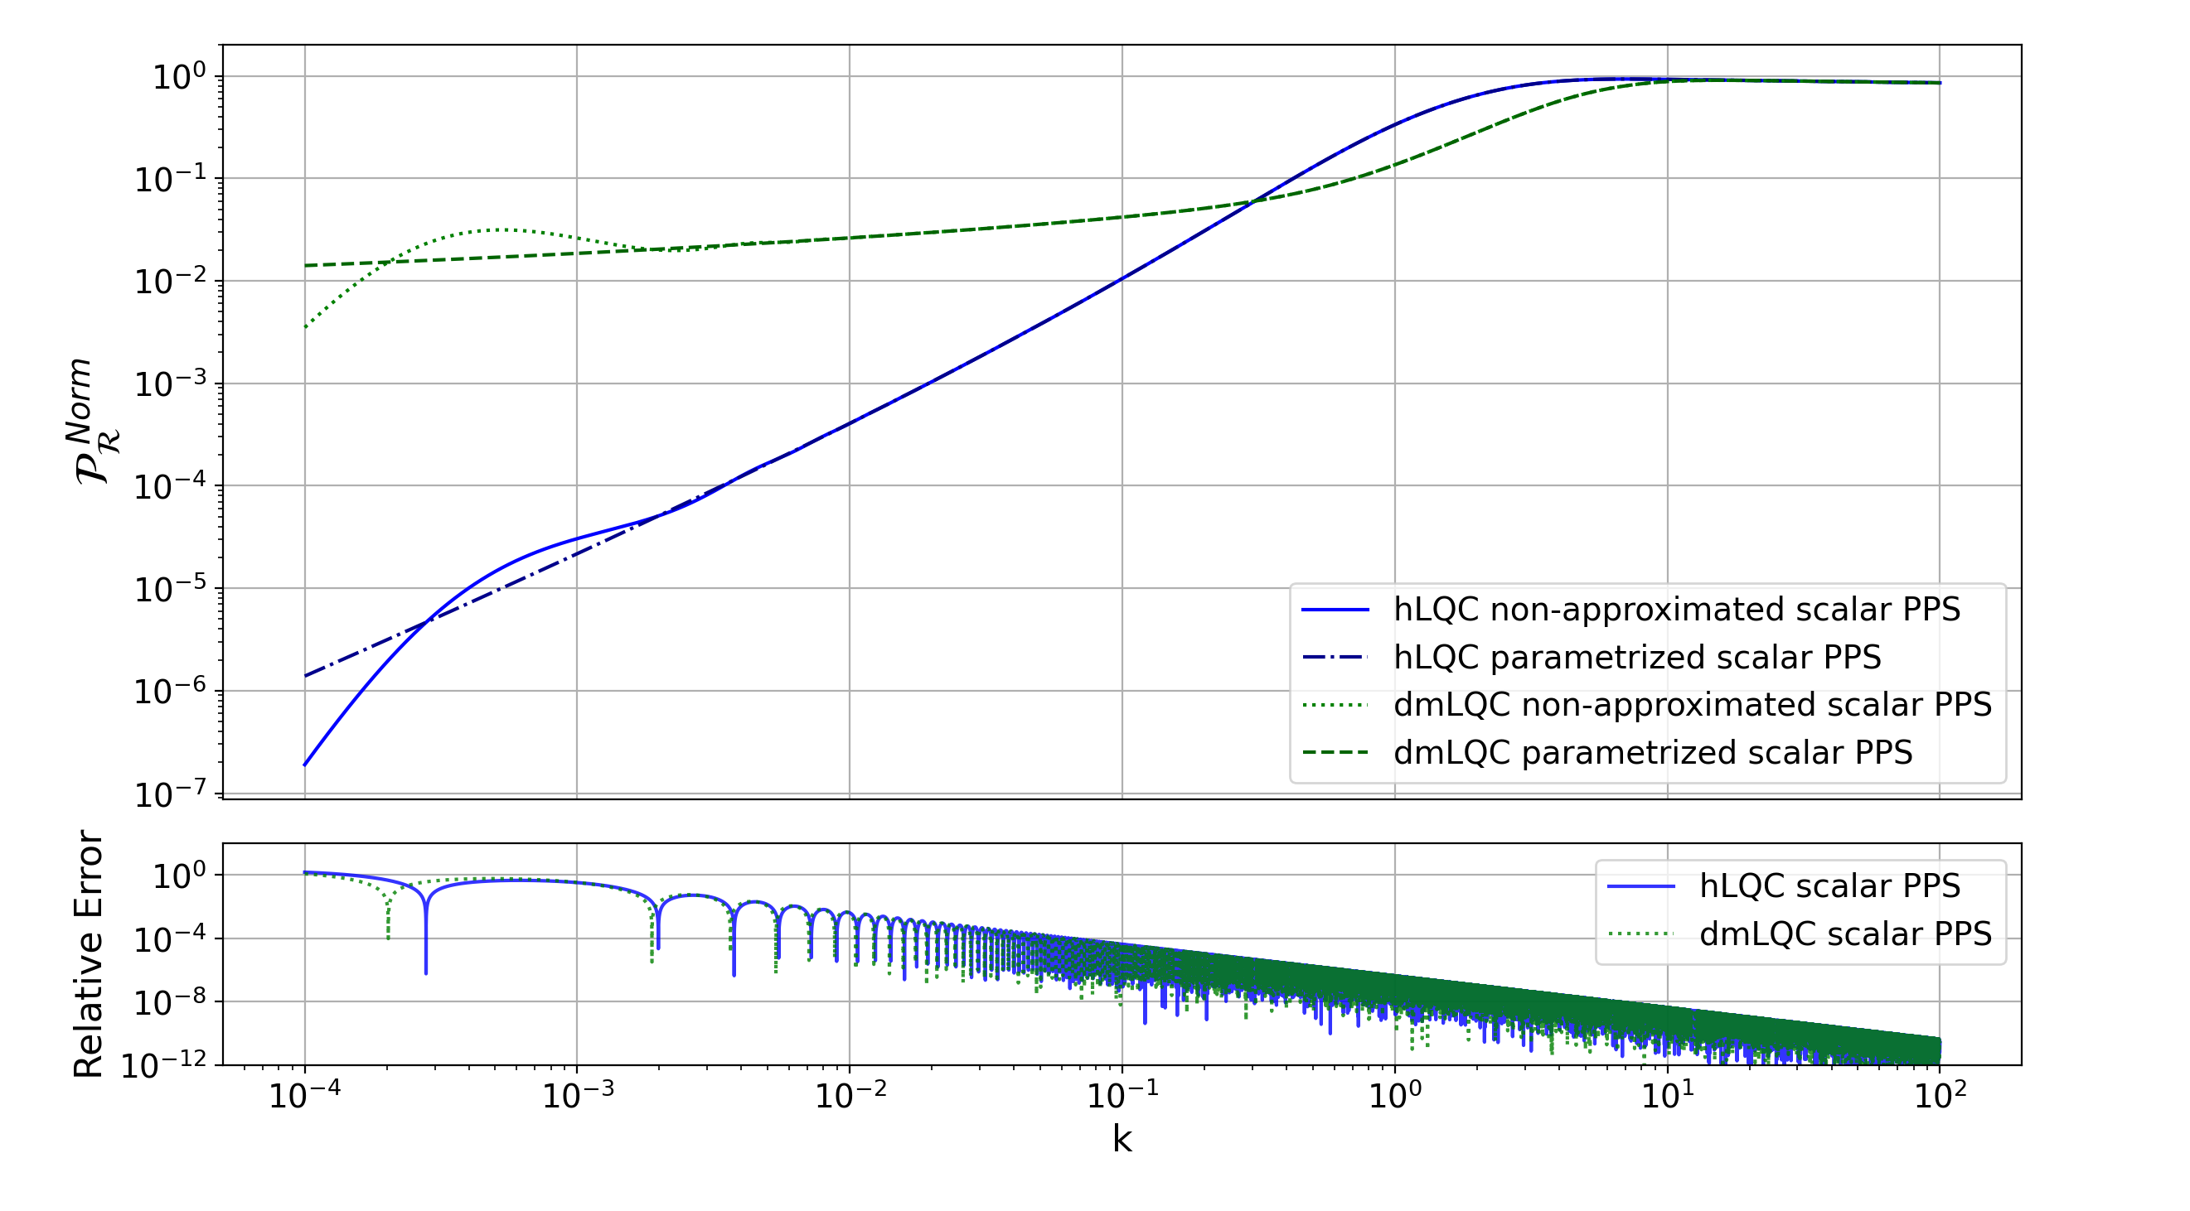
PRIMORDIAL POWER SPECTRUM : SCALAR PERTUBATIONS
FAU² WORKSHOP

Slide 10
PRIMORDIAL POWER SPECTRUM : TENSOR PERTUBATIONS ?
During the quantum bounce regime, the scalar and tensor mode equations are indistinguishable:
$$μ_{k}^{{\left(t\right)}^{′′}}+\left[k^{2}+s^{\left(t\right)}\right]μ_{k}^{\left(t\right)}=0 where s^{\left(t\right)}=−\frac{4π}{3}a^{2}\left(ρ−3P\right)$$
$μ_{k}^{{\left(s\right)}^{′′}}+\left[k^{2}+s^{\left(s\right)}\right]μ_{k}^{\left(s\right)}=0$ $where$ ${ s}^{\left(s\right)}=s^{\left(t\right)}+ a^{2}\left[V_{,φφ}+48πV+6\frac{a^{′}φ^{′}}{a^{3}ρ}V_{,φ}−\frac{48π}{ρ}V^{2}\right]$
Only the bounce epoch impacts into slow roll constant modes in our parametrization:
$A_{k}^{\left(t\right)}$ = $A_{k}^{\left(s\right)}({ ρ}_{c},a_{0})$ and ${ B}_{k}^{\left(t\right)}$ =$B_{k}^{\left(s\right)}({ ρ}_{c},a_{0})$
FAU² WORKSHOP

Slide 11

PRIMORDIAL POWER SPECTRUM : TENSOR PERTUBATIONS
FAU² WORKSHOP

Slide 12


ANGULAR POWER SPECTRUM SCALE
To compute the Angular Power Spectrum, we need to take in account :
    The observable modes window is: $2×{10}^{−4}Mpc^{−1}≤\text{k}\text{/}a_{today}≤6×{10}^{−1}Mpc^{−1}$
    We need to transform the scale units from Planck units to $Mpc^{−1}$ and to take in account our convention:
In our convention: $a_{today}= e^{ΔN}a_{Bounce}$
$$k_{Mpc^{−1}}/a_{today}≃e^{ 131−ΔN} k_{Planck}/a_{Bounce}$$
FAU² WORKSHOP

Slide 13
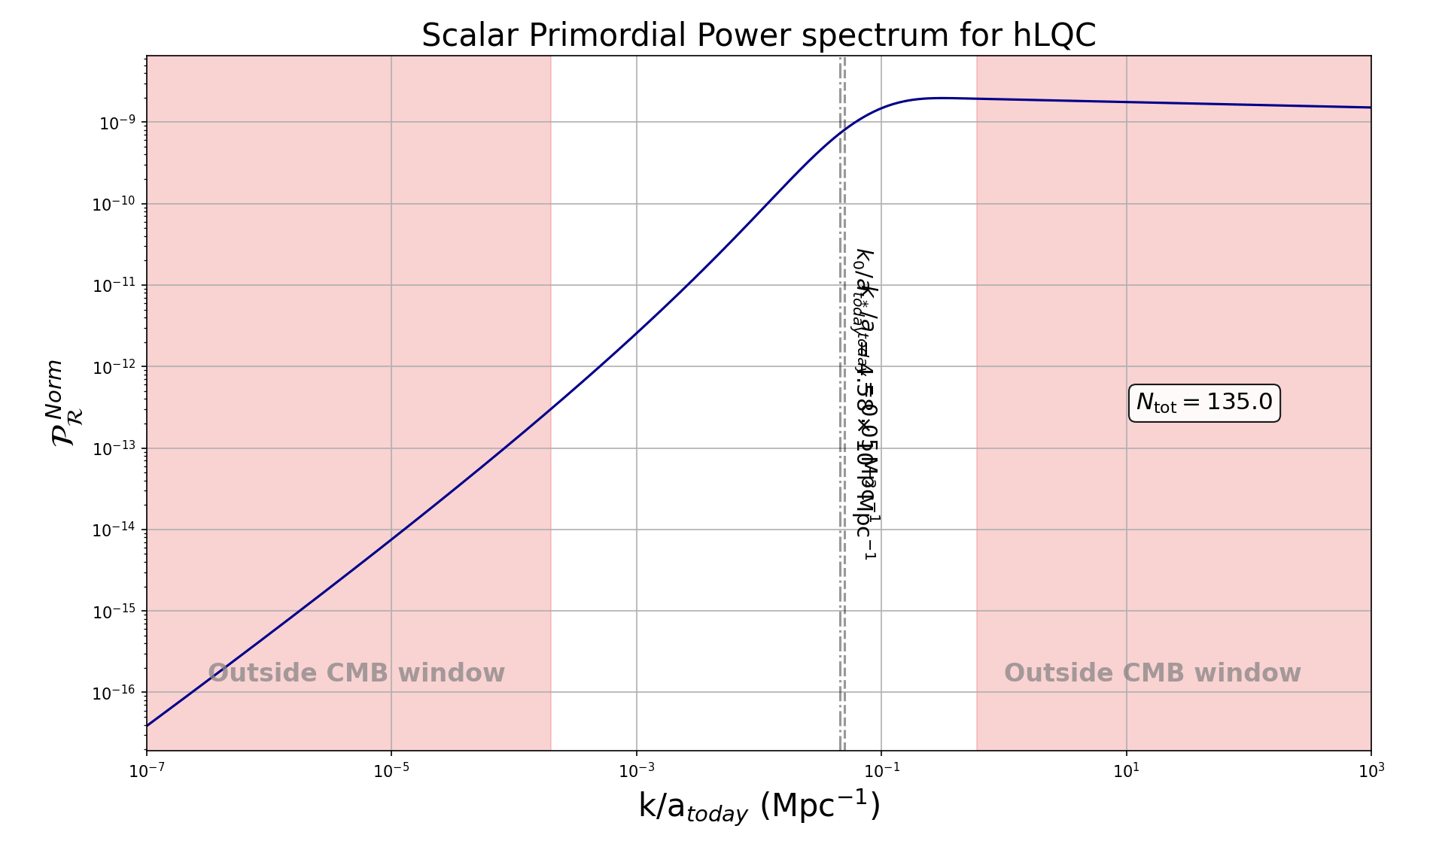
CMB OBSERVABLE WINDOW IN THE PRIMORDIAL POWER SPECTRUM
FAU² WORKSHOP

Slide 14
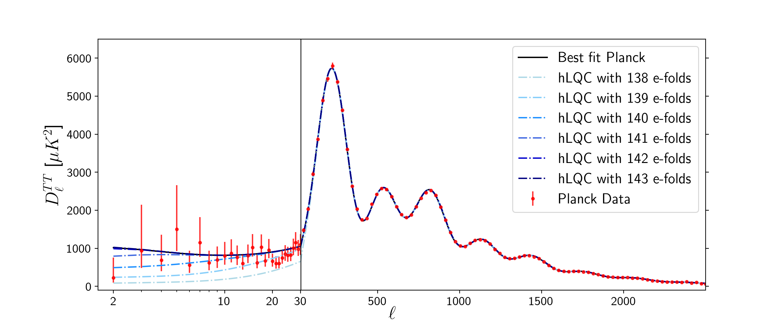
ANGULAR POWER SPECTRUM: HYBRID CASE
FAU² WORKSHOP

Slide 15
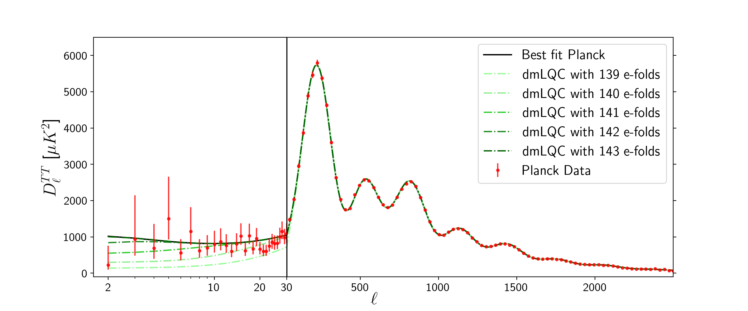
ANGULAR POWER SPECTRUM: DRESSED METRIC CASE
FAU² WORKSHOP

Slide 16
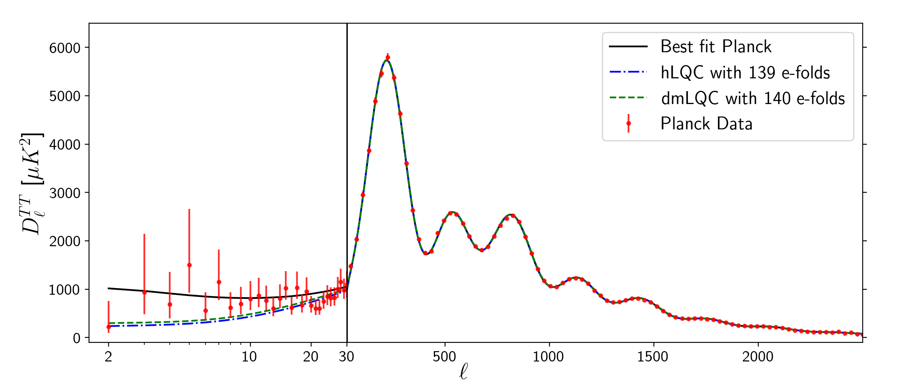
ANGULAR POWER SPECTRUM: hLQC vs dmLQC
FAU² WORKSHOP

Slide 17
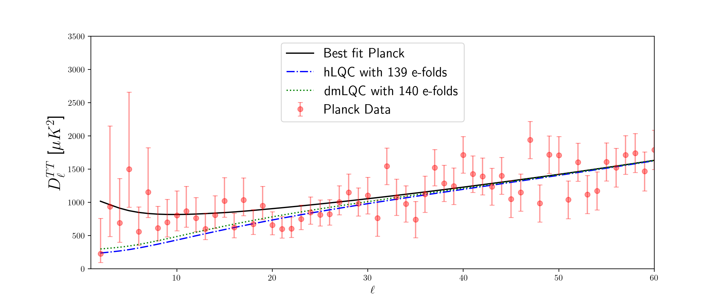
ANGULAR POWER SPECTRUM: ZOOM IN
FAU² WORKSHOP

Slide 18
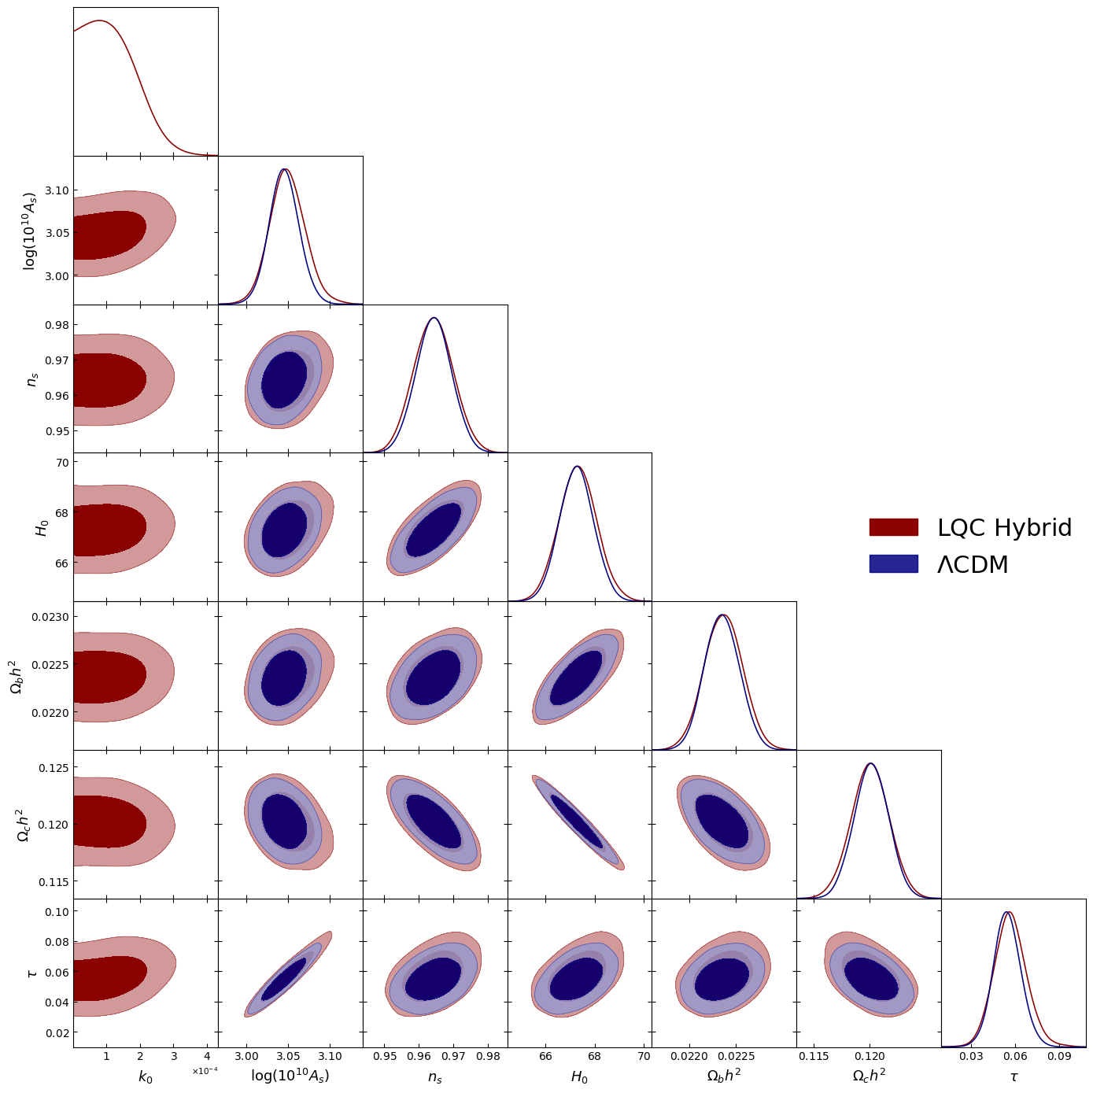
WHAT IS NEXT ?
PRELIMINARY RESULTS
Bayesian inference !
FAU² WORKSHOP

Slide 19
INTERDISCIPLINARY CONNECTIONS?
Conceptual foundations of Loop Quantum Cosmology (LQG techniques in symmetry-reduced spacetimes).
Fundamental questions in Quantum Field Theory in Curved Spacetimes (vacuum ambiguity and quantum states…)
Interface between Quantum Gravity and Cosmology.
Toward connecting quantum gravity effects with cosmological observations!
FAU² WORKSHOP

Slide 20
CONCLUSIONS:
From the LQC framework we have computed the scalar and tensor PPS.
The resulting parametrized PPS depends on 2 LQC parameters (+ usual SR parameters).
The Angular Power Spectrum agrees with Planck data and shows a power suppression at large scale which may improve the best fit of Planck.
Future perspectives :
  Bayesian inference and model comparison with ΛCDM.
  Future measurements of tensor perturbations ?
FAU² WORKSHOP

Slide 21

arXiv:2605.14657v1[gr-qc]
Email : antonio.vicente@iem.cfmac.csic.es

