Slide 1
Status of 3D Analyses of HESS Data in Complicated Fields with focus on GC
Yu Wun Wong
Christopher van Eldik
14.10.2021
FRANCI Meeting

Slide 2
The Galactic Center: A Black Hole
(The Royal Swedish Academy of Sciences)
In 2020 the Nobel Prize was awarded to the radio discovery of the Sgr A* at the galactic center

Slide 3
The Galactic Center:
(LaRosa et al. 2000)
More than just a black hole!

Slide 4
The Galactic Center:
(LaRosa et al. 2000)
More than just a black hole!

Slide 5
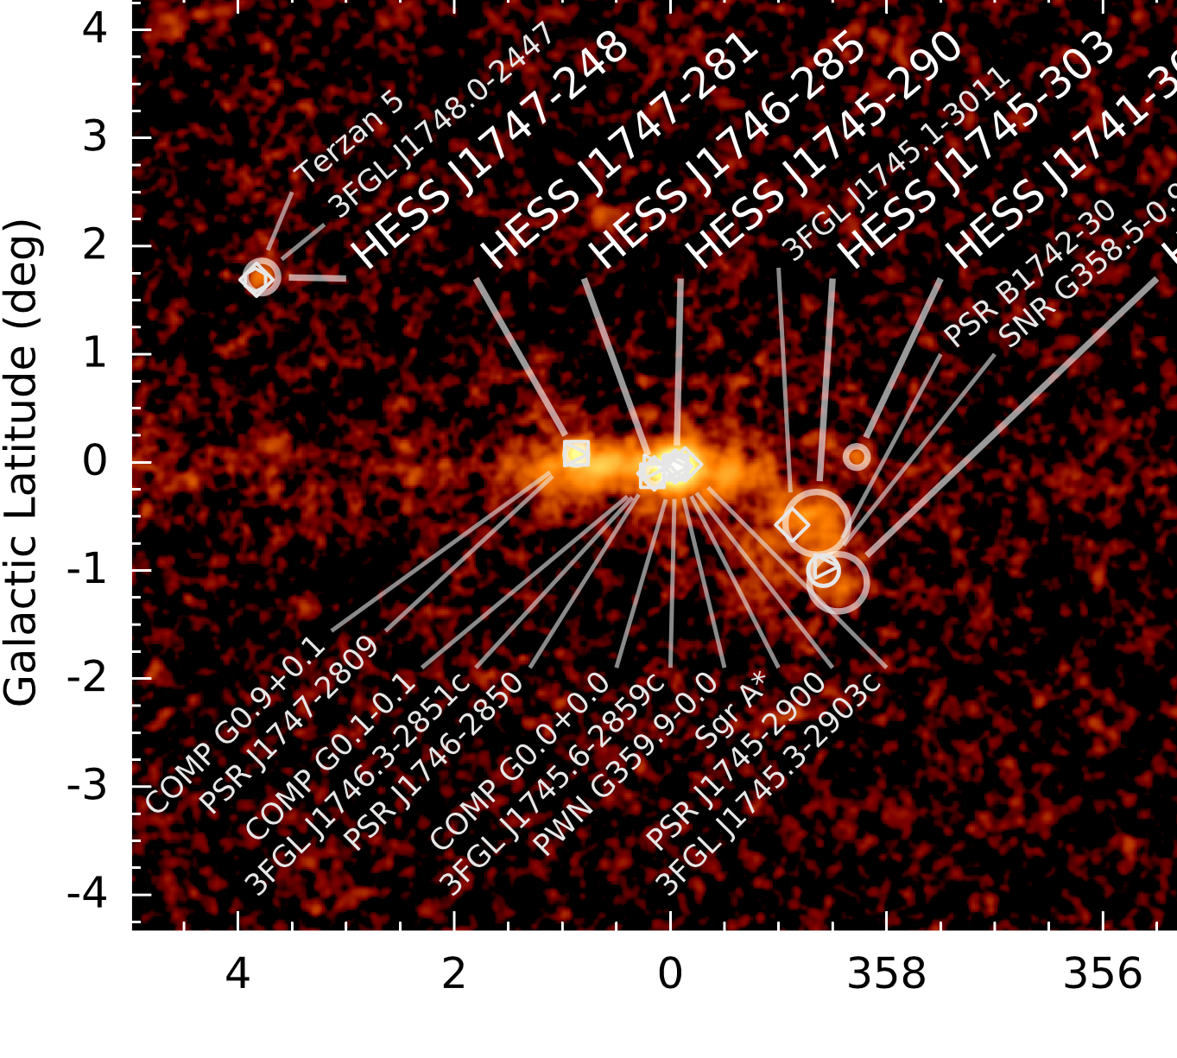
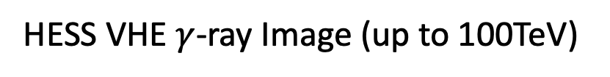



The Galactic Center:
HESS VHE $γ$-ray Image (up to 100TeV)
$$1°≈150pc$$
(HGPS 2018)
Many closely packed sources, and … the diffuse $γ$-ray emission!

Slide 6
Diffuse $γ$-ray emission
Linkage with the local cosmic ray accelerator
Trace back to the particle diffusion properties
Challenging to study due to the complexity in the GC region
  Need good telescope and data

Slide 7
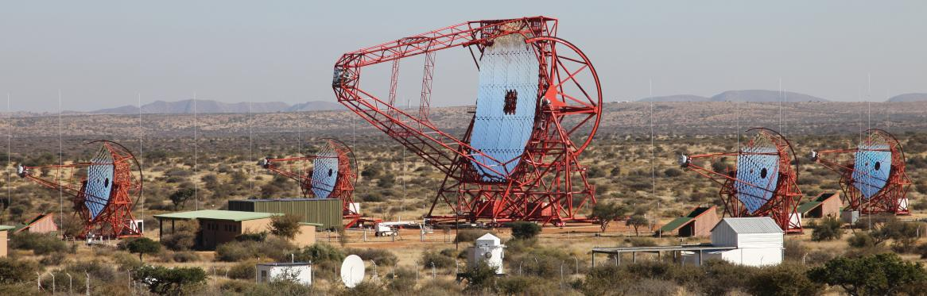

Data
Dataset: HESS I (2004-2012,197h), HESS II (2013-2015,96h)
Region: 4.3$°$ $×$ 4.3$°$ centered at GC
Energy Range: up to 80 TeV
List of Sources: J1745-290, G0.9+0.1, J1746-285, J1745-303, J1746-308, J1741-302, Unknown Gaussian Source, Diffuse Emission Template, Pre-Fit BKG
Latest 3D Analysis: Gammapy-0.18.2 (Fit both spatial and energy axes)

Slide 8
Data
Dataset: HESS I (2004-2012,197h), HESS II (2013-2015,96h)
Region: 4.3$°$ $×$ 4.3$°$ centered at GC
Energy Range: up to 80 TeV
List of Sources: J1745-290, G0.9+0.1, J1746-285, J1745-303, J1746-308, J1741-302, Unknown Gaussian Source, Diffuse Emission Template, Pre-Fit BKG
Latest 3D Analysis: Gammapy-0.18.2 (Fit both spatial and energy axes)
If NOTHING except the background is fitted

Slide 9
Data
Dataset: HESS I (2004-2012,197h), HESS II (2013-2015,96h)
Region: 4.3$°$ $×$ 4.3$°$ centered at GC
Energy Range: up to 80 TeV
List of Sources: J1745-290, G0.9+0.1, J1746-285, J1745-303, J1746-308, J1741-302, Unknown Gaussian Source, Diffuse Emission Template, Pre-Fit BKG
Latest 3D Analysis: Gammapy-0.18.2 (Fit both spatial and energy axes)
If EVERYTHING is fitted

Slide 10
Data
Dataset: HESS I (2004-2012,197h), HESS II (2013-2015,96h)
Region: 4.3$°$ $×$ 4.3$°$ centered at GC
Energy Range: up to 80 TeV
List of Sources: J1745-290, G0.9+0.1, J1746-285, J1745-303, J1746-308, J1741-302, Unknown Gaussian Source, Diffuse Emission Template, Pre-Fit BKG
Latest 3D Analysis: Gammapy-0.18.2 (Fit both spatial and energy axes)
If there is NO diffuse emission template

Slide 11




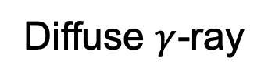
Building the Diffusion Template
Molecular Cloud
Diffuse $γ$-ray
H2
H2
p-p interaction
p
p
Diffusing Protons

Slide 12
Molecular Cloud
Clouds at different distances display distinctive absorption lines
  Able to extract the face-on position of the molecules
(Sawada et. al. 2004)
Notes:
Clouds with equal excitation temperatures and optical depths but different distances, display distinctive absorption lines

Slide 13

Molecular Cloud
(Tsuboi et. al. 1999)
CS data
Strong foreground and background contamination in the low velocity range of $\left|v\right|≤30 km s^{−1}$ using CO emission line
-> Project the CS emission data onto the CO/OH look-up table
CO/OH model
Face-on
Line-of-sight
(Sawada et. al. 2004)

Slide 14
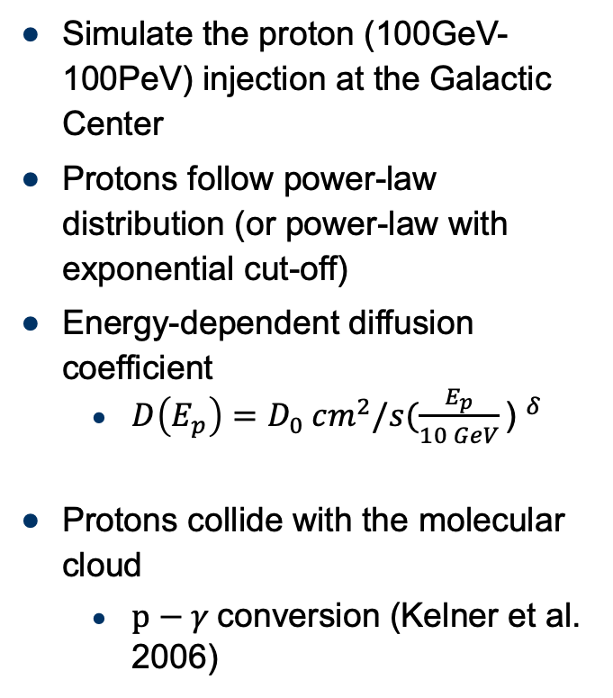
Diffusing Protons
Simulate the proton (100GeV-100PeV) injection at the Galactic Center
Protons follow power-law distribution (or power-law with exponential cut-off)
Energy-dependent diffusion coefficient
  $D\left(E_{p}\right)=D_{0} {cm}^{2}/s{(\frac{E_{p}}{10 GeV}\text{) }}^{δ}$
Protons collide with the molecular cloud
  $p−γ$conversion (Kelner et al. 2006)

Slide 15
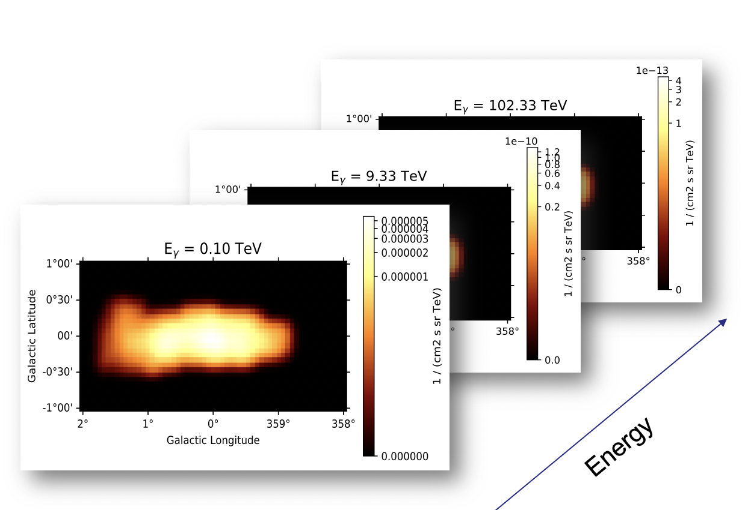
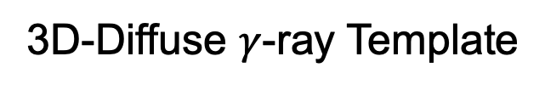
Building the 3D-Diffusion Template
Molecular Cloud
3D-Diffuse $γ$-ray Template
p
p
Diffusing Protons
2 spatial axes and
1 energy axis!

Slide 16
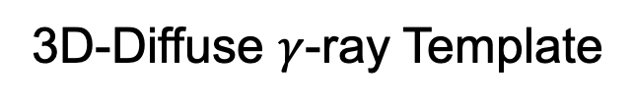
Fitting the 3D-Diffusion Template
3D-Fitting Result
3D-Diffuse $γ$-ray Template

Slide 17
Template Optimization
Full-scale likelihood scan through all the diffusion parameters
  Search for the minimum(the best) likelihood value
  Search for the best diffusion parameters that can descript the excess emission at the GC

Slide 18
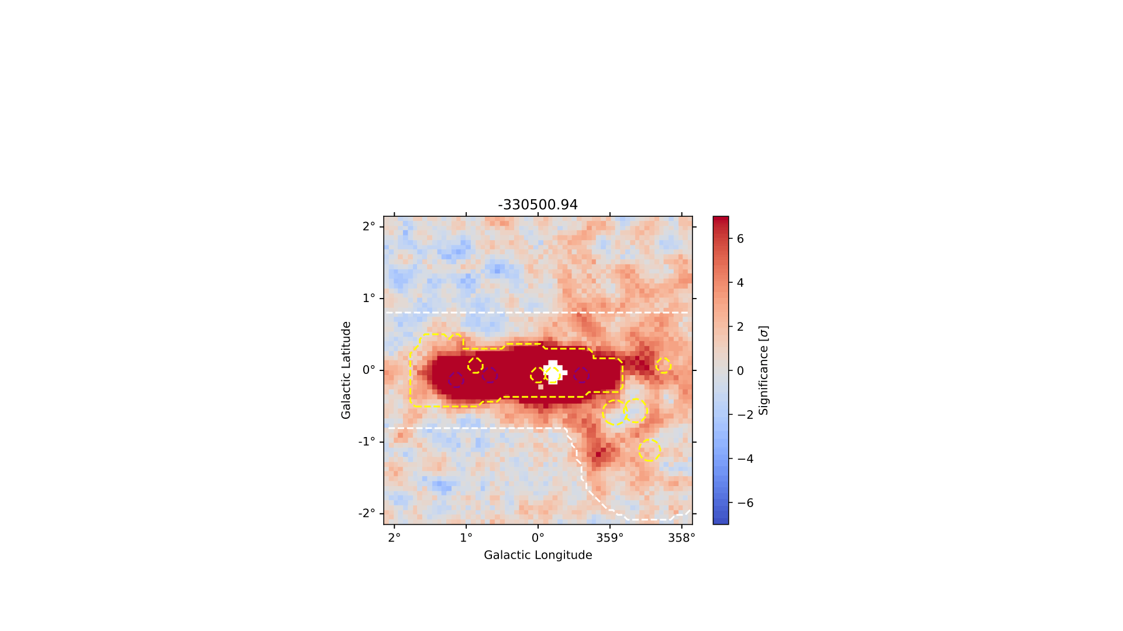
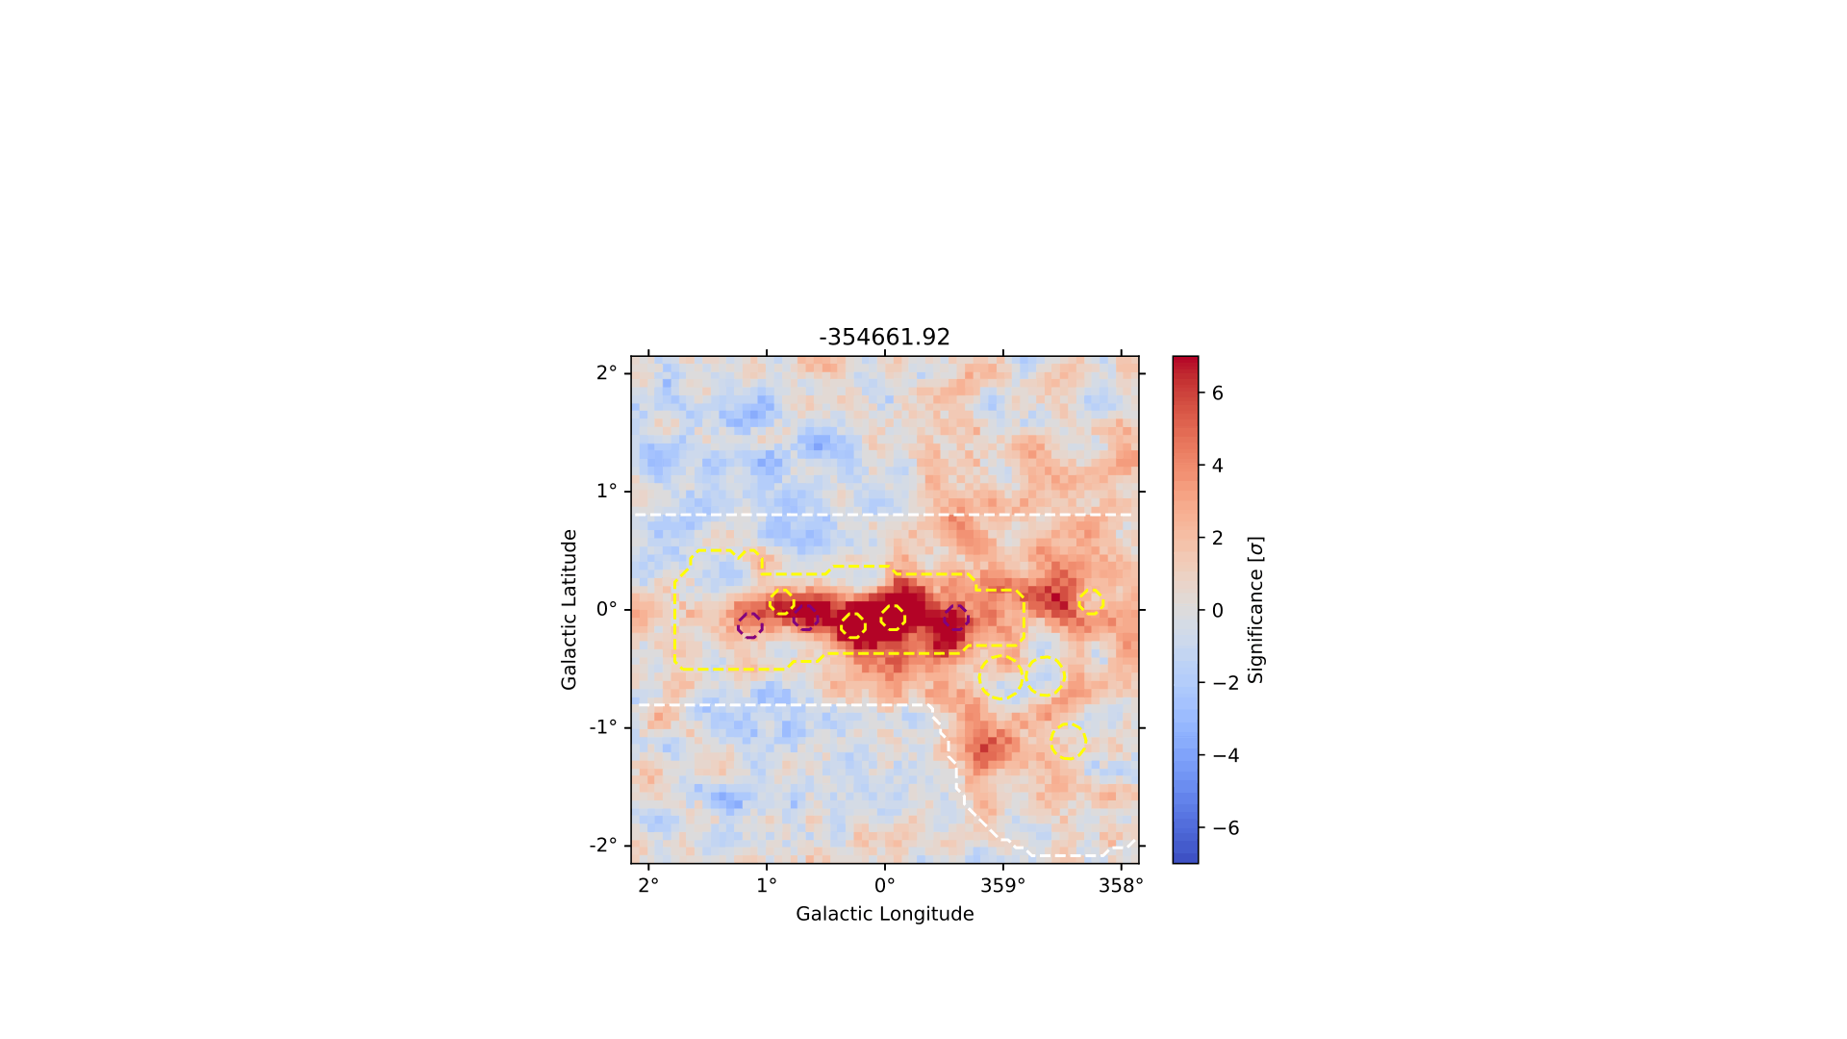
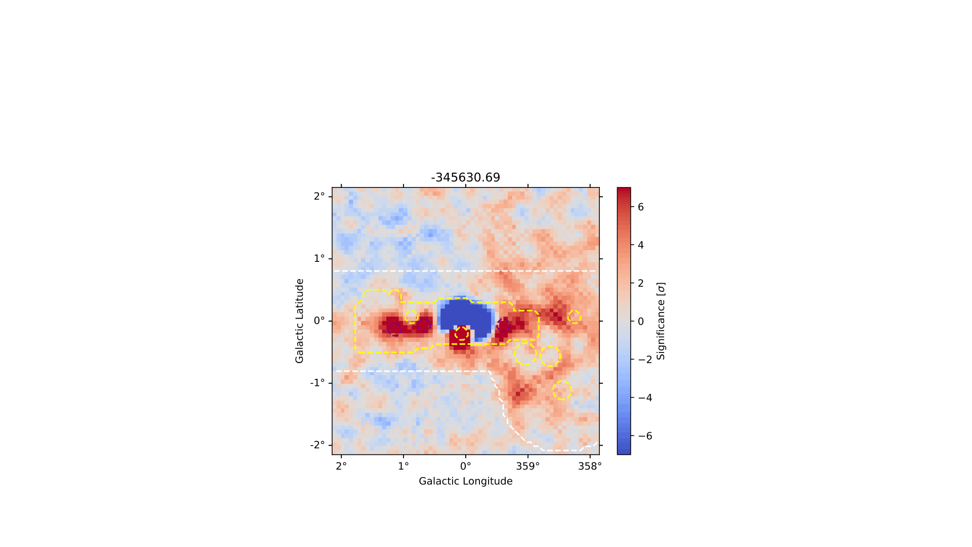
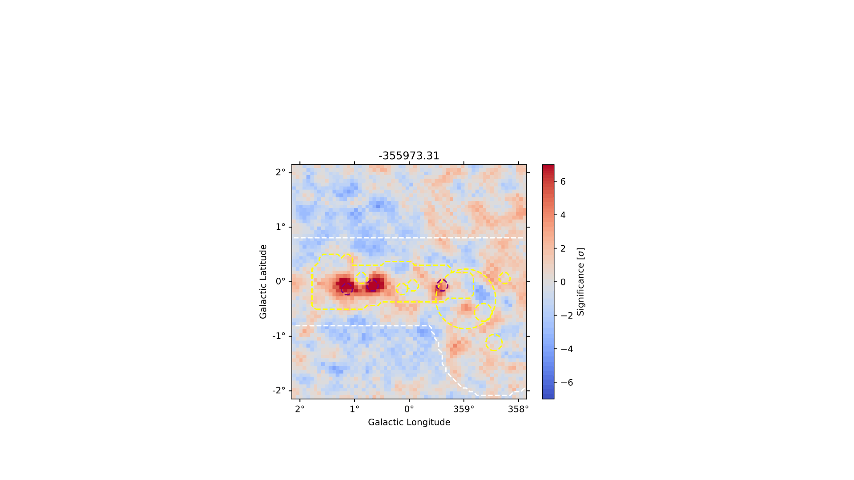
Changing Everything
Changing Index
Changing DT
Changing Delta
18

Slide 19
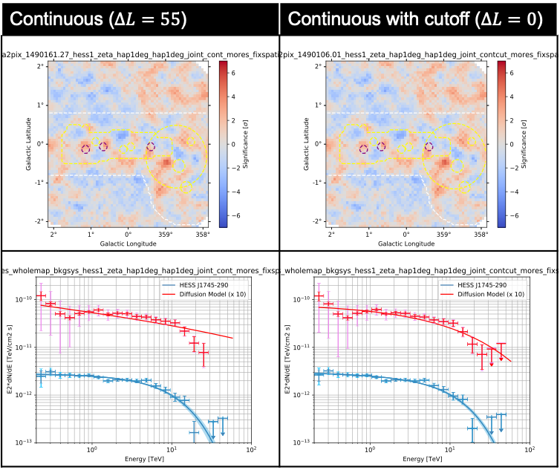
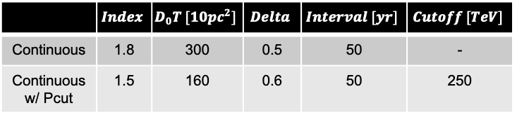
Result
cont
contcut
At high energies, the data do not match with the diffusion spectrum
Continuous ($ΔL=55$) | Continuous with cutoff ($ΔL=0$)
preliminary
Diffusion Parameters
Diffusion Spectrum
Central Source Spectrum
 | $$Index$$ | $$D_{0}T [10pc^{2}]$$ | $$Delta$$ | $$Interval [yr]$$ | $$Cutoff [TeV]$$
Continuous | 1.8 | 300 | 0.5 | 50 | -
Continuous w/ Pcut | 1.5 | 160 | 0.6 | 50 | 250

Slide 20
Result
cont
contcut
At high energies, the data do not match with the diffusion spectrum
We need the proton cut-off (?)
  Better spectrum at high energies
  Better likelihood
Continuous ($ΔL=55$) | Continuous with cutoff ($ΔL=0$)
preliminary
Diffusion Parameters
 | $$Index$$ | $$D_{0}T [10pc^{2}]$$ | $$Delta$$ | $$Interval [yr]$$ | $$Cutoff [TeV]$$
Continuous | 1.8 | 300 | 0.5 | 50 | -
Continuous w/ Pcut | 1.5 | 160 | 0.6 | 50 | 250

Slide 21
Other Interesting Fields
Thanks for your attention!
Background Systematic Studies
  -> Lars, Kaori, Katrin, Andi, Rajshree, and more
Dark Matter Sensitivity Studies
  -> Katrin, and more
Different Complicated Regions Studies
  -> The 3D analysis group

Slide 22
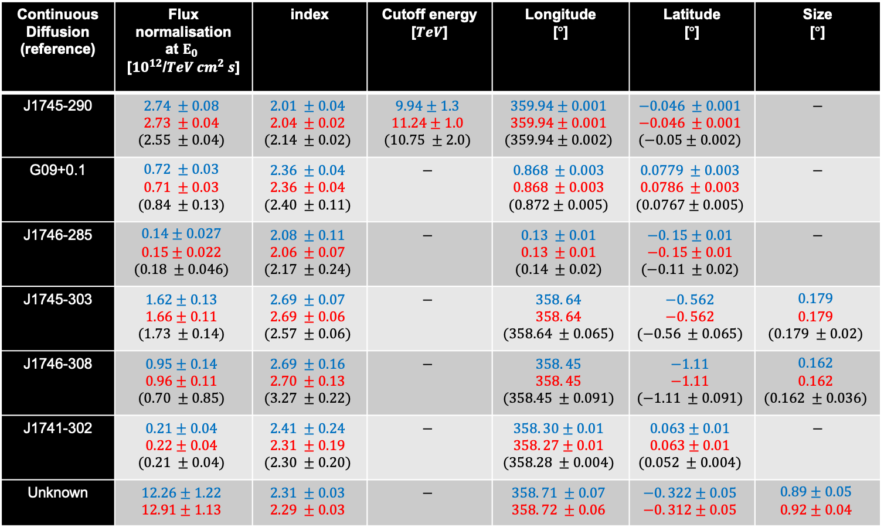
Backup
Without Cut-Off
With Cut-Off
Continuous Diffusion (reference) | Flux normalisation at $E_{0}$ [$10^{12}$/$TeV cm^{2} s$] | index | Cutoff energy [$TeV$] | Longitude [$°$] | Latitude [$°$] | Size [$°$]
J1745-290 | $$2.74 ±0.08$$ $$2.73 ±0.04$$ $$(2.55 ±0.04)$$ | $$2.01 ±0.04$$ $$2.04 ±0.02$$ $$(2.14 ±0.02)$$ | $$9.94±1.3$$ $$11.24±1.0$$ $$(10.75 ±2.0)$$ | $$359.94±0.001$$ $$359.94±0.001$$ $$(359.94±0.002)$$ | $$−0.046 ±0.001$$ $$−0.046 ±0.001$$ $$(−0.05±0.002)$$ | $$−$$
G09+0.1 | $$0.72 ±0.03$$ $$0.71 ±0.03$$ $$(0.84 ±0.13)$$ | $$2.36 ±0.04$$ $$2.36 ±0.04$$ $$(2.40 ±0.11)$$ | $$−$$ | $$0.868 ±0.003$$ $$0.868 ±0.003$$ $$(0.872±0.005)$$ | $$0.0779 ±0.003$$ $$0.0786 ±0.003$$ $$(0.0767±0.005)$$ | $$−$$
J1746-285 | $$0.14±0.027$$ $$0.15±0.022$$ $$(0.18 ±0.046)$$ | $$2.08 ±0.11$$ $$2.06 ±0.07$$ $$(2.17 ±0.24)$$ | $$−$$ | $$0.13 ±0.01$$ $$0.13 ±0.01$$ $$(0.14 ±0.02)$$ | $$−0. 15±0.01$$ $$−0. 15±0.01$$ $$(−0.11 ±0.02)$$ | $$−$$
J1745-303 | $$1.62±0.13$$ $$1.66±0.11$$ $$(1.73 ±0.14)$$ | $$2.69 ±0.07$$ $$2.69 ±0.06$$ $$(2.57 ±0.06)$$ | $$−$$ | $$358. 64$$ $$358. 64$$ $$(358.64 ±0.065)$$ | $$−0. 562$$ $$−0. 562$$ $$(−0.56 ±0.065)$$ | $$0.179$$ $$0.179$$ $$(0.179 ±0.02)$$
J1746-308 | $$0.95±0.14$$ $$0.96±0.11$$ $$(0.70 ±0.85)$$ | $$2.69 ±0.16$$ $$2.70 ±0.13$$ $$(3.27 ±0.22)$$ | $$−$$ | $$358. 45$$ $$358. 45$$ $$(358.45 ±0.091)$$ | $$−1.11$$ $$−1.11$$ $$(−1.11 ±0.091)$$ | $$0.162$$ $$0.162$$ $$(0.162 ±0.036)$$
J1741-302 | $$0.21±0.04$$ $$0.22±0.04$$ $$(0.21 ±0.04)$$ | $$2.41 ±0.24$$ $$2.31 ±0.19$$ $$(2.30 ±0.20)$$ | $$−$$ | $$358. 30±0.01$$ $$358. 27±0.01$$ $$(358.28 ±0.004)$$ | $$0.063±0.01$$ $$0.063±0.01$$ $$(0.052 ±0.004)$$ | $$−$$
Unknown | $$12.26±1.22$$ $$12.91±1.13$$ | $$2.31 ±0.03$$ $$2.29 ±0.03$$ | $$−$$ | $$358. 71 ±0.07$$ $$358. 72 ±0.06$$ | $$−0. 322±0.05$$ $$−0. 312±0.05$$ | $$0.89±0.05$$ $$0.92±0.04$$

Slide 23
Backup:
Sub-energy Analysis
(Continuous with Pcut)
The significance maps are looking fine at different energies
The distributions are close to the standard gaussian

Slide 24
Backup:
Spatial Profile
(Continuous with Pcut)
The spatial profiles are counts integrated along the galactic latitude and longitude
Looking fine again at different energies

