Slide 1

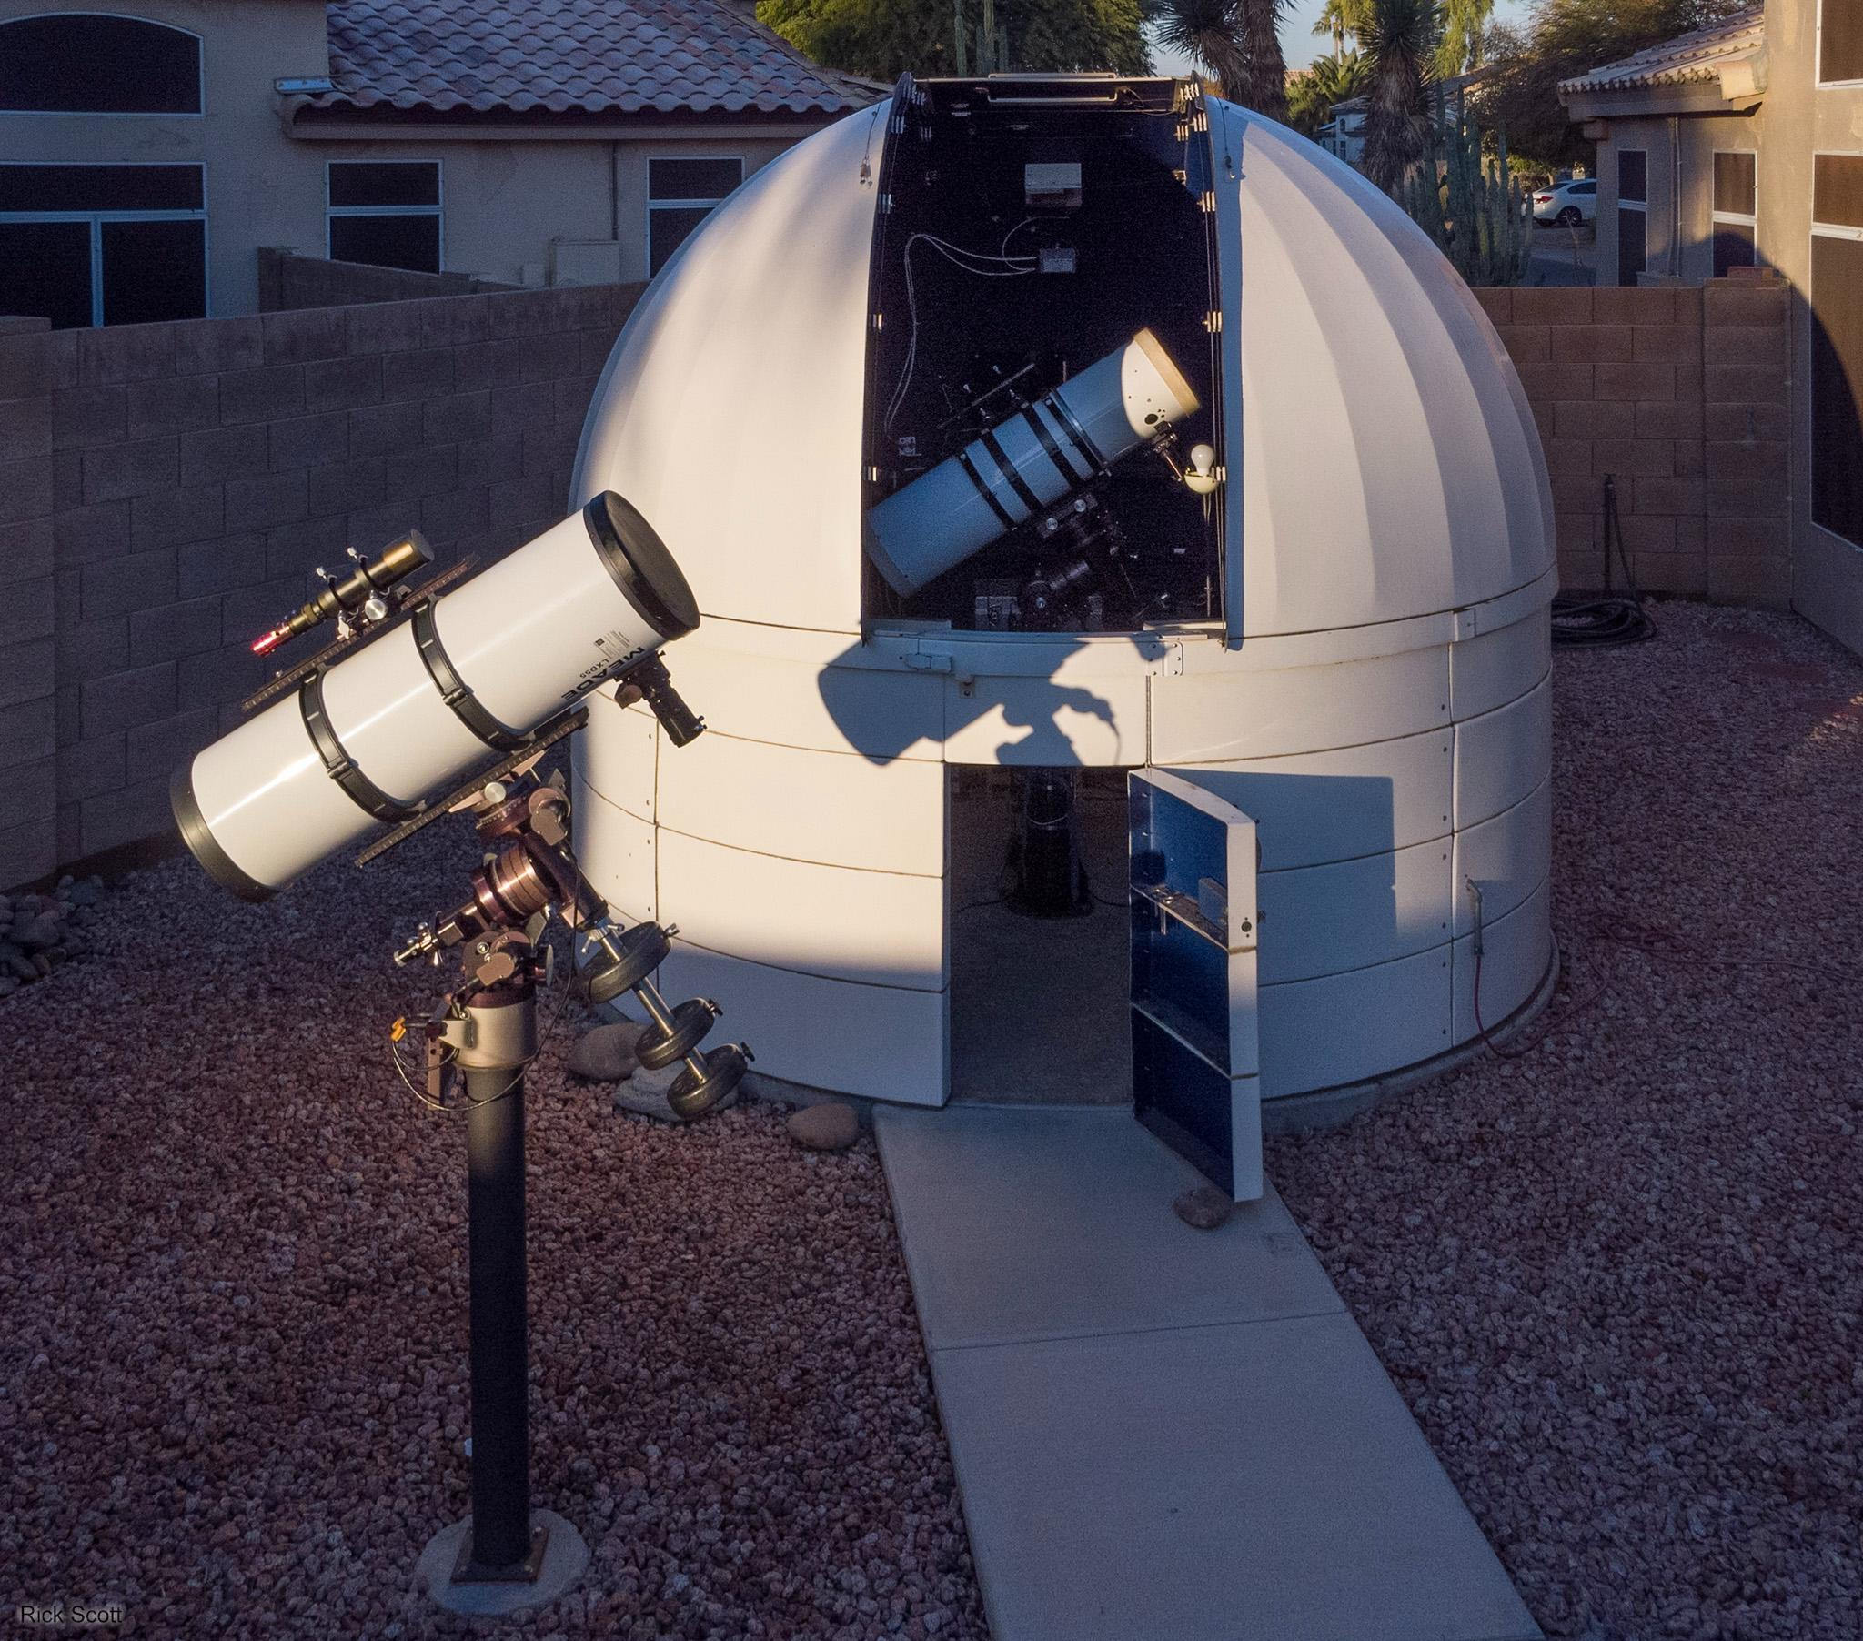
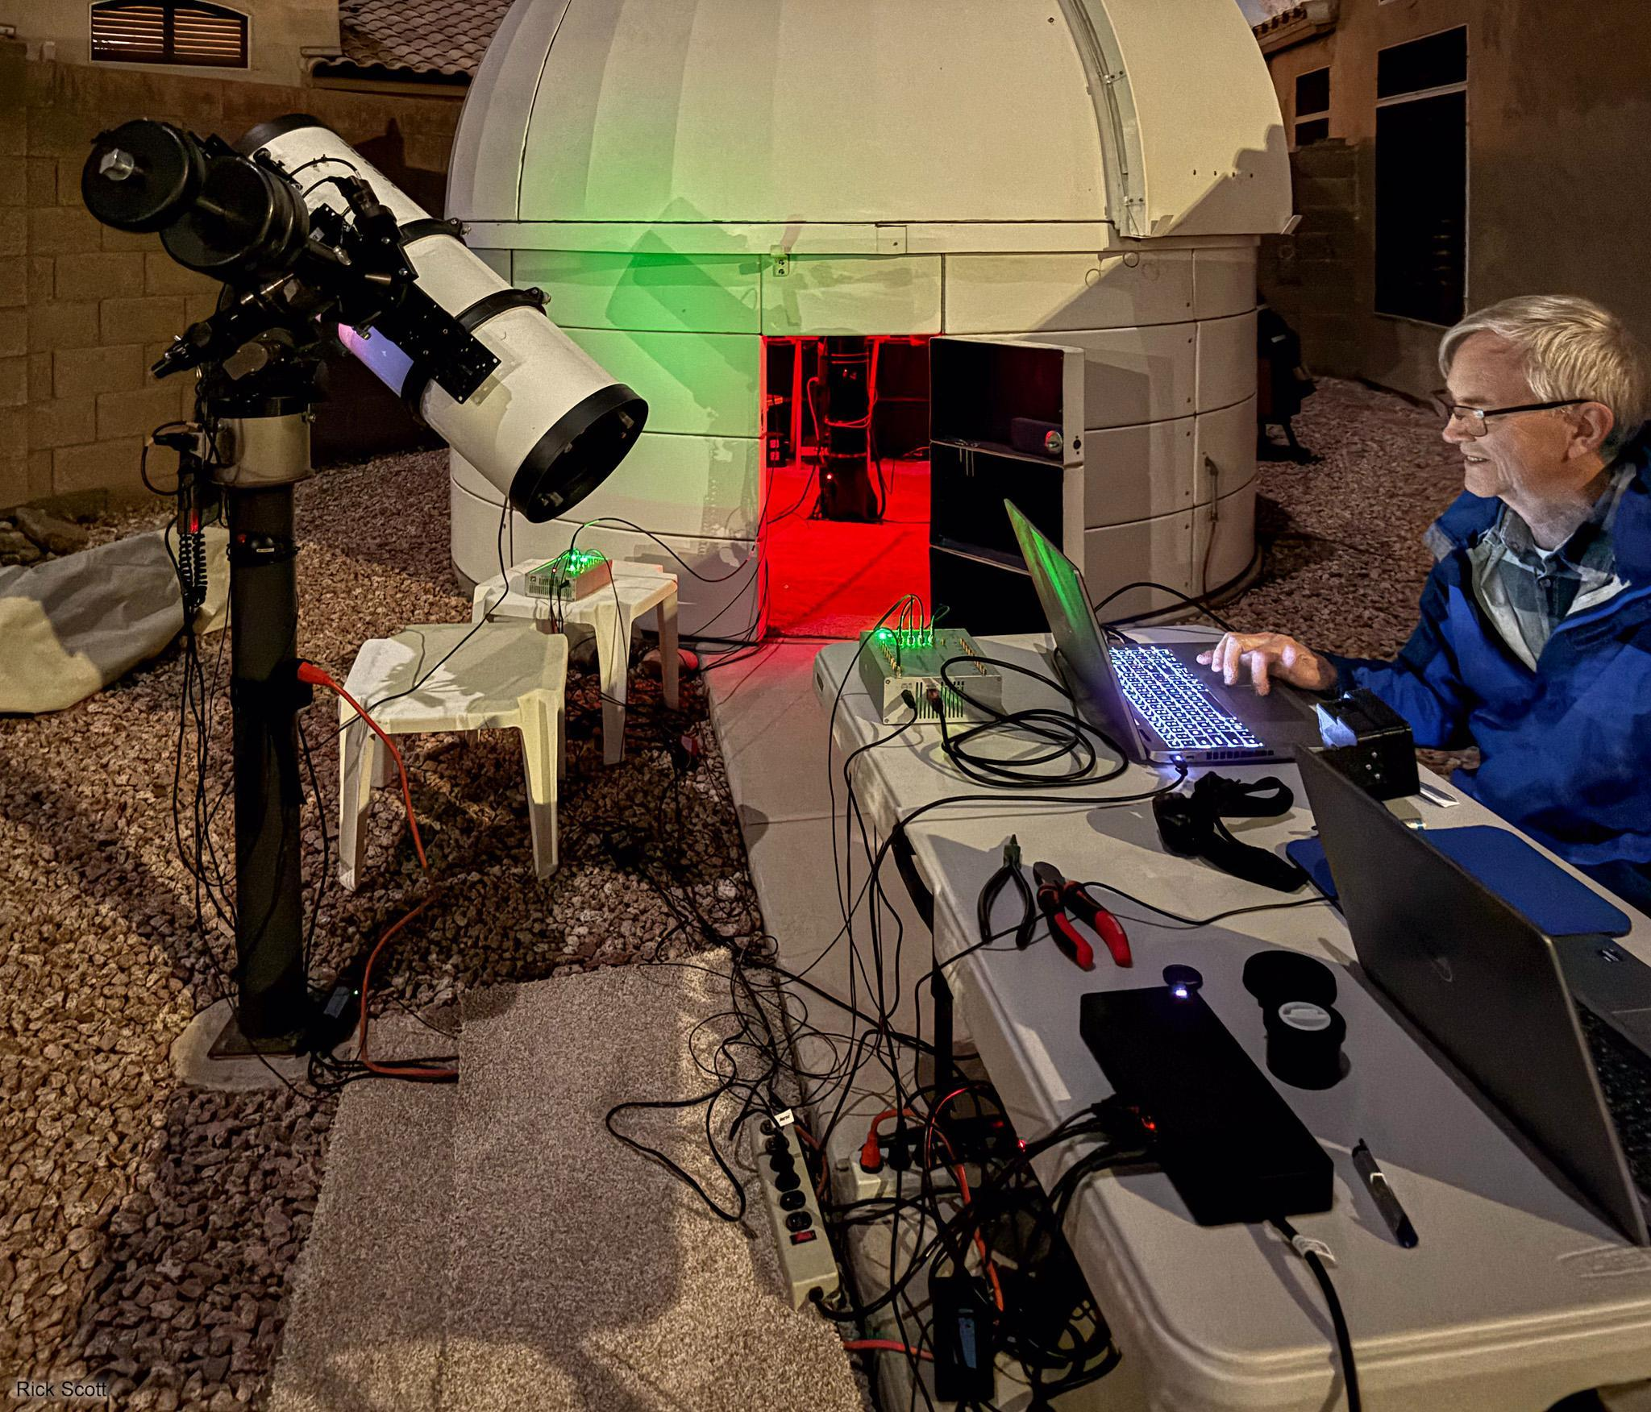
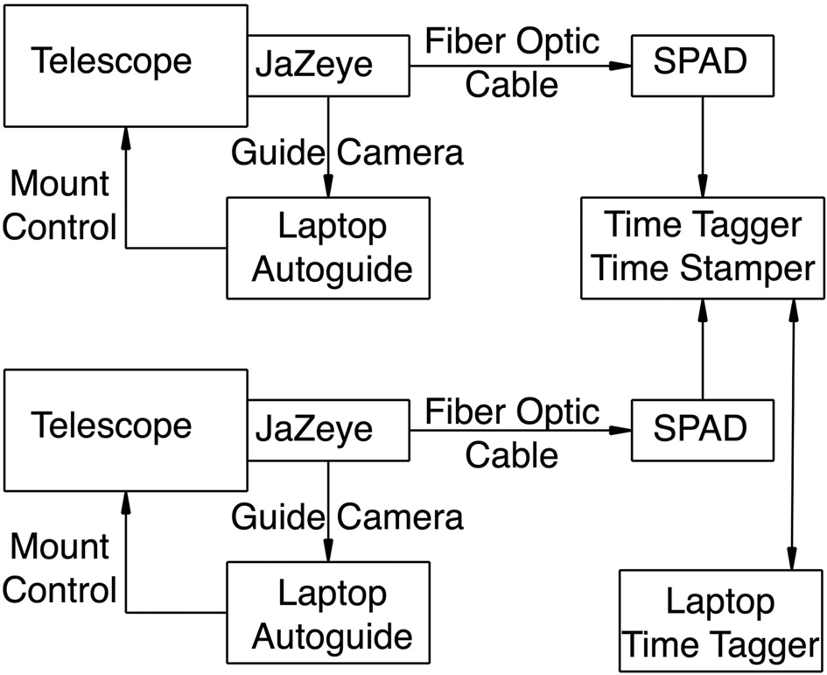
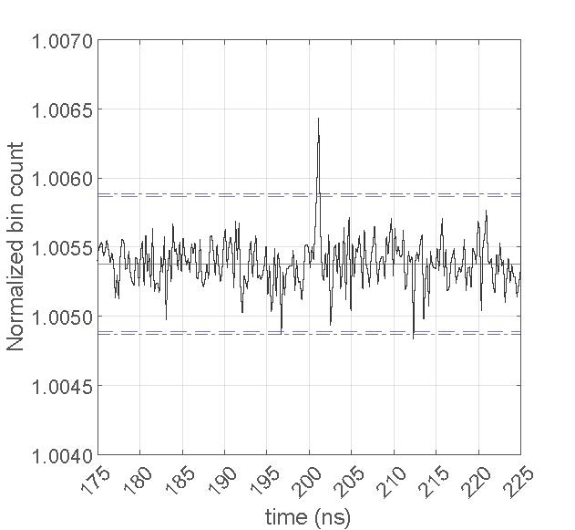
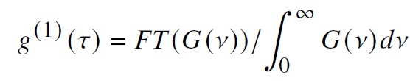
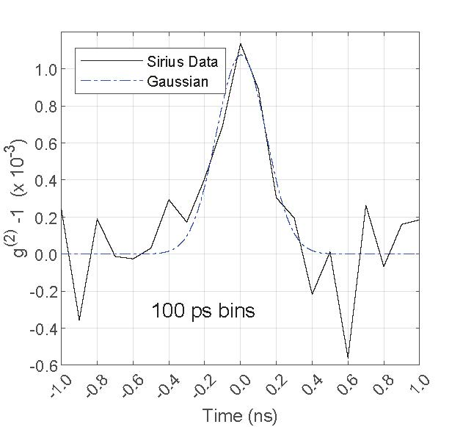
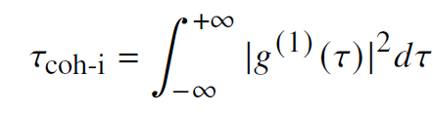
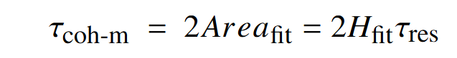
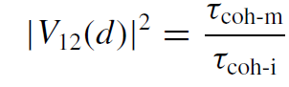
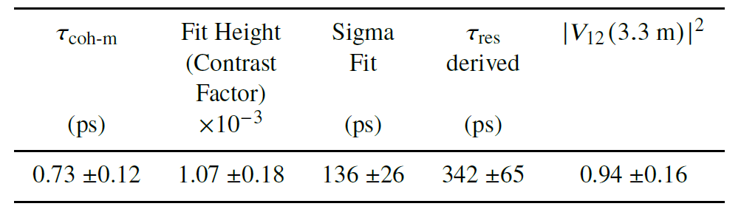
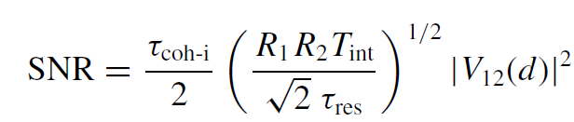
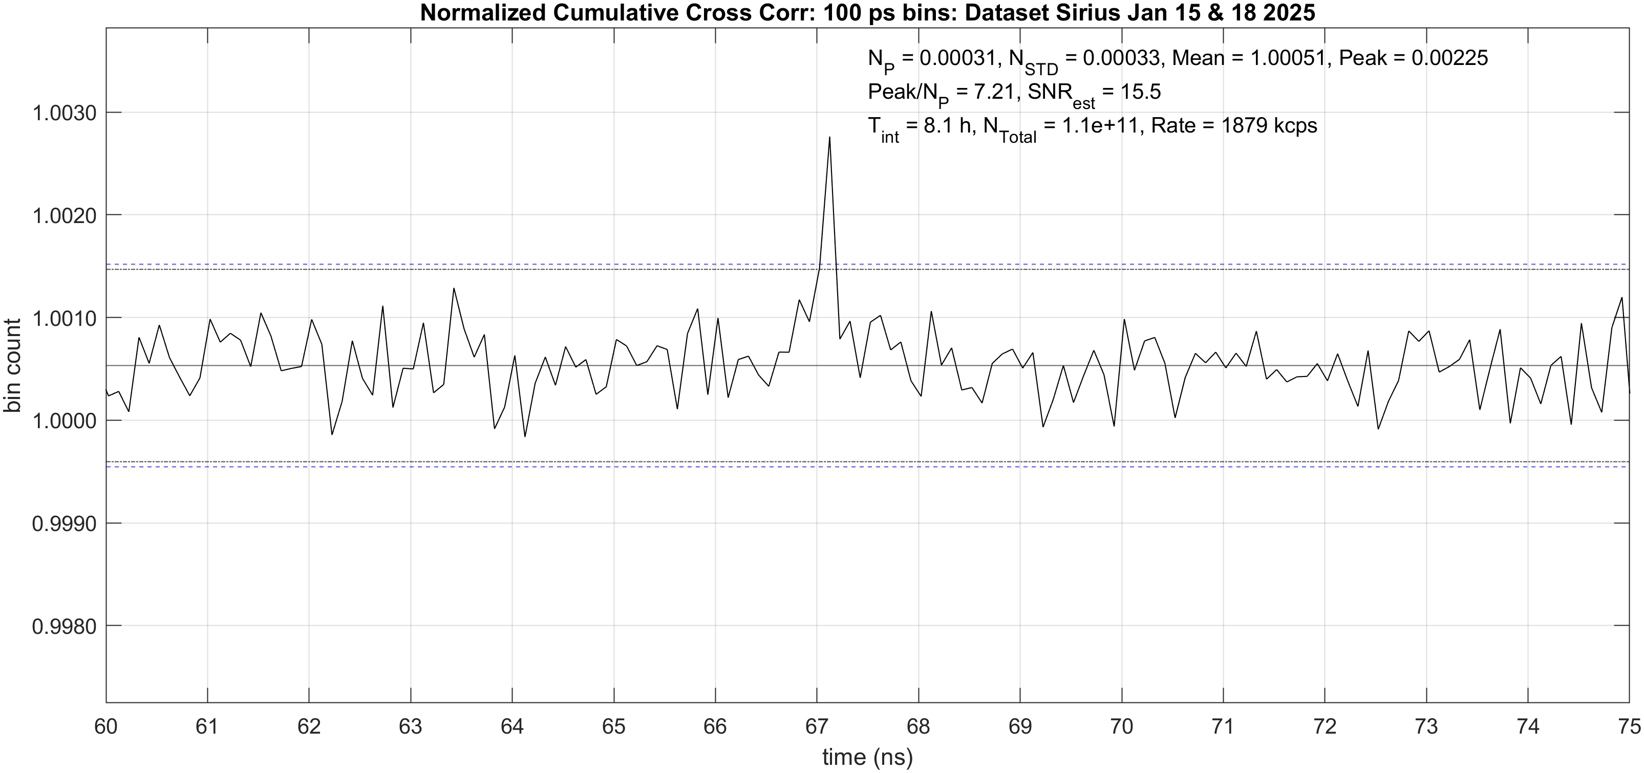
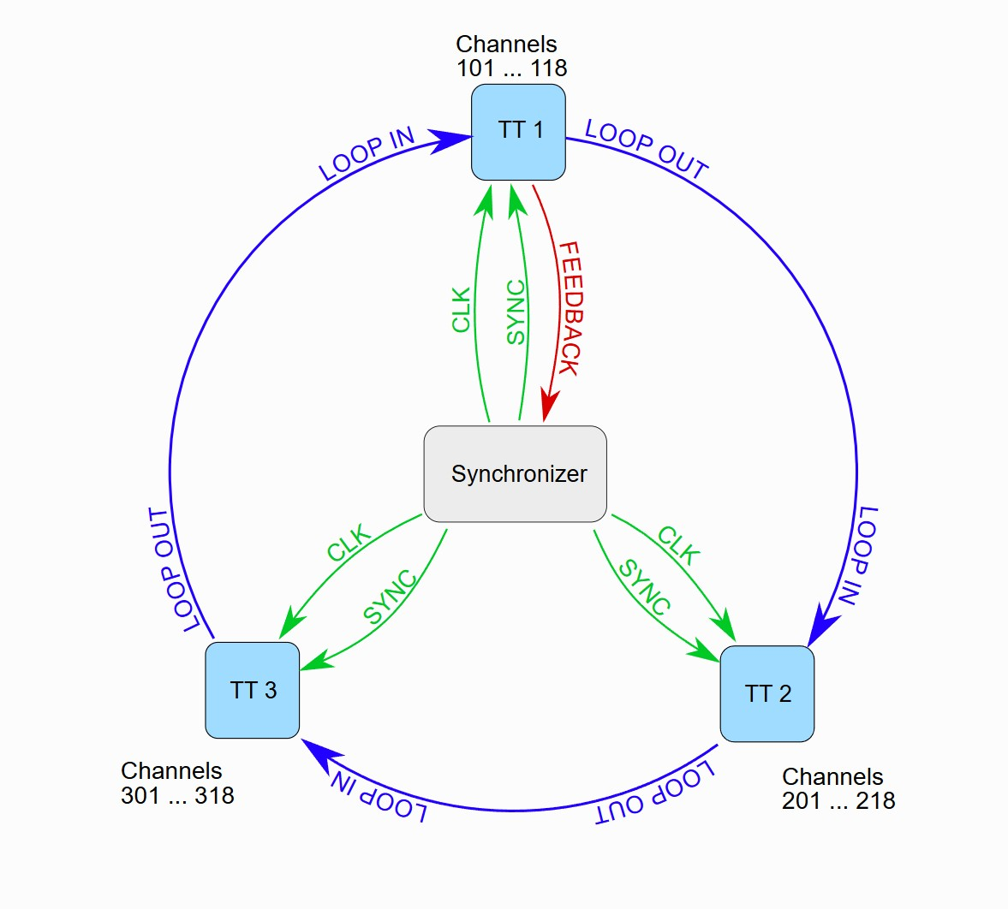

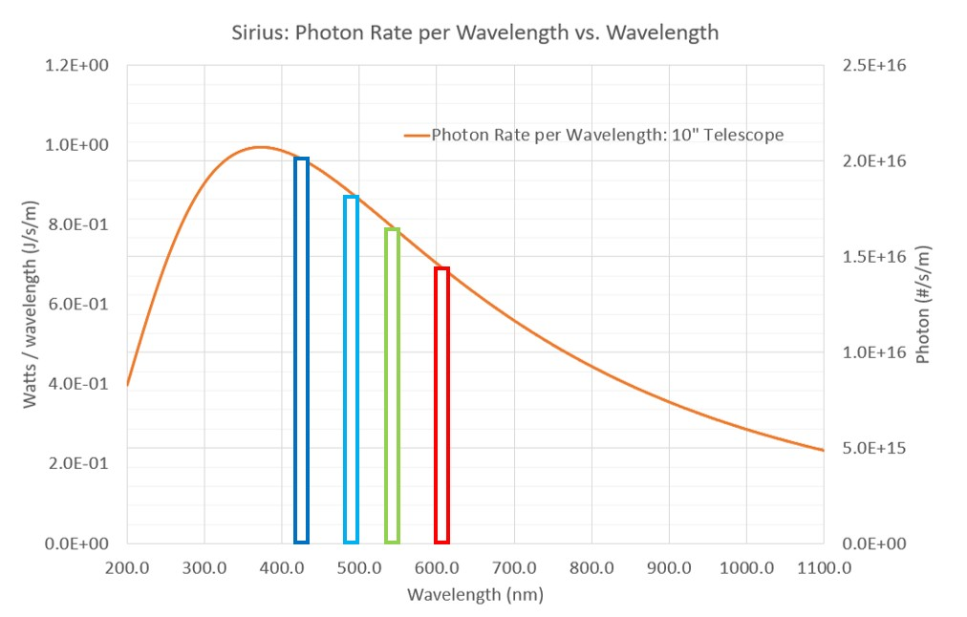
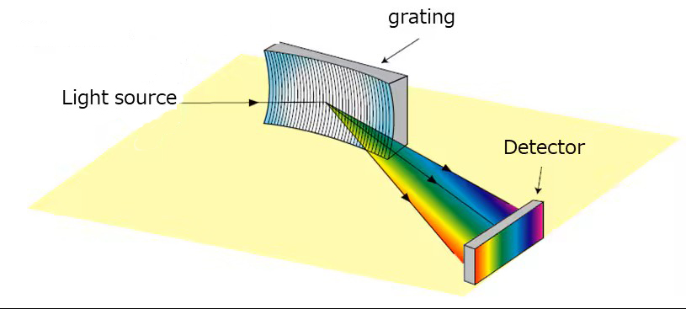
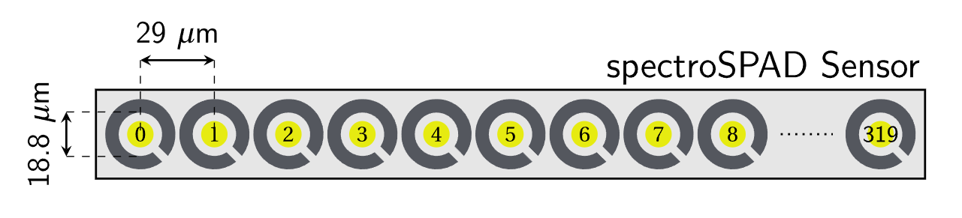
Stellar Intensity Interferometry Results on Sirius
with 0.25 m Telescopes and Enhancements for the Future
Tom Mozdzen, Rick Scott, Isaac Smith, Phil Mauskopf
2024 Measurements for MNRAS 2025 Paper
Delay line
T_{int}=13.55 h
1.9 Mcps
200 ps bins
+/- 3 σ std
+/- 3 N_{poisson}
Detection SNR ~7.1 Visibility² at 3.3 m (0.94 +/-0.16) agrees with expected value of 0.94 +/-0.01
Jitter Enhancements and Collection Time Reduction Plans (NSF Funding 2025)
T_{int} = 7.8 h
100 ps bins
Detection SNR ~7.7
T_{coh-m} = 0.73 +/-0.10
Fit Height = 2.8e-3
Fit Sigma = 63 ps
τ_{res} = 159ps
|V₁₂(3.3m)|²=0.94 +/-0.13
Jitter Reduction
Time Tagger Jitter 42 → 8 ps (σ)
Step Index (3 m)→ GRIN fiber (1 m)
Delay Cable Reduction
a) 50 m → 25 ft
T_{int} reduction:
Multi-band Spectrometer
Linear array of SPADs
Use more of the spectrum
No t=0 crosstalk
No delay cable =
No delay cable jitter
Shimadzu
REFERENCES
Two Swabian Time Taggers + Synchronizer
T. J. Mozdzen, R. M. Scott, P. D. Mauskopf, and R. R. Rodriguez, MNRAS 537, 2527 (2025).
1
Copyright Arizona State University 2025

