Slide 1
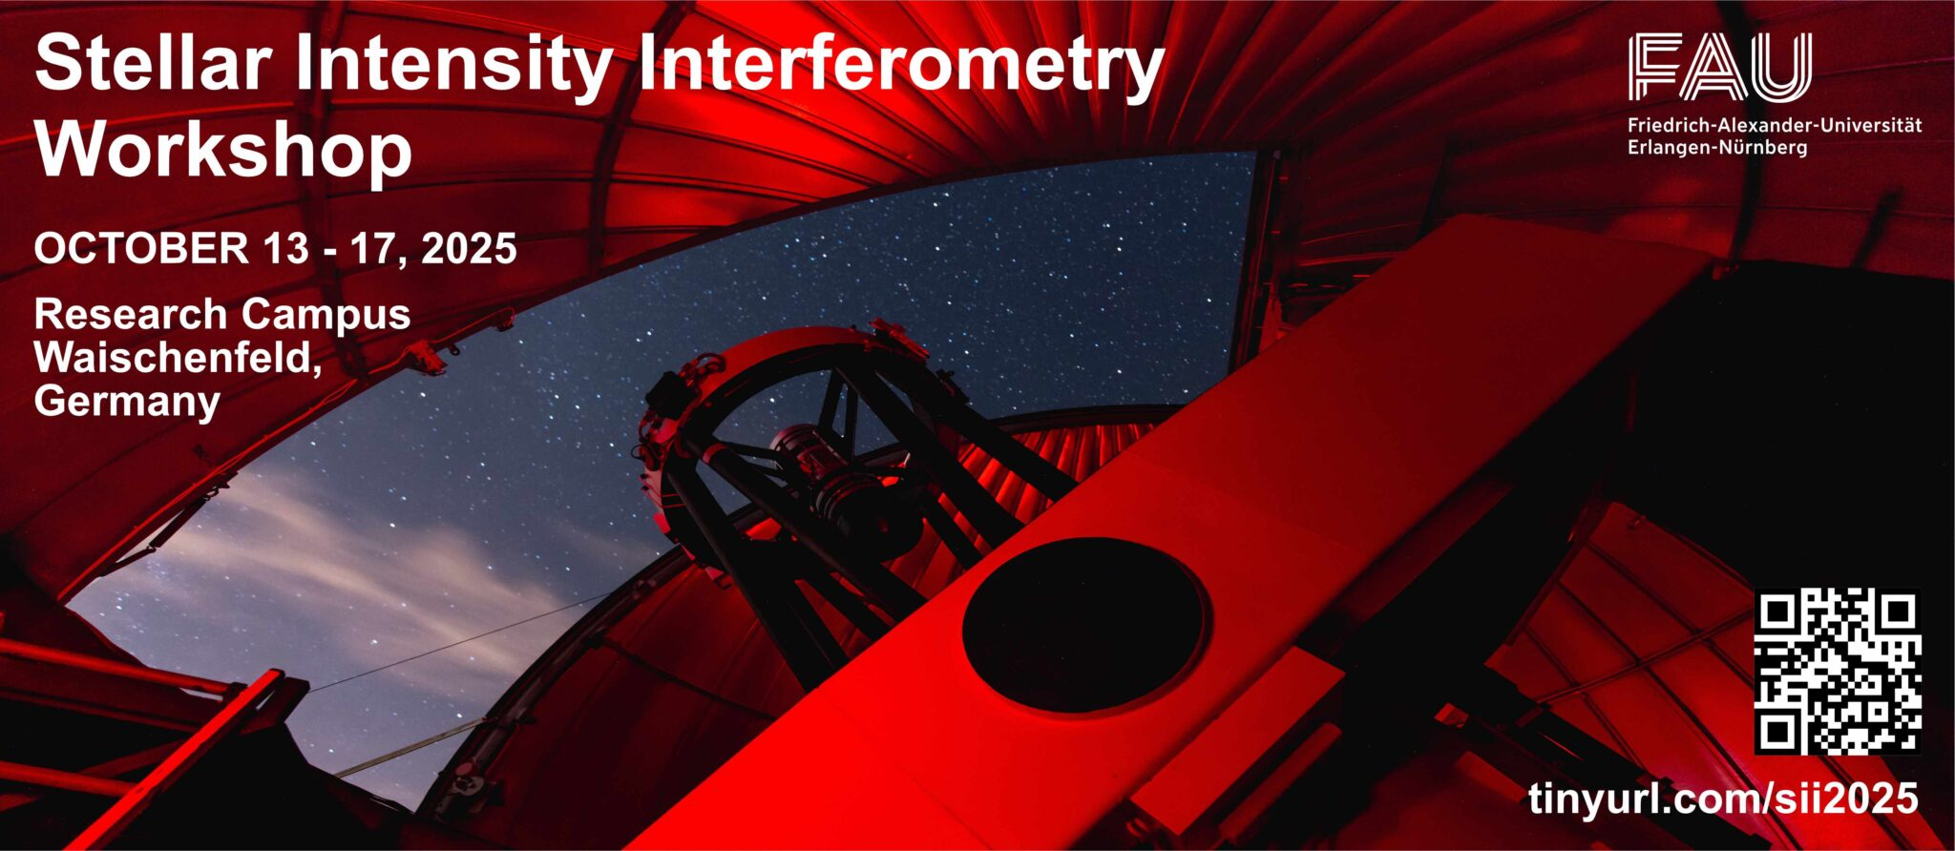
Status of modeling VERITAS measurements on Spica
Workshop talk: preliminary fit to preliminary data
Mike Lisa, Ohio State University
for the VERITAS Collaboration

Slide 2
⍺ Virginis
binary of blue giant with main-sequence secondary: period 346853 sec (4.0145 days)
beyond spectroscopic binary - imaged by Hanbury Brown at Narrabri [1]
Both members are rapid rotators (gravitational darkening etc)
Close proximity (semi-major axis ≈ 1.5 mas ~ θ₁ ≈ 0.9 mas)
  gravitationally distorted
  mutual reflectivity [2]
  potentially affected by stellar winds [3]
Two orbiting circular stars is
clearly a crude approximation
… nevertheless…
[1] Herbison-Evans et al, MNRAS (1971) 151 161
[2] Bailey et al, Nature Ast. 3 (2019) 636
[3] Geis et al, ApJ 479 (1997) 408

Slide 3
Modeling a binary system
Symbol | Name | note |  | HB 1971
P | Period | Known. Not a fit parameter | 4.0145 days | given
T | Time of periastron | From spectroscopy | HJD 2454189.40 ± 0.2 days | given
e | Eccentricity | From time dep. of doppler-shifted spectral lines. | Several estimates exist Fit param | given 0.146
ω | Longitude of periastron (line of apsides, major axis) | From spectroscopy – evolves with time over 120 years | Spectroscopy uncertainties significant -> Fit param | given
Ω | Position angle of line of nodes |  | Fit param | fitted
i | Inclination |  | Fit param | fitted
a | Semimajor axis |  | Fit param | fitted
θ_{UD,1} | UD ang. diam. of primary |  | Fit param | fitted
θ_{UD,2} | UD ang. diam. of secondary | Dimmer. Reduced sensitivity. | Fit param (often fixed) | Fixed 0.4 mas
R | Brightness ratio (>1) |  | Fit param | fitted
Norm | Instrumental normalization | zero-baseline |V|² | Fit param | fitted

Slide 4
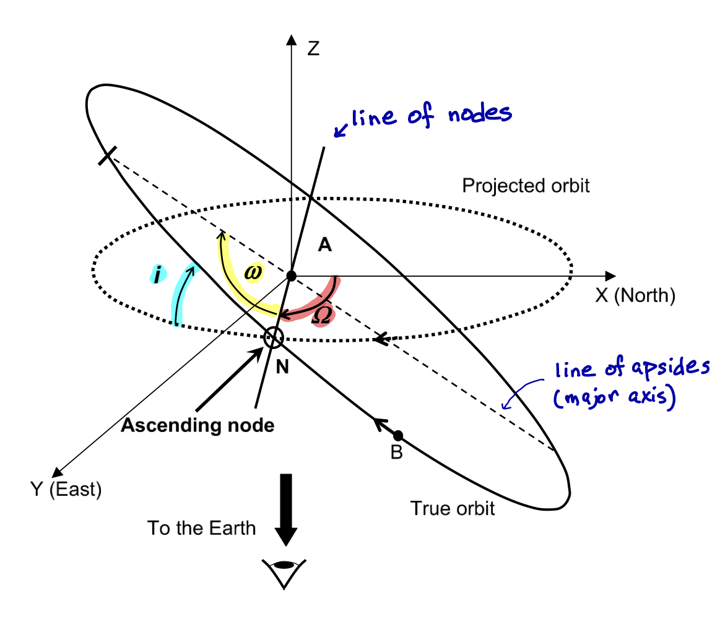
Modeling a binary system
Symbol | Name | note |  | HB 1971
P | Period | Known. Not a fit parameter | 4.0145 days | given
T | Time of periastron | From spectroscopy | HJD 2454189.40 ± 0.2 days | given
e | Eccentricity | From time dep. of doppler-shifted spectral lines. | Several estimates exist Fit param | given 0.146
ω | Longitude of periastron (line of apsides, major axis) | From spectroscopy – evolves with time over 120 years | Spectroscopy uncertainties significant -> Fit param | given
Ω | Position angle of line of nodes |  | Fit param | fitted
i | Inclination |  | Fit param | fitted
a | Semimajor axis |  | Fit param | fitted
θ_{UD,1} | UD ang. diam. of primary |  | Fit param | fitted
θ_{UD,2} | UD ang. diam. of secondary | Dimmer. Reduced sensitivity. | Fit param (often fixed) | Fixed 0.4 mas
R | Brightness ratio (>1) |  | Fit param | fitted
Norm | Instrumental normalization | zero-baseline |V|² | Fit param | fitted
Bonneau, Millour, Meiland arxiv:1510:08229

Slide 5
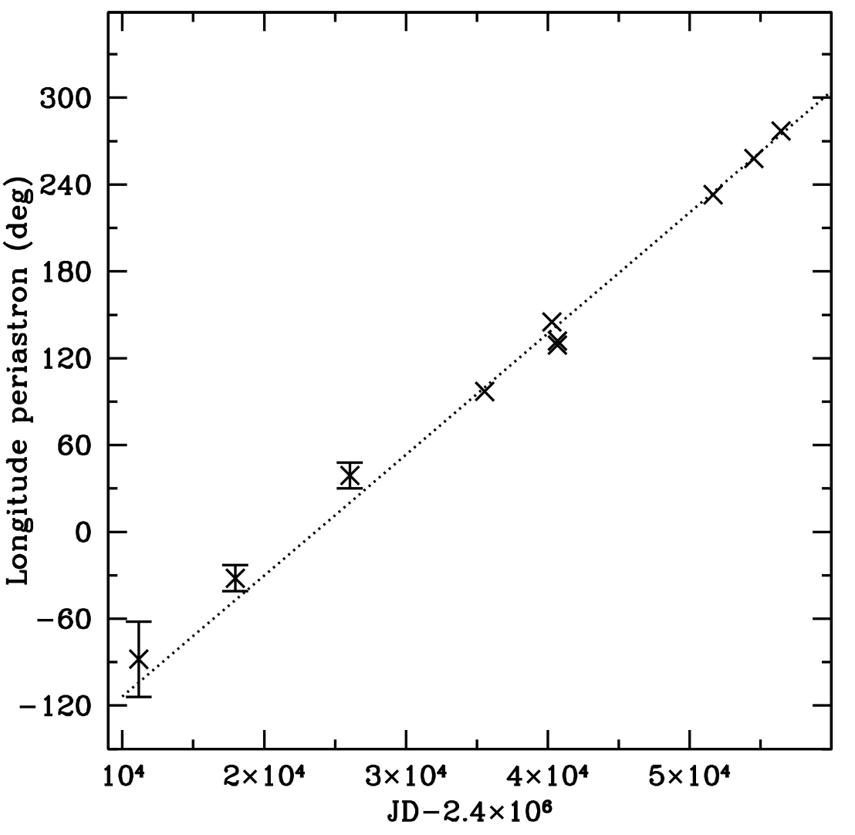
Modeling a binary system
Symbol | Name | note |  | HB 1971
P | Period | Known. Not a fit parameter | 4.0145 days | given
T | Time of periastron | From spectroscopy | HJD 2454189.40 ± 0.2 days | given
e | Eccentricity | From time dep. of doppler-shifted spectral lines. | Several estimates exist Fit param | given 0.146
ω | Longitude of periastron (line of apsides, major axis) | From spectroscopy – evolves with time over 120 years | Spectroscopy uncertainties significant -> Fit param | given
Ω | Position angle of line of nodes |  | Fit param | fitted
i | Inclination |  | Fit param | fitted
a | Semimajor axis |  | Fit param | fitted
θ_{UD,1} | UD ang. diam. of primary |  | Fit param | fitted
θ_{UD,2} | UD ang. diam. of secondary | Dimmer. Reduced sensitivity. | Fit param (often fixed) | Fixed 0.4 mas
R | Brightness ratio (>1) |  | Fit param | fitted
Norm | Instrumental normalization | zero-baseline |V|² | Fit param | fitted
Harrington (2016) A&A 590 A54
U= 117.9 ± 1.8 yr
(other estimates exist)
apsidal motion

Slide 6
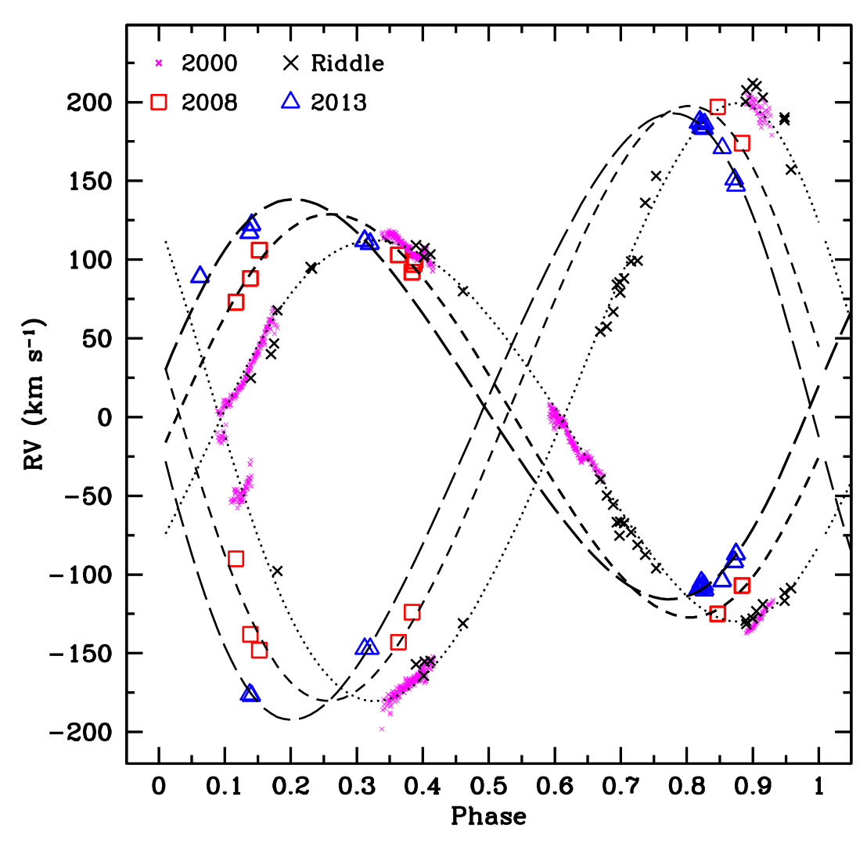
Modeling a binary system
Symbol | Name | note |  | HB 1971
P | Period | Known. Not a fit parameter | 4.0145 days | given
T | Time of periastron | From spectroscopy | HJD 2454189.40 ± 0.2 days | given
e | Eccentricity | From time dep. of doppler-shifted spectral lines. | Several estimates exist Fit param | given 0.146
ω | Longitude of periastron (line of apsides, major axis) | From spectroscopy – evolves with time over 120 years | Spectroscopy uncertainties significant -> Fit param | given
Ω | Position angle of line of nodes |  | Fit param | fitted
i | Inclination |  | Fit param | fitted
a | Semimajor axis |  | Fit param | fitted
θ_{UD,1} | UD ang. diam. of primary |  | Fit param | fitted
θ_{UD,2} | UD ang. diam. of secondary | Dimmer. Reduced sensitivity. | Fit param (often fixed) | Fixed 0.4 mas
R | Brightness ratio (>1) |  | Fit param | fitted
Norm | Instrumental normalization | zero-baseline |V|² | Fit param | fitted
Radial velocity measurements of Si III 4552 Å line
yield spectroscopic determination of e, compiled by
Harrington.
Determination is non-trivial (see e.g. Harrington),
and several estimates exist:
0.067 ± 0.014 Riddle (2000) PhD Georgia State
0.108 ± 0.014 Harrington (2016) A&A 590 A54
0.133 ± 0.017 Tkachenko (2016) MNRAS 458, 1964
0.146 ± 0.009 Struve (1958) ApJ 128, 310 - used by HB

Slide 7
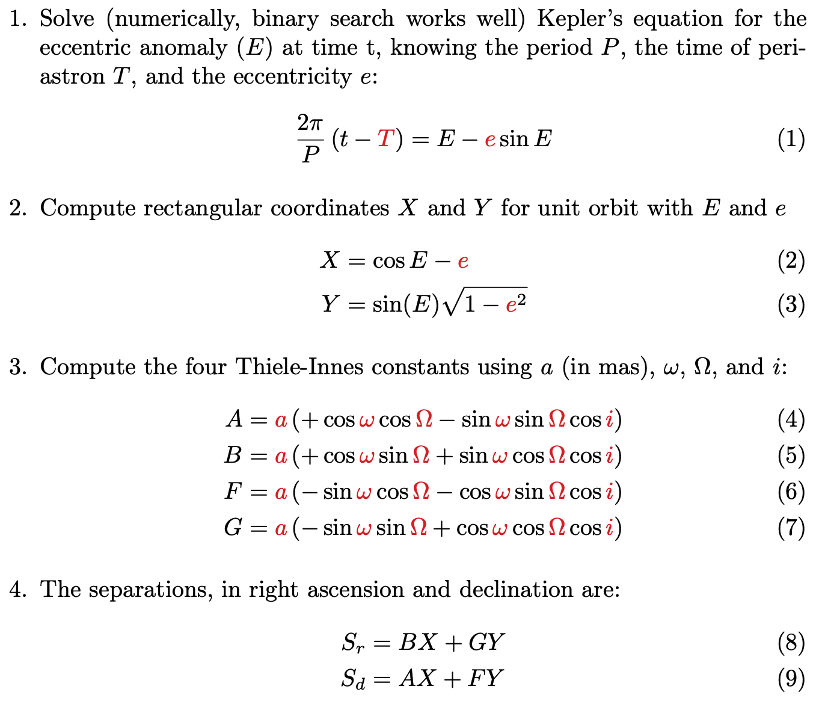
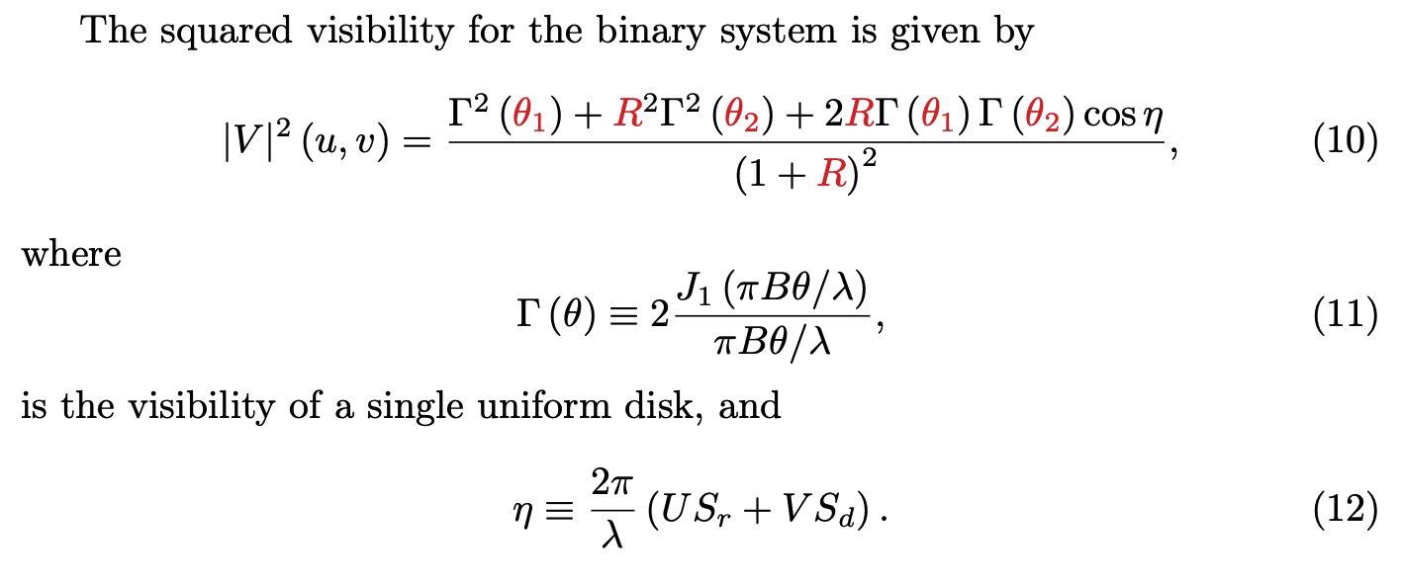
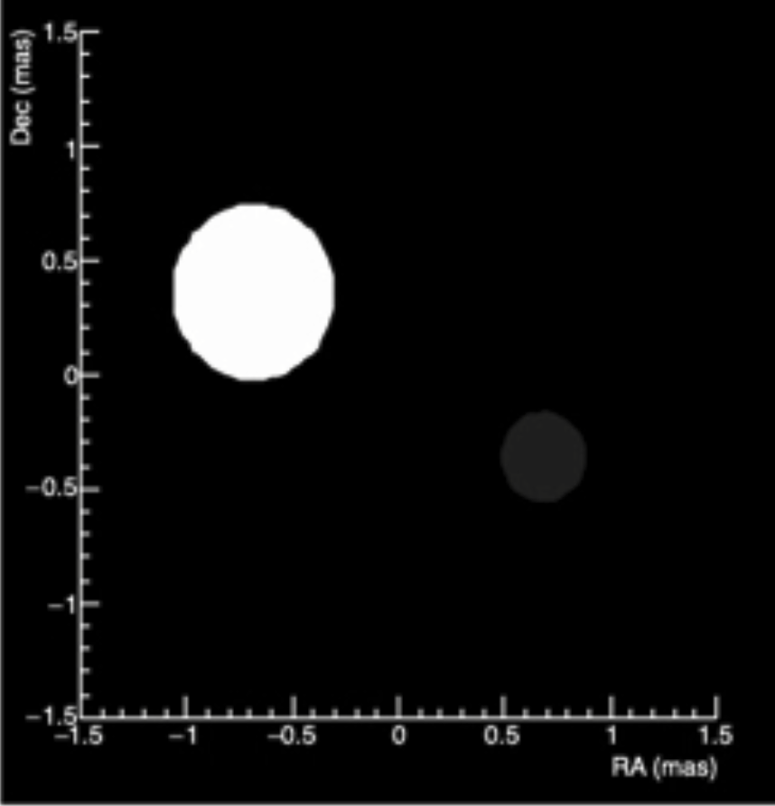
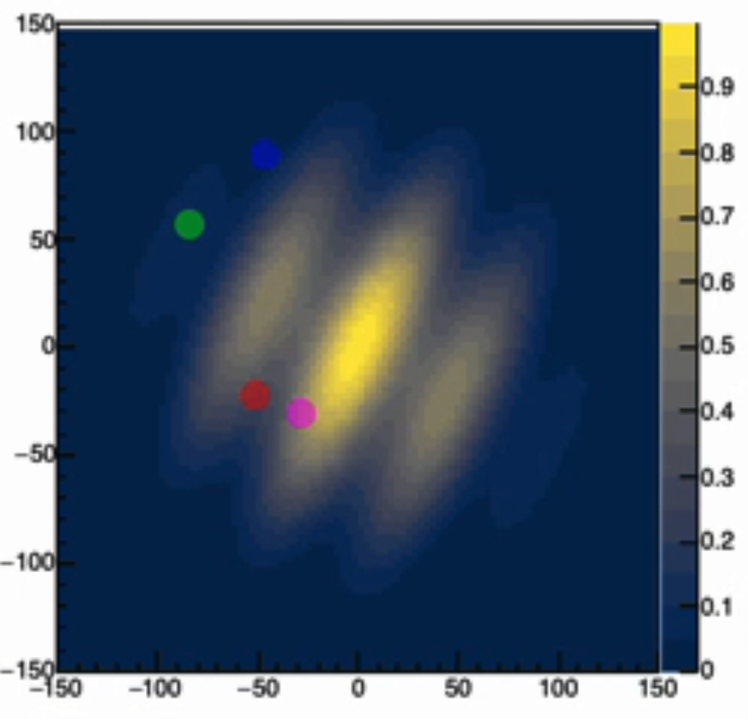
Calculating the positions and squared visibility
correcting for
apsidial motion
Following Pan (2000) and Aufdenberg

Slide 8
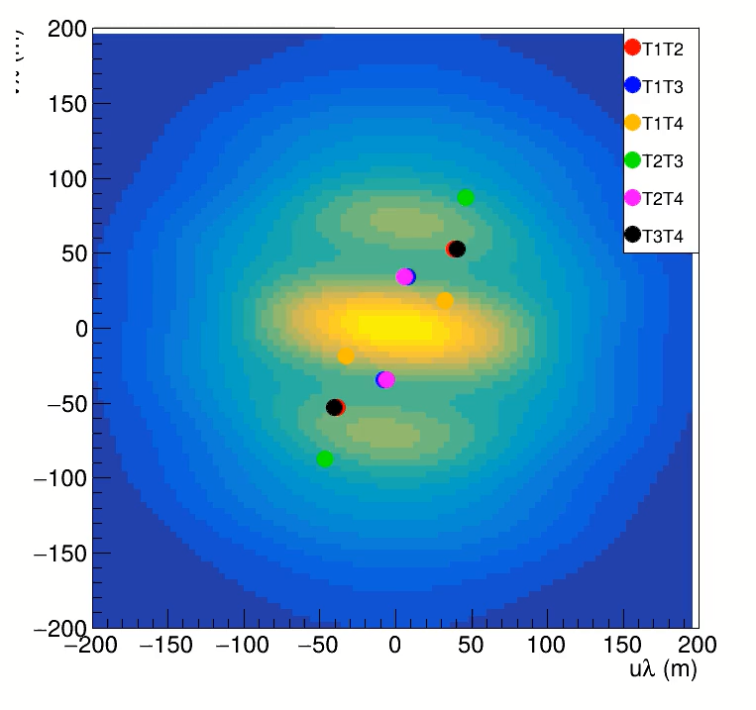
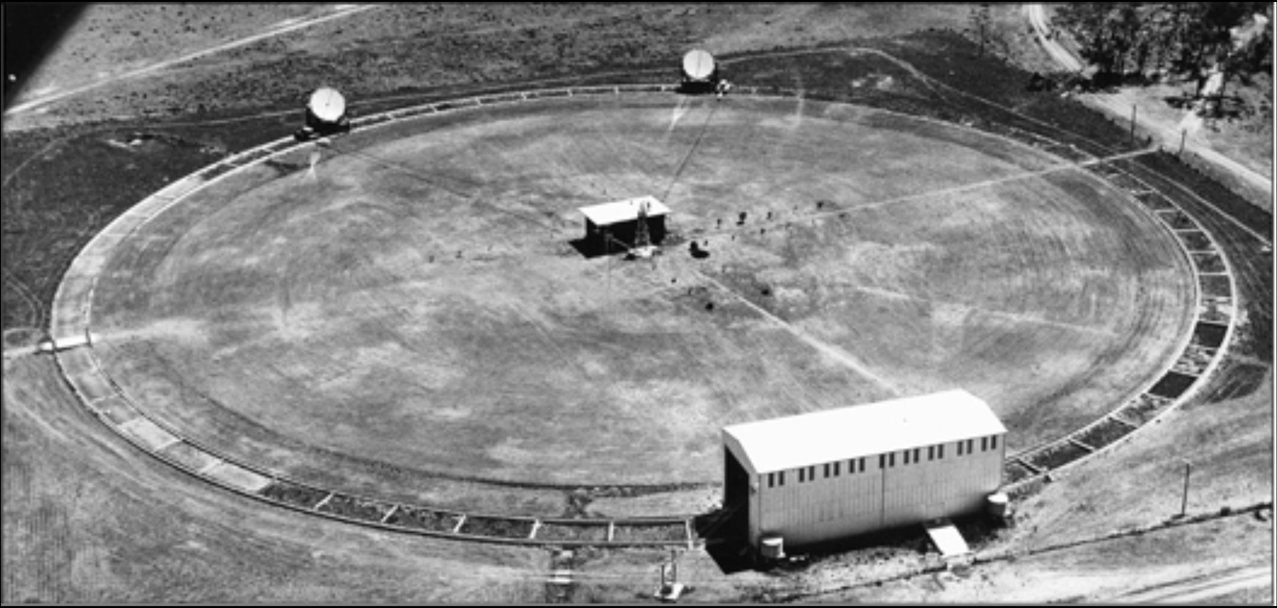
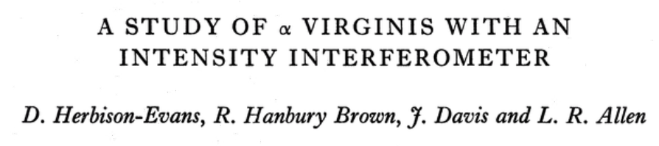
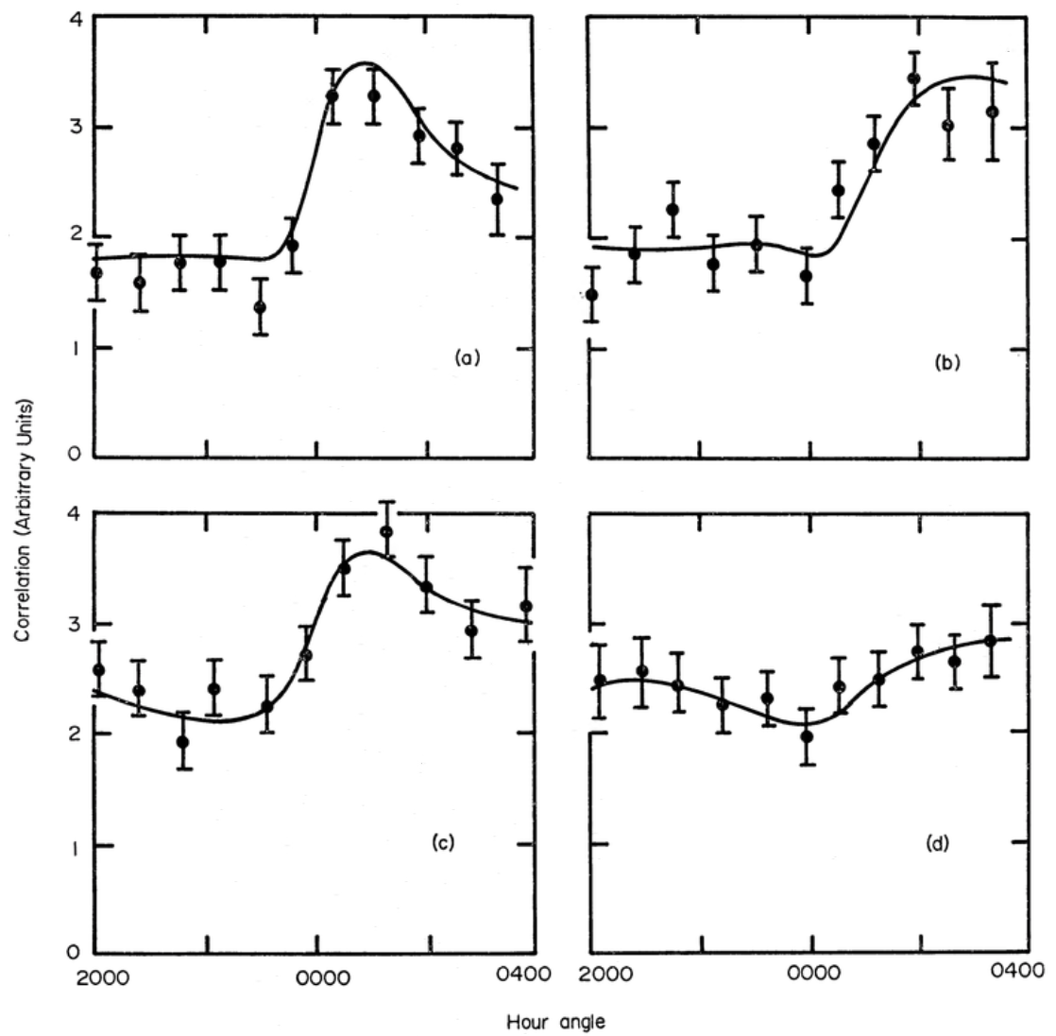
Hanbury Brown measurement of Spica
Spica simulation – J. Aufdenberg
points: VERITAS coverage
MNRAS (1971) 151 161
|b| = 39.1 m. data every ~48 minutes
Separation of telescopes constant and baseline ⊥ line of sight to star
Wiggles imply non-circular shape
JD2440672+680+692
JD2440673+677+689
|V|² (a.u.)
𝜒²/N = 25/44
JD2440678+682+690
JD2440675+683+691
Hour Angle

Slide 9
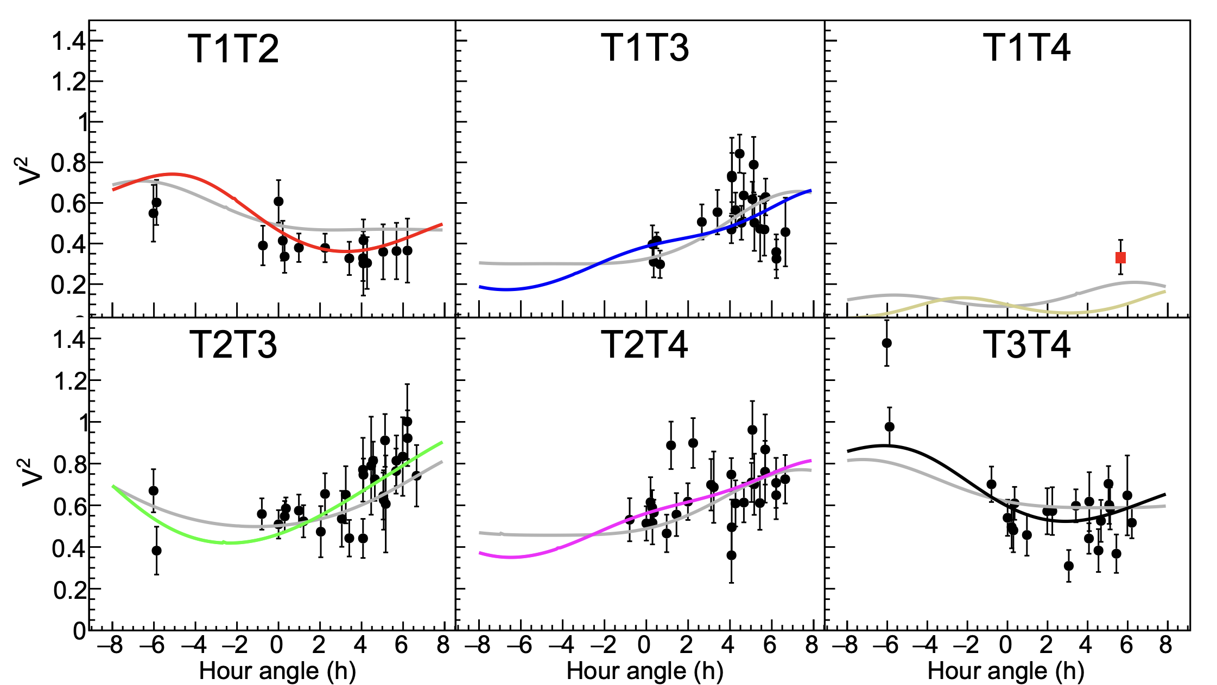
Hanbury Brown measurement of Spica
Spica simulation – J. Aufdenberg
points: VERITAS coverage
MNRAS (1971) 151 161
|b| = 39.1 m. data every ~48 minutes
Separation of telescopes constant and baseline ⊥ line of sight to star
Wiggles imply non-circular shape (not so for fixed-telescope arrays)
JD2440672+680+692
JD2440673+677+689
|V|² (a.u.)
VERITAS ApJ (2025)
in press
𝛾 Cas:
θ_{max}/θ_{max} = 1.28 ± 0.04
(grey curves for round
star wiggle, too!)
Important to see data
with errors vs theory
𝜒²/N = 25/44
JD2440678+682+690
JD2440675+683+691
Hour Angle

Slide 10
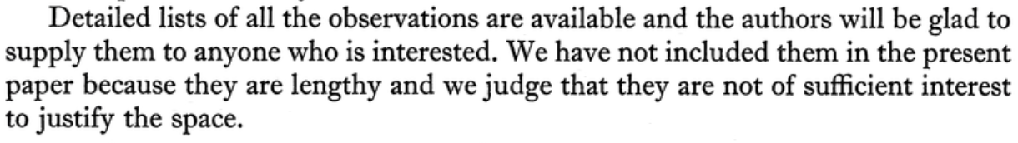
Hanbury Brown measurement of Spica
Spica simulation – J. Aufdenberg
points: VERITAS coverage
MNRAS (1971) 151 161
|b| = 39.1 m. data every ~48 minutes
Separation of telescopes constant and baseline ⊥ line of sight to star
Wiggles imply non-circular shape (not so for fixed-telescope arrays)
Day-to-day variations clearly demonstrate dynamic system
consistent with ~4-day period of Spica
JD2440672+680+692
JD2440673+677+689
|V|² (a.u.)
Important to see data
with errors vs theory
𝜒²/N = 25/44
JD2440678+682+690
JD2440675+683+691
800 observation intervals were fitted (19 rejected as outliers)
Hour Angle

Slide 11
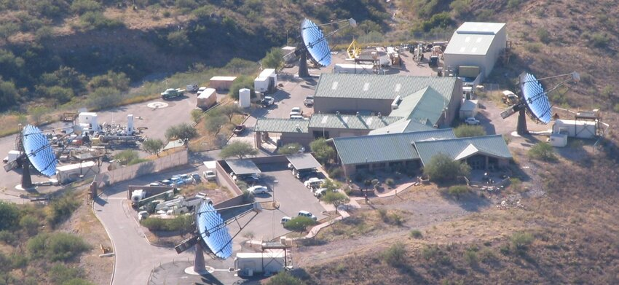
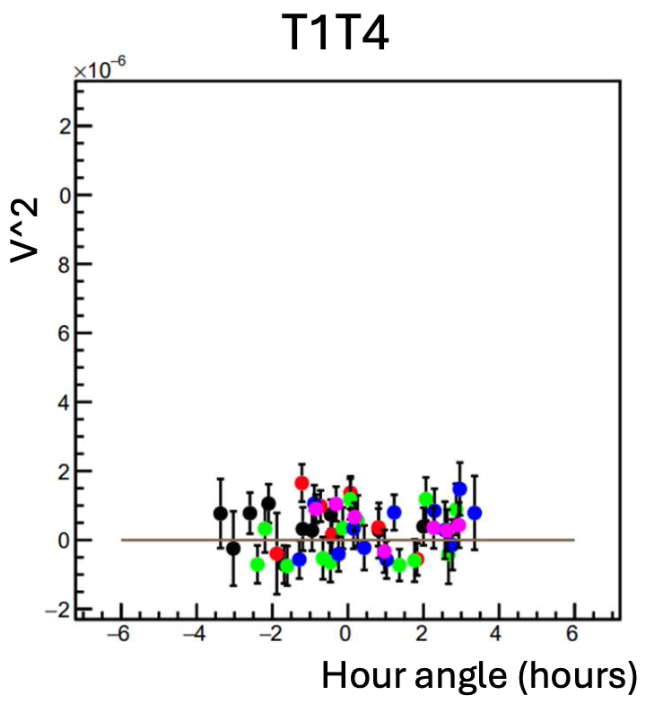
Relevant for Spica: T1T2 T2T3 T2T4 T3T4 (T1T3 and T1T4 had too low signal/noise)
T4
T3
T2
T1
ignore colors here
T1T3 & T1T4 too large baseline to measure signal above noise
- see talk of John Scott

Slide 12
The data
Period = 4.0145 days
Night # | Date (UTC) | # tel. pairs | Observation time (h) | Pair-hours (h) | Pair-hours not T1T3 or T1T4
0 | 2024-02-22 | 6 | 5.41 | 30.8 | 21.6
1 | 2024-02-24 | 6 | 5.66 | 34.0 | 22.6
2 | 2024-05-17 | 6 | 0.98 | 5.9 | 3.9
3 | 2024-05-23 | 3 | 1.80 | 5.4 | 5.4
4 | 2024-05-24 | 1 | 2.71 | 2.7 | 2.7
5 | 2024-05-25 | 6 | 3.85 | 23.1 | 15.4
6 | 2024-05-26 | 6 | 2.05 | 12.3 | 8.2
7 | 2025-03-10 | 3 | 5.17 | 15.5 | 10.3
8 | 2025-03-11 | 3 | 6.40 | 19.2 | 12.8
9 | 2025-05-07 | 3 | 5.41 | 16.2 | 5.41
10 | 2025-05-15 | 6 | 4.92 | 29.5 | 19.7
11 | 2025-05-16 | 6 | 5.17 | 31.0 | 20.7
Total |  |  | 49.53 | 225.6 | 147.8
2 days
83 days = 82.7 ¼-cycles
1 day
77 days = 76.7 ¼-cycles
1 day
57 days = 56.8 ¼-cycles
8 days
1 day
~400 datapoints (~15-minutes) fitted

Slide 13
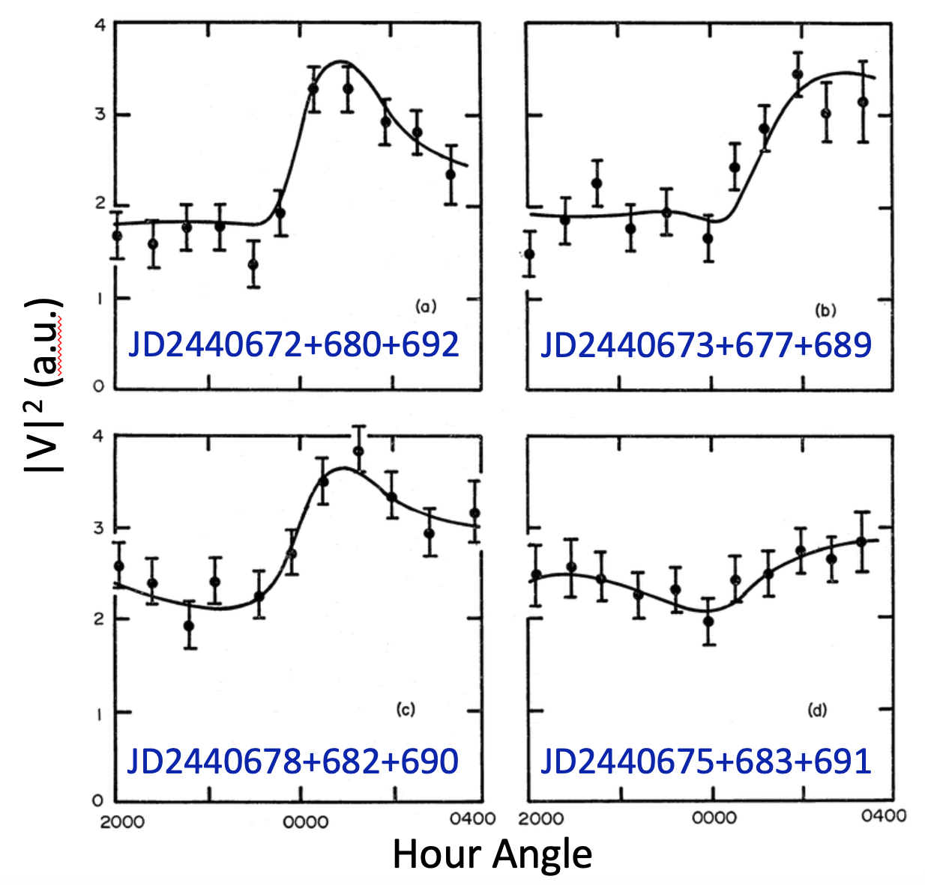
The data
Period = 4.0145 days
Night # | Date (UTC) | # tel. pairs | Observation time (h) | Pair-hours (h) | Pair-hours not T1T3 or T1T4
0 | 2024-02-22 | 6 | 5.41 | 30.8 | 21.6
1 | 2024-02-24 | 6 | 5.66 | 34.0 | 22.6
2 | 2024-05-17 | 6 | 0.98 | 5.9 | 3.9
3 | 2024-05-23 | 3 | 1.80 | 5.4 | 5.4
4 | 2024-05-24 | 1 | 2.71 | 2.7 | 2.7
5 | 2024-05-25 | 6 | 3.85 | 23.1 | 15.4
6 | 2024-05-26 | 6 | 2.05 | 12.3 | 8.2
7 | 2025-03-10 | 3 | 5.17 | 15.5 | 10.3
8 | 2025-03-11 | 3 | 6.40 | 19.2 | 12.8
9 | 2025-05-07 | 3 | 5.41 | 16.2 | 5.41
10 | 2025-05-15 | 6 | 4.92 | 29.5 | 19.7
11 | 2025-05-16 | 6 | 5.17 | 31.0 | 20.7
Total |  |  | 49.53 | 225.6 | 147.8
2 days
83 days = 82.7 ¼-cycles
1 day
77 days = 76.7 ¼-cycles
1 day
57 days = 56.8 ¼-cycles
8 days
For a fixed-position telescope pair, visibility for a dynamic system depends on two independent clocks
1 day
~400 datapoints (~15-minutes) fitted

Slide 14
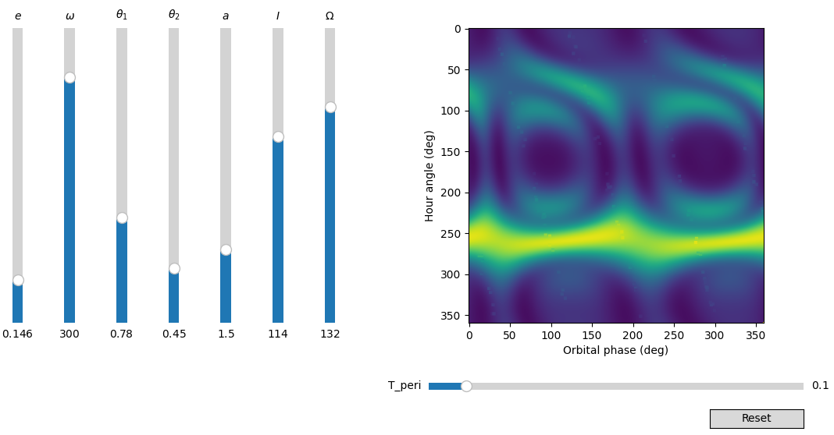

The camouflage plot: A very cool concept by Prasenjit et al.
Choose a telescope pair
Choose orbital parameters
Visibility pattern shown in 2D (time-versus-time)
In principle, can place measurements in this space and adjust orbital parameters until the data “disappear”
Still playing with this, but errorbars/fluctuations in real data may limit its utility

Slide 15
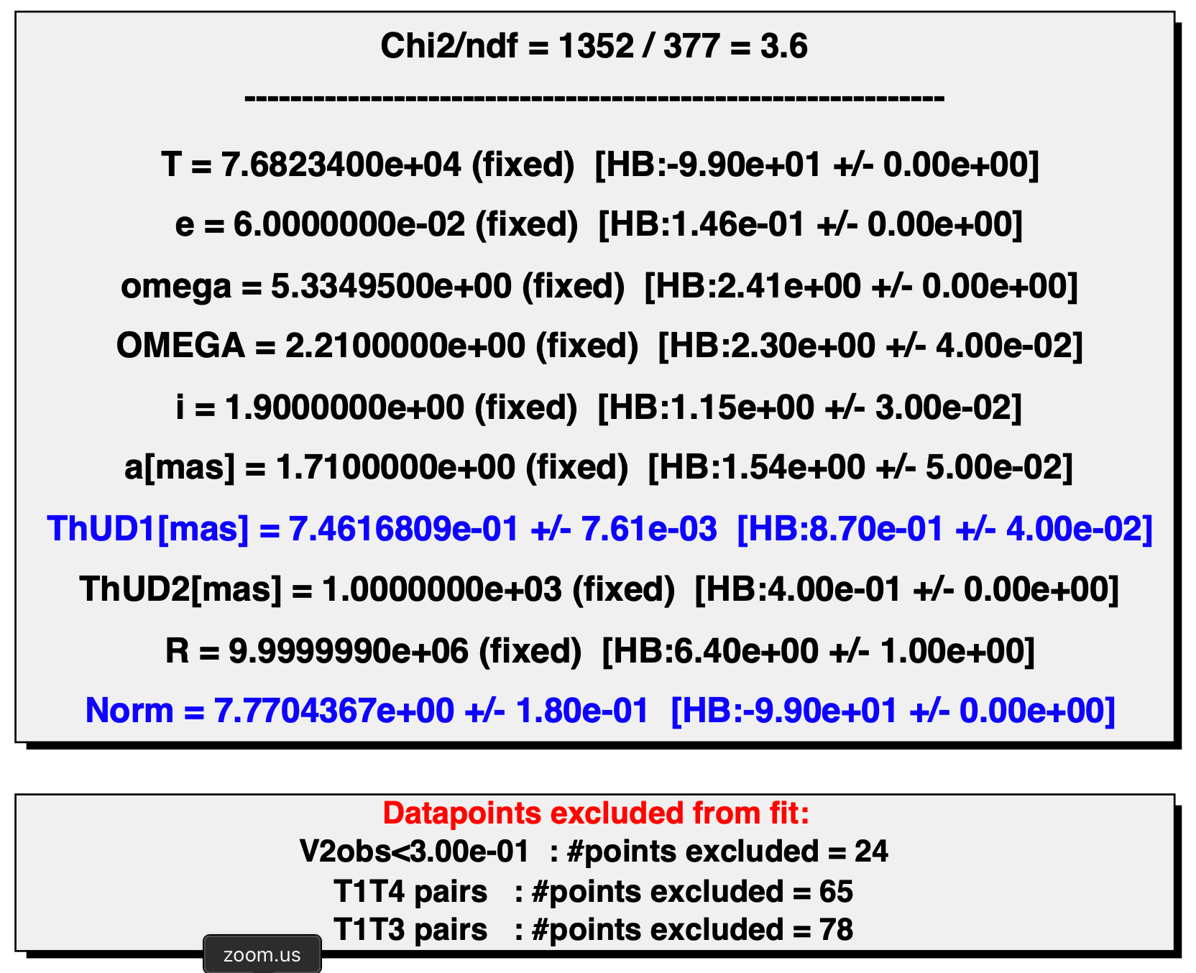
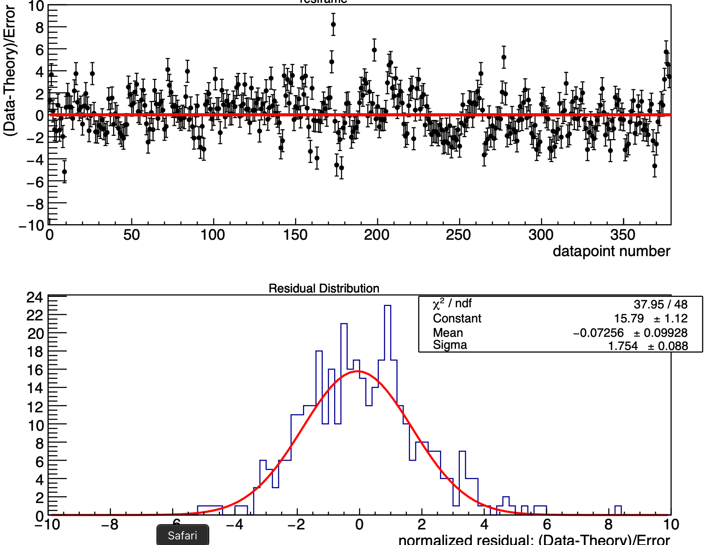
Fit 7 – Single Round Star

Slide 16
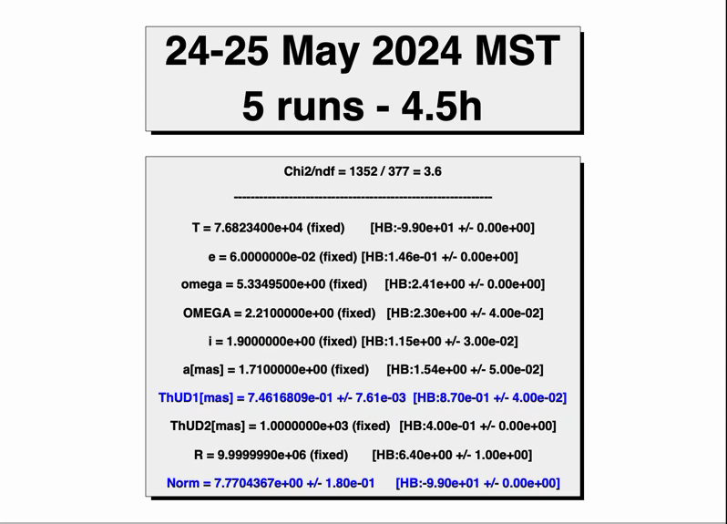
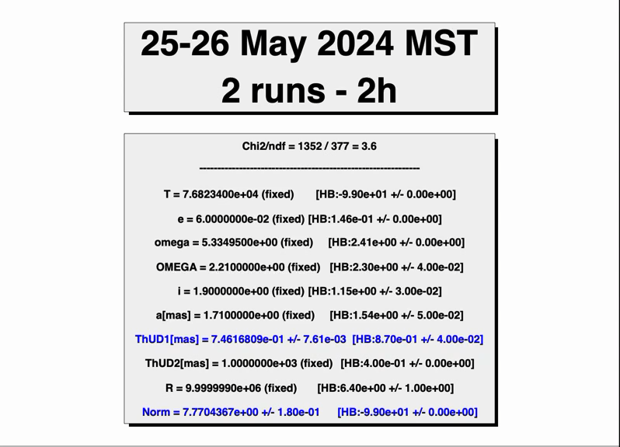
Fit 7 (single round star) – Nights 5,6 – 1 day apart

Slide 17
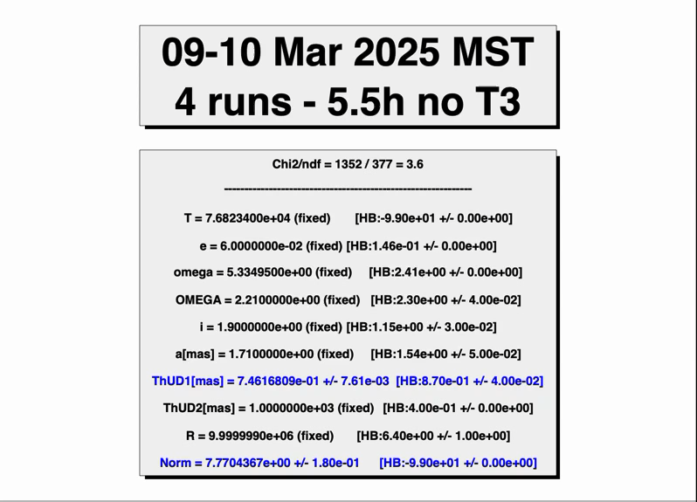
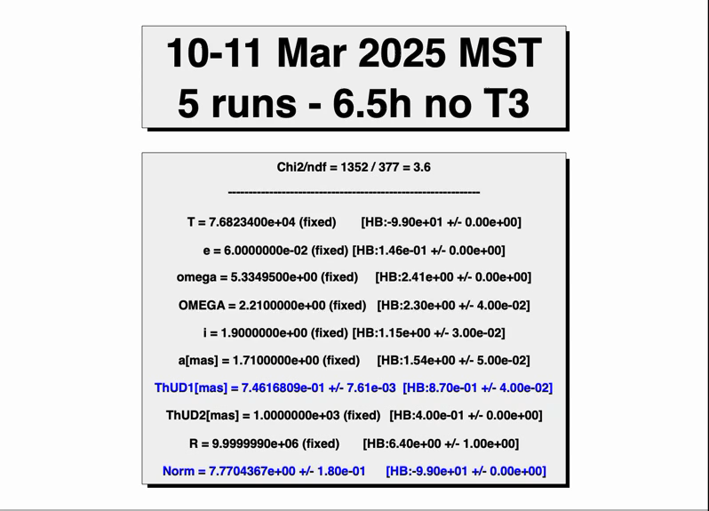
Fit 7 (single round star) – Nights 7,8 – 1 day apart

Slide 18
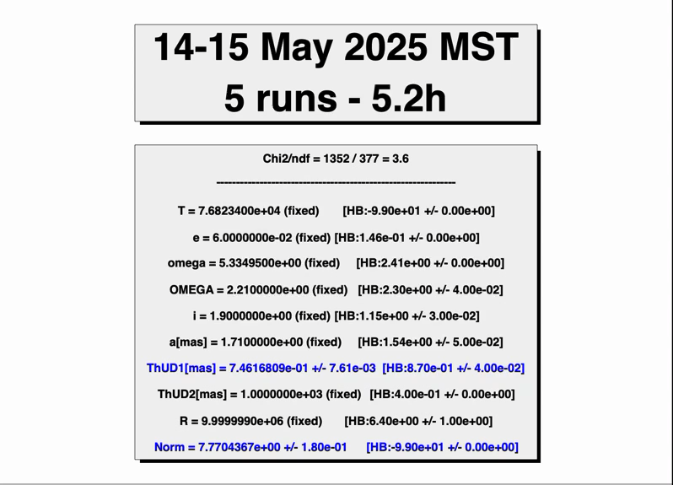
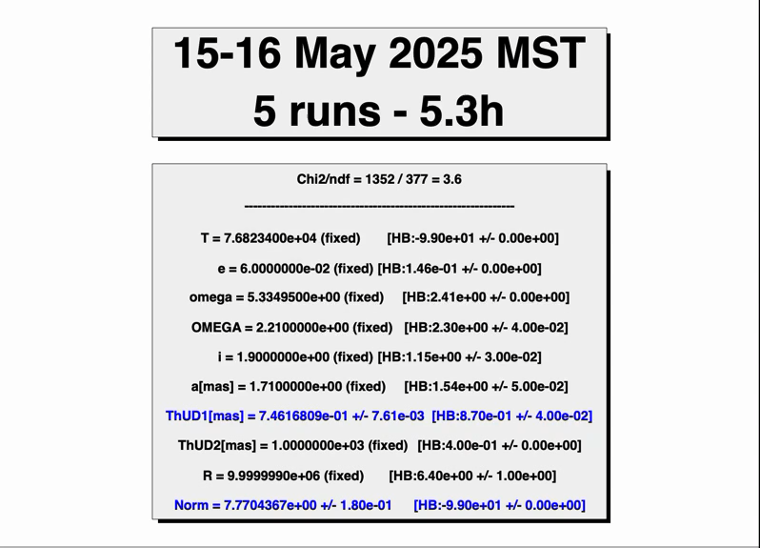
Fit 7 (single round star) – Nights 10,11 – 1 day apart

Slide 19
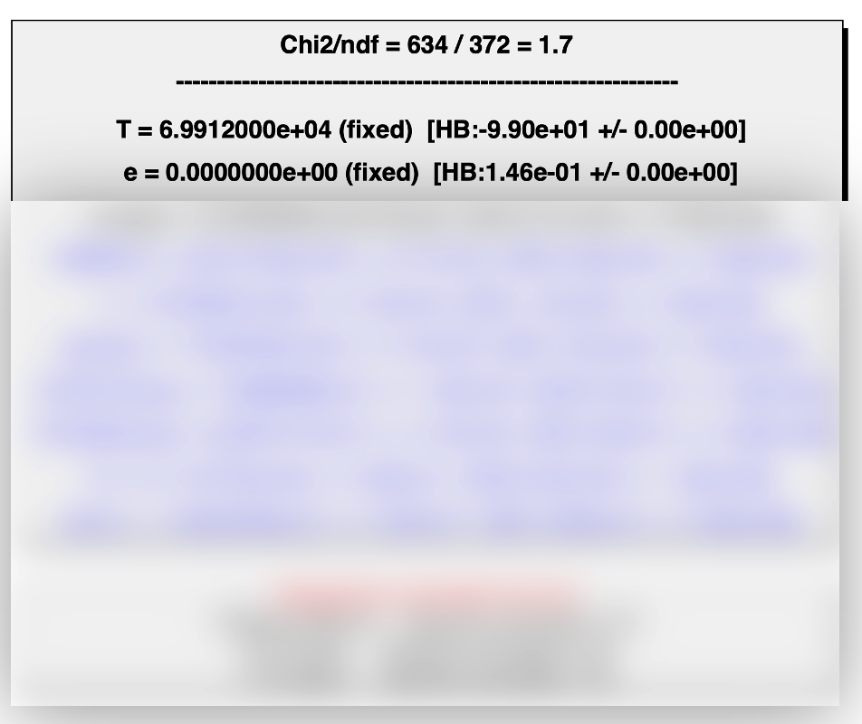
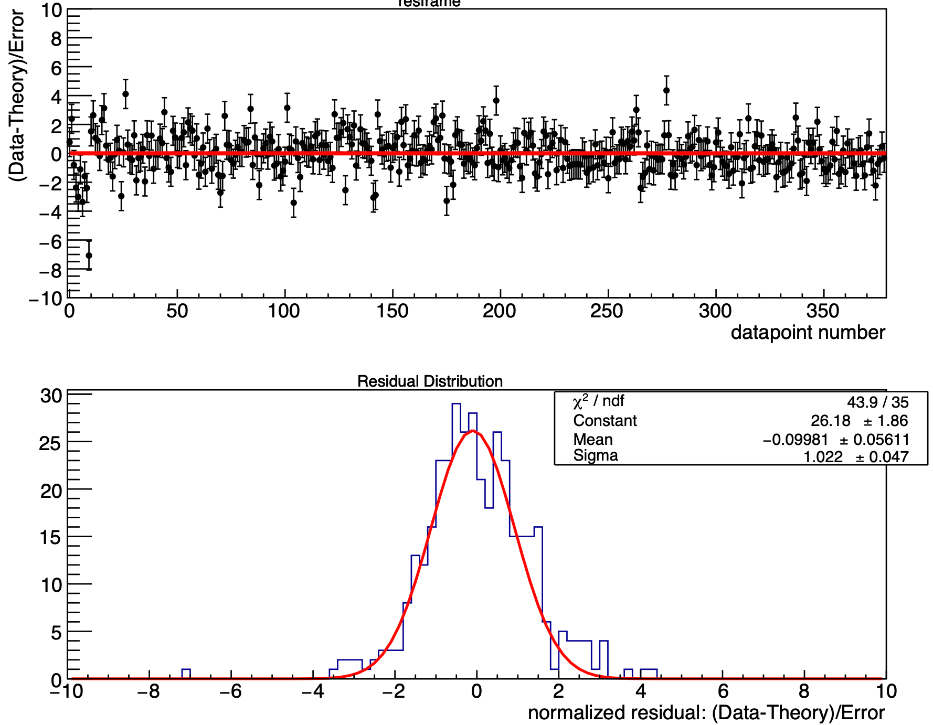
Fit 3 - Binary Star with e=0 and T shifted 1.9 hours

Slide 20
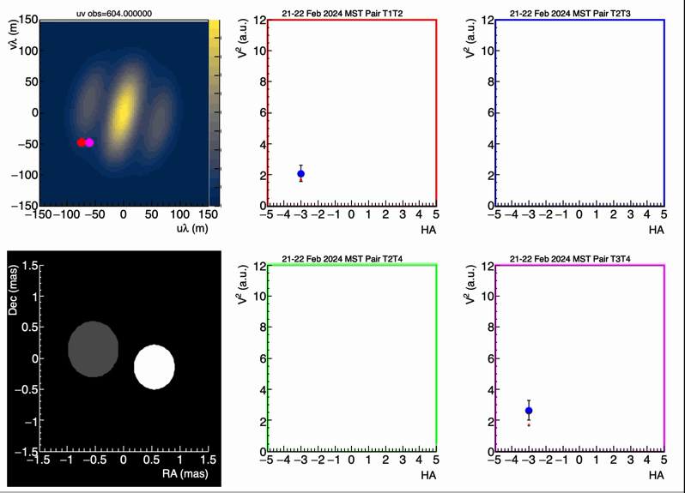
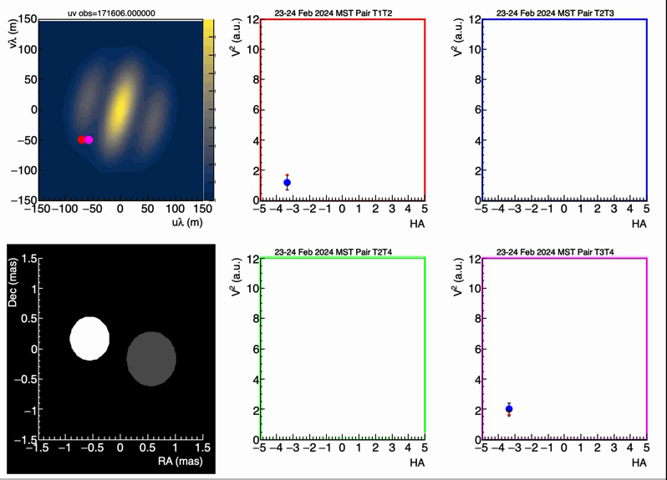
Fit 3 - e=0 - Nights 0,1 – 2 days apart

Slide 21
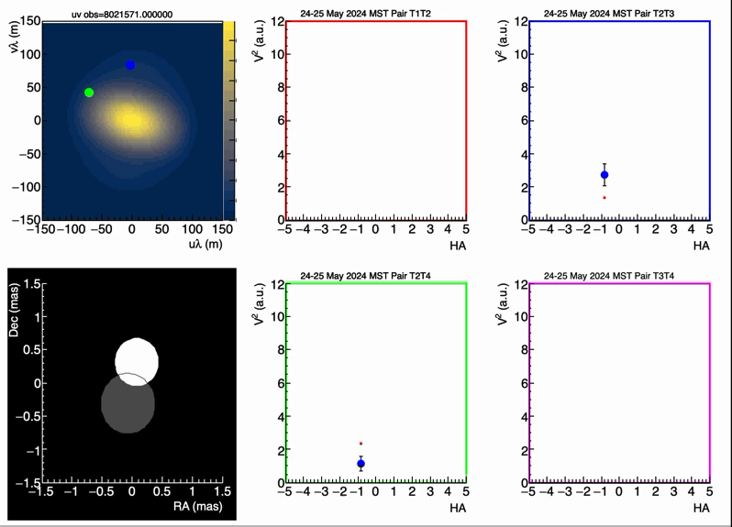
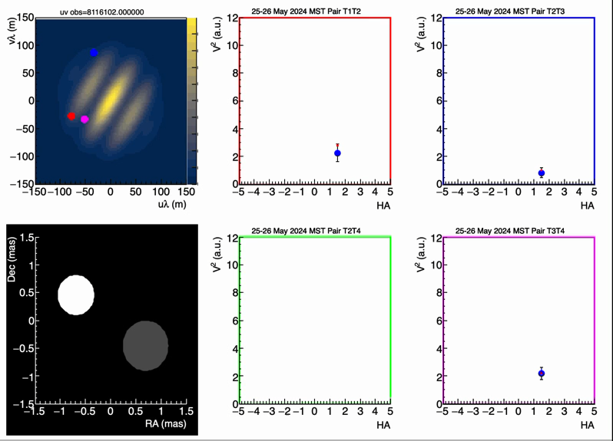
Fit 3 - e=0 - Nights 5,6 - 1 day apart

Slide 22
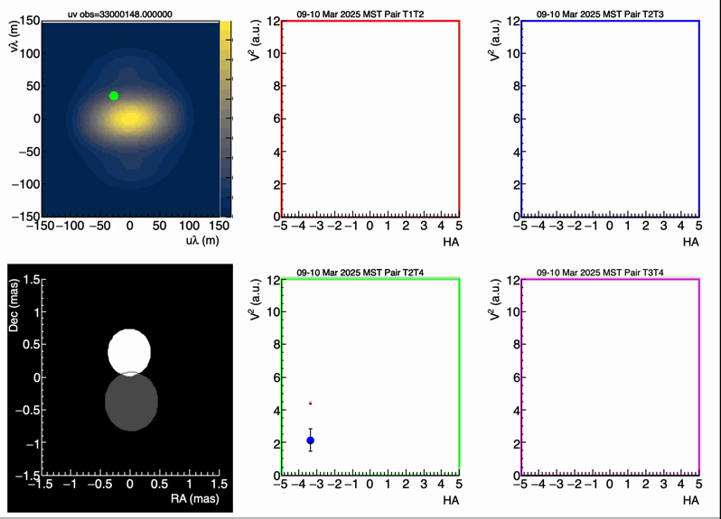
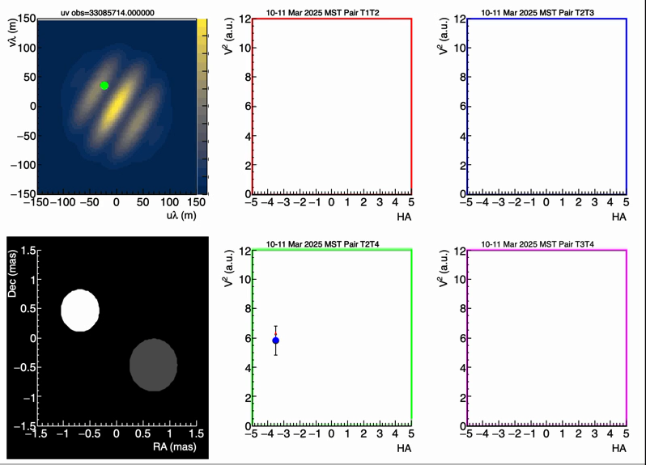
Fit 3 - e=0 - Nights 7,8 - 1 day apart

Slide 23
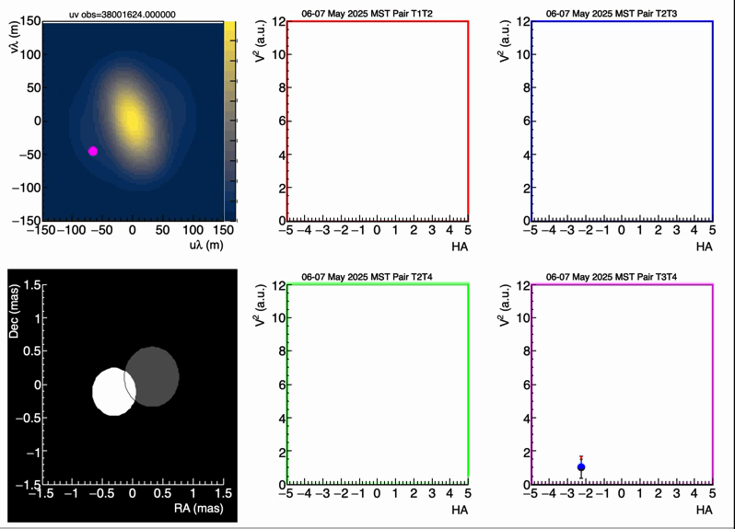

Fit 3 - e=0 – Days 9,10 – 8 days apart

Slide 24
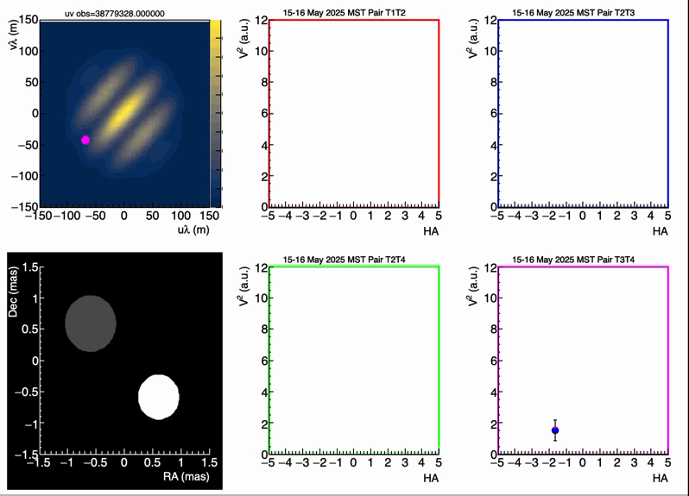
Fit 3 - e=0 – Days 10,11 – 1 day apart

Slide 25
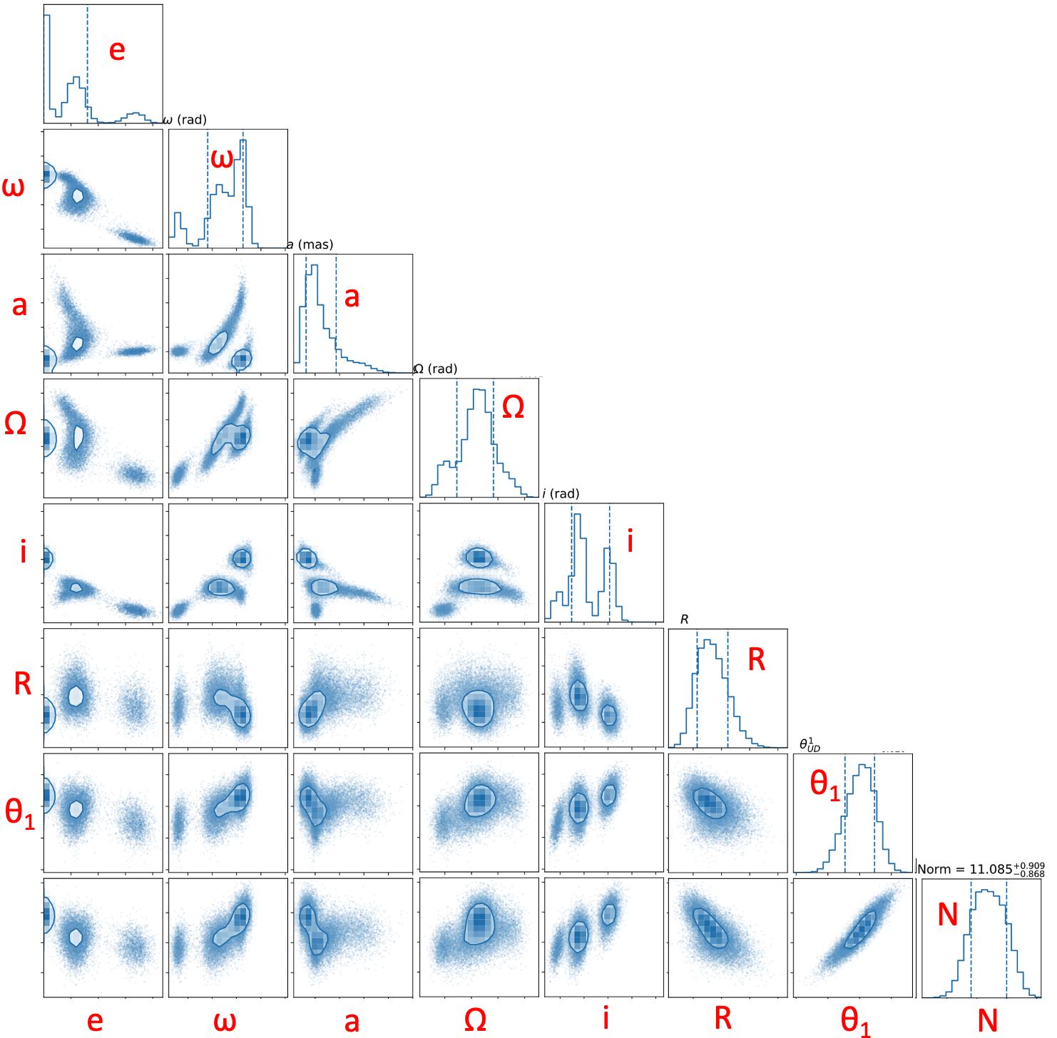
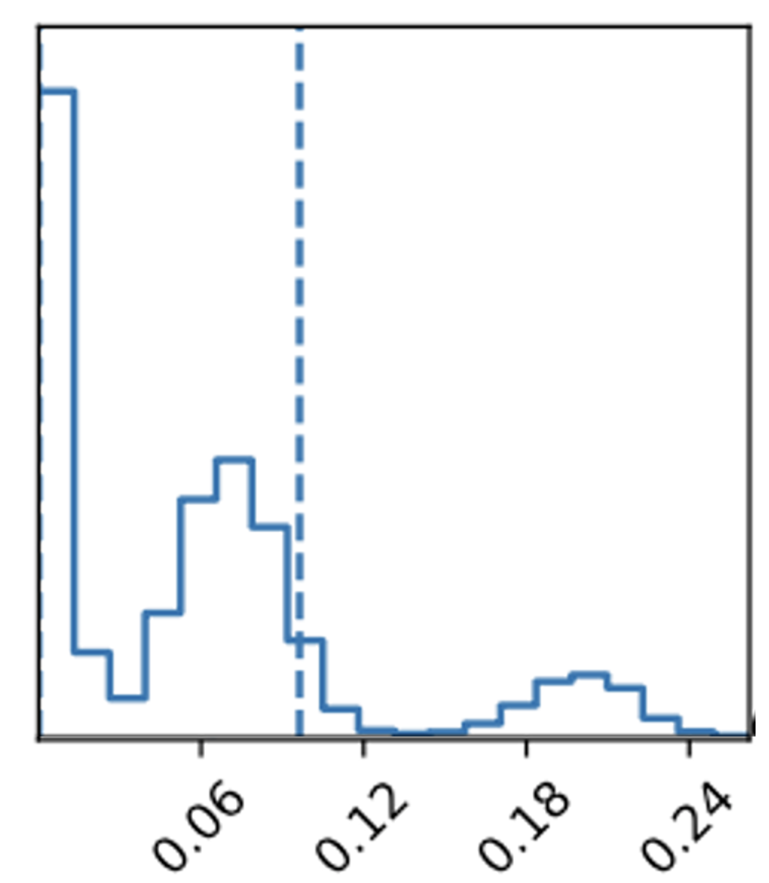
LMFIT bootstrap of 20,000 variations
(Consistent with TMinuit fit)
T0 fixed; θ₂ = 0.4 mas, as per HB
3 eccentricity regions:
e=0 fits best, but discrepant with spectroscopy by >3𝜎
e≈0.2 produces eclipses which are not observed
e≈0.06 consistent with some spectroscopic reports
(e≈0.14, taken as given by HB, is disfavored)
e
N

Slide 26
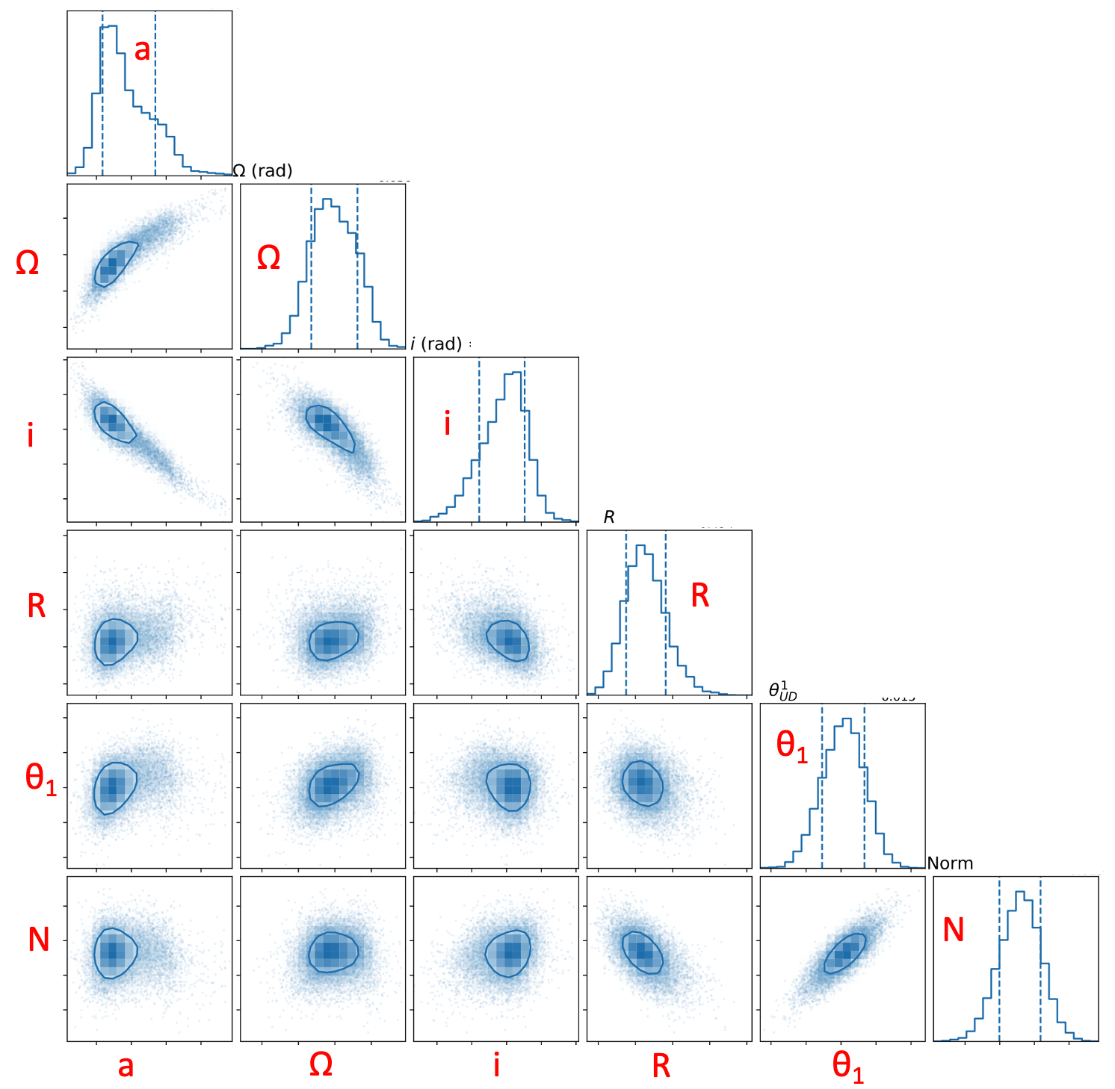
Example: setting e=0.05 (not necessarily the “best”)
Reasonable, well defined/constrained orbital parameters
Still, this remains a work in progress

Slide 27
Summary
VERITAS has analyzed ~150 pair-hours of observations on Spica with good coverage in (u,v)
  another ~90 pair-hours not yet fully analyzed
While a fitting code can/will return parameters, visualizing data-theory is valuable
Display/comparison of data-vs-theory is non-trivial for fixed telescope arrays
Visibility measured by any pair on a dynamic system depends
on 2 independent times, further complicating visualization
A standard binary star model is being used to fit preliminary
VERITAS data
  reasonable fits are achievable
  preliminary result: perhaps somewhat low eccentricity
  preliminary result: sensitivity to time of periastron, line of apsides
  which have non-negligible uncertainties from spectroscopy
  may have statistical power to probe love number
21st century SII is continuing its steps towards more
complex sources
Mean ≈ 0.0
sigma ≈ 1.0

Slide 28
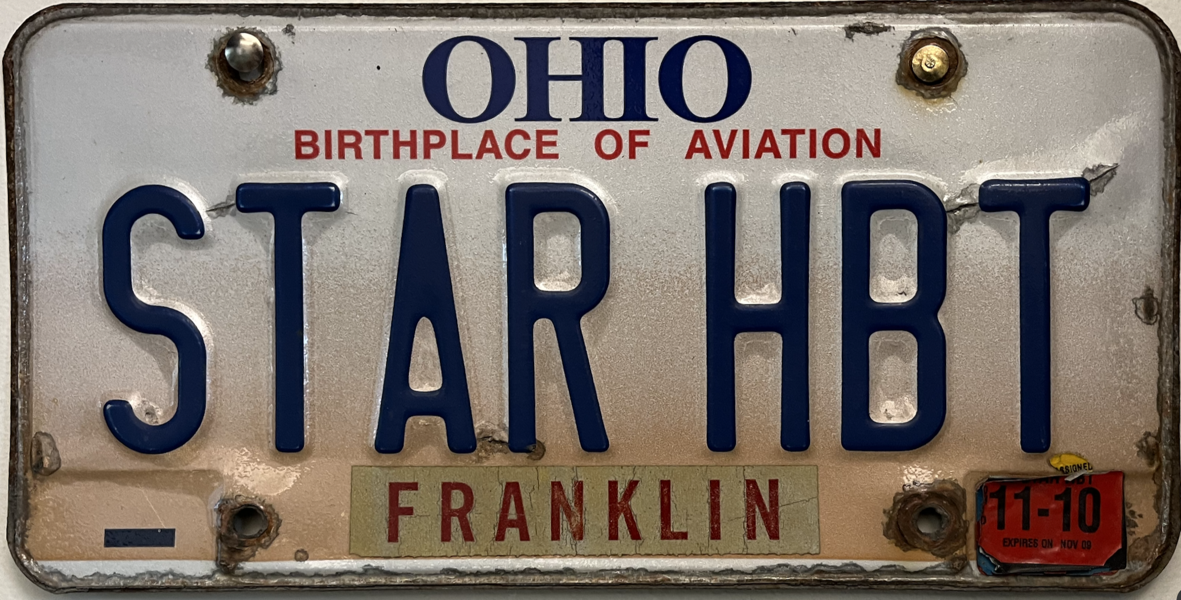
Thanks for your attention

