Slide 1






Intensity Interferometry at Calern and beyond: towards wavelength multiplexing and the resolution of Sirius B
William Guerin for the I2C consortium (Intensity Interferometry at Calern)
Institut de Physique de Nice (INPHYNI)
Université Côte d’Azur & CNRS
https://inphyni.univ-cotedazur.eu/sites/cold-atoms
Notes:
Bleus UCA (RVB):
Bleu clair: 0, 175, 215 → titres de slides et bandeau de pied de page
Bleu moyen: 0, 150, 188
Bleu foncé: 0, 126, 161 → Nom/affiliation du slide titre, réferences, flèches.
Couleurs flashy de la charte graphique UCA:
Magenta: 229, 0, 91
Orange: 249, 176, 0
Vert: 149, 193, 31

Slide 2

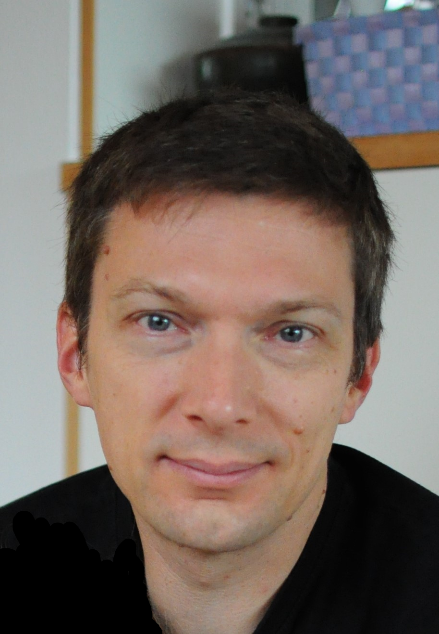

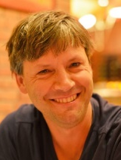
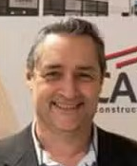


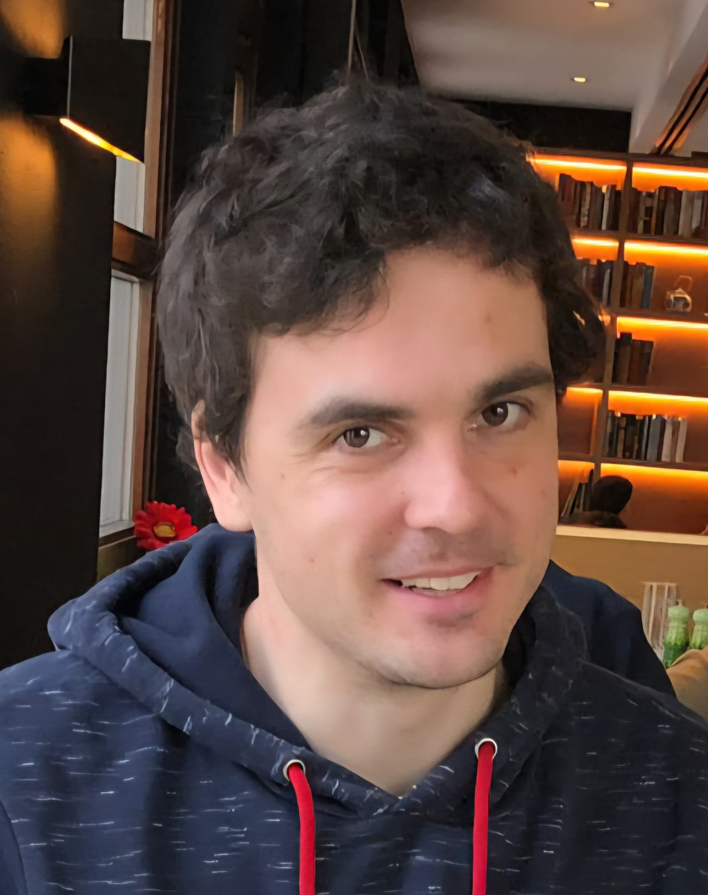

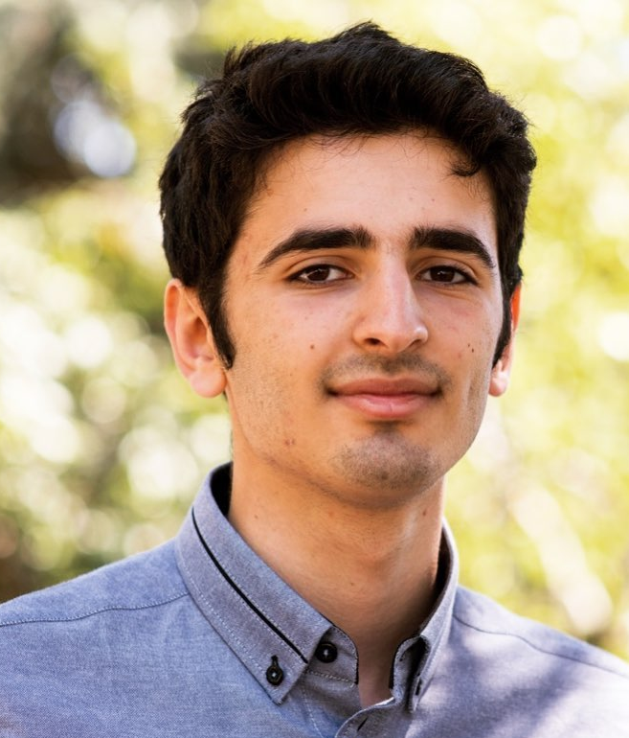
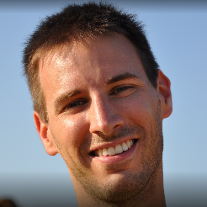

The I2C consortium
INPHYNI, cold-atom team
Lagrange (OCA)
Former members: Antoine Dussaux
(Post-doc, 2015-2016)
Antonin Siciak
(PhD student, 2018-2021)
Nolan Matthews
(Post-doc, 2021-2023)
Robin Kaiser
William Guerin
Mathilde Hugbart
Guillaume Labeyrie
Jean-Pierre Rivet
Olivier Lai
Géoazur, MéO team (OCA)
Federico
Izraelevitch
Andreas
Zmija
Tolila Sarah
Ilian
Ellafi
Clément Courde
Julien Chabé

Slide 3
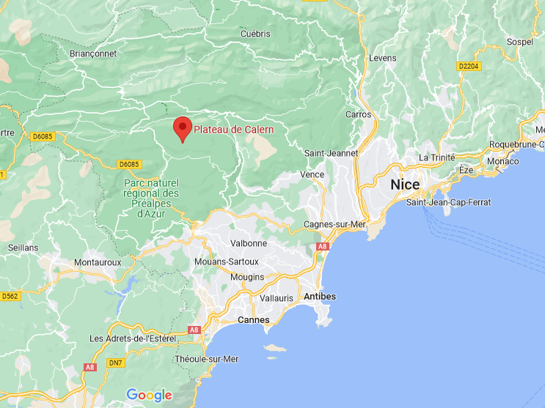
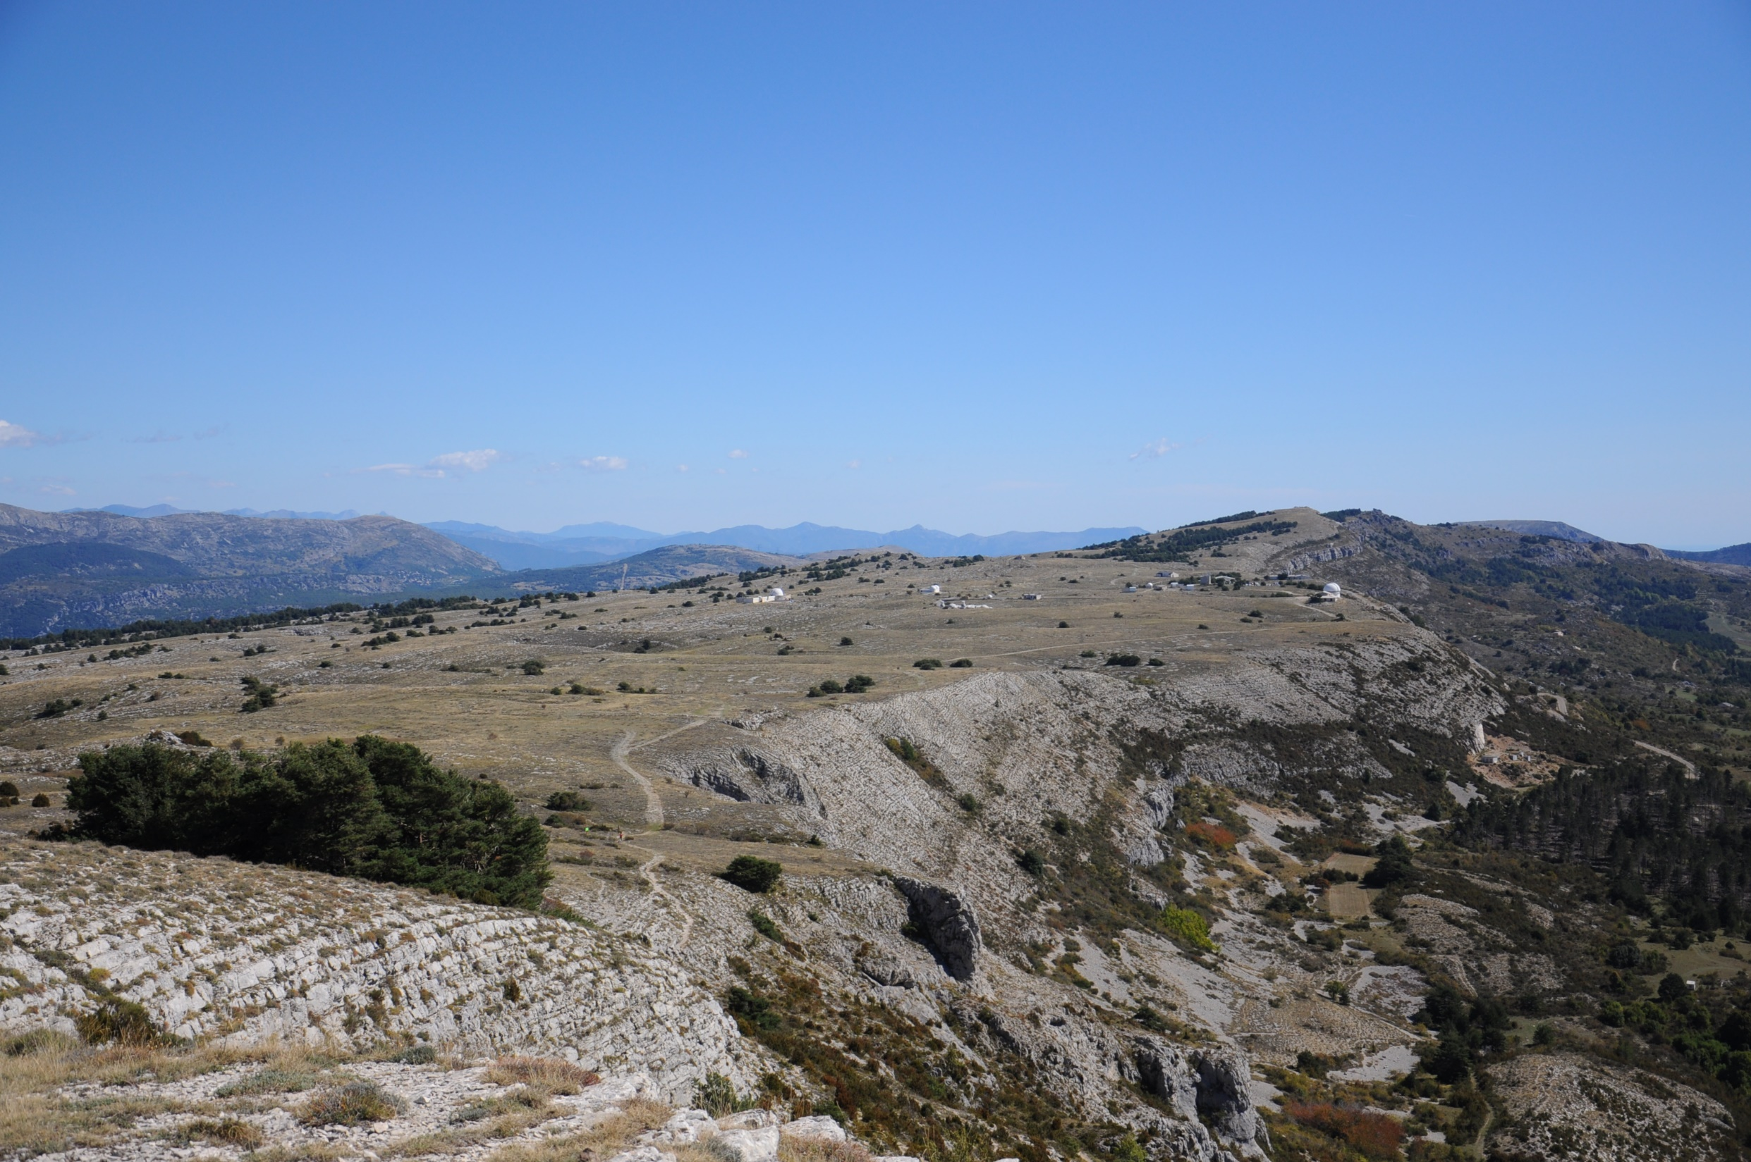
Calern
30 km
Telescopes, altitude = 1280 m

Slide 4
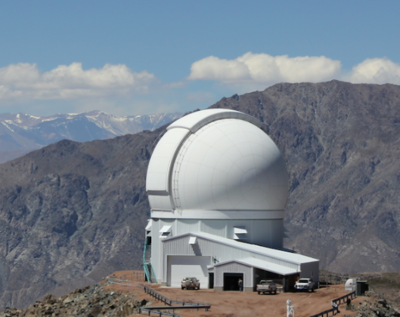
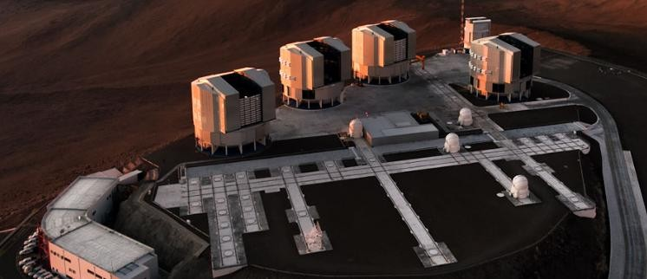
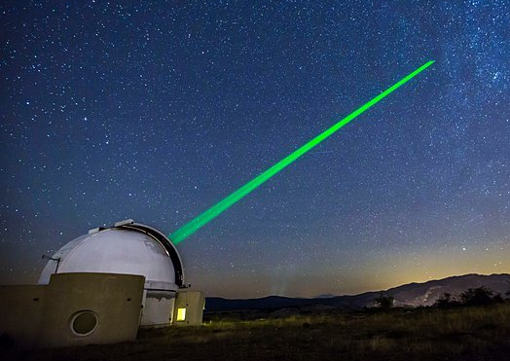
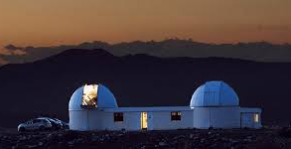
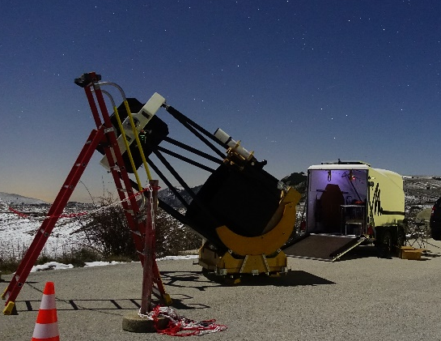
Our approach: SII with optical telescopes
Drawback: - Large arrays of large optical telescopes will never be available
Advantages:
SOAR, Ø = 4.1 m
The small PSF allows using the best detectors and other photonic technologies (fibers, narrow filters, etc.)
The instrument can be adapted to any existing facility
No issue with the sky background
Methodology:
ATs, Ø = 1.7 m
Step-by-step progress
Tests and calibrations in the lab
On-sky demonstrations at Calern
Go to bigger facilities…
MéO, Ø = 1.5 m
C2PU, Ø = 1 m, B = 15 m
T1M, Ø = 1 m
C2PU, Ø = 1 m, B = 15 m

Slide 5
Outline
First generation instrument (2015-2024):
Second generation instrument (work in progress):
Brief summary of what we did so far
Wavelength multiplexing in the blue
Towards the resolution of Sirius B

Slide 6
Brief summary of what we’ve done so far
Learning how to measure sub-nanosecond intensity correlation, test on light scattered by a hot vapor
2015
Dussaux et al., PRA 93, 043826 (2016)
2016
Feasibility study + design + lab test of a telescope instrument
Guerin et al., MNRAS 472, 4126 (2017);
Feb.: Bunching with star light (one telescope)
MNRAS 480, 245 (2018)
2017
Oct.: Intensity interferometry with two telescopes
2018
Aug.: SII at Hα on P Cygni, refinement of the star’s distance
Rivet et al., MNRAS 494, 218 (2020)
Apr.: Bunching at SOAR in one night (η Car)
2019
Guerin et al., Proc. SF2A 2021, p. 331
Feb.: SII at Hα on Rigel
Aug.: SII at Hα on P Cygni (again)
de Almeida et al., MNRAS 115, 1 (2022)
2020
Proposal for SII with segmented mirrors (I3T concept)
Gori et al., MNRAS 505, 2328 (2021)

Slide 7
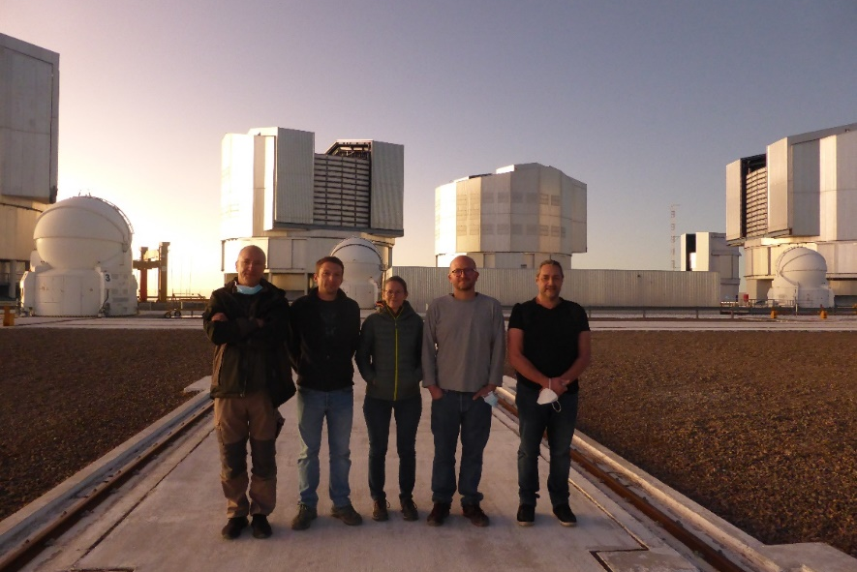
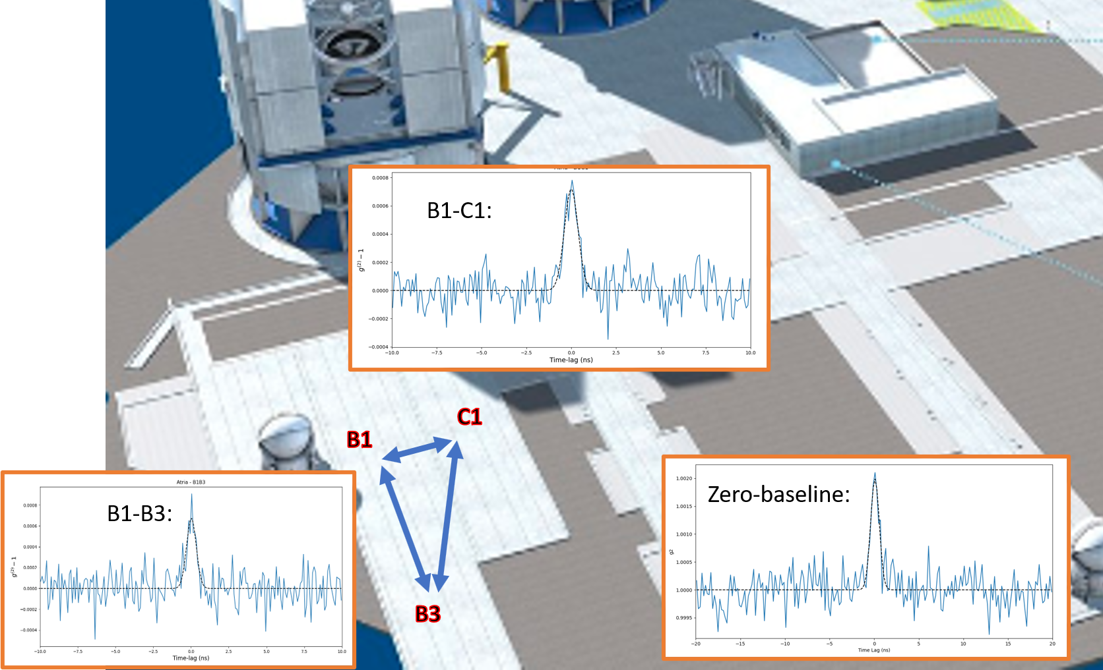
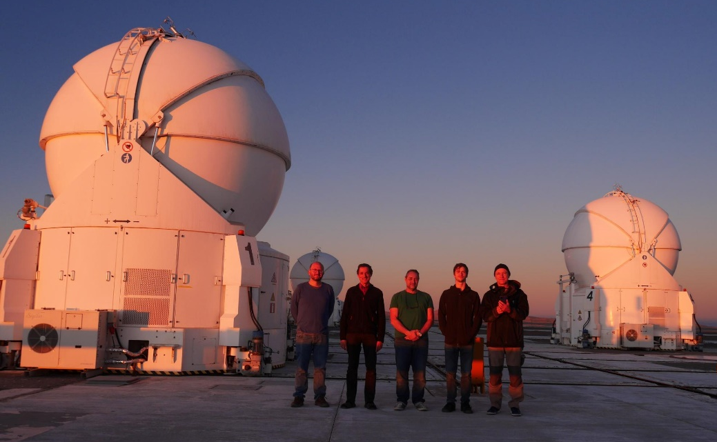
Brief summary of what we’ve done so far
ANR project starts (€€)
2021
Adding tip-tilt correction…
Matthews et al., Astron. J. 167, 117 (2023)
Jan.: SII on γ Cas between the laser ranging telescope and a 1 m mobile telescope
2022
March: Technical run (6 nights) at Paranal on two ATs at their maintenance station (separation 49 m)
Matthews et al., Proc. SPIE 12183, 121830 (2022)
2023
May: Technical run (5 nights) at Paranal on three ATs at standard stations
June: First lab test of multiplexing N_{ch} = 5
2024
Tolila et al., Proc. SF2A 2024, p. 197
Extension of I3T
Matthews et al., MNRAS 538, 867 (2025)
ERC project starts (€€€€€)
2025

Slide 8
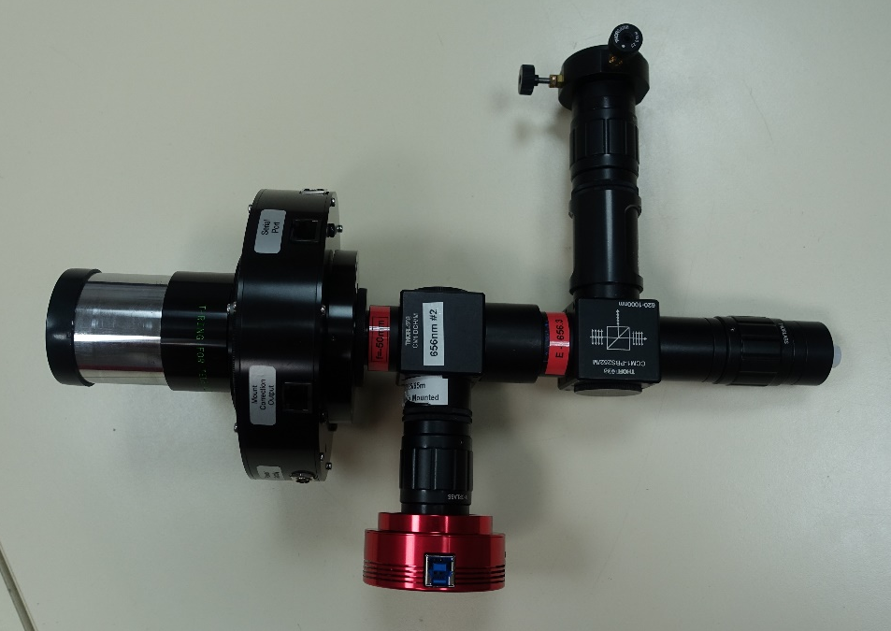
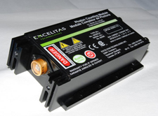
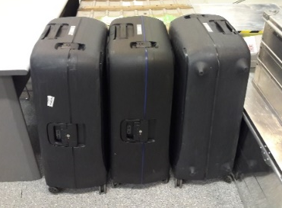
First generation instrument
Main features:
Photon-counting regime (shot-noise limited)
Compact and transportable
Real-time computation of the g⁽²⁾
Two polarization channels
Tip-tilt correction
Technical details:
Filter width Δλ = 1 nm (τ_{c} ~ 1 ps)
λ = 780 nm or 656 nm (Hα)
Light injected in MMF (Ø = 100 µm)
Detectors τ_{el} ~ 500 ps (FWHM)
Time tagger from Swabian Instrument
How to transport a stellar interferometer:

Slide 9


Towards a second-generation instrument
What we want (as everyone):
Better detectors: lower timing jitter & good quantum efficiency
Wavelength multiplexing
Adaptable to large telescopes and long baselines
Excellent throughput
$$×\sqrt{N_{ch}}$$
To do what ? The design depends on the objectives…
Dalal et al., Phys. Rev. D 109, 123029 (2024)
Guerin et al., Comptes Rendus. Phys., in press (2025); arXiv:2503.22446

Slide 10
Goal: partial resolution of Sirius B
Sirius B: the closest and brightest white dwarf (“mind-blowing“ in Saha’s plot), m_{B} = 8.4
No angular diameter of a white dwarf has even been measured directly (evaluated from photometry)
Why ? Needs baseline ~ 1 km !
Right time to do it (separation ~ 11”) !
Notes:
Separation challenging (impossible) for a Cherenkov telescope

Slide 11
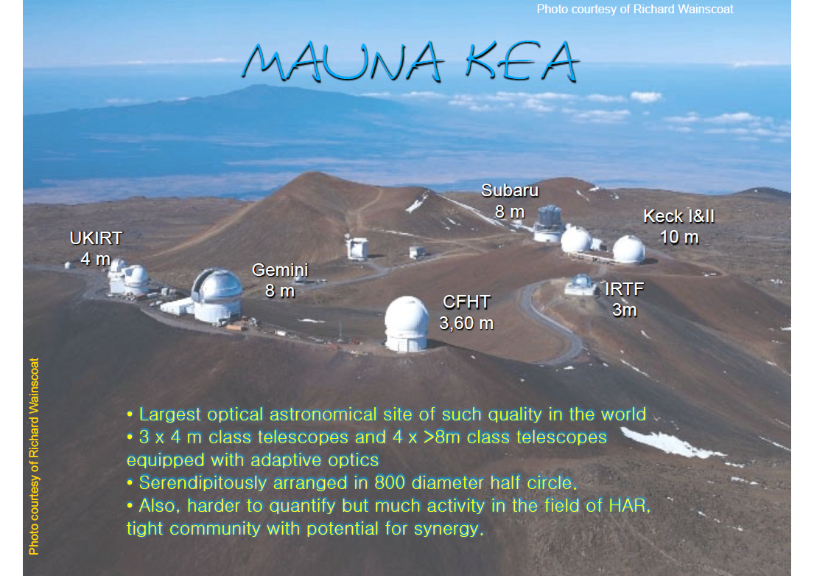
Where to do it ?
Olivier Lai is well introduced there…
800 m
Larger baselines:
Subaru – Gemini: 790 m
Keck I – Gemini: 630 m
Keck I – CFHT: 630 m
(Another possibility could be at Paranal: UTs – Vista : ~1.5 km, but more complicated access…)

Slide 12
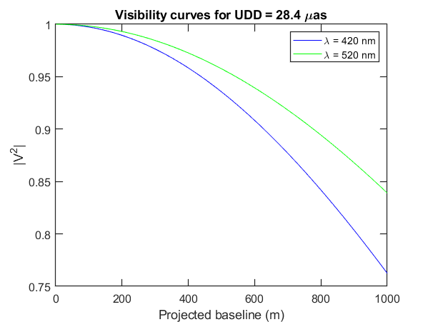
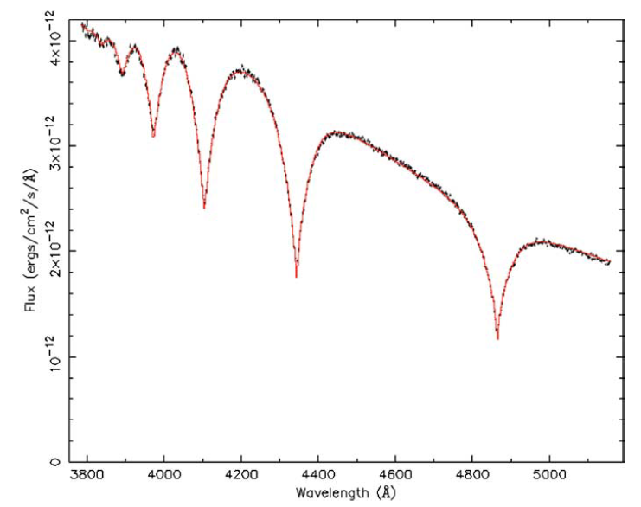
At which wavelength ?
Even 800 m is not enough: the shorter the better !
λ = 420 nm
Notes:
Radius of Sirius B from: spectrum + photometry + parallax
Sirius B: A New, More Accurate View
J. B. Holberg, M. A. Barstow, F. C. Bruhweiler, A. M. Cruise, and A. J. Penny
Spectrum of Sirius B: data from HST:
Hubble Space Telescope Spectroscopy of the Balmer lines in Sirius B†
M.A. Barstow, Howard E. Bond, J.B. Holberg, M.R. Burleigh, I. Hubeny and D. Koester

Slide 13
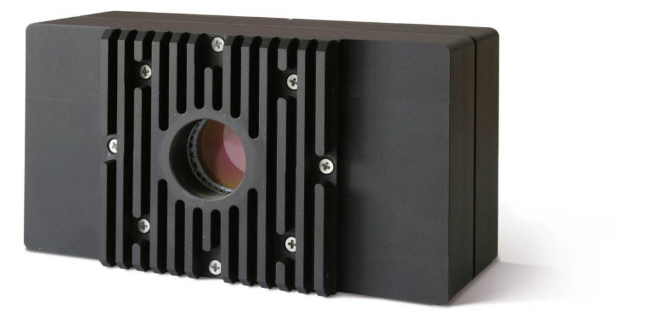
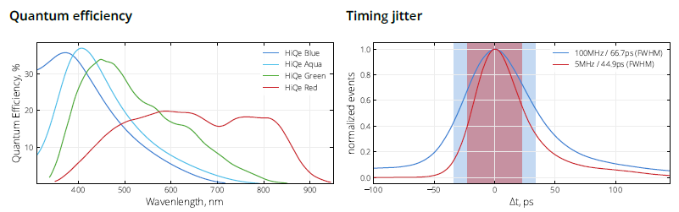
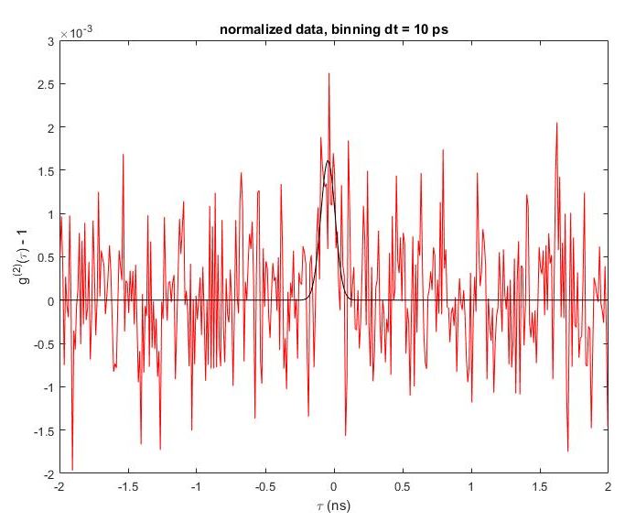
With which detectors ?
Inspired by the Erlangen group (J. von Zanthier): LINPinx from Photonscore
Leopold et al., JATIS 11, 035005 (2025)
QE ~ 33% @ 420 nm
Jitter ~ 30 – 35 ps (FWHM)
Negligible dark count, low dead time (max count rate ~ 100 MHz)
Diameter = 8 mm !!!
 Tested on sky (Sept. 2025)

Slide 14
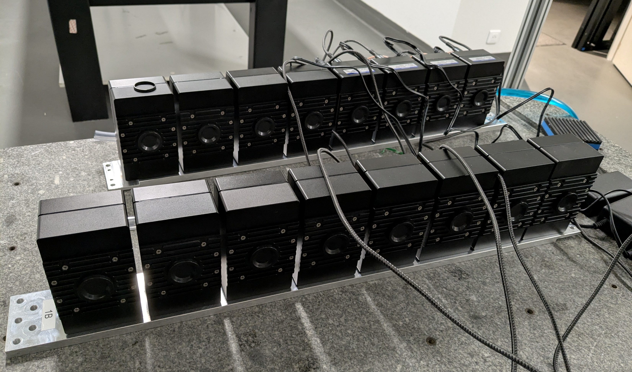
Wavelength multiplexing
Big detectors… ☺ Easy to focus light onto it without losses
☹ Not scalable to many channels
Buy 32 detectors !
16 channels × 2 telescopes

Slide 15

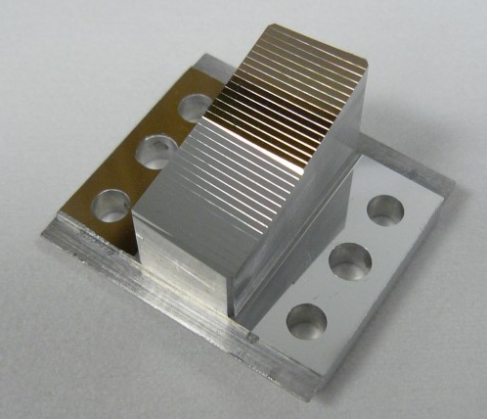
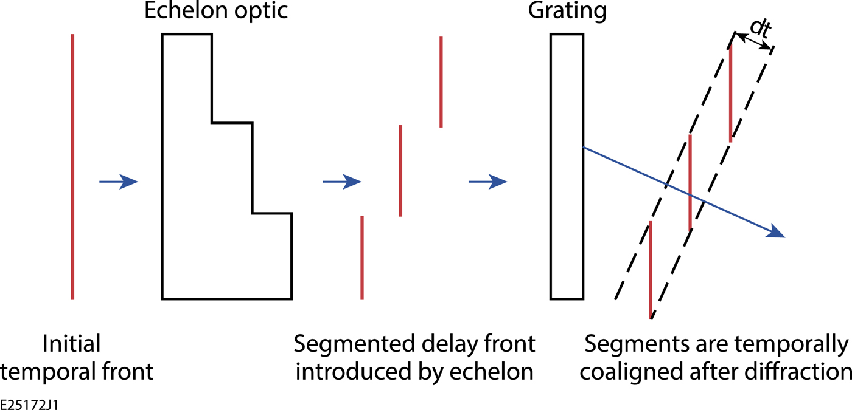
How to disperse the light ?
Preliminary design based on 3 optical elements:
Diffraction grating
Echelon to compensate the grating’s temporal dispersion
Slicer to increase the spatially separation between the wavelengths
See Ilian Ellafi’s poster
Katz et al., Rev. Sci. Instrum. 87, 11E535 (2016)

Slide 16

Integration to the telescopes
Compact coupling module
Adapted to each telescope,
has to reject Sirius A
Multichannel instruments
Same for all telescopes, doesn’t move,
can be well calibrated in the lab
GRIN MMF Ø = 400 µm
(Exail photonics)
NA = 0.12
Dispersion < 1 ps/m
Transmission > 80% for 10 m
Bent Cassegrain @ Keck
Strategic plan :
1- First test on one Keck
2- Duplicate + interferometry (baseline = 85 m)
3- Adapt to CFHT + long-baseline interferometry (630 m)
4- Convince Gemini and adapt (→ larger area)
5- Convince Subaru and adapt (→ longer baseline: 790 m)

Slide 17
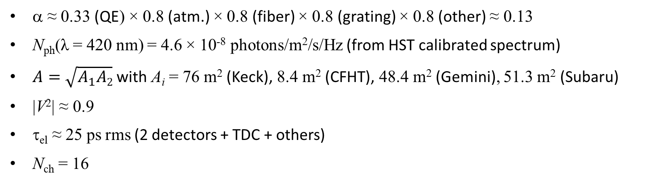
Feasibility assessment
α ≈ 0.33 (QE) × 0.8 (atm.) × 0.8 (fiber) × 0.8 (grating) × 0.8 (other) ≈ 0.13
N_{ph}(λ = 420 nm) = 4.6 × 10⁻⁸ photons/m²/s/Hz (from HST calibrated spectrum)
$A=\sqrt{A_{1}A2}$ with A_{i} = 76 m² (Keck), 8.4 m² (CFHT), 48.4 m² (Gemini), 51.3 m² (Subaru)
|V²| ≈ 0.9
τ_{el} ≈ 25 ps rms (2 detectors + TDC + others)
N_{ch} = 16
SNR = 10 reached in …
T_{obs} = 46 h for Keck – CFHT (630 m)
T_{obs} = 8 h for Keck – Gemini (630 m)
T_{obs} = 12 h for Subaru – Gemini (790 m)
For a precise determination of the angular diameter: needs larger baselines !
UTs – Vista (1.5 km) @ Paranal or GTC – WHT (1.1 km) @ Roque de Los Muchachos
Notes:
Expected count rate around 330 kcps/channel with these numbers
Effect not included: reduction of the SNR due to non-square spectra

Slide 18
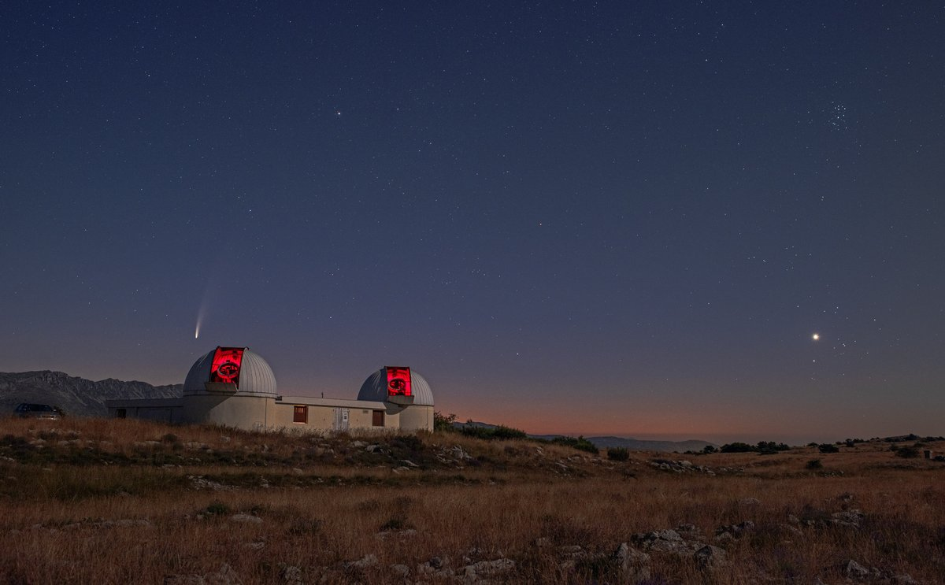
Guerin et al., MNRAS 472, 4126 (2017)
Guerin et al., MNRAS 480, 245 (2018)
Rivet et al., Exp. Astron. 46, 531 (2018)
Lai et al., Proc. SPIE 10701, 1070121 (2018)
Rivet et al., MNRAS 494, 218 (2020)
Gori et al., MNRAS 505, 2328 (2021)
Guerin et al., Proc SF2A (2021)
de Almeida et al., MNRAS 515, 1 (2022)
Matthews et al., Proc. SPIE 12183, 121830G (2022)
Matthews et al., Astron. J. 167, 117 (2023)
Tolila et al., Proc. SF2A, p. 197 (2024)
Matthews et al., MNRAS 538, 867 (2025)
Guerin et al., Comptes Rendus. Physique, in press (2025)
Thank you !
https://inphyni.univ-cotedazur.eu/sites/cold-atoms/research/i2c
(Picture by Serge Brunier)
18

Slide 19
Why not use SPAD arrays ?
Big telescopes, either:
with AO: low throughput ☹ (and in the blue anyway…)
without AO: VERY hard to focus on small-area detectors
Conservation of étendue (or “optical extent”): A Ω = cst
Seeing = 0.65” = 3.2 µrad (median seeing on Maunea Kea)
A = (8 m)²
If you want to focus on, say, A’ = (20 µm)², you need NA = 0.98 !!!
If you focus with a large NA, say NA = 0.5 (i.e. 30°) (without aberration!), you’ll get A’ = (50 µm)².
That’s also why we want to use MMF with Ø = 400 µm (NA = 0.12)…

Slide 20
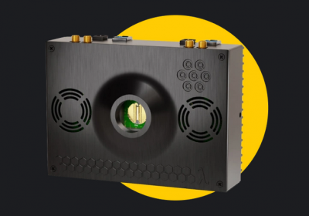
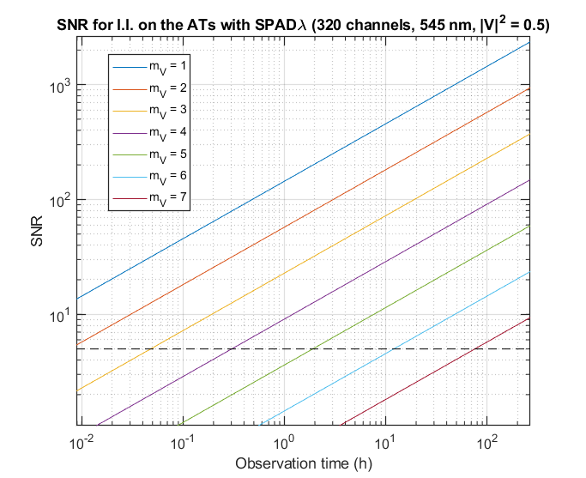
SPAD arrays with small telescopes
SPADλ from PIimaging
Linear array of 320 pixels
Pixel size = 18 µm, pitch = 28 µm, 80% fill factor with microlenses (limited NA)
Jitter 90 ps (FWHM), QE = 50% @ 500 nm
Expected SNR using the ATs at Paranal: (free one week /month !!!)
→ mag. 6 in one night, 7 in one week
Notes:
Parameters:
tau_et = 50 ps
QE = 80%
In the red
Visibility = 0.5
Obstruction and all losses taken into account (bona fide)

Slide 21
Limitations to the SNR
Not useful to improve the detectors’ jitter τ_{el} beyond the coherence time τ_{c}.
For a given spectral range, increasing the number of channels increases τ_{c} → the SNR saturates.
Example:
τ_{el} = 10 ps
Δλ = 0.1 nm @ 500 nm
τ_{c} = 8 ps < τ_{el} OK
Then if N_{ch} = 2000
→ Δλ_{tot} = 200 nm !
Guerin et al., Comptes Rendus. Phys., in press (2025); arXiv:2503.22446

Slide 22
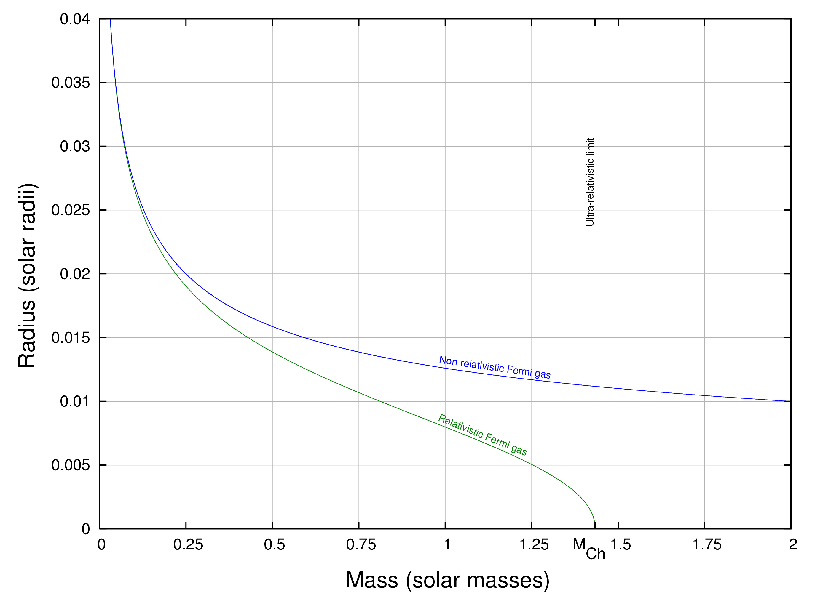
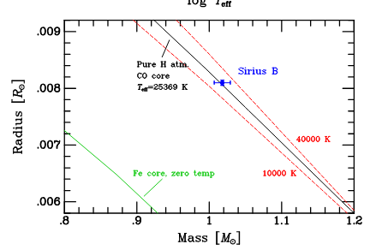
Sirius B
Chandrasekhar, MNRAS 95, 207 (1935)
Bond et al., ApJ 840, 70 (2017)

Slide 23
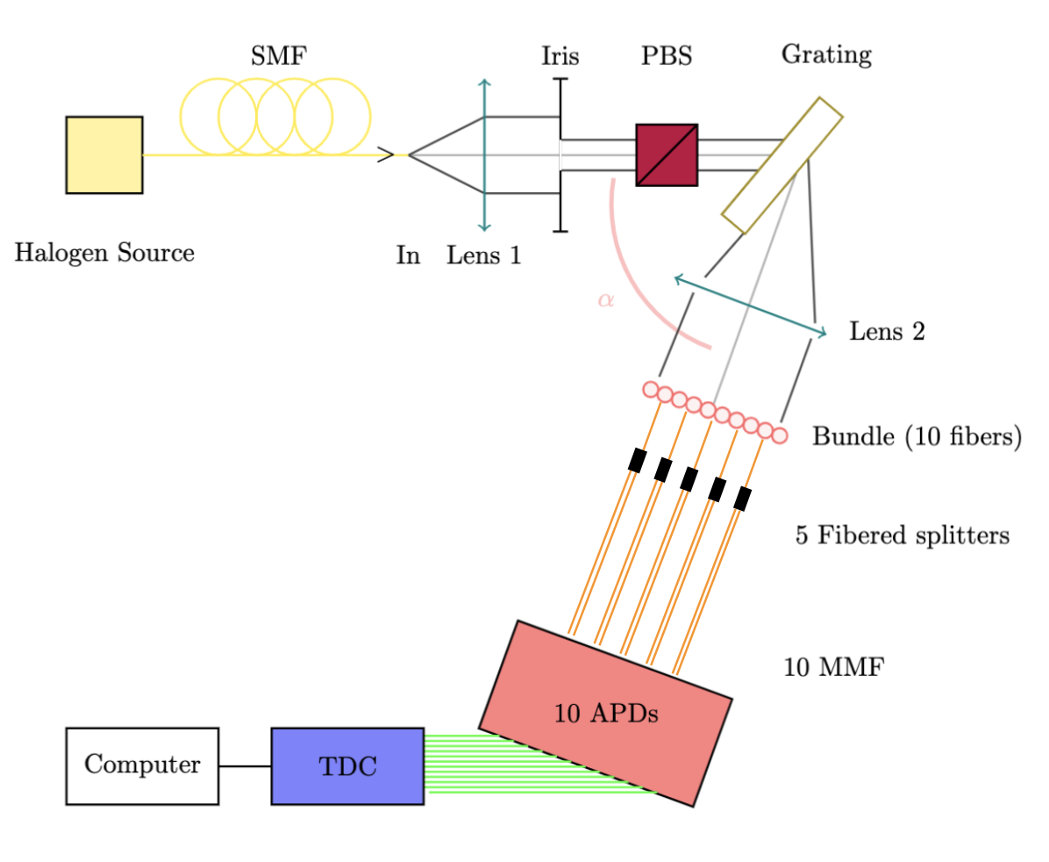
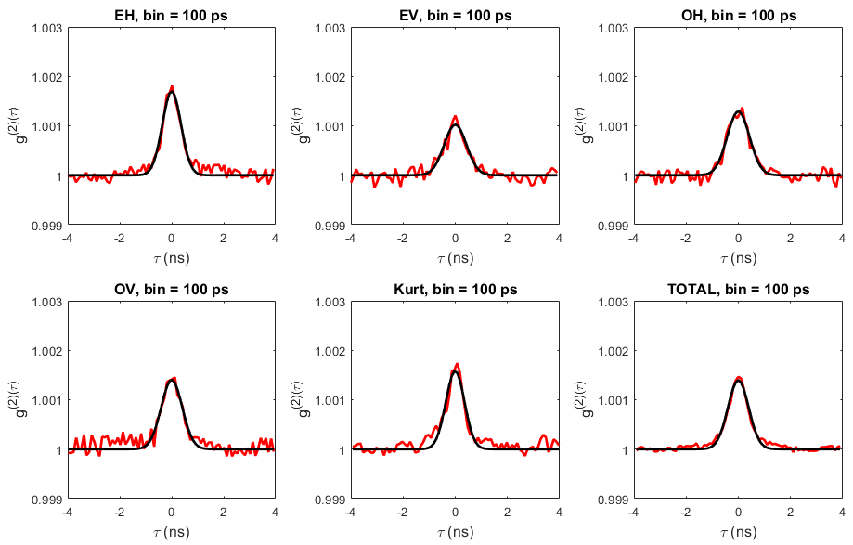
First lab tests of wavelength multiplexing
Single SNRs between 21 and 32 → Σ(SNR²) = 59
Measured SNR on the total curve: 51. Not bad, but averaging not optimum!
Tolila et al., Proc. SF2A, p. 197 (2024)

Slide 24
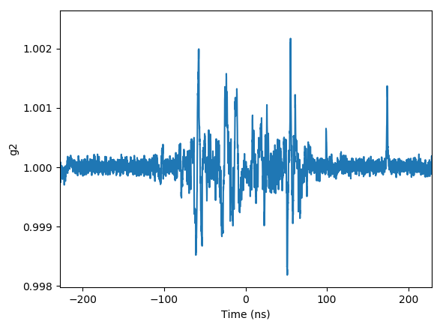
Noise
Spurious correlations (induced by the TDC and/or by cross talk between APDs)
→ avoided using cable (electronic or optical) delays.
Measurement limited by photon statistics down to 1% (at least).
Coherence time agrees with the measured spectral filter.
Matthews et al., Proc. SPIE 12183, 121830 (2022)

Slide 25
Some astrophysical measurements: P Cygni’s distance
Stellar model (CMFGEN)
Spectroscopy
Physical size
(luminosity distribution)
Distance
Angular size
(luminosity distribution)
Visibility measurements
Rivet et al., MNRAS 494, 218 (2020)
Almeida et al., MNRAS 515, 1 (2022)

