Slide 1
SNRs as PeVatron candidates for CTA
Ziwei Ou
Institut de Physique Nucléaire d’Orsay
Université Paris-Sud
Supervisor: Tiina Suomijärvi
2018|10|08
Notes:
10/8/18
1
1

Slide 2
Cherenkov Telescope Array
Supernova Remnants as PeVatron candidates
Naima and model fitting
Main results
Summary
Notes:
10/8/18
2
2

Slide 3
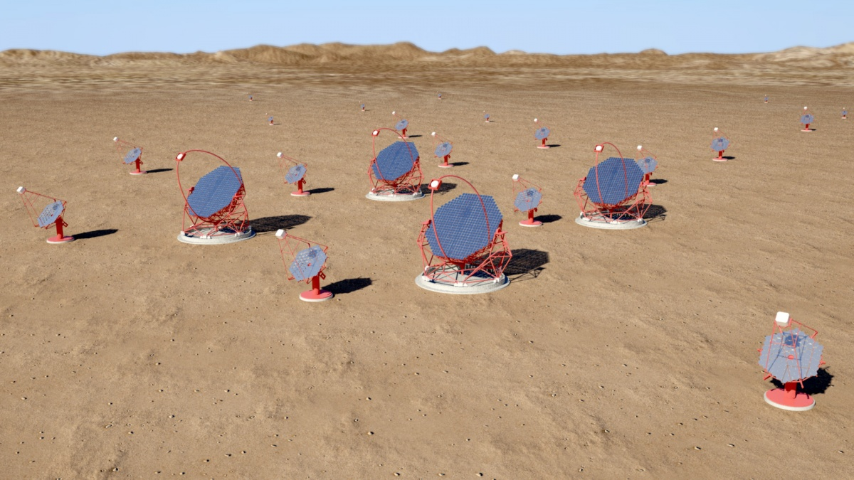

Cherenkov Telescope Array (CTA)
Small-sized telescopes (SST): 1 TeV - 300 TeV
Medium-sized telescopes (MST): 100 GeV - 10 TeV
Large-sized telescopes(LST): 20 GeV- 200 GeV
North site: La Palma (Spain)
South site: Paranal (Chile)

Slide 4
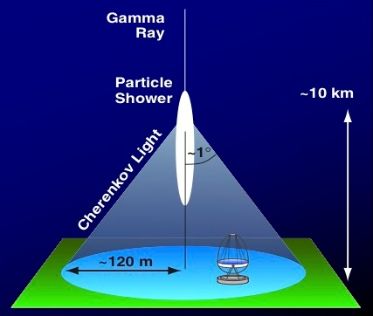
CTA detect the Cherenkov light
induced by gamma-ray

Slide 5
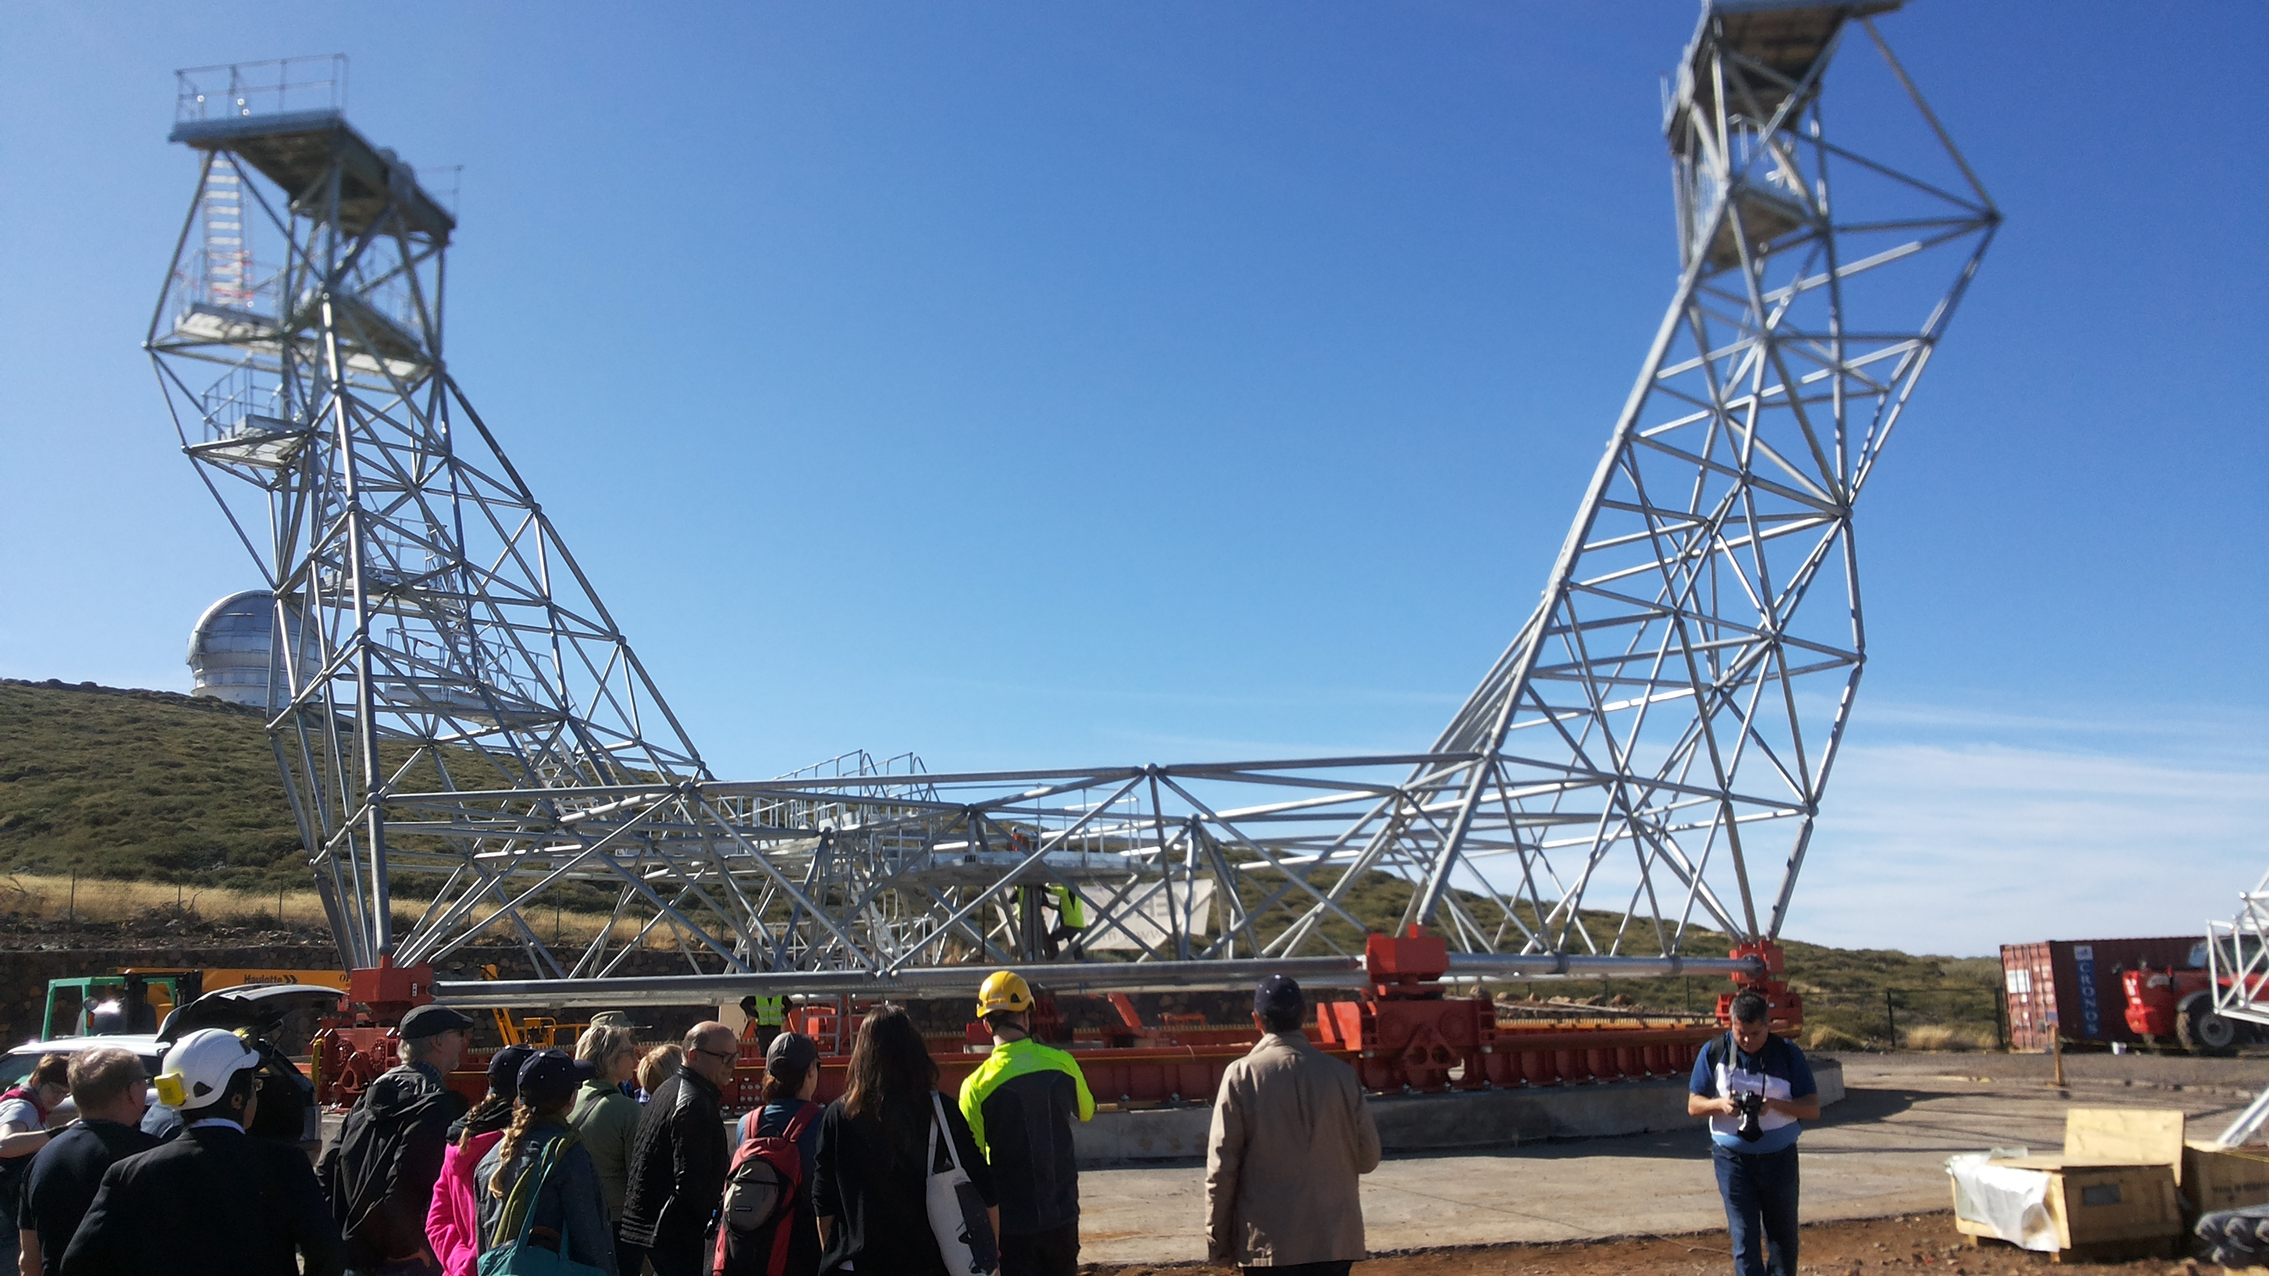
LST, 2017-11, La Palma, Spain

Slide 6
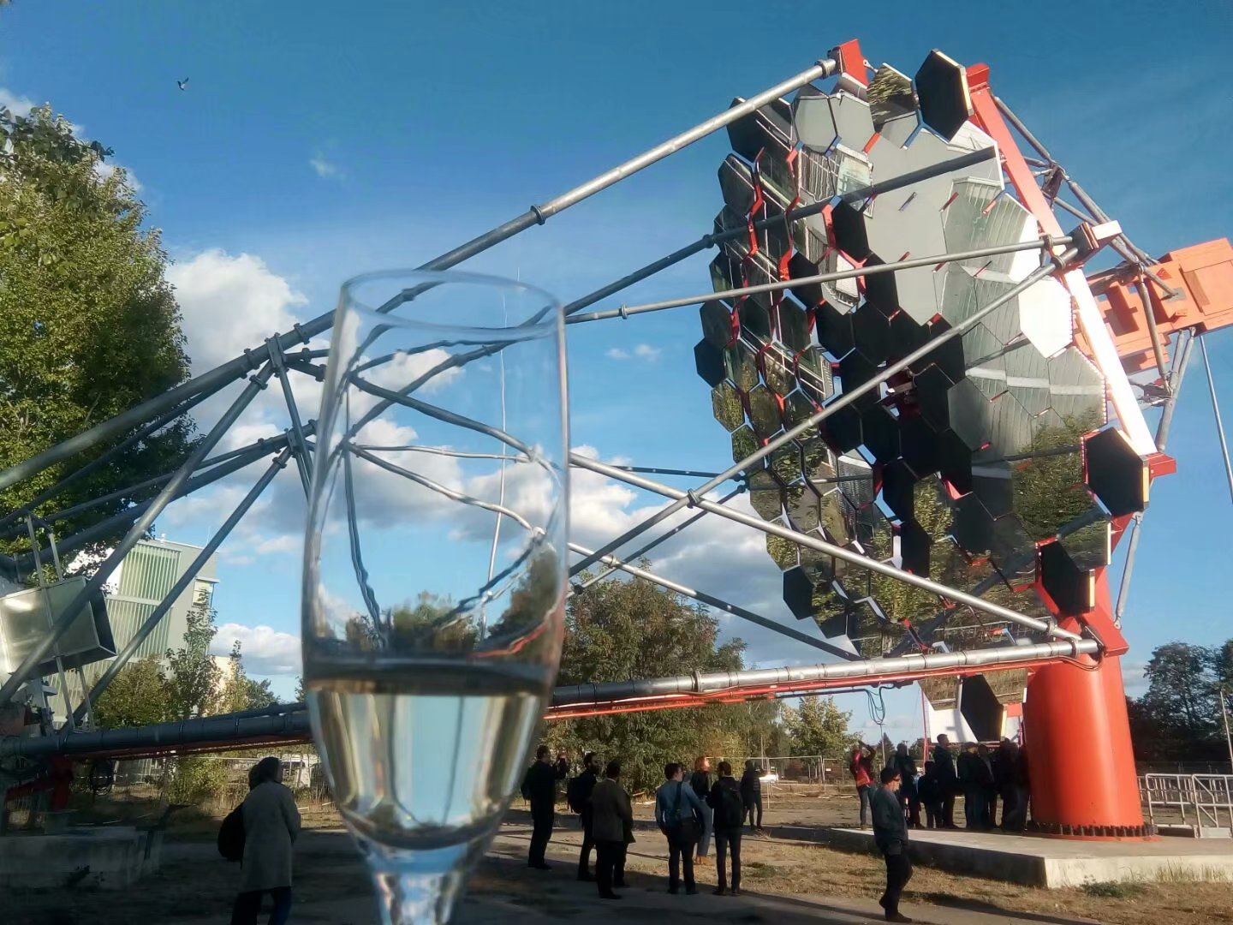
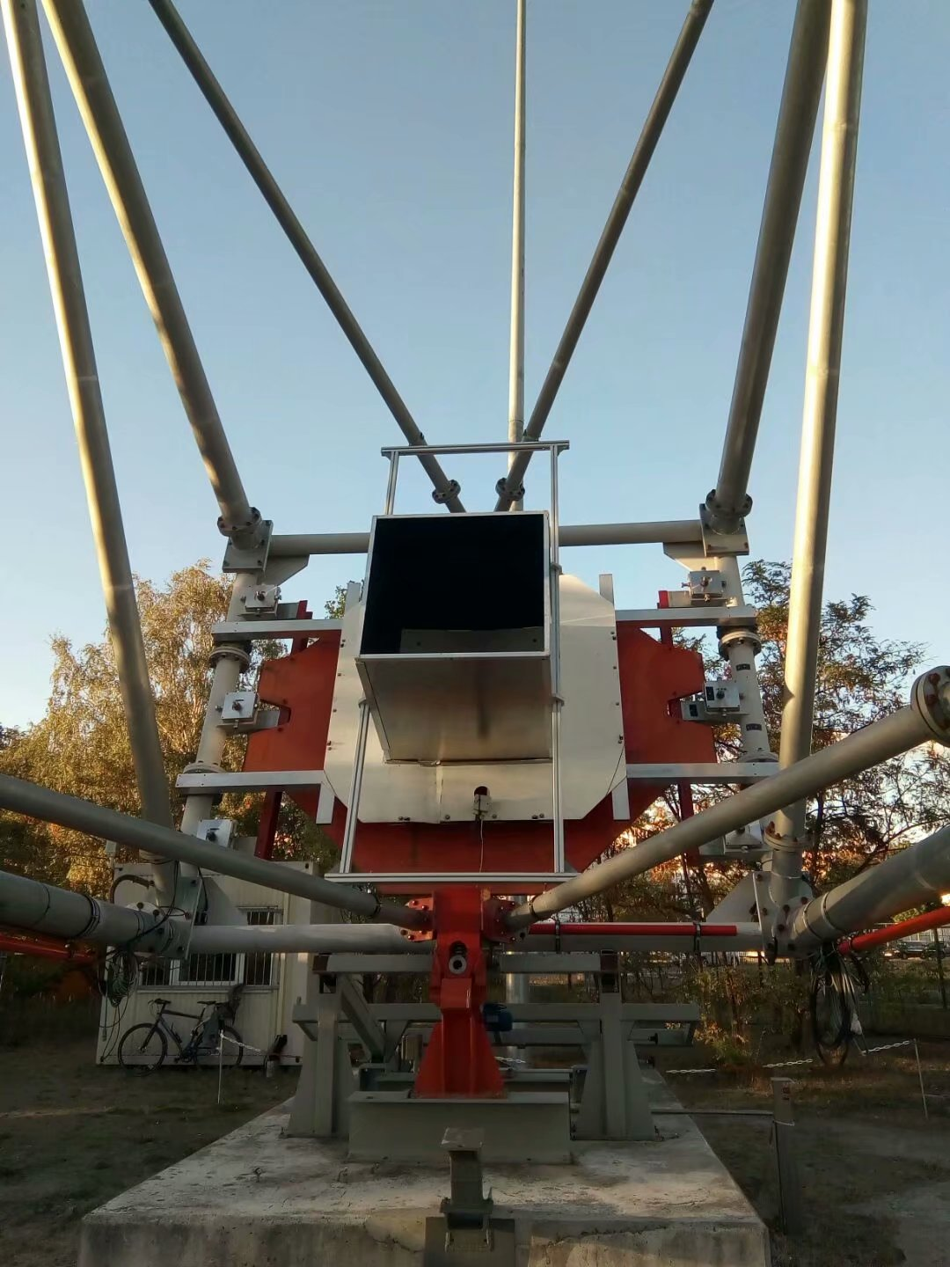
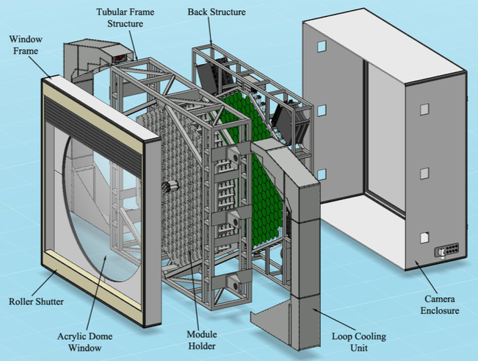
MST, 2018-09, DESY, Germany

Slide 7
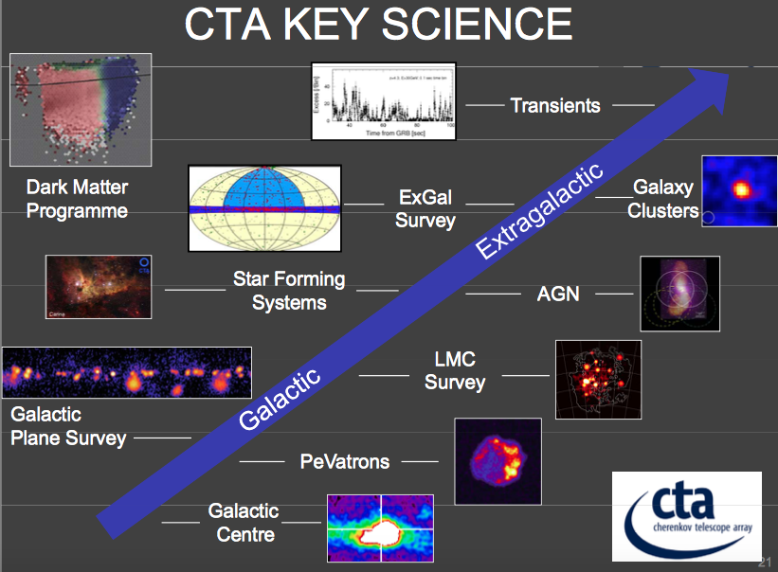

CTA: Cosmic-rays PeVatron as a Key Science Project (KSP)
from Rene Ong (2015)

Slide 8
Cosmic-Rays accelerated up to 1 PeV
PeVatrons: astrophysical object accelerated particles above 1 PeV (10^15eV).
The energy of spectrum of Cosmic-Rays (CRs) extends until few PeV where it steepens originating the ‘knee’.
Theoretical prediction and measurements of CR indicate that the CR should be accelerated up to 1 PeV in our Galaxy.

Slide 9
Supernova Remnants (SNRs) as promising Galactic PeVatron candidates
The detection of SNRs with spectrum up to 100 TeV imply that they are one kinds of PeVatron candidates, because ~100 TeV photons are produced by ~ PeV protons. (observation)
SNRs are able to satisfy the cosmic-ray energy requirement by converting the kinetic energy into accelerated particle. (theory)
SNRs (and Pulsar Wind Nebulae) are the majority of Galactic poululation.

Slide 10
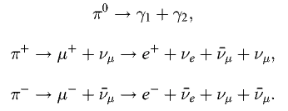
Proton-proton collision induces pion decay
\
For accelerated protons, hadronic
interactions with ambient matter
produce neutral pion, decaying into
two γ-ray photons

Slide 11
DC-1 data, Prod3b IRF and ctools
Data Challenge one (DC-1): simulated data enable the CTA Consortium Science Working Group to derive science benchmarks for the CTA KSP.
DC-1 includes Galactic Plane Scan (GPS) as one of the key science projects. We use GPS data to analysis SNRs.
Prod3b Instrumental Response Functions (IRFs): the performance values are derived from Monte Carlo simulation of CTA instrument based on the CORSIKA air shower code.
Ctools: a soft package developed for scientific analysis of CTA data. We run ctools pipeline to judge whether SNRs from TeVCat are considered in DC-1 GPS, and to draw the spectrums.

Slide 12
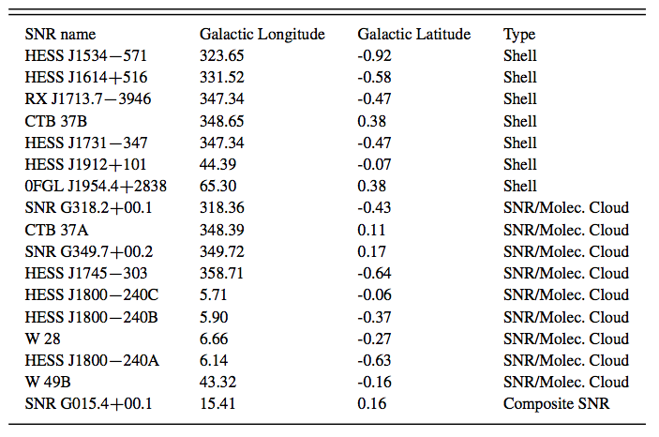
Low Galactic latitude from TeVCat

Slide 13
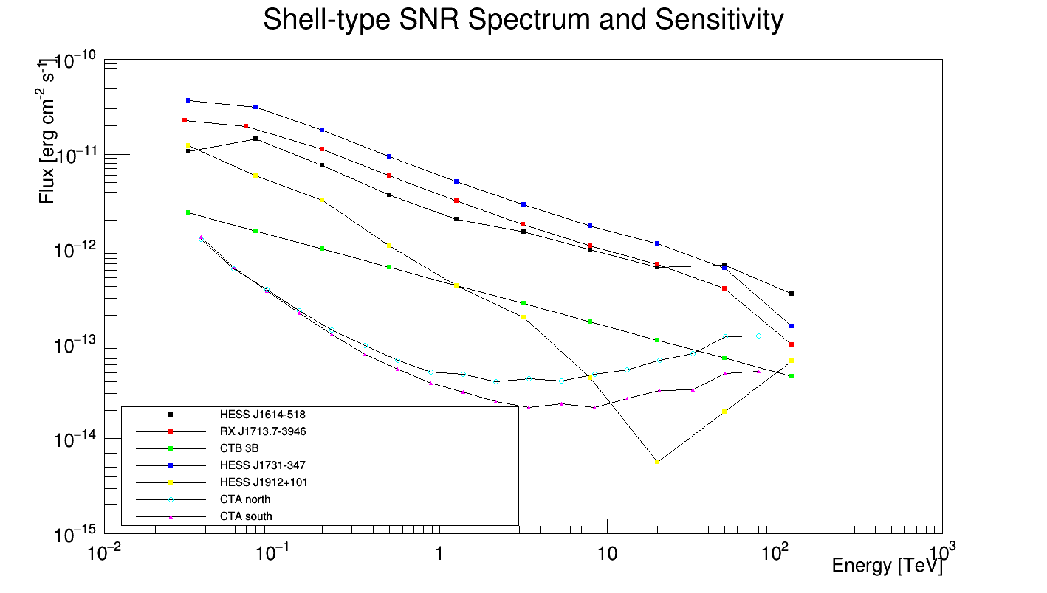

Slide 14
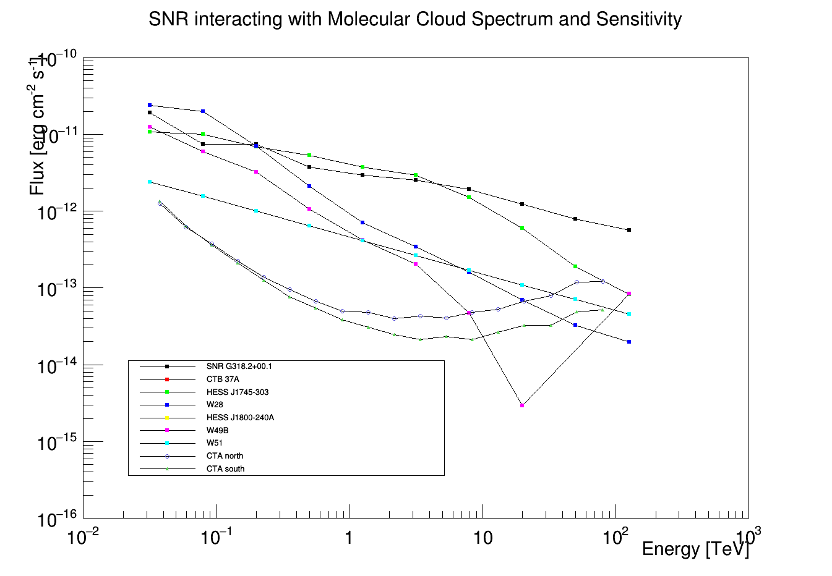

Slide 15
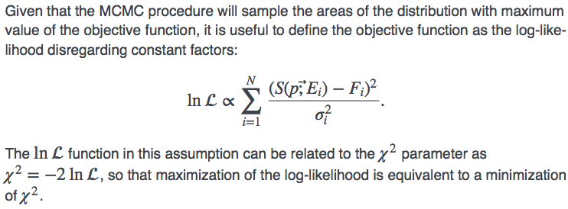
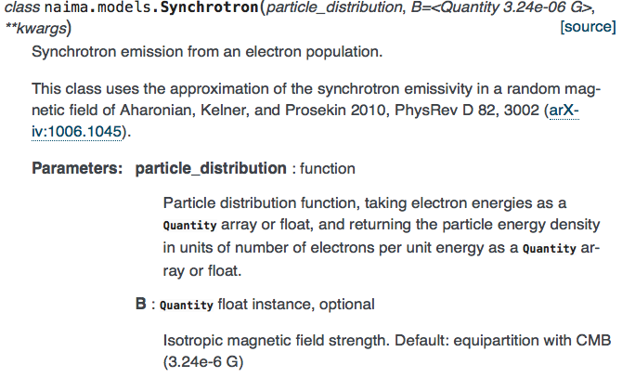
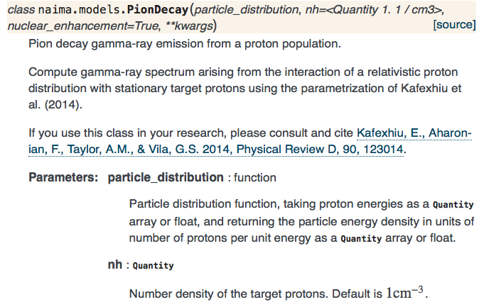


Naima python package

Slide 16
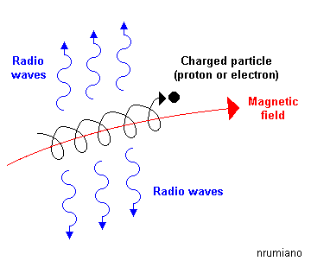
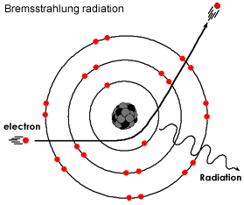
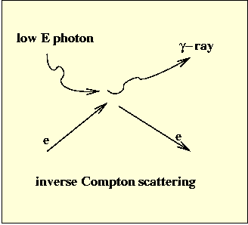
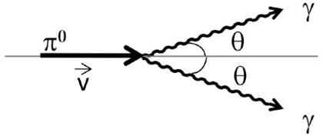
Radiation mechanism for SNRs
Four main non-thermal radiative mechanisms for producing γ-ray
Synchrotron
pion-decay

Slide 17
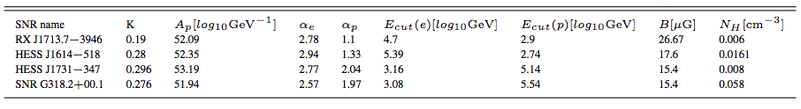

Electron and proton follow exponential cutoff power-law

Slide 18
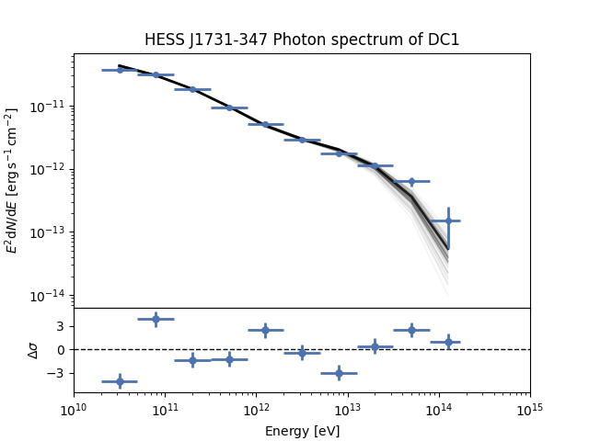
Notes:
10/8/18
18
18

Slide 19
HESS J1731-347 Spectral Energy Distribution
Notes:
10/8/18
19
19

Slide 20
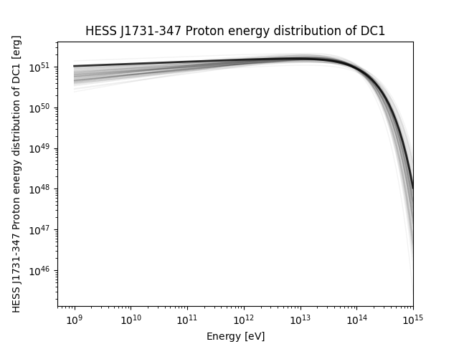
Notes:
10/8/18
20
20

Slide 21
Summary
Proton cut-off energy values as PeVatron indicators.
Distinguish pion-decay or inverse Compton process dominate SNRs radiation.
I do not consider the energy dispersion.
Reset the XML model definition file to smooth residuals maps.

