Slide 1
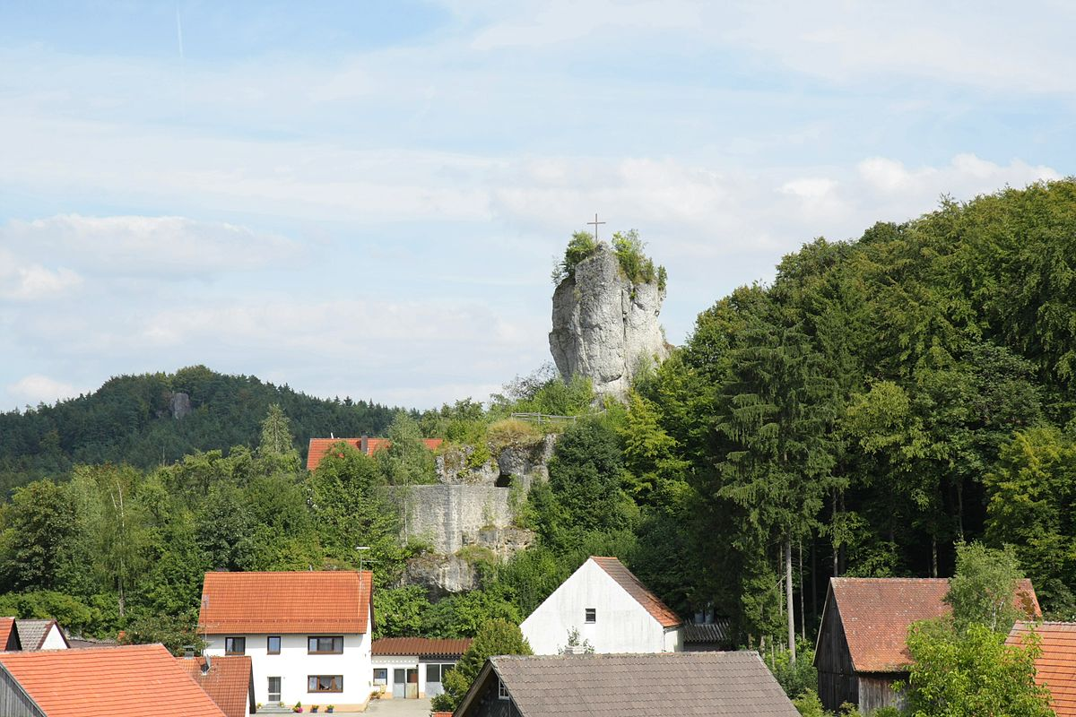
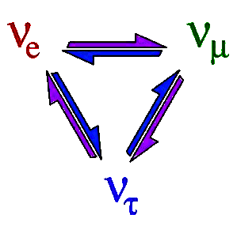
3. Reactor Neutrinos
3.5 Experiments & Results
Achim Stahl – RWTH Aachen University – JARA-FAME

Slide 2
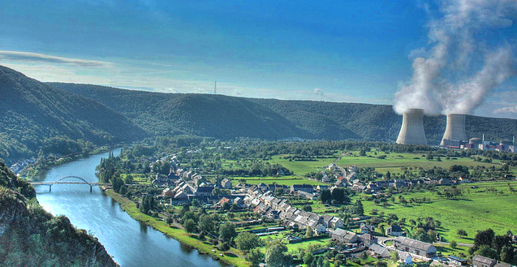

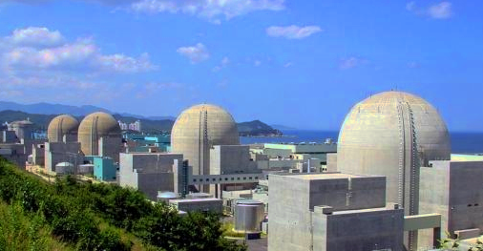

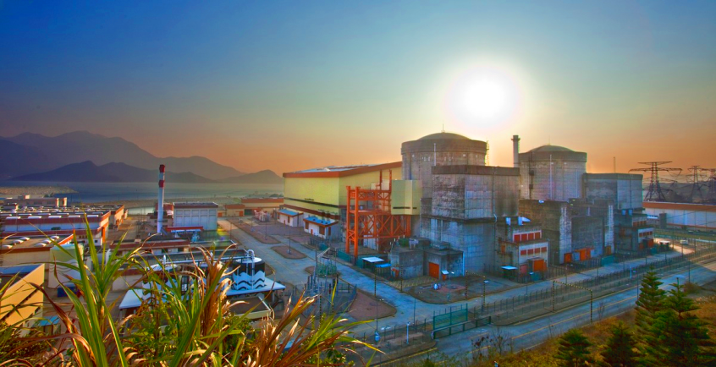

The 3 Experiments
Double Chooz
Reno
Daya Bay
Notes:
Introduction of the 3 experiments

Slide 3
The 3 Experiments
Double Chooz
8.5 GW_{th}
reactor cores
energy res. 6% (1 MeV)
overburden: 300m
statistics: 18 000 IBD
detectors
400 m
1050 m
8t
far detector
8t
Reno
16.8 GW_{th}
energy res. 7% (1 MeV)
overburden: 450m
statistics: 52 000 IBD
290 m
1380 m
16t
16t
far detector
Daya Bay
80t
energy res. 8% (1 MeV)
overburden: 860m
statistics: 150 000 IBD
40t
1650 m
17.4 GW_{th}
490 m
far detector
40t
365 m
Notes:
Introduction of the 3 experiments

Slide 4
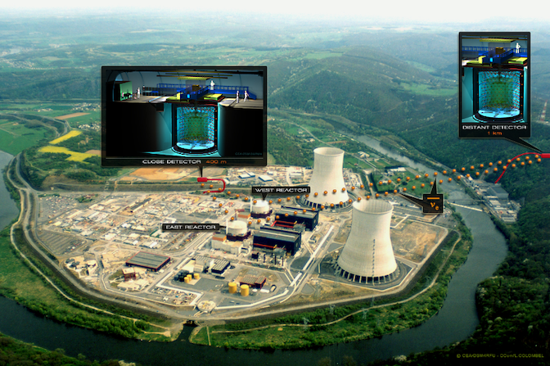

Double Chooz
supported by
Notes:
Neutrino-Oscillations: The PMNS-Matrix

Slide 5
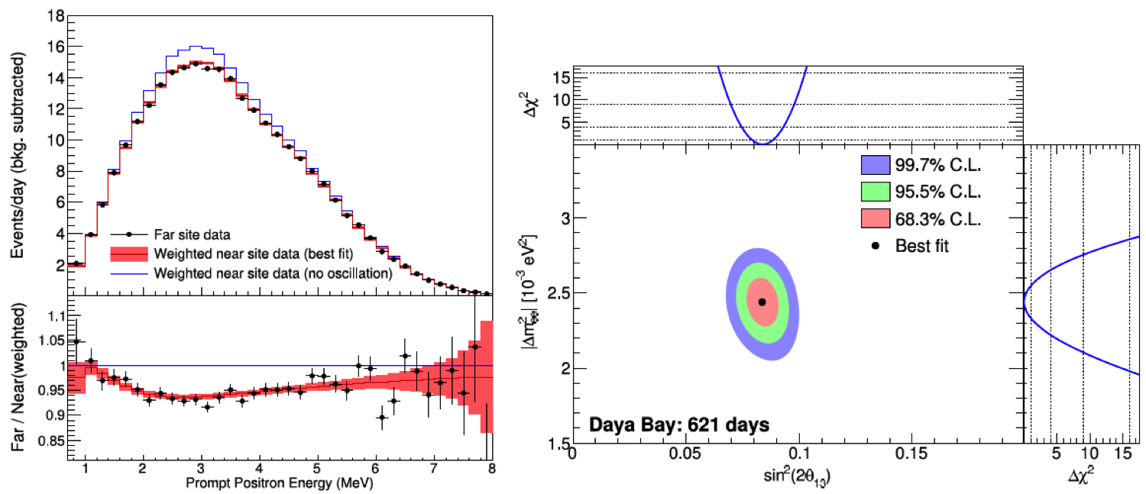
DAYA Bay: Result

Slide 6
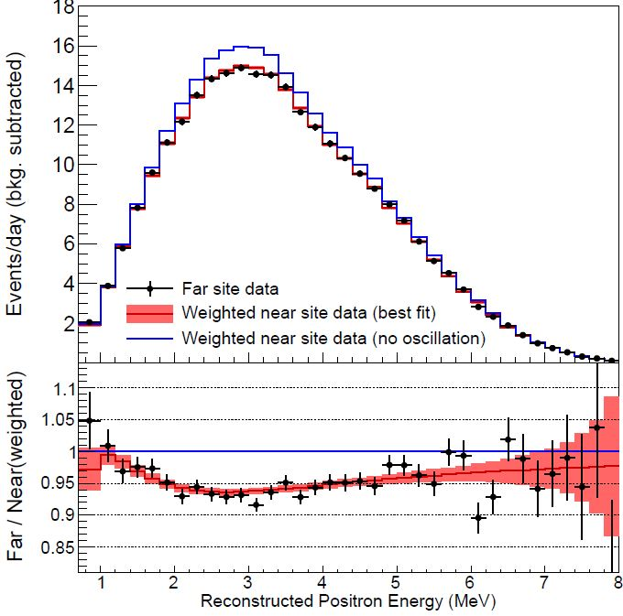
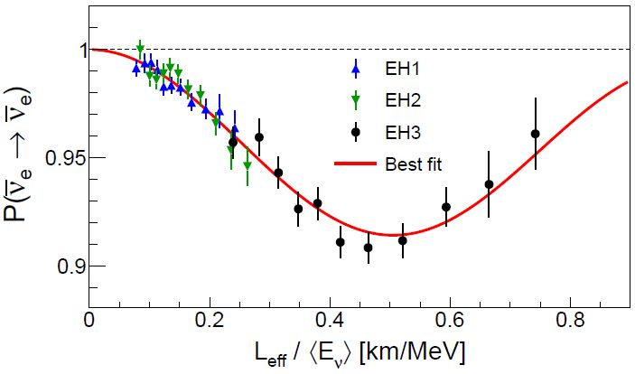
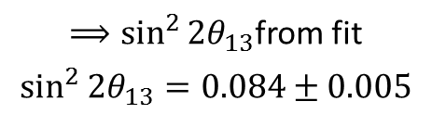
Measured Spectrum
$⟹\sin^{2}{2θ_{13}}$from fit
$$\sin^{2}{2θ_{13}}=0.084±0.005$$
F.P. An et al.
arXiv 1505.03456
May, 2015

Slide 7
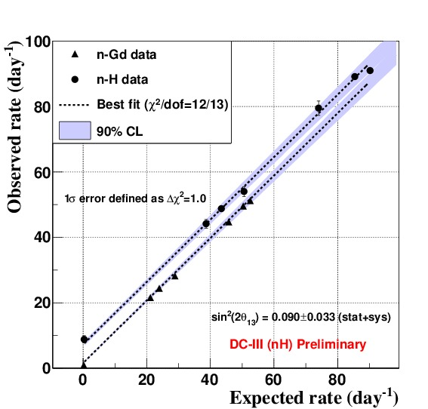
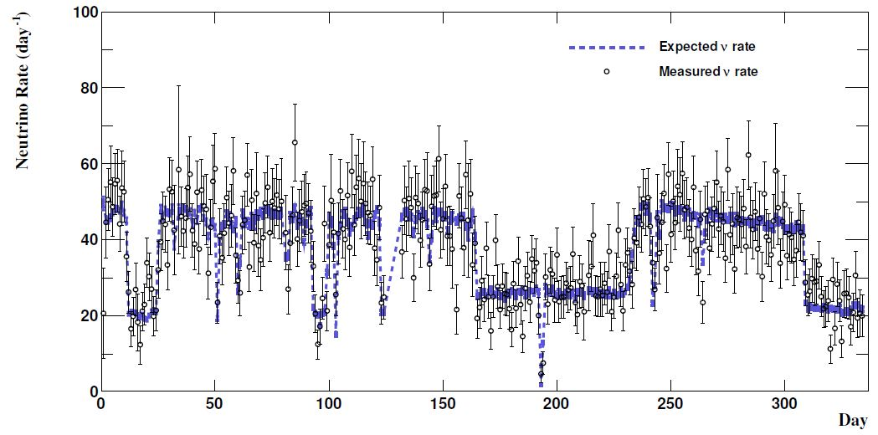
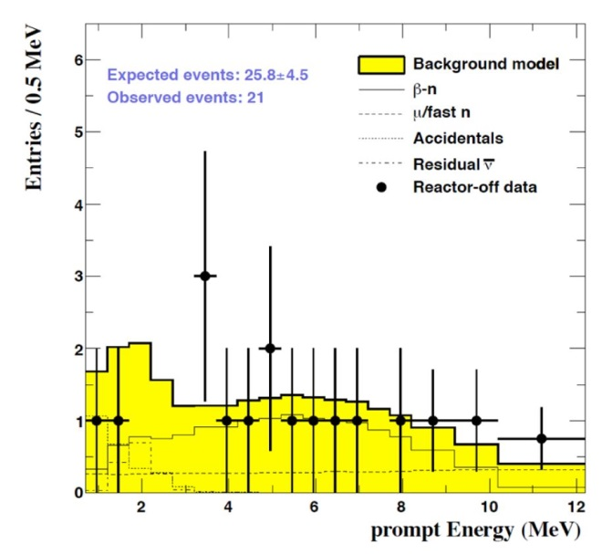
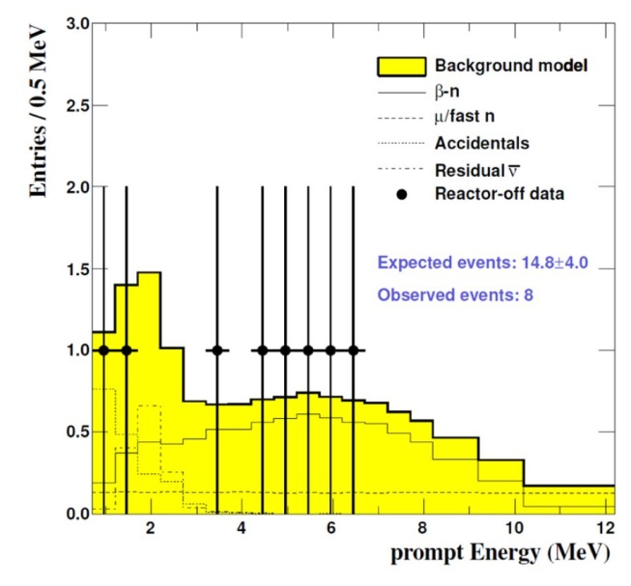
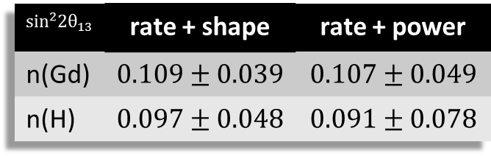
Background Estimate
P. Novella (for Double Chooz).; Phys.Procedia 61 (2015) 502-510
Double Chooz: Measure Background from Reactor-Off Periods
7.5 days of Reactor-Off
$$sin^{2}2θ_{13}$$ | rate + shape | rate + power
n(Gd) | $$0.109±0.039$$ | $$0.107±0.049$$
n(H) | $$0.097±0.048$$ | $$0.091±0.078$$

Slide 8
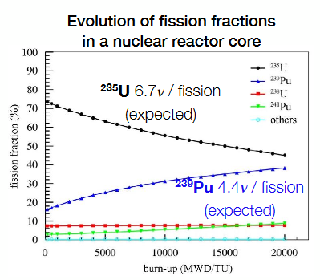
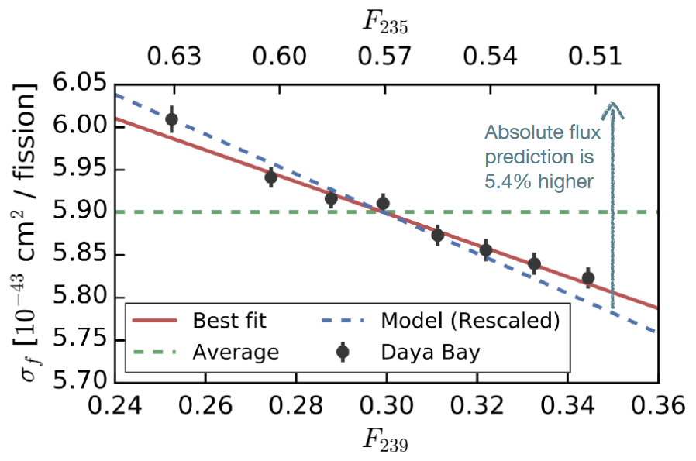
Reactor Fuel Burn-up

Slide 9
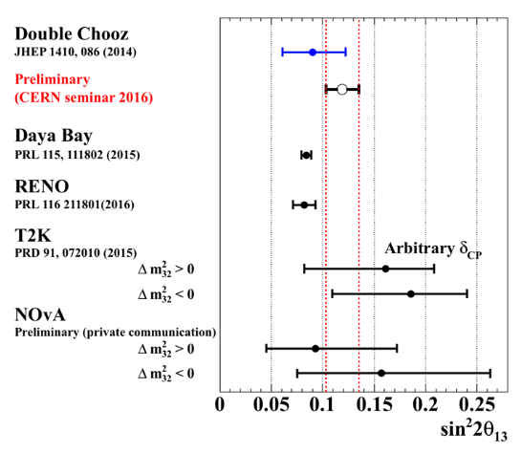
RESULTS

Slide 10
3. Reactor Neutrinos
Discussion
Achim Stahl – RWTH Aachen University – JARA-FAME

Slide 11
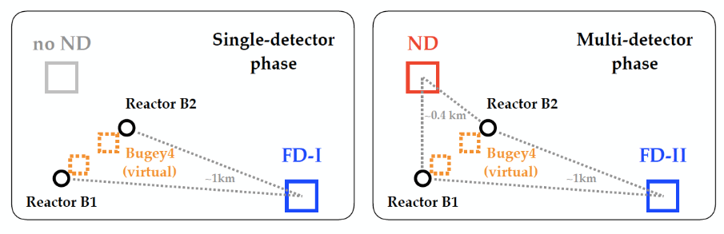
Flux Normalization
Far Data – MC Fit
Far Data – Near Data Fit

Slide 12
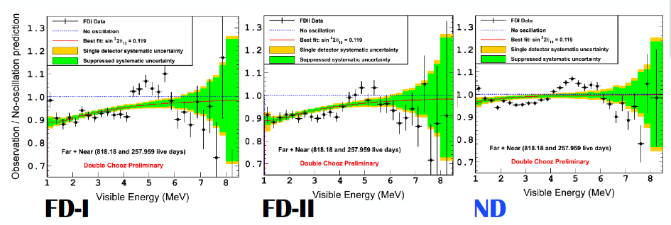

Slide 13
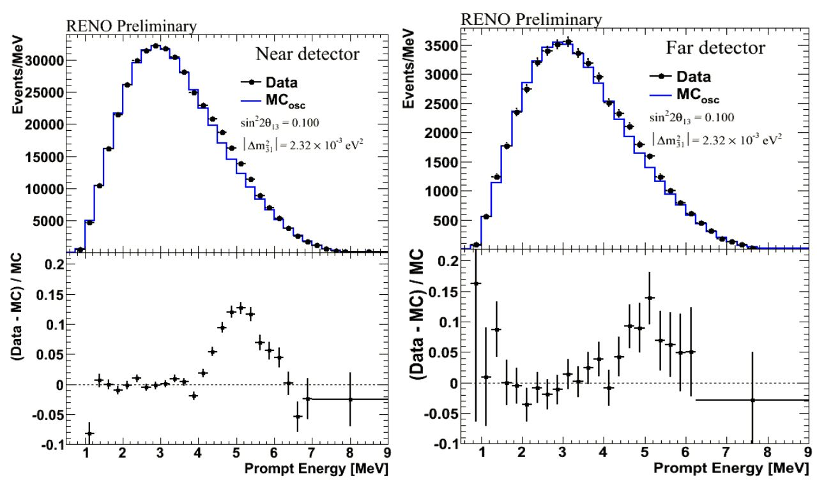

Slide 14
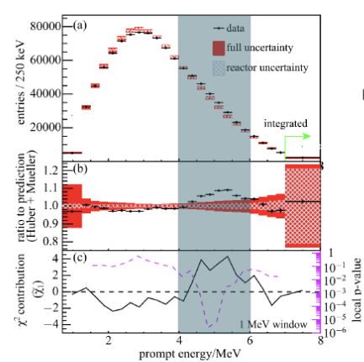

Slide 15
Find potential explenations of the bump
Inspect the published data: Find arguments pro and con the explanations
http://dayabay.ihep.ac.cn/
http://doublechooz.in2p3.fr
http://neutrino2016.iopconfs.org/home

