Slide 1
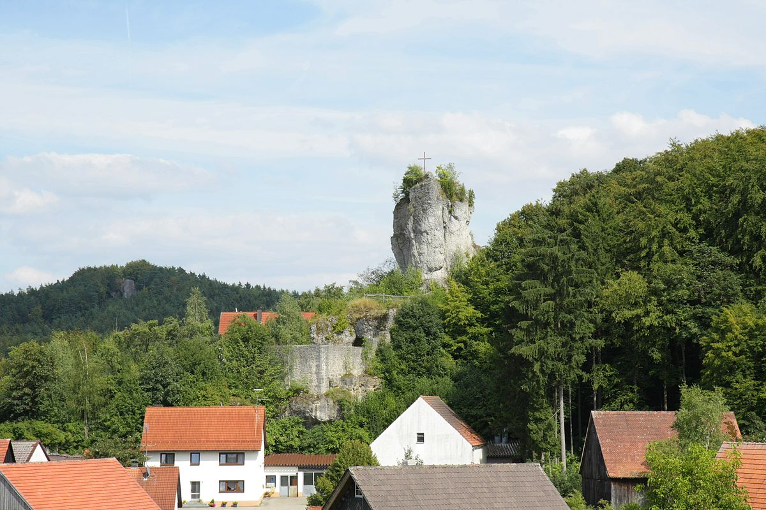
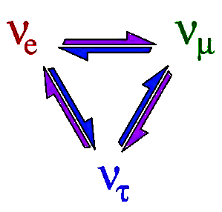
3. Reactor Neutrinos
3.2 Reactor Neutrino Physics
Achim Stahl – RWTH Aachen University – JARA-FAME

Slide 2
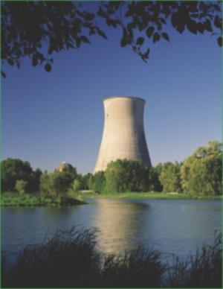
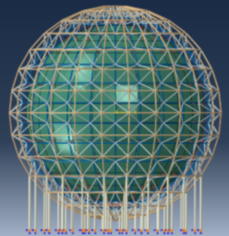
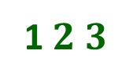
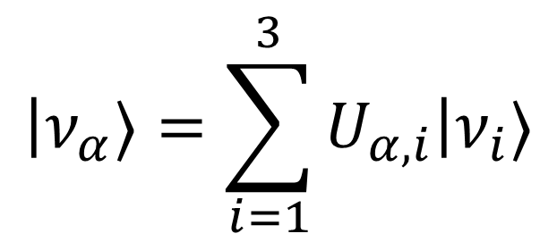
Neutrino Oscillations
Flavour
Eigenstates
Mass
Eigenstates
$$\left|ν_{α}\right.〉=\sum_{i=1}^{3}{U_{α,i}\left|ν_{i}〉\right.}$$
$$e μ τ$$
1$2 3$
How neutrinos
interact
How neutrinos
propagate
$$\left(\begin{matrix}1 & 0 & 0 \\ 0 & \cos{θ_{23}} & \sin{θ_{23}} \\ 0 & −\sin{θ_{23}} & \cos{θ_{23}}\end{matrix}\right) \left(\begin{matrix}\cos{θ_{13}} & 0 & \sin{θ_{13}}e^{−iδ} \\ 0 & 1 & 0 \\ −\sin{θ_{13}}e^{iδ} & 0 & \cos{θ_{13}}\end{matrix}\right) \left(\begin{matrix}\cos{θ_{12}} & \sin{θ_{12}} & 0 \\ −\sin{θ_{12}} & \cos{θ_{12}} & 0 \\ 0 & 0 & 1\end{matrix}\right)$$
Pontecorvo Maki Nakagawa Sakata - matrix
Notes:
Neutrino-Oscillations: The PMNS-Matrix

Slide 3
Neutrino Oscillations
Flavour
Eigenstates
Mass
Eigenstates
$$\left(\begin{matrix}\cos{θ_{13}} & 0 & \sin{θ_{13}}e^{−iδ} \\ 0 & 1 & 0 \\ −\sin{θ_{13}}e^{iδ} & 0 & \cos{θ_{13}}\end{matrix}\right)$$
$$Δm^{2}≈2.4 {10}^{−3} eV^{2}$$
$$θ_{13}≈9°$$
Reactor Oscillations
$$e μ τ$$
1$2 3$
How neutrinos
interact
How neutrinos
propagate
$$\left(\begin{matrix}1 & 0 & 0 \\ 0 & \cos{θ_{23}} & \sin{θ_{23}} \\ 0 & −\sin{θ_{23}} & \cos{θ_{23}}\end{matrix}\right) \left(\begin{matrix}\cos{θ_{13}} & 0 & \sin{θ_{13}}e^{−iδ} \\ 0 & 1 & 0 \\ −\sin{θ_{13}}e^{iδ} & 0 & \cos{θ_{13}}\end{matrix}\right) \left(\begin{matrix}\cos{θ_{12}} & \sin{θ_{12}} & 0 \\ −\sin{θ_{12}} & \cos{θ_{12}} & 0 \\ 0 & 0 & 1\end{matrix}\right)$$
Pontecorvo Maki Nakagawa Sakata - matrix
Notes:
Neutrino-Oscillations: The PMNS-Matrix

Slide 4
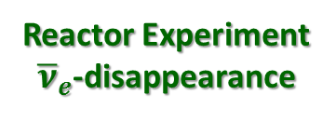
Oscillation Pattern
$$\begin{matrix}P_{α→β}=δ_{αβ} −4 \sum_{i>j}{Re\left(U_{αi}^{∗}U_{βi}U_{αj}U_{βj}^{∗}\right)\sin^{2}{\frac{\left(m_{i}^{2}−m_{j}^{2}\right)L}{4E}}} \\ +2 \sum_{i>j}{Im\left(U_{αi}^{∗}U_{βi}U_{αj}U_{βj}^{∗}\right)\sin{\frac{\left(m_{i}^{2}−m_{j}^{2}\right)L}{2E}}} \end{matrix}$$
Reactor Experiment
${\overline{ν}}_{e}$-disappearance
Notes:
Sources and oscillation lengths

Slide 5
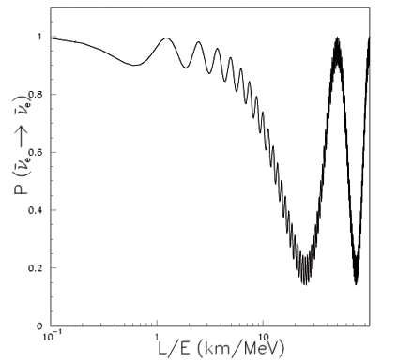
Oscillation Pattern
$$\begin{matrix}P_{α→β}=δ_{αβ} −4 \sum_{i>j}{Re\left(U_{αi}^{∗}U_{βi}U_{αj}U_{βj}^{∗}\right)\sin^{2}{\frac{\left(m_{i}^{2}−m_{j}^{2}\right)L}{4E}}} \\ +2 \sum_{i>j}{Im\left(U_{αi}^{∗}U_{βi}U_{αj}U_{βj}^{∗}\right)\sin{\frac{\left(m_{i}^{2}−m_{j}^{2}\right)L}{2E}}} \end{matrix}$$
Reactor Experiment
${\overline{ν}}_{e}$-disappearance
$$θ_{13}$$
$$θ_{12}$$
atmospheric
frequency
$$ν_{e}$$
solar frequency
Notes:
Sources and oscillation lengths

Slide 6
Oscillation Pattern
$$\begin{matrix}P_{α→β}=δ_{αβ} −4 \sum_{i>j}{Re\left(U_{αi}^{∗}U_{βi}U_{αj}U_{βj}^{∗}\right)\sin^{2}{\frac{\left(m_{i}^{2}−m_{j}^{2}\right)L}{4E}}} \\ +2 \sum_{i>j}{Im\left(U_{αi}^{∗}U_{βi}U_{αj}U_{βj}^{∗}\right)\sin{\frac{\left(m_{i}^{2}−m_{j}^{2}\right)L}{2E}}} \end{matrix}$$
Reactor Experiment
${\overline{ν}}_{e}$-disappearance
near
far
$$ν_{e}$$
current experiments
KamLAND
next generation
Notes:
Sources and oscillation lengths

Slide 7
Oscillation Pattern
leading terms:
$$\begin{matrix}P_{{\overline{ν}}_{e}→{\overline{ν}}_{e}}=1 −\sin^{2}{2θ_{13}}\sin^{2}{\frac{Δm_{ee}^{2}L}{4E}}−\cos^{4}{θ_{13}}\sin^{2}{2θ_{12}}\sin^{2}{\frac{Δm_{21}^{2}L}{4E}} \\ \end{matrix}$$
$\sin^{2}{\frac{Δm_{ee}^{2}L}{4E}}=\cos^{2}{θ_{12}}\sin^{2}{\frac{Δm_{31}^{2}L}{4E}}+\sin^{2}{θ_{12}}\sin^{2}{\frac{Δm_{32}^{2}L}{4E}}$, $Δm_{ij}^{2}=m_{i}^{2}−m_{j}^{2}$
Reactor Experiment
${\overline{ν}}_{e}$-disappearance
near
far
$$ν_{e}$$
current experiments
KamLAND
next generation
Notes:
Sources and oscillation lengths

