Slide 1
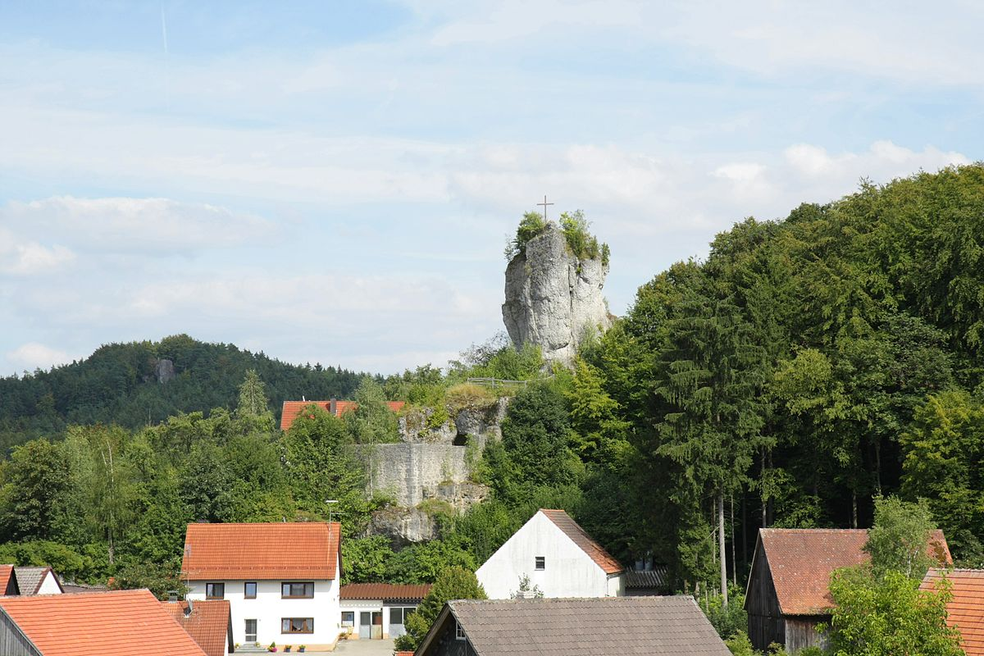
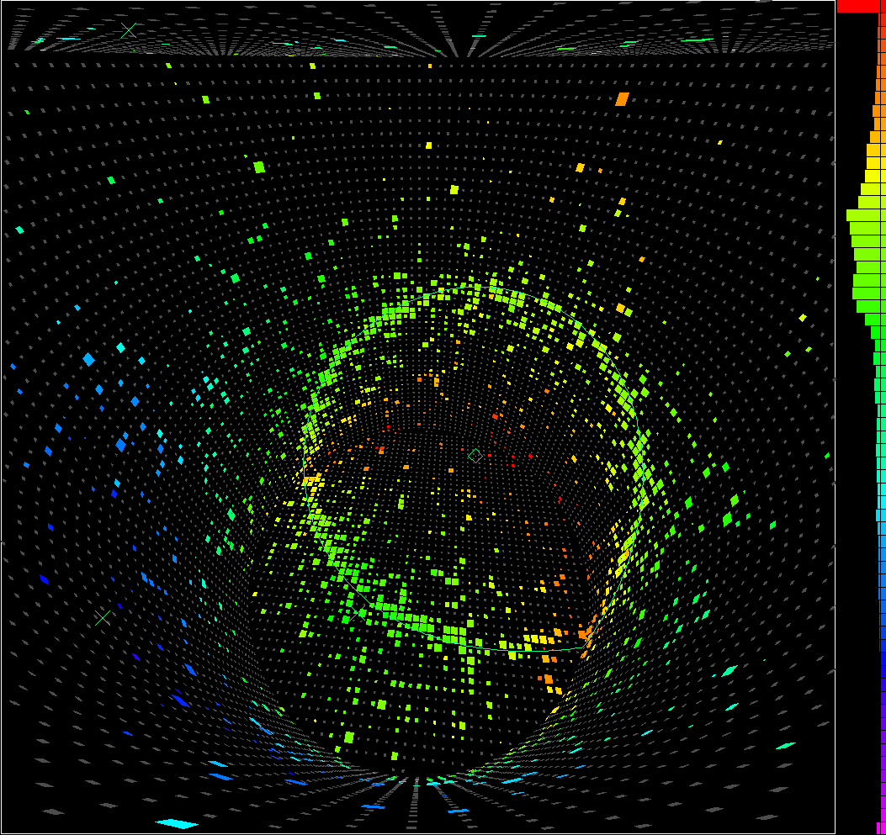
2. Solar Neutrinos
2.1 Super-K
Achim Stahl – RWTH Aachen University – JARA-FAME

Slide 2
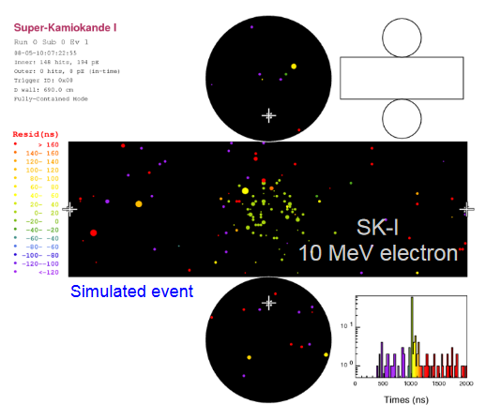
Event Display
Lightyield:
6 p.e. / MeV

Slide 3
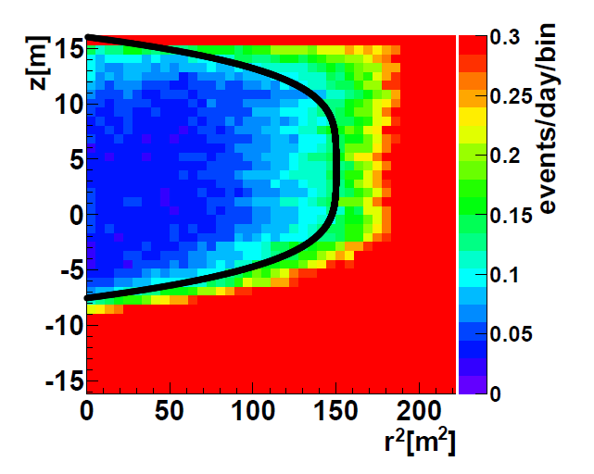
Fiducial Volume
fiducial volume cut
fiducial volume:
22.5 kt
Background rate from the surrounding rock / PMT / steel structure …

Slide 4
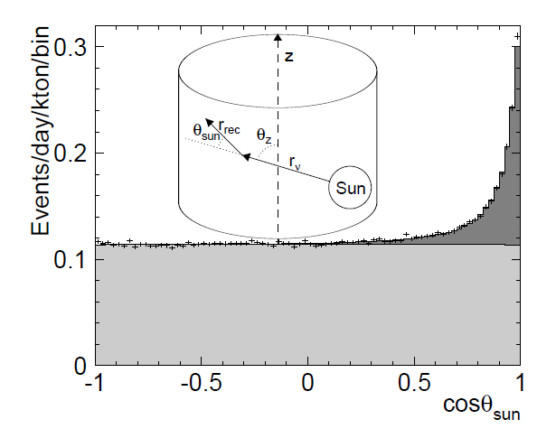
Event Selection

Slide 5
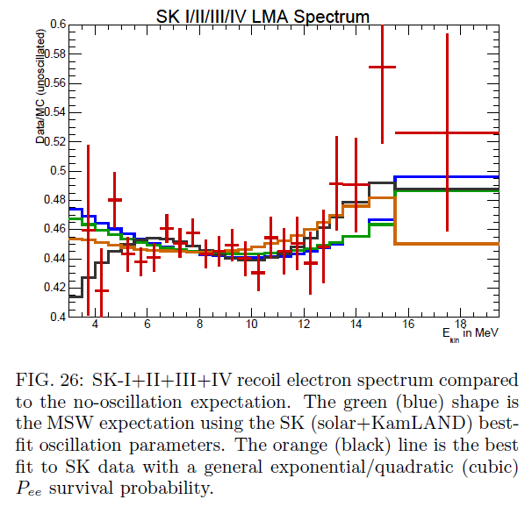
Energy Spectrum

Slide 6
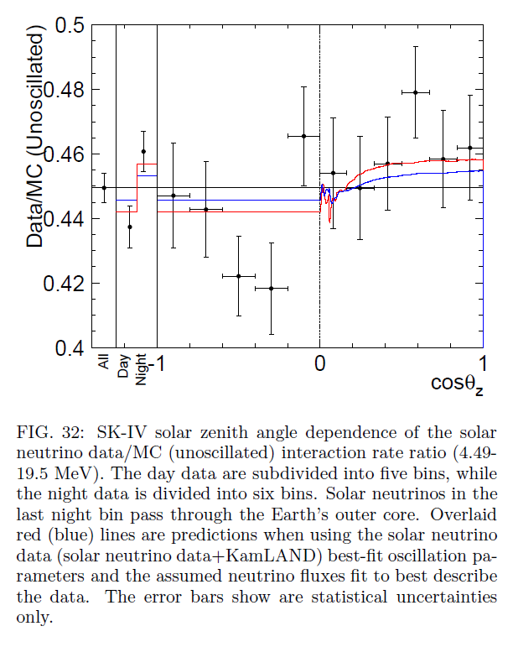
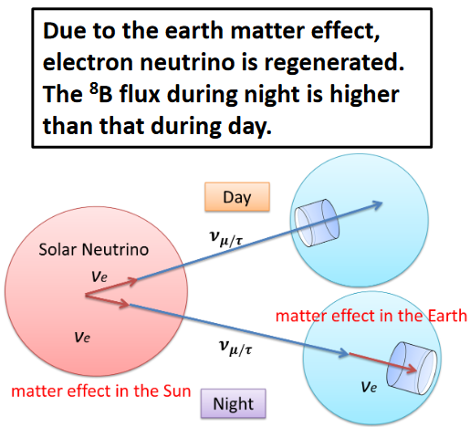
Day-Night Effect

Slide 7
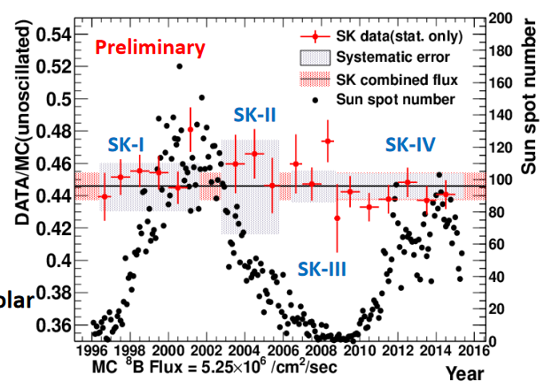
Yearly Flux

Slide 8
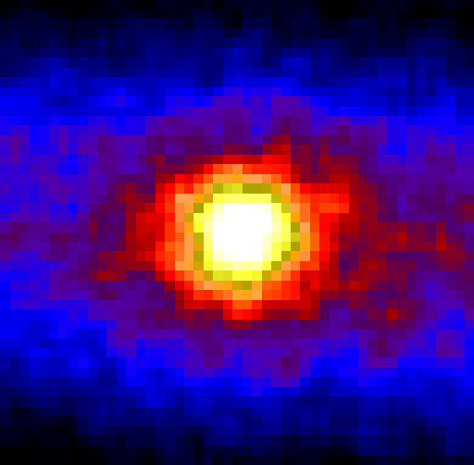
Neutrino-Image of Sun

Slide 9
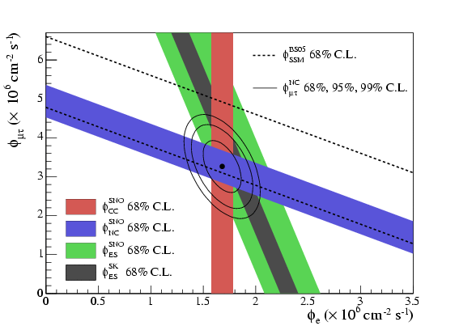
2. Solar Neutrinos
2.2 SNO
Achim Stahl – RWTH Aachen University – JARA-FAME

Slide 10
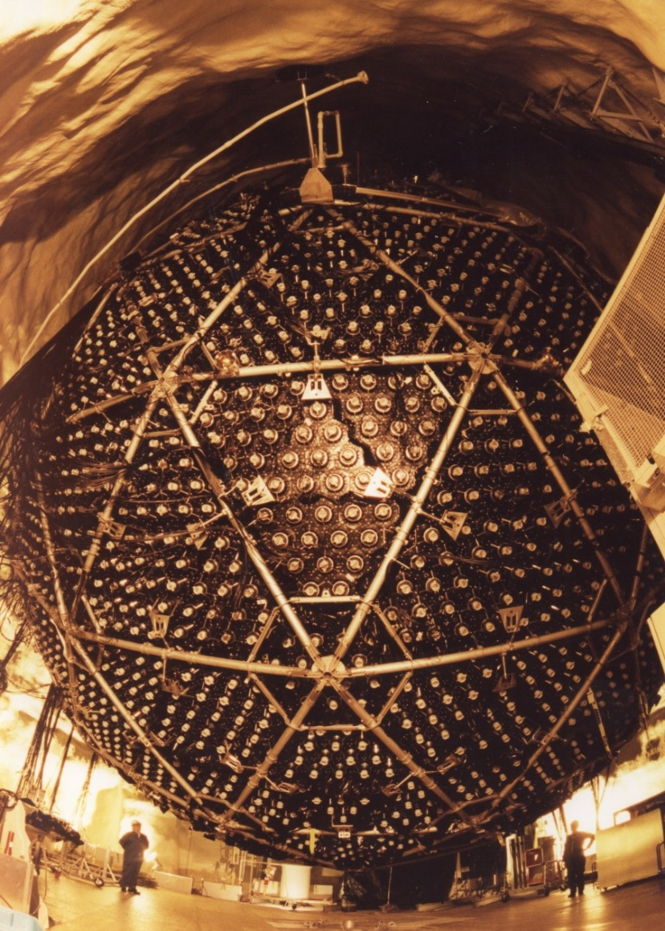
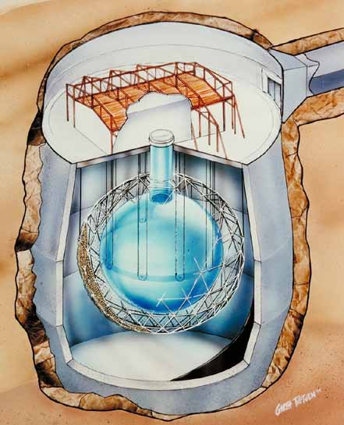
Sudbury Neutrino Observatory
1000 t of $D_{2}O$, $6 m$ radius
normal water for shielding
9600 PMTs

Slide 11
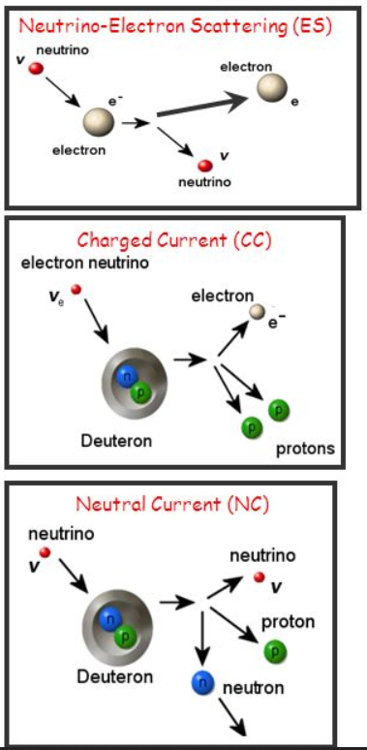
Detection Principle
Phase !:
pure $D_{2}O$
Phase II:
NaCl for n capture
Phase III:
ionisation chambers
for n detection

Slide 12
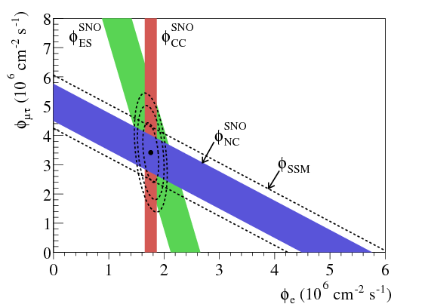
Result

Slide 13
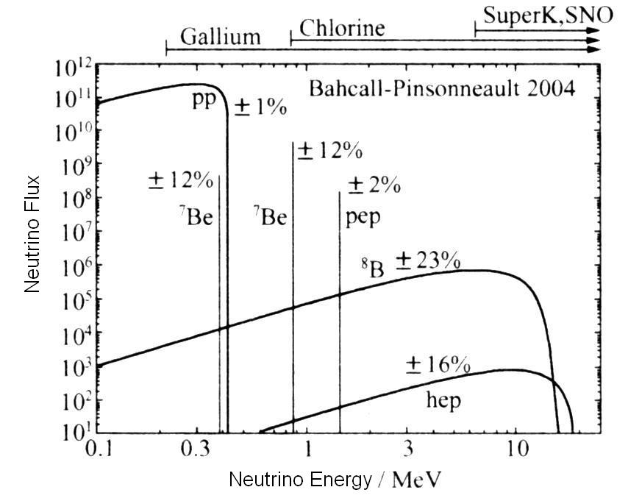
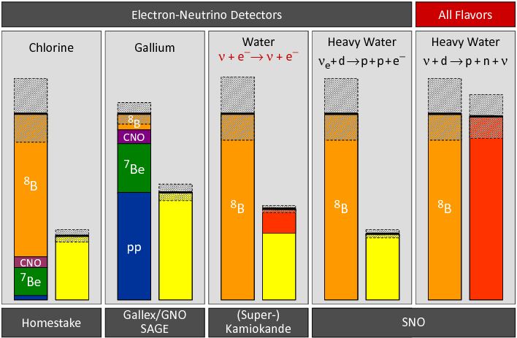
Results

Slide 14
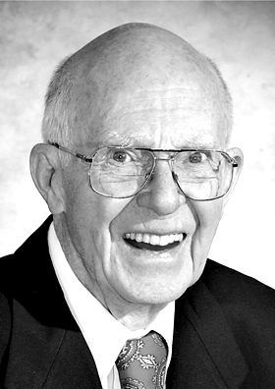
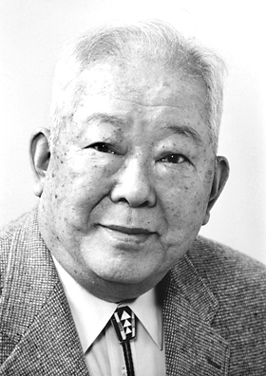
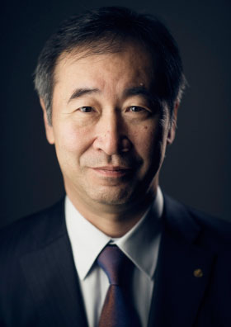
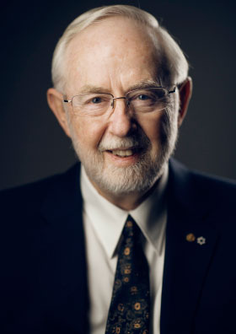
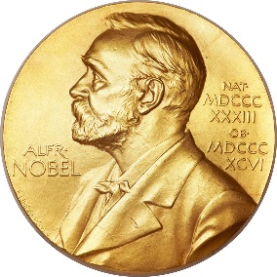
Nobel Prizes
2002
2015
Kamiokande
Super-K
SNO
Raymond Davis jr.
Masatoshi Koshiba
Takaaki Kajita
Arthur B. McDonald
“for pioneering contributions to astrophysics, in particular for the detection of cosmic neutrinos”
"for the discovery of neutrino oscillations, which shows that neutrinos have mass"

Slide 15
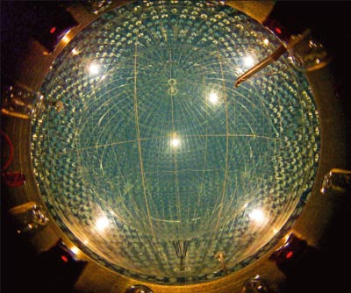
2. Solar Neutrinos
2.3 Borexino
Achim Stahl – RWTH Aachen University – JARA-FAME

Slide 16
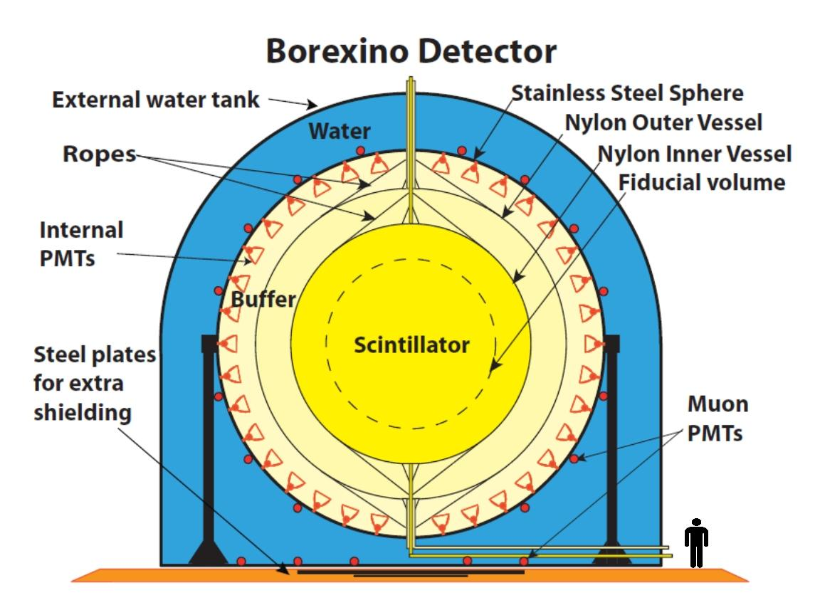
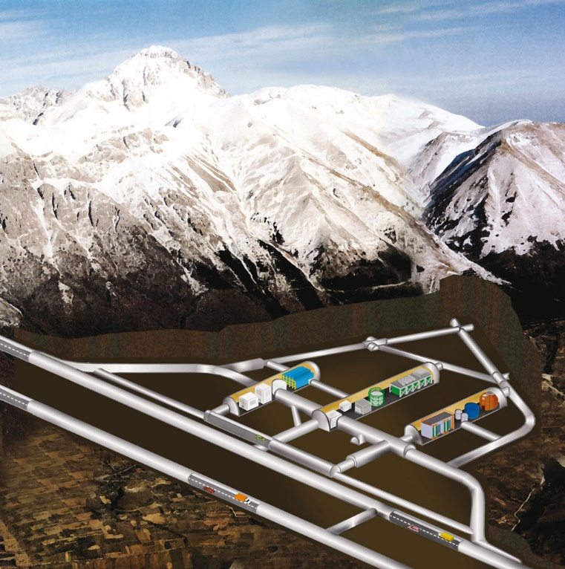
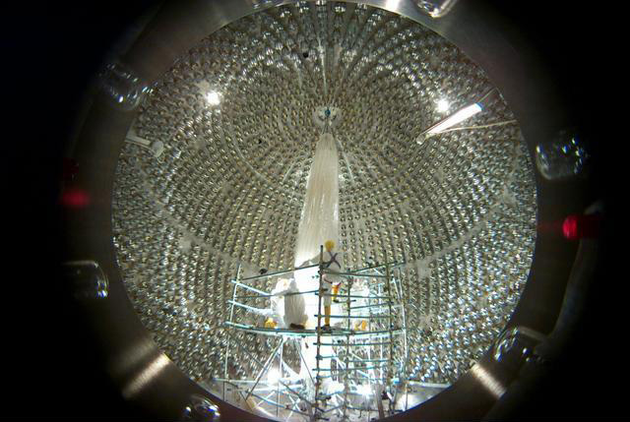
BOREXINO Experiment
Real-time detection of solar neutrinos
Liquid scintillator: 278 t

Slide 17
BOREXINO Experiment
Real-time detection of solar neutrinos

Slide 18
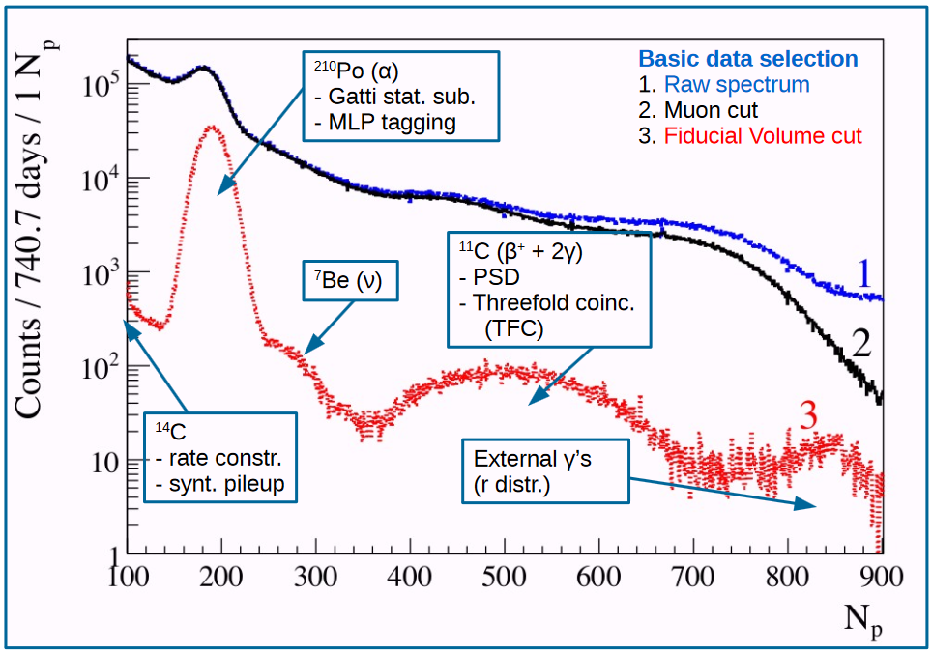
Borexino Spectrum

Slide 19
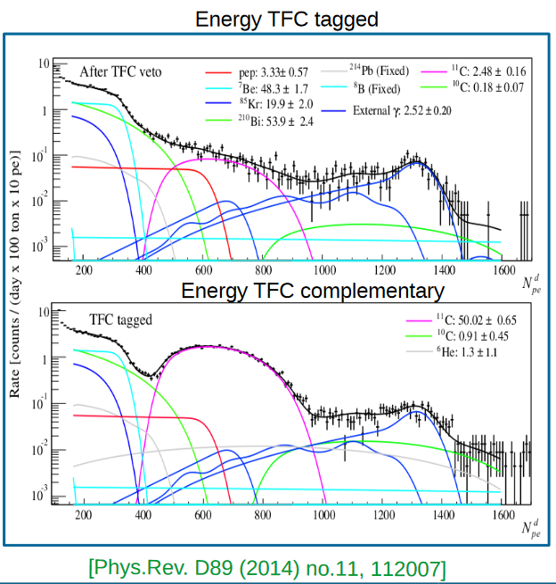
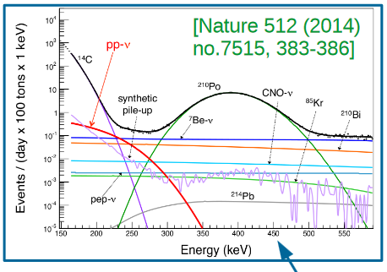
Borexino Fit

Slide 20
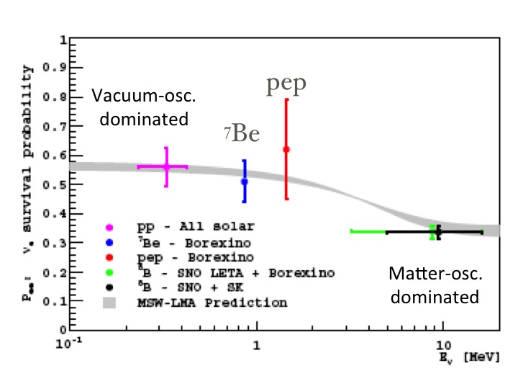
Result: All

