Slide 1
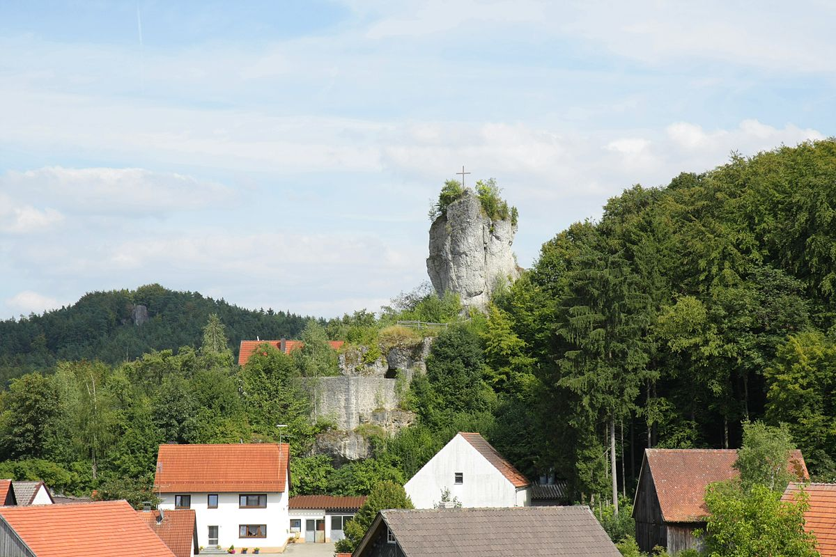
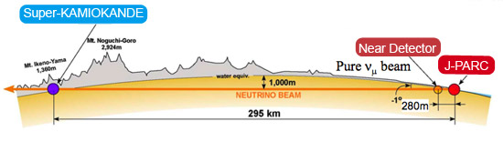
6. Neutrino Beams
6.1 Beam Concepts
Achim Stahl – RWTH Aachen University – JARA-FAME

Slide 2
A Neutrino Beam
Target

Slide 3

A Neutrino Beam
B
Horn
.
Target
$$π^{+} π^{−}$$

Slide 4


A Neutrino Beam
B
Horn
$$μ^{+}$$
$$ν_{μ}$$
Target
$$π^{+} π^{−}$$
Absorber
technological challenges: target, horn, …
hadron physics in the target
  dedicated experiments: NA61/SHINE
  measurements with near detectors
  models

Slide 5
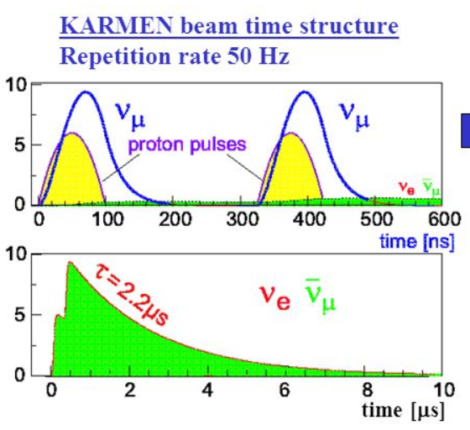
PIDAR: pion decay-at-rest

Slide 6
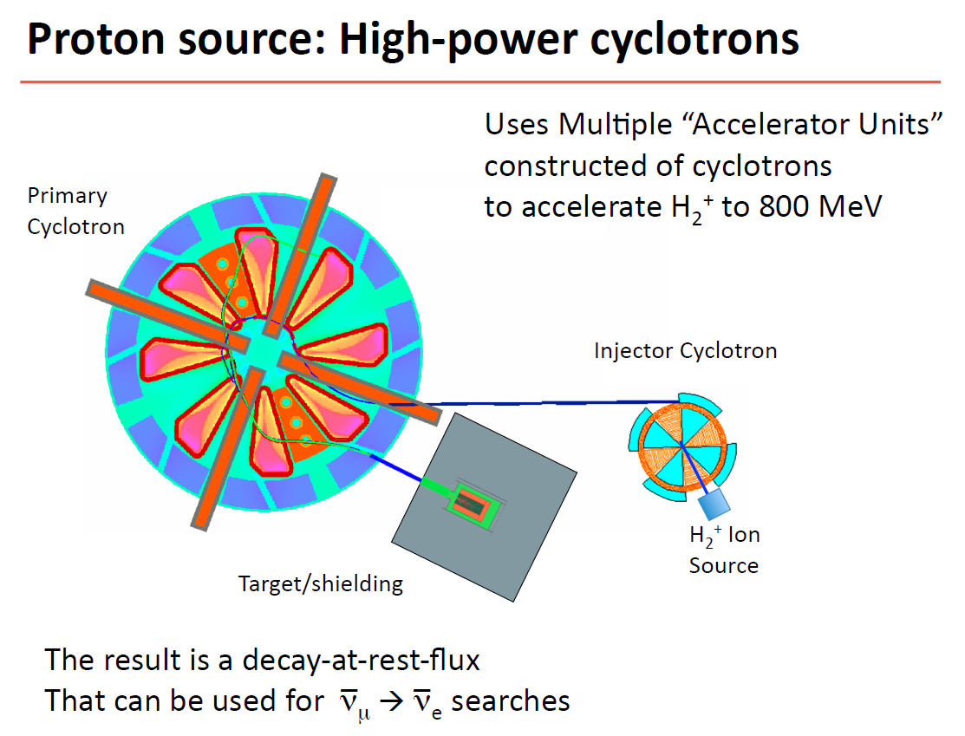
Michi Wurm
-- LENA --

Slide 7
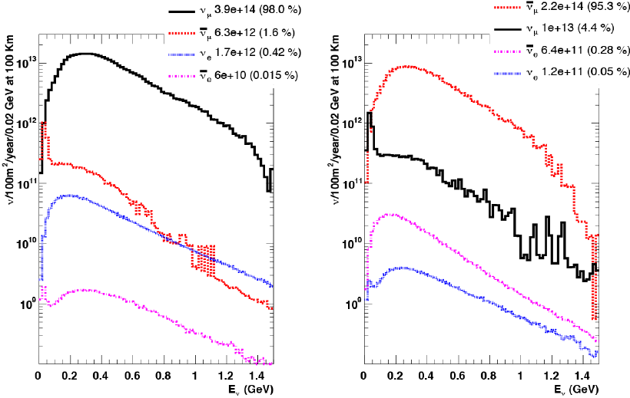
CERN SPL: 5 GeV, 5 MW proton beam

Slide 8
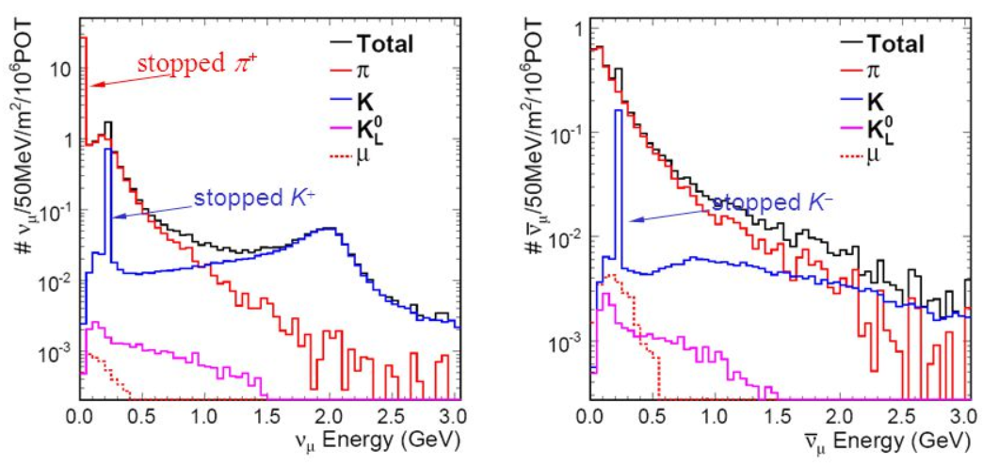
NUMI beam, FermiLab (120 GeV)
raw
tuned

Slide 9
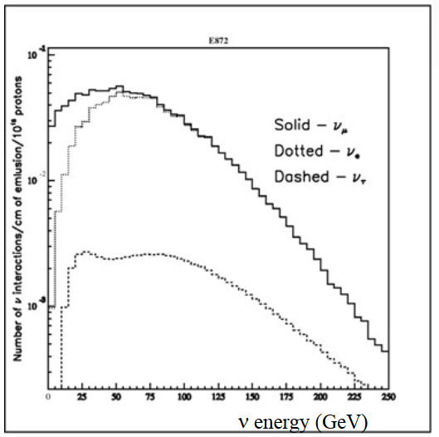
tau-neutrino beam for DONUT experiment

Slide 10
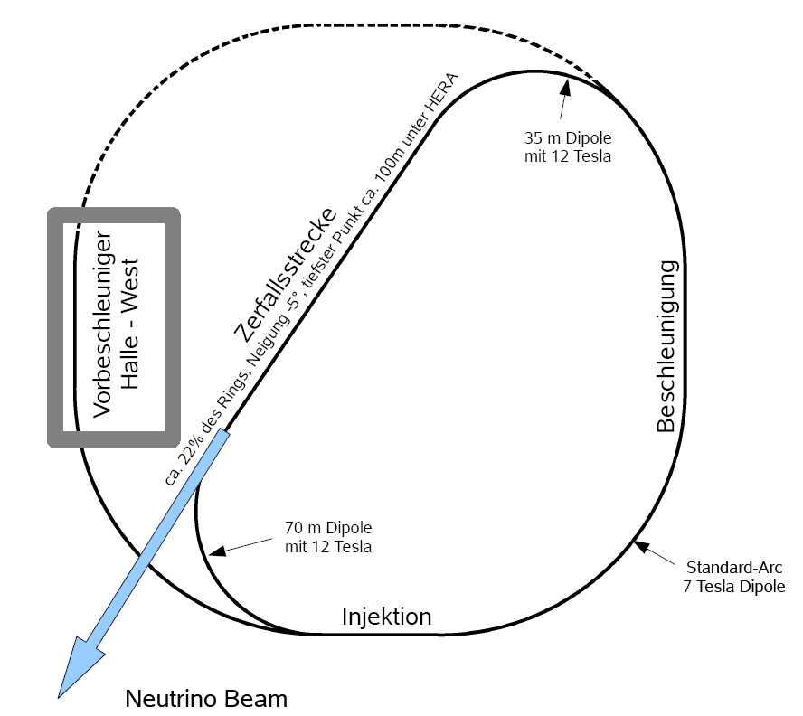
Conceptional Layout
accelerator in HERA tunnel used as
decay ring and for
final acceleration
12 T dipole
35 m length
Decay section
approx. 22% of the ring, pointing down at 5°, lowest point 100m below HERA
Preaccelerator
„Halle West“
Acceleration
12 T dipole
2 x 35 m length
Injection

Slide 11
6. Neutrino Beams
6.2 Beam Elements
Achim Stahl – RWTH Aachen University – JARA-FAME

Slide 13
Example: MiniBooNE target
Material: Beryllium
Shape: cylinder
Length: 1.7 interacCon lengths
for 8 GeV/c protons (71cm)
Diameter: 1cm
Air cooled

Slide 14
Example: NuMI (MINOS) target Material: Graphite with Al casing
Shape: ruler 6.4 mm x 15 mm x 20 mm ) x 47 (2 interacCon lengths)

Slide 15
NuMI horn (MINOS)

Slide 16
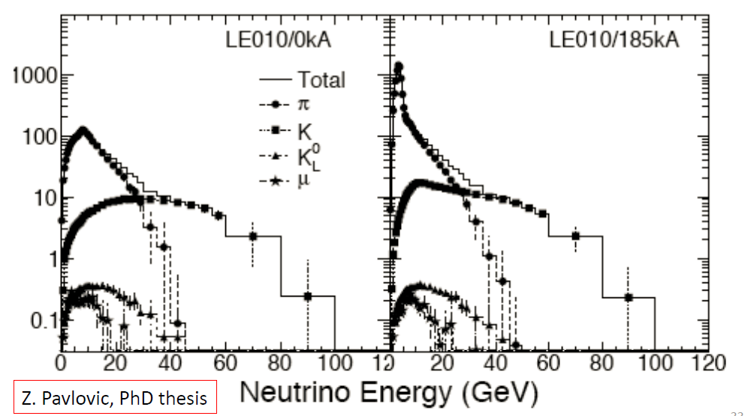

Slide 18
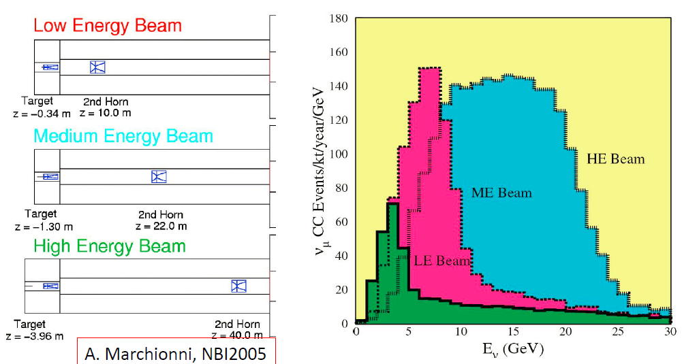

Slide 19
T2K decay tunnel during construction, 1 atm He, 94 m long

Slide 20
NuMI: copper pipe @ vacuum, 2 m diameter, 677 m long

Slide 21
NuMI: beam dump, 1 kt Al-core, embedded in concrete, water cooled

Slide 22
6. Neutrino Beams
6.3 Off-axis beam
Achim Stahl – RWTH Aachen University – JARA-FAME

Slide 23
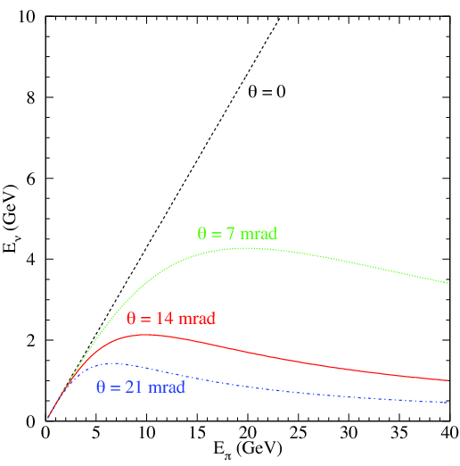

Slide 24
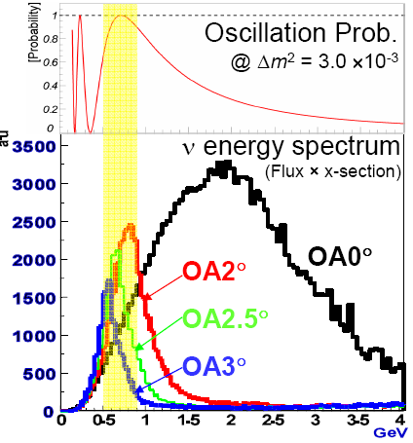
T2K-beam
2.5° off-axis

Slide 25
6. Neutrino Beams
6.4 Example T2K beam
Achim Stahl – RWTH Aachen University – JARA-FAME

Slide 26
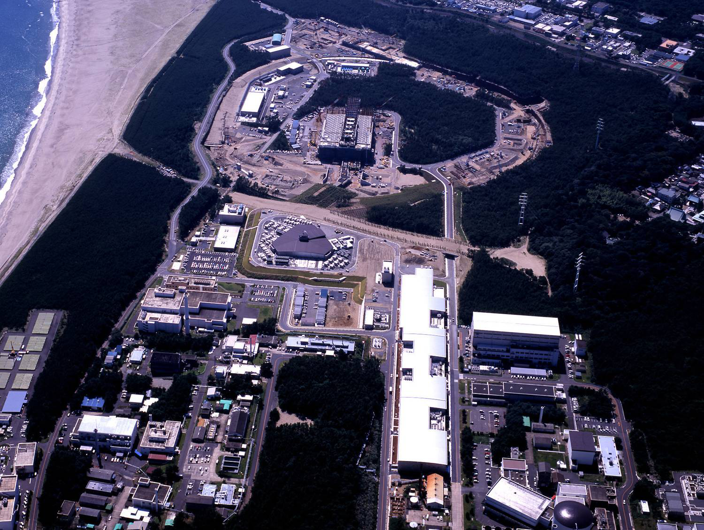
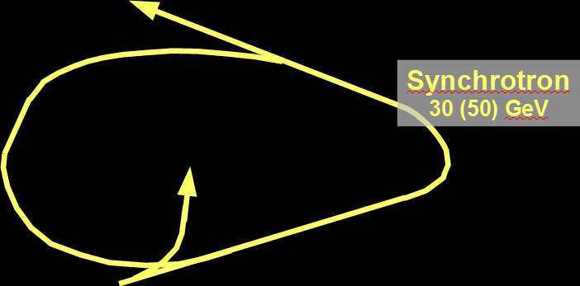
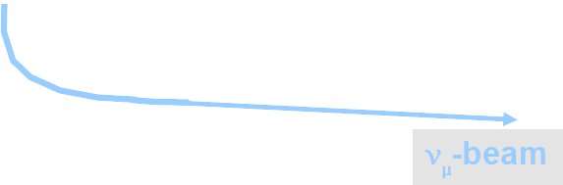
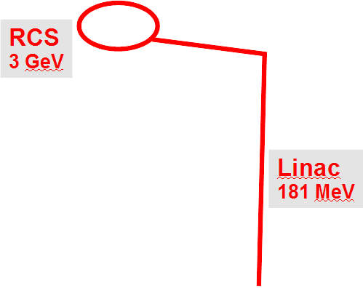

Slide 27
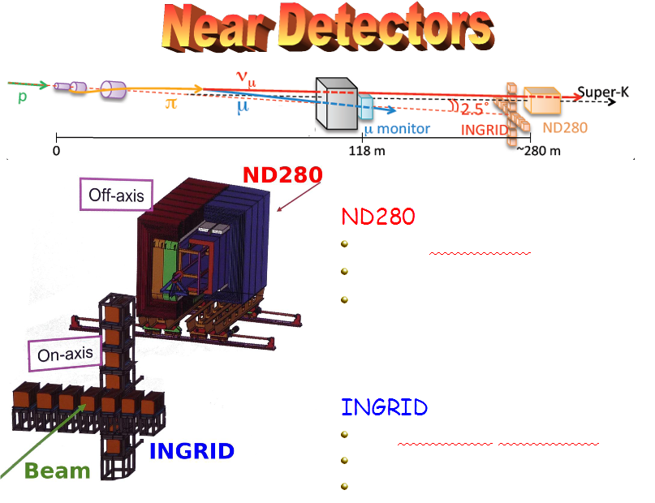

Slide 28
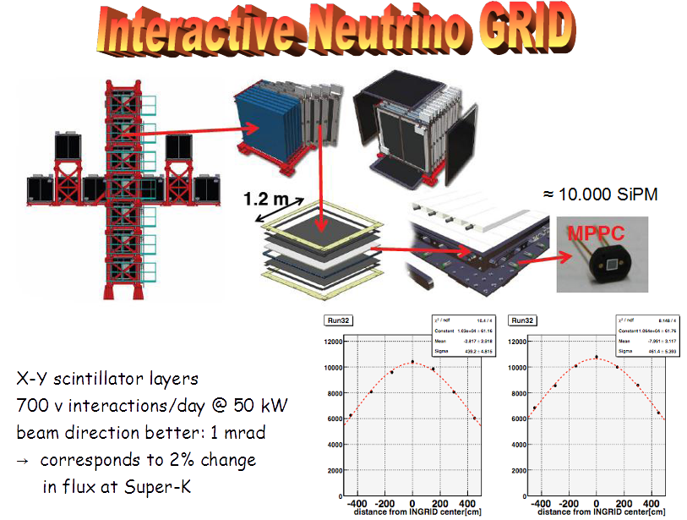

Slide 29
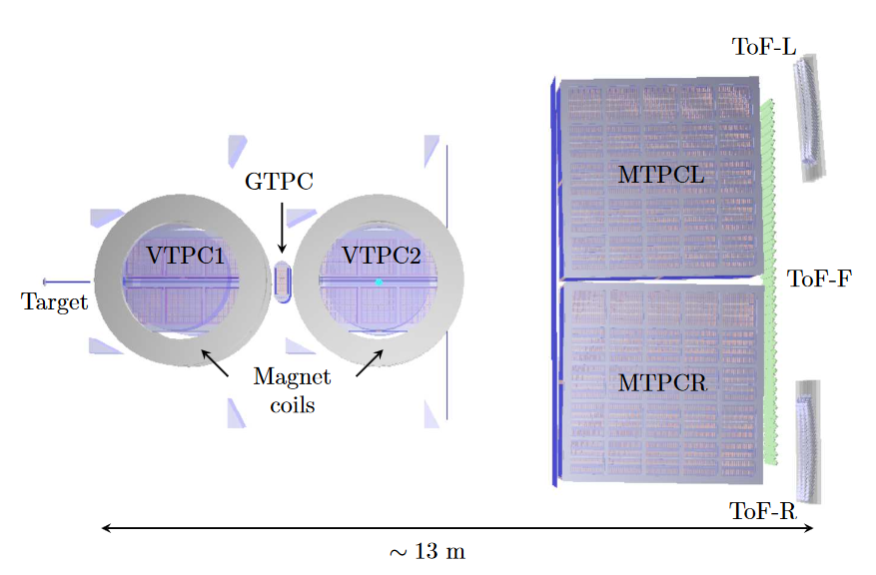
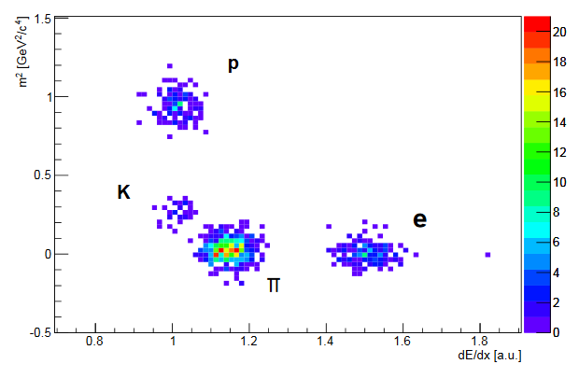
NA61/SHINE: Hadron production experiment @ CERN

Slide 30
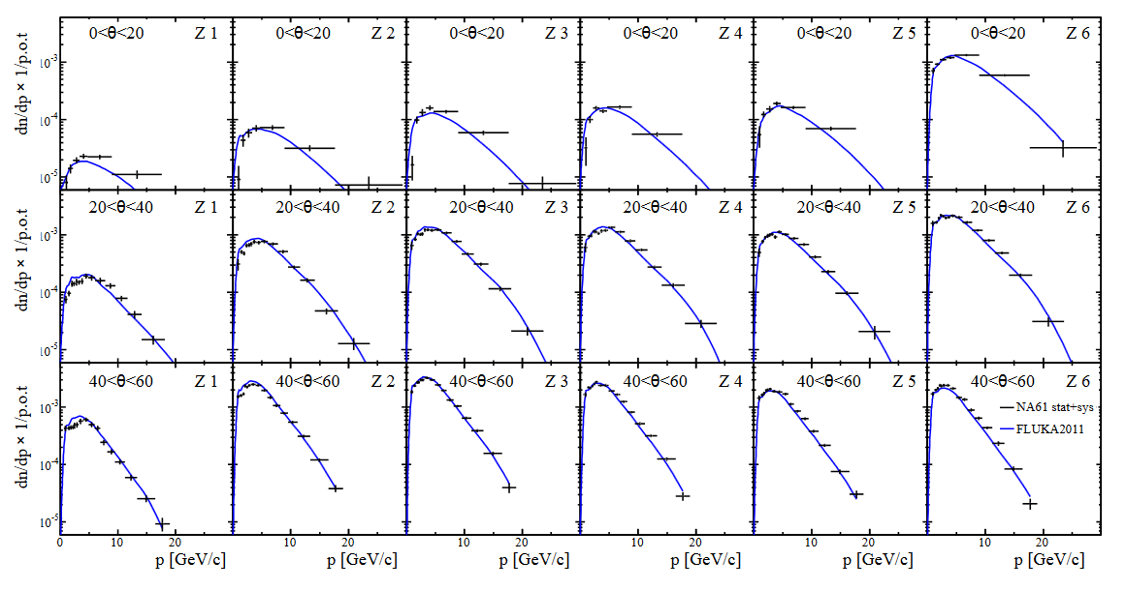
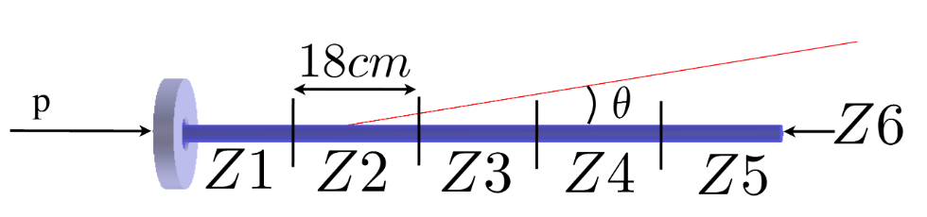
SHINE Results: T2K Target Replica

Slide 31
6. Neutrino Beams
6.5 Experiments
Achim Stahl – RWTH Aachen University – JARA-FAME

Slide 32
Discovery of the muon neutrino
Lederman, Steinberger, Schwartz (nobel price 1988)
Be-target
p-beam
pions
neutrinos
detector
1962

Slide 33
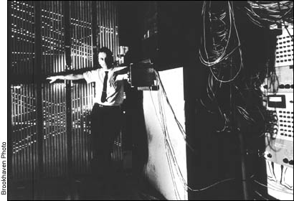

Slide 34
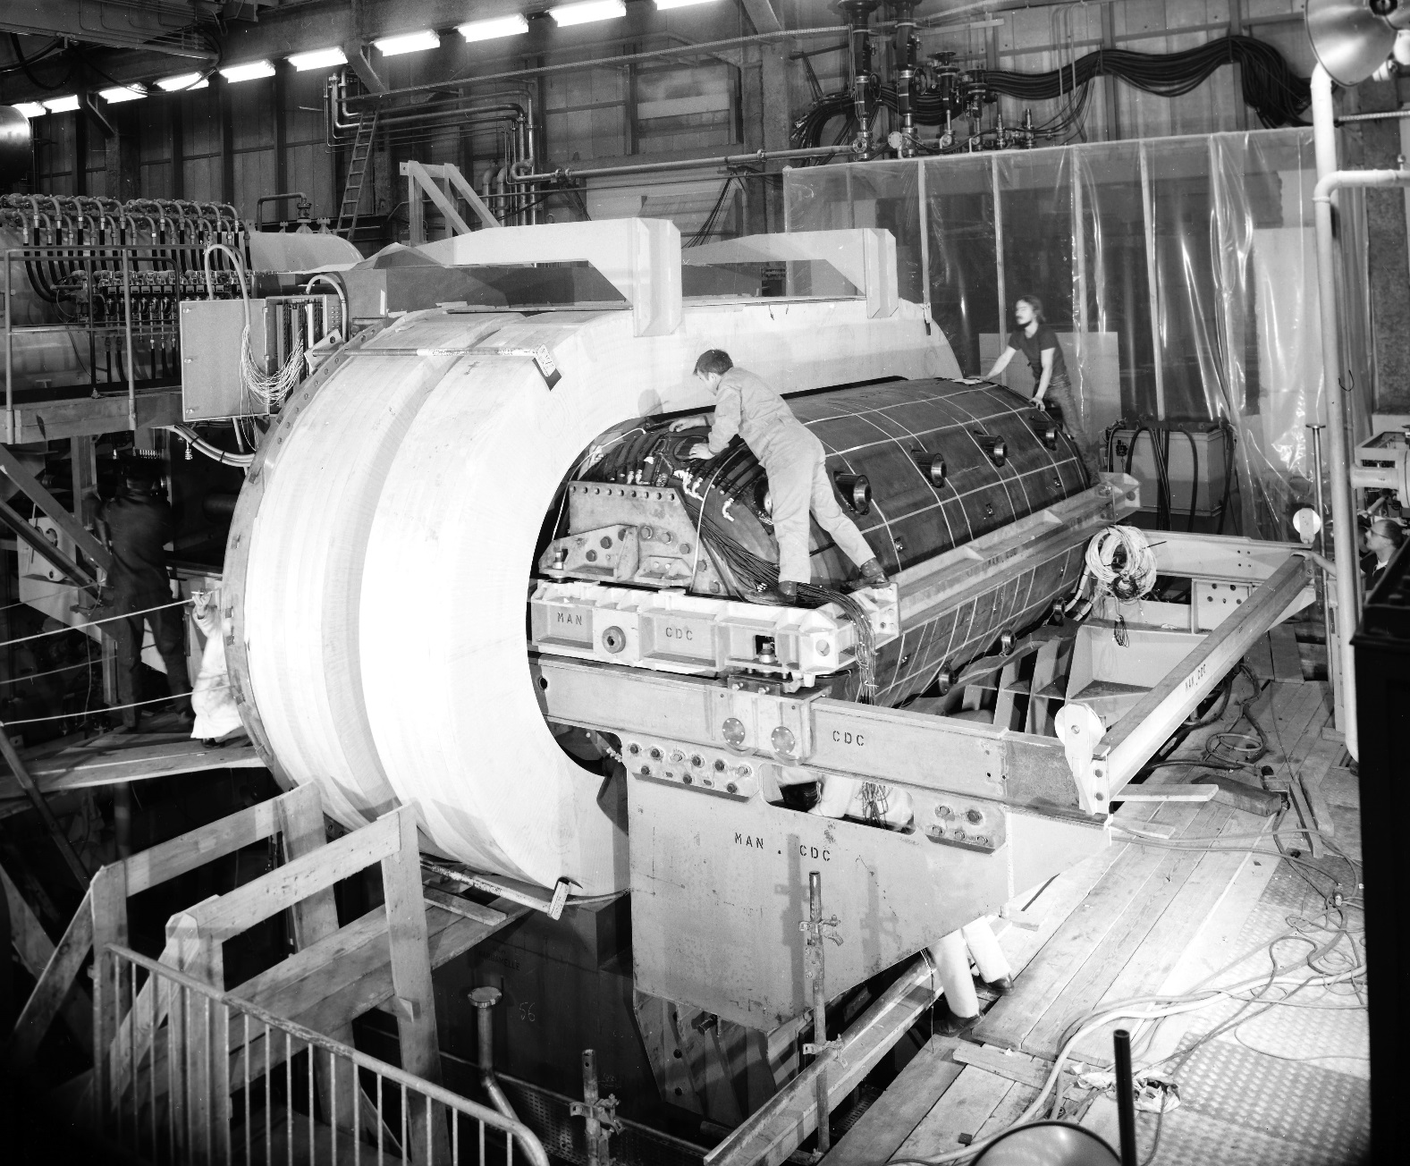
Gargamelle
1970

Slide 35
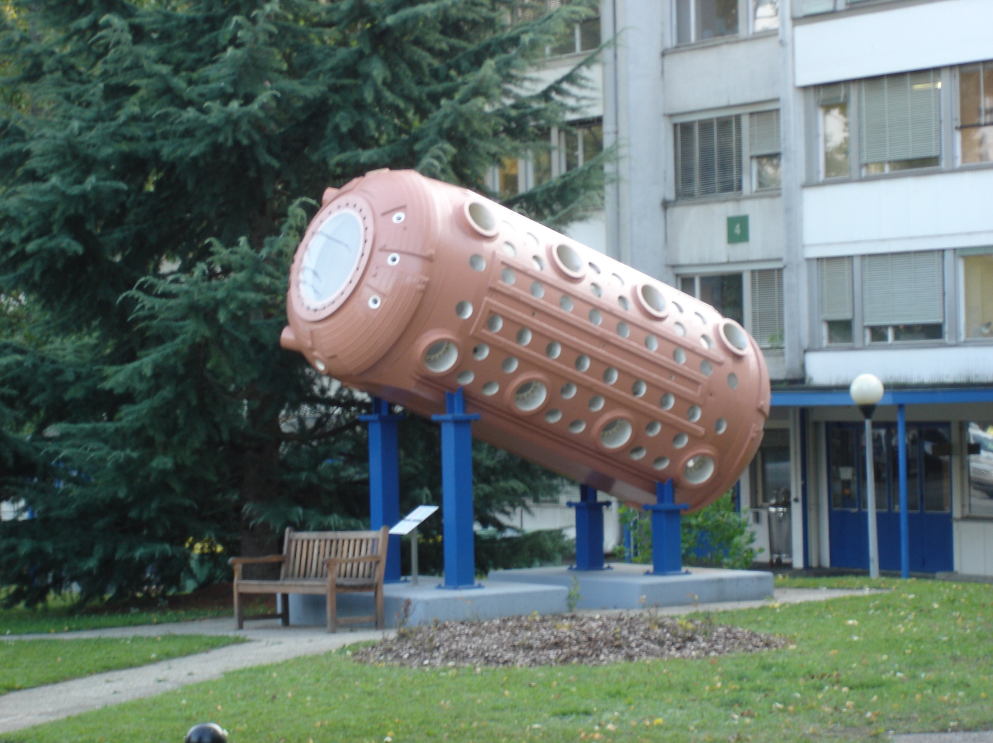

Slide 36
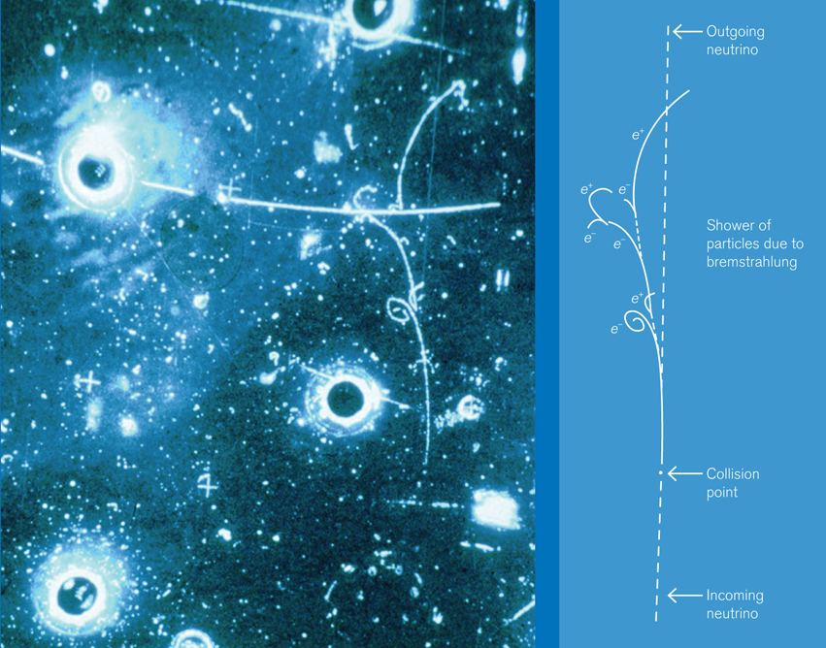
1973

Slide 37
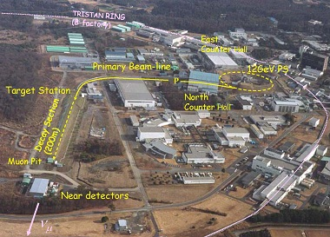
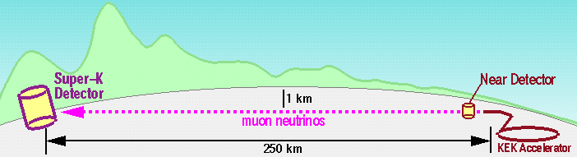
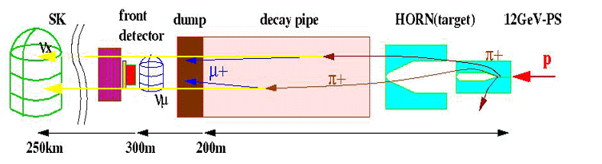
K2K: KEK to Kamioka

Slide 38
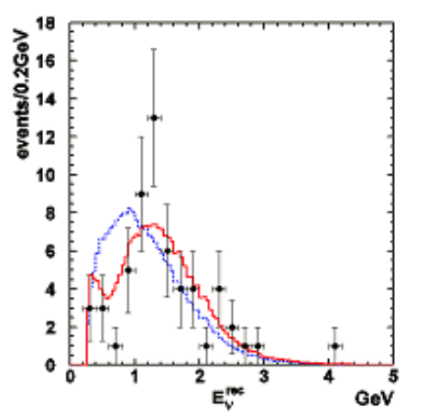

K2K: result
$ν_{e}$-apearance
confirmation of the
atmospheric neutrino oscillation

Slide 39

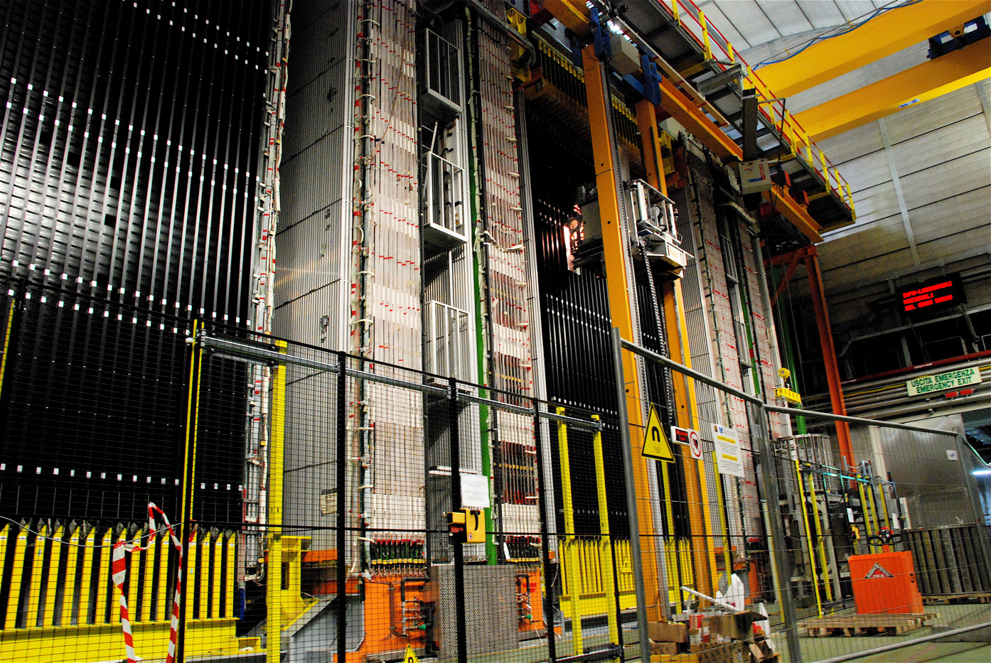


OPERA
Verification: $ν_{μ}→ν_{τ}$
1998: Super-K discovers oscillation of
atmospheric neutrinos ($ν_{μ}$-disapp.)
1999: Letter-of-Intent OPERA
2003: start of construction
2008: first beam
2010: first $ν_{τ}$ detected
2012: last beam

Slide 40
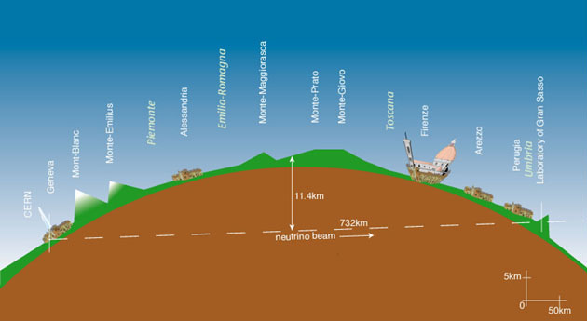
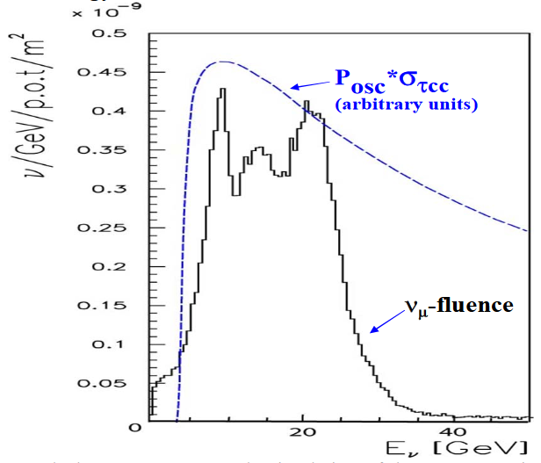
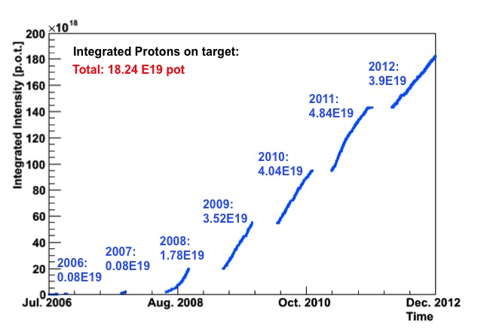
The CNGS-BEAM
CERN to Gran Sasso
CERN-SPS
400 GeV

Slide 41
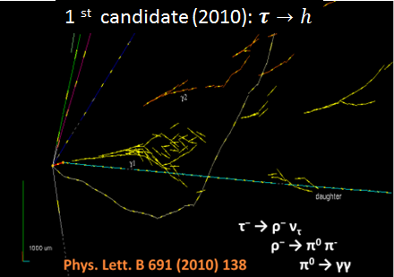
OPERA Events
Reconstruction
1 mm
τ
ν_{τ}
Pb
57 × 2 emulsion layers (42 μm thick)
poured on a 200 μm plastic base

Slide 42
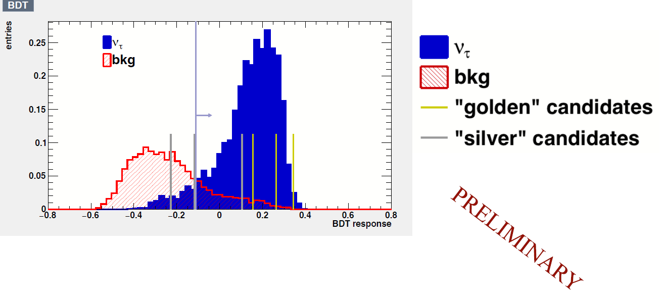
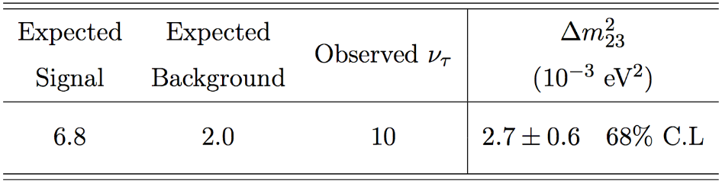
OPERA Events
Reconstruction
1 mm
τ
ν_{τ}
Pb
57 × 2 emulsion layers (42 μm thick)
poured on a 200 μm plastic base
5.2 σ significance

Slide 43
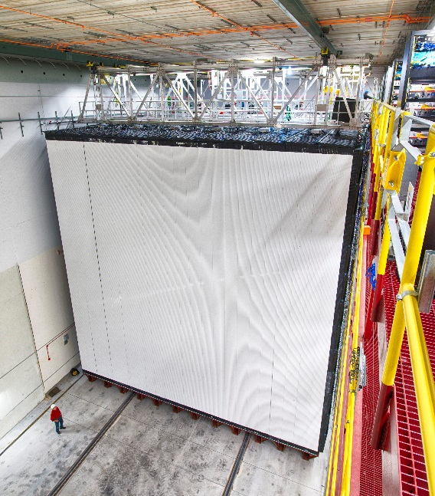

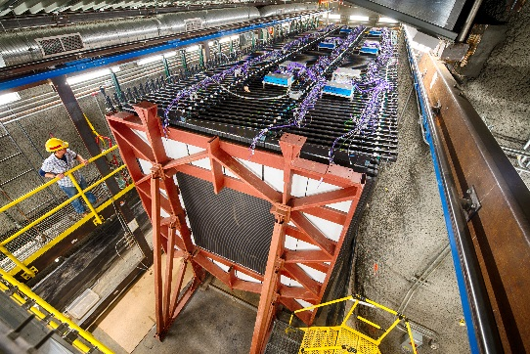
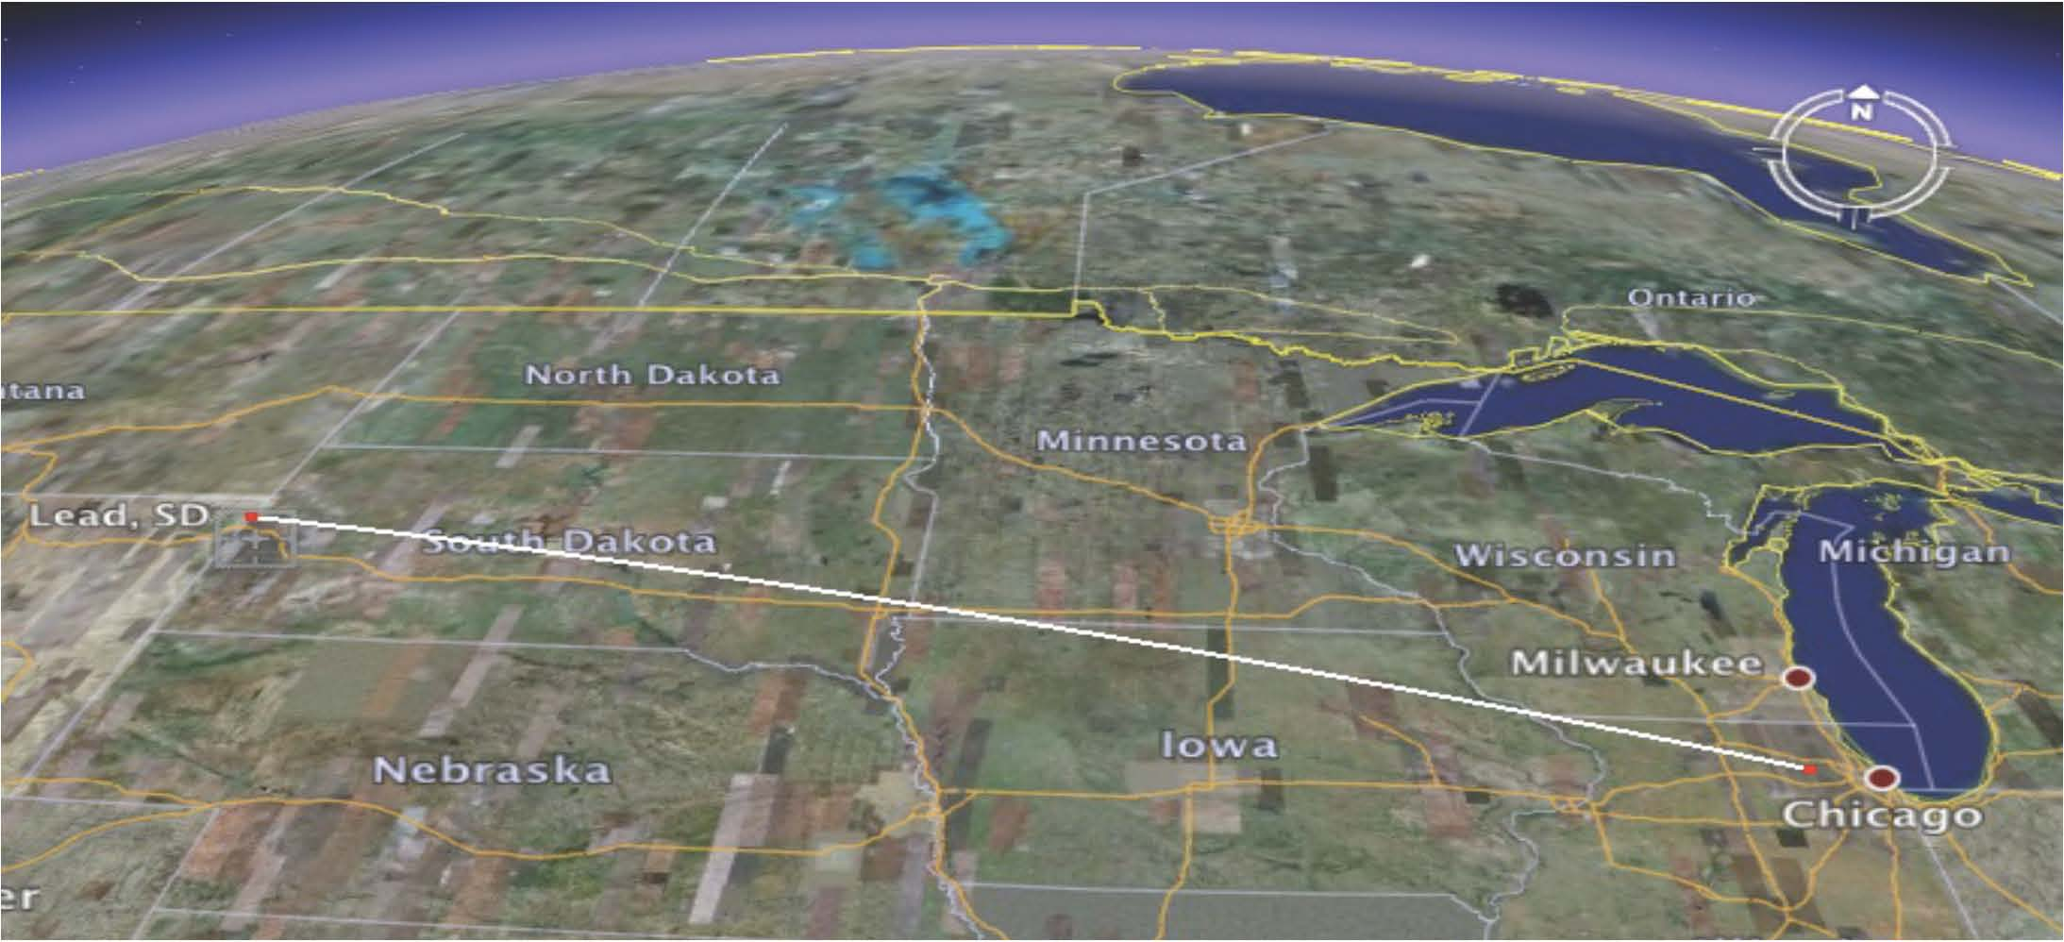
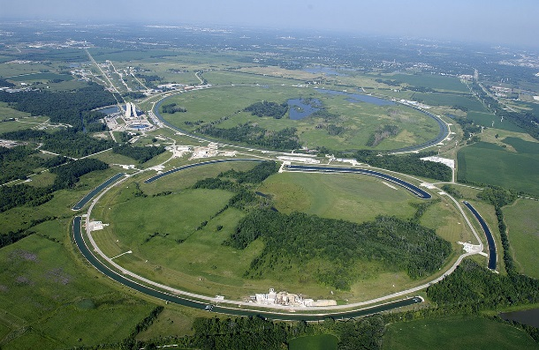


NuMI-Beam
far detector
(14 kt)
MINOS: completed
No$ν$a: started Oct. 2014
near detector (300 t)
Nova
Ash River
MINOS
Soudan
DUNE
Sanford
735 km
810 km
1300 km
43

Slide 44

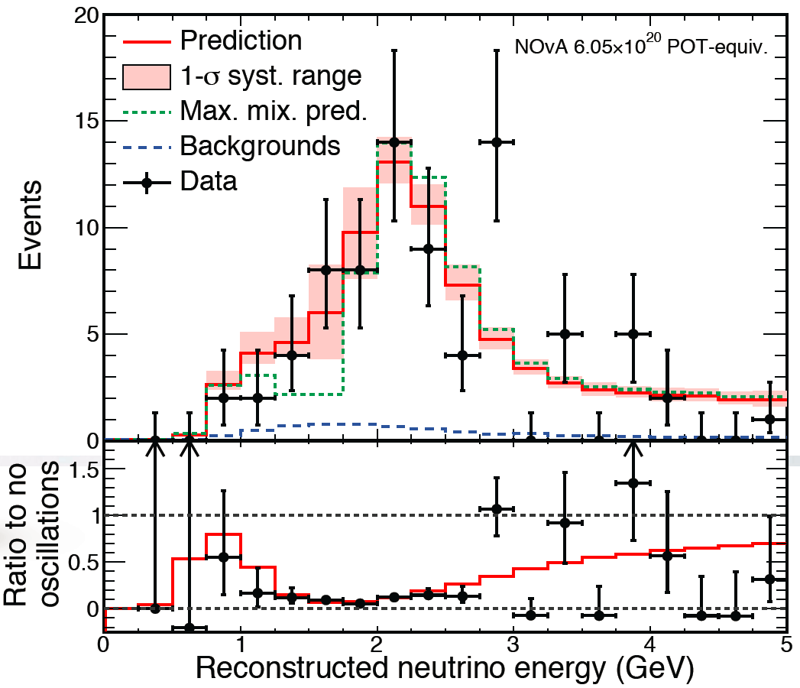
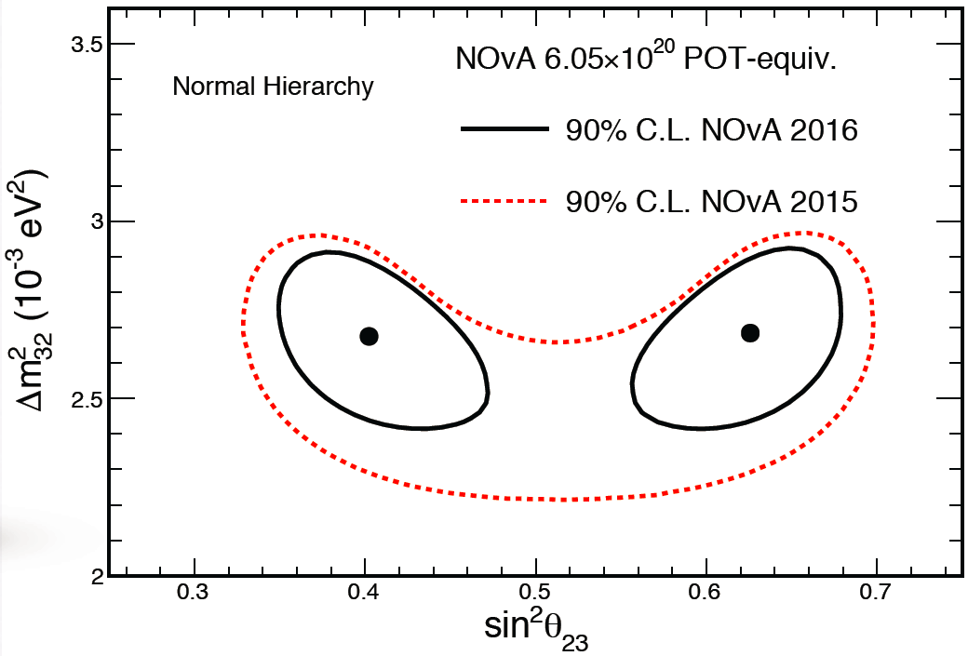



NOVA-DISAppearance
Maximal mixing disfavored at $2.6 σ$
$$\left|Δm_{32}^{2}\right|=\left(2.67±0.11\right)×{10}^{−3}eV^{2}$$
$\sin^{2}{θ_{23}={0.404}_{−0.022}^{+0.030}}$ or ${0.624}_{−0.030}^{+0.022}$

Slide 45
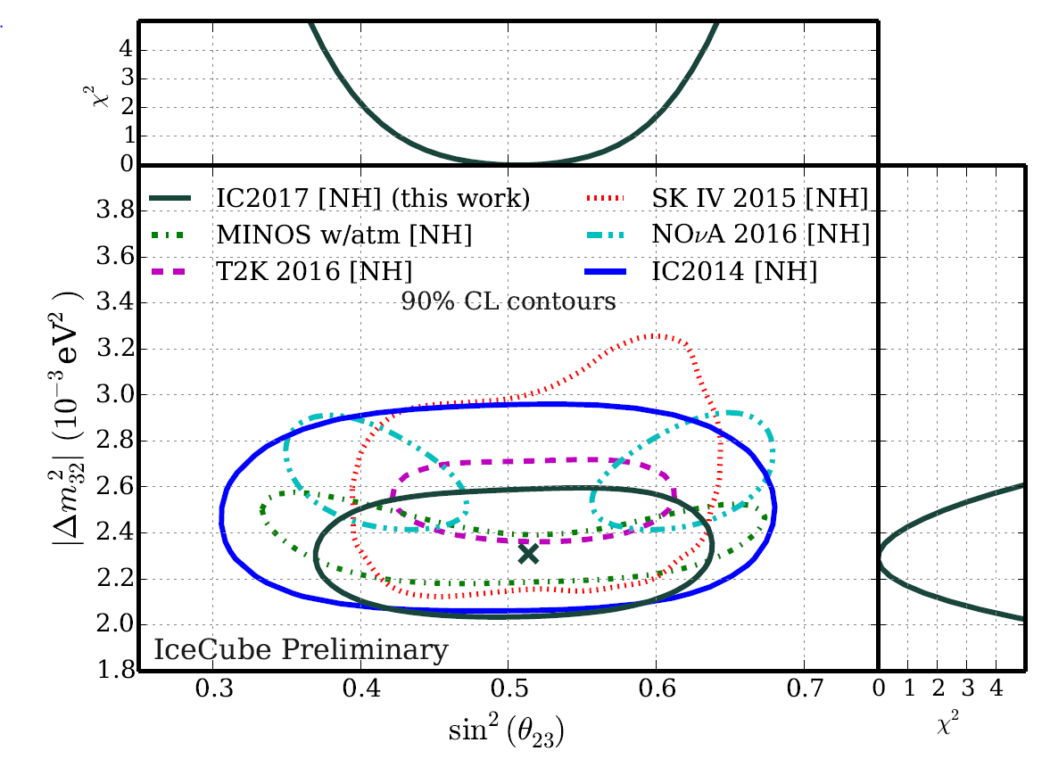
Maximal Mixing ?

Slide 46
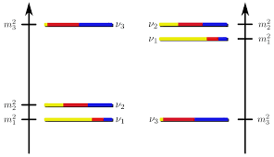
7. Mass Hierarchie
7.1 Motivation
Achim Stahl – RWTH Aachen University – JARA-FAME

Slide 47
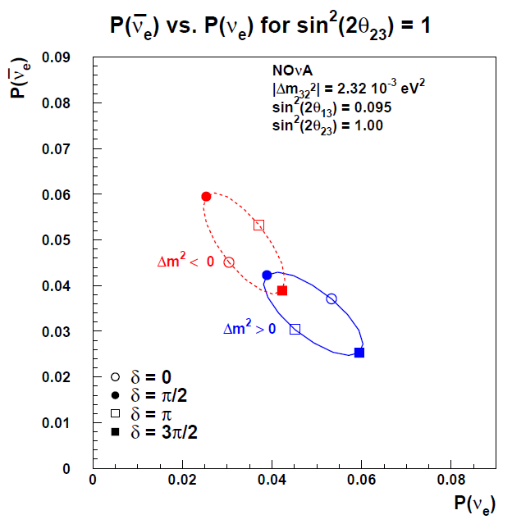
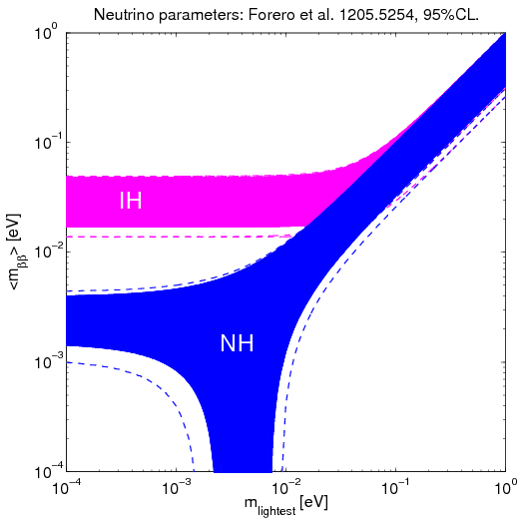
Impact of the Mass Hierarchy
CP Violation
Majorana Neutrinos

Slide 48
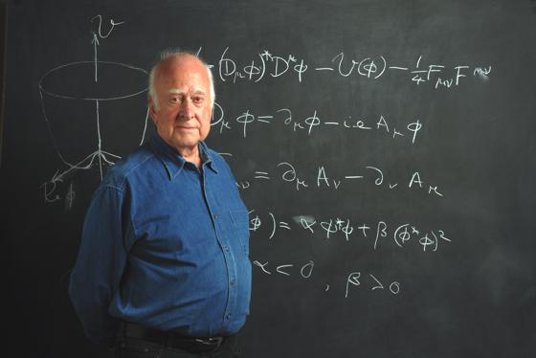




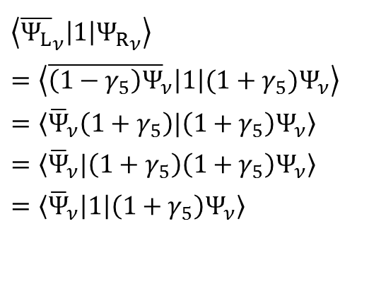



Neutrino Masses
Chirality Structures in the Standard Model
$$ν_{e}$$
$$ν_{e}$$
$$\left\langle {\overline{Ψ}}_{ν}|Ψ_{ν}\right\rangle$$
$$H^{0}$$
Does not exist
in the S.M.
$\left\langle {\overline{Ψ_{L}}}_{ν}\left|1\right|{Ψ_{R}}_{ν}\right\rangle$
$=\left\langle {\overline{\left(1−γ_{5}\right)Ψ}}_{ν}\left|1\right|(1+γ_{5})Ψ_{ν}\right\rangle$
$=\left\langle {\overline{Ψ}}_{ν}\left(1+γ_{5}\right)|\left(1+γ_{5}\right)Ψ_{ν}\right\rangle$
$=\left\langle {\overline{Ψ}}_{ν}|\left(1+γ_{5}\right)\left(1+γ_{5}\right)Ψ_{ν}\right\rangle$
$=\left\langle {\overline{Ψ}}_{ν}\left|1\right|\left(1+γ_{5}\right)Ψ_{ν}\right\rangle$
$$ν_{L}^{−}$$
$$ν_{R}^{−}$$
It‘s a sterile
component
$$H^{0}$$
chirality flipping

Slide 49
7. Mass Hierarchie
7.2 Methods
Achim Stahl – RWTH Aachen University – JARA-FAME

Slide 50


Method 1: Matter Effects
all neutrinos
ν_{e} only
ν
ν
ν_{e}
e⁻
$$\begin{matrix}\begin{aligned}\begin{matrix}P_{{\overline{ν}}_{μ}→{\overline{ν}}_{e}}= ……………… \\ \begin{aligned} \\ + ………………\end{aligned} \\ − …\frac{aL}{4 E}\cos{\frac{Δm_{23}^{2}L}{4 E}}\sin^{ }{\frac{Δm_{13}^{2}L}{4E}}\end{matrix} \\ \\ \end{aligned} \\ \end{matrix}$$
Z⁰
W
e⁻
e⁻
e⁻
ν_{e}
Hierarchy of ν₁ and ν₂
Determined from matter
effects in the sun.
ν
ν
ν_{e}
ν_{e}
W⁻
ν_{e}
Z⁰
e⁻
e⁻
e⁻
e⁻
50

Slide 51


Oscsillation Pattern
$$\begin{matrix}P_{α→β}=δ_{αβ} −4 \sum_{i>j}{Re\left(U_{αi}^{∗}U_{βi}U_{αj}U_{βj}^{∗}\right)\sin^{2}{\frac{\left(m_{i}^{2}−m_{j}^{2}\right)L}{4E}}} \\ +2 \sum_{i>j}{Im\left(U_{αi}^{∗}U_{βi}U_{αj}U_{βj}^{∗}\right)\sin{\frac{\left(m_{i}^{2}−m_{j}^{2}\right)L}{2E}}} \end{matrix}$$
Example:
Neutrino Beams
Numerically relevant terms only
+
+
Jarlskog‘s Determinant for neutrinos: $0.033\sin{δ}$ (quarks: ${4⋅10}^{−5}$)

Slide 52

Method 1: Matter Effects
Matter Effect is proportional to L!
Long baseline Beams
T2K (295 km) too short
Noνa (810 km) 2σ
LBNE/DUNE (1300 km)
excellent
neutrino beam

Slide 53


Matter Effects: Orca
Resonant transition (MSW) near the core of the earth
atmospheric
neutrinos

Slide 54



Slide 55
Method 1: Matter Effects
Matter Effect is proportional to L!
Long baseline Beams
T2K (295 km) too short
Noνa (810 km) 2σ
LBNE/DUNE (1300 km)
excellent
neutrino beam

Slide 56













Method 2: 3-Flavour-Interference
normal hierarchy
inverted hierarchy
$$ν_{3}$$
$$ν_{2}$$
$${Δm}_{21}$$
$$ν_{1}$$
$${Δm}_{31}$$
not to scale!
$${Δm}_{31}$$
$${Δm}_{32}$$
$$ν_{2}$$
$${Δm}_{21}$$
$$ν_{1}$$
$${Δm}_{32}$$
$$ν_{3}$$
$$Δm_{31,\text{normal}}>Δm_{31,\text{inverted}}$$

Slide 57




Oscillation Pattern
leading terms:
$$\begin{matrix}P_{{\overline{ν}}_{e}→{\overline{ν}}_{e}}=1 −\sin^{2}{2θ_{13}}\sin^{2}{\frac{Δm_{ee}^{2}L}{4E}}−\cos^{4}{θ_{13}}\sin^{2}{2θ_{12}}\sin^{2}{\frac{Δm_{21}^{2}L}{4E}} \\ \end{matrix}$$
$\sin^{2}{\frac{Δm_{ee}^{2}L}{4E}}=\cos^{2}{θ_{12}}\sin^{2}{\frac{Δm_{31}^{2}L}{4E}}+\sin^{2}{θ_{12}}\sin^{2}{\frac{Δm_{32}^{2}L}{4E}}$, $Δm_{ij}^{2}=m_{i}^{2}−m_{j}^{2}$
Reactor Experiment
${\overline{ν}}_{e}$-disappearance
near
far
$$ν_{e}$$
current experiments
KamLAND
next generation

Slide 58





Oscillation Pattern
Yu-Feng Li et al.,
Phys.Rev. D88 (2013) 013008
leading terms:
$$\begin{matrix}\begin{aligned}P_{{\overline{ν}}_{e}→{\overline{ν}}_{e}}=1 −cos^{2}θ_{12}\sin^{2}{2θ_{13}}\sin^{2}{\frac{Δm_{31}^{2}L}{4E}} \\ −\sin^{2}{θ_{12}}\sin^{2}{2θ_{13}}\sin^{2}{\frac{Δm_{32}^{2}L}{4E}} \\ −\cos^{4}{θ_{13}}\sin^{2}{2θ_{12}}\sin^{2}{\frac{Δm_{21}^{2}L}{4E}}\end{aligned} \\ \end{matrix}$$
high frequency
high frequency
low frequency
$$Δm_{ij}=m_{i}^{2}−m_{j}^{2}$$
$$\left|Δm_{31}^{2}\right|=\left|Δm_{23}^{2}\right|+\left|Δm_{12}^{2}\right|$$
$$\left|Δm_{31}^{2}\right|=\left|Δm_{23}^{2}\right|−\left|Δm_{12}^{2}\right|$$

Slide 59

Oscillation Pattern
Yu-Feng Li et al.,
Phys.Rev. D88 (2013) 013008
leading terms:
$$\begin{matrix}\begin{aligned}P_{{\overline{ν}}_{e}→{\overline{ν}}_{e}}=1 −cos^{2}θ_{12}\sin^{2}{2θ_{13}}\sin^{2}{\frac{Δm_{31}^{2}L}{4E}} \\ −\sin^{2}{θ_{12}}\sin^{2}{2θ_{13}}\sin^{2}{\frac{Δm_{32}^{2}L}{4E}} \\ −\cos^{4}{θ_{13}}\sin^{2}{2θ_{12}}\sin^{2}{\frac{Δm_{21}^{2}L}{4E}}\end{aligned} \\ \end{matrix}$$
high frequency
high frequency
low frequency
typ. ν-energy: 5 MeV
different frequencies
good L: 50 … 60 km

Slide 63


Slide 65


Slide 67



DUNE: R&D
ICARUS: 600 t
MicroBooNE: 170 t
⁞
Prototypes
⁞
DUNE: 10 000 t
CERN: Neutrino Platform
600t prototypes DUNE SP/DP
SP
DP

Slide 68


DUNE: R&D
ArgoNuT: prototype @ FermiLab
photographic event information
huge challenge in pattern recognition
ICARUS @ GranSasso

Slide 69


Slide 70


Slide 71


Slide 72


Slide 73


Slide 74


