Slide 1
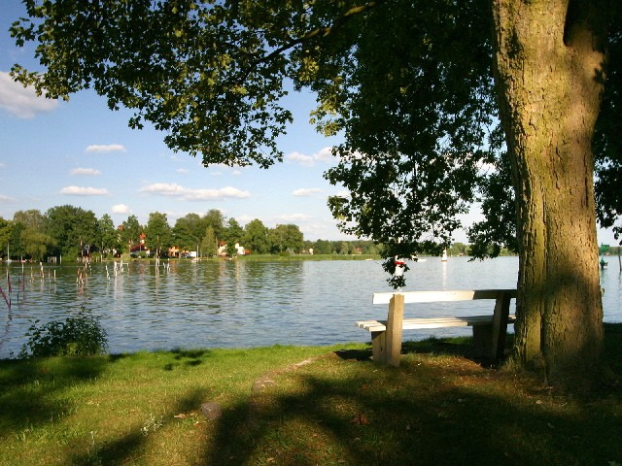
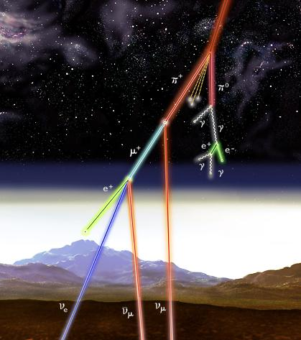
4. Atmospheric Neutrinos
4.1 Physics
Achim Stahl – RWTH Aachen University – JARA-FAME

Slide 2
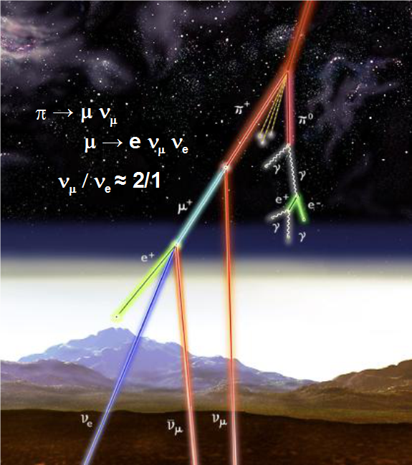
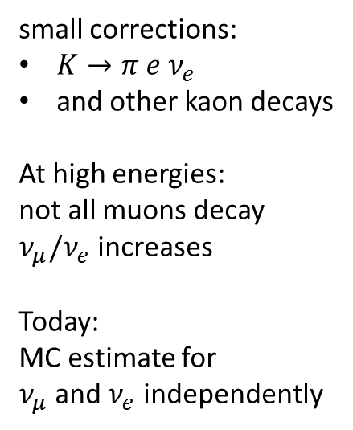
Generation
small corrections:
$K→π e ν_{e}$
and other kaon decays
At high energies:
not all muons decay
$ν_{μ}/ν_{e}$ increases
Today:
MC estimate for
$ν_{μ}$ and $ν_{e}$ independently
Notes:
Introduction of the 3 experiments

Slide 3
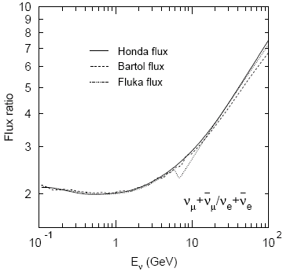
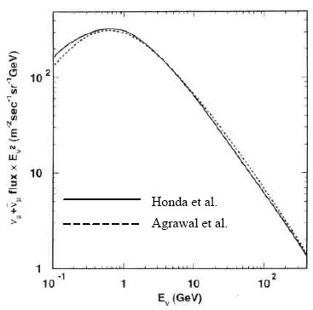
Neutrino Flux

Slide 4
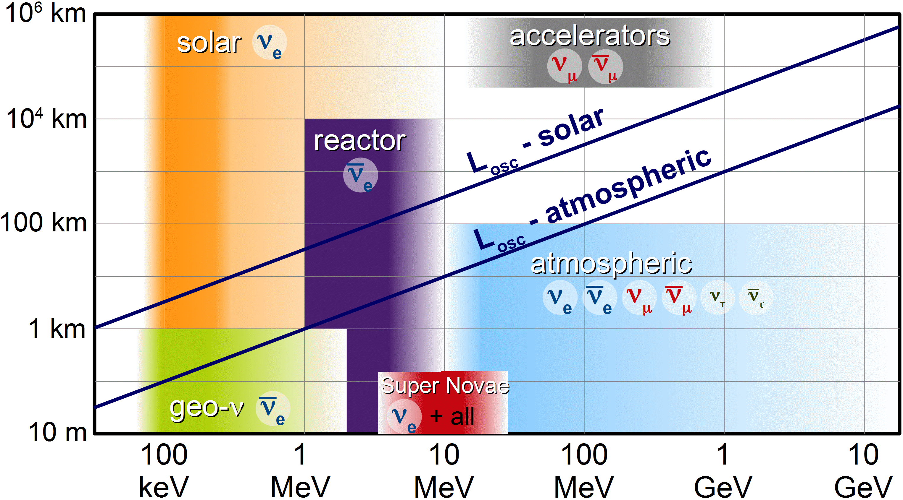
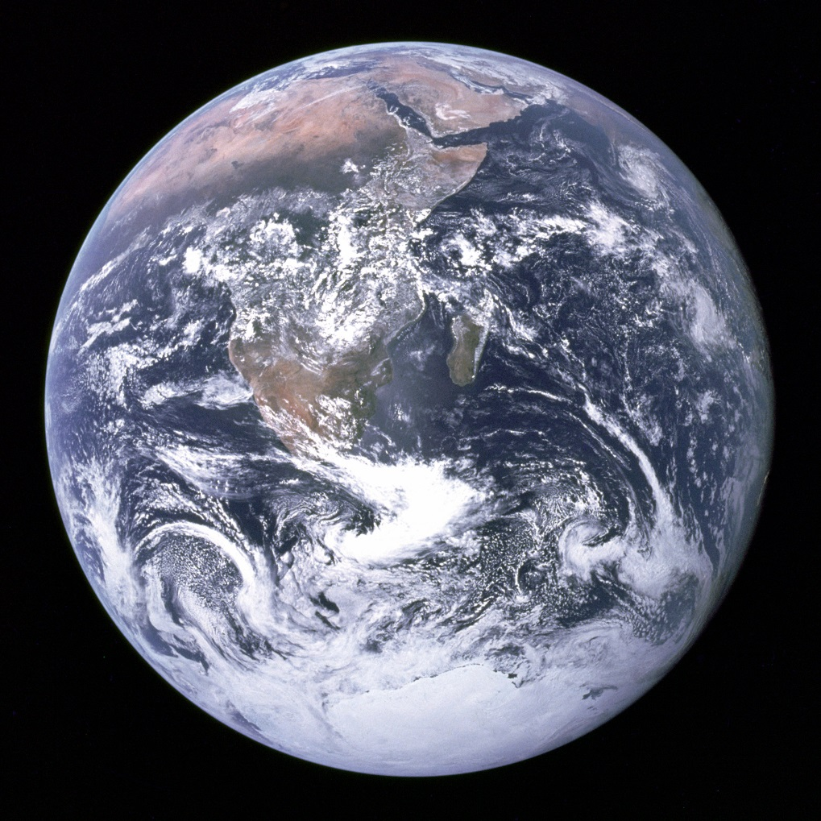
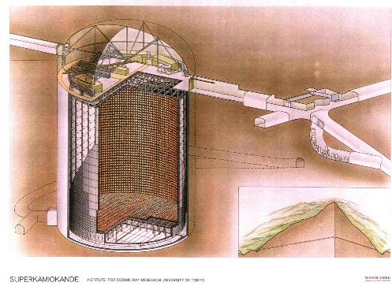


OsciLation
Probability
12700 km
$$ν_{μ}$$
$$μ$$
9000 km
recoil

Slide 5
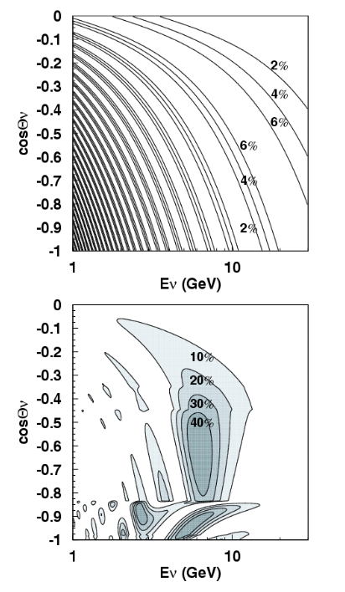
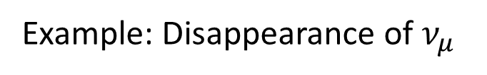
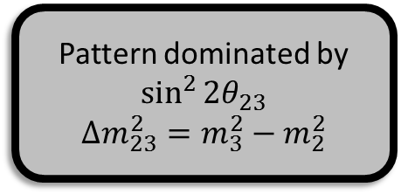
OsciLation Probability
Pattern dominated by
$$\sin^{2}{2θ_{23}}$$
$$Δm_{23}^{2}=m_{3}^{2}−m_{2}^{2}$$
Example: Disappearance of $ν_{μ}$
vacuum oscillations
matter oscillations

Slide 6
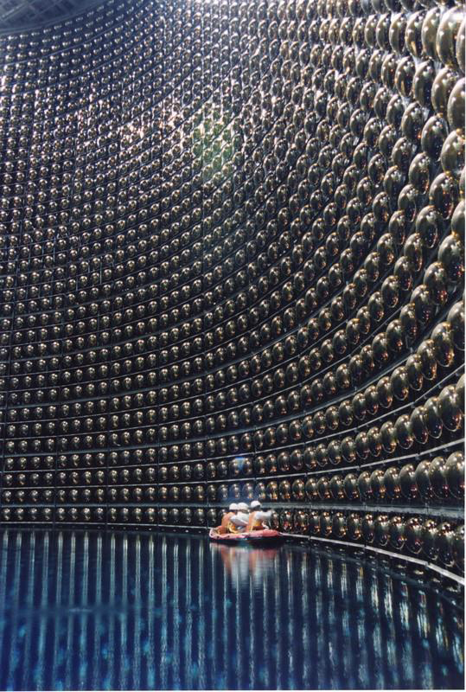
4. Atmospheric Neutrinos
4.2 Super-K Detector
Achim Stahl – RWTH Aachen University – JARA-FAME

Slide 7
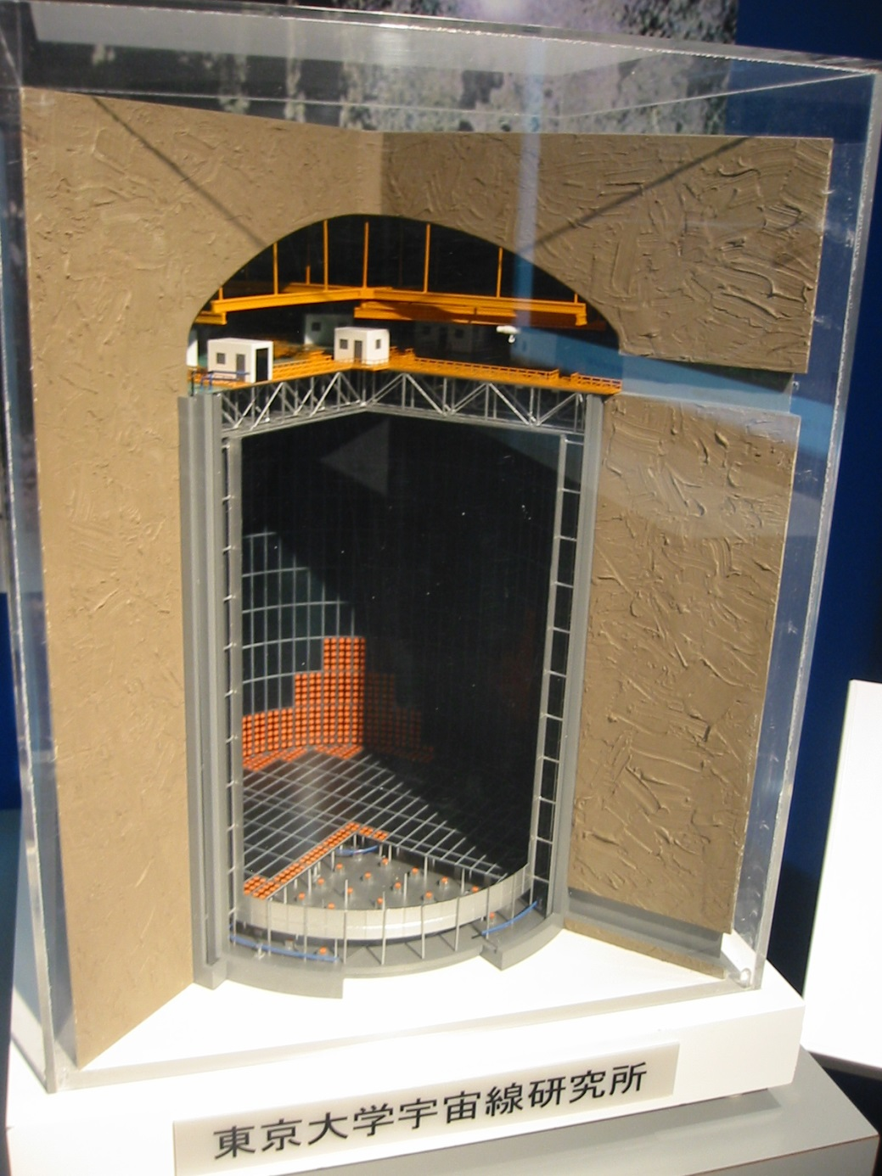
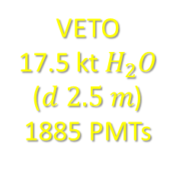
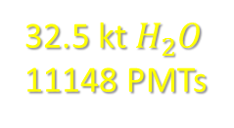
Super-K Detector
32.5 kt $H_{2}O$
11148 PMTs
VETO
17.5 kt $H_{2}O$
($d 2.5 m$)
1885 PMTs

Slide 8
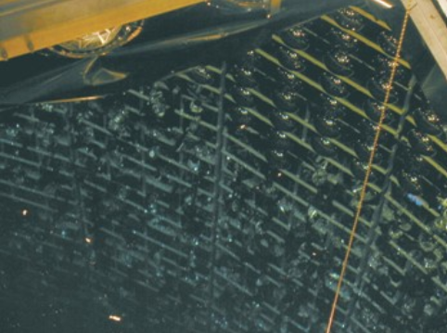
Accident
November 2001:
during refilling after shutdown
(detector ~80% filled)
PMT at the bottom imploted
triggered a chain reaction
1 bar
40 m depth
5 bar

Slide 9
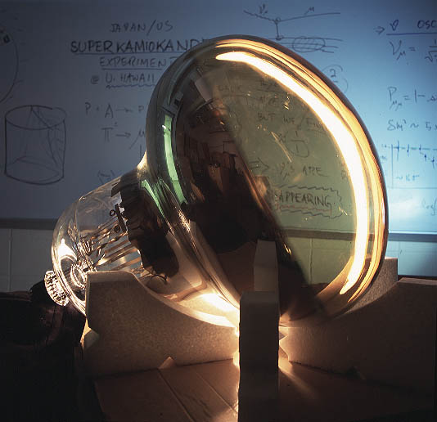
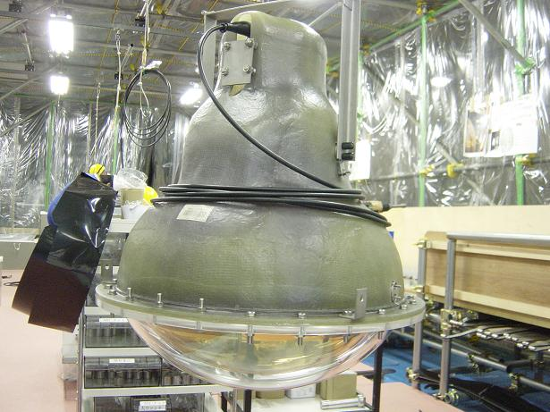
HamaMAtsu 20“ PMT

Slide 10
DATA Runs
SK-I 1996-2001 11146 ID-PMTs
Shutdown June-Nov. 2001; PMT implosion during refill
SK-II 2002-2005 5182 ID-PMTs implosion protection installed
New PMTs produced and installed
SK-III 2005-2008 11146 ID-PMTs
September 2008 new fron-end electronics installed
SK-IV 2008-…
run ongoing

Slide 11
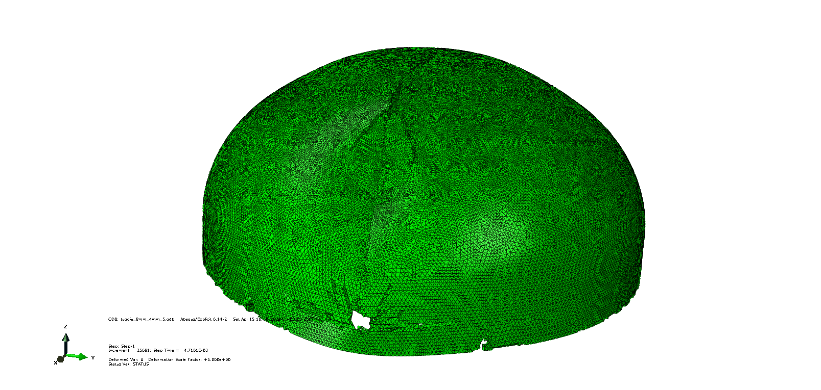
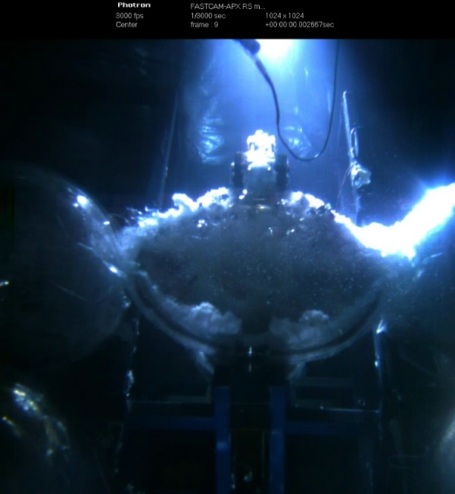
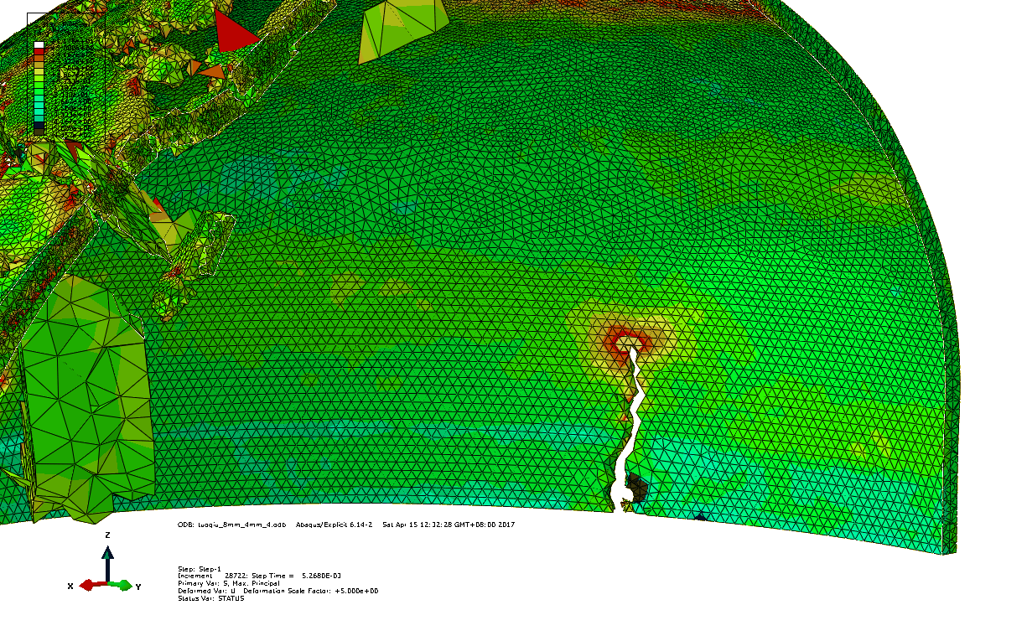
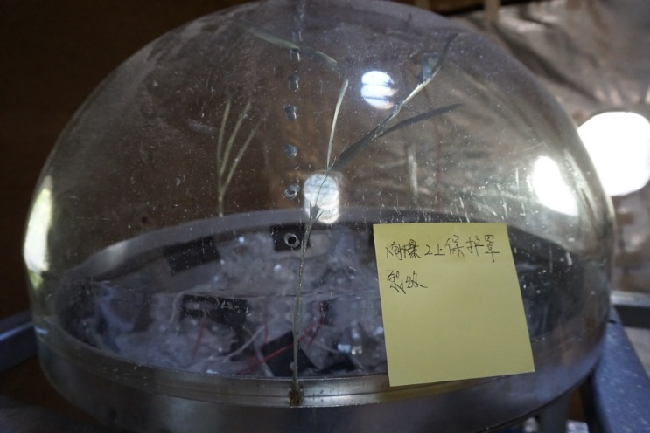
Simulation and experiment comparison
JUNO PMT-Protection
Starting of break
Cracks on the cover

Slide 12
4. Atmospheric Neutrinos
4.3 EVENT SELECTION
Achim Stahl – RWTH Aachen University – JARA-FAME

Slide 13
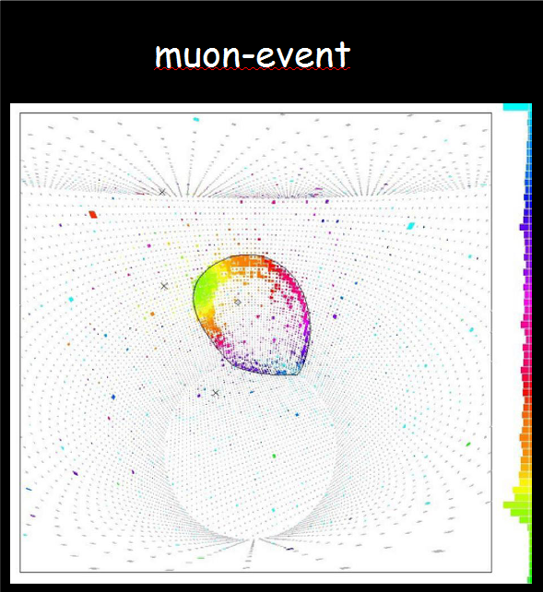


Particle Identification
$$ν_{e}$$
$$μ$$
recoil
Detector: muon track

Slide 14
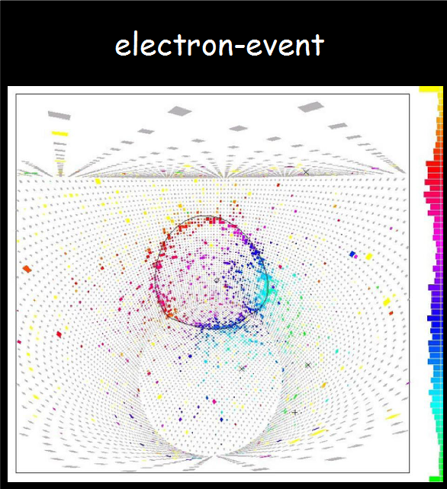

Particle Identification
$$ν_{e}$$
$$e$$
recoil
Detector: e.m. shower

Slide 15
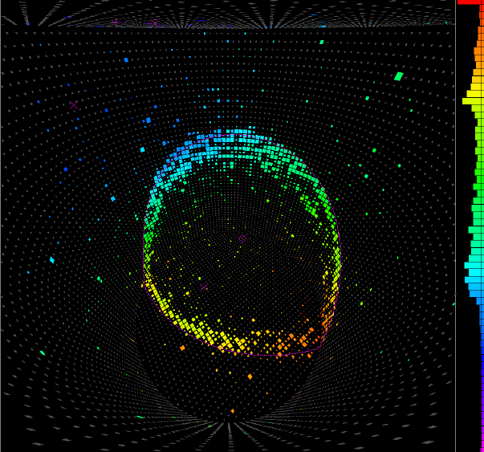
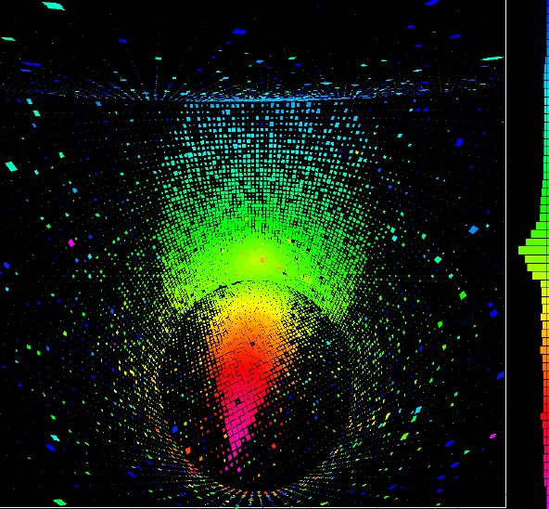
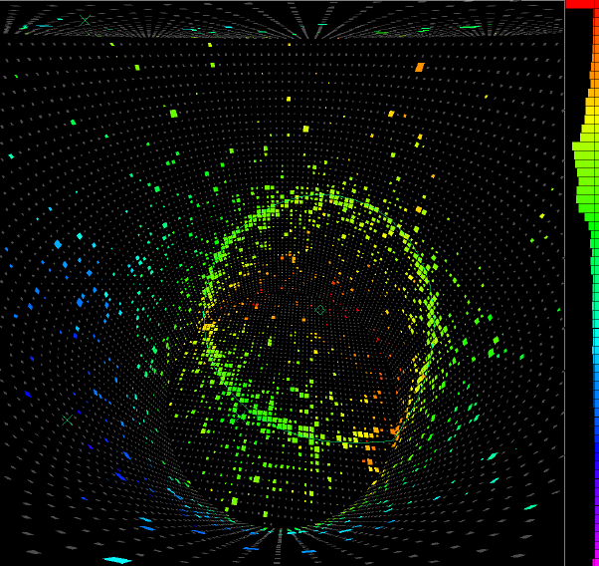
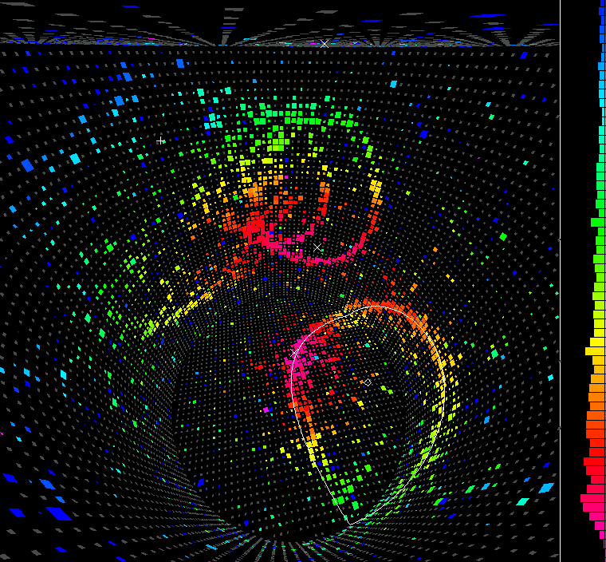
3.3 Atmosphärische Neutrinos
ν_{μ} fully contained
 partially contained
ν_{e}
Multi-ring (Neutrino löst Schauer aus)

Slide 16


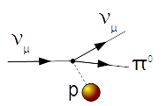
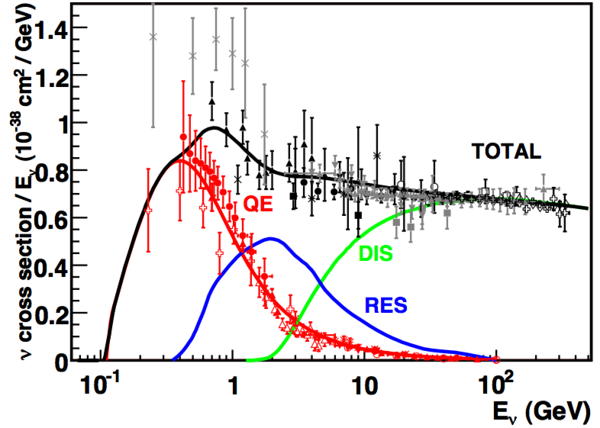
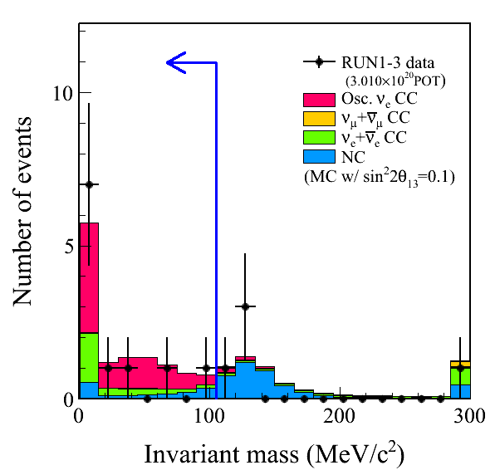
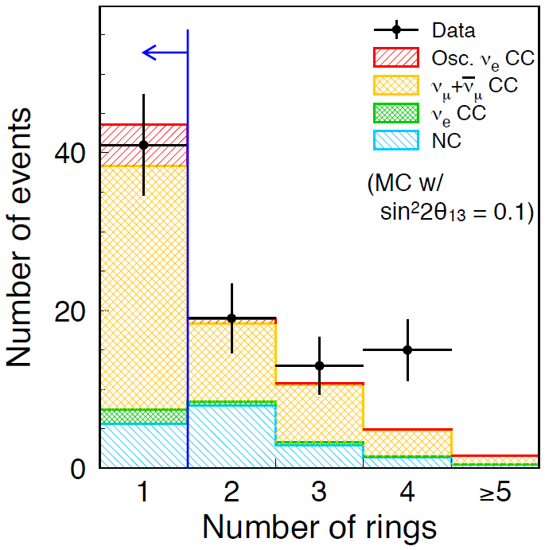
beam neutrinos, not atmospheric

Slide 17
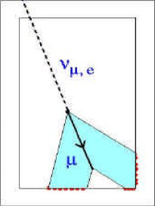
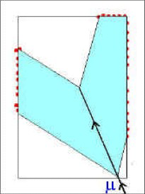
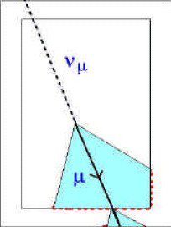
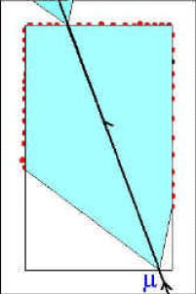
Neutrino Spectra
partially contained
only up-going
fully contained
partially contained
through-going
only up-going

Slide 18
4. Atmospheric Neutrinos
4.4 Results
Achim Stahl – RWTH Aachen University – JARA-FAME

Slide 19
Measured Spectra
ν_{μ}–ν_{τ} oscillation (best fit)
null oscillation
P<400MeV/c
P<400MeV/c
P>400MeV/c
P>400MeV/c
μ-like
e-like

