Slide 1
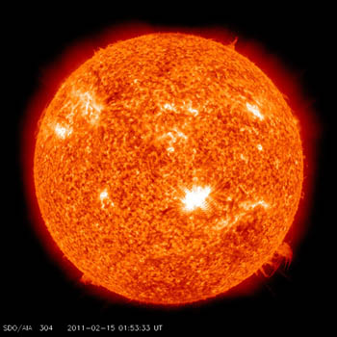
1. Introduction
1.1 Neutrinos from the sun
Achim Stahl – RWTH Aachen University – JARA-FAME

Slide 2
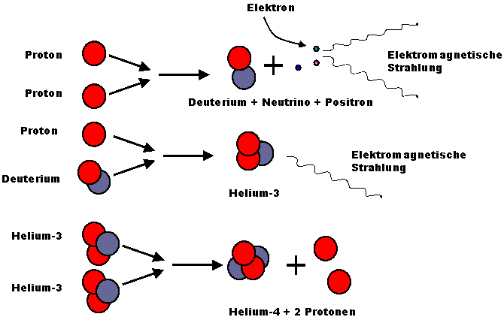
Nuclear Fusion in the Sun
4 p⁺ → ⁴He + 2 e⁻ + 2 ν_{e} + 26.72 MeV

Slide 3
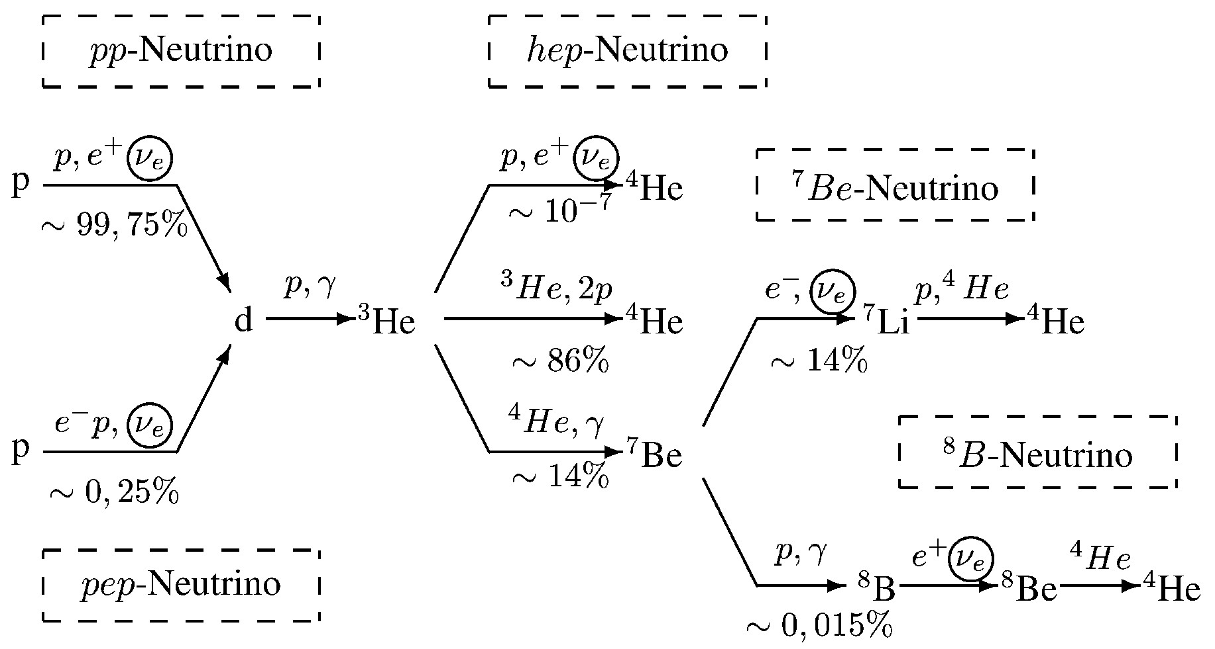
Fusion: Secondary Branches

Slide 4
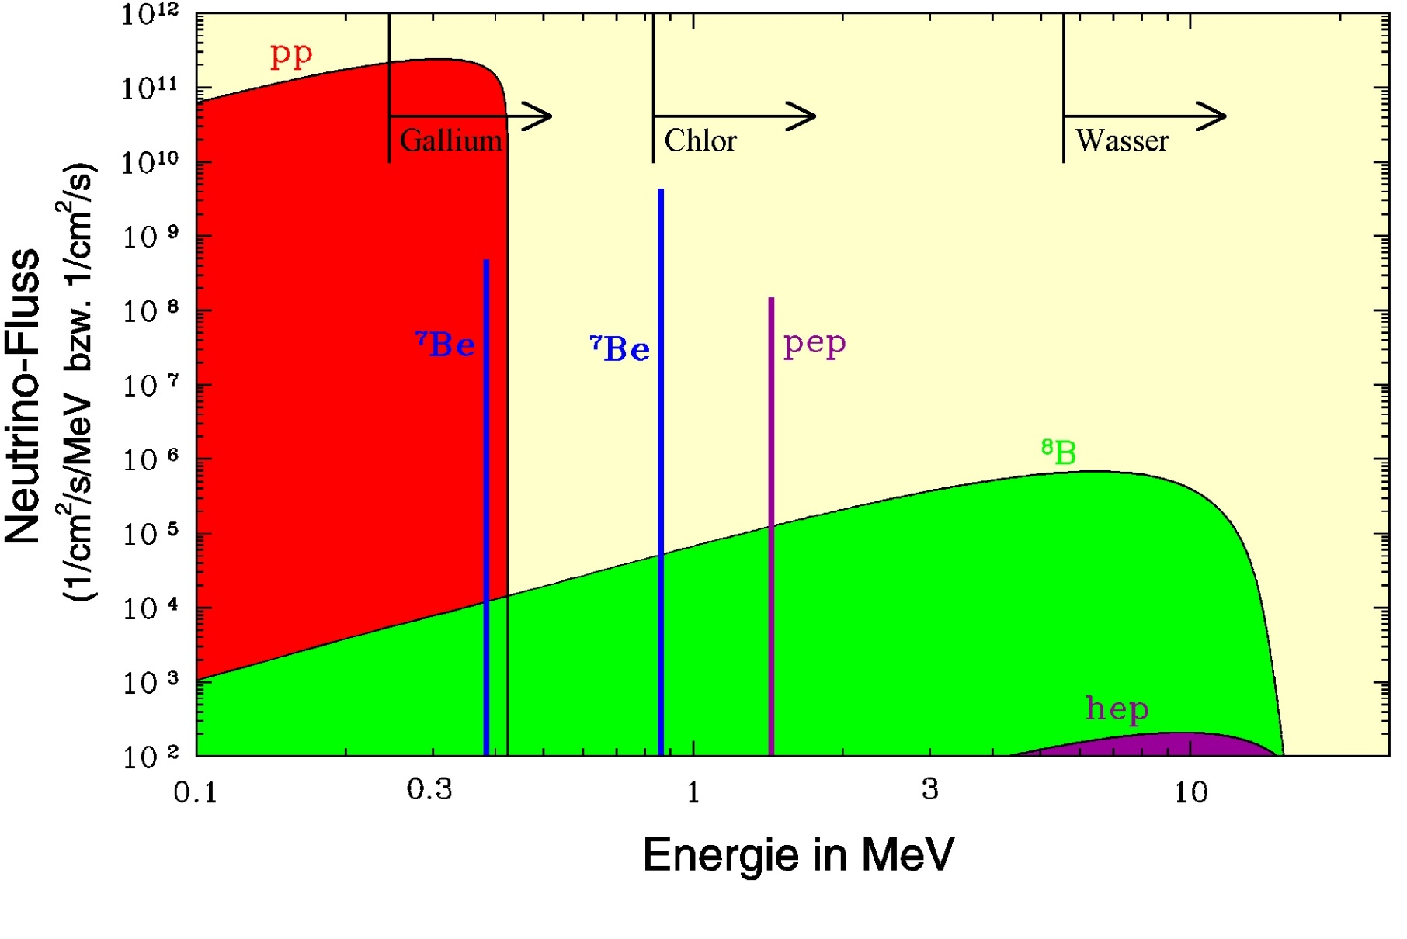
Neutrino Flux

Slide 5
Neutrino Flux

Slide 6
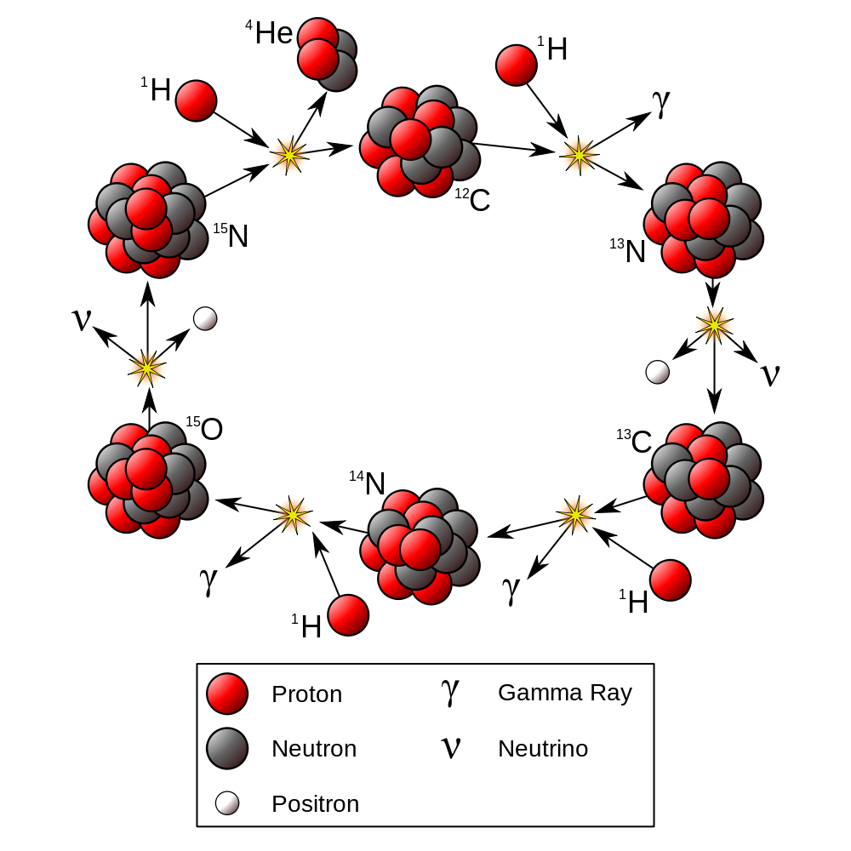
Fusion: CNO cycle

Slide 7
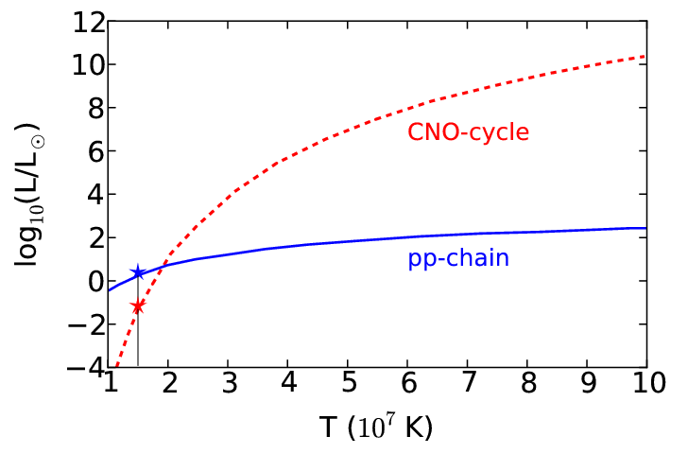
Fusion: CNO cycle

Slide 8
1. Introduction
1.2 Neutrino flux
Achim Stahl – RWTH Aachen University – JARA-FAME

Slide 9
Neutrino Flux
What ist the total flux?

Slide 10
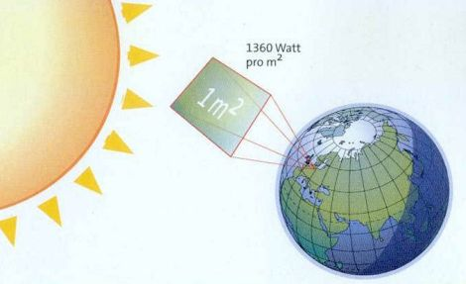
Solar constant

Slide 11
Solar constant

Slide 12
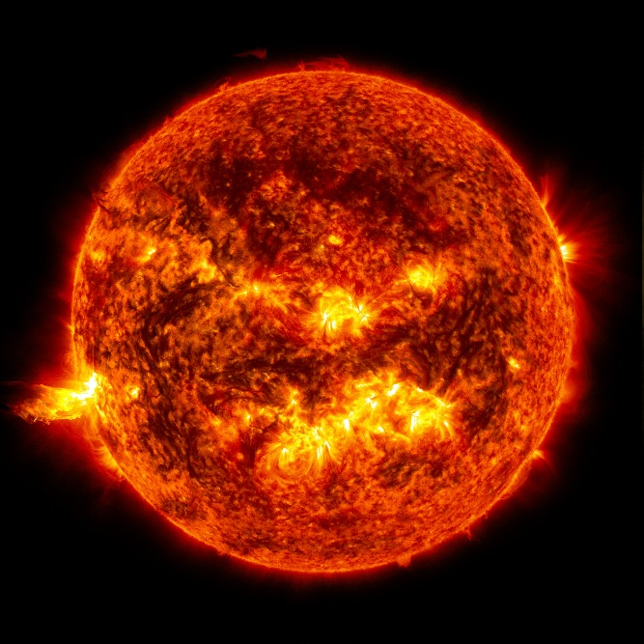
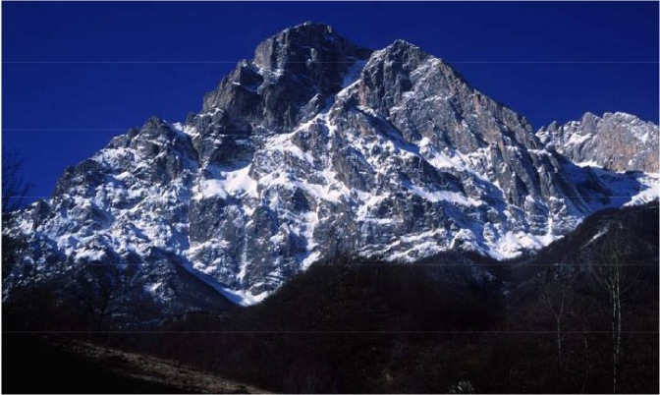
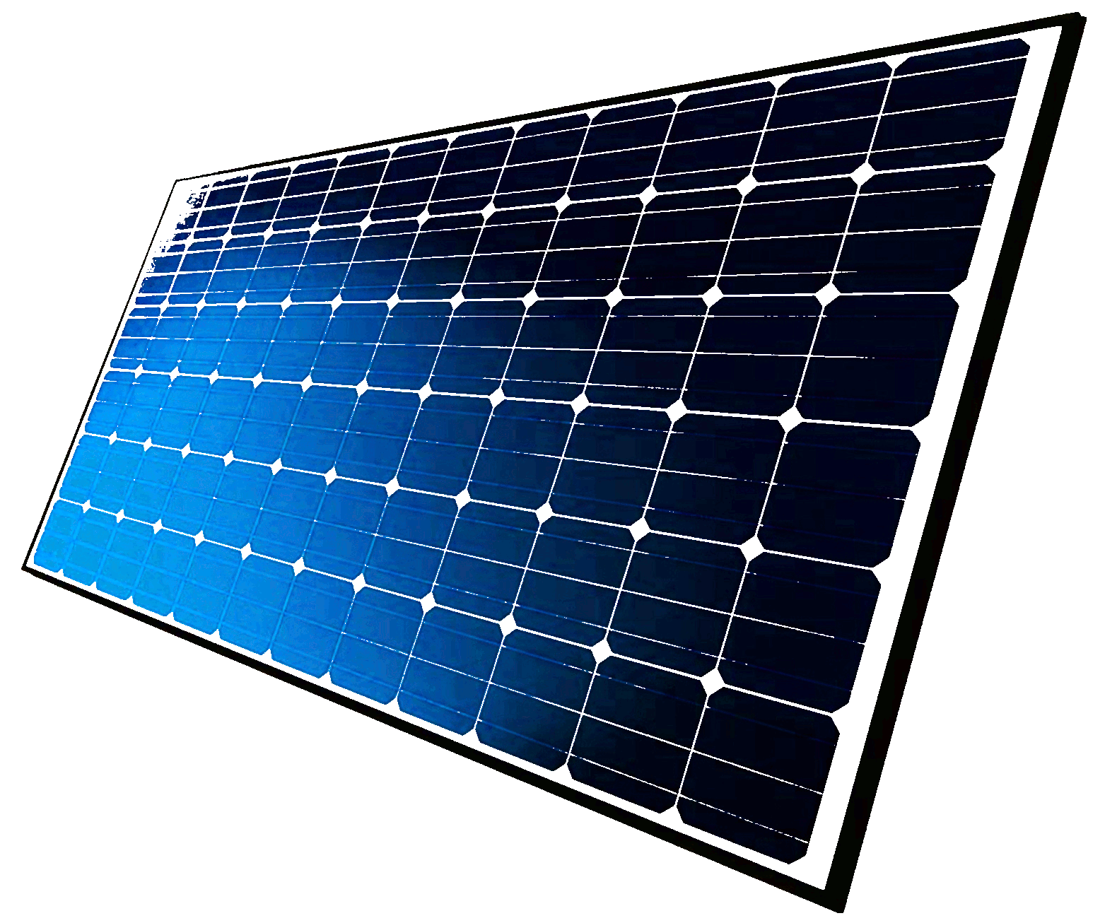
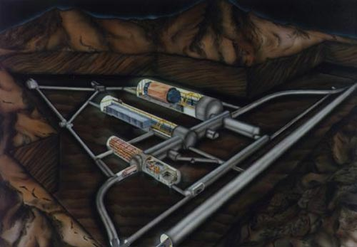
Solar NeutrinoS
Solar constant: $1360\frac{J}{s m^{2}}=8.5 {10}^{15}\frac{MeV}{s m^{2}}$
Neutrino flux: $6.36 {10}^{14}\frac{ν}{s m^{2}}$
nuclear fusion
produces neutrinos
Gran Sasso (Italy)
Shielding against cosmic rays
$$4p^{+}→{}_{ }^{4}{\text{He}}+2e^{+}+2ν_{e}+26.72 MeV$$
neutrino detector
i.e. GALLEX

Slide 13
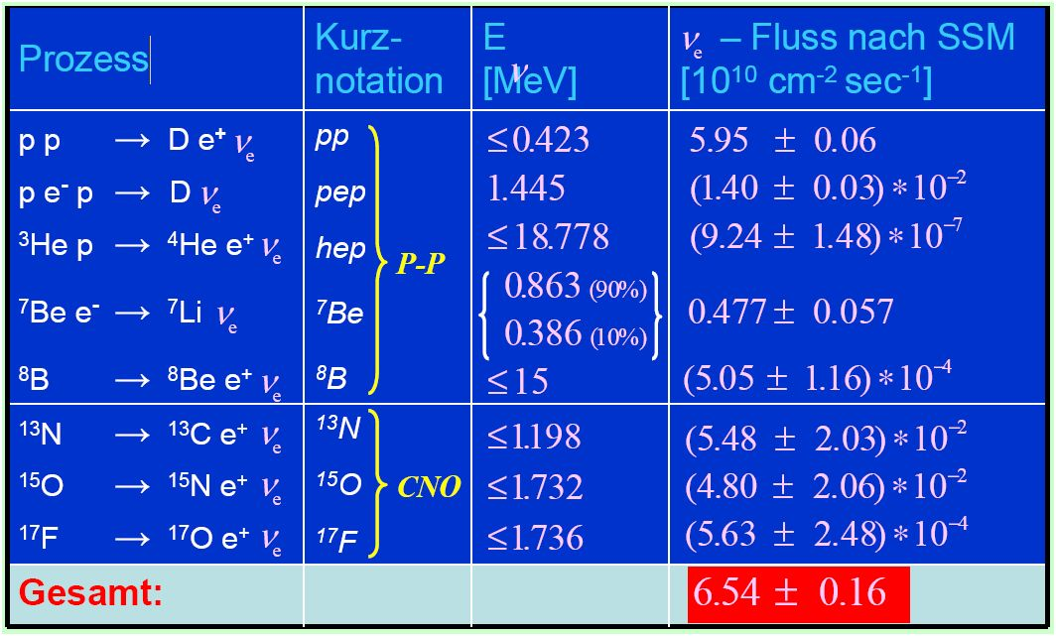
Solar NeutrinoS
Solar constant: $1360\frac{J}{s m^{2}}=8.5 {10}^{15}\frac{MeV}{s m^{2}}$
Neutrino flux: $6.36 {10}^{14}\frac{ν}{s m^{2}}$
nuclear fusion
produces neutrinos
5% accuracy !
origin of the discrepancy ?

