Slide 1
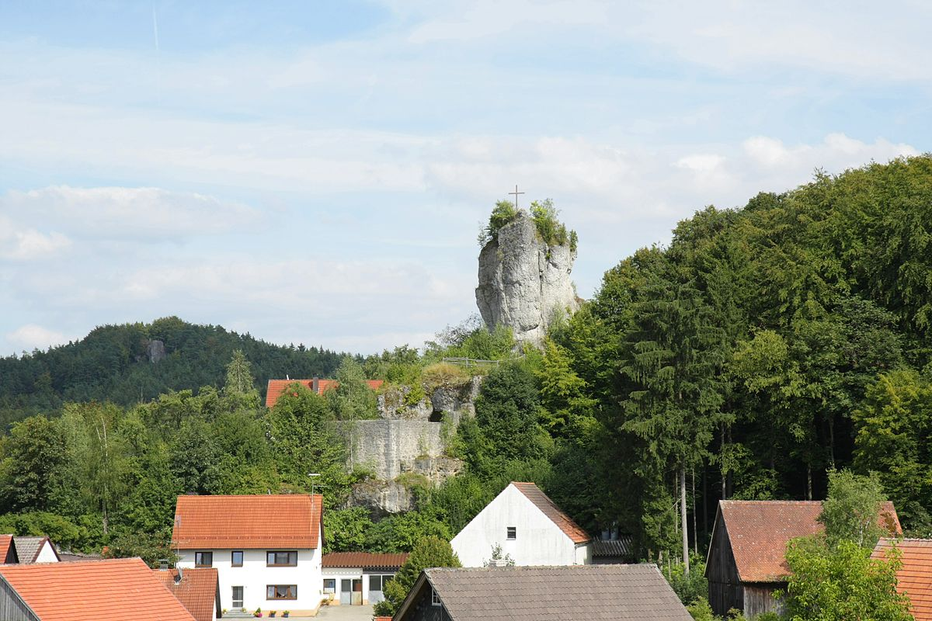
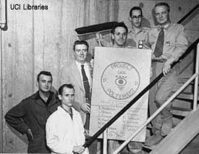
Neutrino Oscillation Experiments
History
Achim Stahl – RWTH Aachen University – JARA-FAME

Slide 2
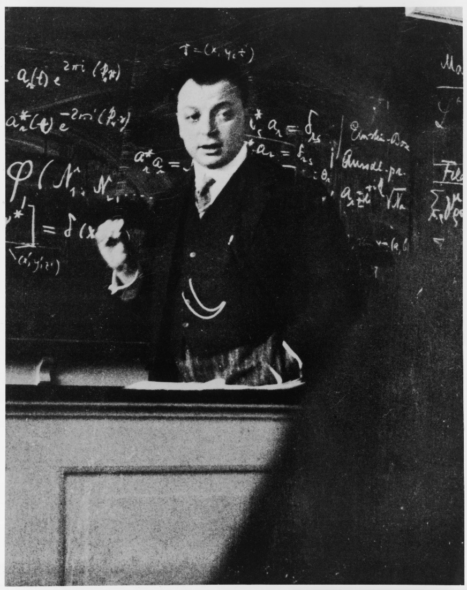
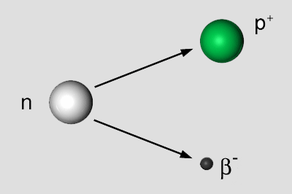
Neutrino Hypothesis
Nuclear $β$-decay:
Spin
$$\frac{1}{2}$$
$$\frac{1}{2}$$
Spin
$$\frac{1}{2}$$
2-body decay:
$$\begin{matrix}p\left(p^{+}\right)+p\left(β^{−}\right)=0 \\ E\left(p^{+}\right)+E\left(β^{−}\right)=E\left(n\right)\end{matrix}$$
⇒ $β^{−}$ monoenergetic !
Wolfgang Pauli

Slide 3
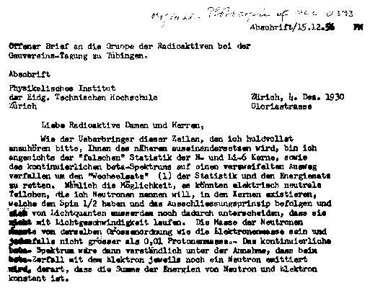
Neutrino Hypothesis
Wolfgang Pauli
1930 1st idea -- 1932 Fermi calculates spectrum -- 1933 publication

Slide 4
Neutrino Hypothesis
Pauli around 1950
(during a visit to CalTech)
‘‘I have done a terrible thing. I have postulated a particle that cannot be detected.’’
→ Poltergeist
Wolfgang Pauli
1934: Bethe/Peierls calculate total cross section $σ≈{10}^{−44} cm^{2}$
mean free path in water $≈$ 1000 light years

Slide 5
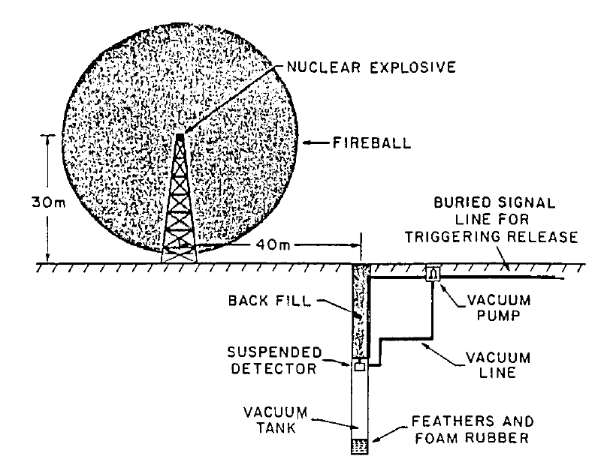
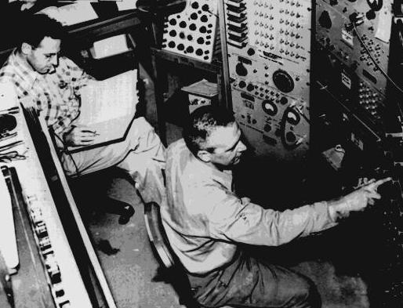
Neutrino Detection
Very first ideas ~ 1950
Cowan & Reines
Search for intensive neutrino sources
“but detector would be destroyed and with uncertain result”
Notes:
Historische Einleitung: Neutrinonachweis Bombe

Slide 6
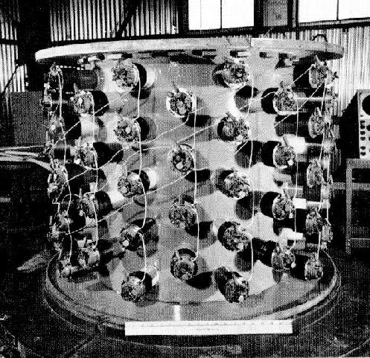
Neutrino Detection
Project „Poltergeist“
Cowen / Reins
1.st attempt: Hanford 1953
„Herr Auge“
300l scintillator
90 PMTs
Notes:
The historical example

Slide 7
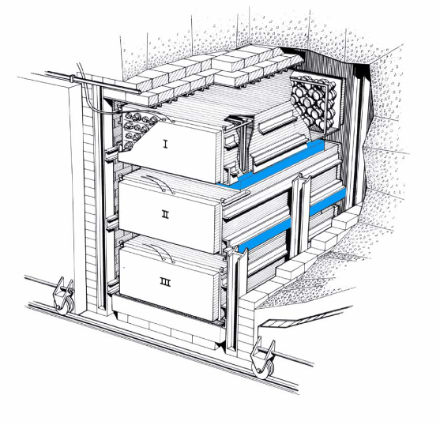
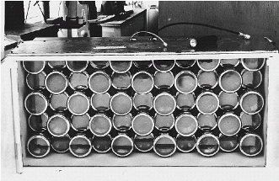
Neutrino Detection
$${\overline{ν}}_{e}$$
$${\overline{ν}}_{e}$$
Szintillator
Szintillator
Target
$$n$$
Target
(CdCl₂+H₂O)
Szintillator
$$e^{+}$$
Target
Szintillator
Szintillator
$${\overline{ν}}_{e}+p→n+e^{+}$$
inverse β-decay (IBD)
1. prompt event: $e^{+}→γγ$
2. delayed event: $n$ thermalization
+ capture on Cd
Notes:
Inverse beta-decay

Slide 8
Today
$${\overline{ν}}_{e}$$
Szintillator+Target
Energy Measurement:
prompt event scintillation from positron gammas from annihilation $E\left({\overline{ν}}_{e}\right)=E_{\text{prompt}}+Q−m_{e}$
delayed event Gd: $30 μsec$ delay, $8 MeV$ H: $200 μsec$ delay, $2.2 MeV$
(Cd→Gd)
$$n$$
$$e^{+}$$
Szintillator+Target
$${\overline{ν}}_{e}+p→n+e^{+}$$
inverse β-decay (IBD)
1. prompt event: $e^{+}→γγ$
2. delayed event: $n$ thermalization
+ capture on Gd
Notes:
Inverse beta-decay

Slide 9
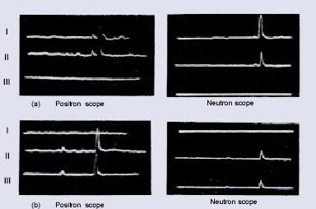
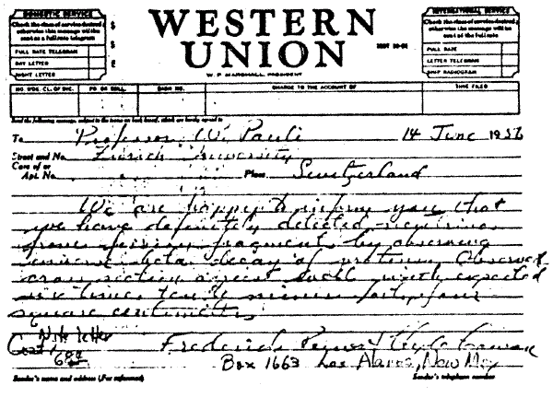
Neutrinosignals
We are happy to inform you that we have definitely detected neutrinos from fission fragments by observing inverse beta decay of protons. Observed cross section agrees well with expected six times ten to minus forty-four square centimeters.

